Slide 1

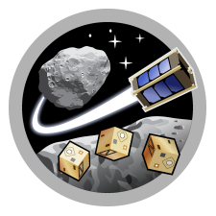


Measuring Air Turbulence in the Stratosphere with High-Altitude Balloons
Reed Spurling & Kongo Lai
Micro Air Vehicles Laboratory
University of Arizona
Collaborators: Dr. Sergey Shkarayev, Alex Kling (NASA Ames), Jim Cronin,
James Hamilton, Ryland Phipps, Tayvien Williams
Interplanetary Small Satellite Conference
2024 May 2

Slide 2
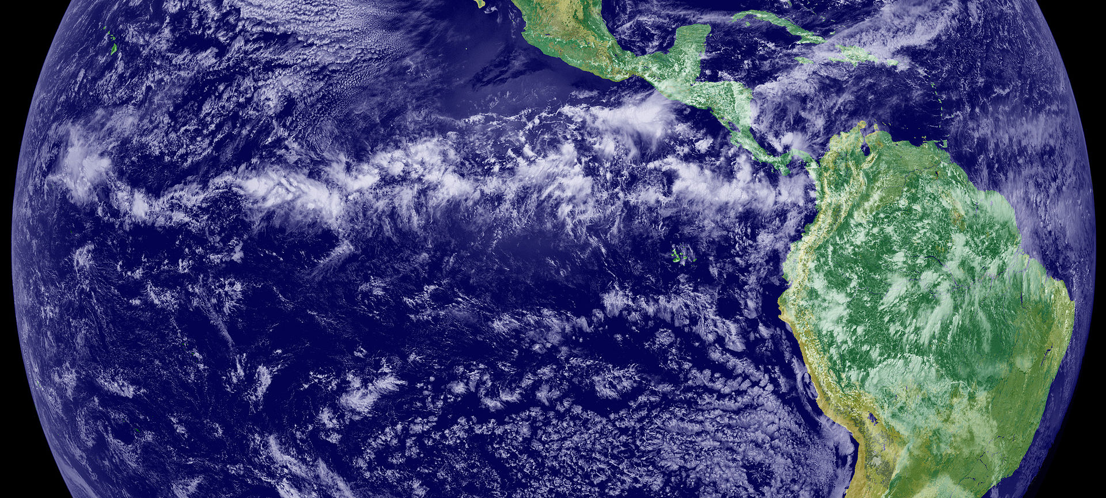
Why Measure Turbulence?
Turbulence (chaotic fluid flow) in the atmosphere affects many things
  Weather and climate (atmospheric circulation and heat transfer)
Image credit: NASA/NOAA GOES-11

Slide 3
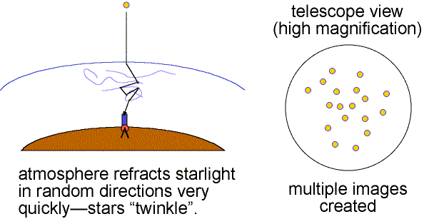
Why Measure Turbulence?
Turbulence (chaotic fluid flow) in the atmosphere affects many things
  Weather and climate (atmospheric circulation and heat transfer)
  Telescope image resolution (seeing)
Image credit: Nick Strobel

Slide 4
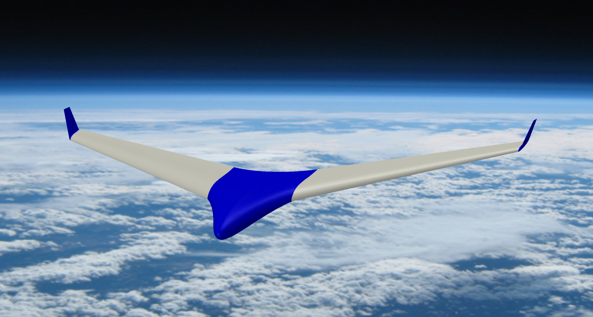
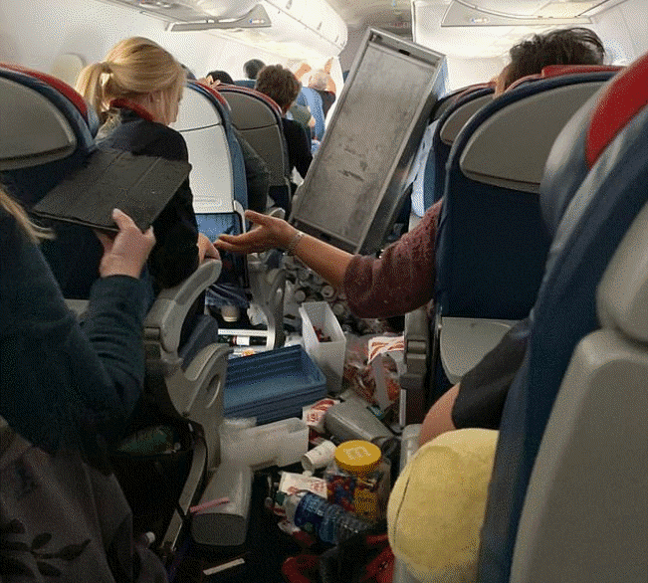
Why Measure Turbulence?
Turbulence (chaotic fluid flow) in the atmosphere affects many things
  Weather and climate (atmospheric circulation and heat transfer)
  Telescope image resolution (seeing)
  Aircraft flight path planning (e.g., to avoid clear-air turbulence)
Image credit: ABC7 News

Slide 5
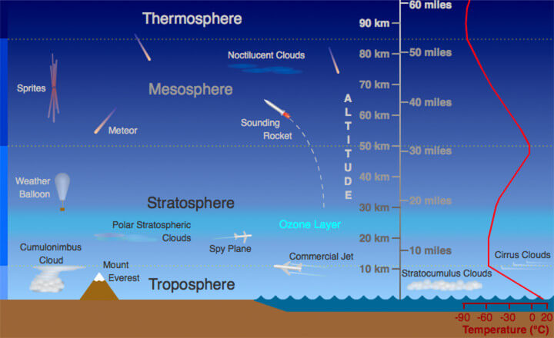
Why Measure Turbulence?
Turbulence in the stratosphere has not yet been fully characterized
Image credit: Randy Russell, UCAR

Slide 6
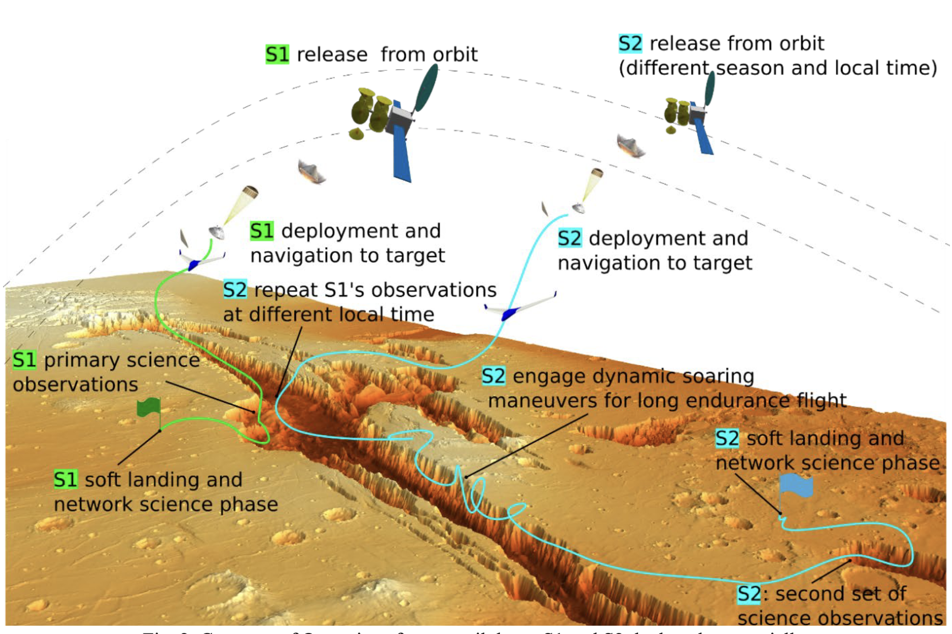
Why Measure Turbulence?
Turbulence in the thin atmosphere of Mars could be experienced by smallsat-deployed vehicles.
  Earth's stratosphere is a Mars analog
Image credit: Adrien Bouskela

Slide 7
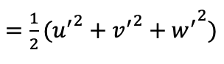

Stratospheric Turbulence Measurements
Total turbulent kinetic energy
Wind velocity u(t)
where ū(t) = mean velocity
u’(t) = velocity perturbation
(at given time and length scales)

Slide 8
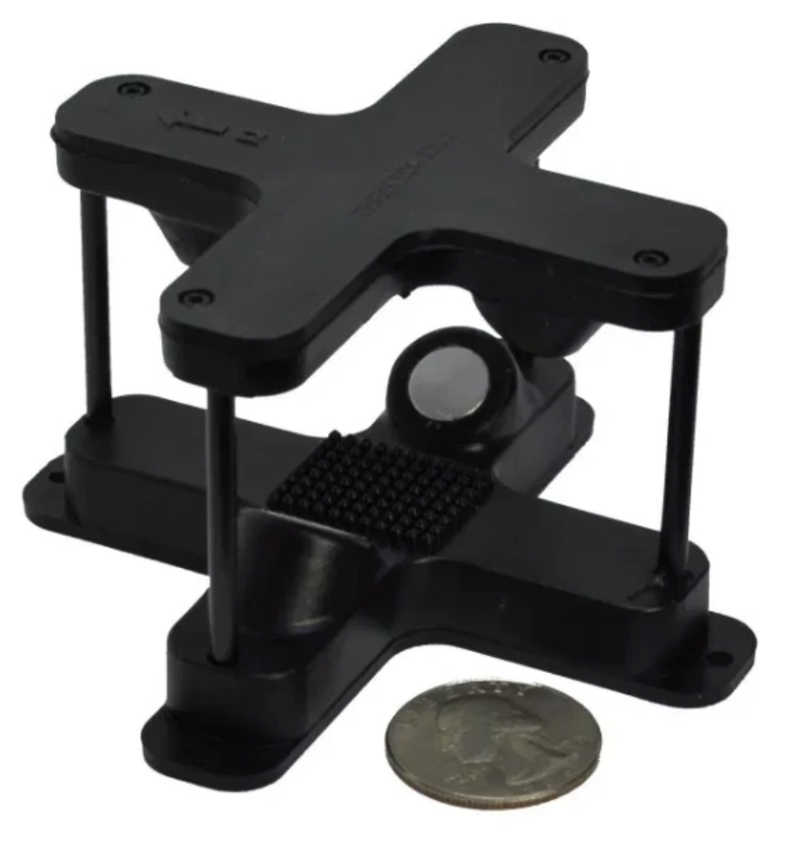
Stratospheric Turbulence Measurements
Mean wind velocity ū(t) obtained from GPS measurements of balloon trajectory
Wind perturbations u’(t) obtained from sensors
  Thermal anemometer
  Ultrasonic anemometer

Slide 9
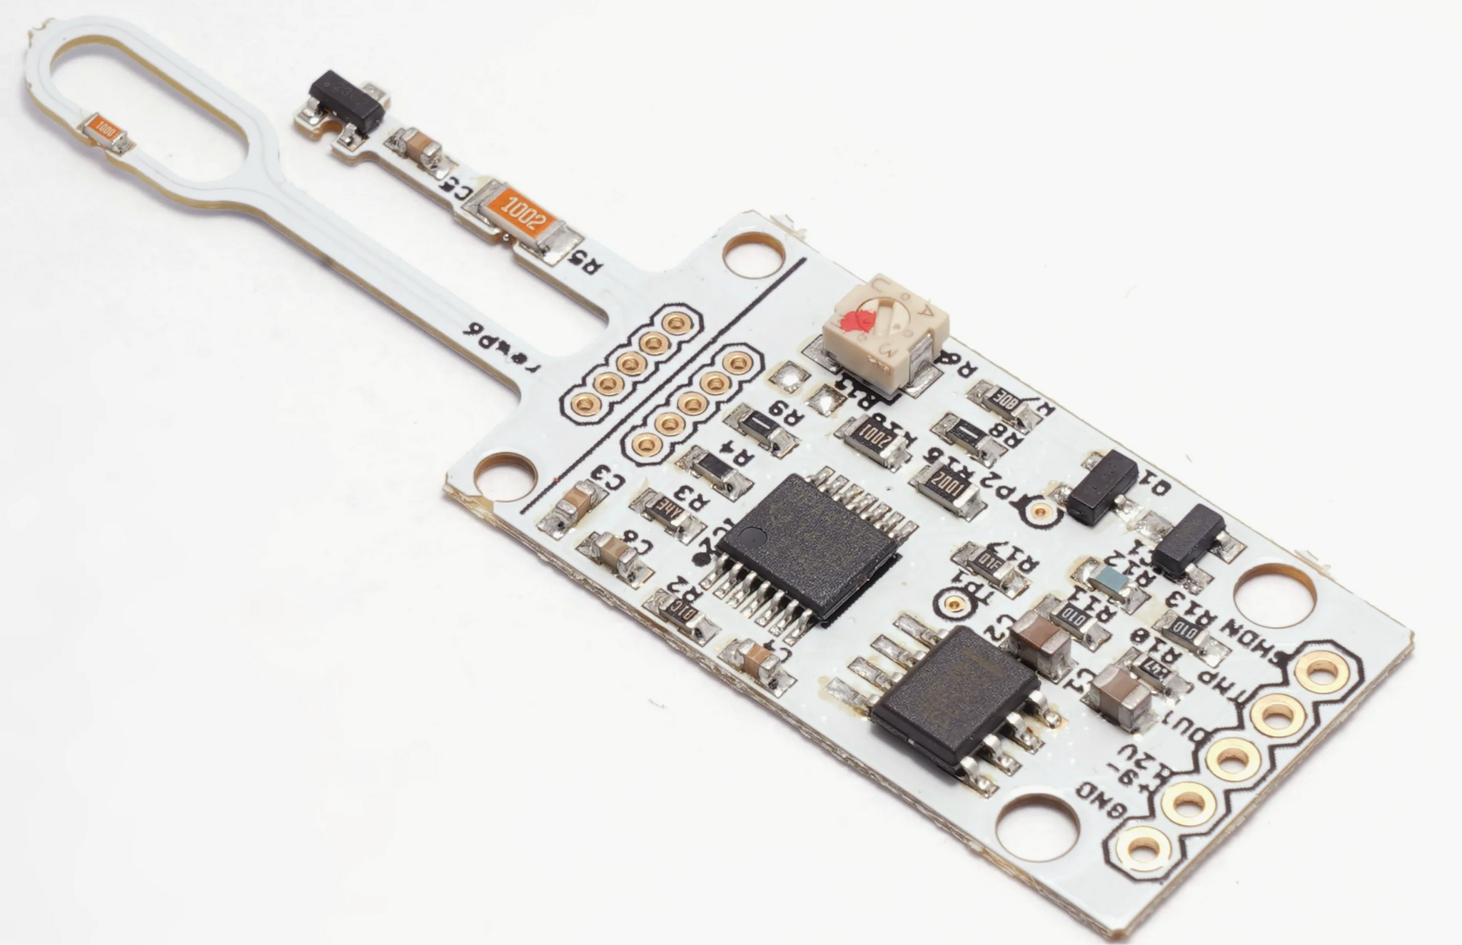
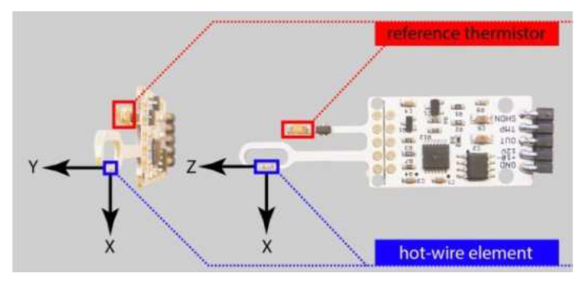
Stratospheric Turbulence Measurements
Mean wind velocity ū(t) obtained from GPS measurements of balloon trajectory
Wind perturbations u’(t) obtained from sensors
  Thermal anemometer

Slide 10
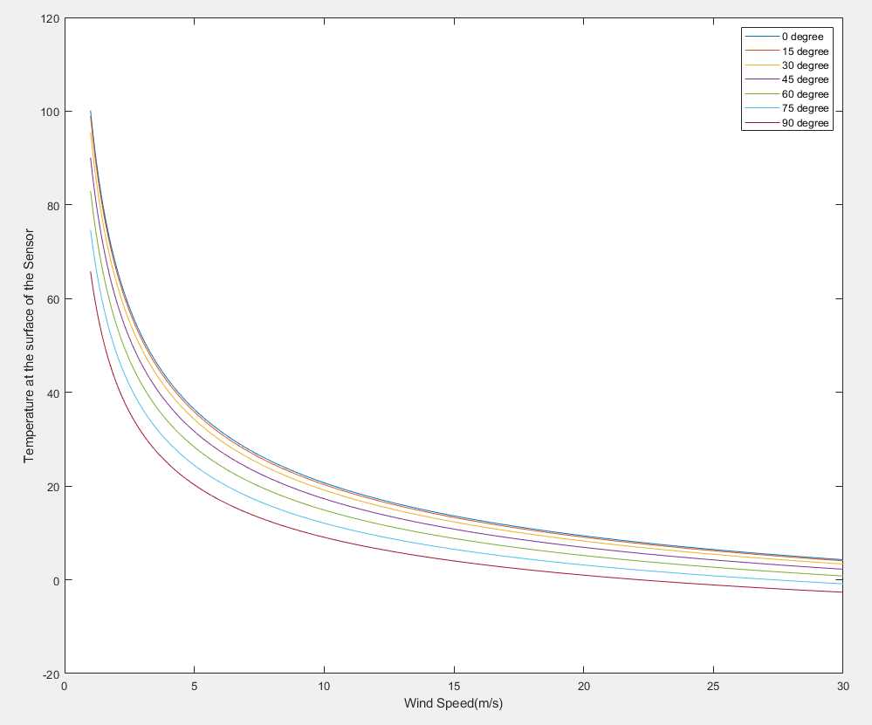


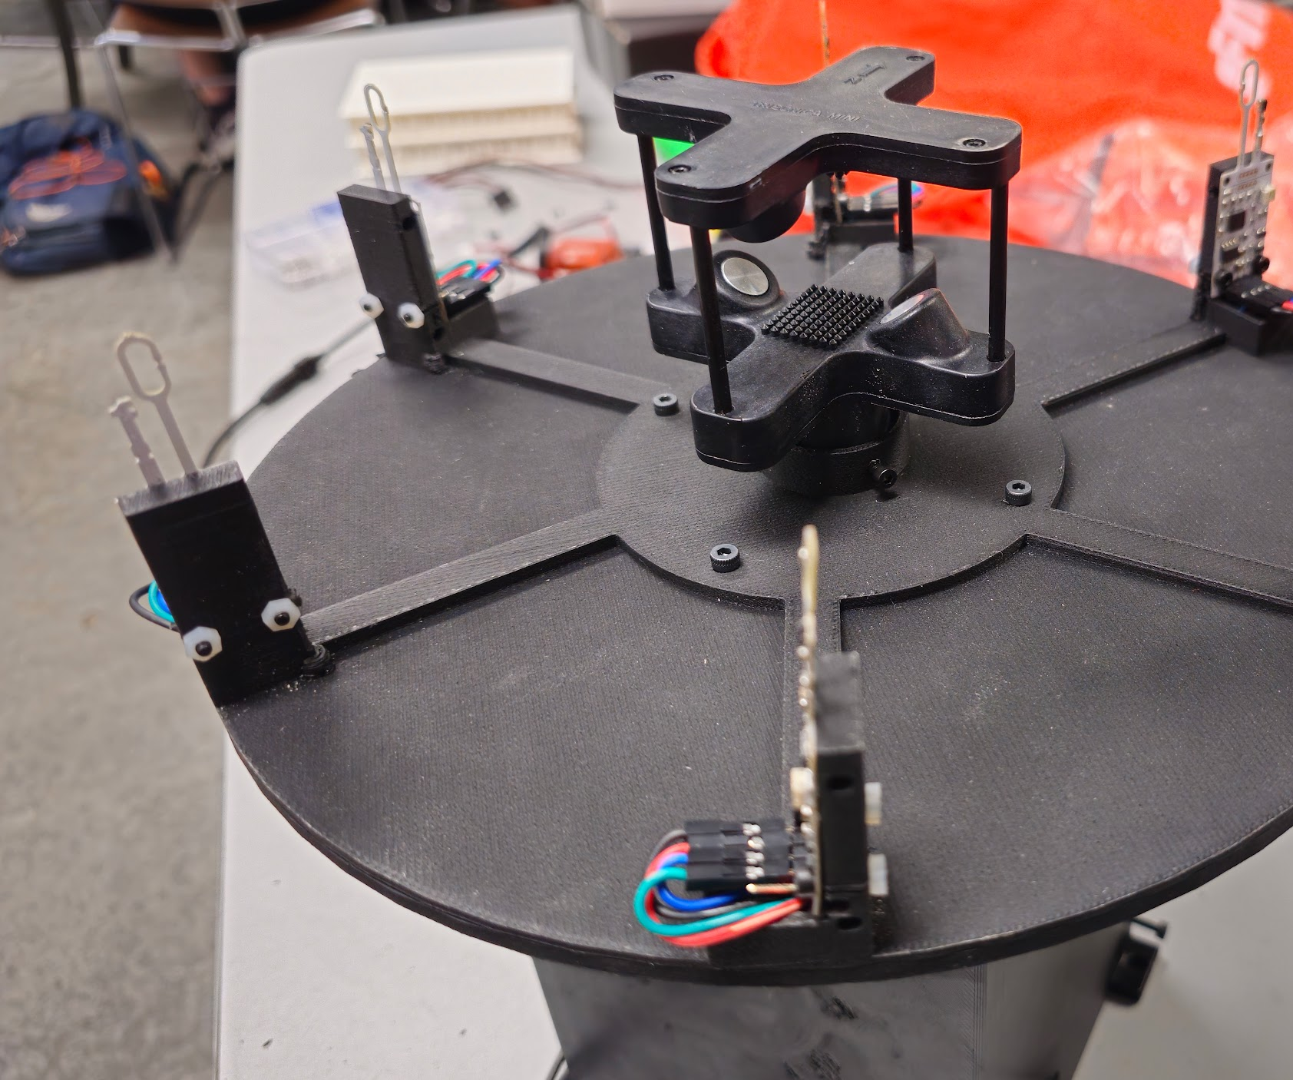
Thermal Anemometer Calibration and Testing
Six sensor array following the angle response of the sensor
Calibration on: Temperature, Wind Speed and background noise.

Slide 11
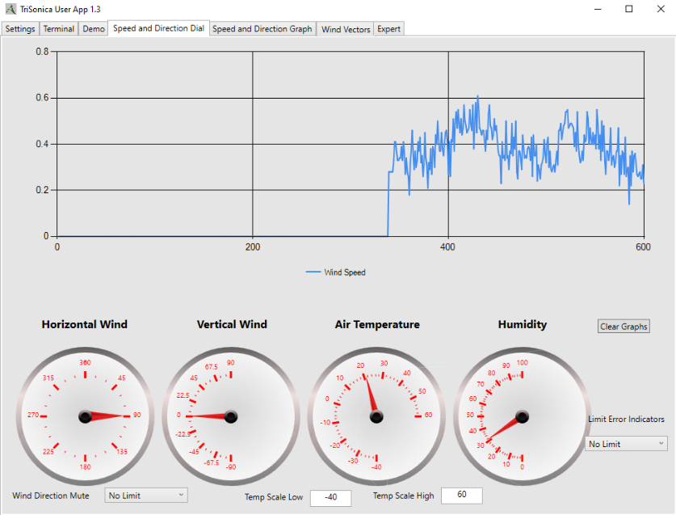
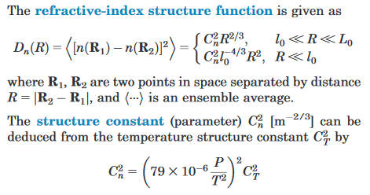
Ultrasonic Anemometer Calibration and Testing
Based on Path length difference
Precalibrated, ALL in one
Required decoding data logger
Notes:
https://www.dl1glh.de/ultrasonic-anemometer.html
Field Guide to atmospheric Optic

Slide 12
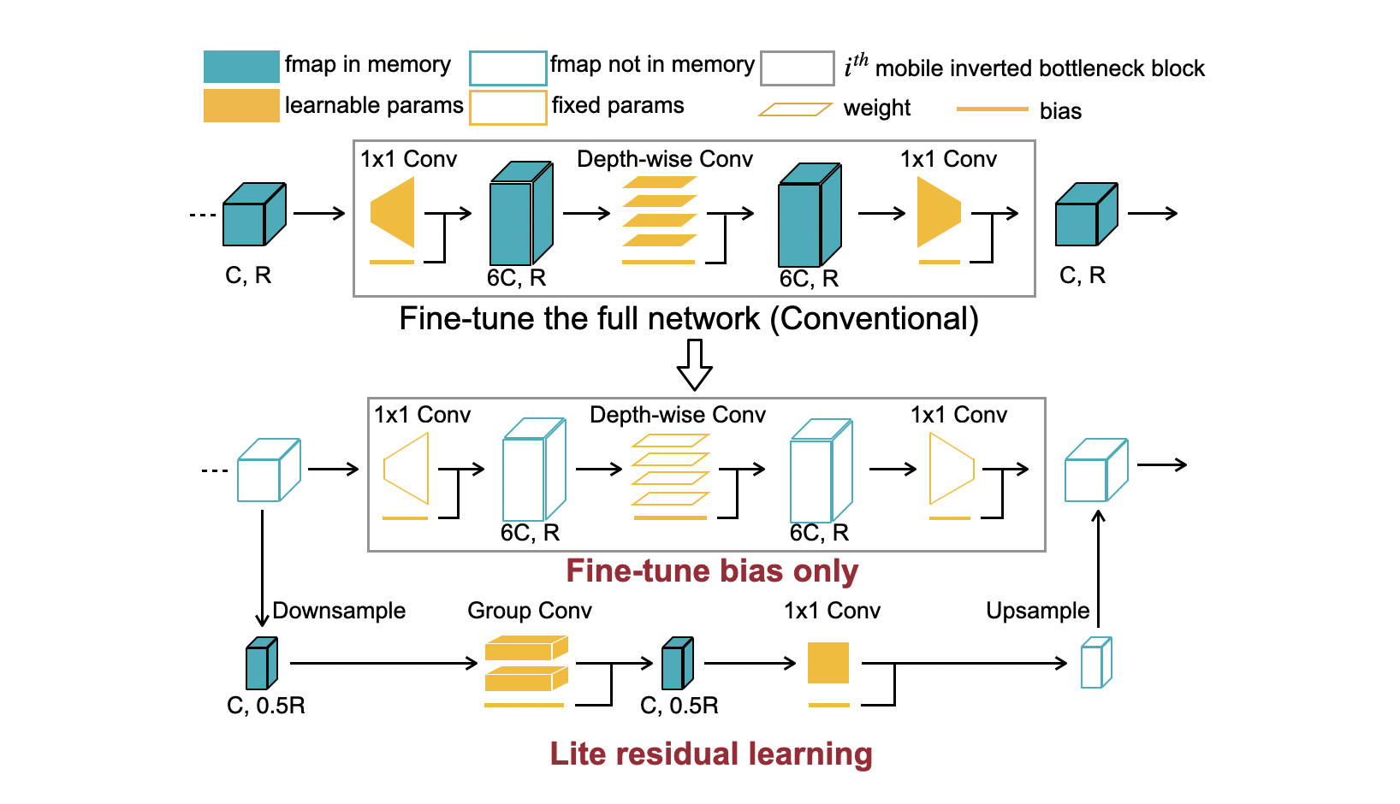
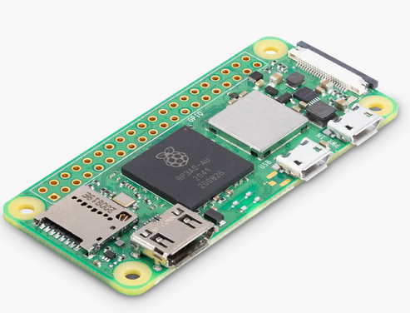
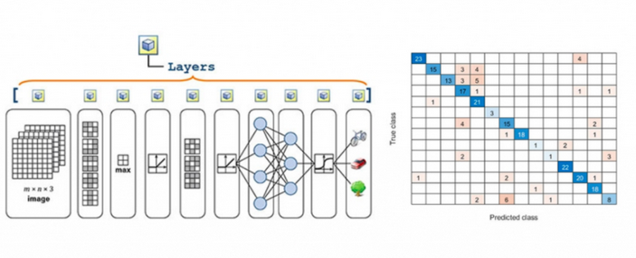
Data Processing
Mathematical approach,
  matrix calculations
  analytic functions
Machine Learning
  Local onboard processing
  MATLAB post-processing

Slide 13
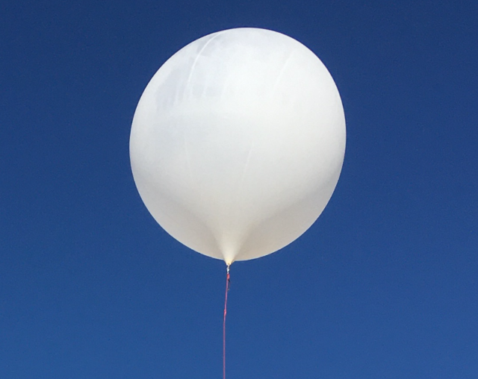
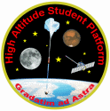
Flight Options
Small weather balloon
  ~2 hr. flight, ~30 km alt.
  Test flight prior to HASP flight
NASA High Altitude Student Platform (HASP)
  Longer flight duration (~6–20 hours)
  Proposal selected!
  Flight next year if funding allows

Slide 14
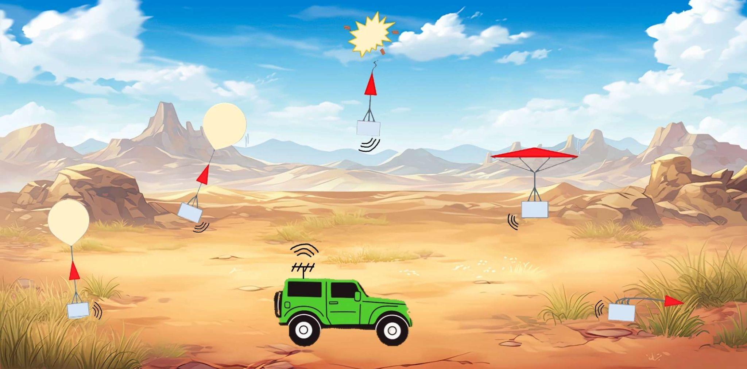
Concept of Operations
3. Burst
4. Descent
(Collect Data)
2. Ascent
(Collect Data)
5. Recovery
Set up and Launch
Chase Car

Slide 15
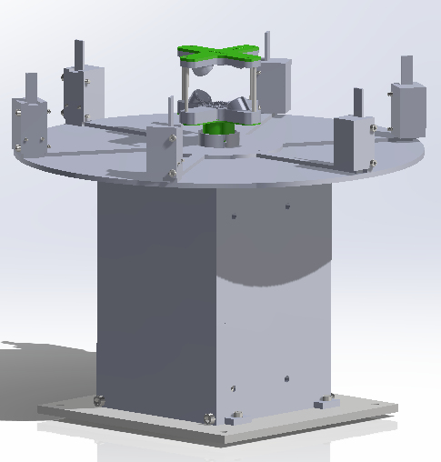
Summary
Stratospheric air turbulence is poorly understood
We plan to study it with
balloon-borne instruments
  Thermal anemometer
  Ultrasonic anemometer
  GPS receiver
Accepted into HASP program, payload built, software tested, ready for flight

