Slide 1
SYSTEM OF AUTONOMOUS AERIAL VEHICLES FOR SUBTERRANEAN EXPLORATION WITH SLAM CAPABILITIES
Nicolas Blanchard
Graduate Student
Electrical & Computer Engineering
Amber Parker
Undergraduate Student
Software Engineering
Arturo Lopez Jr.
Undergraduate Student
Aerospace & Mechanical Engineering
Dr. Sergey Shkarayev
Professor
Aerospace & Mechanical Engineering
Dr. Abhijit Mahalanobis
Professor
Electrical & Computer Engineering
Notes:
Hello all, committee and public, and thank you for attending my thesis defense. My name is Nick Blanchard, and my thesis is titled ‘System of Autonomous Aerial Vehicles for Subeterranean Exploration with SLAM Capabilities’.

Slide 2
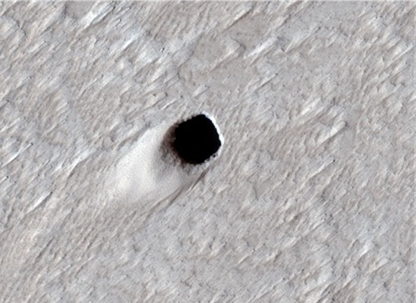
Background and Motivation
Autonomously operating unmanned aerial vehicles (UAVs) are vital for exploring unknown spaces.
Search and rescue missions, building mapping, surveying, reconnaissance, and extraterrestrial cave and lava tube exploration all benefit from a robust system of vehicles capable of remote exploration.
Challenges
GPS-Denied
Low Light
Intricate Structure
RF Propagation Loss
Possible entrance to lava tube near Arsia Mons on Mars. Captured on August 16, 2020. Image courtesy of NASA/JPL-Caltech/University of Arizona.
Notes:
Let’s begin with the background and motivation behind my research.
The motivation behind my research stems from the need to explore hard to reach, remote, and GPS-denied environments. Search and rescue missions, building mapping, surveying, reconnaissance, and extraterrestrial cave and lava tube exploration all benefit from a robust system of autonomous unmanned aerial vehicles.
However, these environments feature a long list of challenges. Some of the primary challenges are the lack of GPS for navigation, low light conditions, an intricate branching structure, and RF propagation loss around corners.

Slide 3
Project Objective
Previous research has achieved:
Vision-based localization in small UAVs (SLAM)
Robot Operating System (ROS) integration for custom control and data processing algorithms
2D mapping and 3D mapping through LiDAR SLAM
The goal of this research is to develop a robust train of vehicles for exploration of unknown and underground environments. We improve on previous work by introducing the leader-follower multi vehicle approach and utilizing a small Time-of-Flight camera for 3D mapping.
Notes:
Previous research in this field has achieved vision based localization in small UAVs, Robot Operating System integration for custom control and data processing algorithms, and 2D and 3D environment mapping through LiDAR SLAM.
The goal of this research is to develop a robust train of vehicles in a leader-follower configuration for exploration of unknown and underground environments. We improve on precious work by introducing the leader-follower multi vehicle approach and utilizing a small Time-of-Flight camera for 3D mapping.

Slide 4
System Architecture and Capabilities

Slide 5
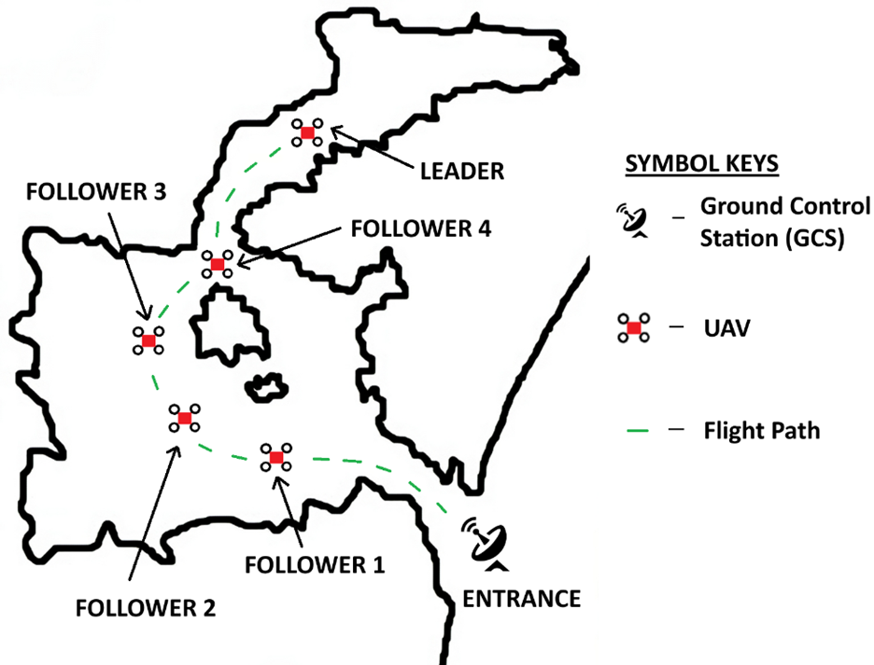
Concept of Operations
Small, lightweight quadcopter drones are deployed to explore the cave
The drones are organized into a train configuration
  A leader drone explores first
  A train of follower drones follow its footsteps
An immobile ground station stays at the entrance
Notes:
The system concept is to deploy small, lightweight quadcopters into the cave. The quadcopters form a vehicle train, where the leader vehicle bravely pushed forward into the cave, and a string of follower vehicles trace the footsteps of the leader. The train configuration is advantageous for four main reasons.
The first is navigation. In this system, only the leader needs to navigate; the followers listen to instructions from the leader instead of finding their own paths.
The second is robustness. In the event of a collision or loss of communication with the leader, one of the followers may take its place.
The third is shape. Cave passageways are often narrow. A long, narrow configuration lends itself well to squeezing through tight corridors.
The fourth is communication. With the train of vehicles extending from the leader back toward the entrance, it is possible to relay communications down the line and extend the effective distance between the leader UAV and the ground control station.

Slide 6
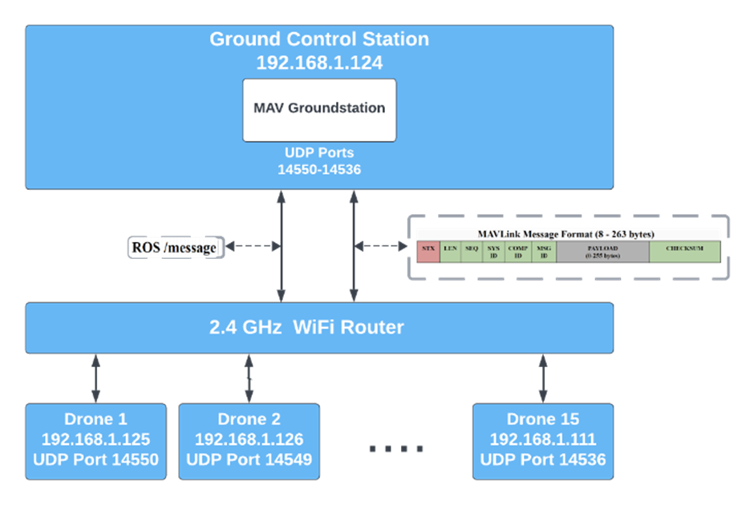
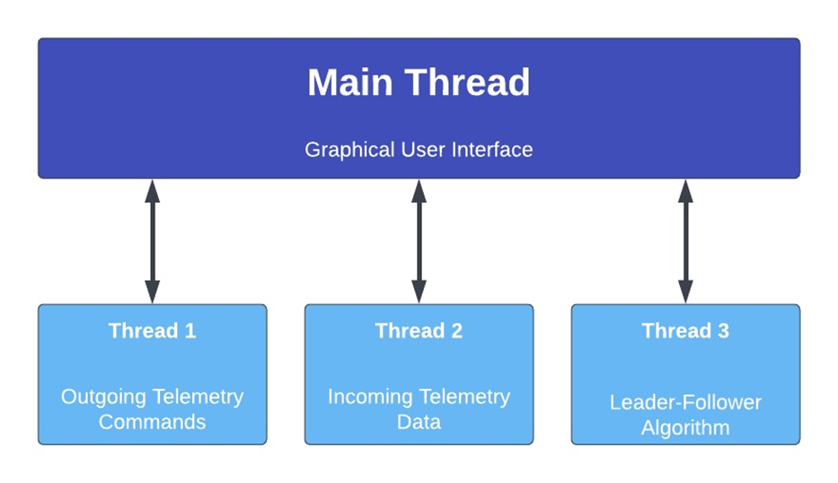
Communication and Connectivity
The Ground Control Station runs a custom application with four different threads: a GUI, a telemetry command transmitter, a telemetry report receiver, and a leader-follower algorithm.
The UAVs and the GCS share a common WiFi network. Each UAV has a unique IP and opens a unique IDP port on the GCS side for telemetry communication.
Notes:
In order to maintain effective communication between the ground control station and the train of drones, a multithreaded application is developed. The main thread of our GCS application hosts a graphical user interface to monitor and control the train. Additional threads transmit telemetry commands to the vehicles, receive incoming telemetry data from the vehicles, and run a leader-follower routine to create the train configuration.
The GCS and the vehicles are linked together by a common WiFi network. Each vehicle in the train has its own IP address and opens a unique UDP port on the ground station computer to send and receive telemetry messages. The telemetry protocol used is MAVLink. Additional information is sent over Robot Operating System, or ROS, also on the same WiFi network.

Slide 7
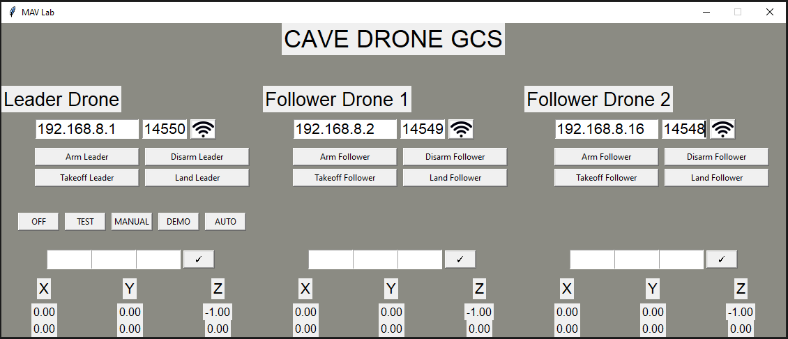
GCS
IP Address and UDP Port
Quick Actions
System Mode
Target Position
Current Position
Notes:
Shown here is the graphical user interface of the custom ground station application that we developed using Python. The top line shows the IP address and UDP port of the vehicle that the user wishes to connect to. Under that, there are quick actions for each vehicle, including arm, disarm, takeoff, and land. Under that, there are buttons to select the system mode; off, test, manual, demo, or autonomous. At the bottom, there is feedback to show the target position of each drone and the current position of each drone.

Slide 8
Leader-Follower Algorithm
Simplified Leader Routine
Simplified Follower Routine
while (1) {
if UAV has traveled far enough:
append new waypoint to list
}
while (1) {
if UAV has reached target waypoint:
if safe distance from next UAV:
go to next waypoint
else:
remain at current waypoint
}
Notes:
Here is some simple pseudocode that represents how the leader-follower algorithm works. The snippet on the left shows the leader logic. The leader goes wherever it is directed to, either by operator inputs or though an autonomous mode that we will discuss later, and appends a waypoint to a list of waypoints every x meters, where x is user configurable.
The follower focuses of navigating toward the current waypoint assigned to it. Once it has reached that waypoint, and it is a safe distance from the next vehicle in the train, it proceeds to the next waypoint in the sequence. There is a user-configurable buffer specifying how far apart the vehicles need to be for safe operation.

Slide 9
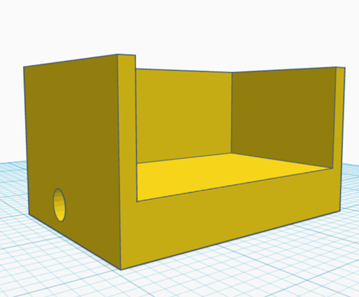
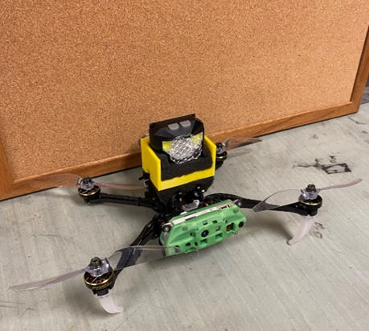
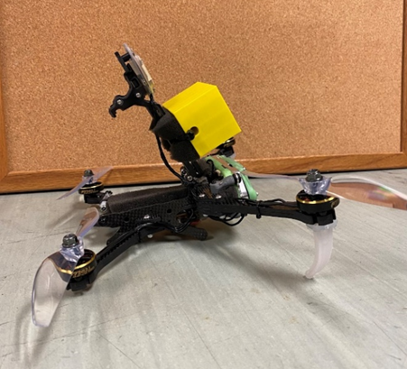
SLAM & VIO
Two requirements for successful viSLAM: strong visual features and low noise IMU measurements
A custom 3D printed light mount holds a headlamp for illumination in dark environments
Vibration damping foam mitigates vibrations introduced by additional weight on top of the airframe
Qualcomm’s viSLAM algorithm is integrated onboard each vehicle
Notes:
There are two requirements to execute successful viSLAM: strong visual features to track and low noise IMU measurements. When flying the vehicles in a cave environment, there is no light to allow for visual feature tracking. So, we created and printed custom light mounts that attach an LED headlamp to each vehicle to illuminate the surroundings. However, the additional weight on top of the airframe introduces vibrations and therefore reduces the quality of our viSLAM results. To mitigate the vibrations, we have vibration damping foam placed between all connection points on the vehicle, primarily around the battery, around the headlamp mount, and around the headlamp itself.

Slide 10
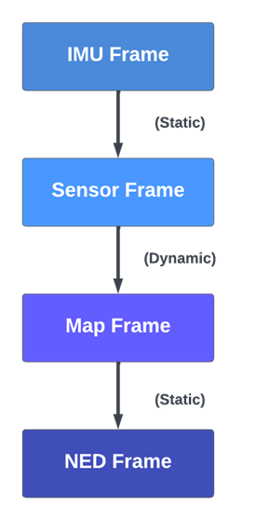
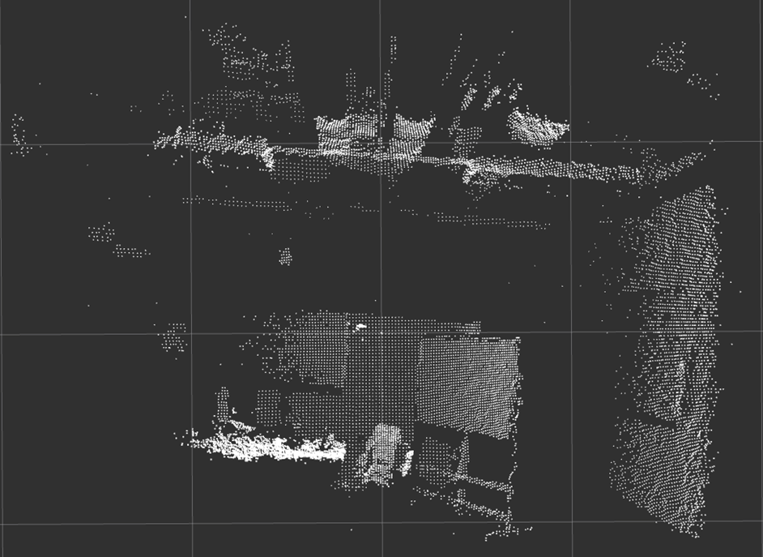
3D Occupancy Mapping
Pointcloud of data in 117x117 degree cone in front of drone ✅
Position and orientation of drone ✅
String of coordinate frame transforms to bring the pointcloud from a frame local to the drone’s position into a frame that is globally stabilized.
Notes:
There are two things that are necessary to perform 3D occupancy mapping. You need to have data telling you what the environment immediately in front of the vehicle looks like, and you need to have data telling you where the vehicle is and where it’s looking. An onboard time-of-flight camera provides pointclouds in a wide cone in front of the vehicle, and the viSLAM gives use pose estimates. Then, using a string of coordinate frame transforms, we can convert the time-of-flight pointcloud from a frame local to the drone’s position into a frame that is globally stabilized.
There transform string begins with a static transform to convert the viSLAM frame into the camera frame. Then, a dynamic transform uses the drone’s position and orientation to place the pointcloud on a global map. It is critical that the pointcloud orientation is transformed before position. Finally, another static transform formats the data in the aerospace standard North-East-Down coordinate system.

Slide 11
Experimental Methods and Results

Slide 12
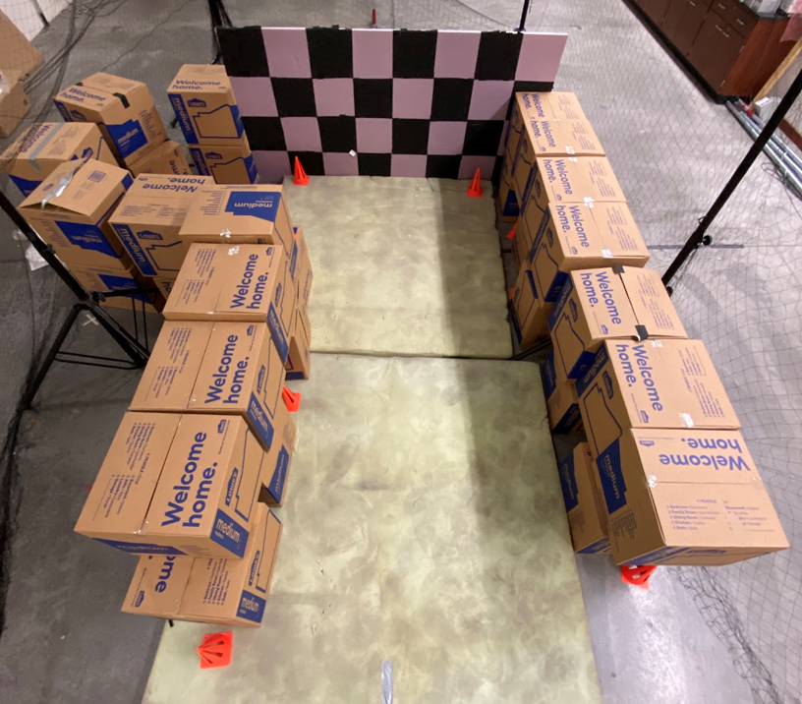
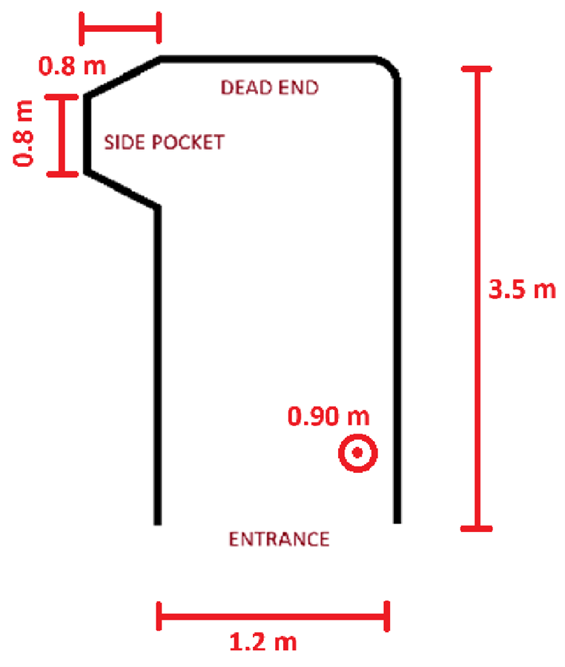
Artificial Cave Environment
Notes:
Here is the artificial cave environment that we constructed for our flight testing; it is intended to be an analog for a confined, feature-bare space. It’s approximately 3.5 meters long, has an entrance a little over 1 meter wide, and is just short of a meter tall. There is a side pocket is is around .8 meters deep to the left.

Slide 13
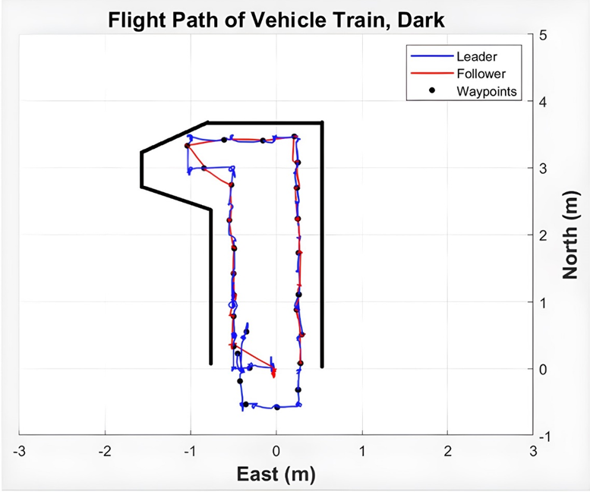
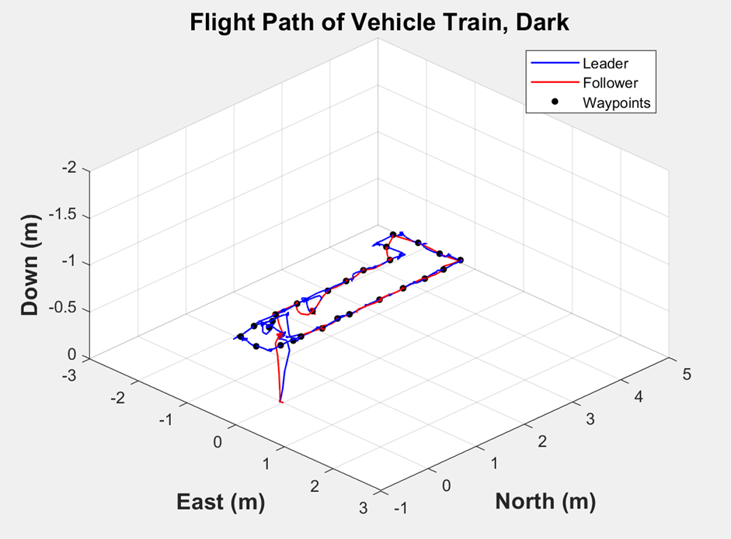
Leader-Follower, Dark

Slide 14
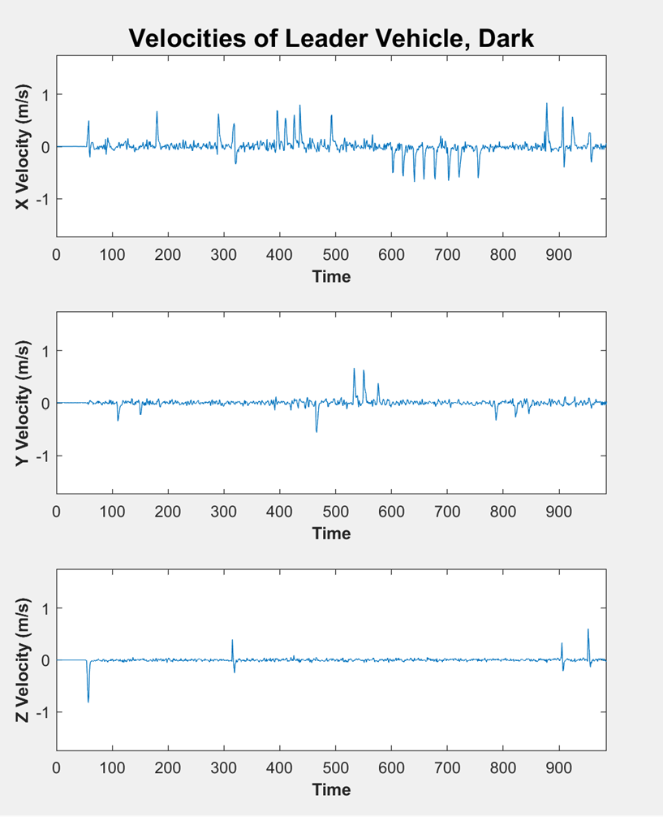
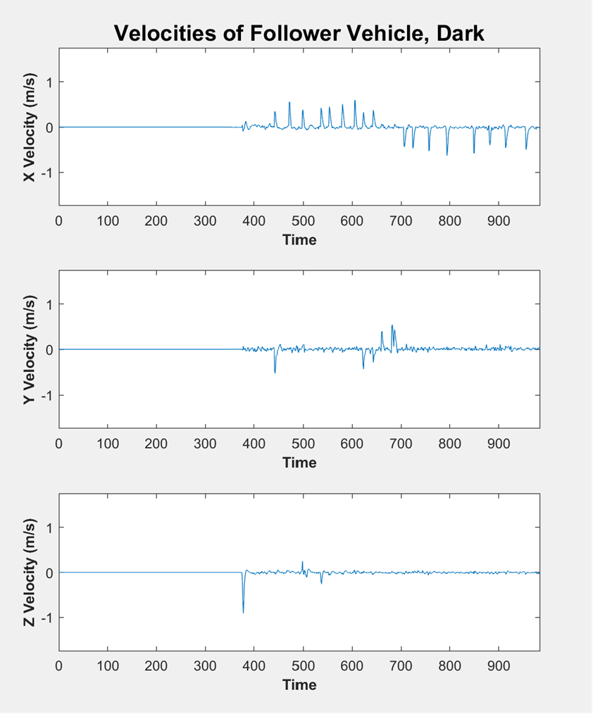
Leader-Follower, Dark

Slide 15
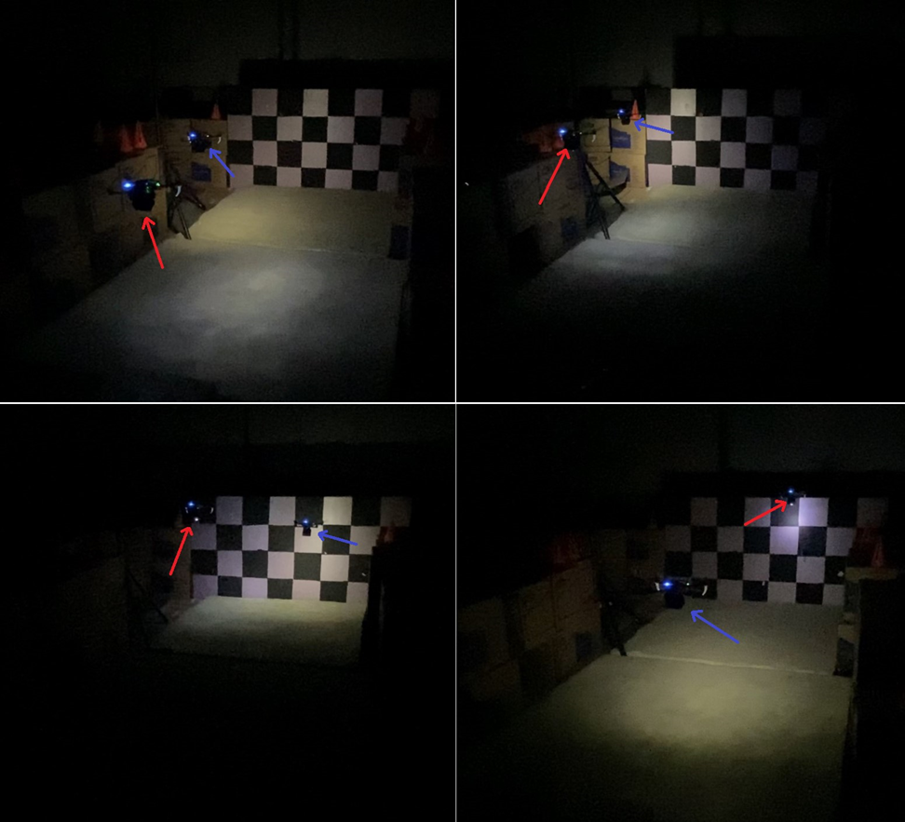
Leader-Follower, Demo

Slide 16
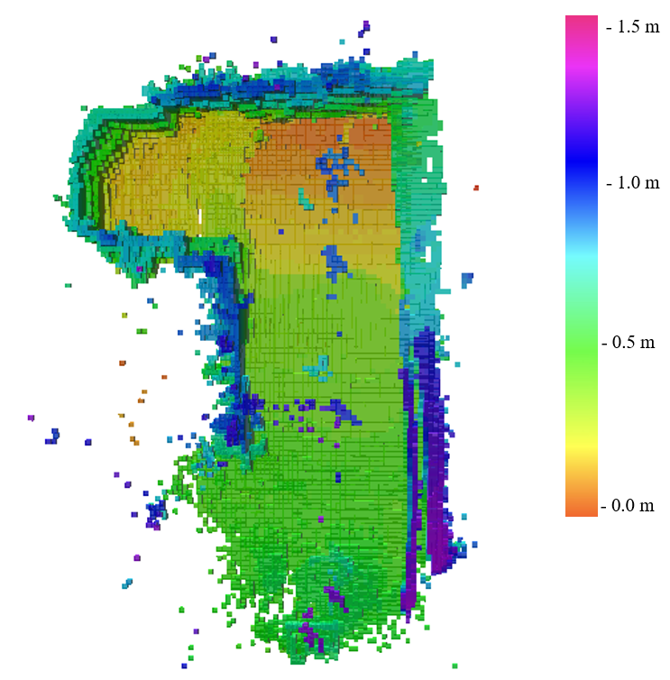
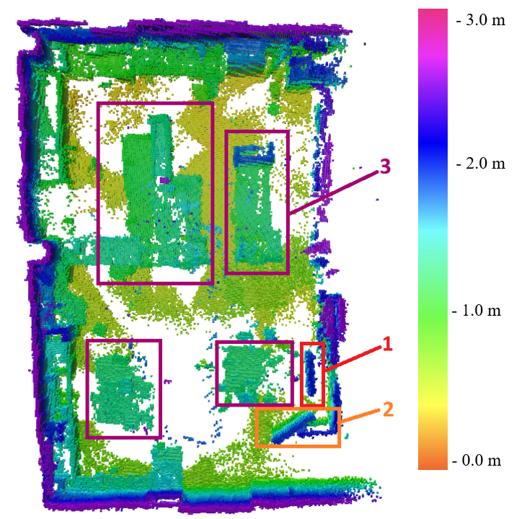
3D Occupancy Mapping

Slide 17
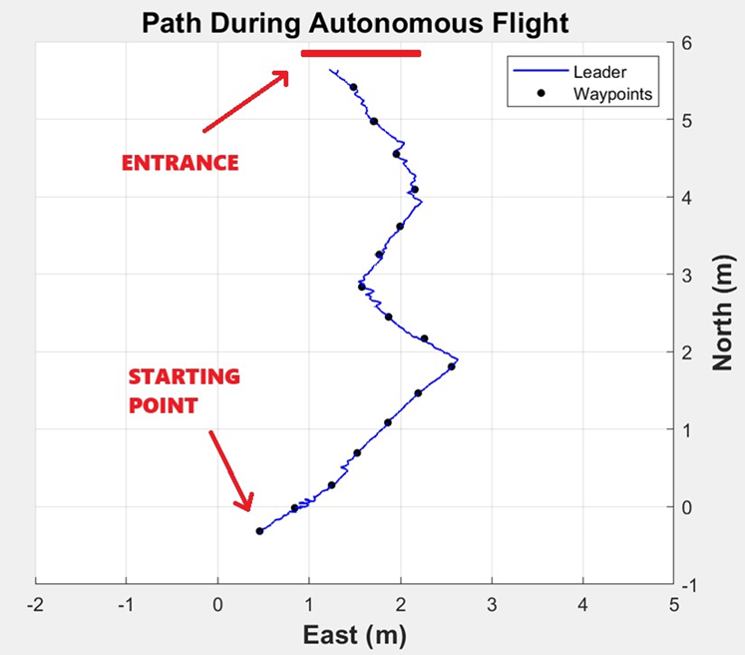
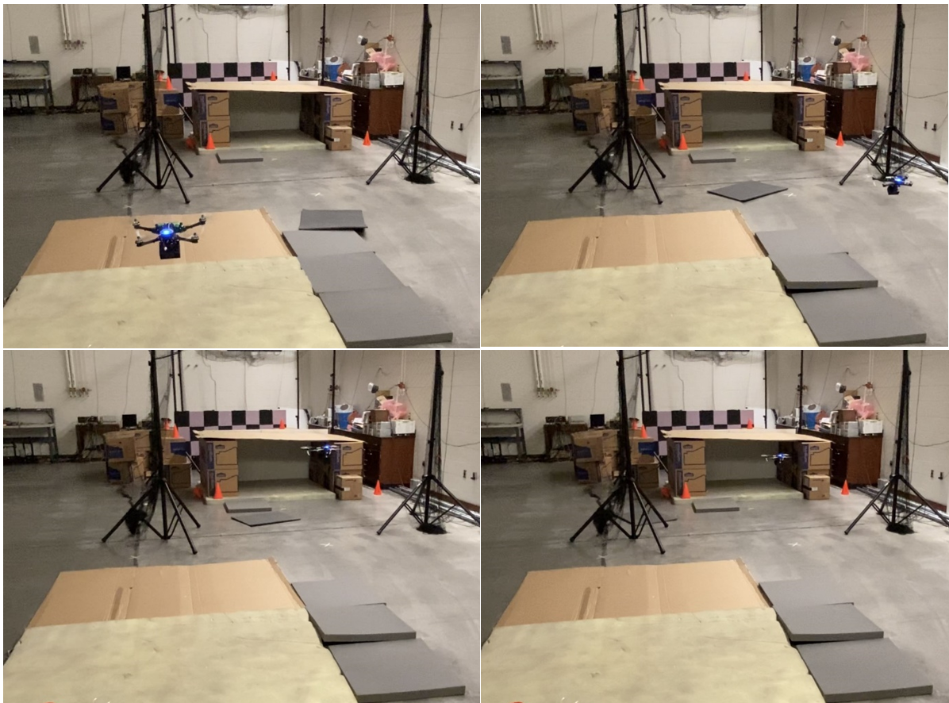
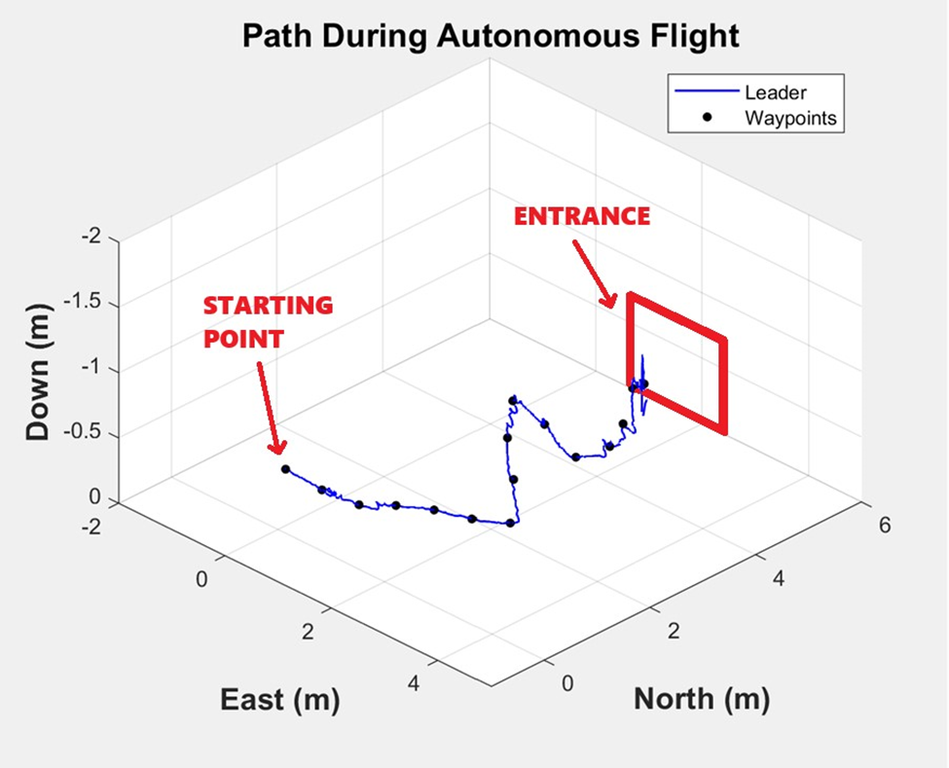
Autonomous Flight Test

Slide 18
Conclusion
Future Work
viSLAM GPS-denied navigation is successfully implemented in lit and dark conditions.
A high resolution 3D occupancy map is created in real time on the ground station side.
A ROS ecosystem lays the foundation for future custom code.
A leader-follower algorithms controls the swarm in a train-like configuration
Object Detection algorithms empower autonomous leader navigation
Consideration of aerodynamics and slipstreams
Path planning
Improving VIO quality
Incorporating the faster object detection model into autonomous flight mode

Slide 19
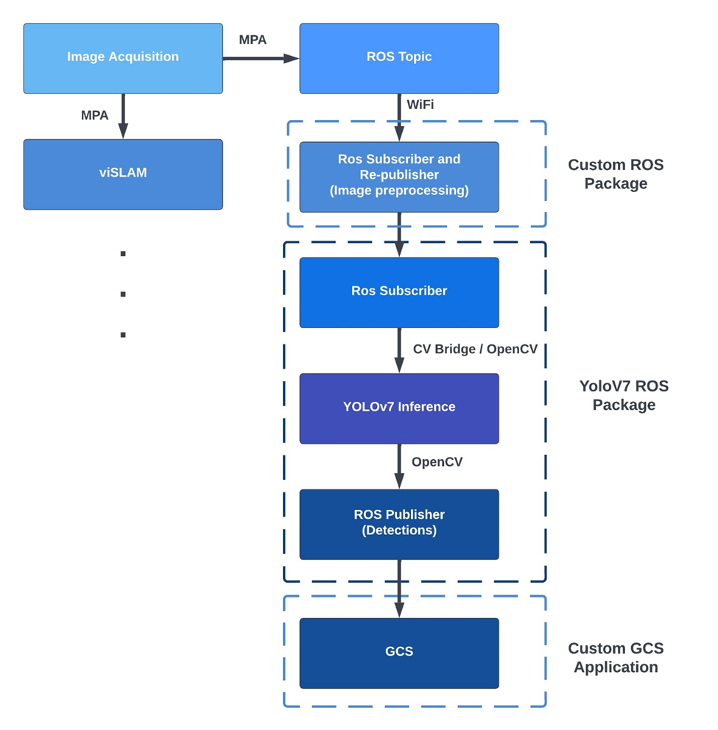
Appendix A: Object Detection
Image acquired by stereo camera.
Image published as ROS topic.
Pre-processing is applied.
Object detection inference is run.
Detections and bounding boxes are published as ROS topics in real time. Our custom GCS application receives the detections and directs the UAV accordingly.
Notes:
Like I mentioned earlier, the YOLOv7 model features ROS support, so this is how we integrated it into our system.

Slide 20
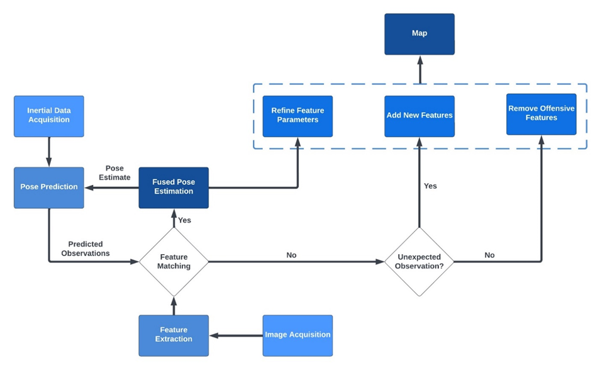
Appendix B: viSLAM Architecture

