Slide 1
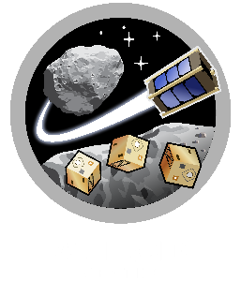
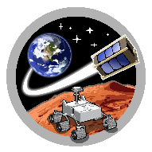



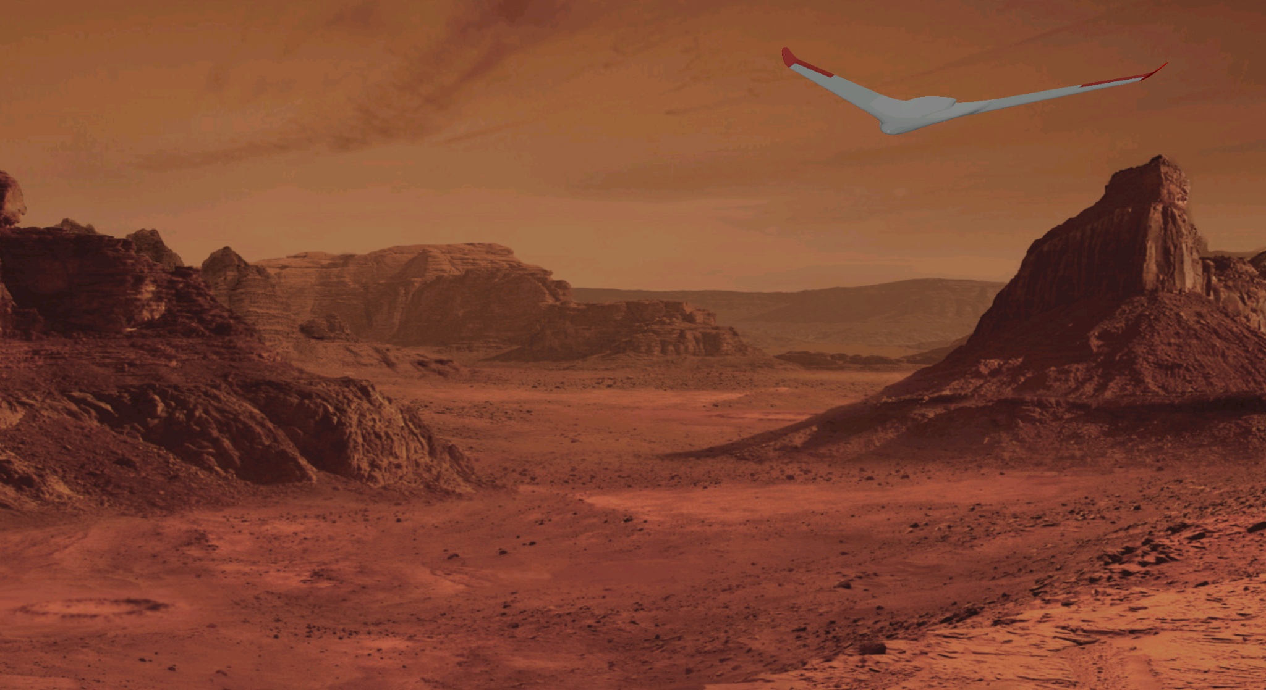
ASTEROIDS
SpaceTREx
Conceptual Design of Unpowered Glider for Soaring Flight in the Martian Atmosphere
Micro Aerial Vehicles (MAV) Laboratory
Aerospace and Mechanical Engineering Department

Slide 2

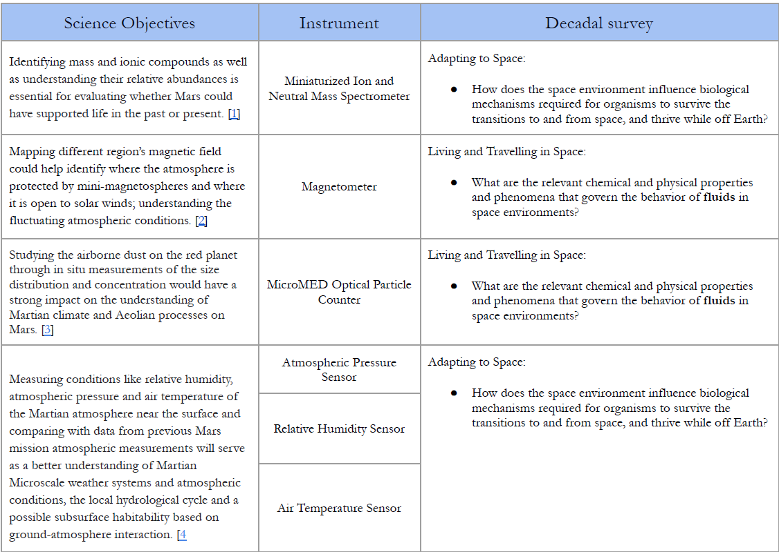
Scientific Objectives
For full sensor payload, weight and size requirements dictate one large sailplane to accompany rover to Mars
Limiting payload to camera and temperature / humidity / pressure sensors allows multiple smaller, less expensive sailplanes

Slide 3
For decades, humanity’s exploration of Mars has been confined to locations easily accessible by wheeled rovers, which are limited by their ground-based nature and relatively slow pace of travel. While these rovers are invaluable for scientific research, they are physically unsuited to access especially rugged terrain, such as canyons and steep craters. However, a solution was demonstrated by the Ingenuity rotorcraft, proving the feasibility of aerial exploration of Mars and leading to a rise in proposed aerial missions, including the development of gliders. Powered by wind patterns for sustained flight, they present an incredible opportunity to traverse previously unexplored and unreachable areas at minimal energy costs.

Slide 4
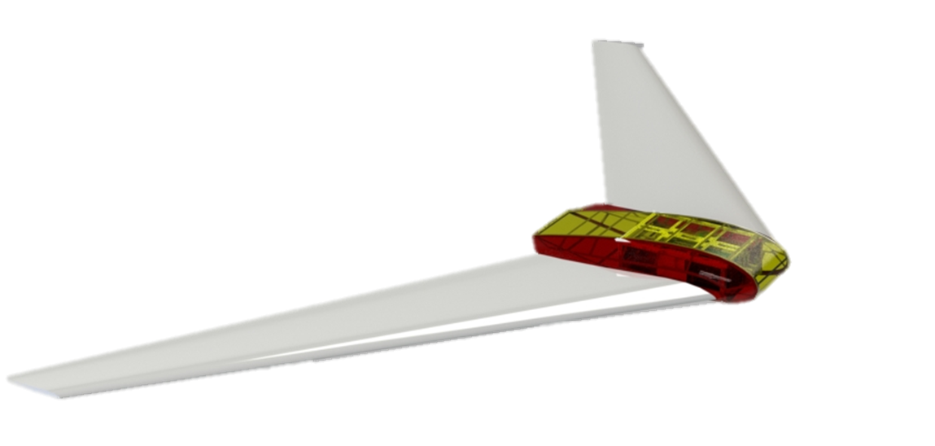
Conceptual Design
Swept Wings
Payload and Sensors
Area (yellow)
NACA 23021
FX 66-H-60
Wing Deployment Mechanism Area (red)
Flying Wing Configuration
Blended Wing Body

Slide 5
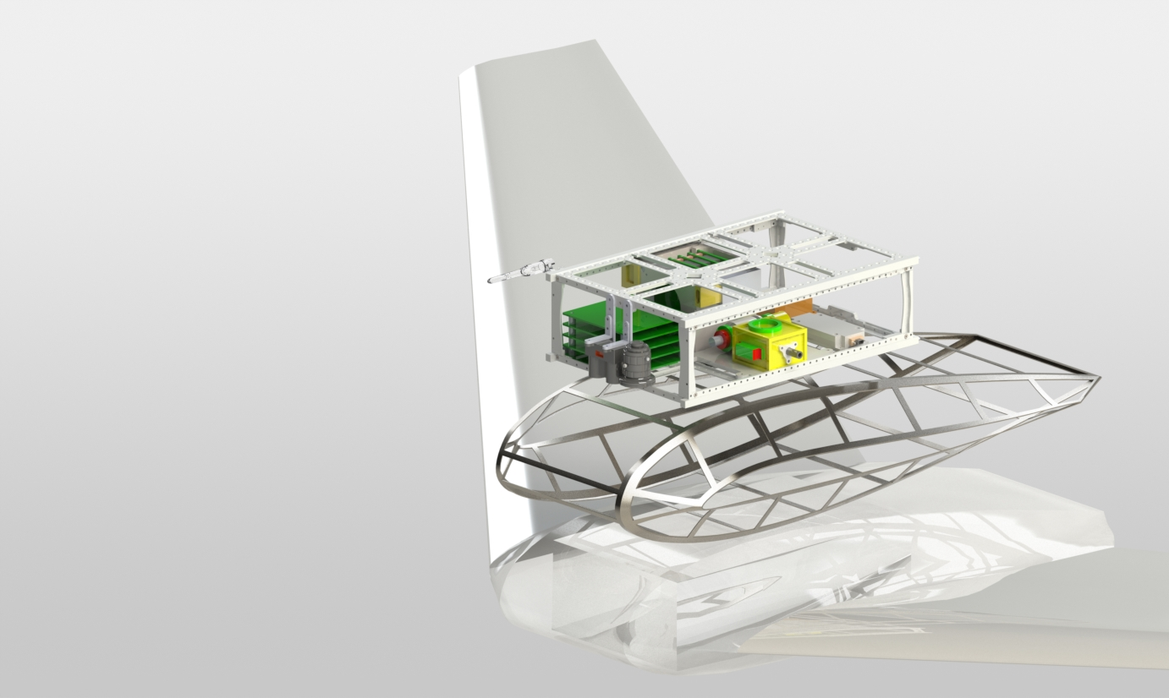
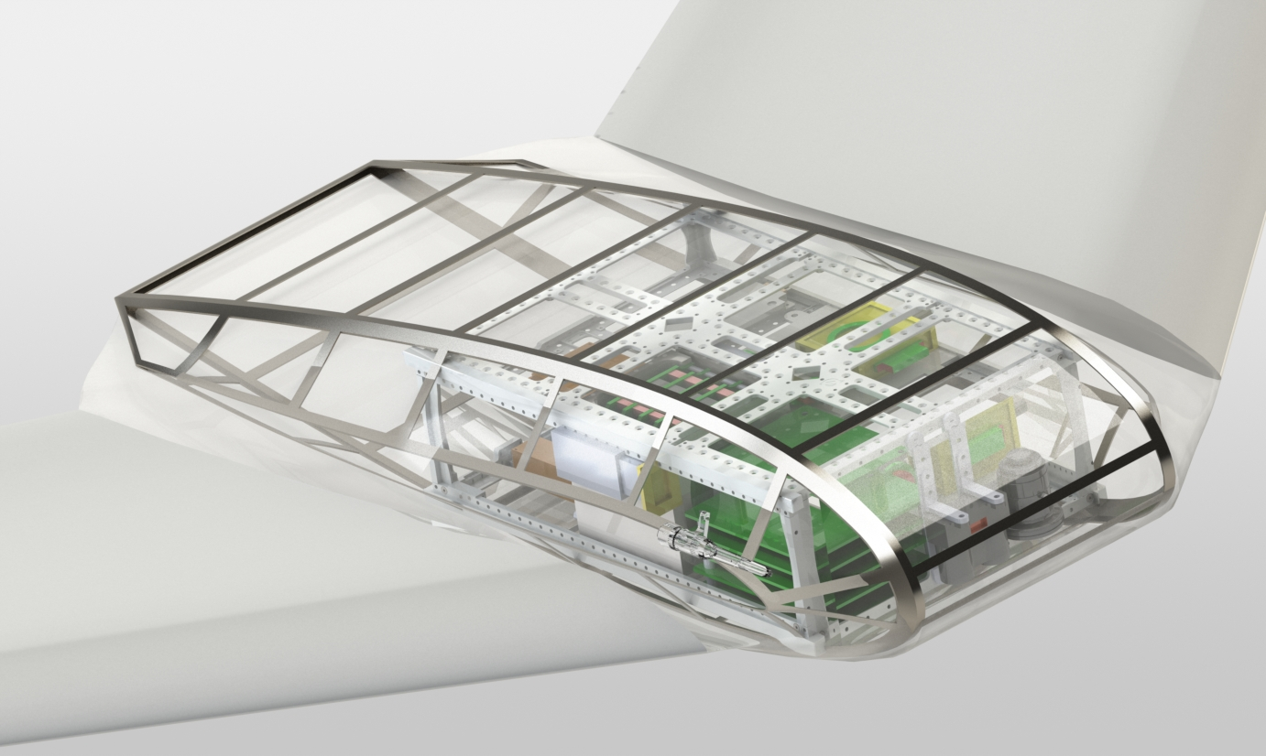
Atmospheric Pressure Sensor
Systems Integration
Air Temperature and Relative Humidity Sensors
Ion and Neutral Mass Spectrometer
6U CubeSat
Structure
Pitot Tube
Altimeter
Magnetometer
Optical Dust Particle Counter
BFS Color Camera
Notes:
Cubesat interface, components, where they go and why, system diagram, power budget, etc etc

Slide 6
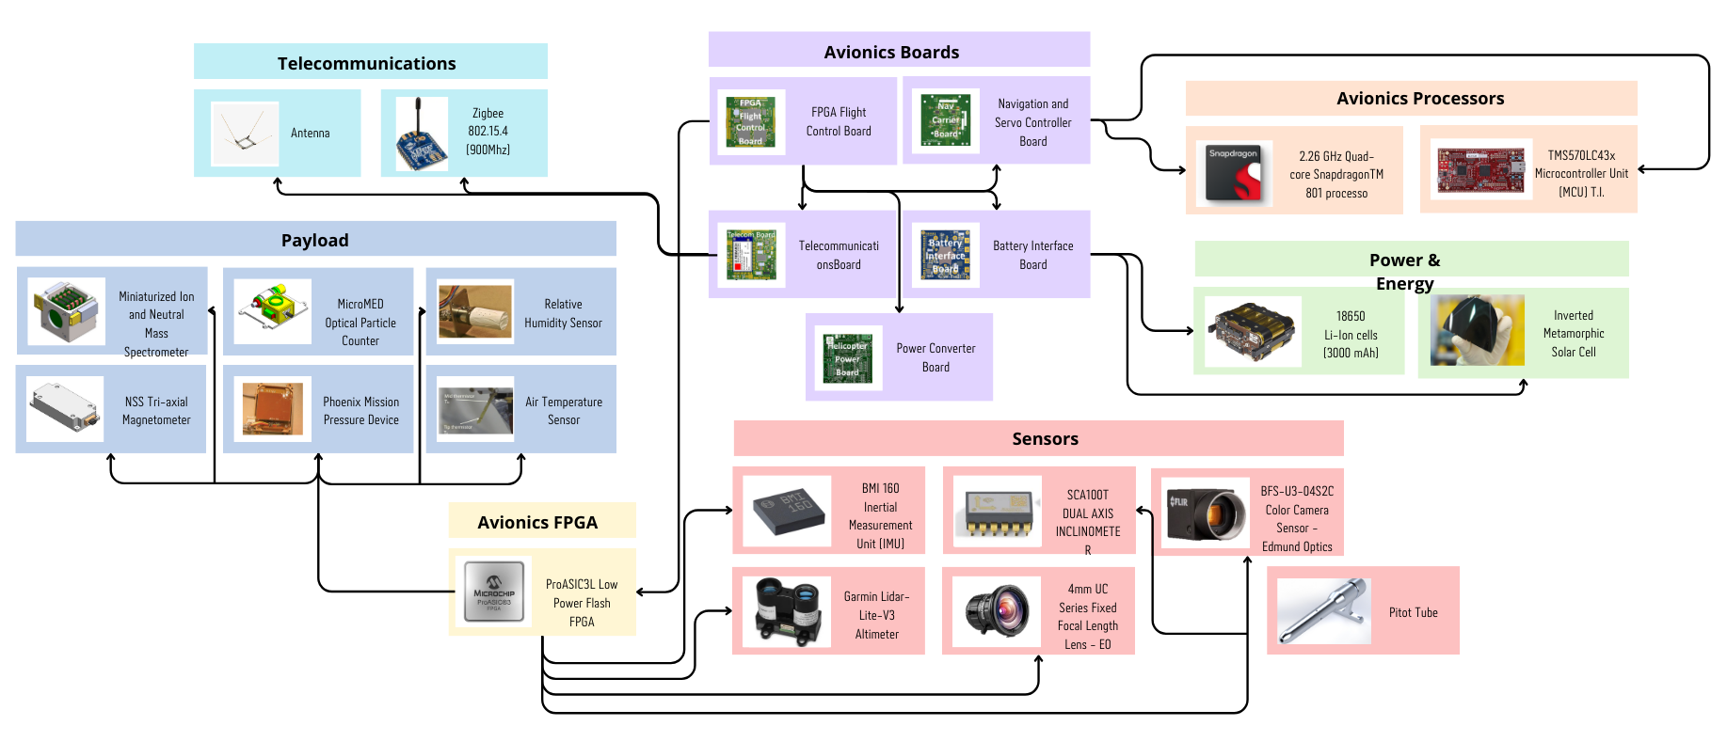
Systems diagram

Slide 7
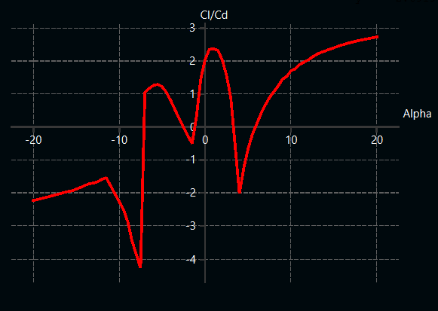
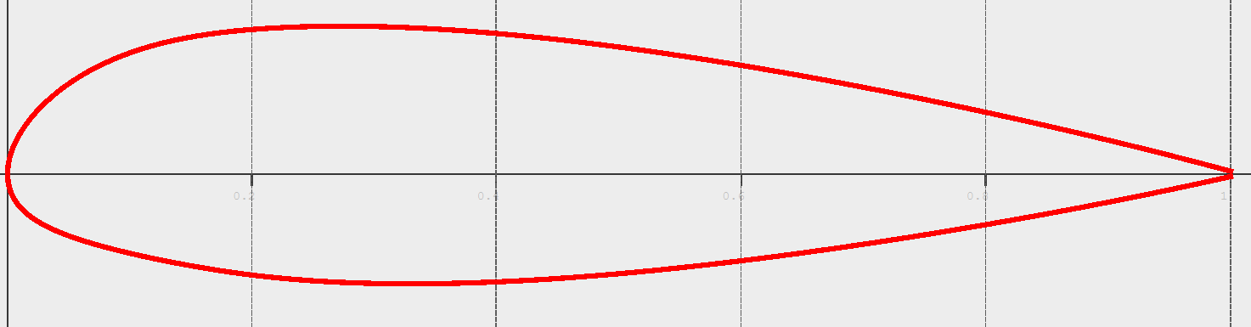
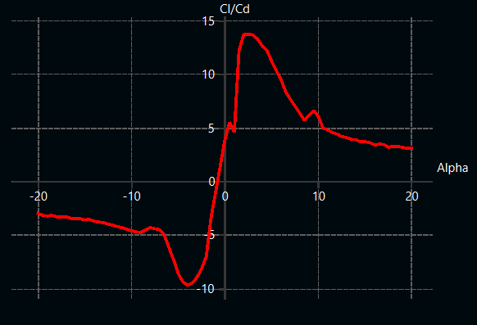
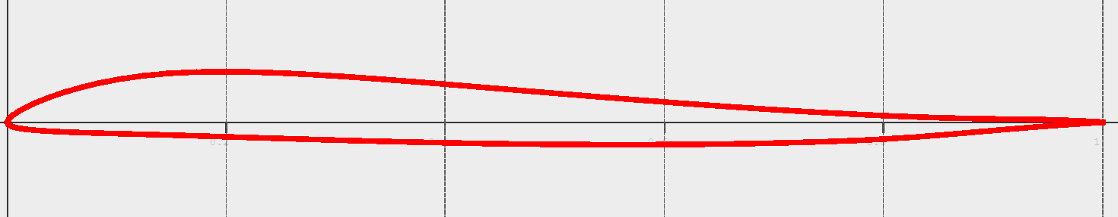
Aerodynamic design: Airfoil Selection
Fuselage: NACA 23012
21% max thickness
1.9% max camber
Fits in a 6U CubeSat frame
Re = 25,000
Wing: FX 66-H-60
6% max thickness for low Reynolds performance
1.7% max camber
Reflex Airfoil
Re = 25,000

Slide 8
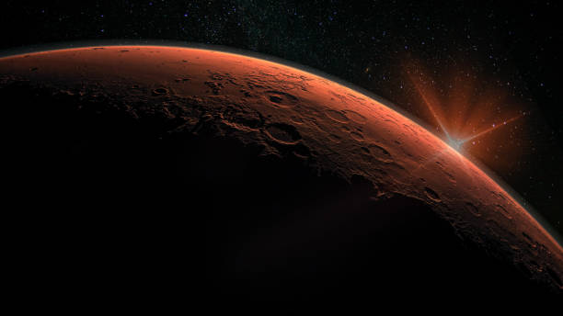

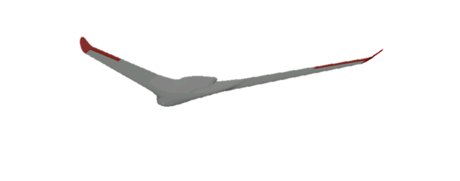
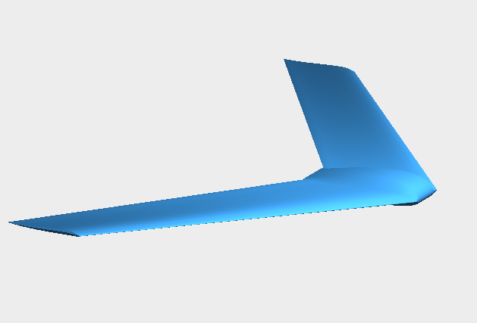
ASTEROIDS
SpaceTREx
Sailplane Design: Planform
Re = 35,000
Span: 4m
Area: 3.15m²
AR: 5.075
Mass: 5kg
Sweep: 40°
Fuselage: 0.95m
V = 40 m/s
M = 0.167
Tip: 0.60m
CL/CD max = 11
Notes:
This is flight data and aero characteristics for V = 40 m/s

Slide 9
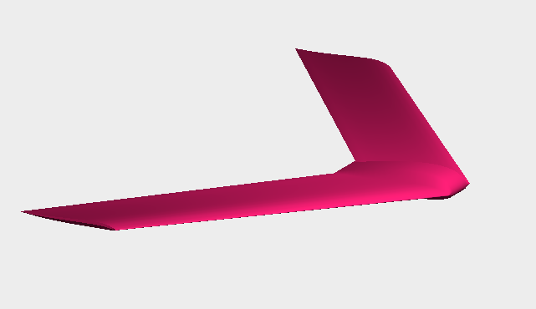
ASTEROIDS
SpaceTREx
Sailplane Design: Scaled
Re = 15,000
Span: 1.5m
Area: 0.5m²
AR: 4.5
Mass: 1kg
Sweep: 40°
Fuselage: 0.3m
V = 55 m/s
Mach = 0.229
Tip = 0.3m
CL/CD max = 7
Scale factor: 0.375
Notes:
This is flight data and aero characteristics for V = 55 m/s, small one needs more speed

Slide 10
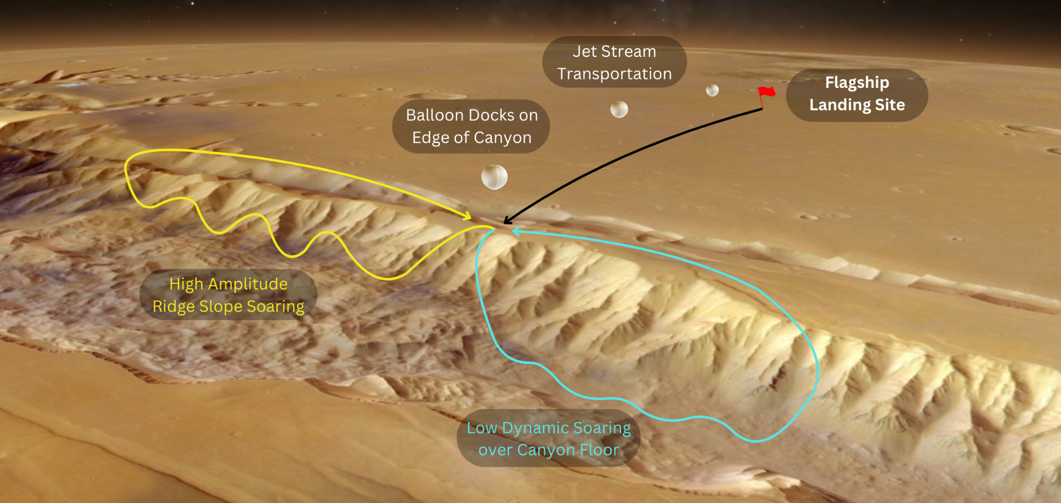
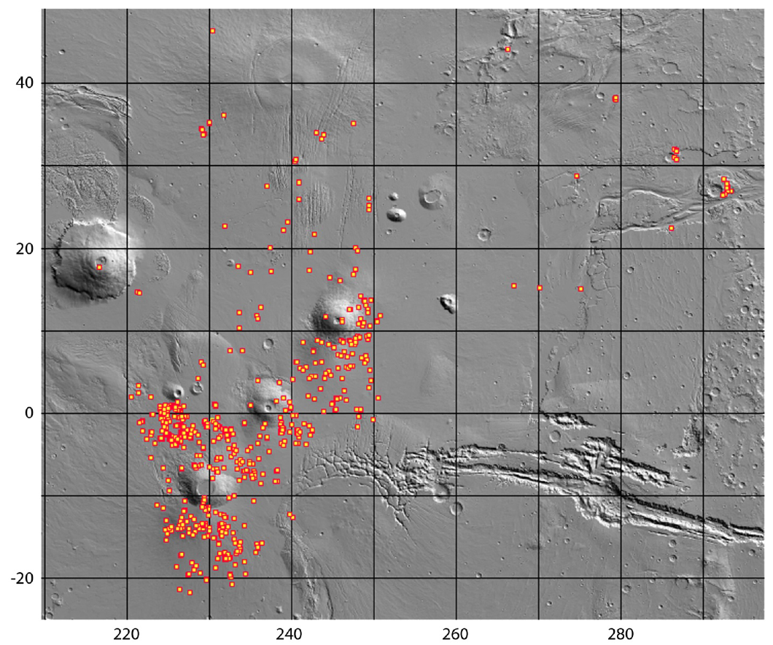
Mission design summery slide
Medium risk, medium reward: multiple distributed sailplanes
High risk, high reward: single sailplane
Speed, gliding range
EDL

Slide 11
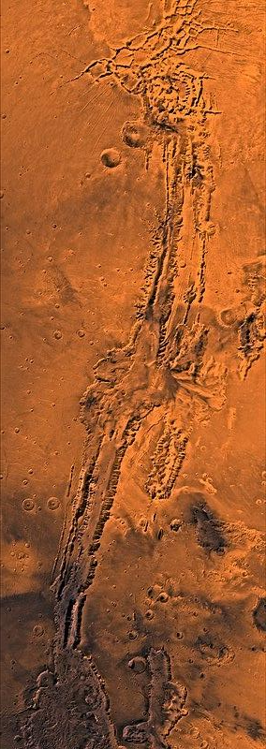
Site A: Valles Marineris (Melas Chasma)
Location: Valles Marineris is 4000 km (2500 mi) long and reaches depths of up to 7 km (4 mi). Approximate latitude -55 to 60 degrees, longitude 30 to 130 degrees
Science Motivation: Erosional features and landslide morphology and seepage of liquid water or sublimation of ground ice suggest for the variation in the morphologic evolution of the canyon system.
Notes:
Vast canyon system that runs along the Martian equator just east of the Tharsis region. Valles Marineris is 4000 km (2500 mi) long and reaches depths of up to 7 km (4 mi). Approximate latitude -55 to 60 degrees, longitude 30 to 130 degrees
Canyon wall erosional features and landslide morphologies indicate that materials have been transported from the walls to the floor essentially by mass wasting and downfaulting. However, seepage of liquid water or sublimation of ground ice could have contributed to the enlargement of the tributary canyons, thus suggesting that variations in climatic conditions could have accounted for the morphologic evolution of the canyon system.

Slide 12
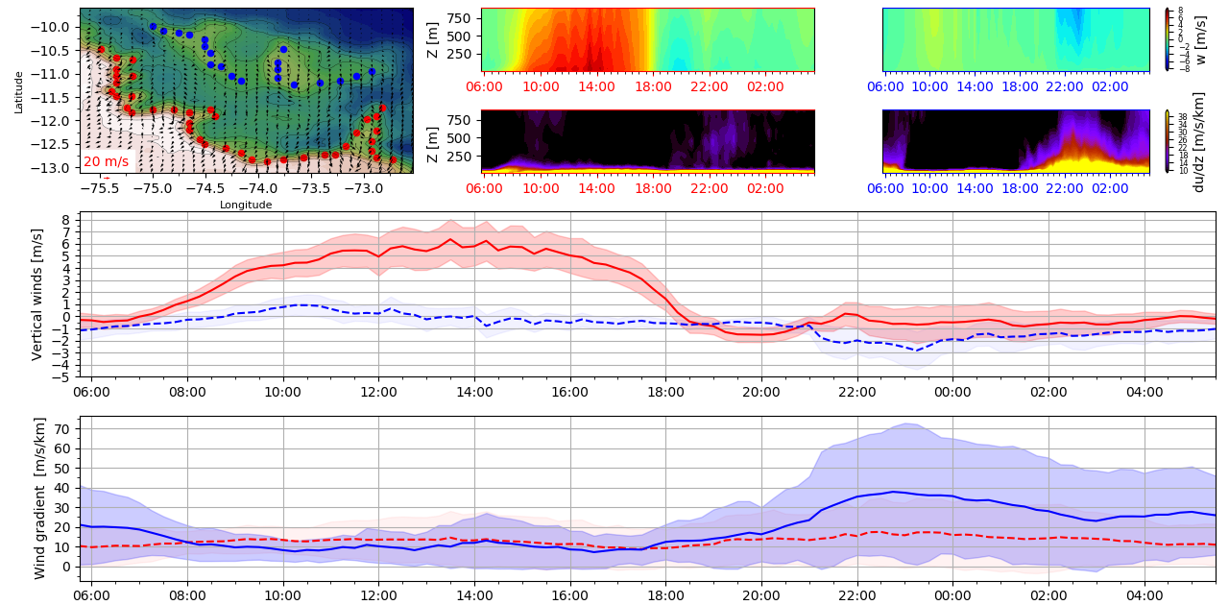
Notes:
Information provided by colleague Alex Kling, it shows vertical wind in the morning around the cliff, quite a lot of shear on the bottom during the second half of the day, mission constructed from this data
Full complete survey

Slide 13
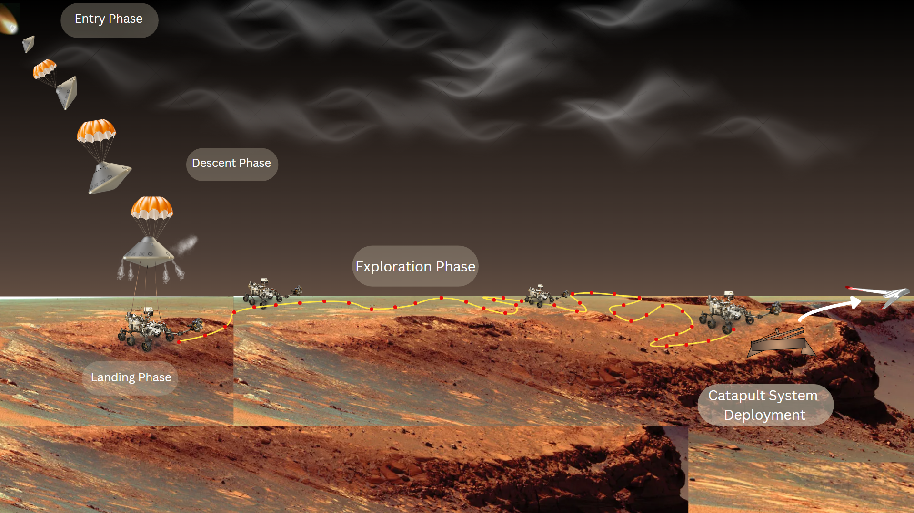
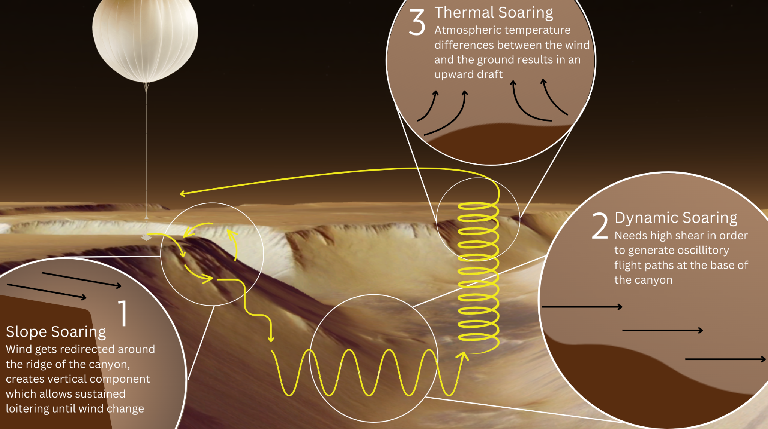

Slide 14
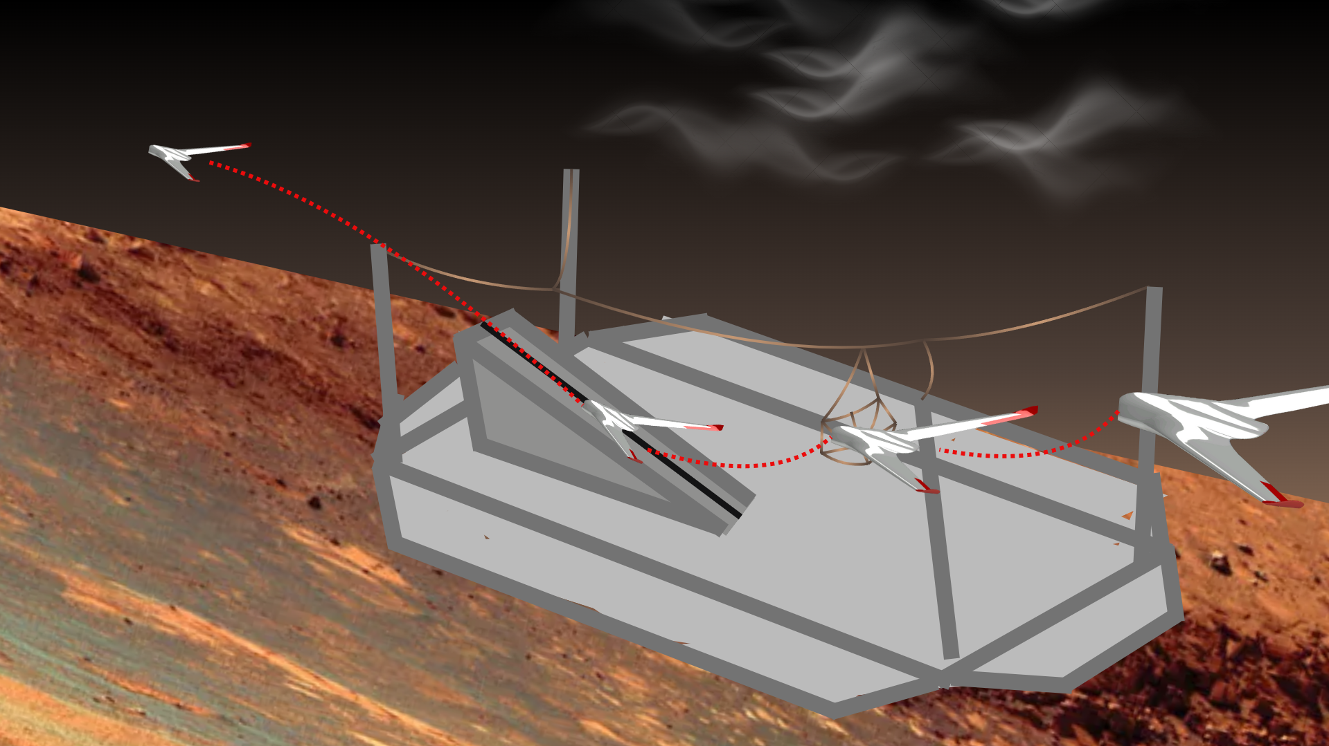

Slide 15
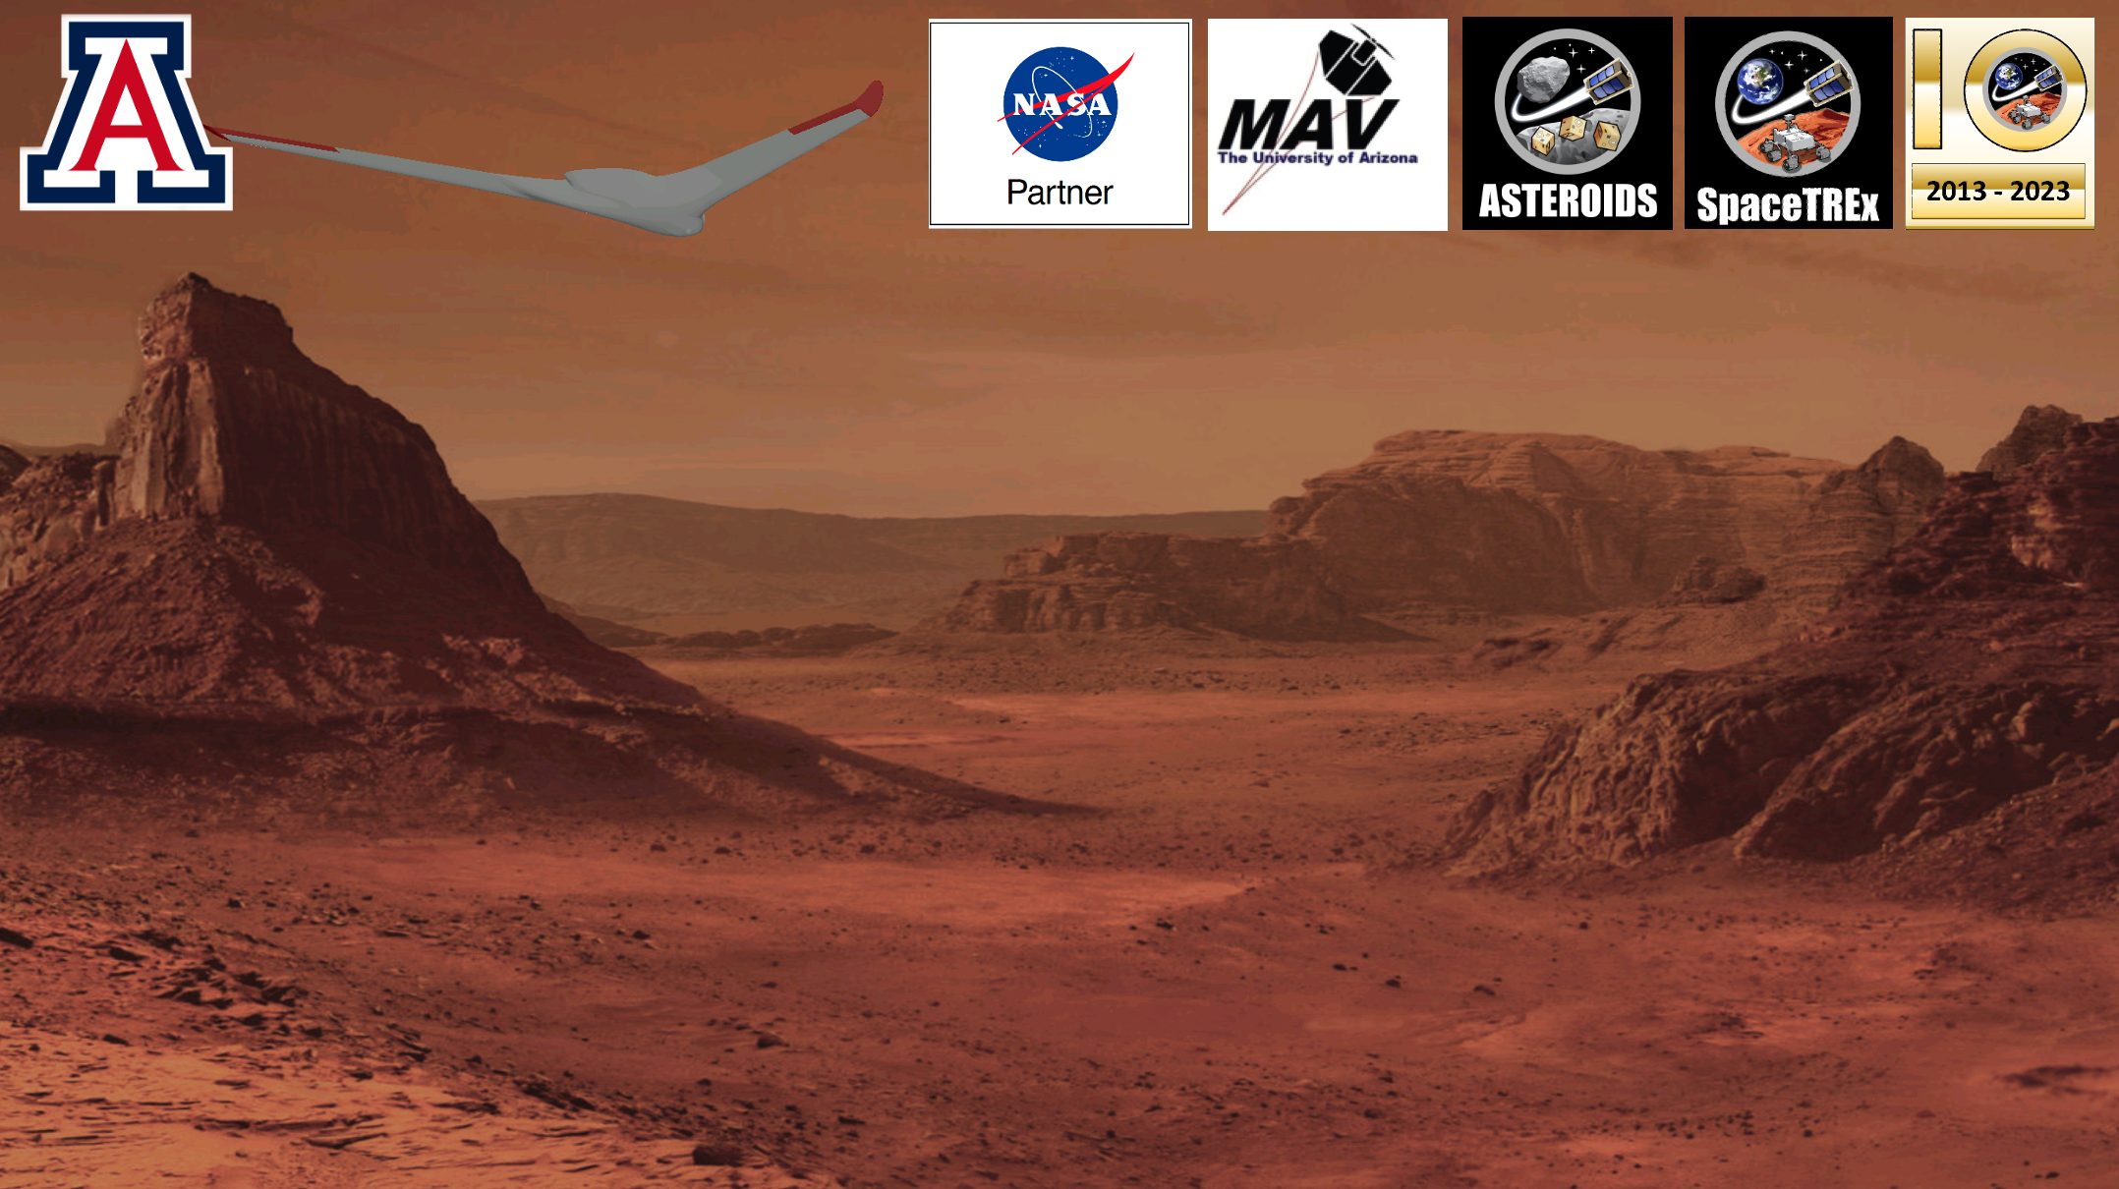
Questions?

