Slide 1
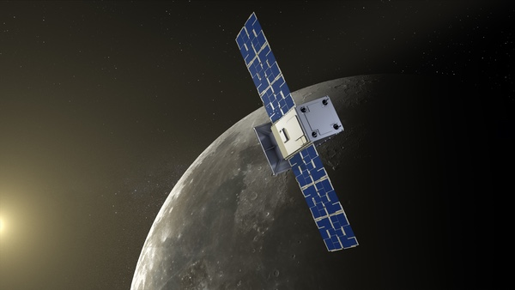


CLEW (Compact Lunar Explorer for Water):
State of the Art IR Spectrometer for a Lunar Cubesat Orbiter
P.E. Clark*ª, T. Hewagama^{b}, C. Brambora^{b}, E. Kan^{b}, T. Livengood^{b}, N. Fiteª
ªMorehead State University Space Science Center, 235 Martindale Rd., Morehead, Ky USA 403351
^{b}NASA Goddard Space Flight Center, 8800 Greenbelt Rd., Greenbelt, MD USA 20771
^{c}University of Maryland, College Park, MD 20742.
12U in Lunar Orbit (Terran Orbital Capstone)

Slide 2
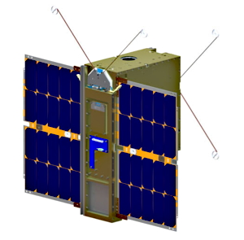
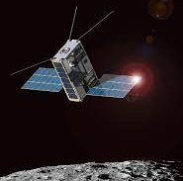
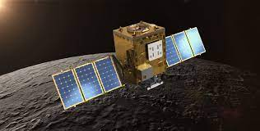
Built/Planned Lunar Orbiting IR Spectrometers
MSU Lunar Ice Cube (GSFC BIRCHES 1 to 3.5 microns for OH/H2O absorption features) (14 kg). Miniaturized version of OVIRS with integrated mini cryocooler
Lockheed Martin LunIR (thermal imaging based terrane mapping) (14 kg). Miniaturized version of MWIR camera with integrated mini cryocooler
Caltech JPL Lunar Trailblazer, HVM3 0.6-3.6 micron NIR/MWIR imager with M3 heritage and LTM thermal imager 6-100 microns) (200kg) with Compact Modular Sounder on TechDemoSat-1 heritage.

Slide 3
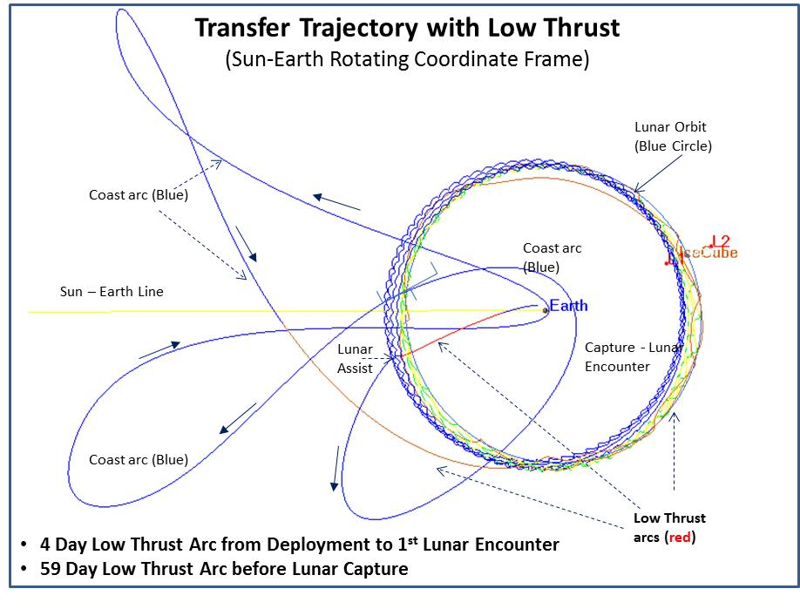
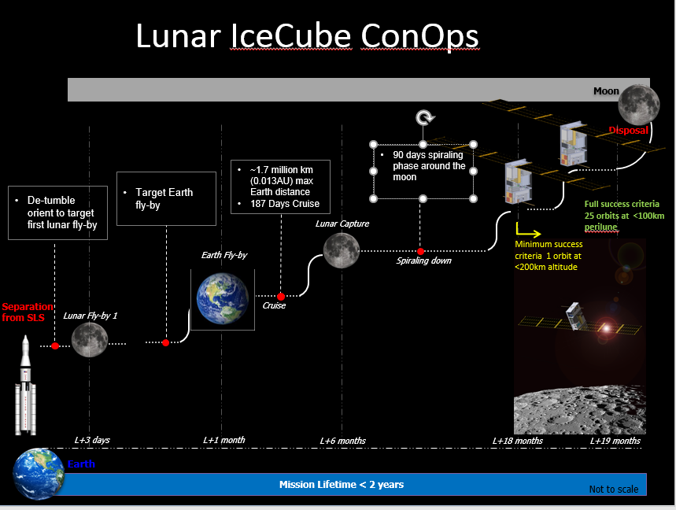
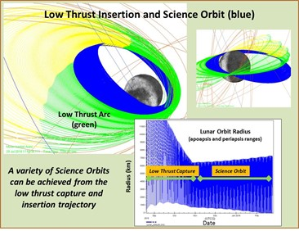
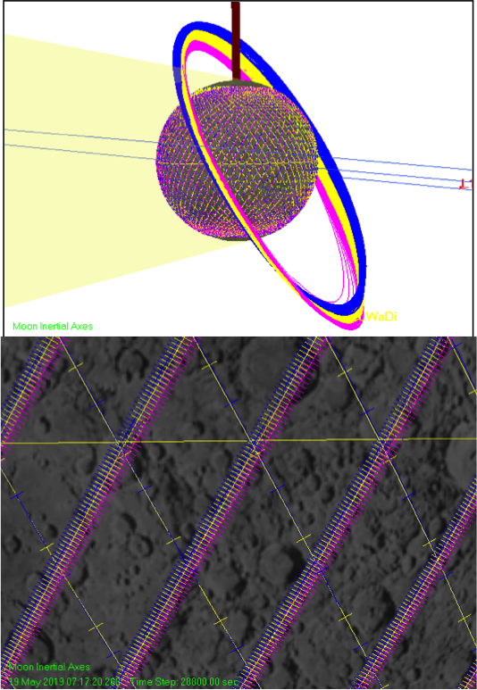
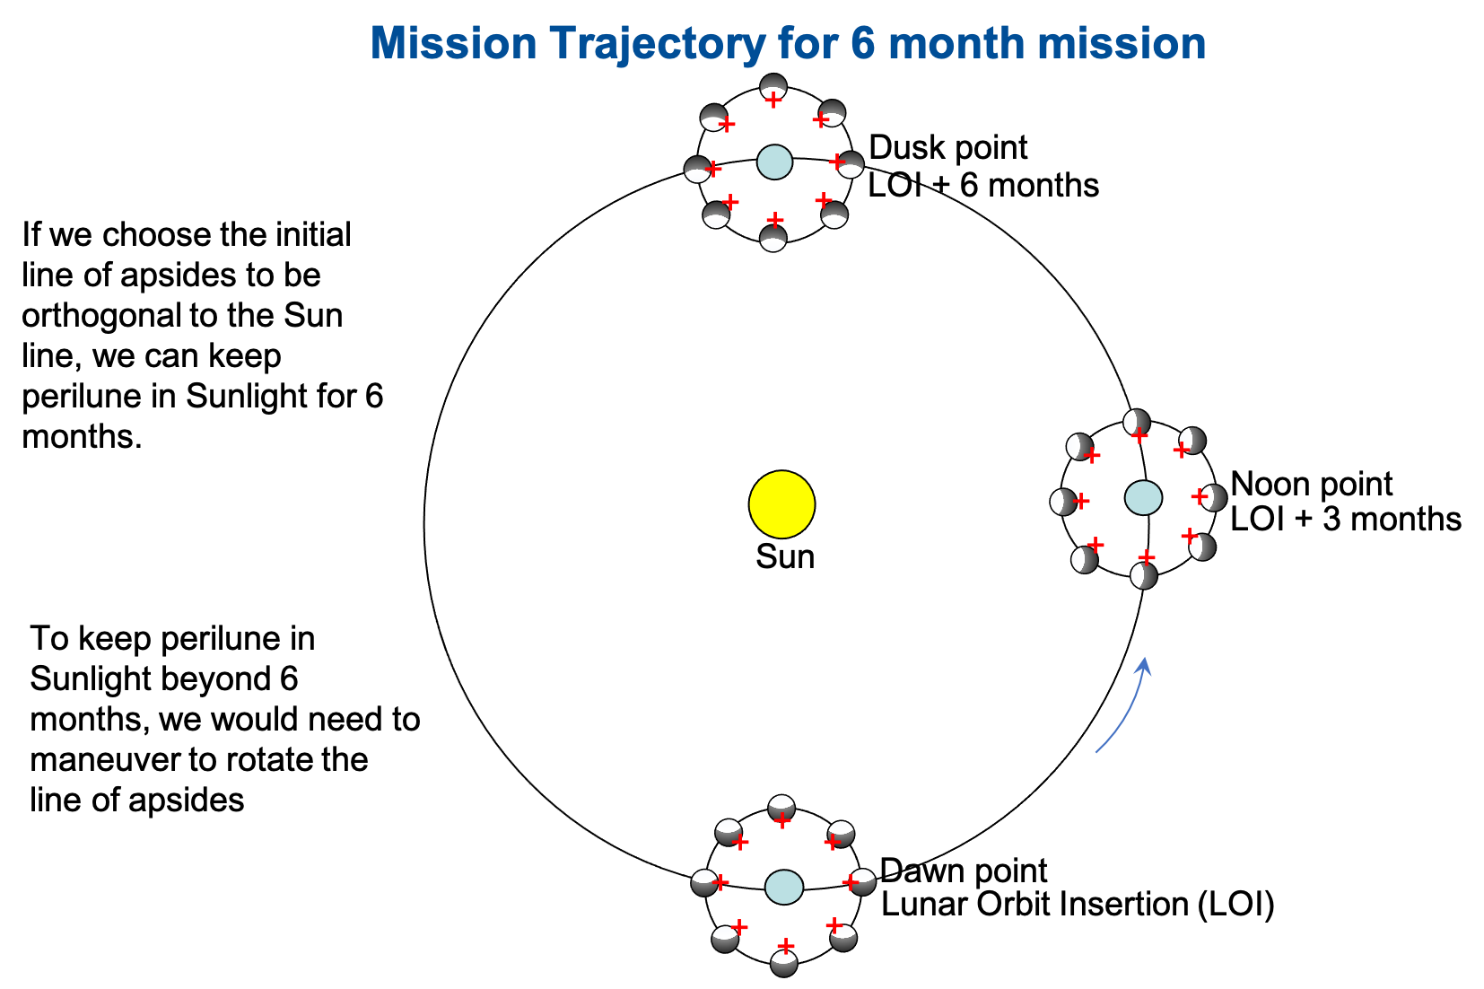
Lunar Ice Cube MIssion Concept

Slide 4
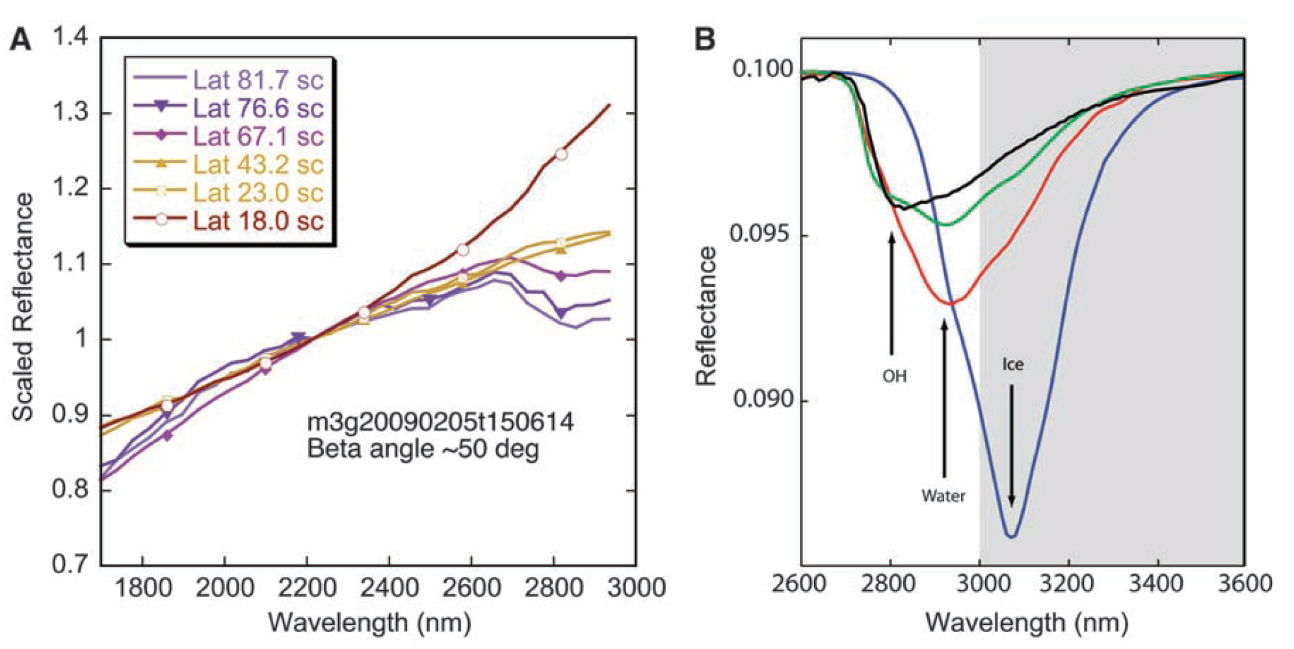
IR Spectrometers and Water: Major Absorption bands
Species | Wavelength μm | Description
water vapor | 2.738 | OH stretch
 | 2.663 | OH stretch
liquid water | 3.106 | H-OH fundamental
 | 2.903 | H-OH fundamental
 | 1.4 | OH stretch overtone
 | 1.9 | HOH bend overtone
 | 2.85 | M3 Feature
 | 2.9 | total H2O
 | 6.1 | H-O-H bend, Salisbury et al. 1997
hydroxyl ion | 2.7-2.8 | OH stretch (mineral)
 | 2.81 | OH (surface or structural) stretches
 | 2.2-2.3 | cation-OH bend
 | 3.6 | structural OH
bound H2O | 2.85 | [33] [35]
 | 3 | H2O of hydration
 | 2.95 | H2O stretch (Mars)
 | 3.14 | feature w/2.95
adsorbed H2O | 2.9-3.0 | R. Clark [34] [36]
ice | 1.5 | band depth-layer correlated
 | 2 | strong feature
 | 3.06 | [13] [19]
 | 11-12 | controversial
hydrated silicates | 3-3.5 | vibrational processes
Reflectance spectra showing water and hydroxyl absorption features depth (~3 microns) as a function of latitude. Chandrayaan M3, Pieters et al 2009
Reflectance spectra with absorption feature strength correlated with time of day. Deep Impact Epoxi. Sunshine et al 2009

Slide 5
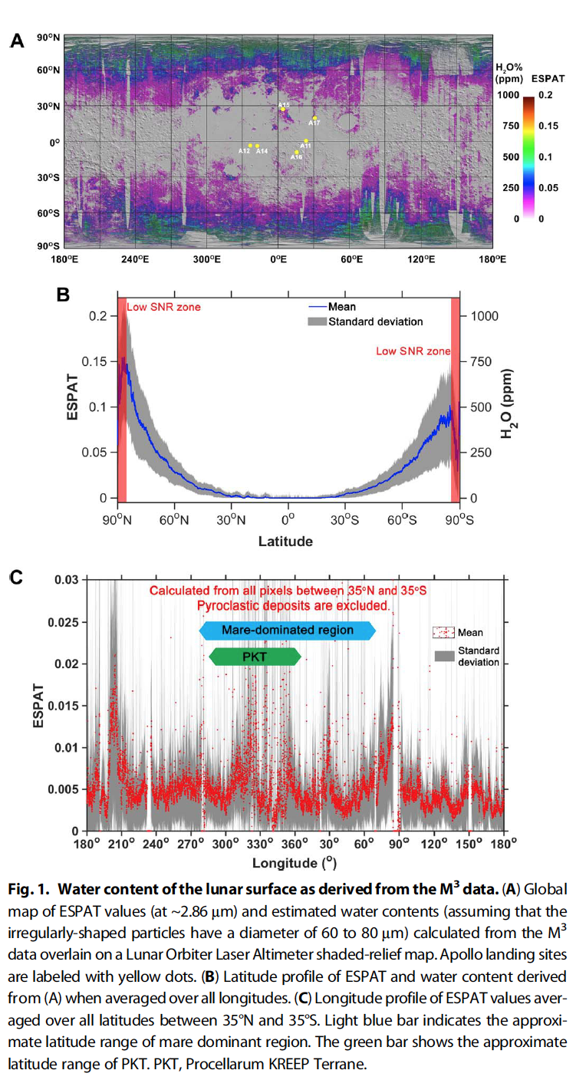
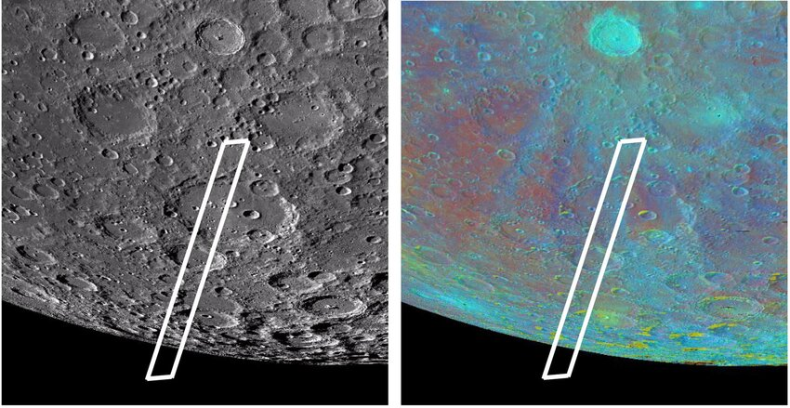
Water Estimates and Limitations
Water content in the polar regions as high as ~1000 ppm (on the scale of tens to hundreds of kilometers) though the variation from that average on the scale of potential resource extraction (meters to tens of meters, thus requiring in situ observations) is unknown.
Some estimates water (OH or H₂O or both) enrichment in large pyroclastic deposits up to 0.5 wt% and in Permanently Shadowed Regions (PSRs) up to 30 wt.% surface exposed water ice.
The speciation (OH or H₂O or both) of adsorbed lunar surface water unclear.
Absorptions due to OH vibrations can occur ~2.65 to 2.9 μm; fundamental stretching vibrations of OH occur near ~2.8 μm; first overtone of the H₂O bending vibration occurs near ~3.0 μm
presence of H₂O produces a more rounded and broader 3 μm band, while the absorption of purely OH creates a more asymmetric band with long tail towards longer wavelength highly variable in position and strength depending on the bonding energy to the cation to which OH is attached
M3 wavelength cut off 3 microns; EPOXI and VIMS data wider spectral range out to 4.5 μm and 3.2 μm, respectively, but residual thermal emission, low spatial resolution complicates analysis.
SOFIA detected absorption band at 6 microns NOT SHARED WITH OH ‘found within glasses or sheltered voids between grains’ around Clavius Crater in 100 to 400 ppm range (e.g., Honnibal et al, 2020)
Figure 2. a) Mapped water content from M3 data exhibits strong latitudinal diurnal variations ([16], Figure 6A); b) The y axis indicates the absorption strength of water bands near 3 micron in M3 data c) suggesting latitudinal and diurnal variations in lunar surface water ([20], Figure 4B).

Slide 6
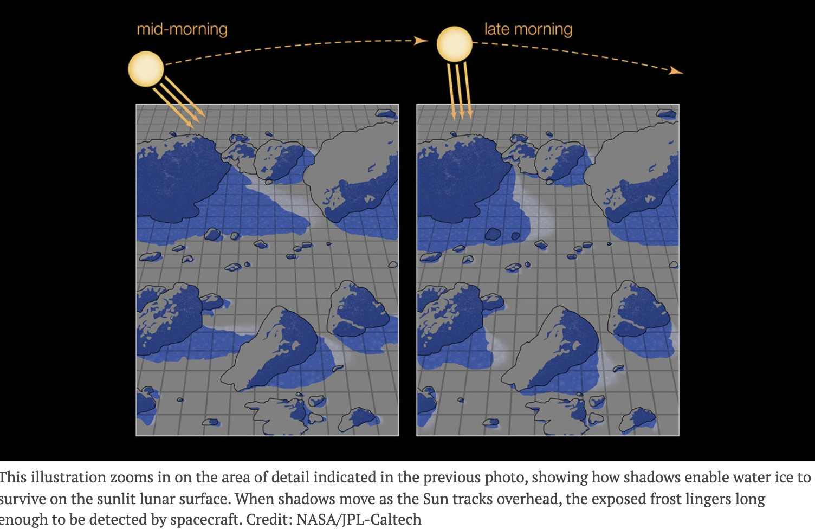
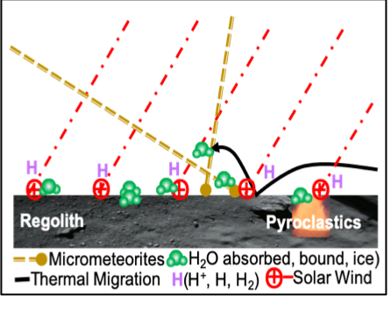
Some unanswered questions about lunar water:
Are primary sources exogenic, endogenic, or chemogenic origin, or some combination thereof?
How are the forms of water (hydroxyl, molecular adsorbed or bound water, ice, exospheric water) distributed and how does distribution vary within a cycle? from cycle to cycle?
What is the quantitative relationship between lunar temperature, illumination (solar zenith angle, time of day, shadow), and form of water (hydroxyl, molecular bound or adsorbed, ice, exospheric)?
How does this distribution vary as a function of terrain type, geochemistry, and maturity?
Recent reviews suggest multiple forms of water at the Moon. Water could be derived from the interior via outgassing or as bound water in volcanic deposits, or from exterior volatile-rich sources such as infalling comets, or result from in situ interaction with solar wind and/or micrometeorites [11].
To what extent, where, and how water can be extracted as a resource depends on the mechanism and timing of its production to a large extent.

Slide 7
CLEW: Compact Lunar Explorer or Water
During the last year we have developed a concept for a follow-on to BIRCHES, CLEW that fits within 12U payload constraints:
low cost, compact 2.5 to 12.5 micron range IR spectrometer, with modest increases in SWAP relative to BIRCHES
yet consists of high heritage components with greatly advanced capabilities in sensitivity, spectral coverage, and less active cooling demand at comparable wavelengths [e.g., Althobaiti and al-naib, 2020]]
as exemplified by the Compact Thermal Imager (CTI) [Jhabvala et al, 2010, 2019], combined with the EUCLID SIDECAR ASIC [Loose et al, 2018; Jennings et al, 2022]
Although initially developed for astronomical applications, the CTI has already been modified for lunar surface applications as the Compact Lunar Hydration and Mineralogical Explorer (CLuHME) [Bower et al, 2022] with the incorporation of a Ricor 508 or 548 cryocooler in an IDCA configuration
Limited bandwidth (still <256 kb) precludes configuration as an imaging spectrometer, but our readout design is configured to allow spatial resolution within our 10 x 10 km field of view
Add ons dependent on cost include an internal calibration source and a cubesat contextual camera in 'density slice' mode could be added to assist in position determination by matching crater distribution patterns and the terminator position.

Slide 8
Comparison BIRCHES and CLEW
Property | BIRCHES | CLEW
Spectral Range | 1-4 microns | 2.5-12.5 microns
Spectral Resolution | 20 nm @ 3 microns | 30 nm @ 3 microns
Mass | 3.3 kg | 4.0 kg
Power | 12W/25W | 20W/50W peak (cryocooler inrush)
Volume | 2.25 U | 3.5 U
Spatial Resolution | 10 km@100 km | <100 m x <1000 m @ 100 km
Cryocooler | AIM/IRIS 0.6 W@140K | RICOR 548 0.9W@90K

Slide 9
Next Generation Lunar IR Spectrometers
BIRCHES principal components OVIRS (Origins, Spectral Interpretation, Resource Identification, Security Regolith Explorer Visible and InfaRed Spectrometer) detector and optics flight spares, no longer available, 20 years beyond IR the state of the art.
CLEW Detector system large format Type II InAs/GaSb strained super lattice (SLS), utilizing thin layers of Group III-IV semiconductor material, and FLIR ROIC (ReadOut Integrated Circuit). 1 Mpixel detector assembly. Ricor K508 in Integrated Detector Cryocooler Assembly (IDCA). Well depth 1.1x10⁷ photoelectrons, 16bit channels, able to run up to 32 channel readout. Would exhibit superior performance to BIRCHES, with modest increase in mass (4 kg), easily accommodated in a 12U platform.
GSFC Compact Thermal Imager (CTI) developed initially for astronomical applications, already modified for Earth-orbiting applications as well as lunar surface applications as the Compact Lunar Hydration and Mineralogical Explorer (CLuHME), with the incorporation of a compact cryocooler.
CTI (thermal imager for space station) Schematic.

Slide 10
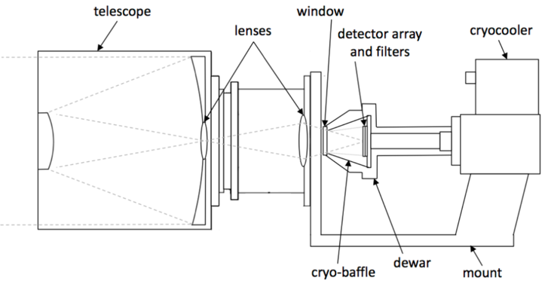
Compact Thermal Imager (CTI)
BIRCHES was designed as a point spectrometer, in order to meet the requirement for continuous data collection while keeping within severe bandwidth constraints. CLuHME is a hyperspectral imager designed to collect ‘snapshot’ data from 2.5 to 12.5 microns with somewhat lower spectral resolution,
CLEW would have a refractive optics system and LVF wavelength separation similar to CLuHME but require continuous readout over the illuminated portion of the lunar surface and if it were designed as hyperspectral imager would generate much greater data volume than downlink bandwidth allows.
The CTI detector interface allows the development of a sophisticated readout algorithm which enhances spatial resolution (100 meters versus kilometers) while generating volume that is within BIRCHES bandwidth constraints (256 kbs) despite continuous data collection.
Figure 4. Schematic of CLuHME SLS spectrometer. On Next Generation BIRCHES, the telescope and lenses would be replaced by the BIRCHES optics (OBOX).

Slide 11
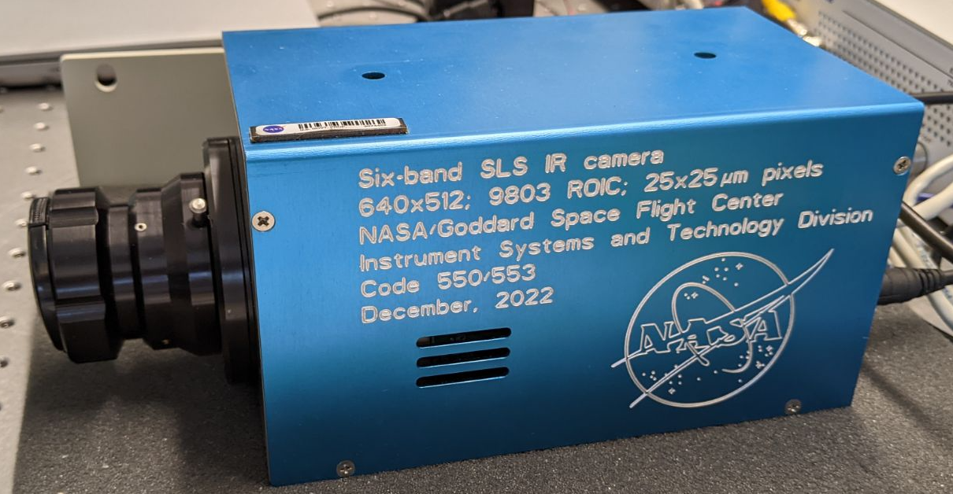
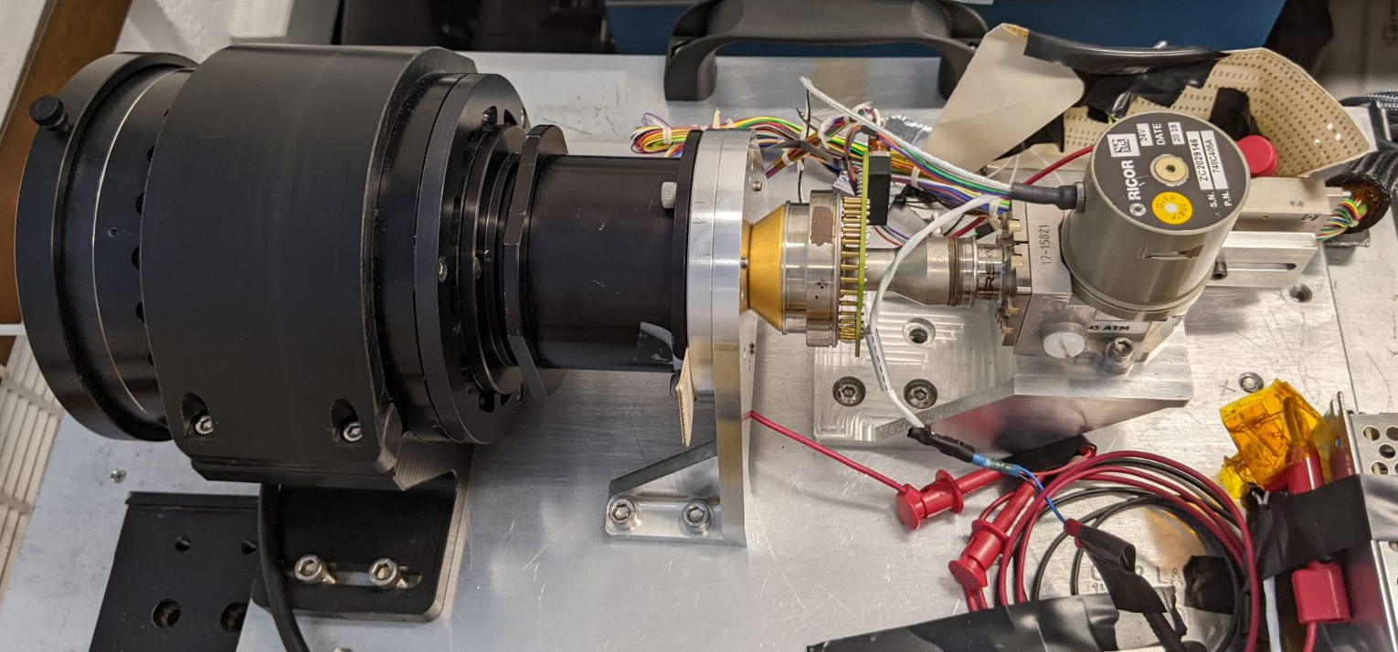
230 x 100 x 100 mm = 9 in x 4 in x 4 in
Analog Science Data,
Biases, CLKs, Temp Sensor (s?),
Heater for Optics (?)
EUCLID
SIDECAR
MODULE (ESM)
Science Data, Telemetry (CCSDS)
(LVDS)
SC C&DH
Commands (CCSDS)
(LVDS)
ESM PWR
PDU
SWITCHED 28 V
Instrument PWR
PDU Card
SC PDU
OPTICS
DET
CC
SWITCHED 28V
RICOR CC PWR
28V RICOR
K548 PWR
Instrument Temp Sensor +
Heater
SC INSTR.
TEMP CTRL

Slide 12
Lunar IceCube - 2 data downlink ConOps for periapsis passage - 1
SLS format 1024x1024, 18 µm pitch
LVF resolving power R~100
100 independent wavebands, 10 pix (columns) per waveband
200 for Nyquist sampling, 5 pixels (column) per wavebin
2 wavebins (5 pix, 1 s-pix) for each waveband (10 pix)
Bandpass: 2.5 – 12.5 µm
Resolution: 25 nm at 2.5 µm; 125 nm at 12.5 µm
S/C Cross Track
6 superpixel rows
Average
5x5 pixels
(18 µm pitch)
superpixel
(90 µm pitch)
Spectrum
1024 pixels
Six s-pixel rows, each s-pix row has 200 wavebins
S/C Along Track
1024 pixels ➜ 1024 / 5 superpixel columns or 205 wavebins ~ 200 wavebins

Slide 13
Current Status
The CLuHME SLS detector system, with its associated cryocooler Teleassembly, are assessed at TRL 6.
Next generation SIDECAR (ACADIA) has already flown on WFIRST (Wide Field InfraRed Survey Telescope).
Replacing and testing the current (TRL 6) BIRCHES detector/cryocooler assembly with CLuHME's and its electronics with ACADIA would require advancing TRL from somewhere between 4 and 5 to TRL 6.
Some of this work has already begun, but will still require at least one year.

Slide 14
Questions?
p.clark@moreheadstate.edu

