Slide 1
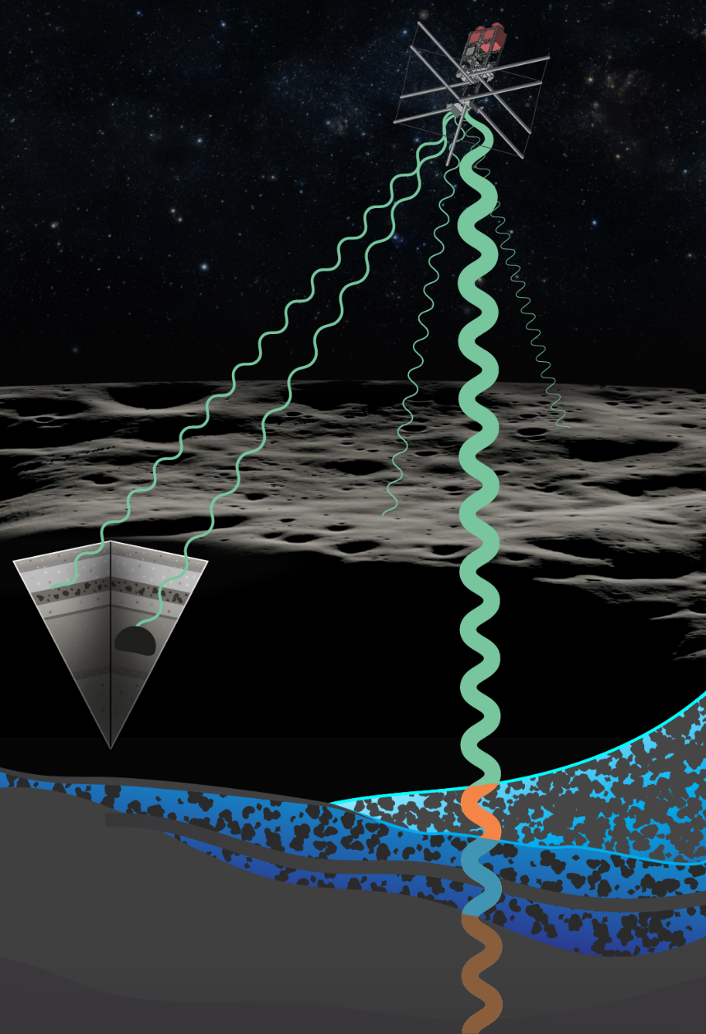




ACORN: the Advanced Compact Orbiting Radar for luNar sounding
Stefano Nerozzi
Lunar and Planetary Laboratory
University of Arizona
UA LPL: Jack Holt
MIT Haystack Observatory: Mary Knapp, Lenny Paritsky
MIT Lincoln Laboratory: Bradley Perry, Alan Fenn

Slide 2
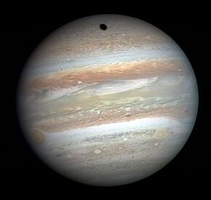
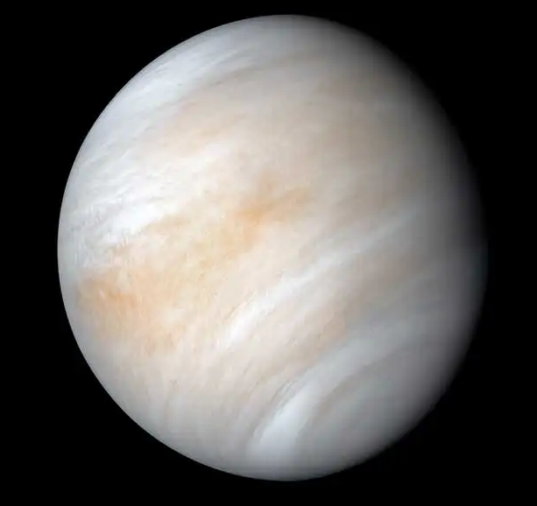
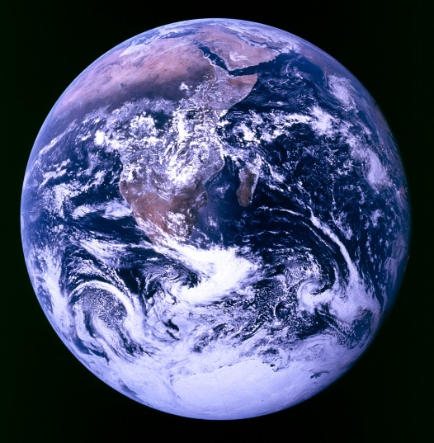
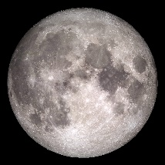
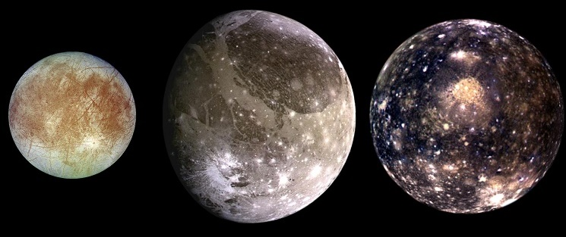
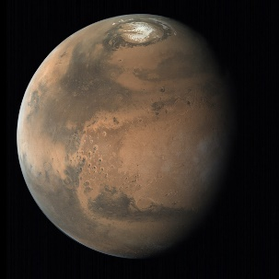
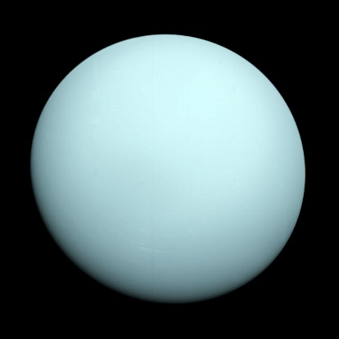
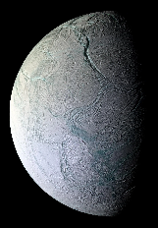
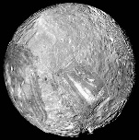
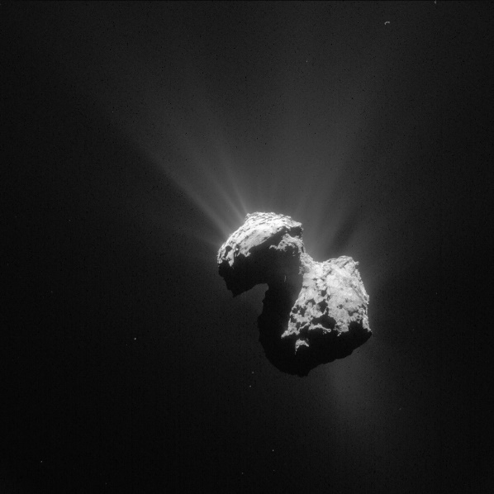
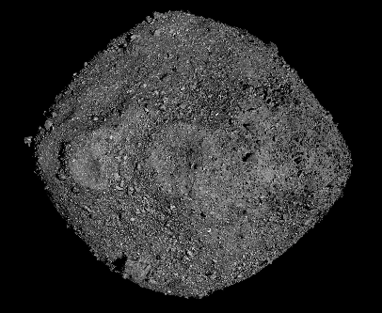
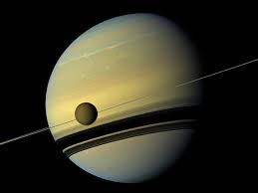
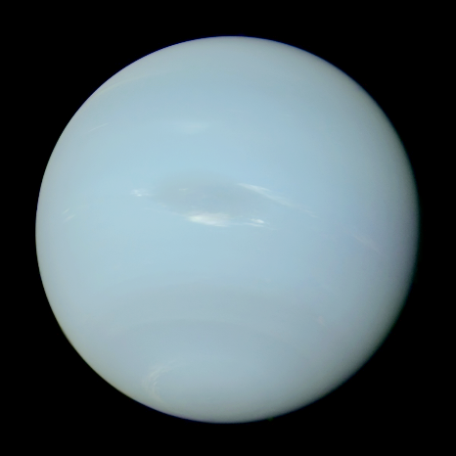
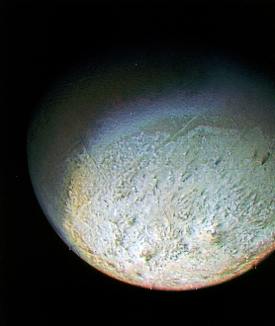
Not just the Moon:
Compact sounding radars across the entire Solar System
Image credit: NASA, ESA

Slide 3
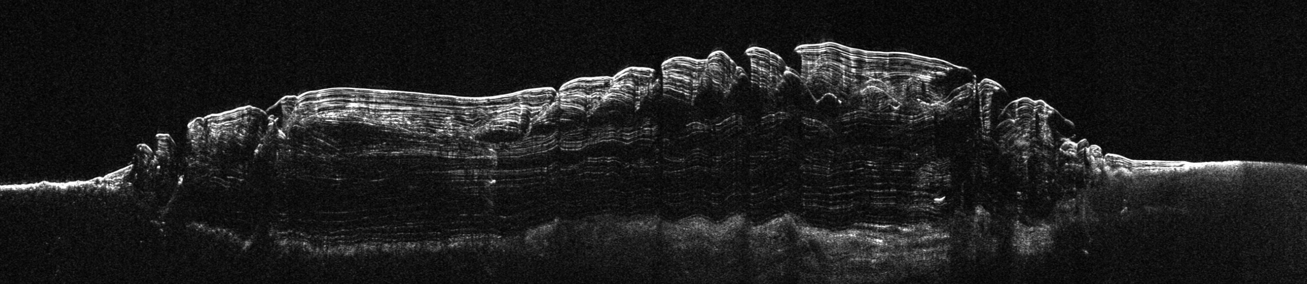
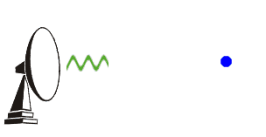
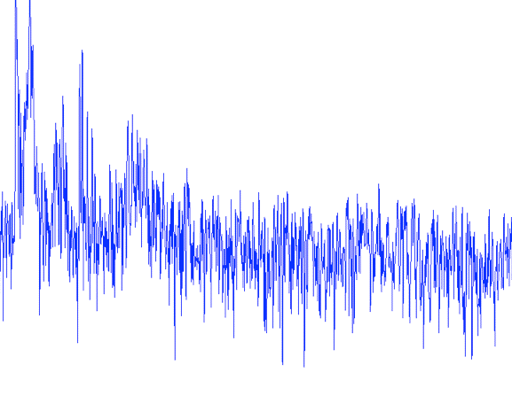
What is a sounding radar?
Single return
Many returns (radar profile of Mars’ north polar ice cap)
Image credit: NASA, NOAA

Slide 4
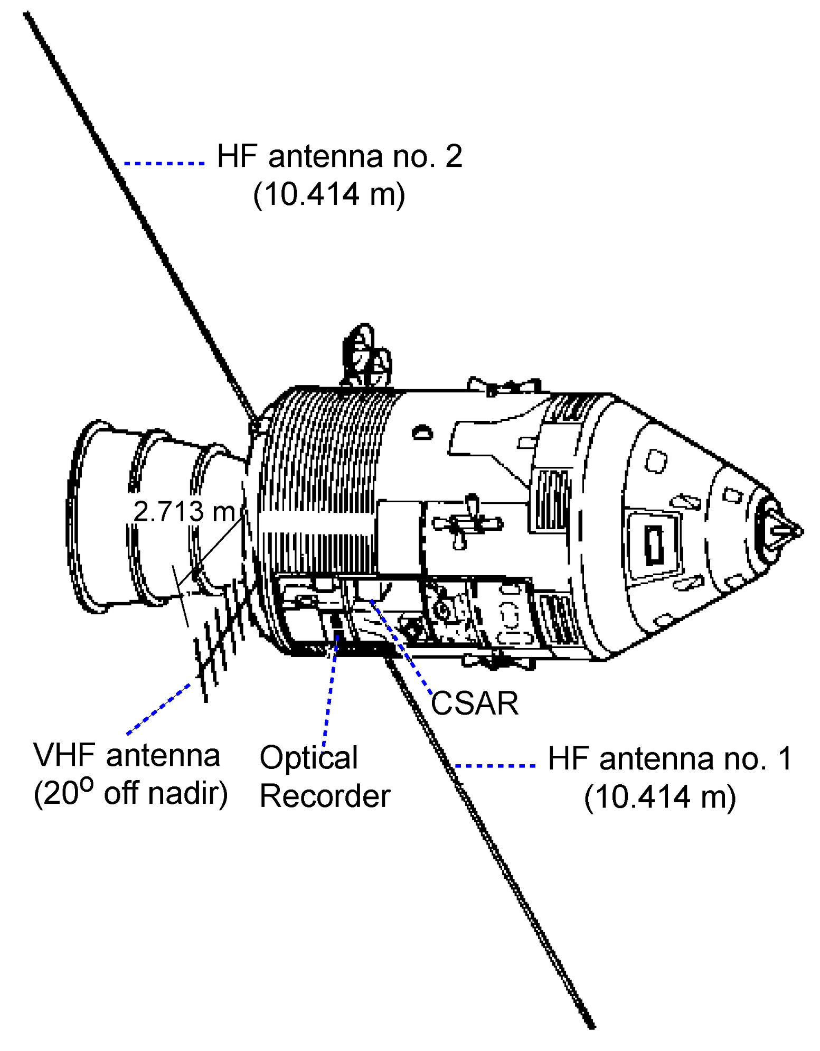
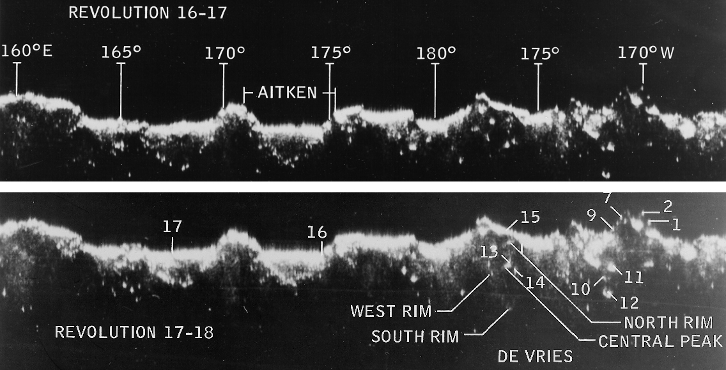
Apollo Lunar Sounder Experiment (ALSE)
A sounding radar flown on Apollo 17, December 1972.
The ALSE operated at 5, 15, and 150 MHz.
Data were stored on film, which was retrieved from the Service Module during an EVA.
Image credit: NASA

Slide 5
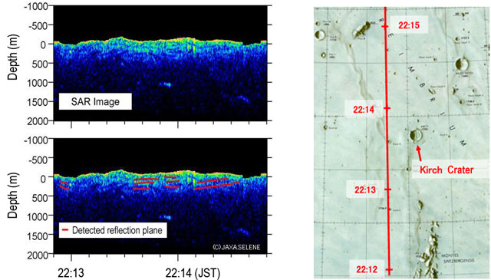
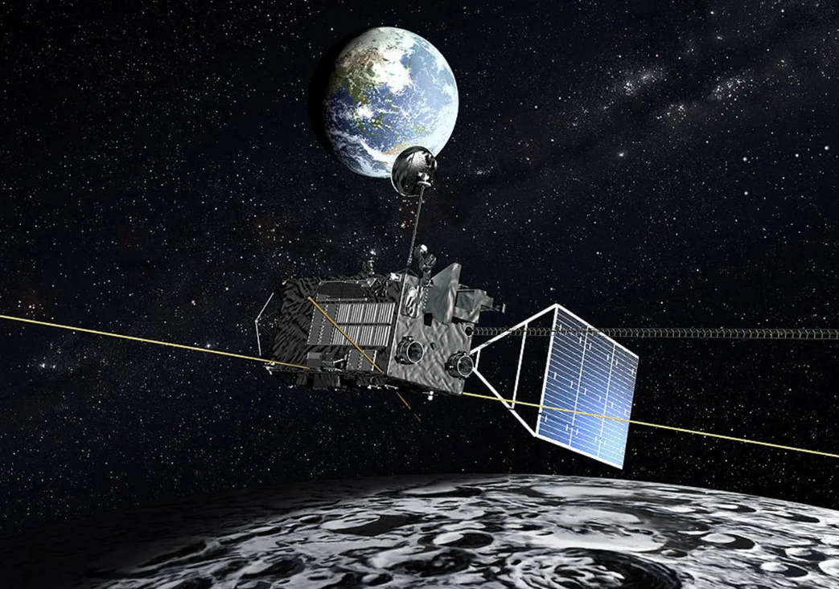
Selene/Kaguya Lunar Radar Sounder (LRS)
Operated from October 2007 to June 2009.
4 - 6 MHz, bandwidth of 2 MHz equates to a 75 m resolution in free space.
Performed passive observations of interplanetary radio sources.
Mass: 23 kg
Power consumption: 57 W (800 W peak power).
Image credit: NASA, JAXA

Slide 6
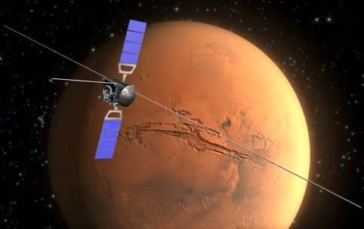
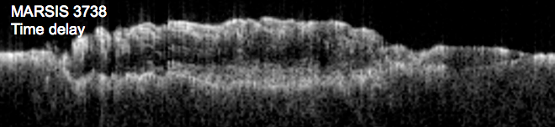
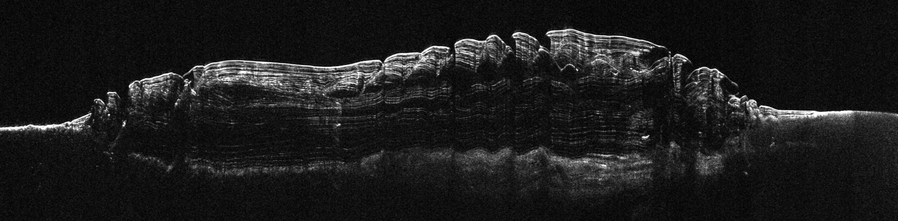
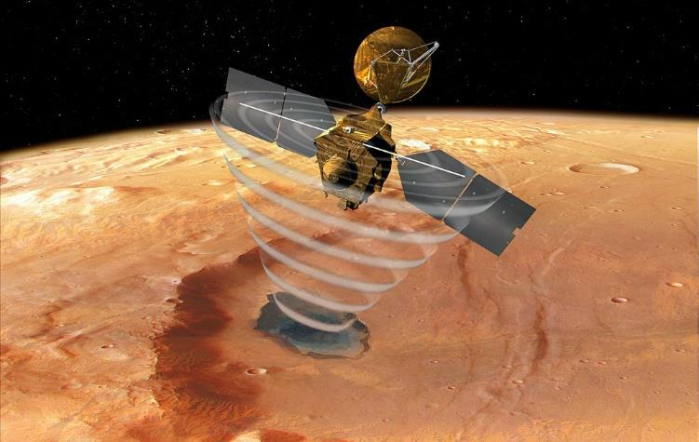
MARSIS and SHARAD
Both radars are in operation at Mars since 2004 and 2005.
Operating at 1-5 MHz (MARSIS) and 15-25 MHz (SHARAD).
Complete coverage of Mars’ polar caps, >50% global coverage.
Mass: 20 kg (MARSIS), 17 kg (SHARAD)
2.5 MHz (1 MHz bandwidth)
SHARAD 519201
Time delay
20 MHz (10 MHz bandwidth)
~ 1000 km
Image credit: NASA

Slide 7
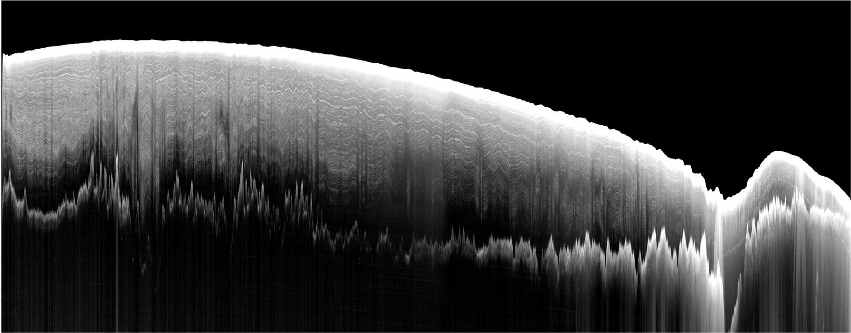
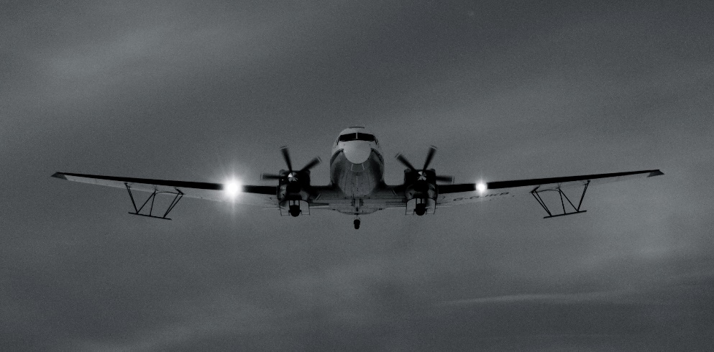
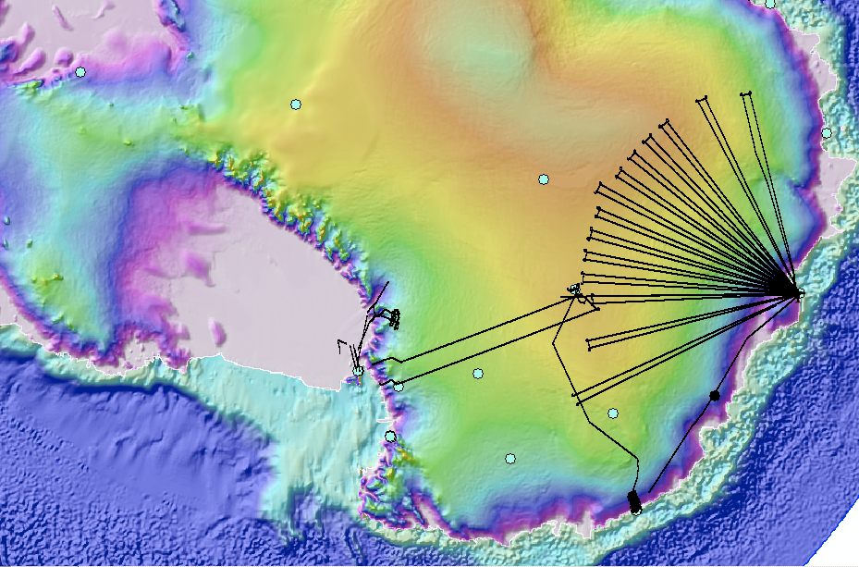
No orbital radar sounders for Earth… yet.
No sounding radars have ever been launched into Earth’s orbit.
All radar sounding campaigns to date operated from ground or airborne platforms.
We have better radar coverage of Mars’s ice caps than Antarctica or Greenland.
Dome C
ice sheet
bedrock
1 km
100 km

Slide 8
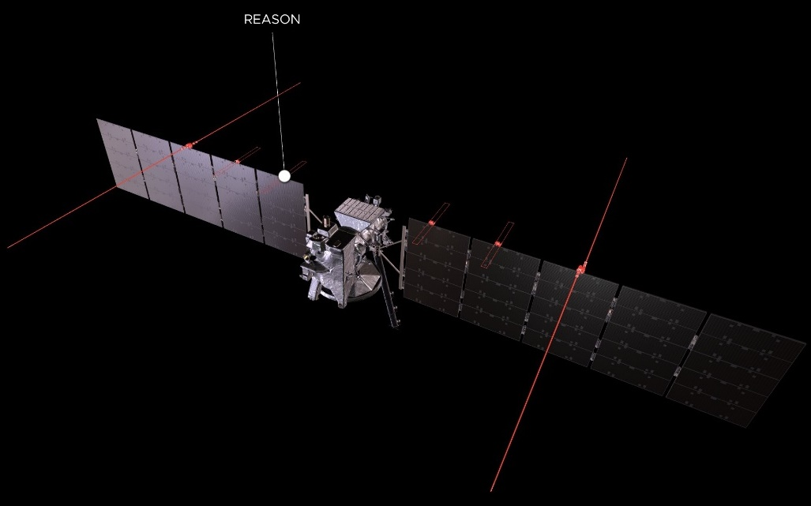
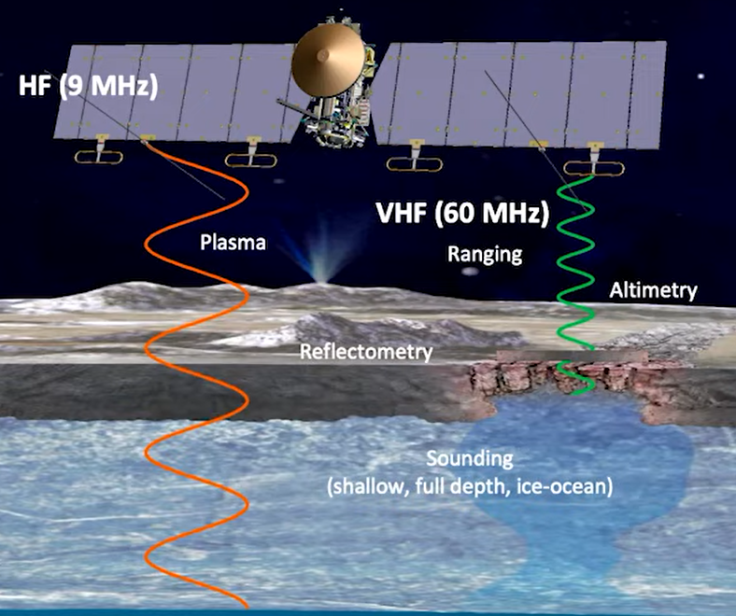
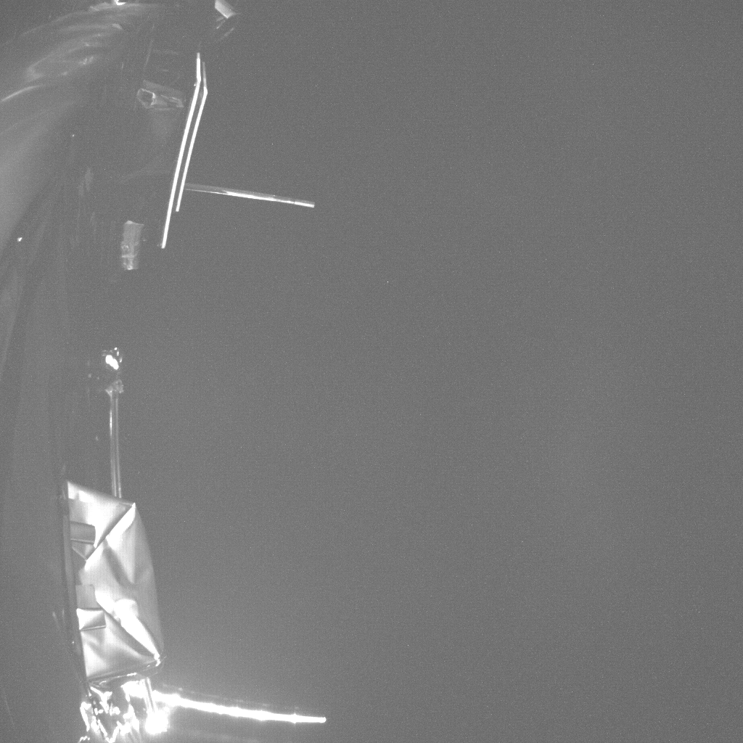
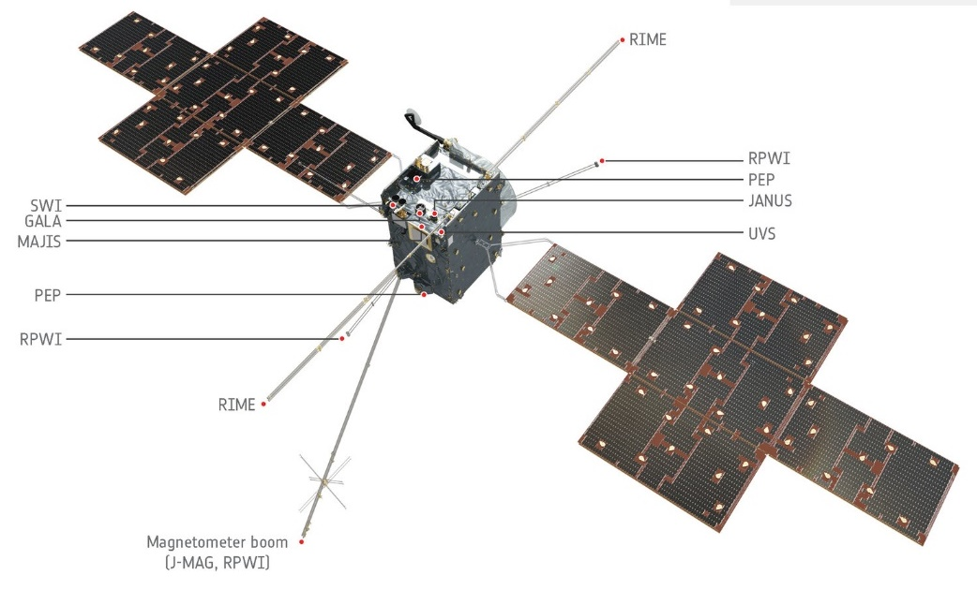
REASON and RIME in the Jovian system
Radar for Europa Assessment and Sounding: Ocean to Near-surface (REASON)
  8.5-9.5 and 55-65 MHz.
  Two arrays of dipoles.
  Mass: 32 kg.
Radar for Icy Moons Exploration (RIME):
  7.5-10.5 MHz.
  Simple dipole.
RIME deployment
Image credit: NASA, JPL, ESA

Slide 9
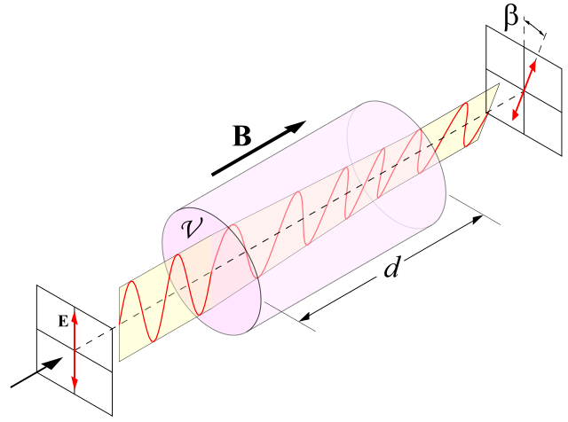
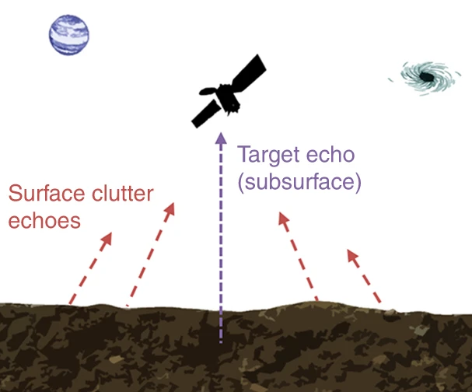
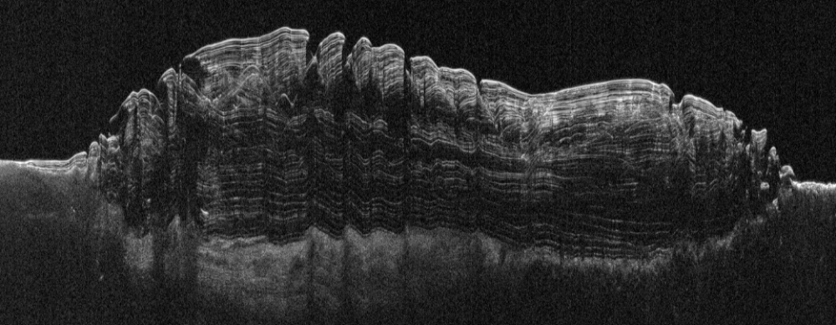
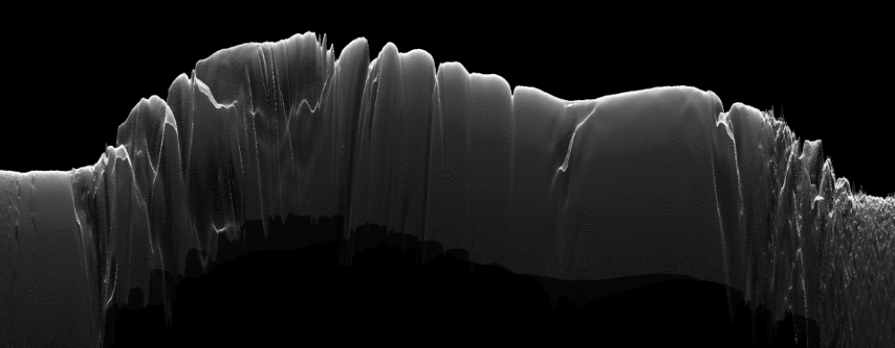
Limitations of orbital radar sounders
Large size and mass: large, flagship missions required.
Only one linear polarization:
  Signal loss due to ionospheric Faraday rotation.
  No complete echo polarization data.
No echo direction of arrival capability to mitigate clutter.
Carrer and Bruzzone (2017)
Notes:
References:
Carrer, L., Bruzzone, L. Solving for ambiguities in radar geophysical exploration of planetary bodies by mimicking bats echolocation. Nat Commun 8, 2248 (2017). https://doi.org/10.1038/s41467-017-02334-1

Slide 10
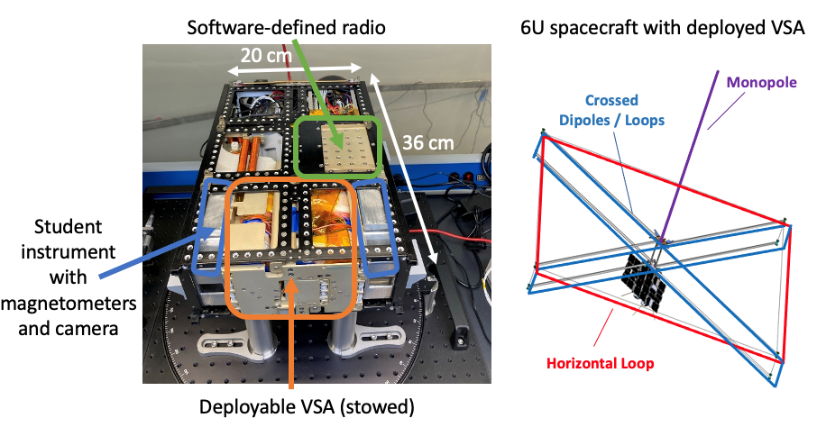
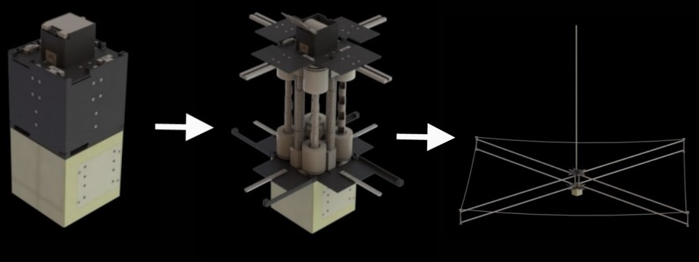
Vector Sensor Antenna (VSA)
Measures all 3D components of both electric and magnetic field of incoming radio signals.
  Full polarimetry and direction of arrival capability.
The AERO-VISTA cubesat mission will employ a VSA to study auroral and cosmic radiation at 0.1-15 MHz.
Antennas are stowed in only 2U volume, 4x4x2 m when deployed.
The full spacecraft fits in only 6U volume, total mass of 10 kg.
Image credit: MIT
Notes:
More info: https://www.eoportal.org/satellite-missions/aero-vista#emvs

Slide 11

Advanced Compact Orbiting Radar for luNar sounding (ACORN)
Fully addresses the need to fully characterize the lunar near-subsurface and possible shallow ice at meter-scale resolution:
TRL 4-5 heritage from AERO-VISTA on most receiver and antenna components.
Ongoing TRL 4 testing of new (smaller) antenna and transmitter.
Addition of 10 W transmitter adds <2 kg in 1-2 U volume, entire spacecraft could fit in 8 U.
Enables several high-priority science investigations, including:
Detection and characterization of polar buried ice.
Stratigraphy of mare basalts and pyroclastic deposits.
Structure of regolith, and deeper ejecta (megaregolith).
Can work as a VHF imaging SAR.

Slide 12
Advanced Radar for Ice and Subsurface Exploration (ARISE)
IIP proposal to raise the TRL of a VHF (40-70 MHz) radar dedicated to Earth ice and subsurface sounding.
TRL 4-5 heritage from AERO-VISTA on most receiver and antenna components.
Follows ACORN’s design, addition of 100 W transmitter in 2-3 U.
12 U cubesat accomodates all components with ample power and thermal management margins.

Slide 13
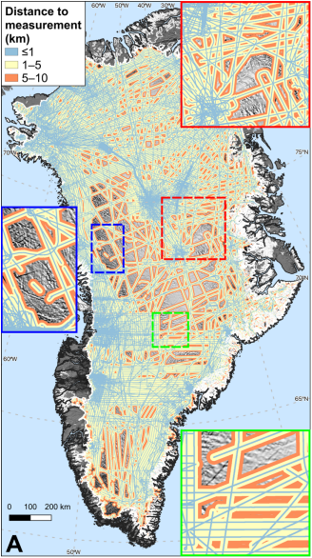
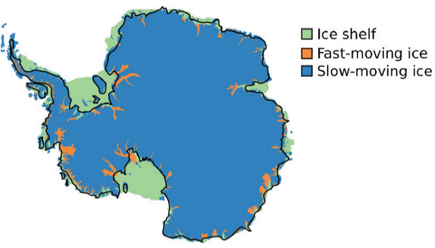
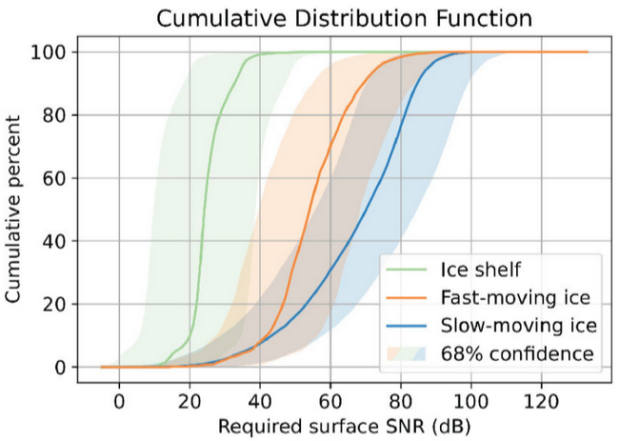
Advanced Radar for Ice and Subsurface Exploration (ARISE)
IIP proposal to raise the TRL of a VHF (40-70 MHz) radar dedicated to Earth ice and subsurface sounding.
Enables unprecendented coverage of Earth’s polar ice:
  100 % of Greenland ice sheet.
  All floating ice, 70% of fast-flowing ice in Antarctica, the major contributors to sea level rise.
  30% of thick inland ice.
Additional opportunity to perform radar sounding of arid regions to characterize acquifers.
Figure credits: MacGregor et al. (2021), Schroeder et al. (2020)
Notes:
References:
MacGregor, J. A., Schroeder, D. M., Khazendar, A., Beauchamp, R. M., & Haynes, M. S. (2023). Bright prospects for orbital radar sounding of the interior of the Greenland Ice Sheet. Presented at the International Geoscience and Remote Sensing Symposium. Retrieved from https://2023.ieeeigarss.org/view_paper.php?PaperNum=1155
Schroeder, D. M., Bienert, N. L., Culberg, R., MacKie, E. J., Teisberg, T. O., Chu, W., & Young, D. A. (2021). Glaciological Constraints on Link Budgets for Orbital Radar Sounding of Earth’s ICE Sheets. In 2021 IEEE International Geoscience and Remote Sensing Symposium IGARSS (pp. 647–650). https://doi.org/10.1109/IGARSS47720.2021.9553237

Slide 14
Wideband Hf Ice and Subsurface Penetrating Radar (WHISPR)
MatISSE proposal to raise the TRL of an HF (10-15 MHz) radar to explore the interior of a wide variety of planetary bodies.
Maintain AERO-VISTA passive receive capabilities to explore planetary radio emissions
(e.g., ionospheric and magnetospheric radio sources).
TRL 4-6 heritage from AERO-VISTA on all receiver and most antenna components.
Ongoing TRL 4 testing of transmitter and active antenna components.
Deep radar sounding of icy moons, asteroids, comets, and terrestrial planets.
Very low mass and power requirements enables radar sounding of outer Solar System targets beyond Jupiter.
Resolution comparable or superior to that of REASON and RIME.

Slide 15
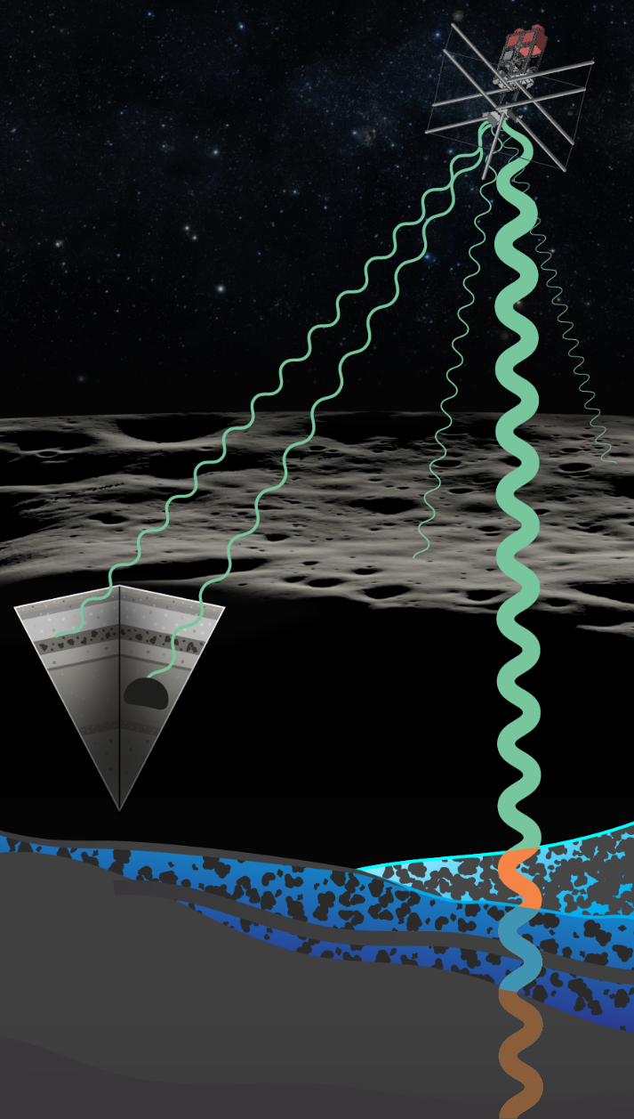
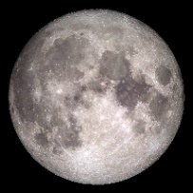





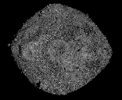
Summary
HF and VHF radar sounders based on vector sensor antenna (VSA) address the need for a new class of small, lightweight, and low power interplanetary radars.
Compact volume: 6U for ACORN and WHISPR, 12 U for ARISE.
Low mass: 6-7 kg for all configurations.
Low power: 21-37 W for ACORN and WHISPR, 38-66 W for ARISE.
Full polarimetry and angle of arrival capability to mitigate clutter and ionospheric Faraday rotation.
Radar sounding in the outer Solar System beyond Jupiter is now feasible!

