Slide 1

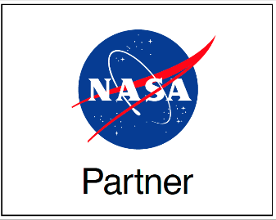
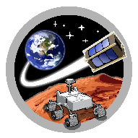
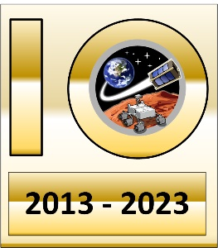
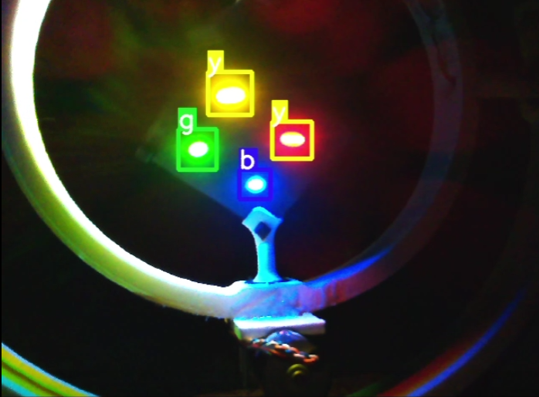
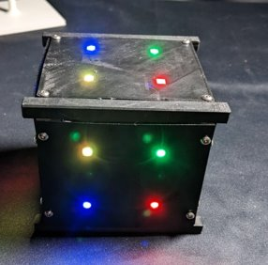
SpaceTREx
Enabling Deep Space Exploration Using Inspectors Accompanying Small Spacecraft System of Systems Architecture
Kargi Chauhan, Athip Thirupathi Raj, Jekan Thangavelautham
Space and Terrestrial Robotic Exploration (SpaceTREx) Laboratory
Aerospace and Mechanical Engineering Department
University of Arizona

Slide 2
Outline
Introduction and Motivation
Challenges
Project Objectives
System Architecture
Method
Results
Future works
Conclusion

Slide 3
Introduction and Motivation
Advancement in Miniaturization
Challenges of Extended Space Missions
Innovative System of System Architecture
Role of Machine Learning and Autonomous Operation
Vision for Inspector Satellites
On-orbit servicing ¹

Slide 4
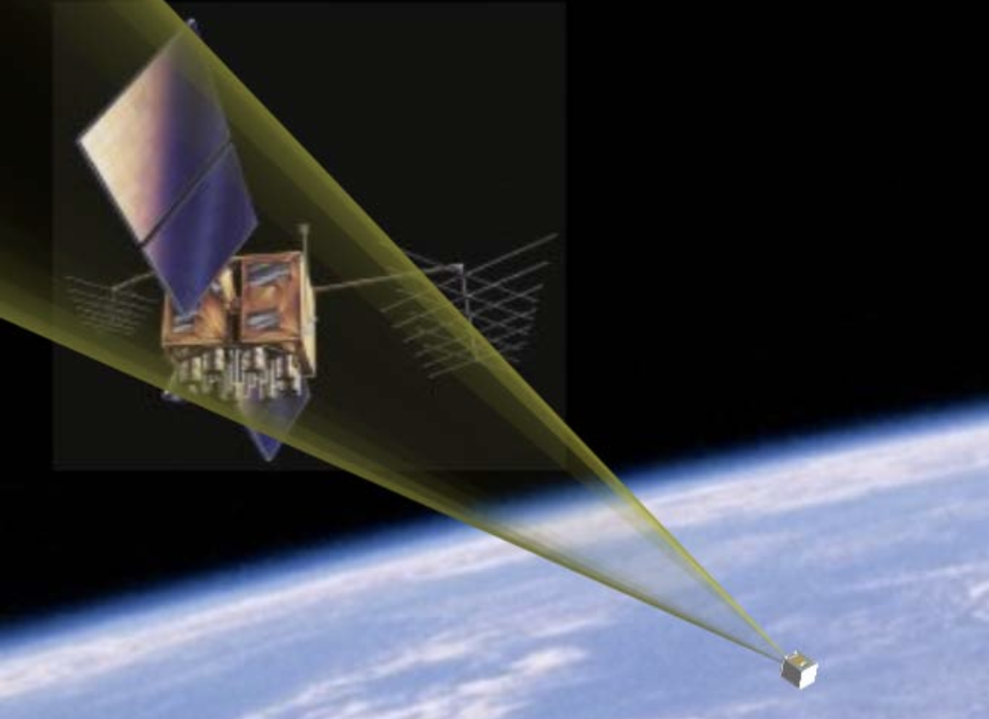
Overview of Aerospace Miniaturization
How miniaturization of electronic, sensors, and actuators has impacted spacecraft design?
  Historical progression
  Impact on Spacecraft Design
  Future Implications
Inspector Satellite ²

Slide 5
The Rise of Small Spacecraft
Cost Efficiency
Technological Advancements
Flexibility and Responsiveness
Small Satellites ³

Slide 6
Machine Learning in Deep Space
Challenges in deep space navigation and communication
The need for autonomous, real-time decision-making
Benefits of ML in enhancing mission efficiency and safety
Machine learning process⁵

Slide 7
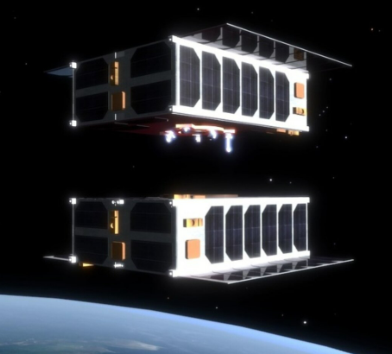
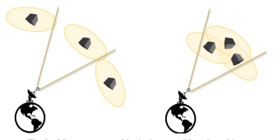
Challenges with Current Technology​
Current methods of depth perception and navigation in space often rely on multiple cameras and intensive technologies, which are not always feasible and cost-sensitive ⁶
Miniaturization alone can't meet the demands of complex, long-duration space missions ⁵
Identifying CubeSats in swarms is challenging, current radio methods have shortfalls in swarms ⁶
Sensor limitations in Harsh Environments - which may be solvable through autonomous systems that help make real-time decisions

Slide 8
Challenges with Singular vision sensors
Relying on a single vision sensor increases the risk of mission failure due to potential malfunctions. Lack of redundancy makes the entire spacecraft vulnerable to a single point of failure, threatening safety and mission objectives. ⁹
Singular vision sensors often have poor depth perception, which is crucial for space navigation. This limitation can result in distance estimation errors, risky maneuvers, and docking operations ⁷
Using just one camera for spacecraft attitude estimation with traditional methods leads to complex and less accurate calculations. This can impair the proper orientation of solar panels, antennas, and sensors, affecting mission performance ⁸

Slide 9
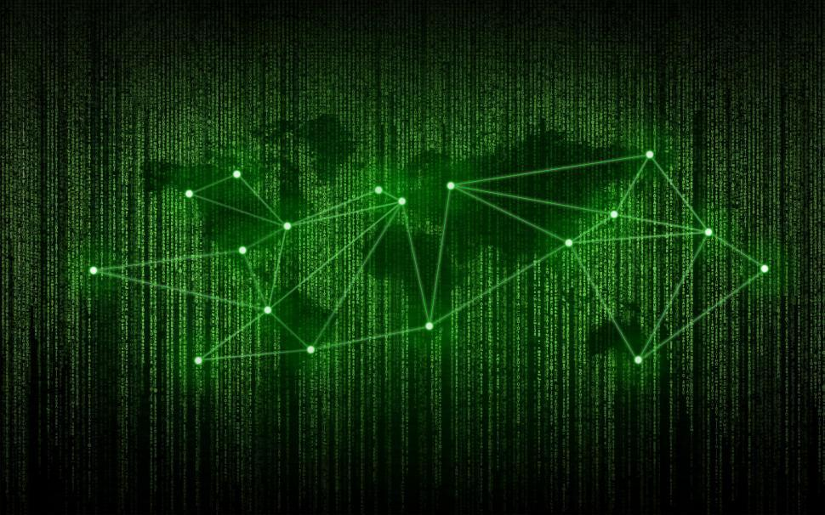
Challenges in Implementing ML in Space Systems
Harsh and unpredictable space conditions ¹⁰
Limitations with accuracy and precision ¹¹
Limited Training Data Available ¹²
May lead to more errors , reduced computational capacity, and degraded performance by ML models

Slide 10
Project Scope/Objective
Robust System Architecture ¹³
Integration of Machine Learning ¹⁴
Comprehensive Testing and Validation ¹⁵

Slide 11
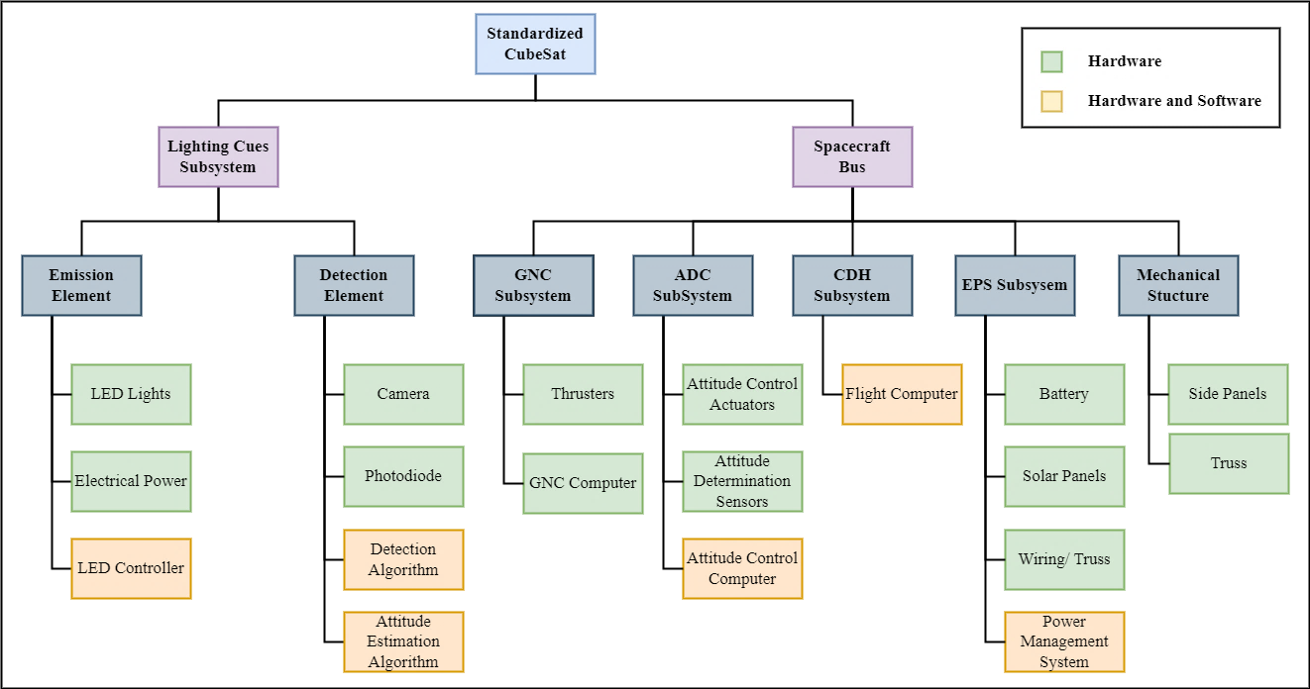
System of System Architecture ¹⁶
The Scope

Slide 12
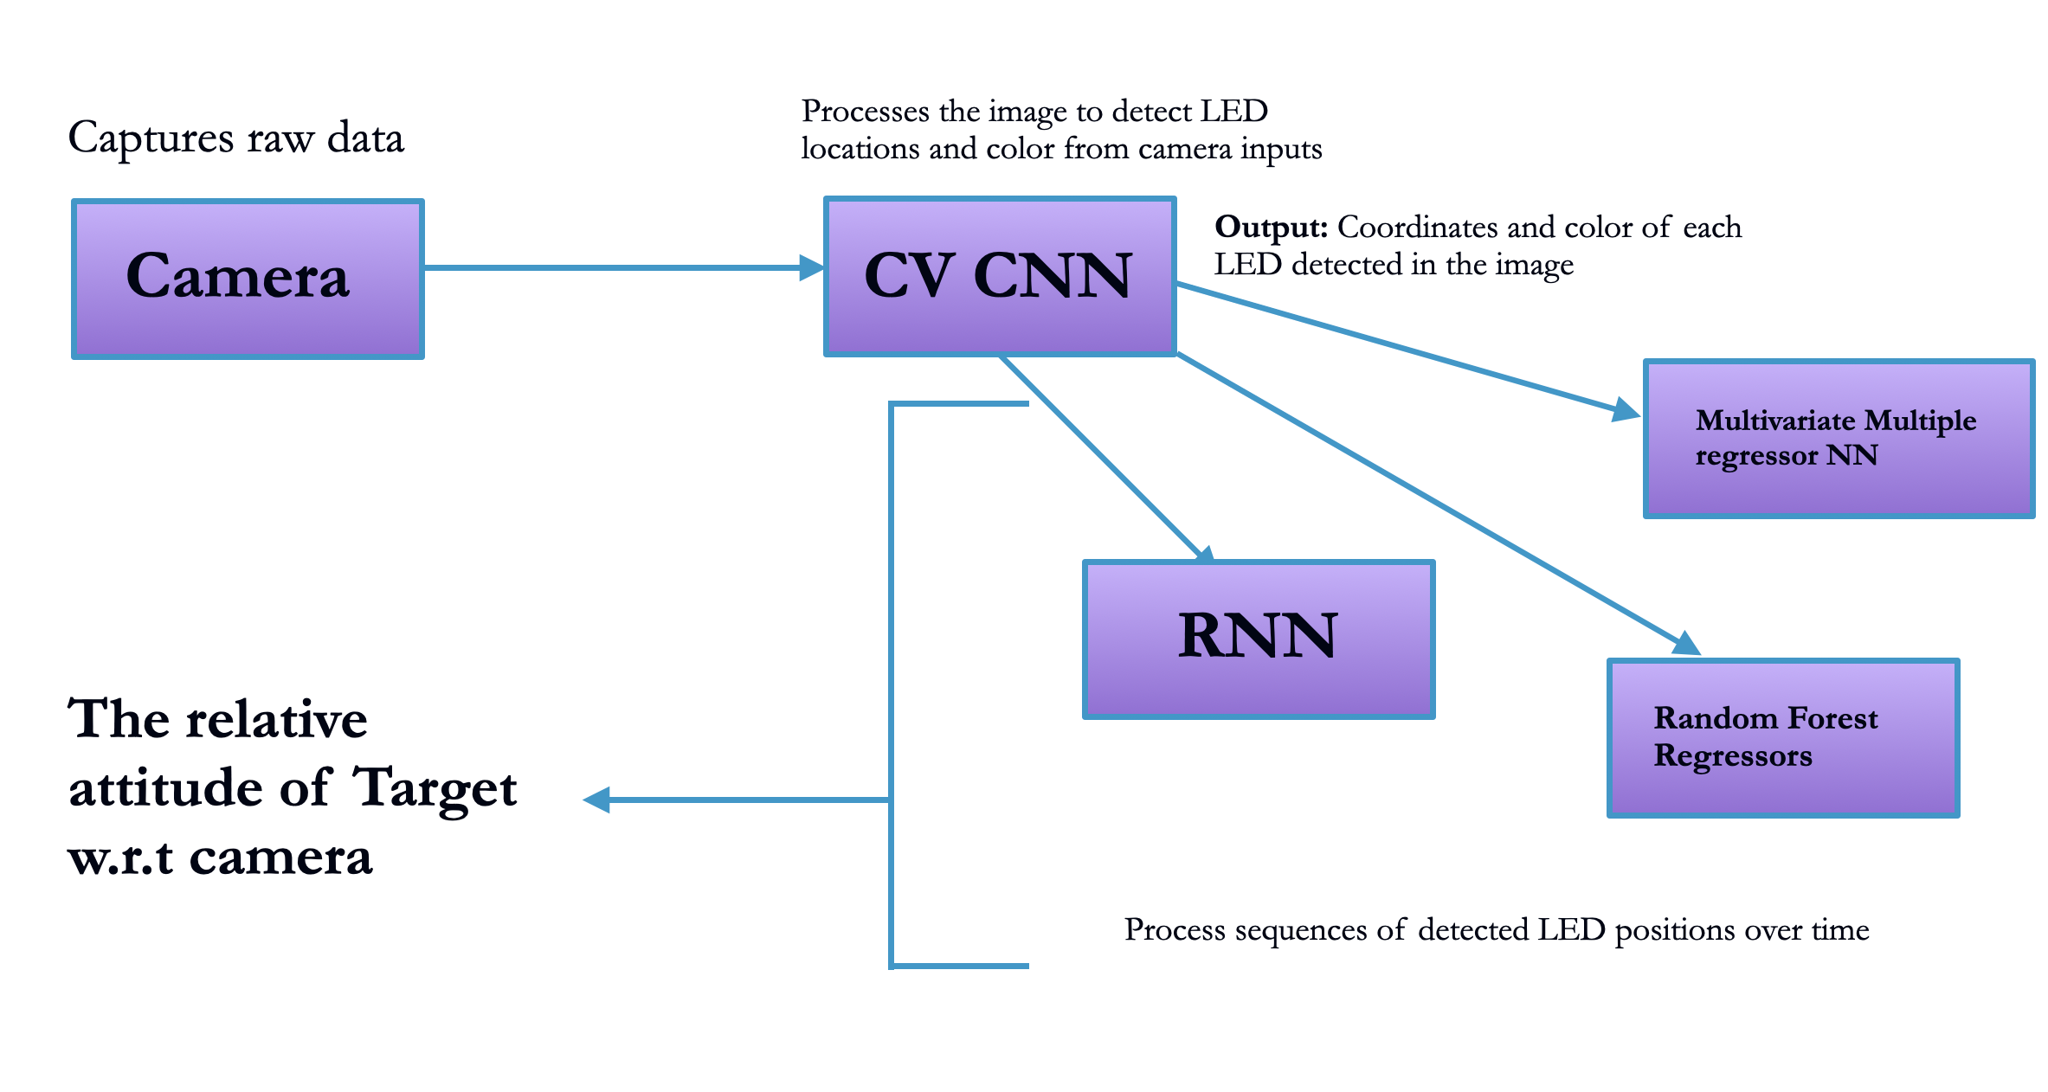
Machine Learning Algorithms

Slide 13
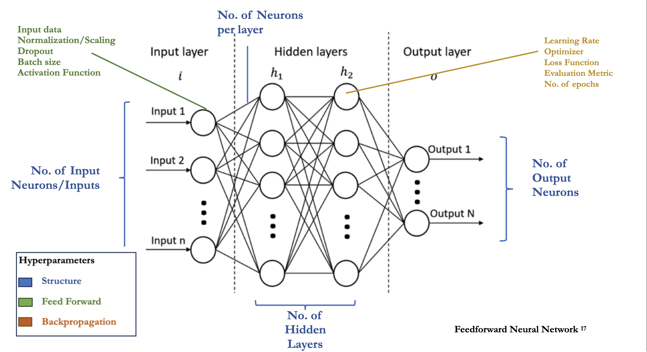
What is a Neural network?

Slide 14
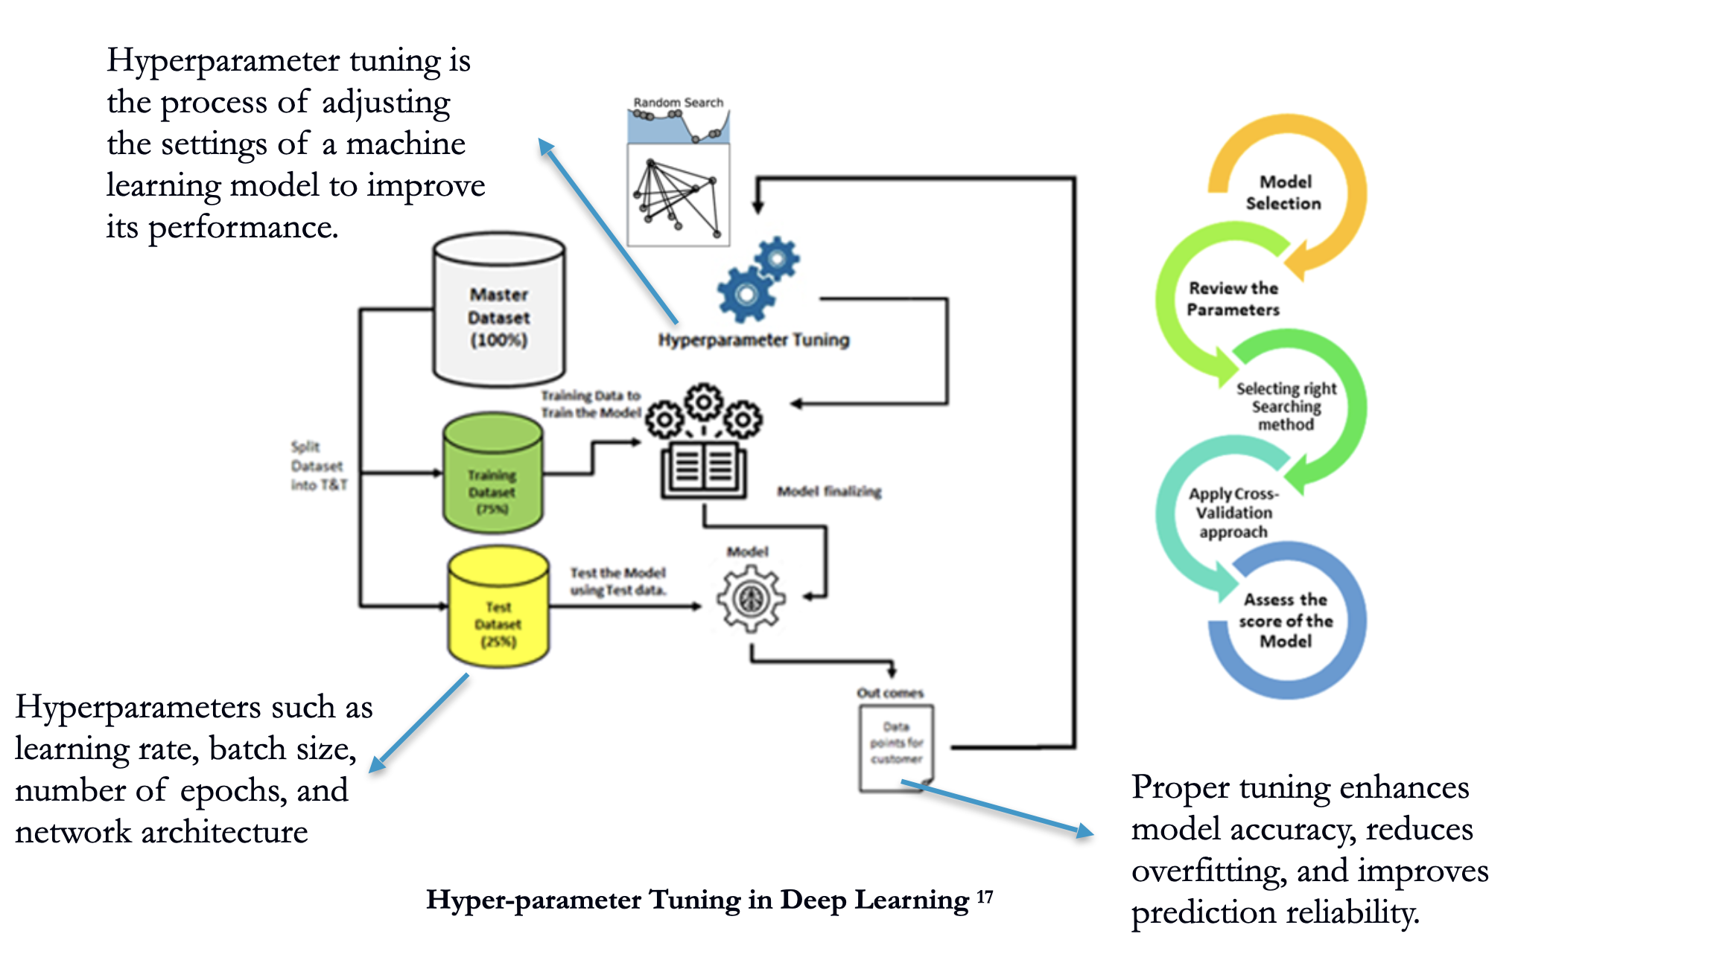
What is Hyperparameter?

Slide 15
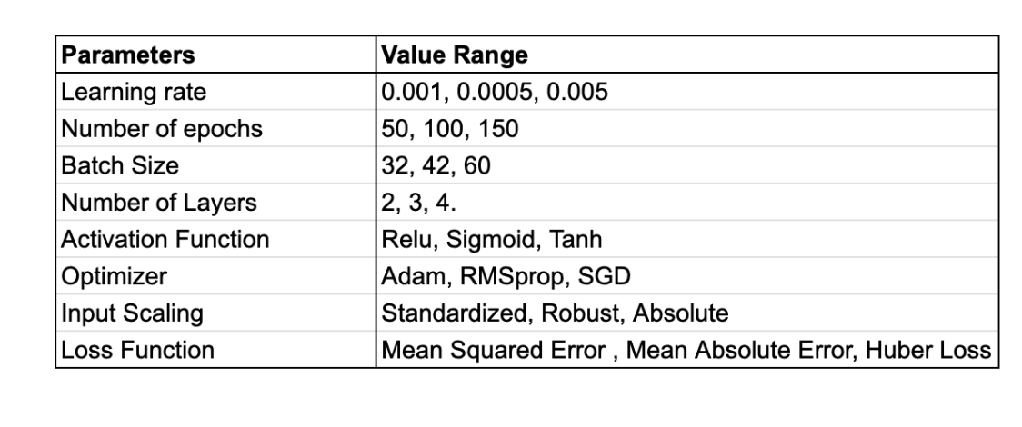
Hyperparameter Tuning

Slide 16
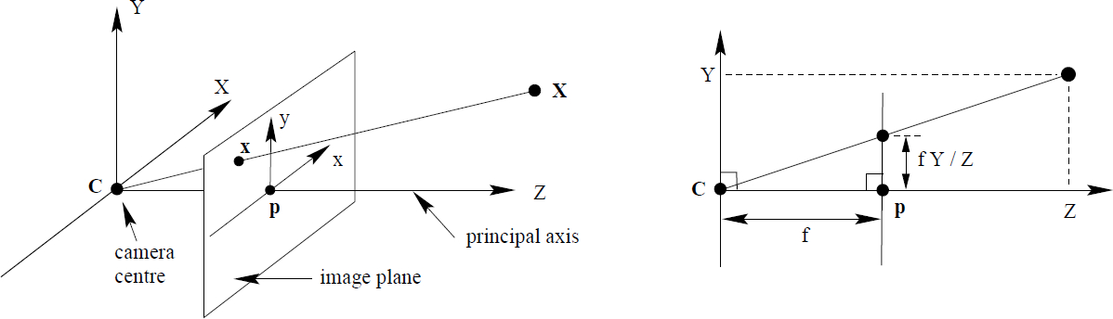
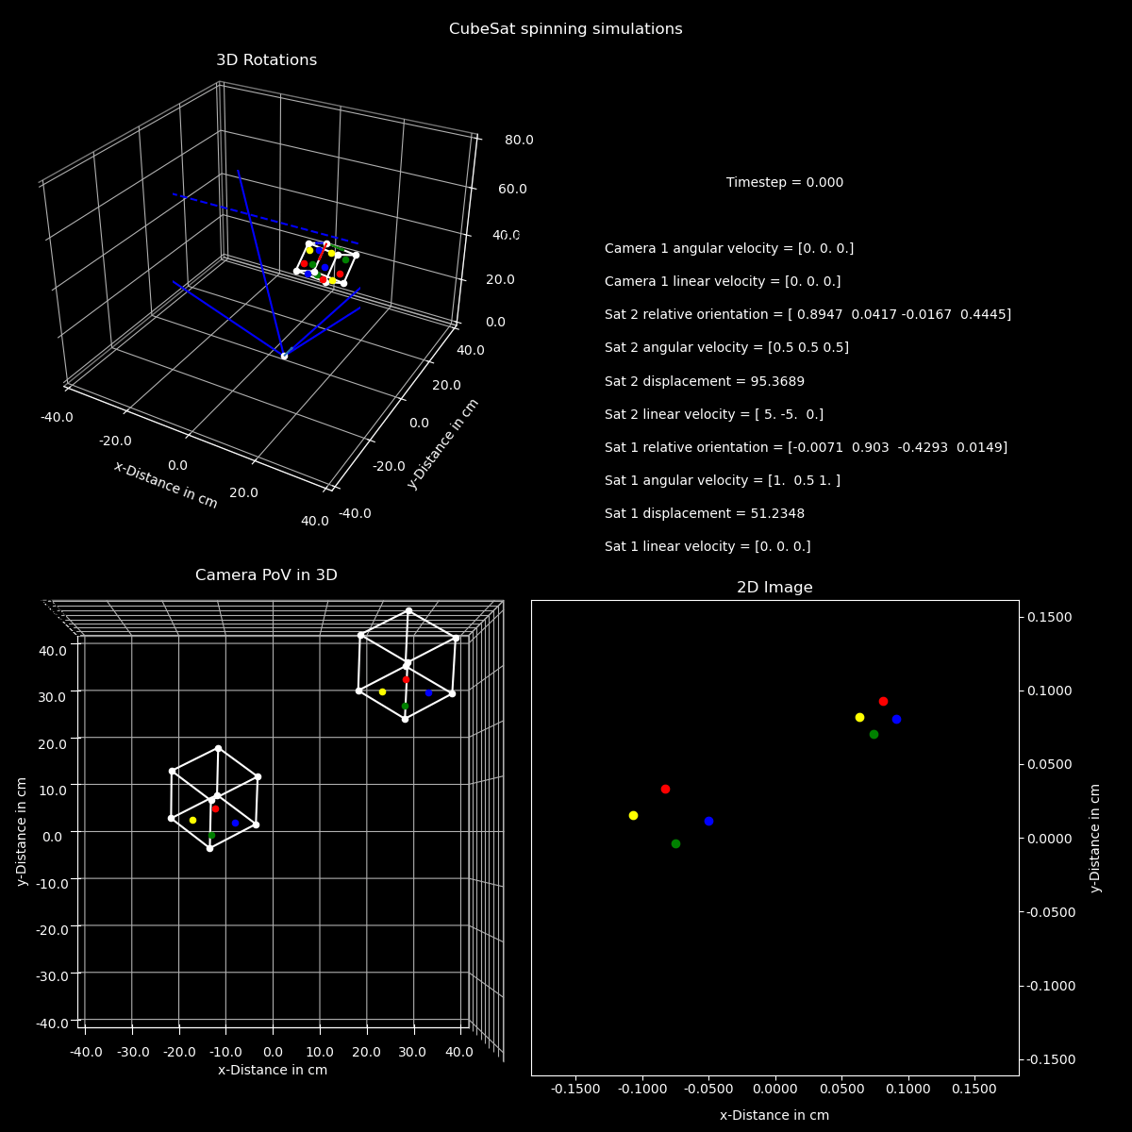

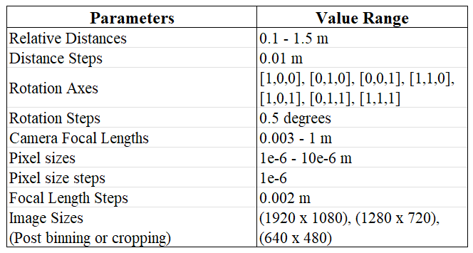
Synthetic Data Generation ¹⁸
Use the pinhole camera model to develop synthetic training data (Generated by Athip)
The simplified model which takes the camera's effective focal length, camera image size, camera pixel size (Intrinsics), and relative position
12 LEDs – 36 columns
1 Focal Length – 1 column
1 Pixel Size – 1 column
1 Image Size – 1 column
~6.45M datapoints
4 quart + 1 range – 5 columns

Slide 17
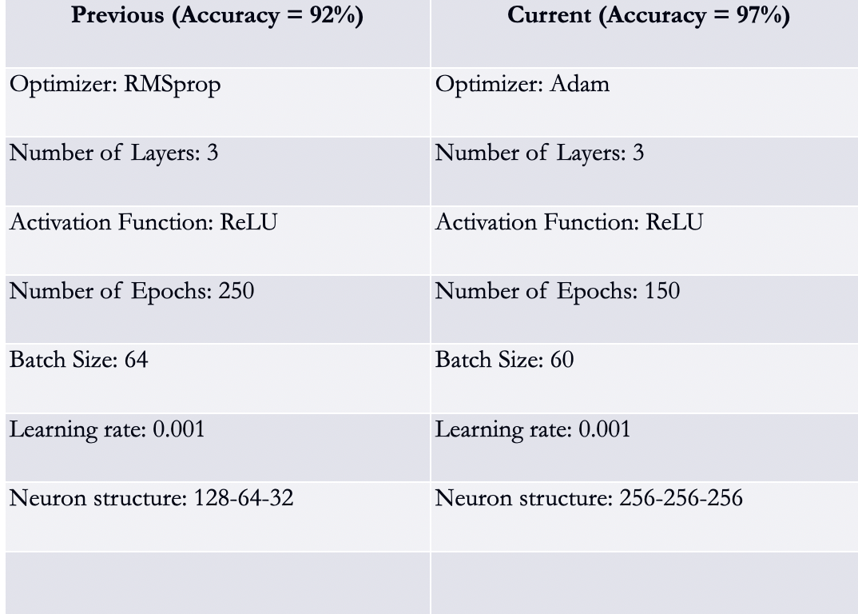
Network Configuration
Hyperparameters ¹⁹

Slide 18
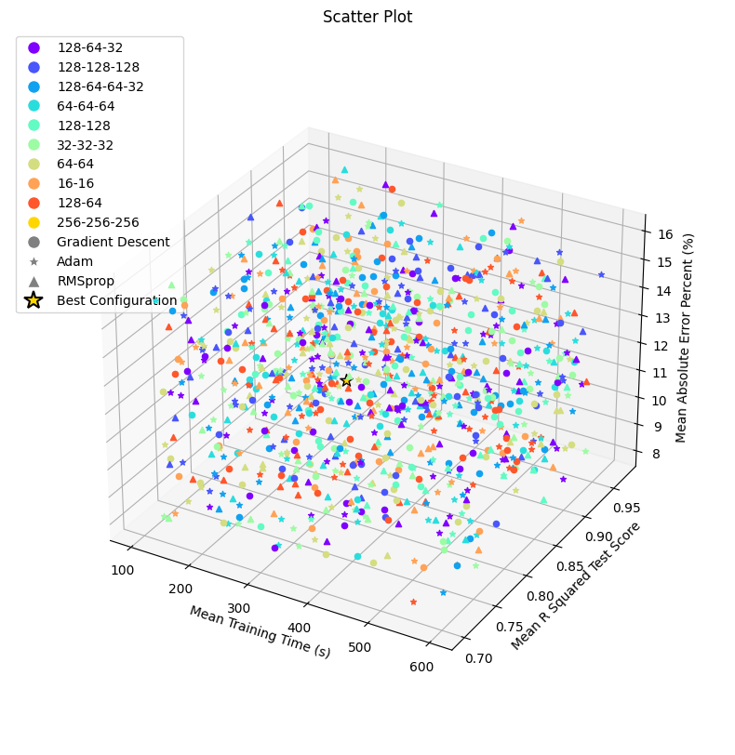
Results of the Hyperparameter Tuning ²⁰

Slide 19
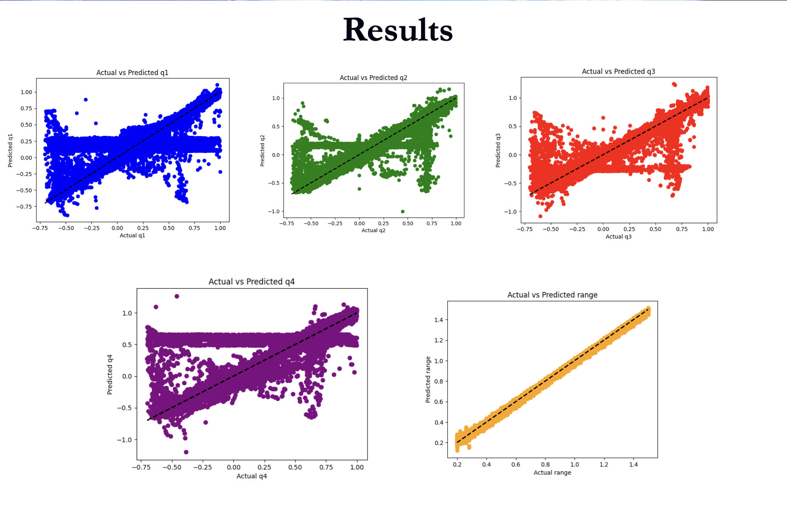

Slide 20
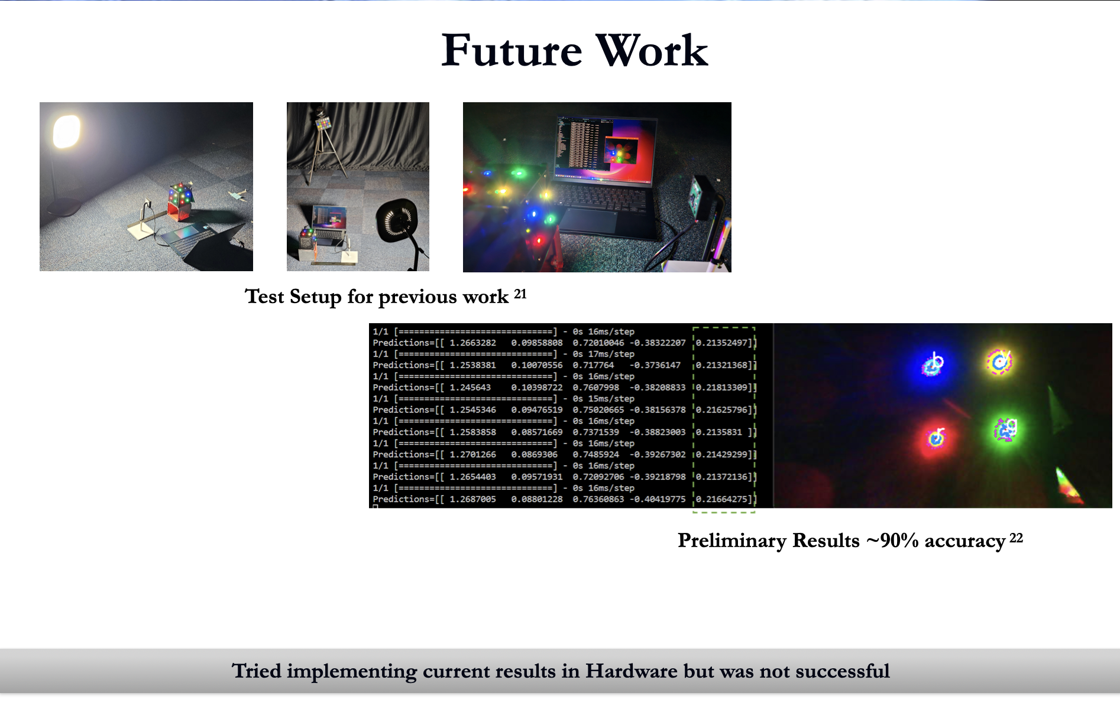

Slide 21
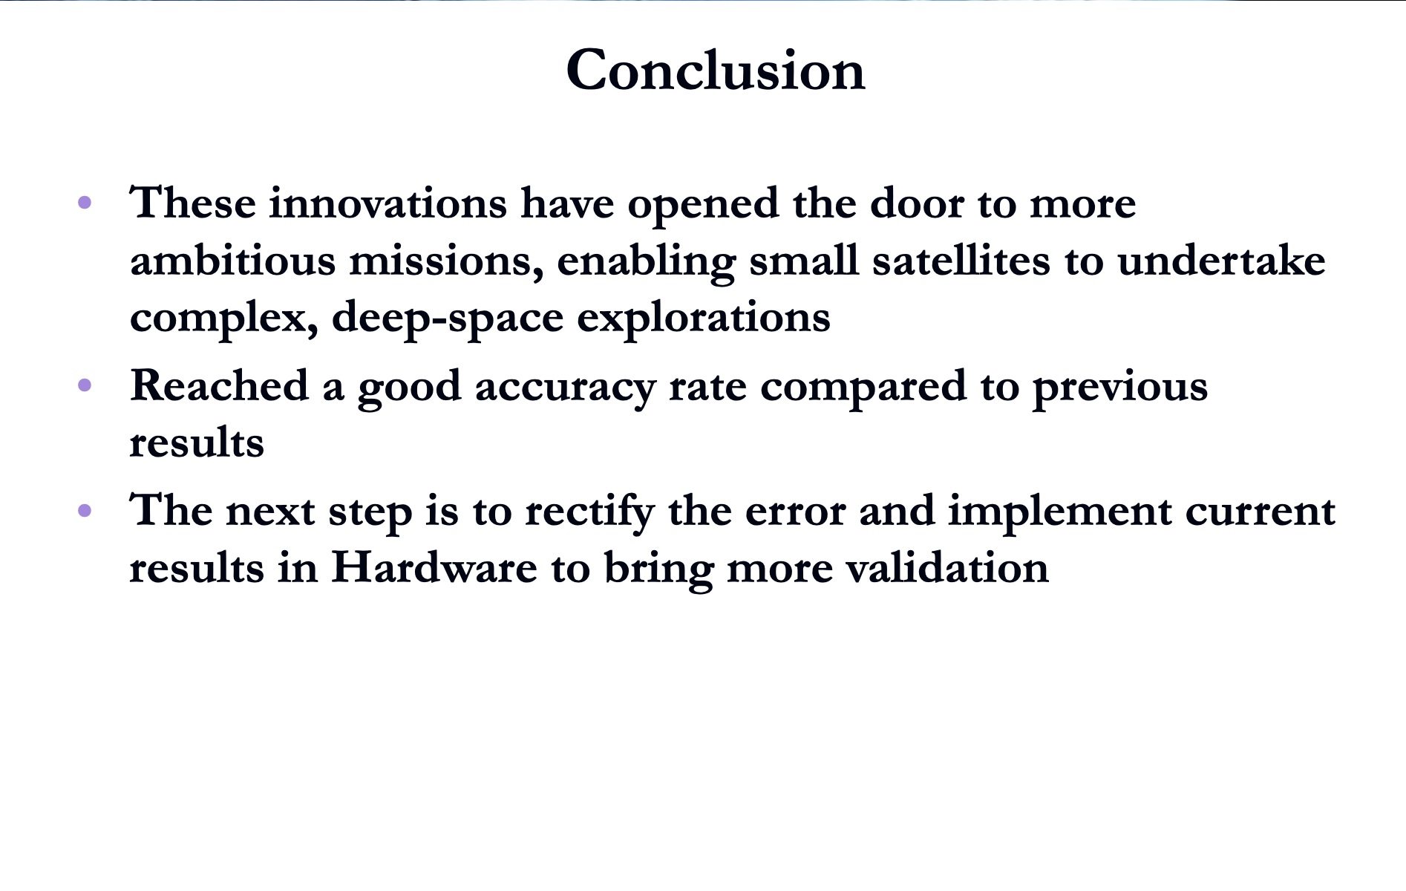

Slide 22
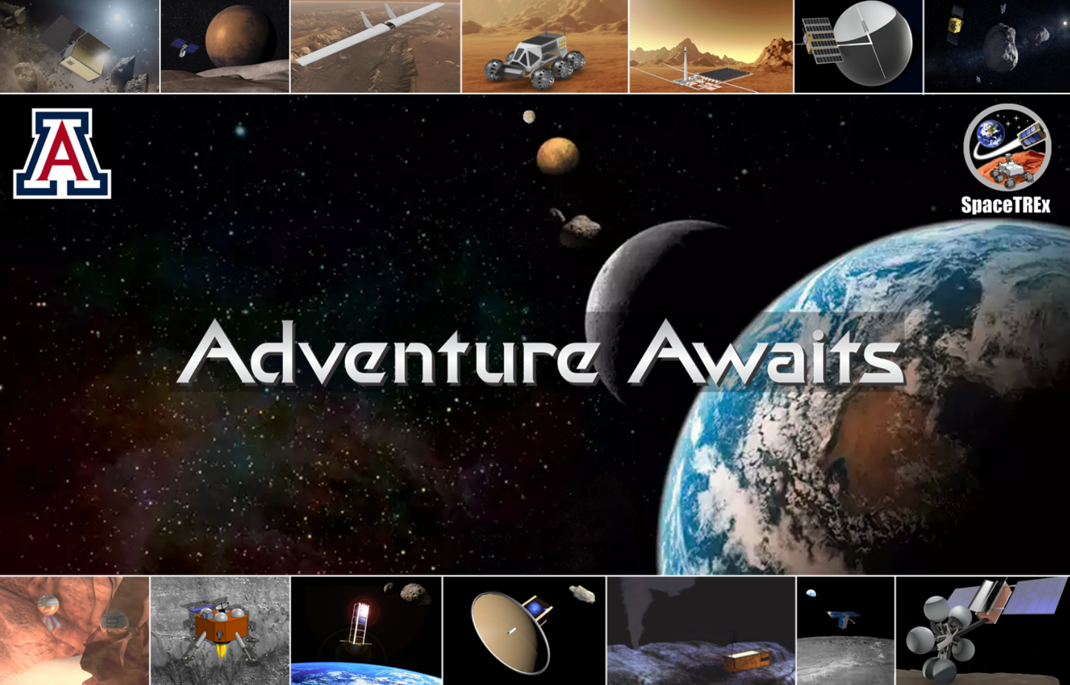
Thank You!

Slide 23
Questions ?

