Slide 1

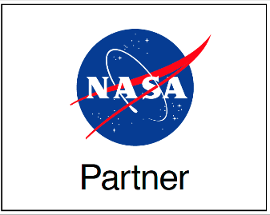


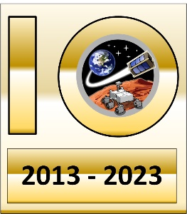
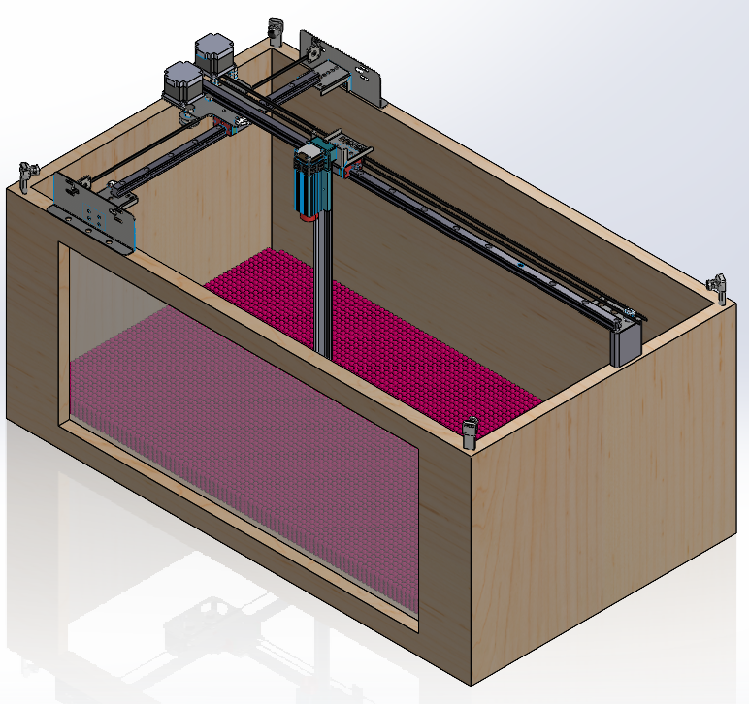
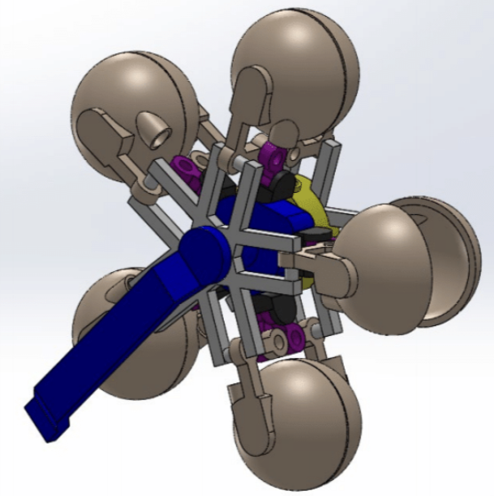
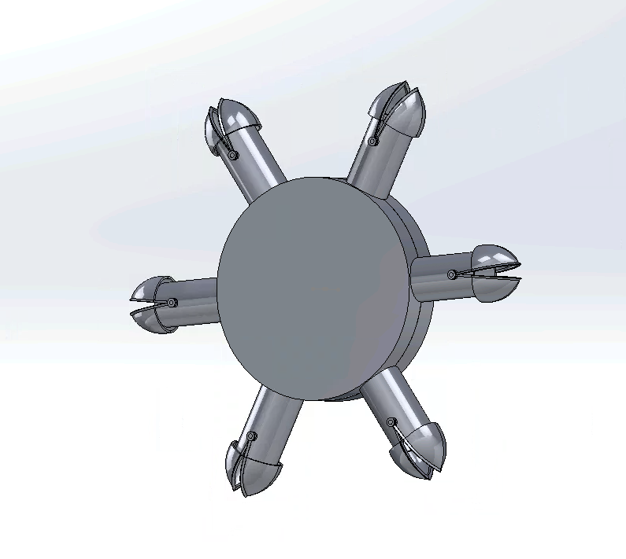
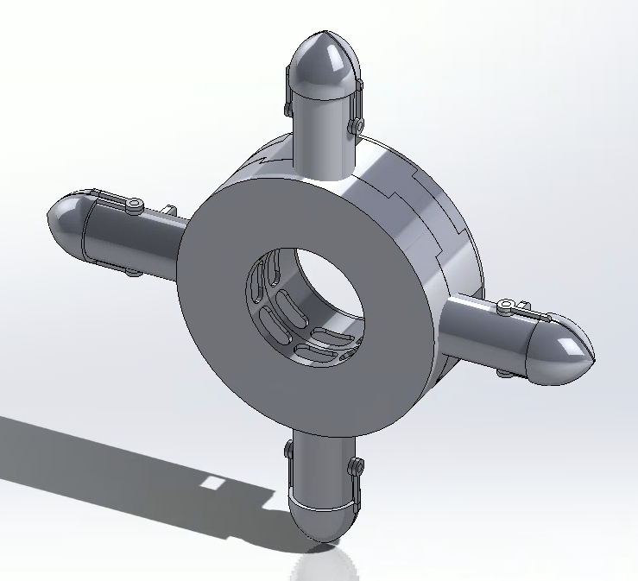
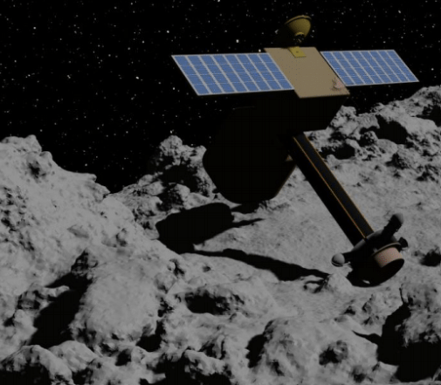
Development of an Asteroid-Mining Bucket Wheel
Korbin Aydin Hansen
Sivaperuman Muniyasamy, Jekan Thangavelautham
Space and Terrestrial Robotic Exploration (SpaceTREx) Laboratory
University of Arizona Department of Aerospace and Mechanical Engineering

Slide 2
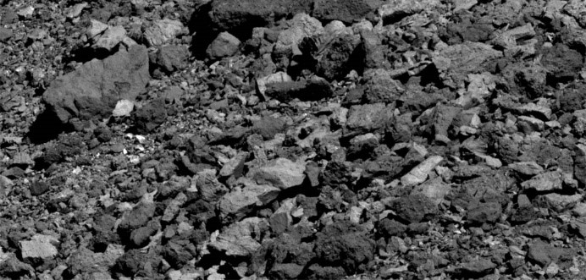
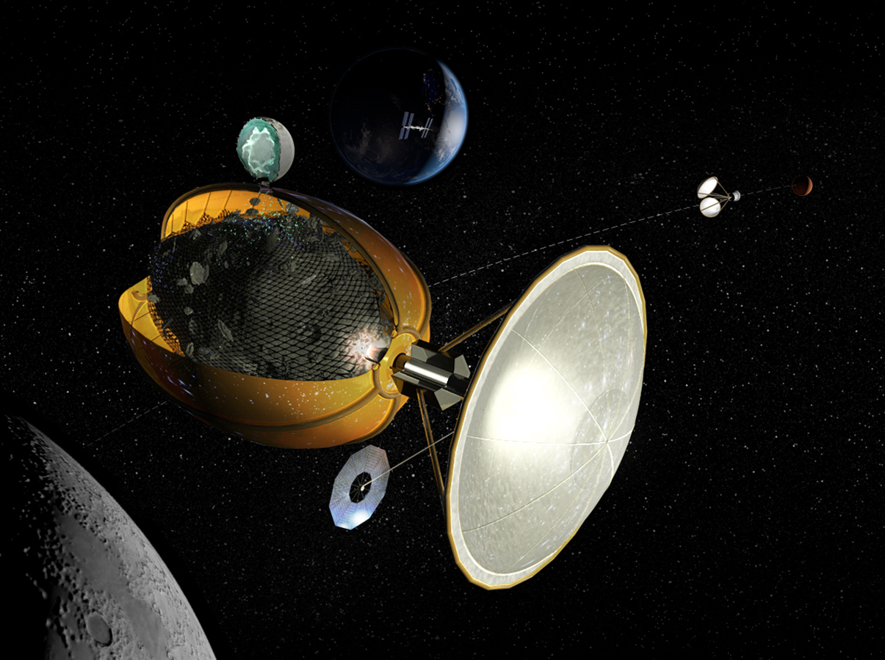
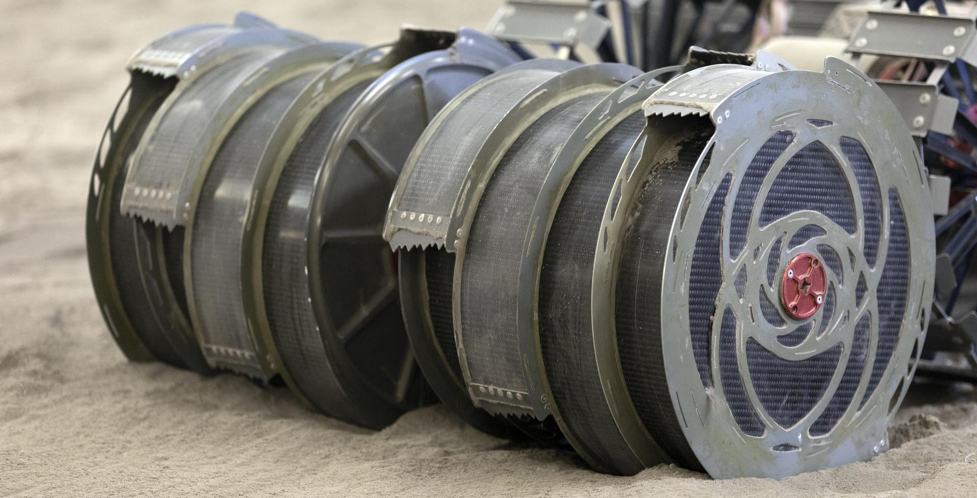
Motivation
Asteroid mining has advantages over Lunar mining in energy cost and resource concentration
Current asteroid mining tools are bulky, lack scalability, differ from established methods
Can we get the best of both worlds?
Solar-thermal mining device envelopes the entire target asteroid
NASA tests the RASSOR bucket wheel mining rover at Swamp Works

Slide 3
Objective
Adapt the bucket wheel device to an asteroid mining context while achieving a similar excavation rate as bucket wheels optimized for the Moon. Bucket wheel models should be economic and physically tested. Thus, an asteroid simulant will be manufactured.
Bucket wheel requirements:
  Generate near-zero reaction forces
  Have high carrying capacity or interface with screw feeder
  Is capable of being 3D-printed
Asteroid Simulant requirements:
  Match physical properties observed on Bennu:
    Cohesion and angle of internal friction
    Bulk density and microporosity
    Grain size
  Be cheap to manufacture in bulk using readily-available materials

Slide 4
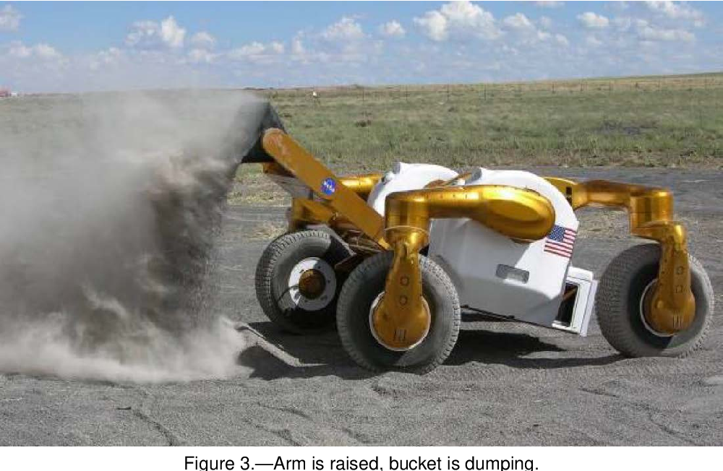
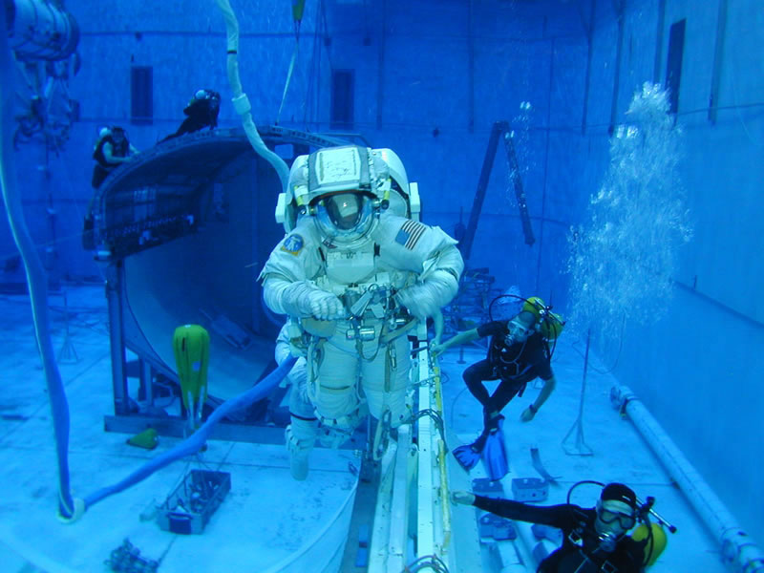
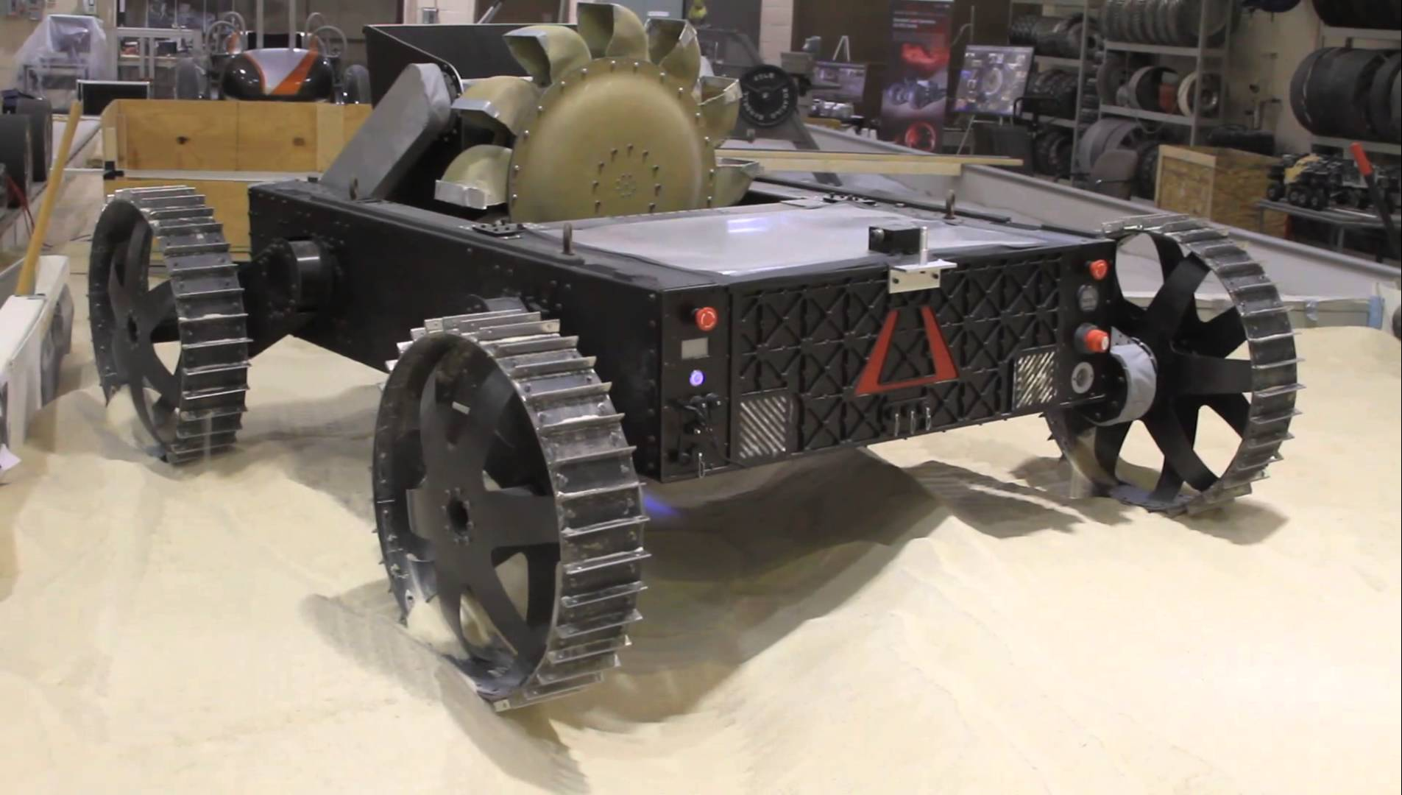
Challenges
No established “best” bucket wheel model → parallel development
Testing must occur on Earth → force sensing and regolith properties may not be accurate
  Buoyant suspension models will not work due to overpowering viscous forces
Material and manufacturing constraints
Different approaches to Lunar excavation
NASA simulates ISS microgravity in a large pool
Notes:
The lunar surface is still a harsh environment even for robots.
The micrometeorite bombardment will destroy the robots mechanically, the surface radiation will destroy the robots electronically.
The temperature variance in a day-night cycle will also pose significant requirements for robot components.
They will have to be sheltered in some fashion.
At the same time, we mustn’t forget to consider technologies that require the least launch budget, as launching payload to the lunar surface is very expensive.

Slide 5
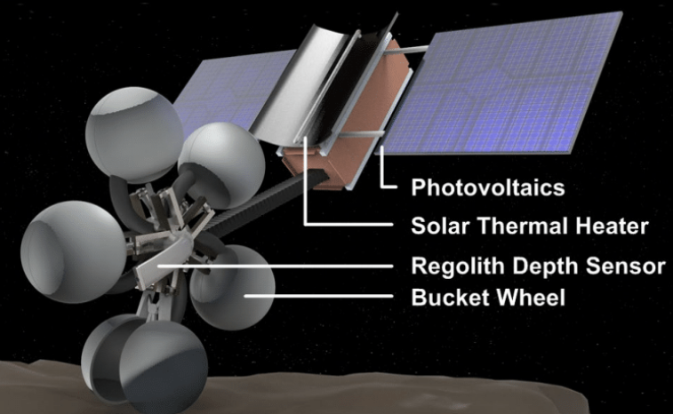
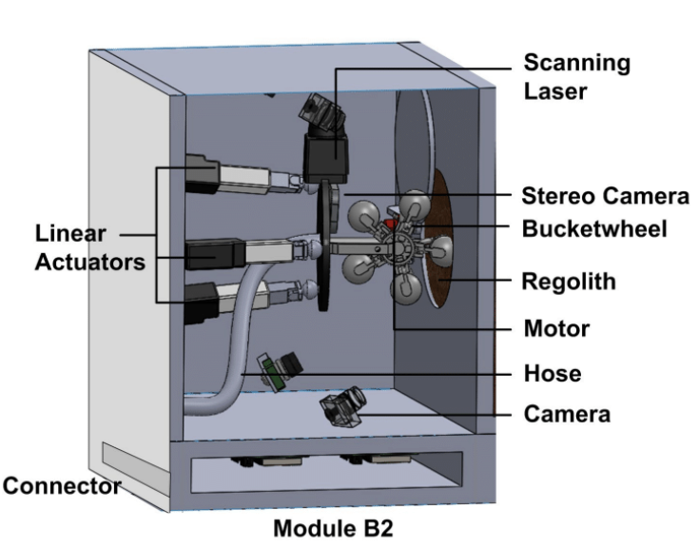
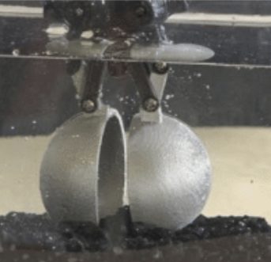
Related Work
The SpaceTrex Laboratory has previously put forth an asteroid bucket wheel design
Biting bucket wheel mounted to satellite
Test configuration for ISS centrifuge
Filling efficiency test with buoyant forces

Slide 6
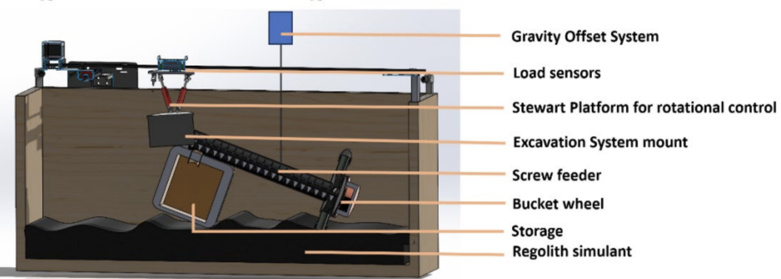
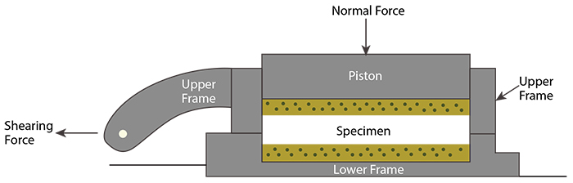
Methodology
Bucket wheels will be attached to a screw feeder, motorized, and mounted to a 2-axis test bed
Trends to analyze: Excavation rate vs. traverse rate or power draw
  Bucket wheel rotates perpendicular to traverse direction
Reaction forces will be measured concurrently
Force sensing data can be used to assess weight and therefore filling efficiency
Regolith cohesion and angle of friction will be determined with a direct shear test
Bucket wheel test bed schematic
Direct Shear Test Schematic

Slide 7
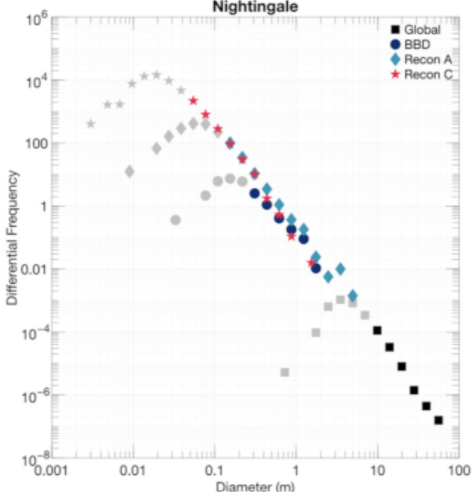
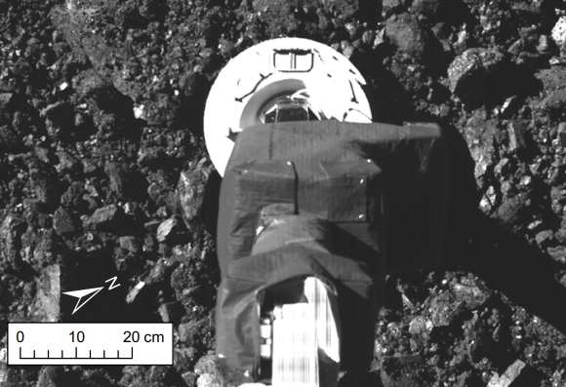
Regolith Simulant Properties
Target cohesion: 0.6–1 Pa (fine soil: 400–2200 Pa)
  Lower bound found by observing the geomorphology of scarps on Bennu
  Upper bound calculated from the force of the OSIRIS-REx TAG event
Target bulk density: 1190 kg m⁻³ (Earth: 5515 kg m⁻³)
Grain sizes follow a power law distribution
Target size range: 1 mm to 1 cm
Bennu grain size trends
OSIRIS-Rex sampling event

Slide 8
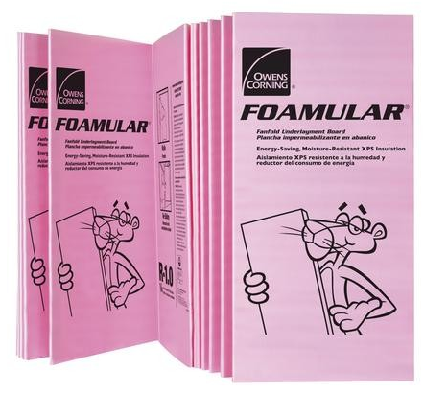
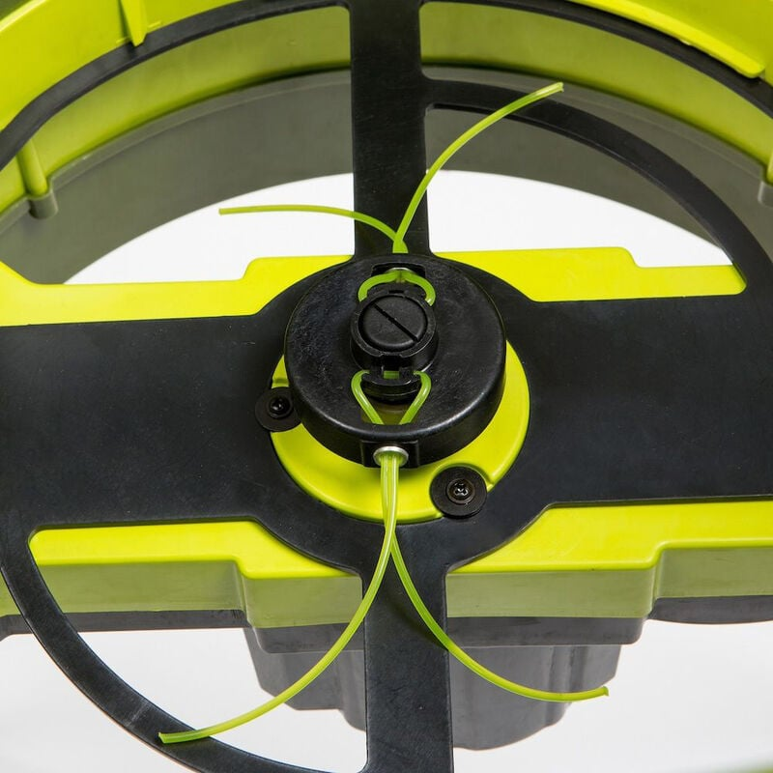
Regolith Simulant Production
Multiple options: Shredded Styrofoam, 3D-printed pieces, resin molds, etc.
Shredding challenges: Cutter durability, achieving target grain sizes, waste
  A sieve is developed to filter large “pebbles”
Target quantity: 10 kg as per the experimental plan
High-strength Styrofoam
Mulcher cutting device

Slide 9
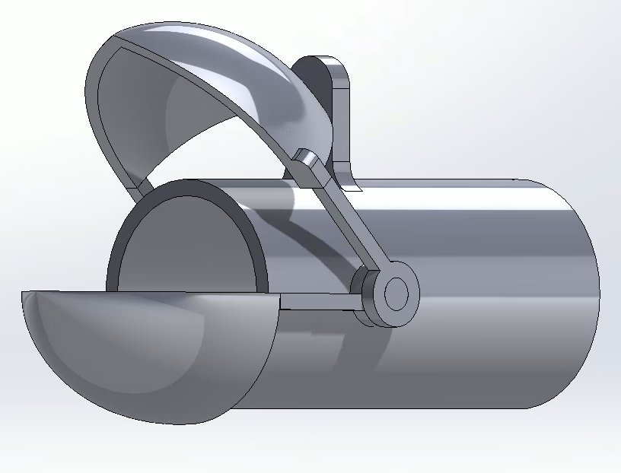
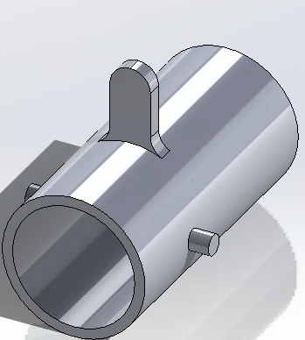
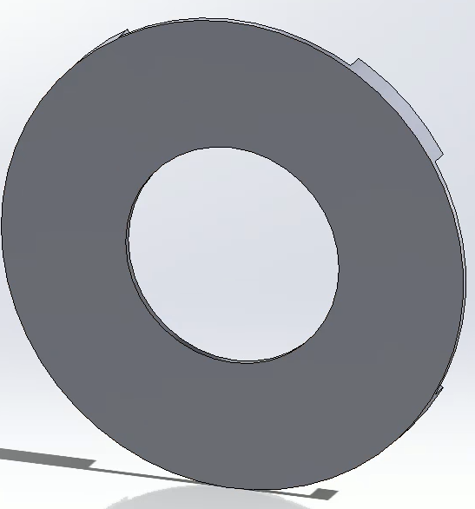
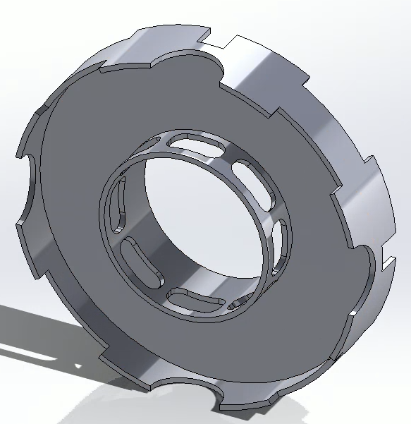
Bucket Wheel Design
Regolith collection
Claw extension
Regolith storage
Old design
Claw tube
Back panel
Drum
Ogive claw
Asymmetric
hinges
Push plate
Piston system
Interface with screw feeder
Servos for rotation

Slide 10
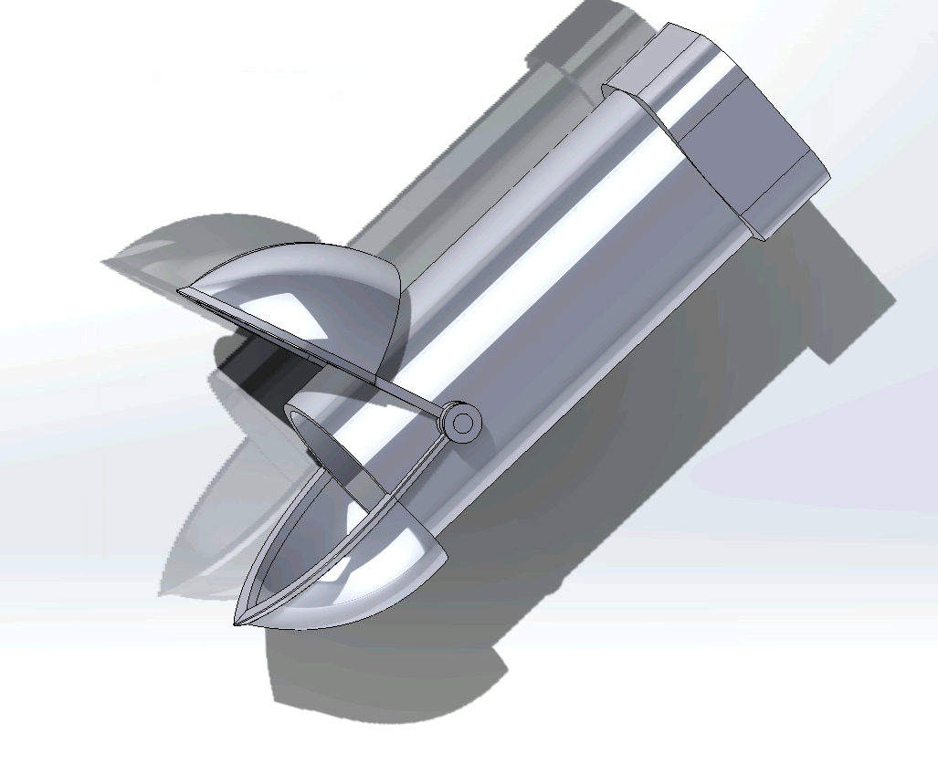
Bucket Wheel Design: Collection
Claws extend perpendicularly to the direction of motion
  Regolith is spatially confined instead of by scooping forces
Claw extension allows the main drum structure to hover above the surface
  This is to reduce normal forces
Large claws + central drum aims to optimize filling efficiency
  Claws are currently small for testing purposes
Current claw tube
Old claw tube

Slide 11
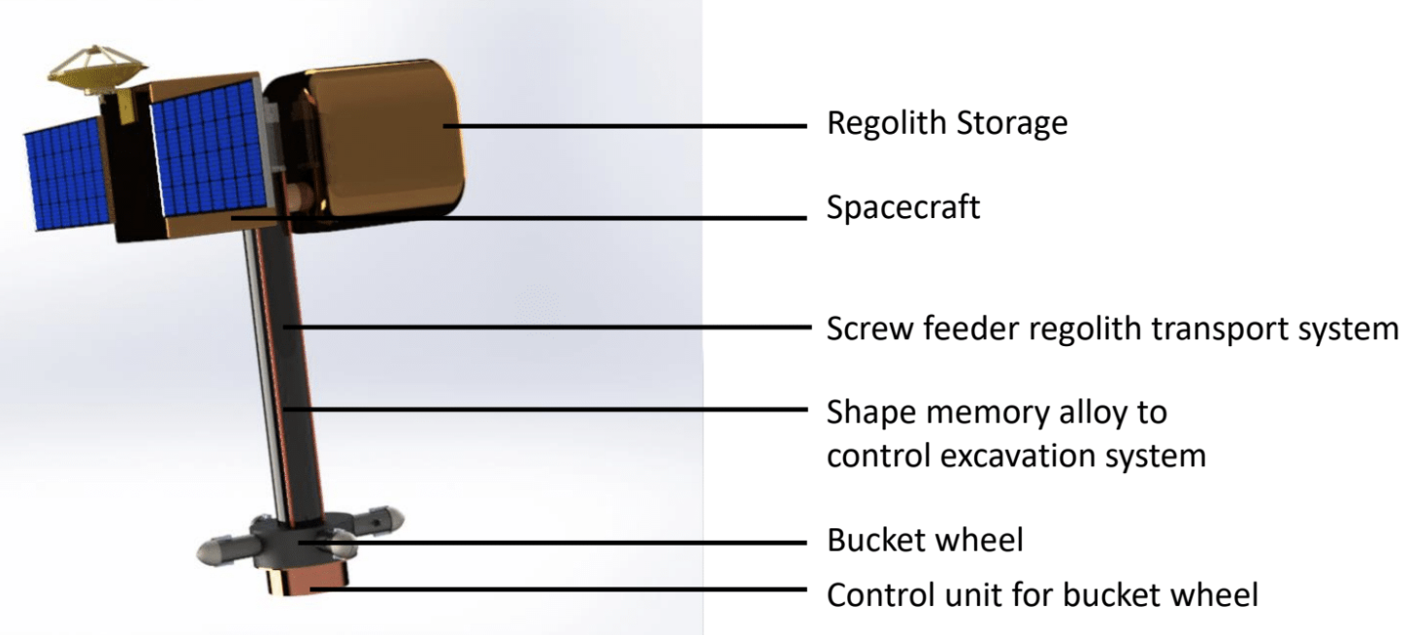
Bucket Wheel Design: Compatibility
The bucket wheel is designed to be compatible with a screw feeder
  An orbiting spacecraft will be able to mine the surface using this extension
  Mobility and dust mitigation issues are largely resolved
The bucket wheel is modified to be donut-shaped, sliding over screw feeder
Mining spacecraft hovering above Bennu’s surface
Schematic of mining spacecraft

Slide 12
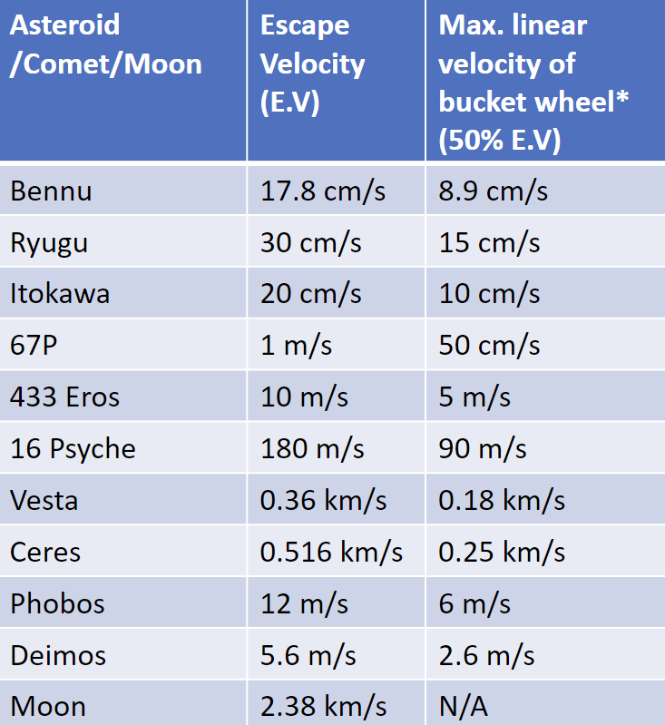
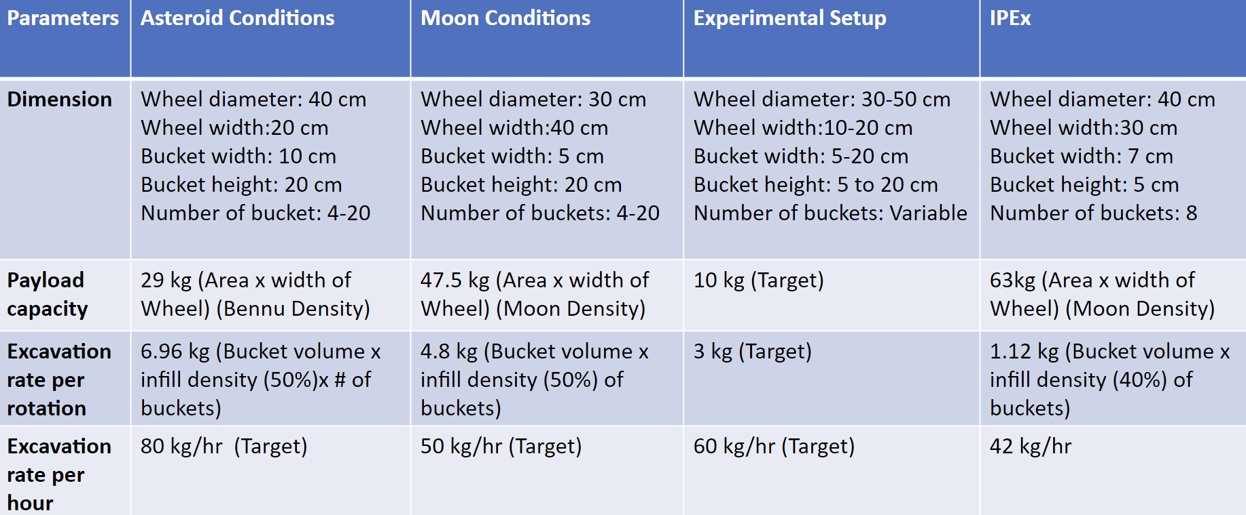
Bucket Wheel Design: Improvements
Surface-relative velocity of buckets is limited
  Decrease rotation speed → enlarge bucket wheels
  Rotate bucket wheels perpendicular to the spacecraft’s motion
  Contra-rotating bucket wheels to cancel out rotational forces

Slide 13
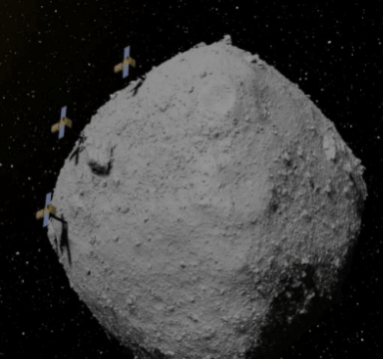
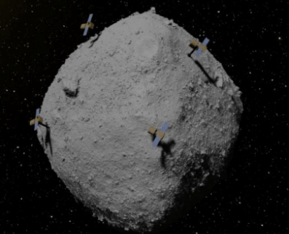
Future Work
Near future: Bypass simulant production bottlenecks, test regolith properties
Mid future: Conduct force and excavation tests, compare performance with previous design (related work), and iteratively improve current design (previous slide)
Far future: Examine the impact of swarm configurations and different orbits on mining energy
A swarm of mining spacecraft following the same polar orbit (left) and different orbits (right)

Slide 14
Thank You!
Q&A

Slide 15
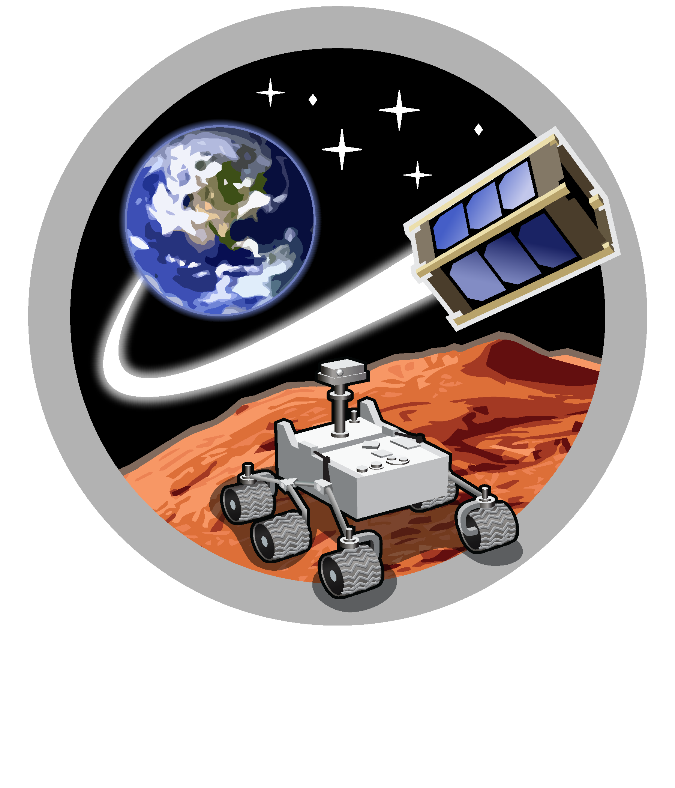

Slide 16
