Slide 1
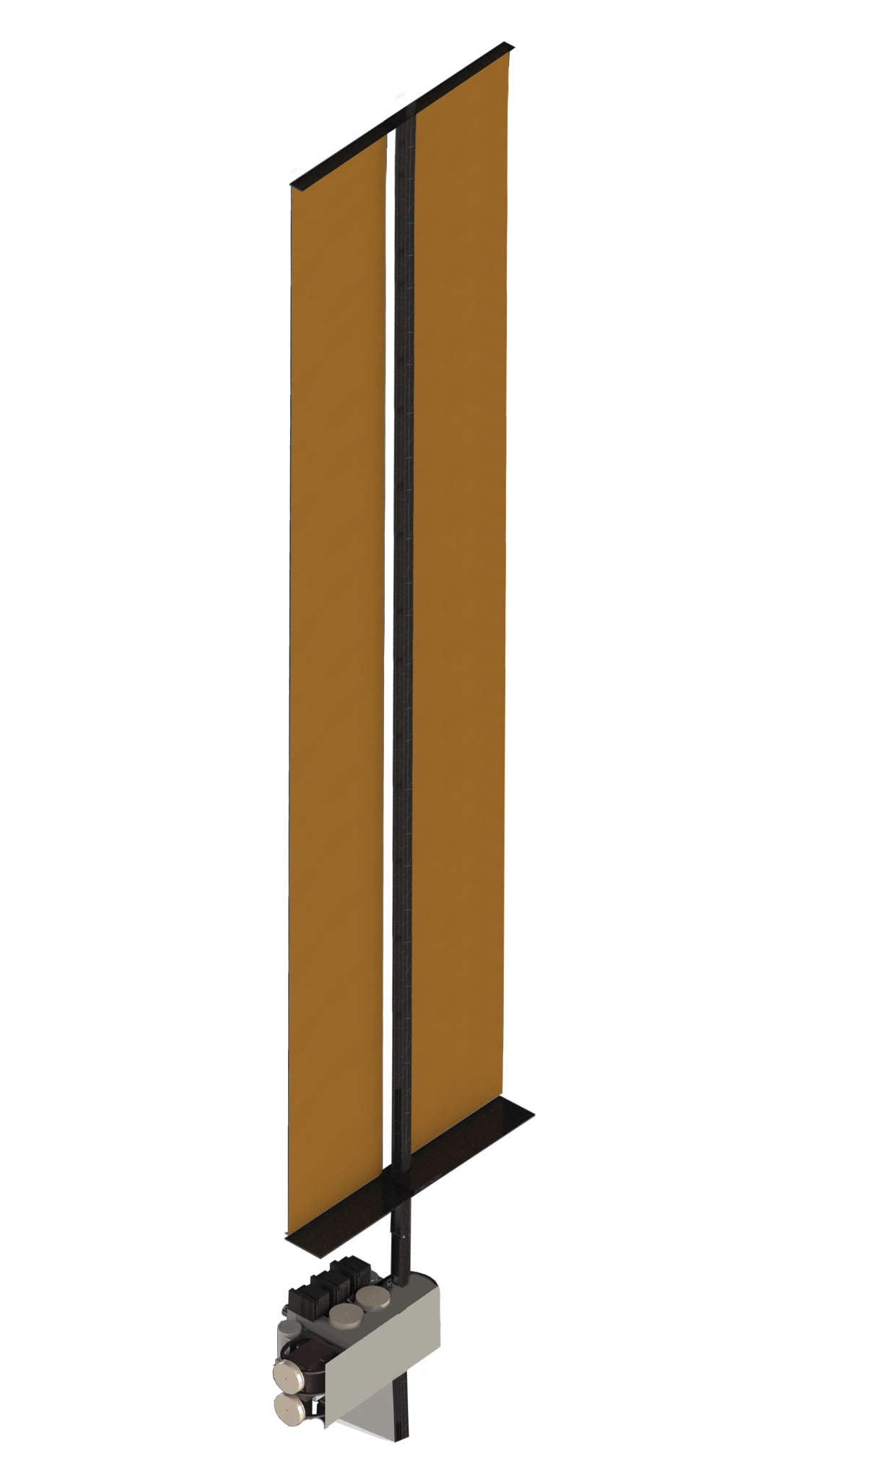
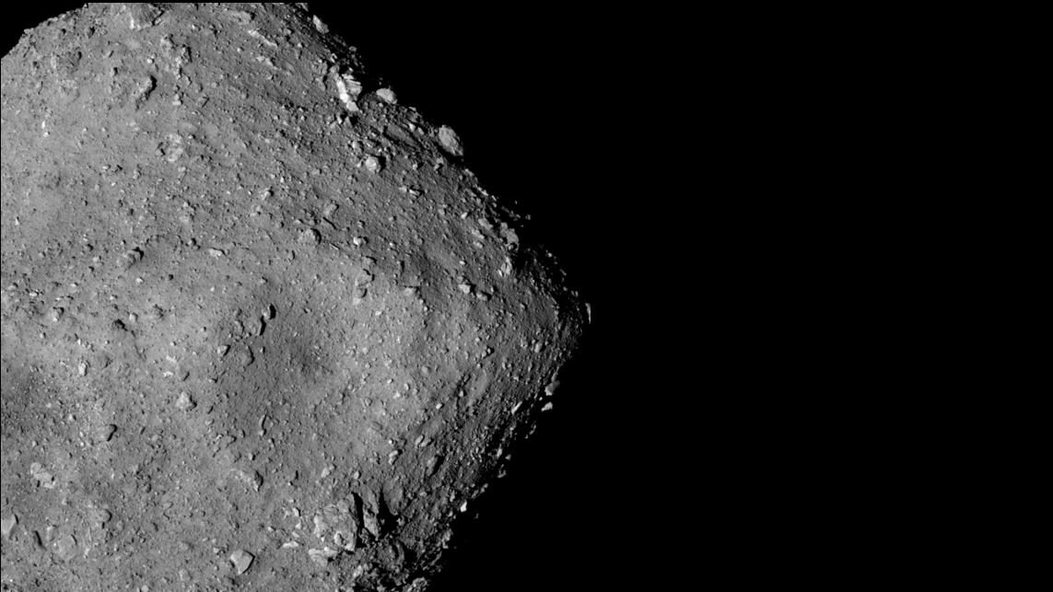

High Frontier: A Low Thrust and Autonomous Navigation Mission for Near-Earth Asteroid Excavation
Dianna Velez, Kalle Anderson, Dale Howell, Lauri Siltala, Lisa Whittle, Daynan Crull, Fiona Boyce, Simon Hallam
d.velez@karmanplus.com
Interplanetary Small Satellite Conference, April 2024
Ryugu Asteroid Image Credit:
Japan Aerospace Exploration Agency (JAXA)

Slide 2

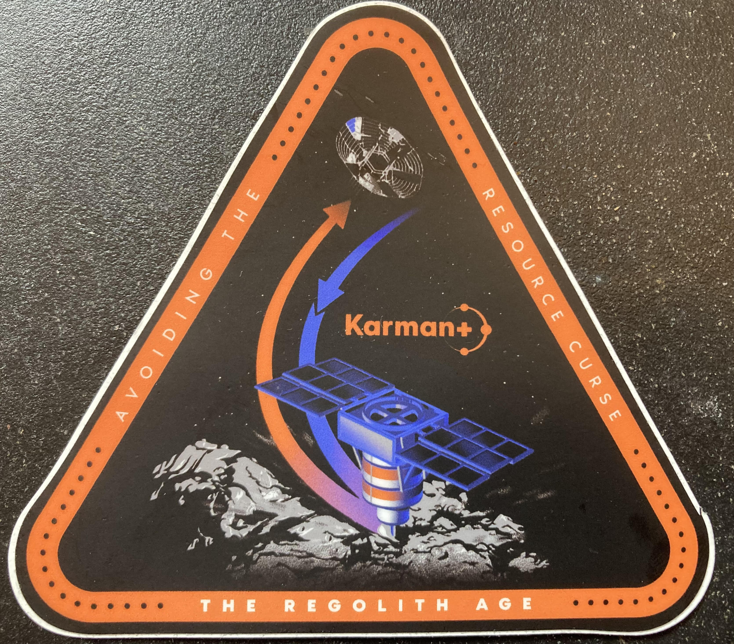
Karman+: Who Are We?
Karman+ is a commercial venture that seeks to mine space resources from near-Earth asteroids to provide abundant, sustainable energy and resources in space and for Earth.
Based in Denver, Colorado
Established 2021
“Start up” culture – cross functional teams and individuals
A diverse set of work experience backgrounds – people are from inside and outside of the space industry
Folks appreciative of being able to stand on the shoulder of giants

Slide 3
High Frontier Mission Objectives
A technical demonstration mission – objectives focused on commercial viability
  1) Rendezvous with a near-Earth asteroid;
  2) Capture regolith from the surface at kilogram scale;
  3) Maintain a total mission cost (s/c, operations, launch, R&D, etc) in the range of $20-30 million;
  4) Provide scientific data on the asteroid, including surface imaging and select physical measurements.
  A focus is showing scalability with the utilized methods

Slide 4
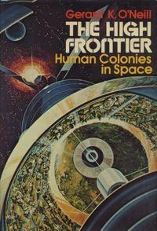
Karman+ Mission Philosophies
We want to provide a broad impact relevant to supporting Deep Space missions (beyond Karman+ and asteroid mining)
  Take calculated enabling and enhancing risks
  Use onboard capabilities to reduce ground communication
  Use Commercial-Off-The-Shelf (COTS) products whenever possible
Be flexible to target mining asteroid
  Karman+ has done significant work determining potential targets^{1, 2}
  As the spacecraft design advances we will down select targets
  Have excavation equipment prepared for a variety of surface conditions
Image Credit: https://www.karmanplus.com/why-the-high-frontier/

Slide 5
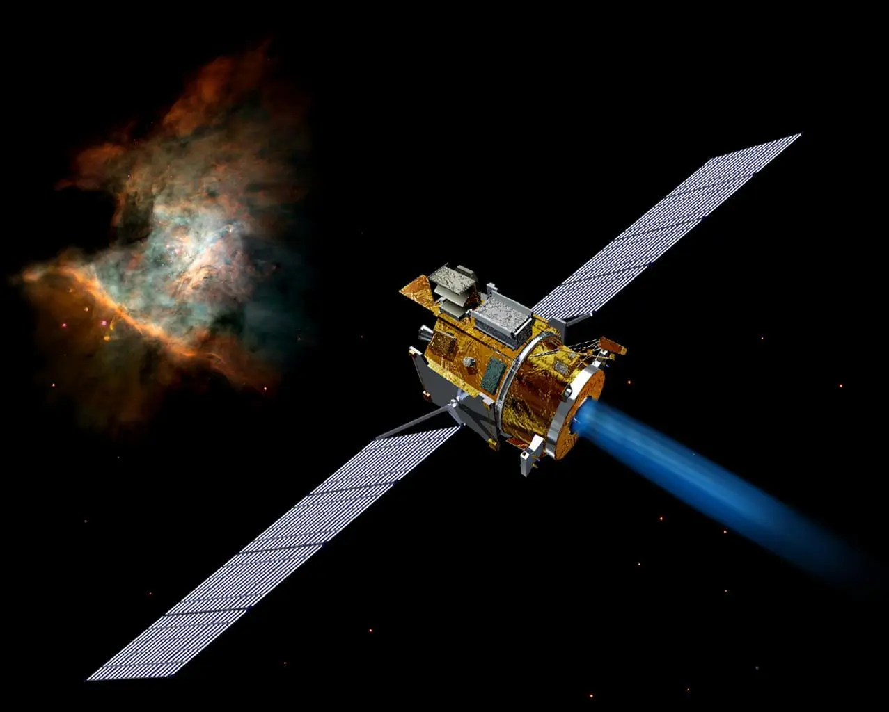

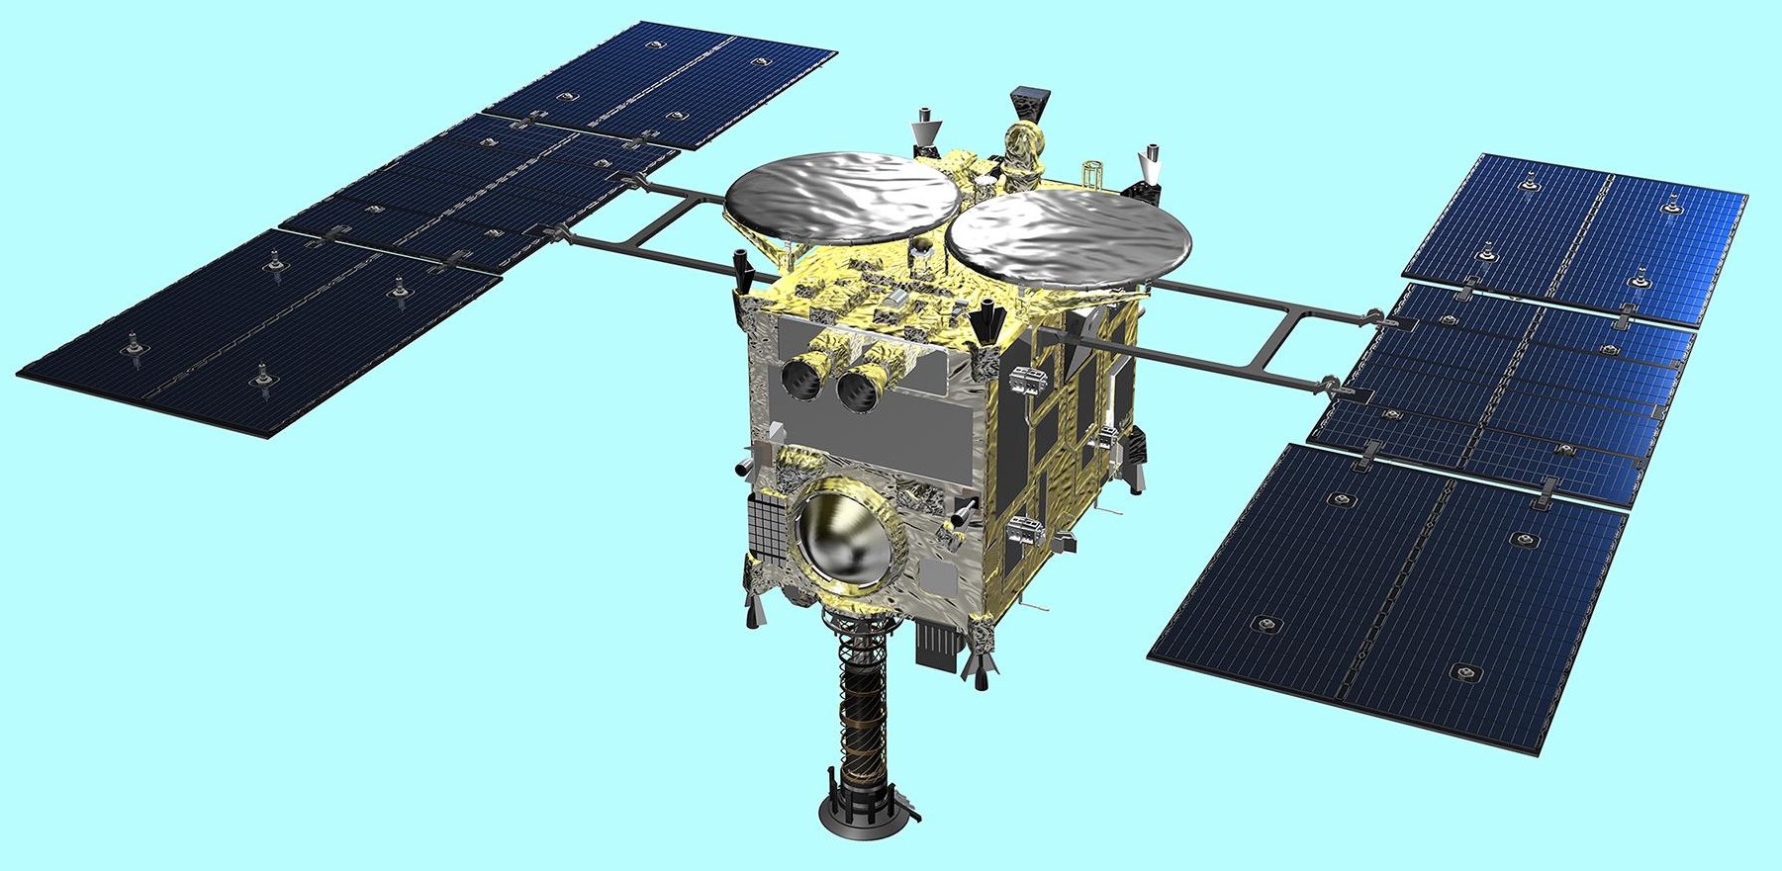
Missions which Inspire and Guide Us
(a subset)
Deep Space 1:
Image credit JPL/NASA
Deep Space 1: SEP spacecraft demonstrating “AutoNav” – using beacon asteroids for navigating interplanetary cruise then for multiple flybys³
Hayabusa / Hayabusa2: SEP spacecraft utilizing station keeping before touch-and-go (TAG) asteroid sampling^{4,5}
OSIRIS-REx: Use of ”natural feature tracking” optical navigation for descent and TAG asteroid sampling⁶
LunaH-Map: autonomous optical navigation demonstration on a 6U cubesat⁷
CAPSTONE: Lunar orbiter 12U cubesat demonstrating radiometric based autonomous navigation with the Chip Scale Atomic Clock 1-way ranging (uplink) experiment⁸
SMART-1: SEP spiral from GTO to Lunar Orbit⁹
Psyche: SEP mission demonstrating Deep Space Optical Comm. (DSOC)¹⁰
Image credit NASA
HAYABUSA2:
Image credit JAXA
https://science.nasa.gov/mission/deep-space-1/
https://www.hayabusa2.jaxa.jp/en/galleries/cg/pages/single3.html
https://blogs.nasa.gov/osiris-rex/2023/10/20/nasas-osiris-rex-achieves-sample-mass-milestone/
Notes:
Image credit sources:
https://science.nasa.gov/mission/deep-space-1/
https://www.hayabusa2.jaxa.jp/en/galleries/cg/pages/single3.html
https://blogs.nasa.gov/osiris-rex/2023/10/20/nasas-osiris-rex-achieves-sample-mass-milestone/

Slide 6
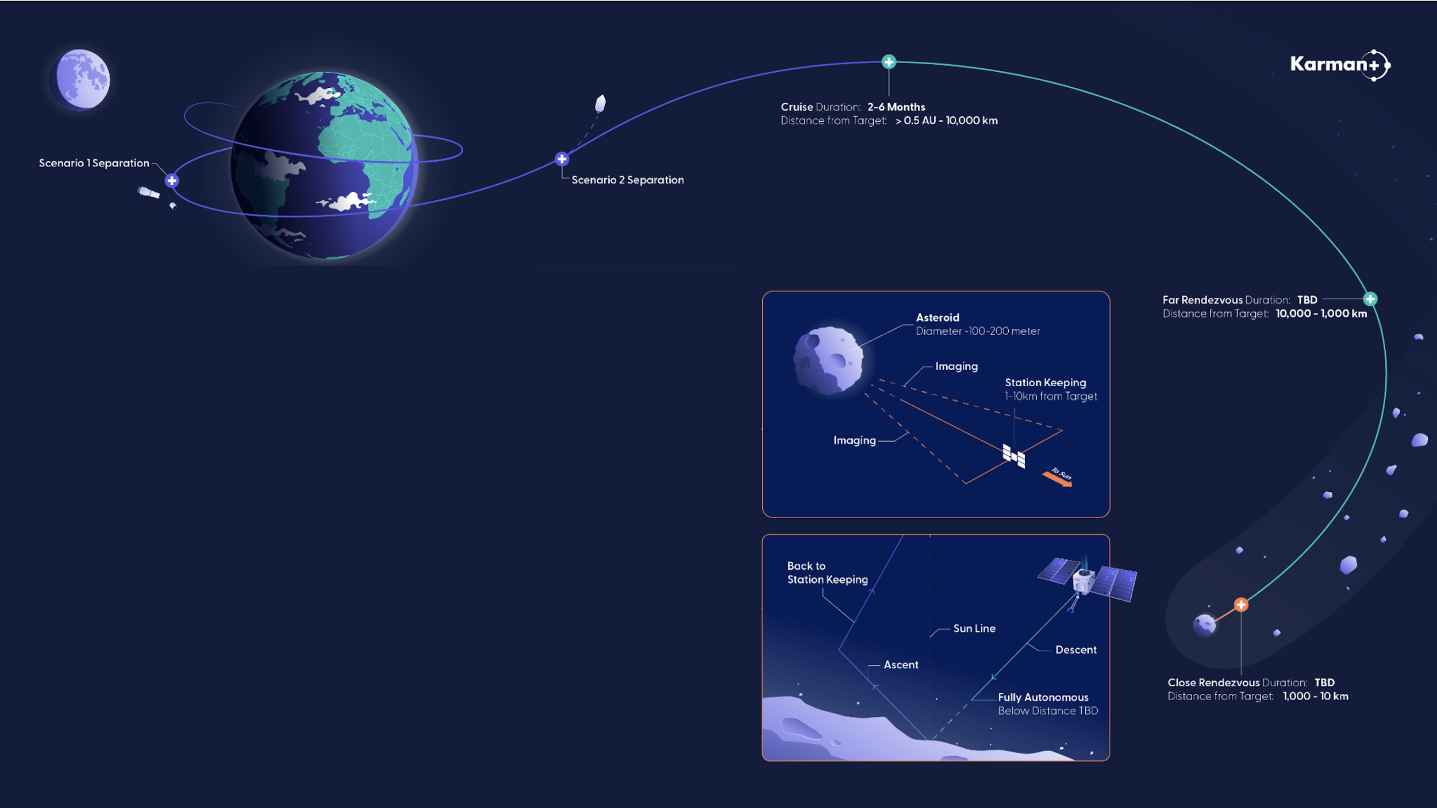
Current preliminary design and concept of operations:
Launch a SEP spacecraft ~720kg to Low Earth Orbit in Q4 2026
Perform a spiral Earth escape
Begin interplanetary cruise ~550kg
Throughout cruise use optical navigation onboard the spacecraft to enable autonomy
Rendezvous with the mining target asteroid, targeting Q4 2027
Perform station keeping while building an onboard asteroid map
Descend to the asteroid using simultaneous localization and mapping
Perform excavation demonstration 1 during a touch-and-go maneuver
Ascend back to station keeping
Perform a mass estimation maneuver
Downlink results
Perform additional TAG excavation with alternate equipment
Use externally developed science instruments payload(s)

Slide 7
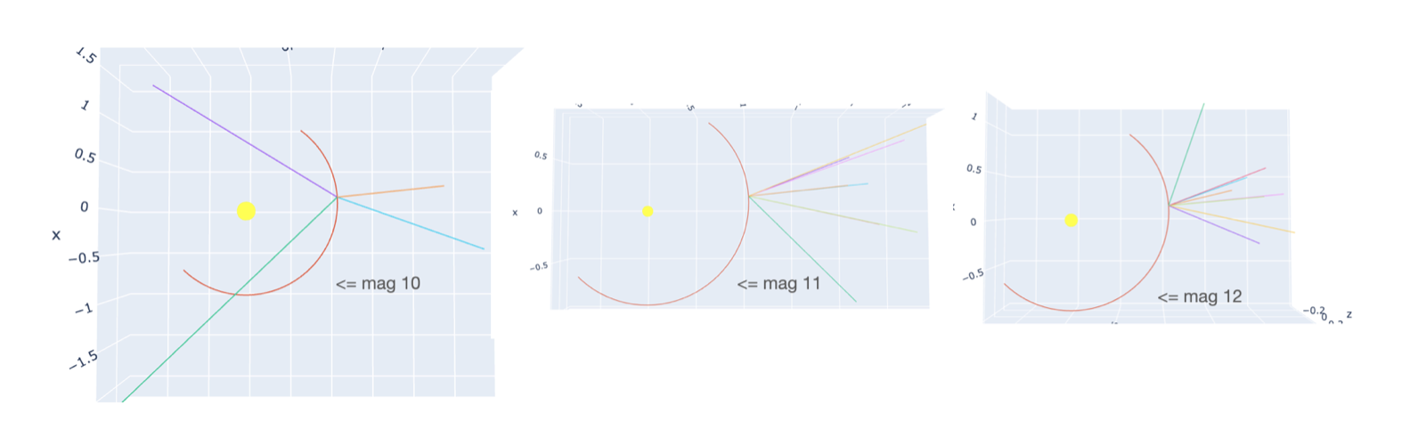
Cruise Navigation Overview
Cruise navigation involves triangulating the spacecraft position from inertial line of sight measurements to known “beacon” asteroids^{3,11}
Having this as an autonomous, on-board capability is motivated by ground contact time limitations
On-board processing involves
  Background estimation
  Source extraction and center finding (big data reduction)
  Astrometric solution from catalog guide stars
  Optionally, photometric solution to calibrate digital counts to absolute radiometric units
  Discrimination of beacon asteroid from other sources
  Fusion of beacon asteroid observation into navigation filter
Other considerations
  Spacecraft jitter affects ability to detect and accurately measure line of site to of faint source. Need to estimate spacecraft jitter performance, and potentially plan for closing attitude loop around nav camera
  Beacon nav operations will be planned to coincide with other shutdowns of SEP thrust (for desaturation or related).
  A ground designed nominal trajectory will be onboard the spacecraft with onboard correction capability
Beacon Nav Examples: Different Beacon Asteroids Selected Due to Camera Sighting Ability and Geometry

Slide 8
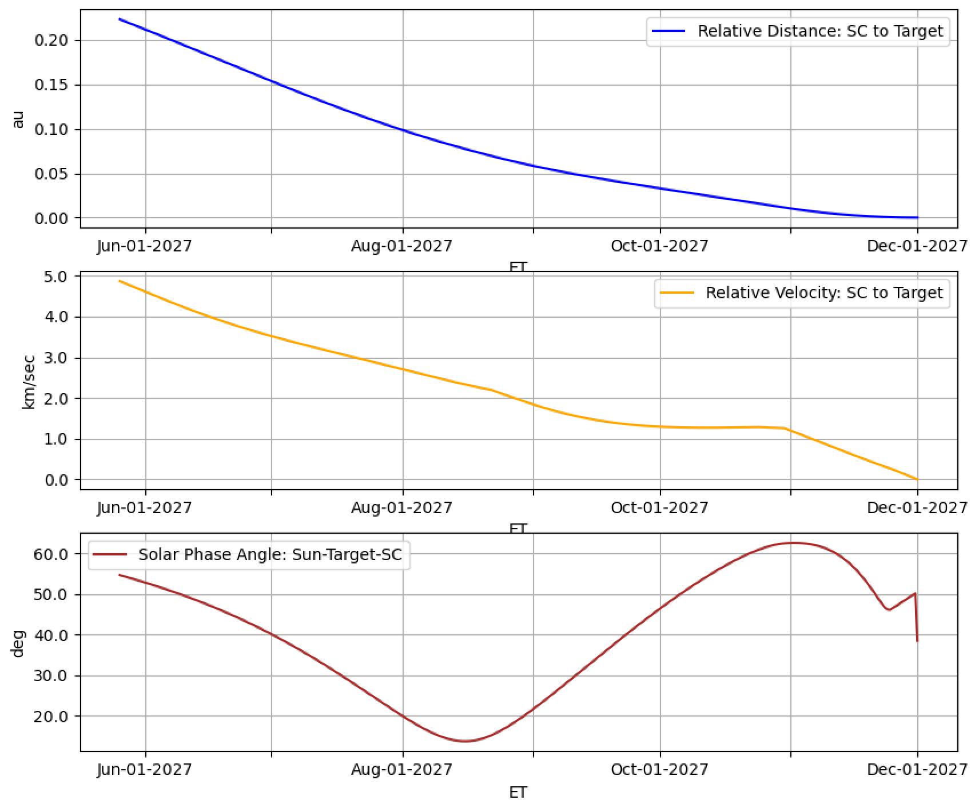
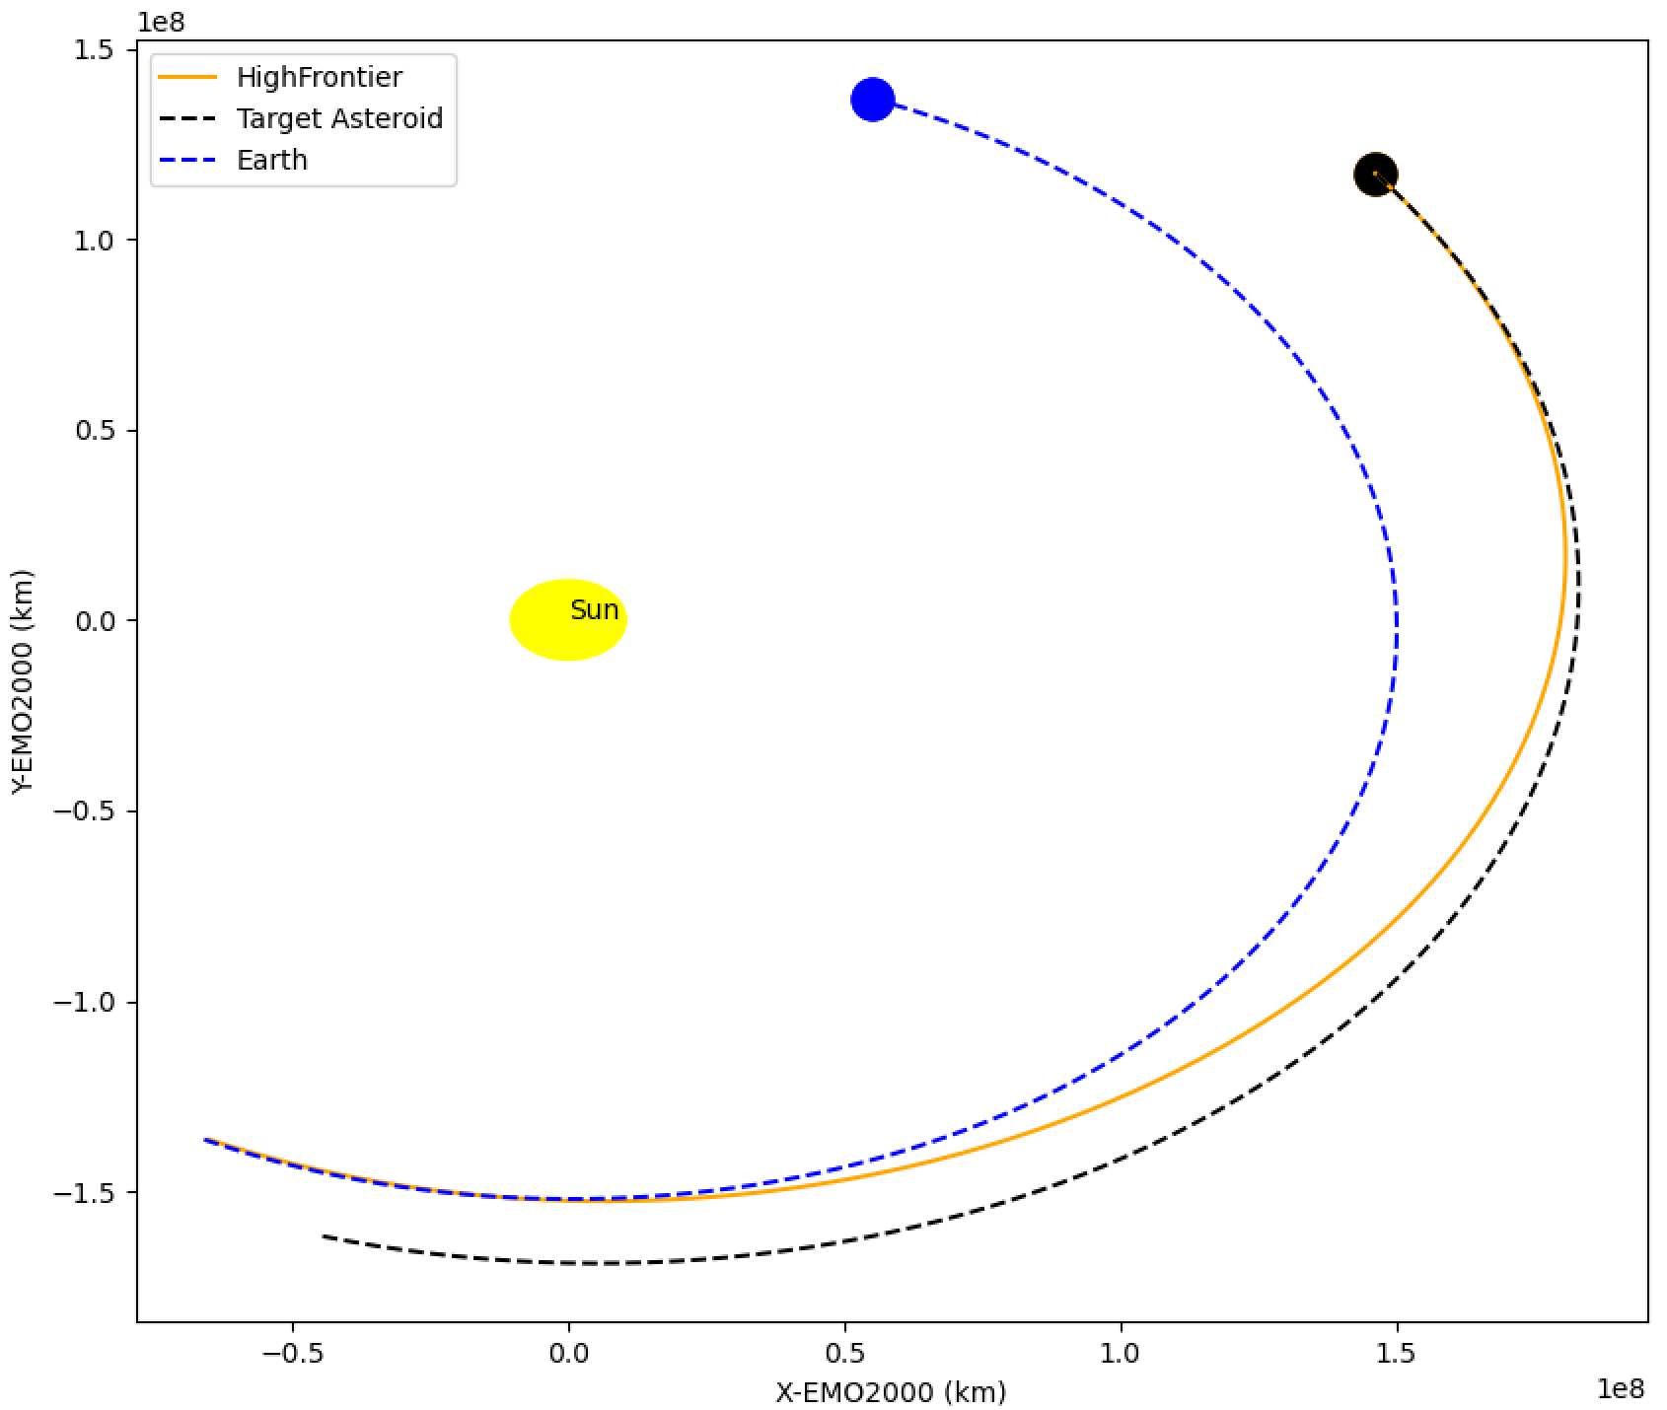
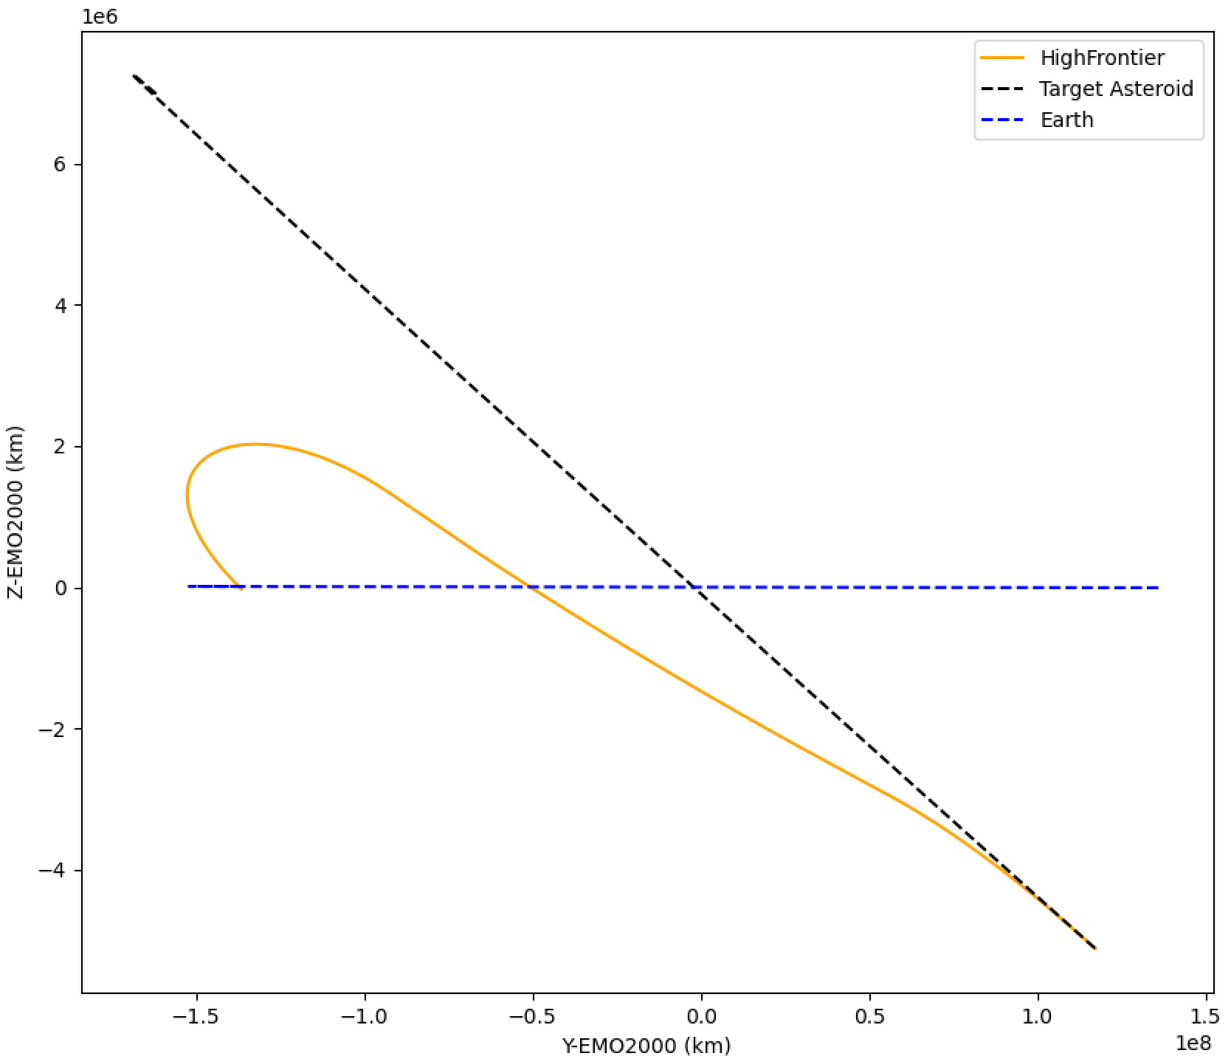
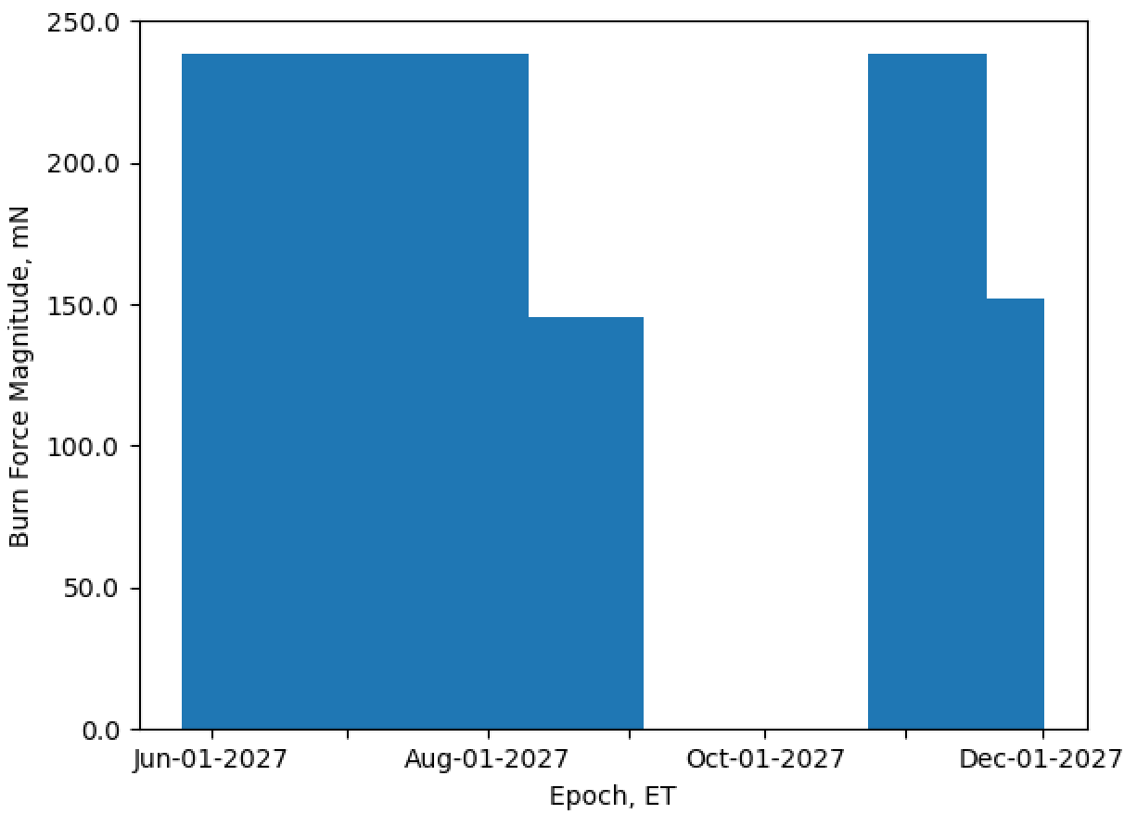
Trajectory Design and Covariance Analysis
JPL MONTE¹²
MCOLL¹³: A low-thrust trajectory design tool using collocation
  MCOLL was previously verified against Mystic, the technique used to design the Dawn and Psyche trajectories
  Karman+ trajectory advancement ongoing
Covariance Analysis: batch filter estimation of the simulated trajectory and measurement data
  Nominal values are not changed from the a priori
  The spacecraft state uncertainty is of primary interest
  Karman+ error models still under development
Example MCOLL Trajectory to an Asteroid Target of Interest

Slide 9
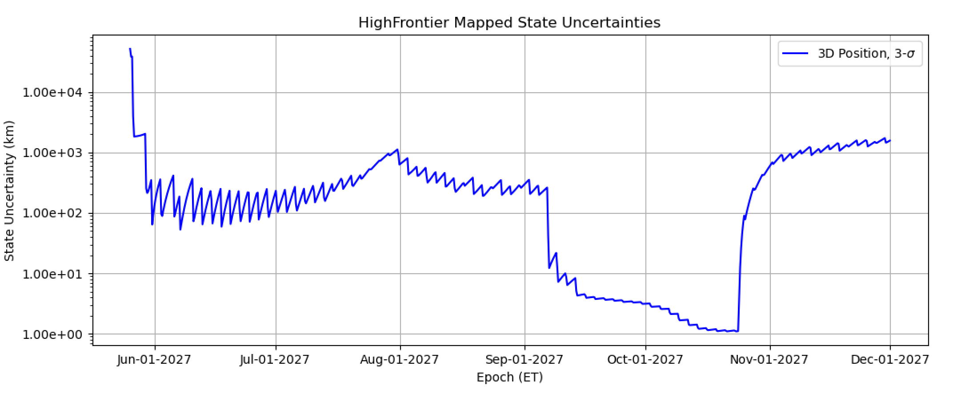
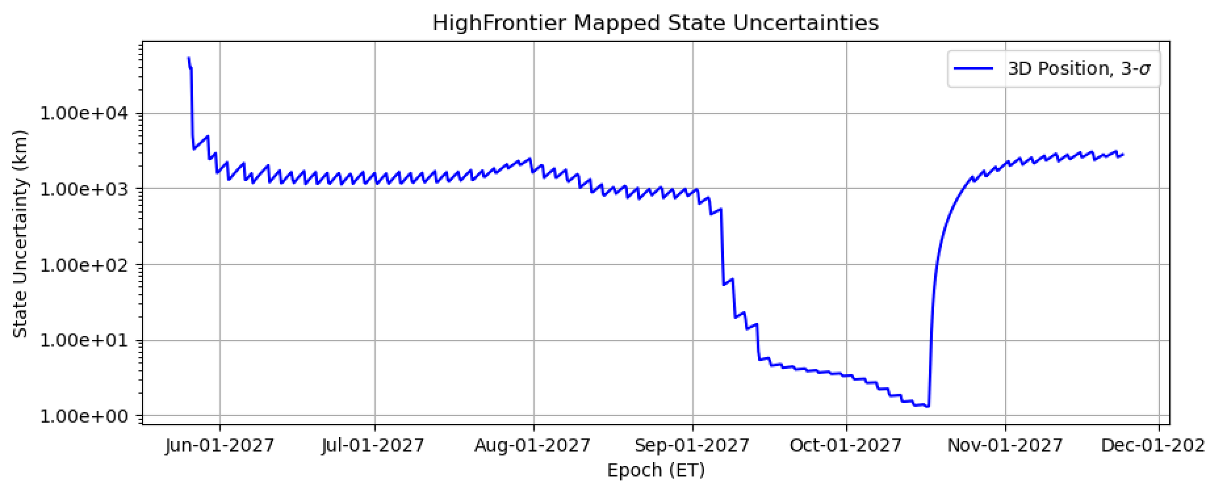
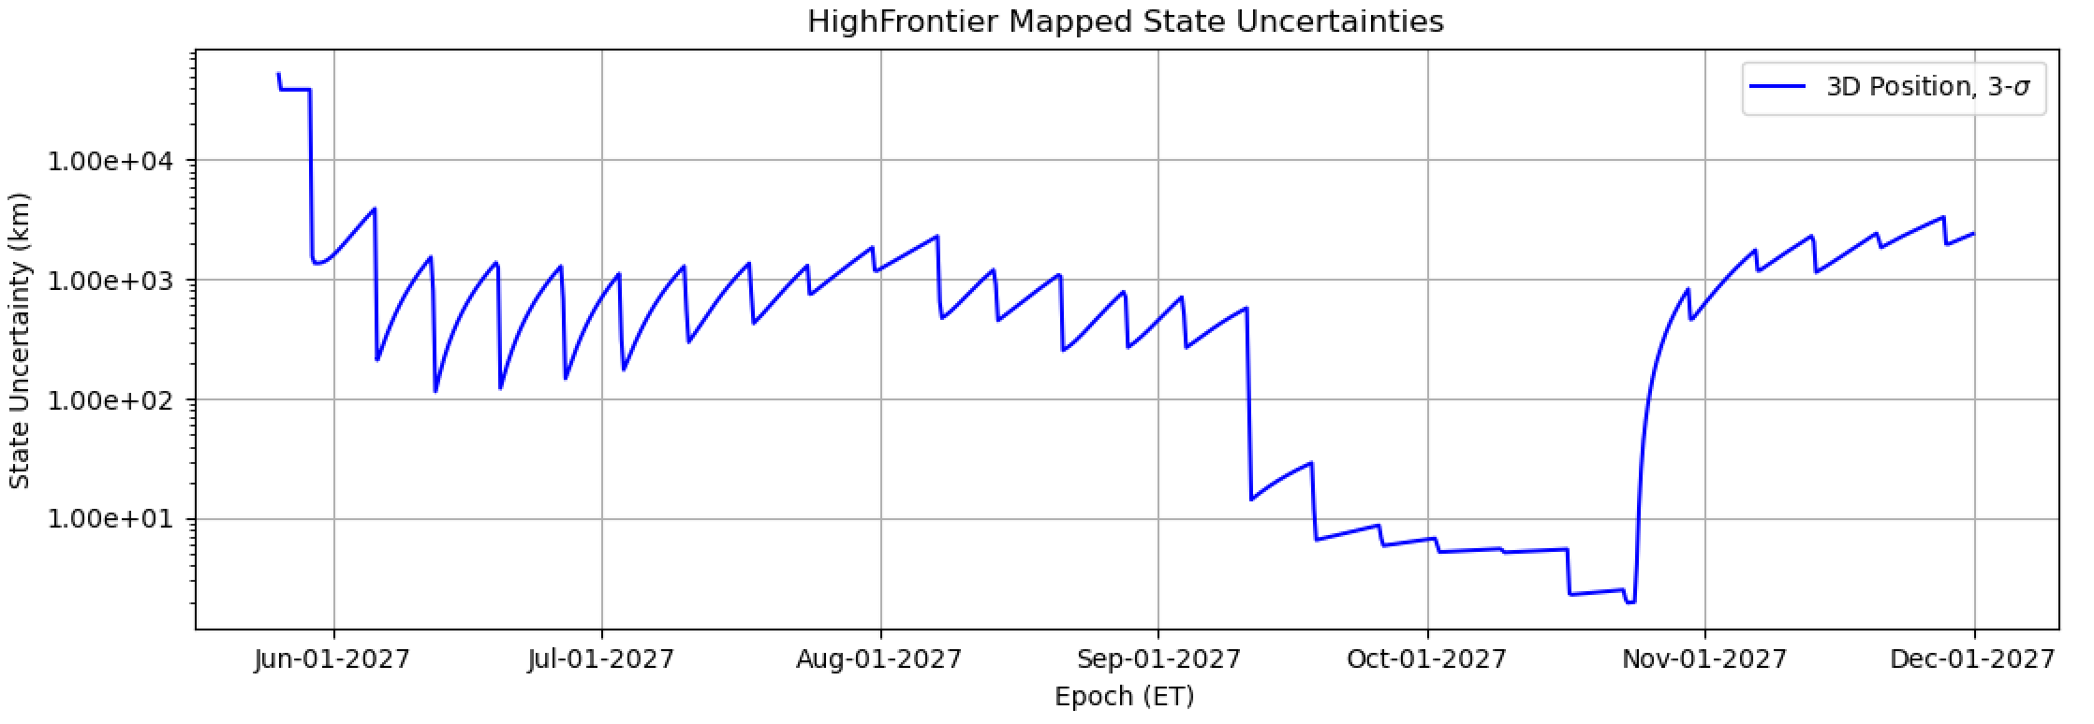
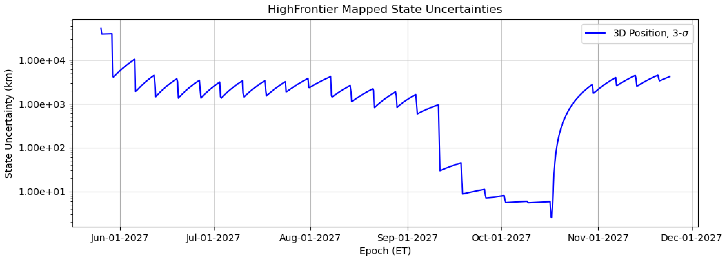
Spacecraft State Uncertainty Examples
Current state
1 week predict
10⁴
10⁴
(3x week Doppler / range track,
1/week optical beacons)
10³
10³
10²
10²
10¹
10¹
10⁰
10⁰
a priori sc state uncertainty set high
Periods without nominal thrusting
Dips align with measurement updates
10⁴
10⁴
(1x week Doppler / range track,
1/week optical beacons)
10³
10³
10²
10²
10¹
10¹
10⁰

Slide 10
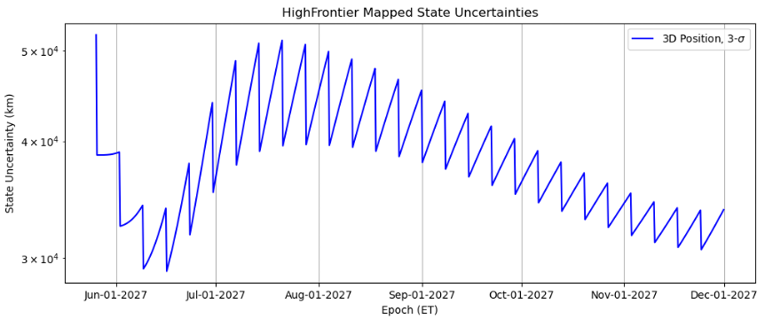
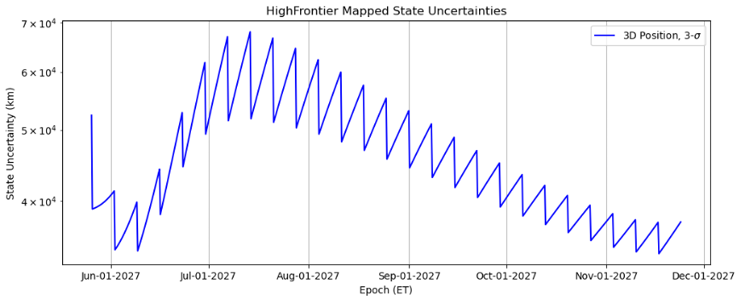
Spacecraft State Uncertainty Examples
Current state
1 week predict
10⁴
10⁴
(1x week Doppler / range track,
1/week optical beacons)
10³
10³
10²
10²
10¹
10¹
opnav not providing same resolution as Doppler / range (as expected)
(1/week optical beacons)

Slide 11
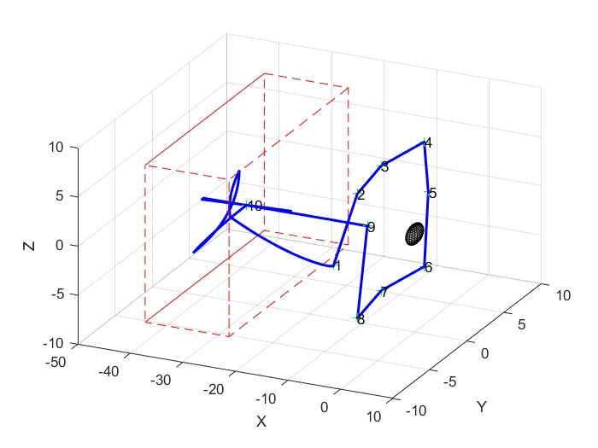
Station Keeping and Asteroid Mapping
The spacecraft will autonomously maintain a specified relative distance and inertial offset to the asteroid safe position 5 km (TBR) sunward of the asteroid, and within 1km (TBR) of the asteroid sun line.
Notionally, the asteroid will be characterized using the narrow field of view camera from a safe standoff distance (~1km)
  Maintaining relatively constant inertial relative offset and phase angle
  Ground sample resolution on order of ~5cm
During asteroid prox ops, the spacecraft will be able to autonomously return to station keeping mode.
  Stationkeeping 8km from asteroid on sun line in 2x2x2km box. 9 imaging locations around sunline 1km from asteroid: +/- 45deg in Longitude, +/- 30 deg in Latitude

Slide 12
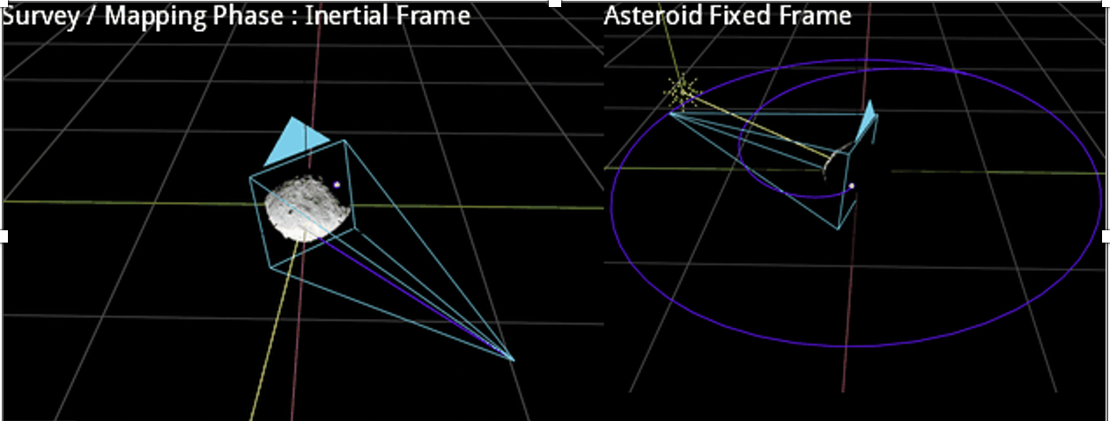
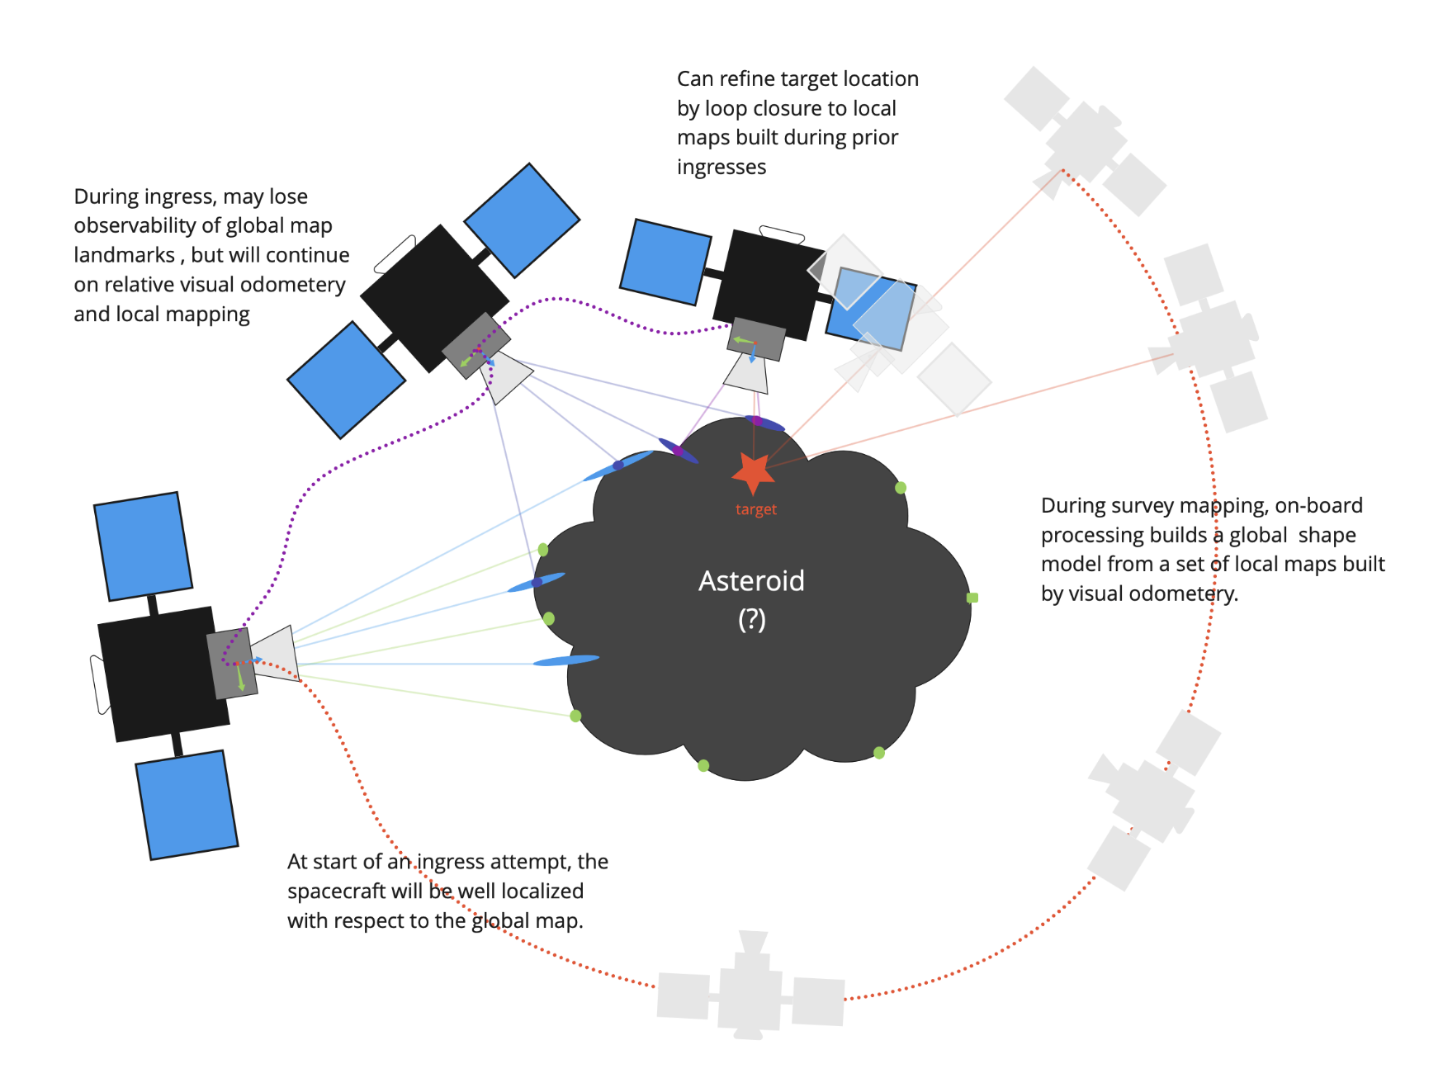
Proximity Operations and Descent Navigation
The target landing site will be specified relative to the map built during this phase, from limited subset of downlinked imagery.
Descent trajectory departure point will be from the standoff position, with good nav solution, relative to the map, in order to compute departure burn
Descent trajectory is nominally a diagonal path to match tangential surface velocity and desired vertical velocity at contact
Spacecraft will continue to map finer scale features, with on-board SLAM, as it descends
Conops motivated by avoiding more extensive high resolution mapping operations and extensive downlink / uplink.
RPO Verification Strategy:
  Full formulation of the mapping / SLAM, but with analytical measurement models,
  End to End simulation and test: image simulation with Blender (Cycles) or similar^{14,15,16}
  Closed loop simulation integrating G&C models with nav code prototypes, progressing to flight code
Mapped from an inertial standoff position, maintaining mostly constant solar phase angle. Descent notionally along diagonal trajectory matching tangential surface velocity and desired vertical contact velocity

Slide 13
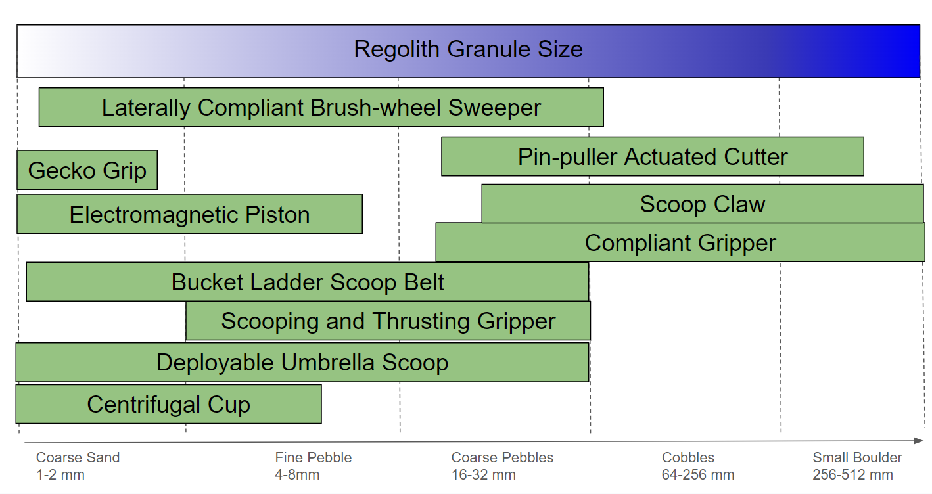
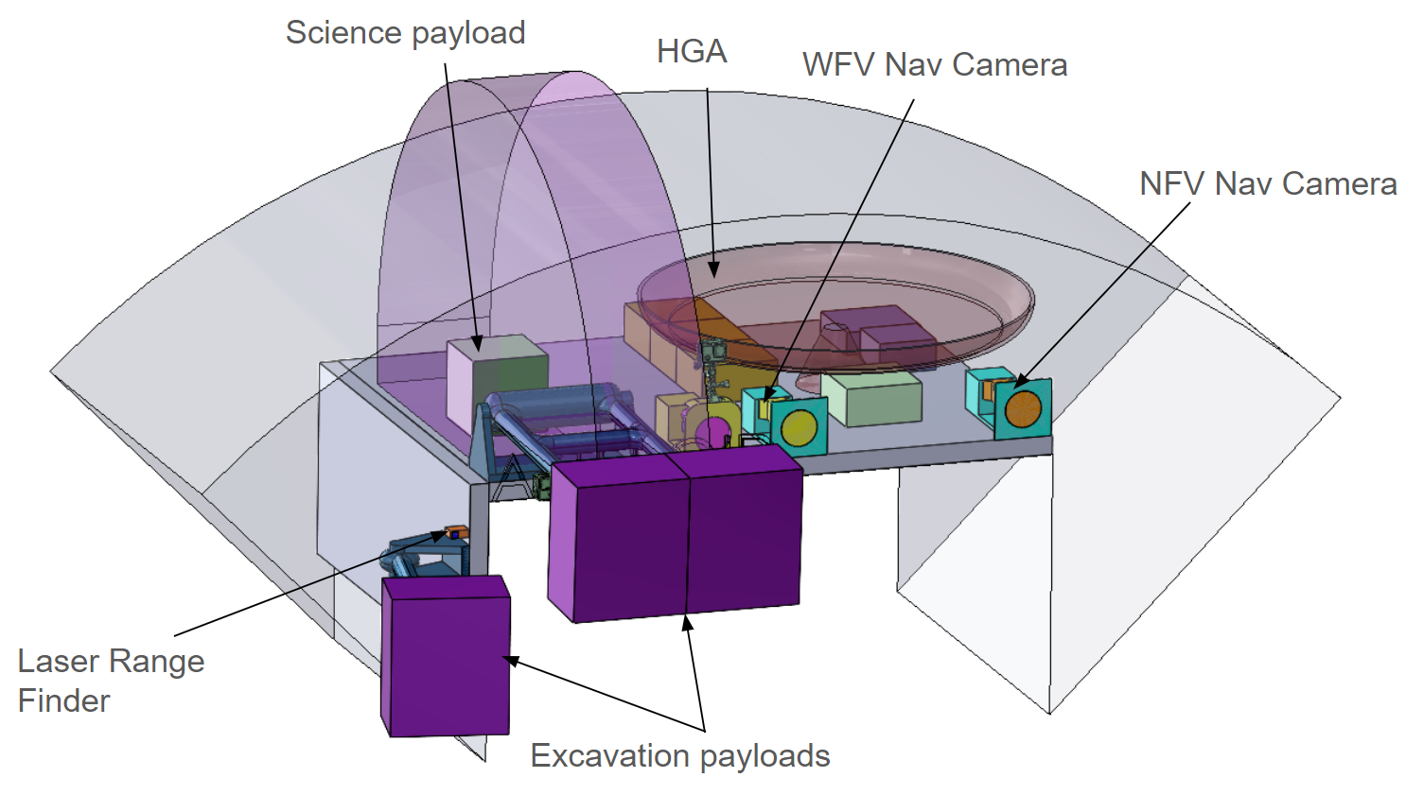
Excavation Concepts and G&C
To have a system agnostic to the unknown asteroid environment, a range of novel options are under development
The excavation team is constantly developing and testing innovative prototype hardware variations
  downselection in June 2024
The asteroid TAG GNC requirement rationales on maximizing flexibility to the excavation method while keeping the spacecraft from harm
COTS Nav cameras may double for excavation equipment
Excavation Concepts and Potential Layout

Slide 14
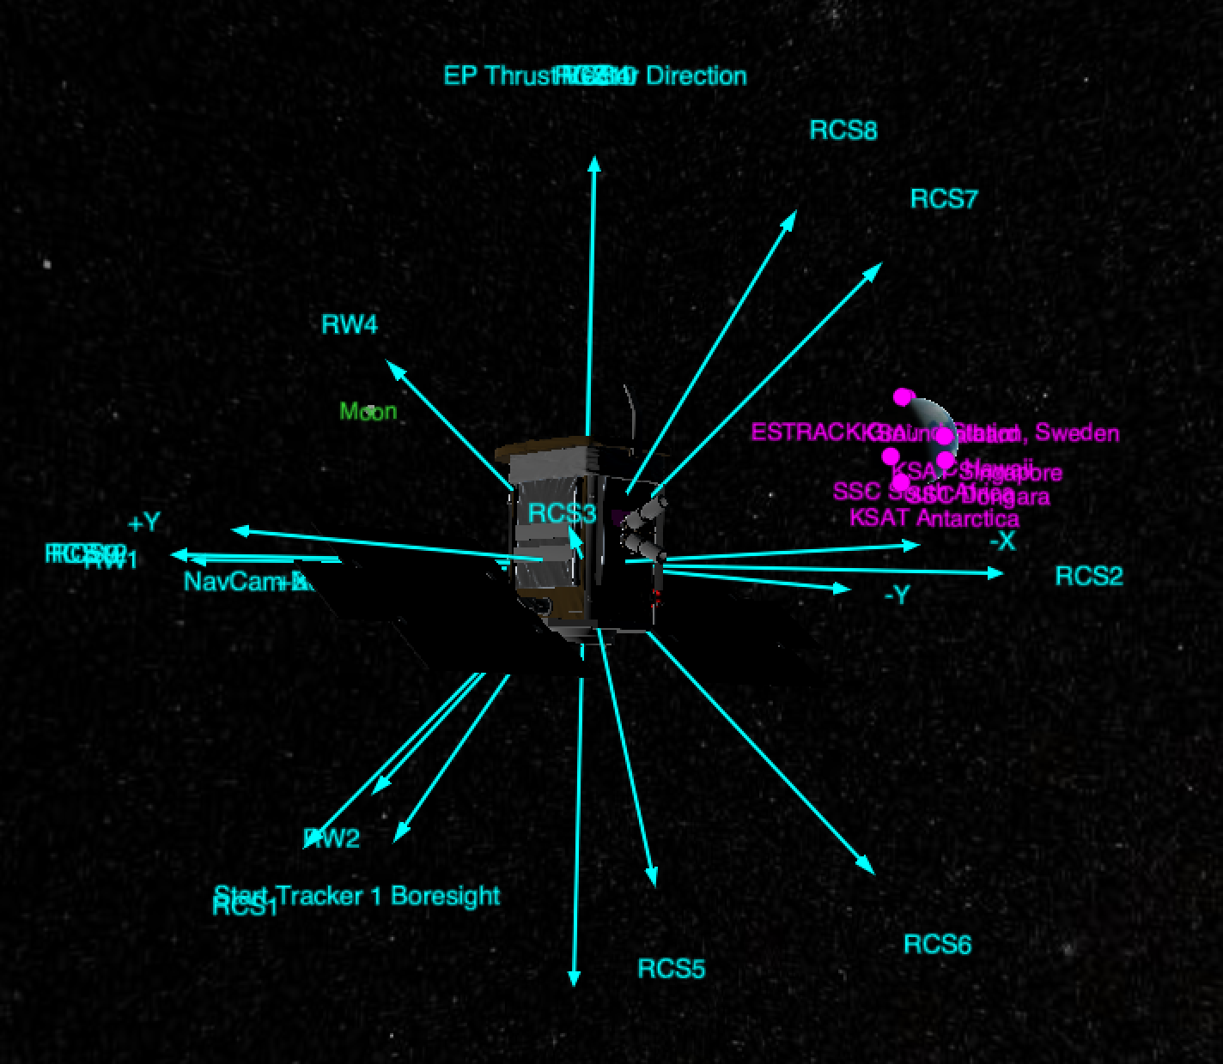
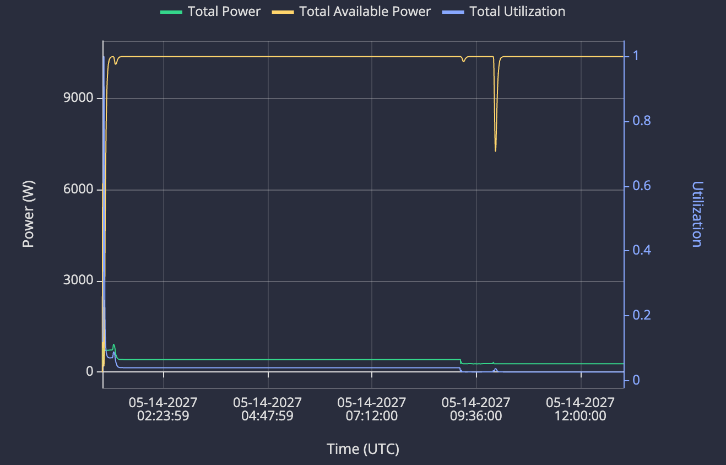
Systems Modeling Summary
In order to verify our performance and mission budgets, a spacecraft simulation was developed
Sedaro¹⁷ was used to analyze the spacecraft design and operational scenarios
The Sedaro spacecraft is kept consistent with the evolving platform
The results have helped inform system budgets and requirements
Sedaro pointing and power High Frontier simulation
Notes:
high power margin here - this scenario is based on the RW pointing modes and obv doesn't include the EP thrusting.

Slide 15
Conclusions
The Karman+ High Frontier mission is taking on a number of challenges in the name of asteroid mining, but with philosophy and techniques that are relevant to lower cost / SmallSat missions
  Decreasing ground communication reliance with optical based autonomous navigation during cruise, proximity operations, and descent
  Looking to COTS hardware where possible
  We think these enabling and enhancing technique should be shared as progress is made in an effort to benefit the broader community
We’re gearing up for a preliminary design review in October 2024
We have a bunch of interesting work ahead and are hiring
  Open positions and a general applications: https://www.karmanplus.com/jobs/
  We’re interested in passionate individuals, eager to learn and try new things
  We’re interested in collaborations and partnerships

Slide 16
Thank you!
www.karmanplus.com
d.velez@karmanplus.com
With Acknowledgement and Special Appreciation for: Daniel Scheeres (UCB), Jay McMahon (UCB), Shyam Bhaskaran (JPL), Dan Grebow (Nabla Zero Labs), Yuichi Tsuda (JAXA), Neel Kunjur (K2 Space), Matthew Gill (Space Radiation Services), Continuum Space Systems, Advanced Space, Atomos Space, SsODNet (Observatoire de Paris), AstorbDB (Lowell Observatory), the MANOS survey, Max Mahlke (Institut d'Astrophysique Spatiale), JPL Horizons, the Minor Planet Center, Petr Pravec (Ondrejov Asteroid Photometry Project), Mikael Granvik (University of Helsinki, Luleå University of Technology), and the entire Karman+ Team

Slide 17
References
L. Siltala, D. Crull, A. Deuitch, S. Hallam, D. Howell, D. Velez, L. Whittle, K. M. Cannon and M. Granvik, "High Frontier: A Fully-Funded Private Excavation Mission to a Near-Earth Asteroid," in Winter Satellite Workshop, Espoo Dipoli, Finland, 2024.
L. Siltala, “The Karman+ leaderboard: How to find a mission target?” “Karman+: News & Blogs” 27 Nov 2023, https://www.karmanplus.com/the-karman-leaderboard-how-to-find-a-mission-target/
S. Bhaskaran, J. Riedel, S. Synnott and T. Wang, "The Deep Space 1 Autonomous Navigation System: A Post-Flight Analysis," AIAA/AAS Astrodynamics Specialist Conference, Denver, CO, AUG 2000.
M. Yoshikawa, T. Kato, T. Ichikawa, H. Yamakawa, J. Kawaguchi, T. Ohnishi and S. Ishibashi, "Orbit Determination of Hayabusa from the Launch to the Asteroid Arrival," 56th International Astronautical Congress of the International Astronautical Federation, the International Academy of Astronautics, and the International Institute of Space Law, Fukuoka, Japan, 2005.
S. Yasuda, K. Matsushima, F. Terui, Y. Mimasu, N. Ogawa, G. Ono, K. Yoshikawa and Y. Tsuda, "Operational Design for Hayabusa2 Touch-Down to Ryugu," AIAA Scitech 2020 Forum, Orlando FL, 2020.
K. M. Getzandanner, K. E. Berry, P. G. Antreasian, J. M. Leonard, C. D. Adam, D. R. Wibben, M. C. Moreau, D. E. Highsmith and D. S. Lauretta, "Small-Body Proximity Operations & TAG: Navigation Experiences & Lessons Learned from the OSIRIS-REx Mission," AIAA SciTech 2022 Forum, San Diego, CA, 2022.
J. Pelgrift, D. Nelson, B. Williams, P. Hailey, T. O’Brien, K. Poetsch, C. Hardgrove, “In-Flight Autonomous Optical Navigation Demonstration Onboard the LunaH-Map Spacecraft”, AAS/AIAA Astrodynamics Specialist Conference, Big Sky MT, 2023 (AAS 23-423)
T. G. Gardner, “The Cislunar Autonomous Positioning System Technology Operations and Navigation Experiment (CAPSTONE): A summary of a Highly Successful Mission Currently Operating in the Cislunar Environment”, Interplanetary Small Satellite Conference, 2023.
O. Camino, M. Alonso, D. Gestal, J. de Bruin, P. Rathsman, J. Kugelberg, P. Bodin, S. Ricken, R. Blake, P. Pardo Voss and L. Stagnaro, "SMART-1 Operations Experience and Lessons Learnt," in 57th International Astronautical Congress, Valencia, Spain, 2006 (IAC-06 B5.3.8).
N. Bradley, J. S. Snyder, D. Lubey, A. Manka, D. R. Jones, D. Velez and D. Koh, "Pre-launch Electric Propulsion Error Models for Psyche Navigation," in 33rd AAS/AIAA Space Flight Mechanics Meeting, Austin TX, 2023 (AAS 23-103).
S. Broschart, N. Bradley, S. Bhaskaran. “Kinetmatic Approximation of Position Accuracy Achieved Using Optical Observations of Distant Asteroids” Journal of Spacecraft and Rockets 56.5 (2019), 1383-1392
S. Evans, W. Taber, T. Drain, J. Smith, H-C. Wu, M. Guevara, R. Sunseri, J. Evans, “MONTE: The Next Generation of Mission Design and Navigation Software, CEAS, Space, J. 10(1) (2018) 79-86.
D.J. Grebow, T.A. Pavlak, “MCOLL: Monte Collocation Trajectory Design Tool”, AAS/AIAA Astrodynamics Specialist Conference, Stevenson, Washington, August 2017.
Blender Online Community, “Blender - a 3D Modeling and Rendering Package” Stichting Blender Foundation, Amsterdam, www.blender.org .
C. M. Ernst, O.S. Barnouin, R.T. Daly, and the Small Body Mapping Team , “The Small Body Mapping Tool (SBMT) for Accessing, Visualizing, and Analyzing Spacecraft Data in Three Dimensions”, LPSC 49, abstract no 1043.
P. Lindenberger, P-E. Sarlin, M. Pollefeys, “LightGlue: Local Feature Matching at Light Speed”, IEEE/CVF International Conference on Computer Vision (ICCV), Paris France, October 2023. (https://github.com/cvg/LightGlue)
https://www.sedaro.com/,

Slide 18
Backup / Alternates

Slide 19
Ground Communication Availability
(or the lack there of)
Deep Space Network (DSN) is an oversubscribed resource
  It must focus on the various NASA and government contracted
DSN alternatives are becoming available
  Karman+ is in the early stages of ground communication discussion and wants to have a robust platform to what services are available
Karman+ onboard techniques will be applicable to especially ground communication limited spacecraft

Slide 20
Potential Future ConOps
Mothership / Daughtership Paradigm
  A large spacecraft takes care of the majority the interplanetary cruise
  One or more smaller spacecrafts perform the asteroid mapping and excavation
    Multiple spacecrafts could be used for stereo mapping, the spacecrafts could be radiometrically linked
    Smaller spacecrafts would allow riskier excavation sites to be considered
  Smaller spacecraft(s) bring back excavated materials to the Mothership
  Mothership brings the excavated material back to the region of interest for utilization
    Mothership could perform some or all material processing onboard

Slide 21
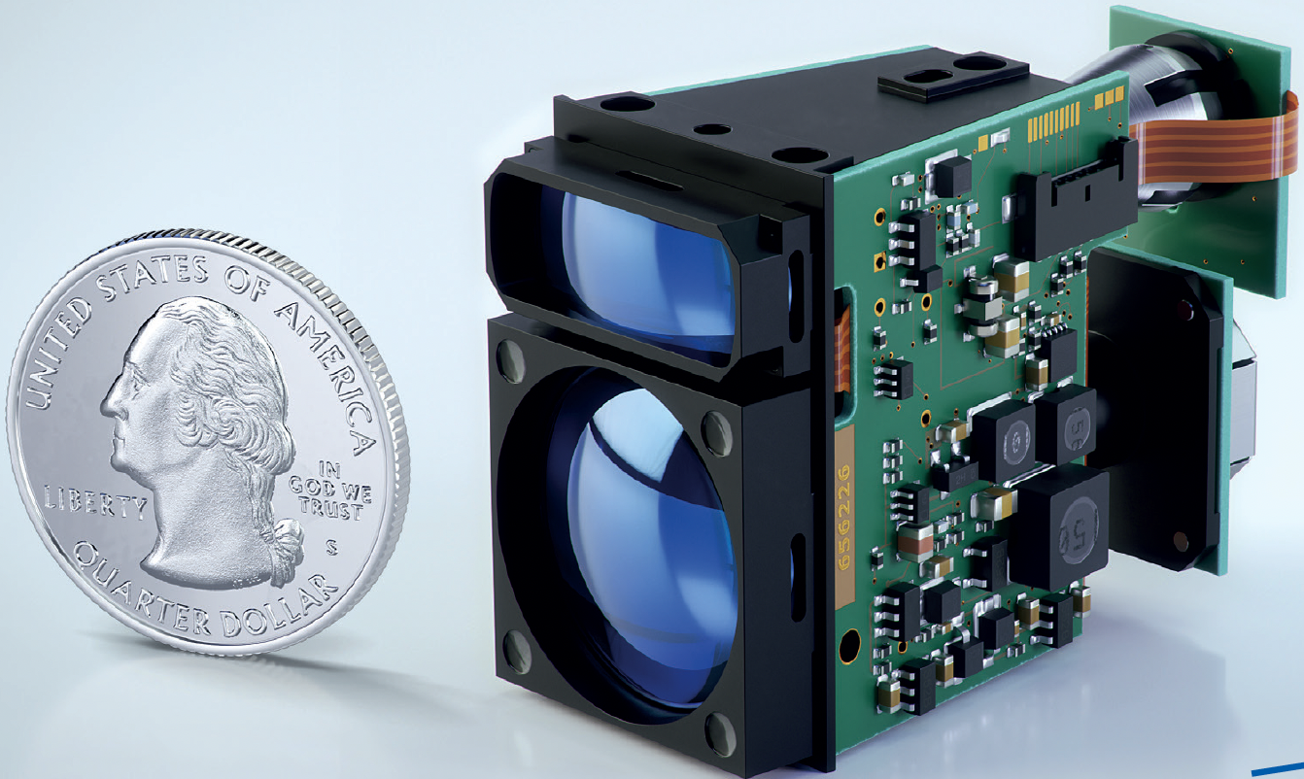
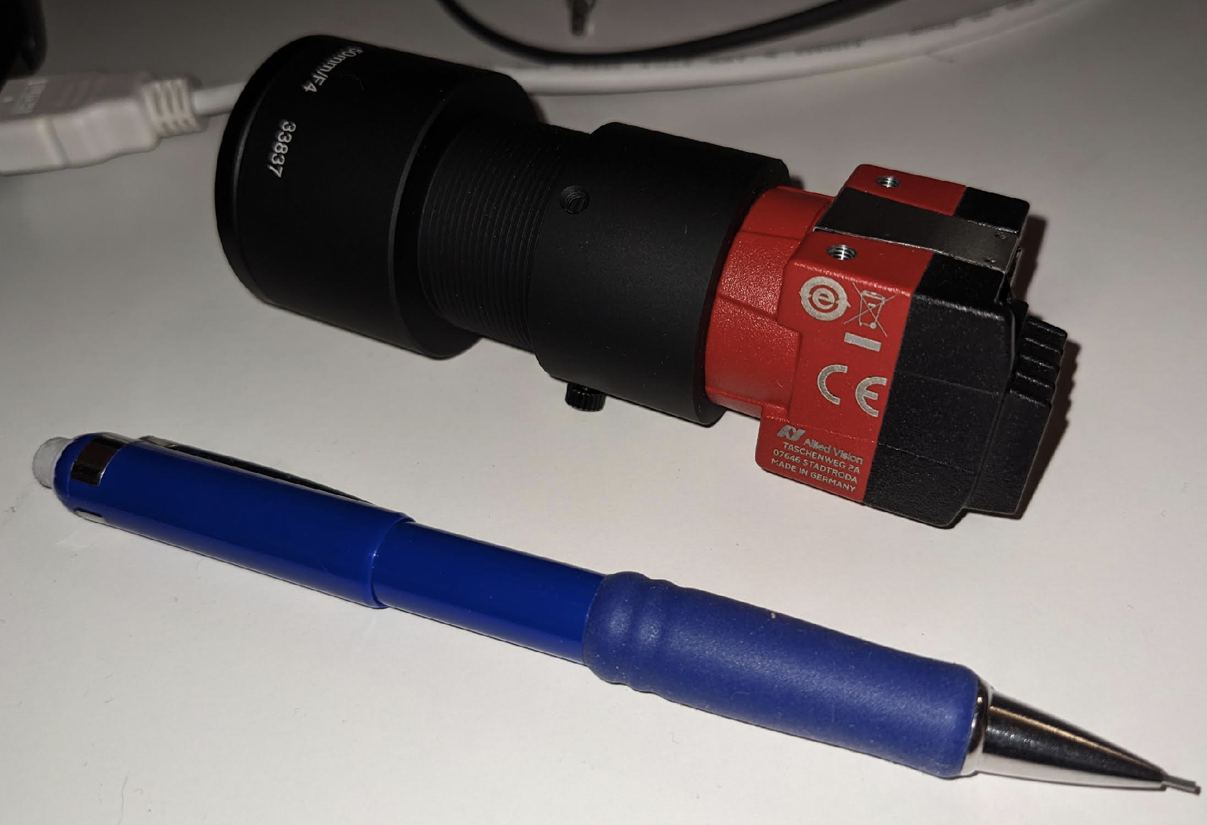
COTS & Radiation Testing
Cameras:
  The workhorse of the mission’s sensors – very high dependency
  A variety of high performing COTS sensors are of interest
Laser Range Finders:
  Several sensors identified which provide a desired resolution at very low mass
Processing boards:
  Review underway with rigorous radiation testing planned
Image credit Jenoptik: DLEM 20LE
Allied Vision camera
https://www.jenoptik.de/-/media/websitedocuments/optics/sensor/dlem-20le-edb.pdf
https://www.alliedvision.com/en/
Notes:
Camera : https://www.alliedvision.com/en/
Jenoptik DLEM 20LE : https://www.jenoptik.de/-/media/websitedocuments/optics/sensor/dlem-20le-edb.pdf

Slide 22
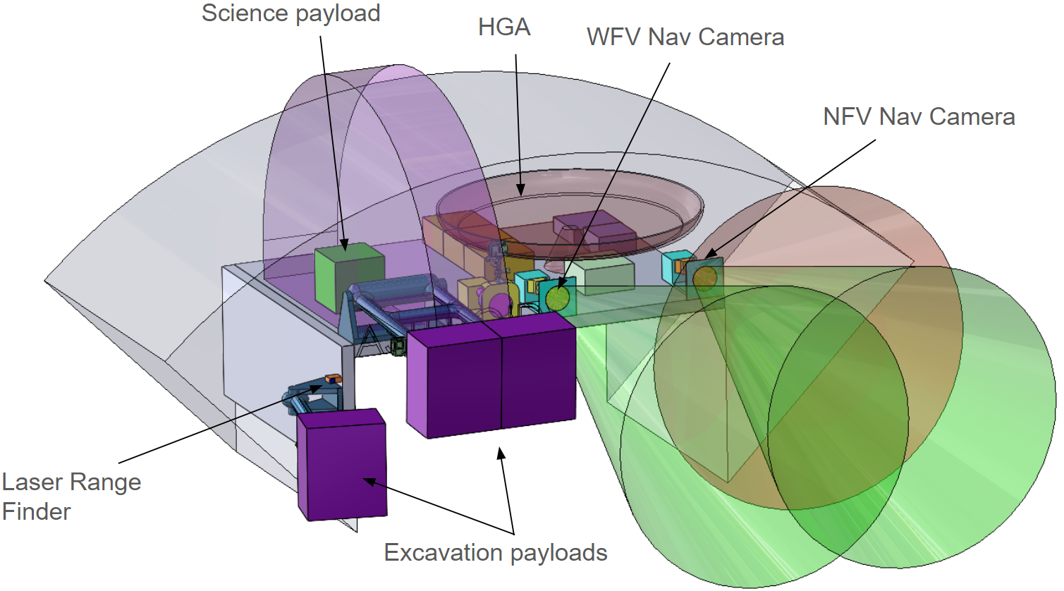
Excavation Concepts and G&C
To have a system agnostic to the unknown asteroid environment, a range of novel options are under development
The excavation team is constantly developing and testing innovative prototype hardware variations
  downselection in June 2024
The asteroid TAG GNC requirement rationales on maximizing flexibility to the excavation method while keeping the spacecraft from harm
COTS Nav cameras may double for excavation equipment
Excavation Concepts and Potential Layout

Slide 23
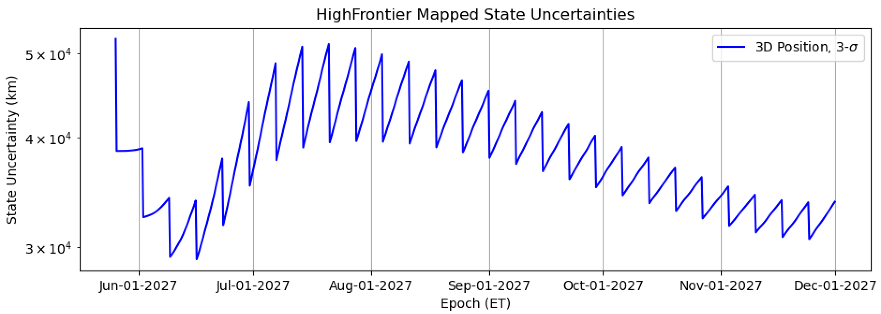
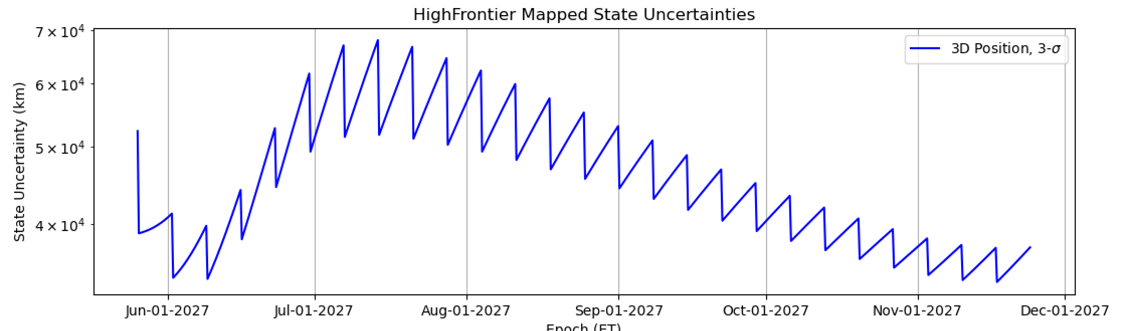
Target X (1/week optical beacons)
Current state
1 week predict

Slide 24
Target X (1x week track, 1/week optical beacons)
Current state
1 week predict

