Slide 1
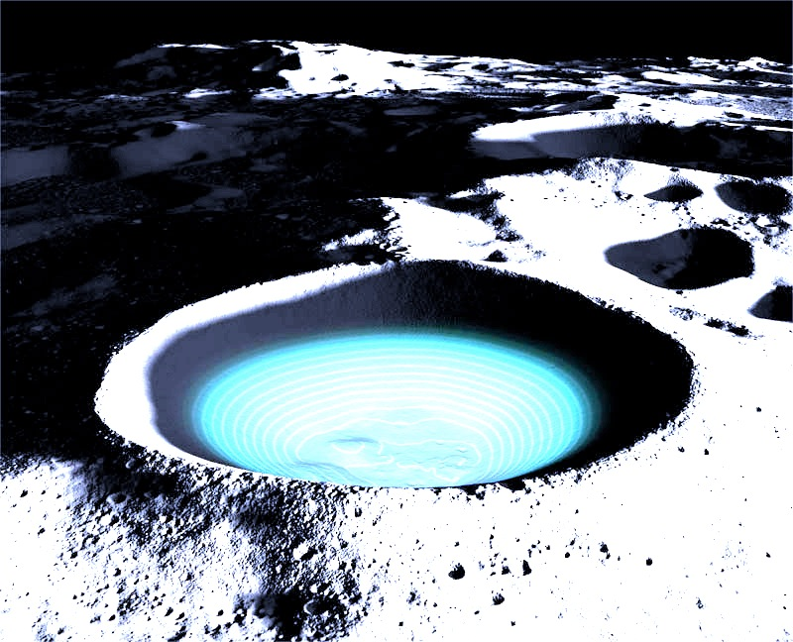
Global Mapping of Lunar Surface Water and Hydroxyl in Context
Timothy A. (Tim) Livengood, UMD
Pamela E. Clark, Morehead State U.
Tilak Hewagama, Eric Kan, Clifford Brambora, NASA GSFC
David C. Bugby, NASA JPL

Slide 2
Science Goals
Distinguish between H₂O and OH in hydrated lunar surface minerals
  H₂O is relatively easy to extract as a resource. OH requires additional H.
Quantify H₂O
  Abundance helps to distinguish between sources/reservoirs
  Indigenous H₂O significantly alters geochemistry and geophysics.
Compare to mineralogy
  How does hydration differ according to dominant minerals?
  Requires unbiased sampling.
Measure diurnal variability
  Is variation consistent with horizontal transport?
  Is transport local (e.g., sequestration into shadows) or regional?
  Is another mechanism required (e.g., diurnal cycle of photolysis and recombination in surface)?
Measure meridional distribution

Slide 3
Measurement Goals
Global map – ~1 km spatial resolution
Chemical form of hydration
  OH: 3 µm OH stretch band
  H₂O: 6 µm H₂O bending band
  H₂O: 11 µm H₂O libration band
Mineralogy – silicate Christiansen feature (~7-8 µm) and other features
Surface temperature – 10-12 µm thermal emission
Diurnal – ≥6 month mission, visit surface features ≥6 times of day

Slide 4
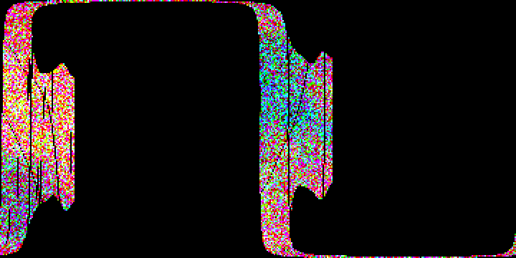
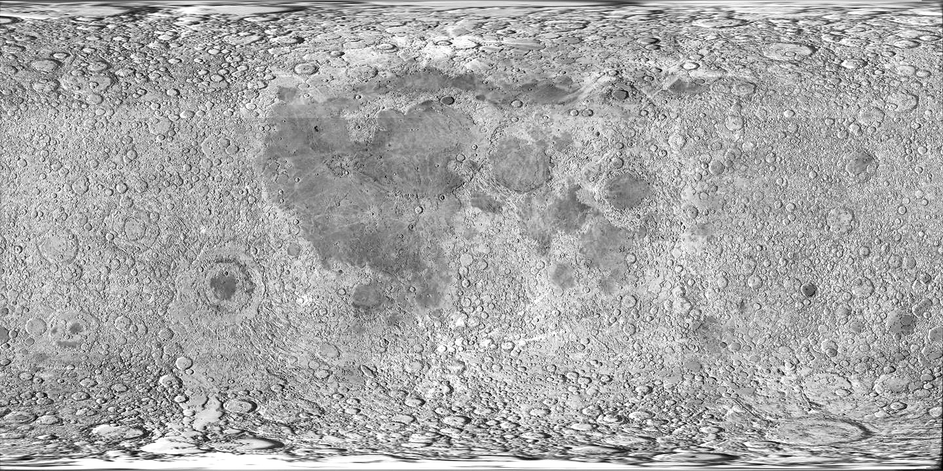
Example mapping, LRO/LEND
+90°
+70°
+50°
+30°
+10°
-10°
-30°
-50°
-70°
-90°
90°W
0°
90°E

Slide 5
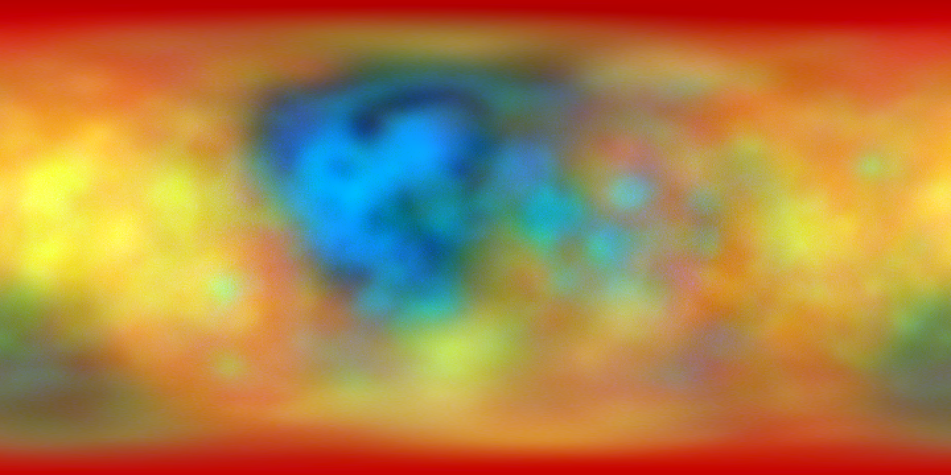
Example mapping, LRO/LEND
+90°
+70°
+50°
+30°
+10°
-10°
-30°
-50°
-70°
-90°
90°W
LCROSS
0°
LP
90°E

Slide 6
Science Background
1960’s: Water postulated in polar Permanently Shadowed Regions (PSR)
1998-1999: evidence for polar water deposits, Lunar Prospector
2009+: Lunar Reconnaissance Orbiter (LRO)
  Equipped to detect water in PSR (LEND, LAMP)
  Equipped to characterize PSR (Diviner, LOLA, Mini-RF)
  Accompanied by LCROSS active experiment
2009: Discovery of global distribution of water in mineral hydrates
  Chandrayaan-1 Moon Mineralogy Mapper (M³)
  Deep Impact EPOXI
  Cassini VIMS

Slide 7
Science Background
Global hydration signature – H₂O or OH?
Increase toward terminator
Diurnal variability

Slide 8
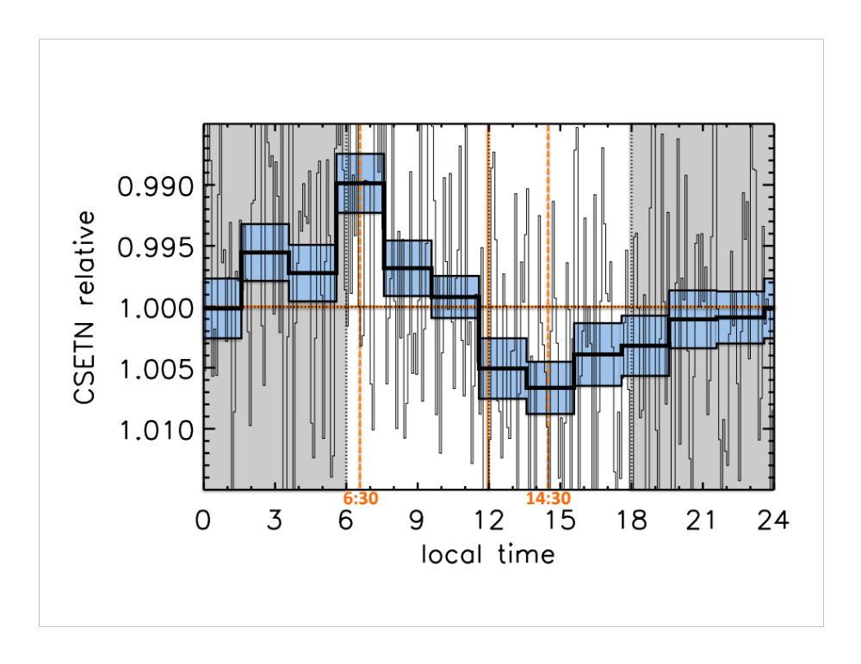
Science Background, LEND
Lunar Exploration Neutron Detector
Diurnal variability
  Measured near equator
  Pattern not identical with optical methods
Horizontal transport required to balance LEND variability,
~10¹⁸ mol/cm² as gas.
Much greater than surface-bounded exosphere.

Slide 9
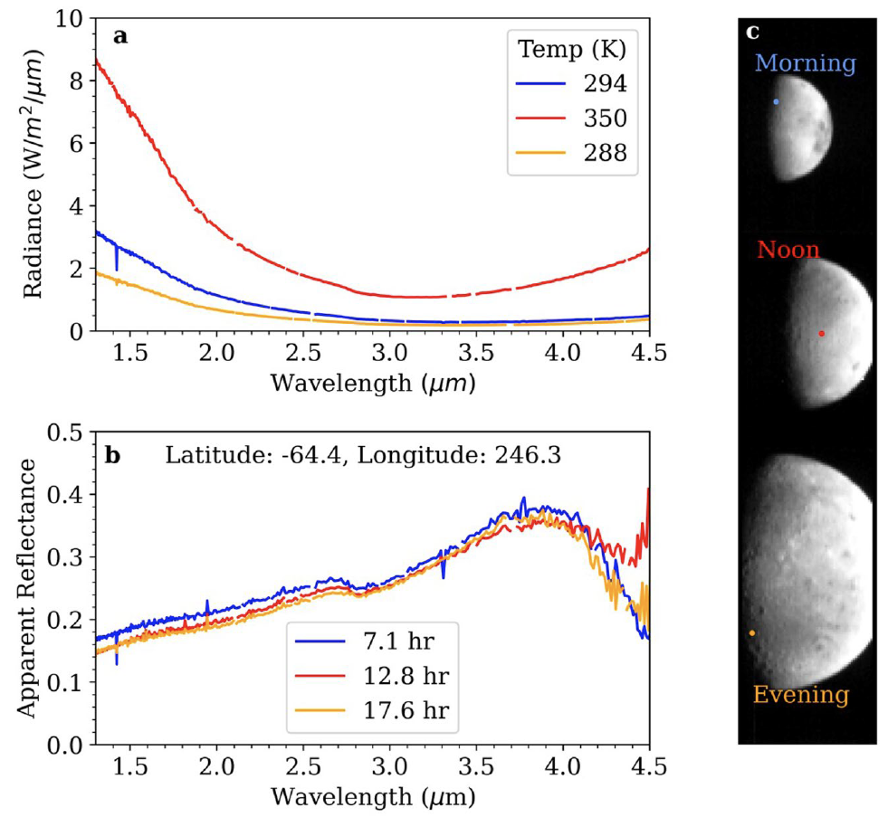
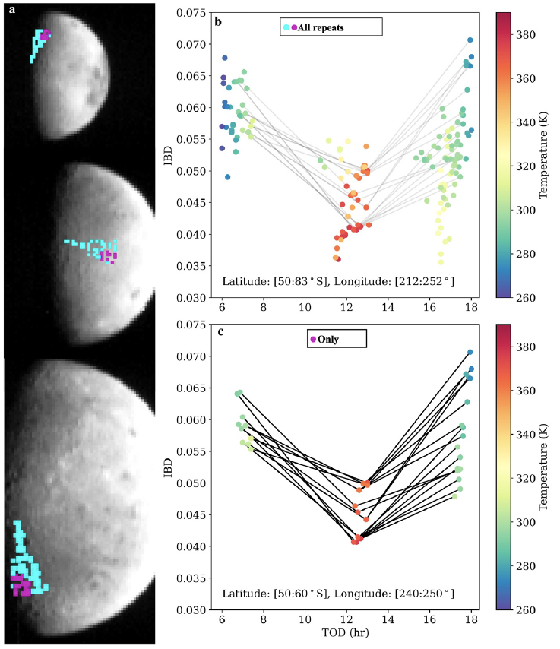
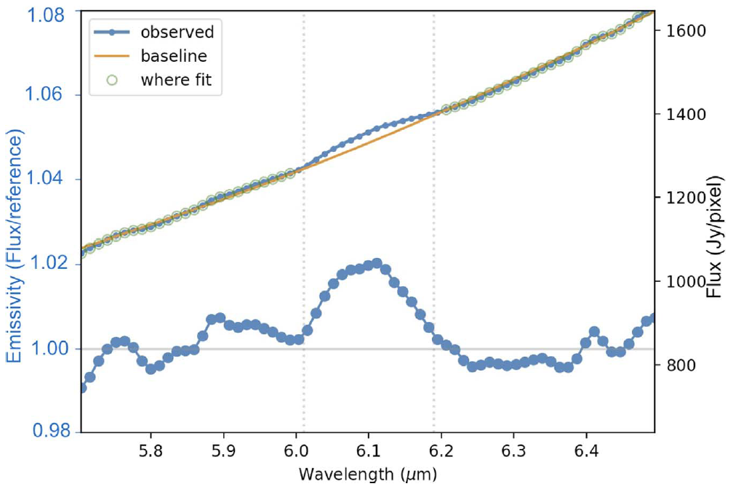
Science Background
Diurnal variability confirmed by Deep Impact – near South Pole
SOFIA test of 6 µm detection.

Slide 10
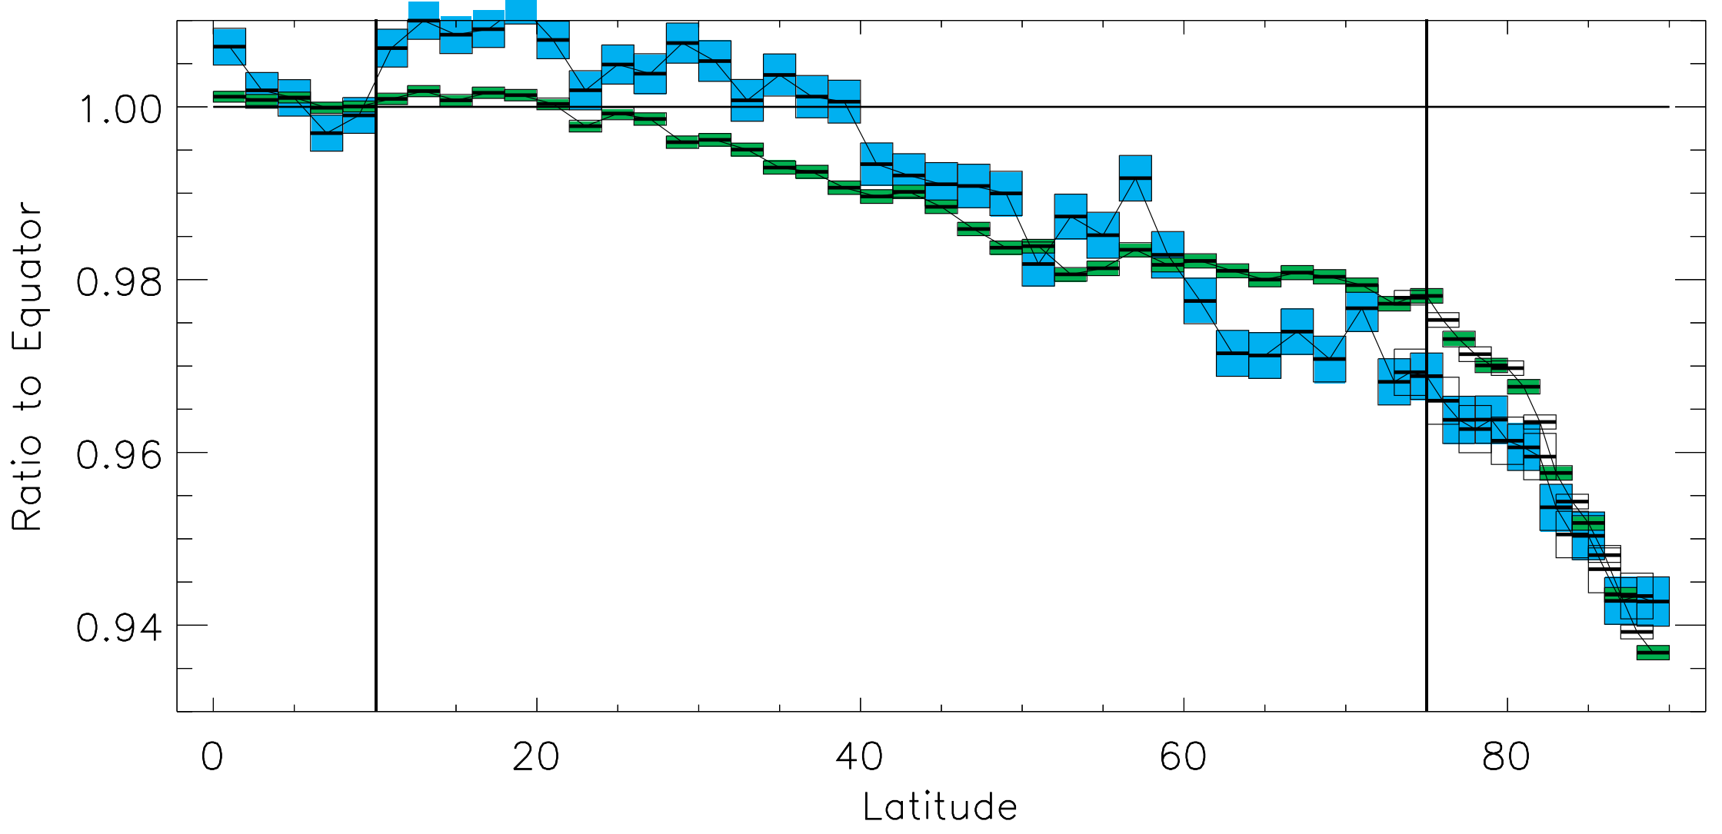
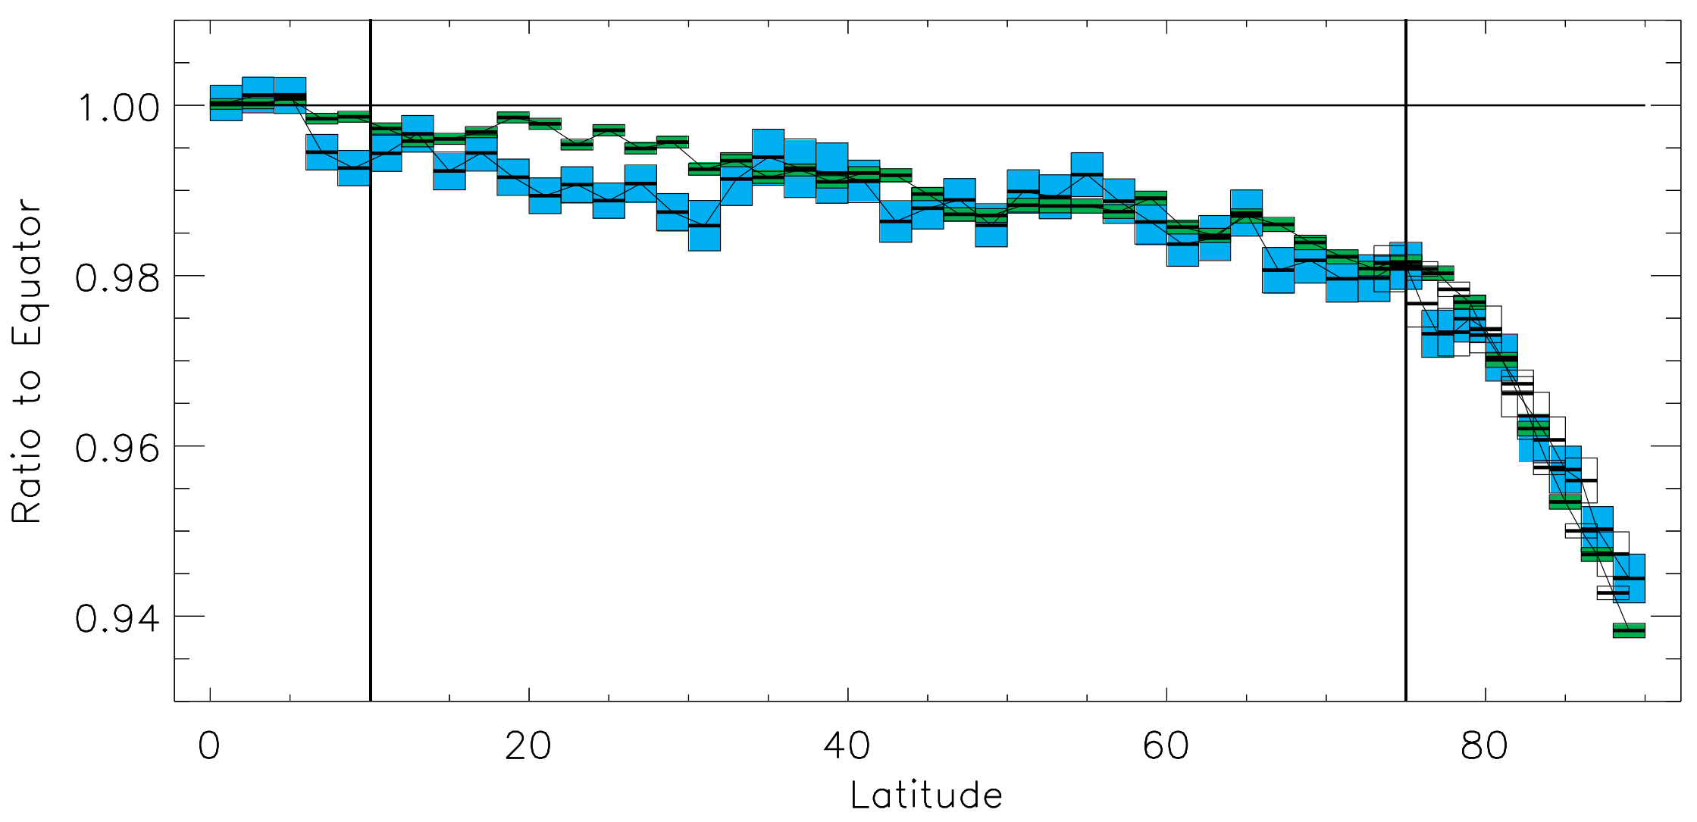
Science Background, LEND
North
Neutron signature of H increases toward poles
Significant signature outside polar regions.
Upper 1m of regolith.
  Supports NIR spectroscopy measures of upper few µm.
South

Slide 11
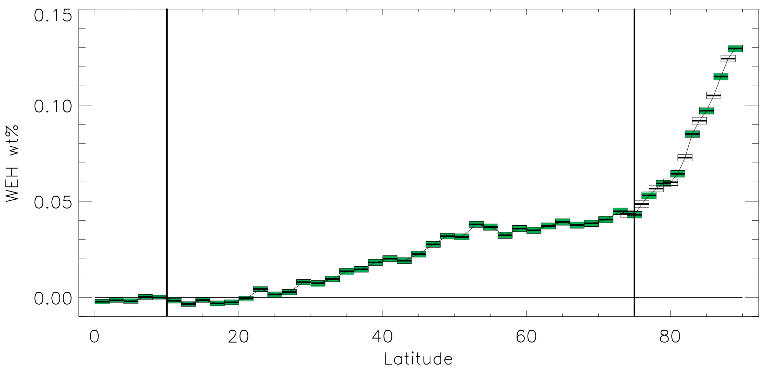
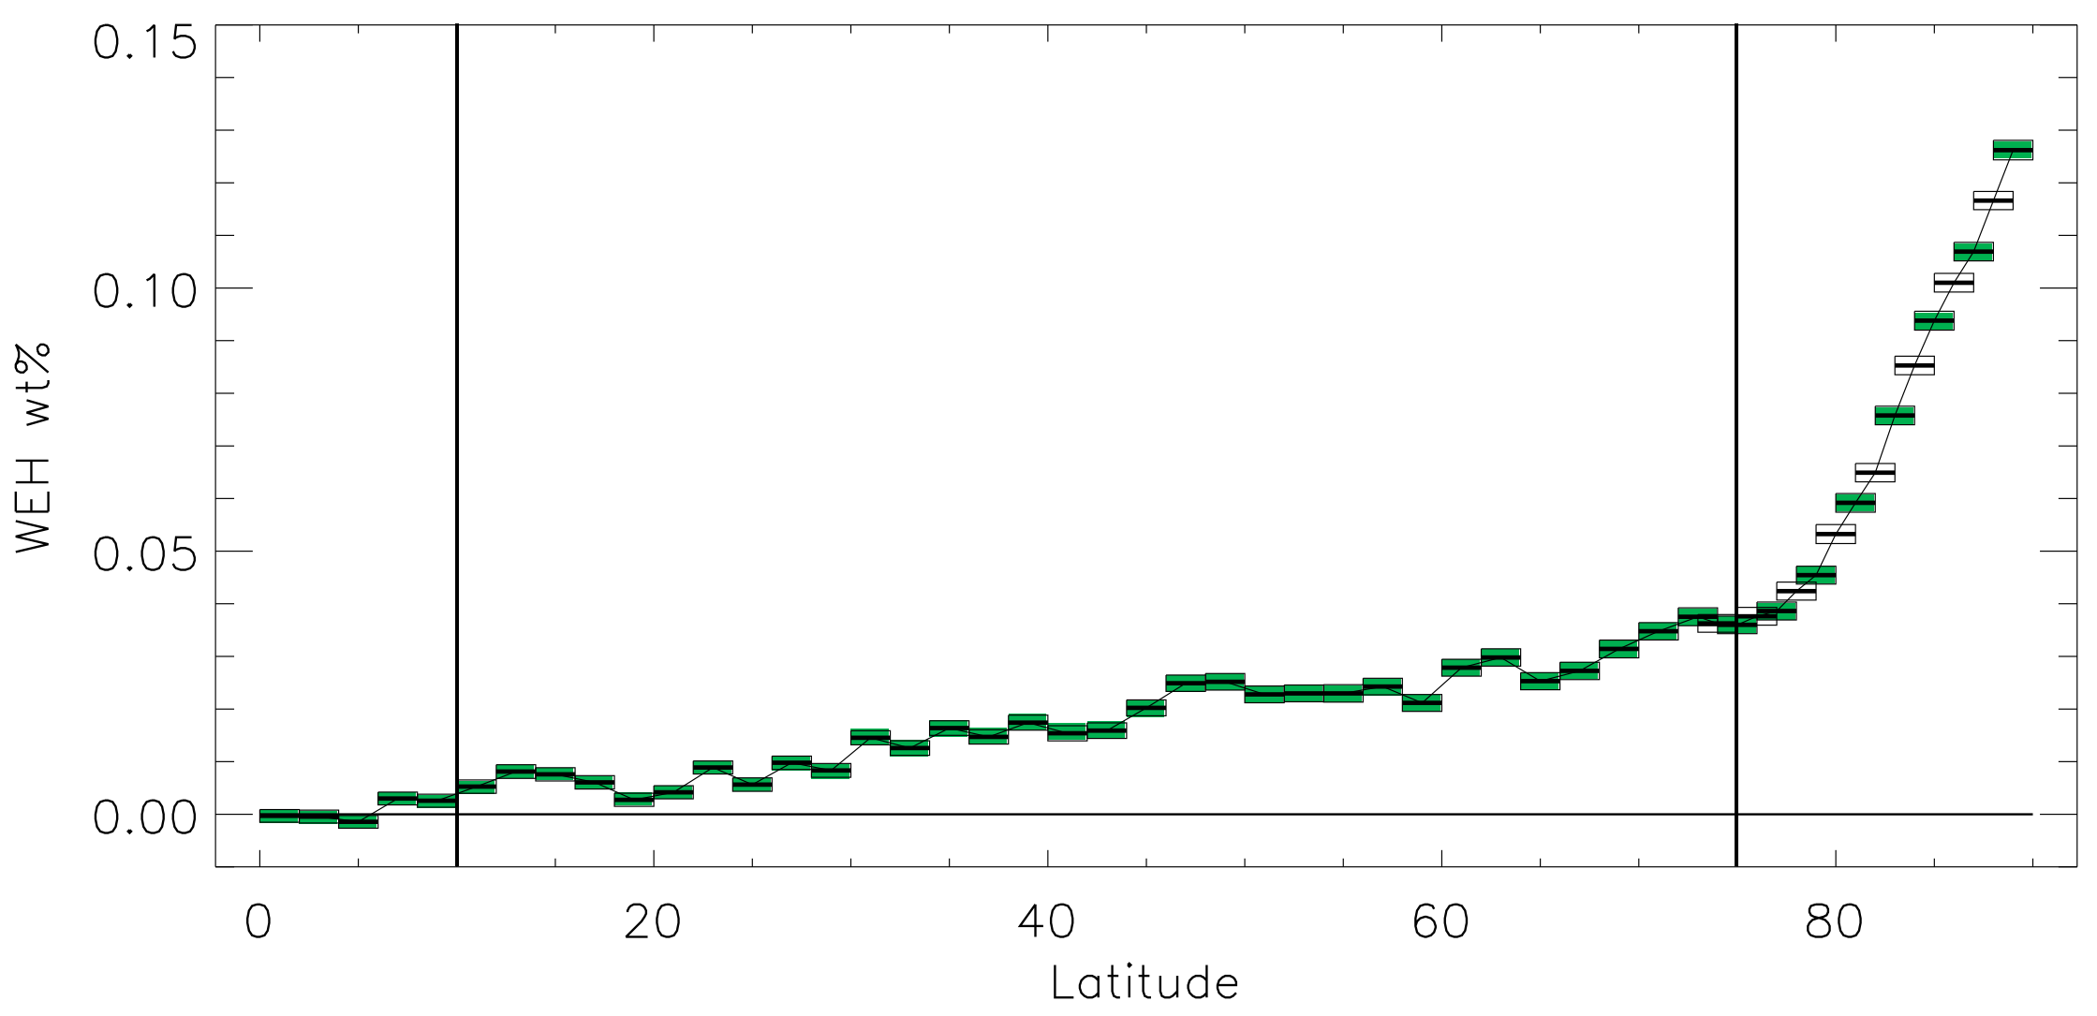
Science Background, LEND
H content of surface increases monotonically from equator to poles.
Significant quantity outside polar regions.
Need to determine chemistry.
  H, H₂? (highly unlikely)
  H₂O, OH?
  Other H-bearing species?

Slide 12
Science Goals
Mission | Global | Diurnal | Surficial water | OH | H2O | Ice | Mineralogy
Chandrayaan-1 M³ | partial | some | ✓ | ✓ |  | ✓ | ✓
Deep Impact EPOXI |  | some | ✓ | ✓ |  | — | ✓
Cassini VIMS |  | some | ✓ | ✓ |  | — | ✓
Chandrayaan-2 IIRS |  | ✓ | ✓ | ✓ |  | ✓ | ✓
Lunar Ice Cube |  |  | ✓ | ✓ |  | ✓ | ✓
Lunar Flashlight |  |  | ✓ |  |  | ✓
LRO LAMP |  | ✓ | ✓
LRO LEND | ✓ | ✓✓ | ✓ |  |  |  | —
SOFIA FORCAST |  |  | ✓ |  | ✓
Lunar Trailblazer |  |  | ✓ | ✓ |  | ✓ | ✓
CLEW | ✓ | ✓ | ✓ | ✓ | ✓ |  | ✓

Slide 13
Compact Lunar Explorer for Water
CLEW
Eccentric orbit to minimize propulsion requirements
Map surface during perihelion passage on day side
NIR-to-MidIR spectrometer
  2.5–12.5 µm, encompasses OH, H₂O, Christiansen feature, temperature
  See Clark et al. (this meeting) for instrument details.
Resolution and swath width adjusted to fit bandwidth constraint.
Global mapping
  6 month prime mission while perilune is on day side.
  6 local solar times at each point on surface, to probe diurnal variability.

Slide 15
Some References
Honniball, C. I., P. G. Lucey, A. Arredondo, W. T. Reach and E. R. Malaret (2022). "Regional Map of Molecular Water at High Southern Latitudes on the Moon Using 6 μm Data From the Stratospheric Observatory for Infrared Astronomy." Geophysical Research Letters 49: e2022GL097786, doi: 10.1029/2022GL097786.
Honniball, C. I., P. G. Lucey, C. M. Ferrari‐Wong, A. Flom, S. Li, H. M. Kaluna and D. Takir (2020). "Telescopic Observations of Lunar Hydration: Variations and Abundance." Journal of Geophysical Research – Planets 125: e2020JE006484 (006412 ppg), doi: 10.1029/2020JE006484.
Laferriere, K. L., J. M. Sunshine and L. M. Feaga (2022). "Variability of Hydration across the Southern Hemisphere of the Moon as observed by Deep Impact." Journal of Geophysical Research – Planets 127(8): e2022JE007361, DOI: 10.1029/2022JE007361.
Reach, W. T., P. G. Lucey, C. I. Honniball, A. Arredondo and E. R. Malaret (2023). "The Distribution of Molecular Water in the Lunar South Polar Region Based upon 6 μm Spectroscopic Imaging." Planetary Science Journal 04(3): 45 (48 pp), doi: 10.3847/PSJ/acbdf2.
Verma, P. A., M. Chauhan and P. Chauhan (2022). "Lunar surface temperature estimation and thermal emission correction using Chandrayaan-2 imaging infrared spectrometer data for H2O & OH detection using 3 μm hydration feature." Icarus 383: 115075, doi: 10.1016/j.icarus.2022.115075.
Wilk, K. A., J. F. Mustard, R. E. Milliken and C. M. Pieters (2024). "Variations in surface adsorbed H2O on lunar soils and relevant minerals." Icarus 411: 115945, doi: 10.1016/j.icarus.2024.115945.

