Slide 1
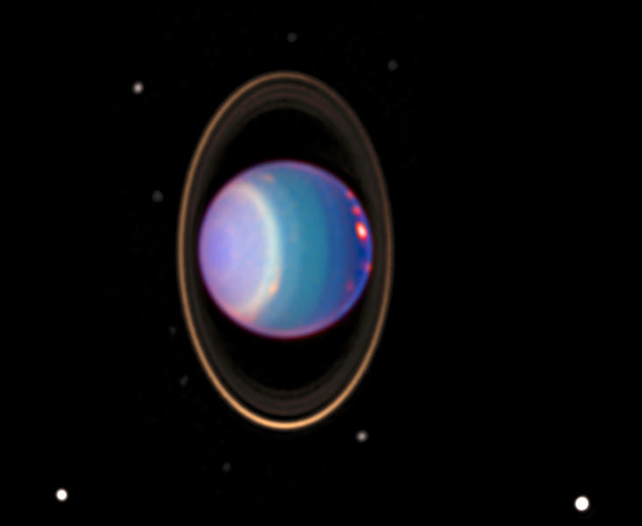


SUMS: Supporting a Uranus flagship Missions with SmallSats
Dylan Barnes¹, Paula do Vale Pereira²
¹M.Sc. Student, ²Assistant Professor
Aerospace Engineering, Florida Institute of Technology
dbarnes2018@my.fit.edu
pdovalepereira@fit.edu
Image by NASA
This Photo by Unknown Author is licensed under CC BY

Slide 2
Outline
Introduction
Mission Definition
Carrier Spacecraft Design
CubeSat Design
Conclusions

Slide 3
Outline
Introduction
Mission Definition
Carrier Spacecraft Design
CubeSat Design
Conclusions

Slide 4
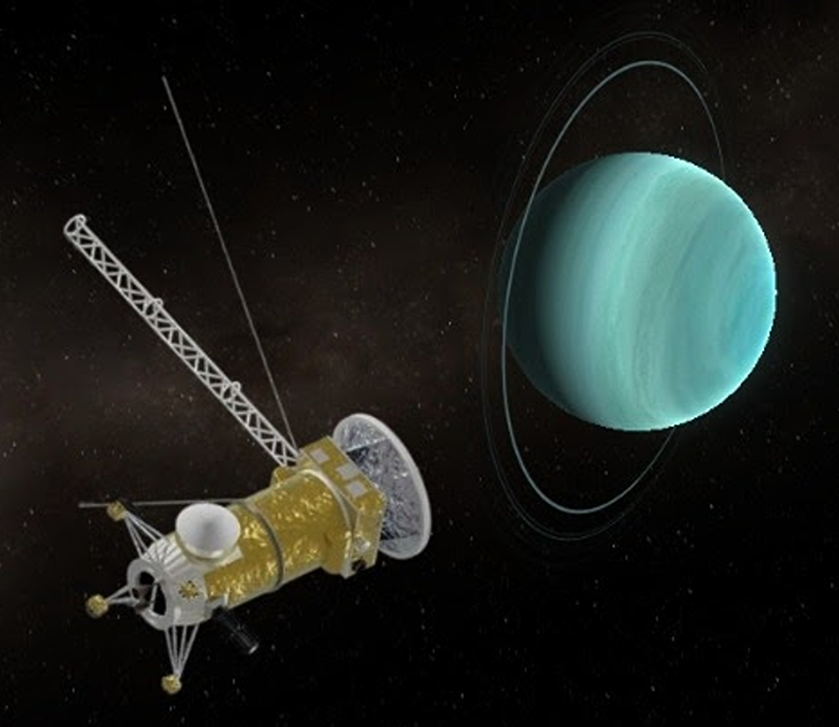
Motivation
2023-2032 Planetary Science and Astrobiology Decadal Survey:
Origins, Worlds, and Life (OWL)
Uranus is the highest-priority flagship mission
  Uranus’s origin, interior, atmosphere, magnetosphere, satellites, and rings
Uranus Orbiter and Probe (UOP)
  7,200 kg spacecraft comprised of orbiter and probe
  To be launched in the early 2030s
  13-year transfer on an Earth-Earth-Jupiter-Uranus trajectory (arrival around 2044)
  4.5-year mission (science through 2049)
Illustration by Gumiho-Fox-From-Mars

Slide 5
We propose a CubeSat mission to Uranus in support
of the Flagship Mission.
Built and launched in a shorter timeline
Potential 2033 launch
6-year transfer on an Earth-Jupiter-Uranus trajectory
Arrival by 2040 has unique scientific benefits
Swarm of CubeSats and a carrier spacecraft
Data collection method has unique scientific benefits

Slide 6
Historical Precedent
Planetary Observation Missions:
LEMUR
Can-X
QuakeSat-1
TROPICS
GRACE
DICE
MMS
CubeSats beyond Low Earth Orbit:
LICIACube
CAPSTONE
MarCO
Lunar Flashlight

Slide 7
Benefits and Challenges
Benefits of CubeSat Swarms
Challenges of CubeSat Swarms
Interoperability
Higher data capture
Bandwidth redundancy
Reduced mission failure rates
Ability to obtain global coverage and measurements
Reconstruct three-dimensional models of observed phenomena through observing it from multiple viewpoints
Reduced mission timeline
While reduced mass, volume, and power requirements typically mean a decrease in cost, they also constrain payloads
  Smaller and less power-intensive instruments
  Reduced instrument capacity, versatility, or both
Long-range communication restrictions

Slide 8
Outline
Introduction
Mission Definition
Carrier Spacecraft Design
CubeSat Design
Conclusions

Slide 9
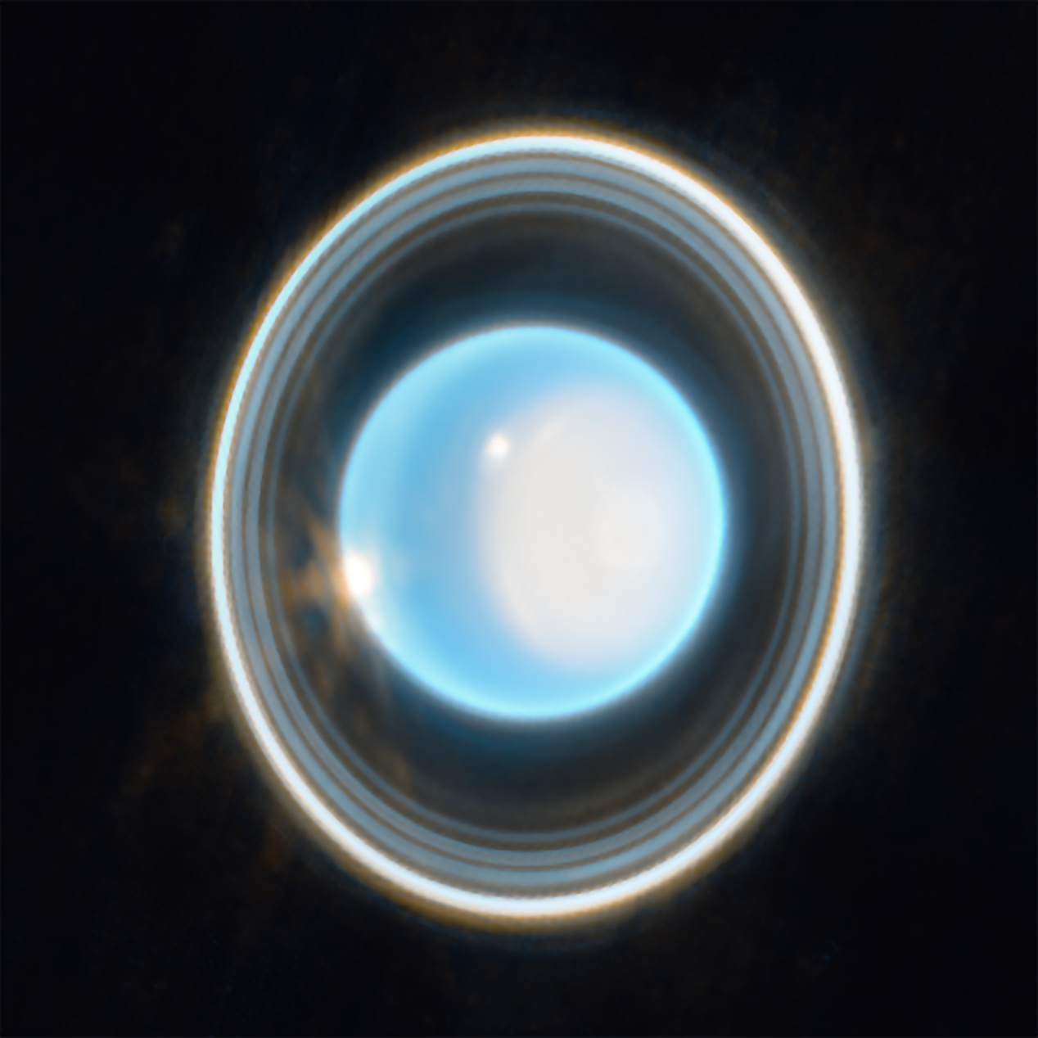
Mission Statement
The mission aims to gather data on the composition, interior, atmosphere, and magnetosphere of Uranus, investigate its rings, and study its moons and their evolution throughout time.
Image by NASA

Slide 10
Truncated Science Traceability Matrix
Science Objectives | Physical Parameter | Observables and Potential Instruments
Measure the internal composition of Uranus. | Chemical composition, thermal emissions, optical emissions, high-energy emissions, radio emissions, gravitational fields. | In Situ and Remote Sensing for Composition: Spectrometry (Optical & X-ray), Mass Spectrometry, Particle Detectors, Neutron Spectroscopy, Plasma Sensor Gravity Field Measurements: Superconduction Gravimeters, Accelerometers, Doppler Shift, Radiometric Tracking, Differential Spacecraft Acceleration
Measure the atmospheric structure and dynamics of Uranus. | Deep vortexes, storms, wave patterns, non-equilibrium species distribution, time-dependent mapping of gravity and magnetic fields, radio occultations, and seismology. | Vertical Mixing: Infrared Spectroscopy Internal Dynamics: Gravimeter, Magnetometers, Magnetic Resonance Spectrometers
Measure the climate, circulation, and meteorological patterns of Uranus. | Multiwavelength emission of cloud tops and lower atmospheric layers at local and global scales and at short and long time scales. | Multiwavelength Remote Sensing: Cameras, Spectrometers, Radiometers, and Photometer Meteorology: Spectrometer, Radiometers, Imagers, Mass Spectrometers, Infrared Spectrometer, Anemoeter, Radiosondes, Barometers
Determine what processes lead to the structure, content, and dynamics of Uranus's magnetosphere and ionosphere. | Plasma, particle, and magnetic field observations, ion/neutral composition measurements, thermal properties at various latitude and altitudes in Uranus across latitudes. | Ionospheric Measurements: Mass Spectrometer, Magnetometer, Radio Occultation, Spectral Scans, Particle Detectors (Solid-state, Scintillation, Gas), Caloriemeter, Electrostatic Analyzer Thermospheric Measurements: Spectrometers, Spectrophotometers, Radiometers, Infrared sensor, Plasma sensor, Langmuir probes, Ion drift meters
Determine how Uranus interacts with its environment, moons, and rings. | Tidal dissipation on Uranus's angular momentum, micrometeoroid and comet impacts, influence of seasonal solar insolation on Uranus's atmosphere. | Planetary Tidal Dissipation: Accelerometers, Gravimeters, Radio tracking, Time-series imaging and spectral data

Slide 11
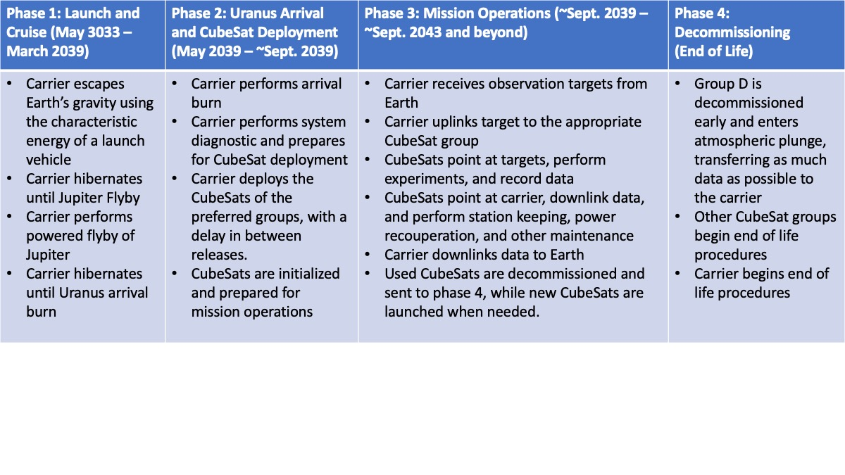
Concept of Operations

Slide 12
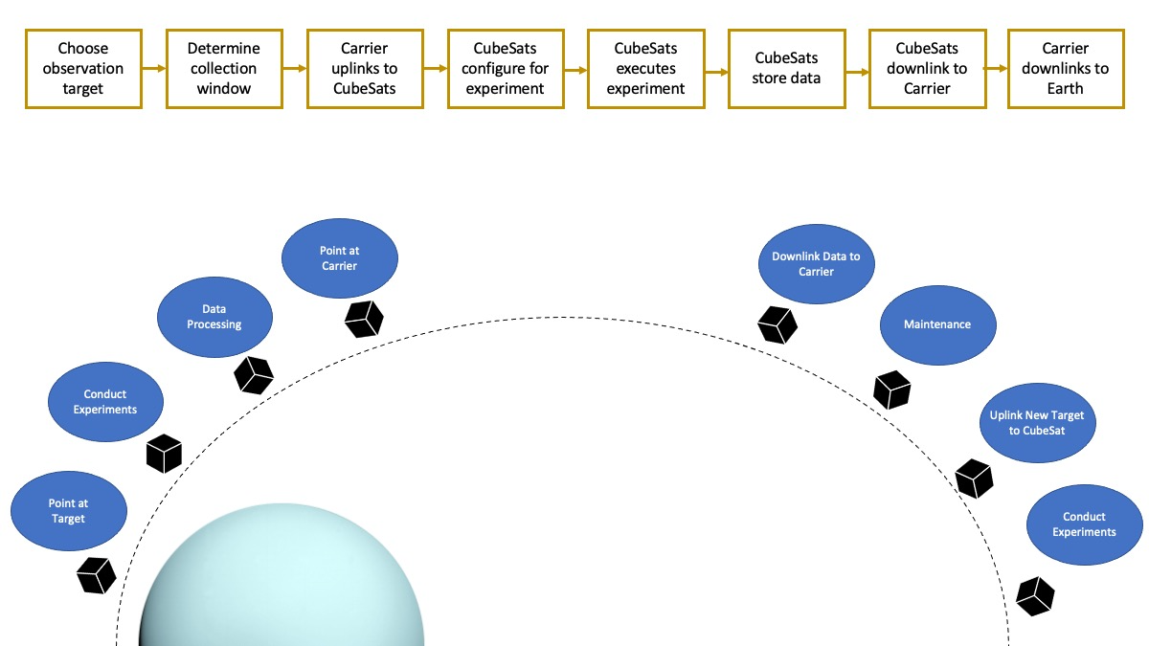
Concept of Operations

Slide 13
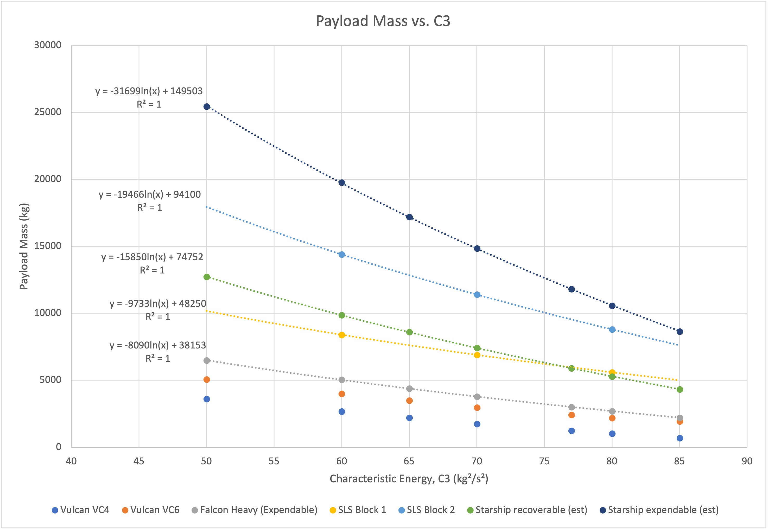
Interplanetary Trajectory
Proposed trajectory is a 6-year Earth-Jupiter-Uranus (EJU) interplanetary transfer
Calculated using numerical solutions to Lambert’s problem, the method of patched conics, and planetary ephemeris data from the NASA/Caltech Jet Propulsion Laboratory’s Horizons database
Spacecraft sized through launch vehicle characteristic energy (C3) and the rocket equation
Figures included are sized from the SLS Block 2 launch characteristics

Slide 14
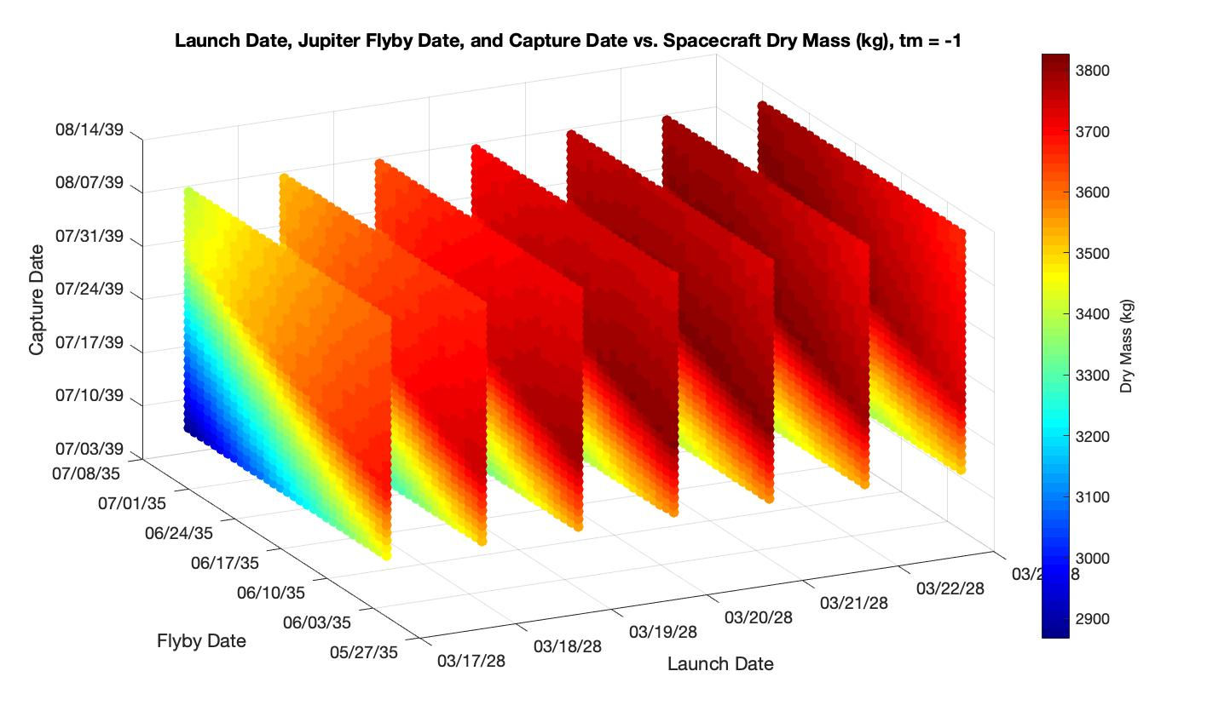
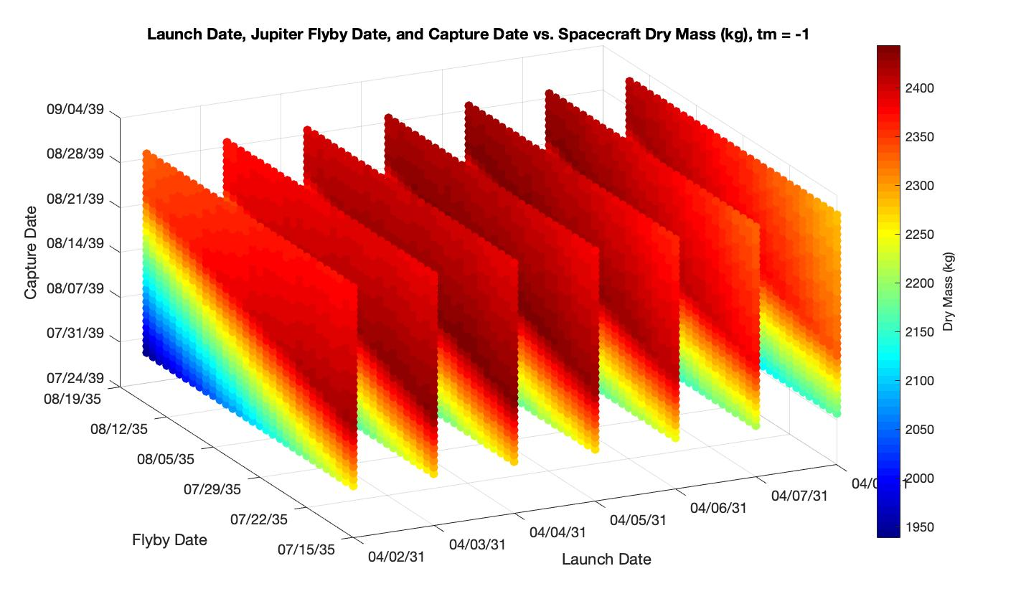
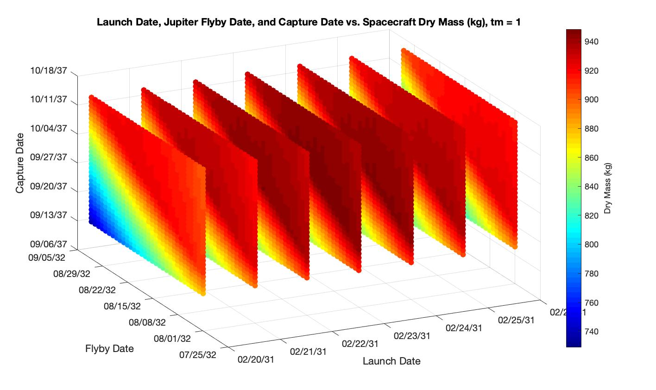
Interplanetary Trajectory

Slide 15
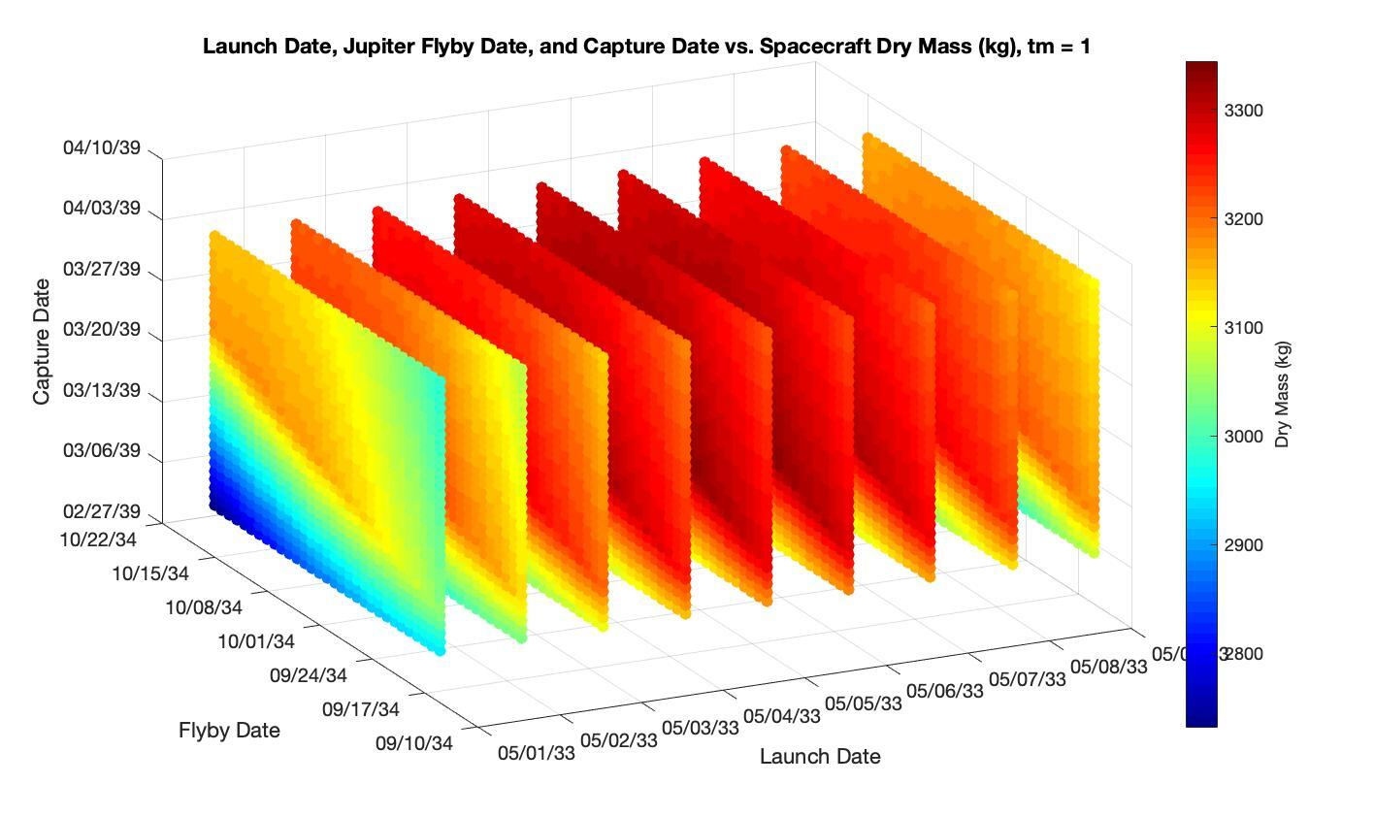
Interplanetary Trajectory
Best solution

Slide 16
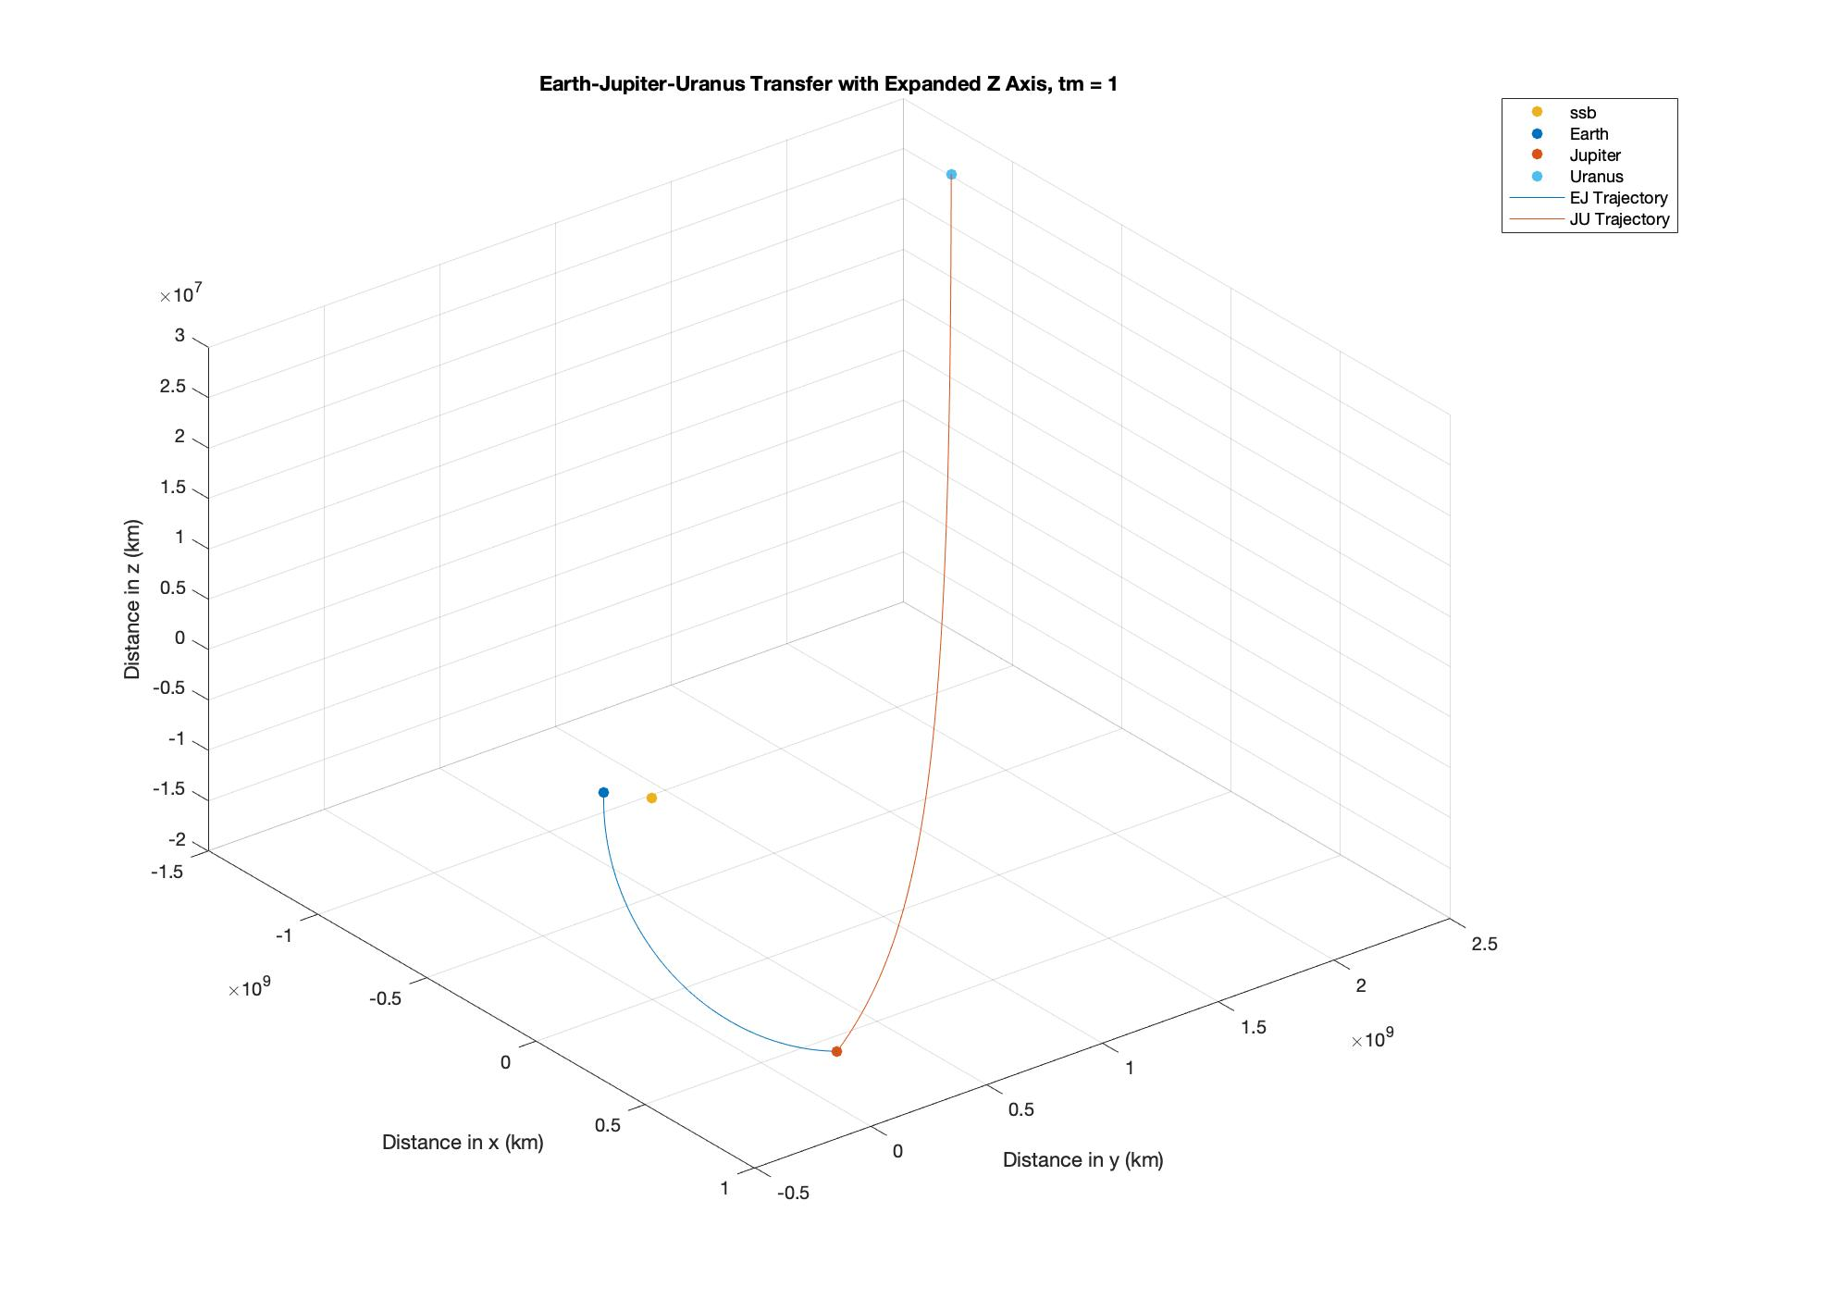
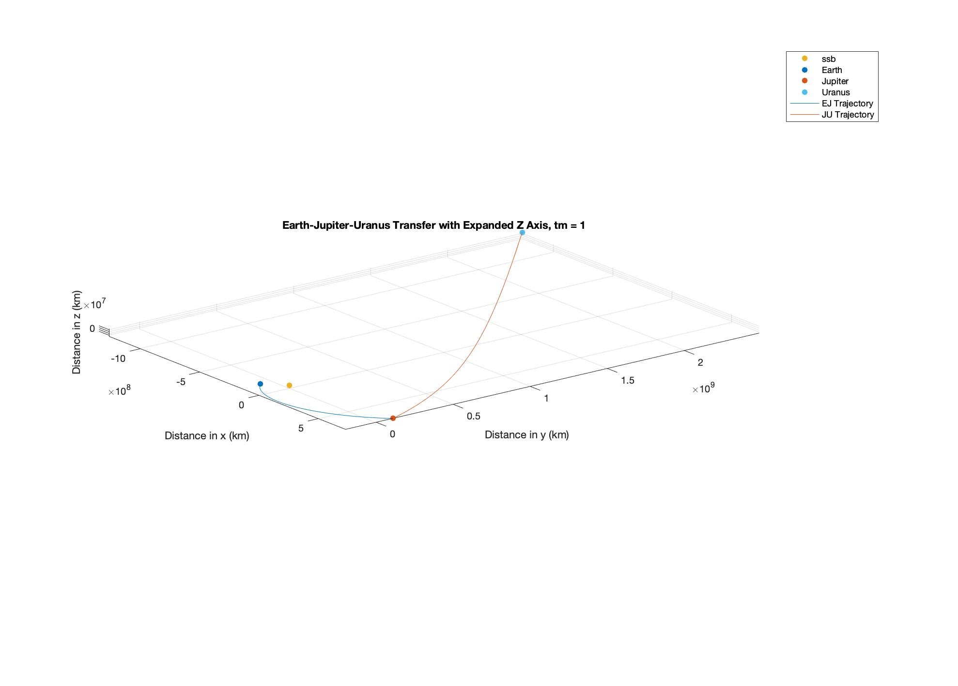
Interplanetary Trajectory
Best solution

Slide 17
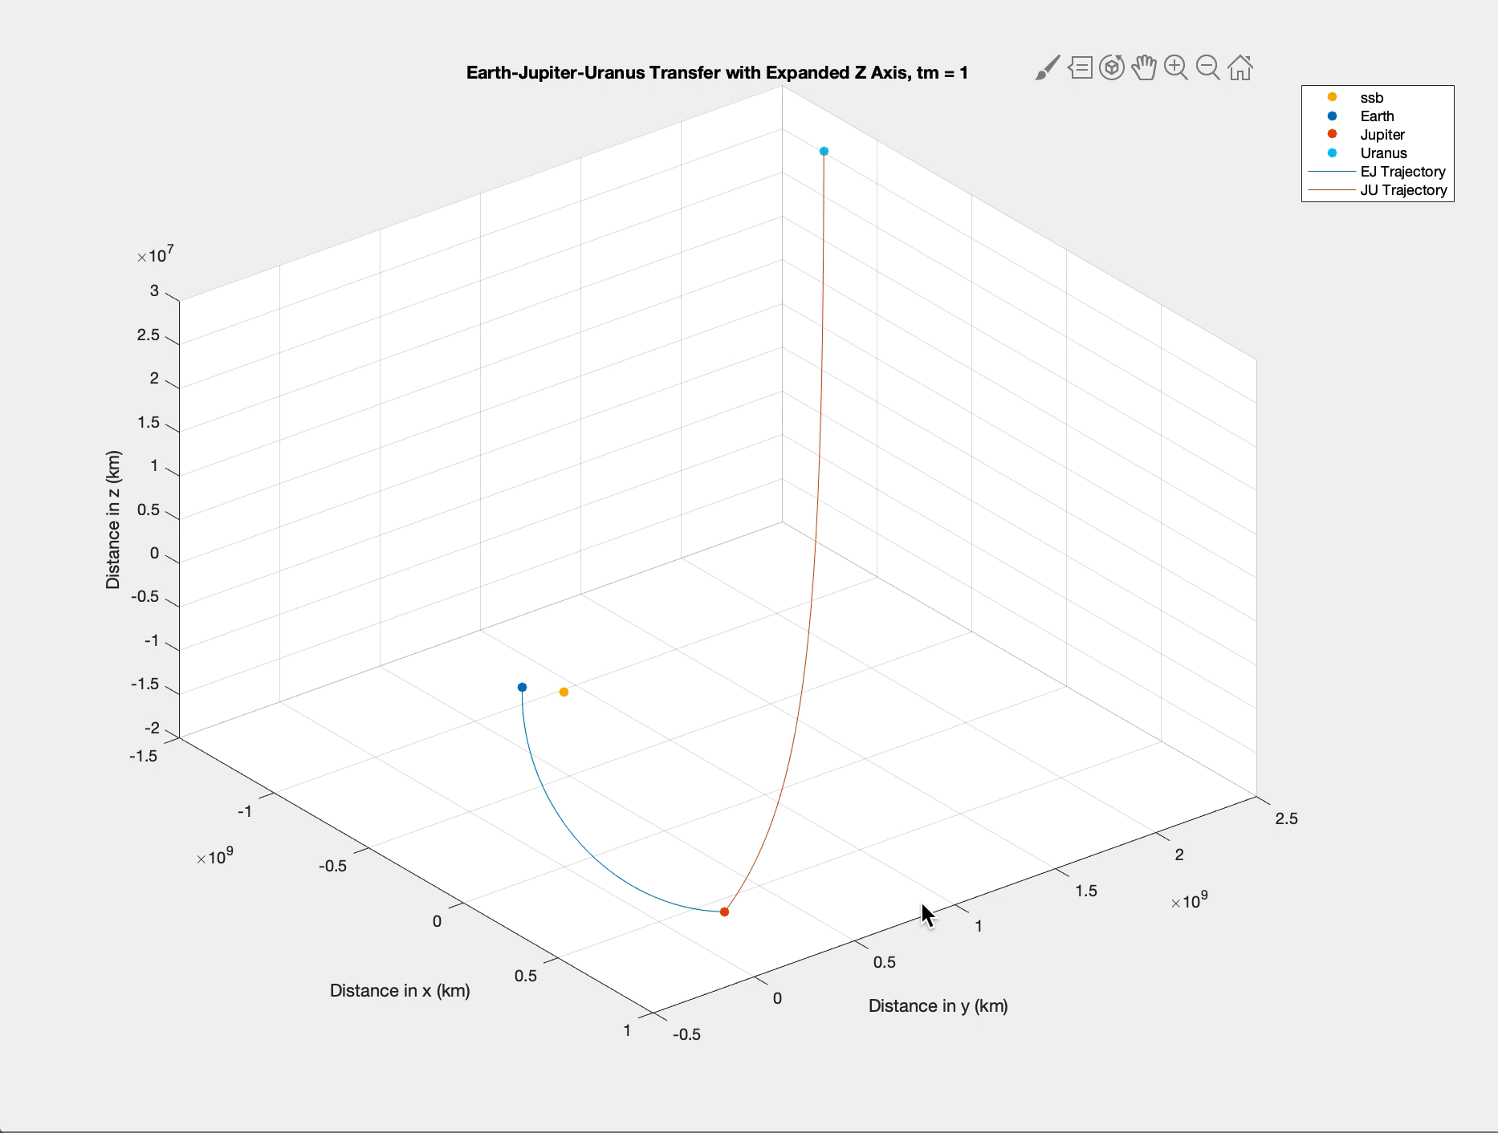
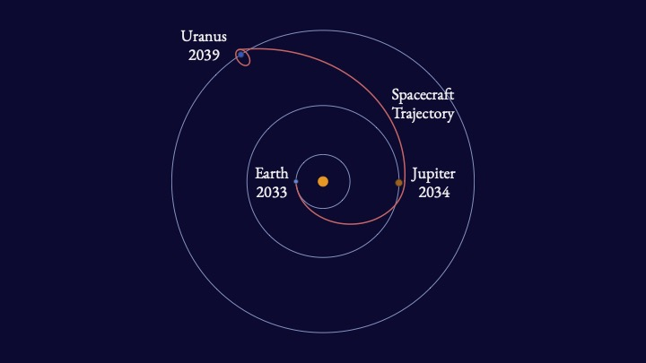
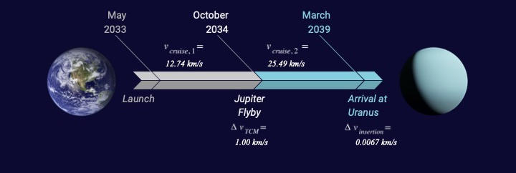
Interplanetary Trajectory
Best solution

Slide 18
Outline
Introduction
Mission Definition
Carrier Spacecraft Design
CubeSat Design
Conclusions

Slide 19
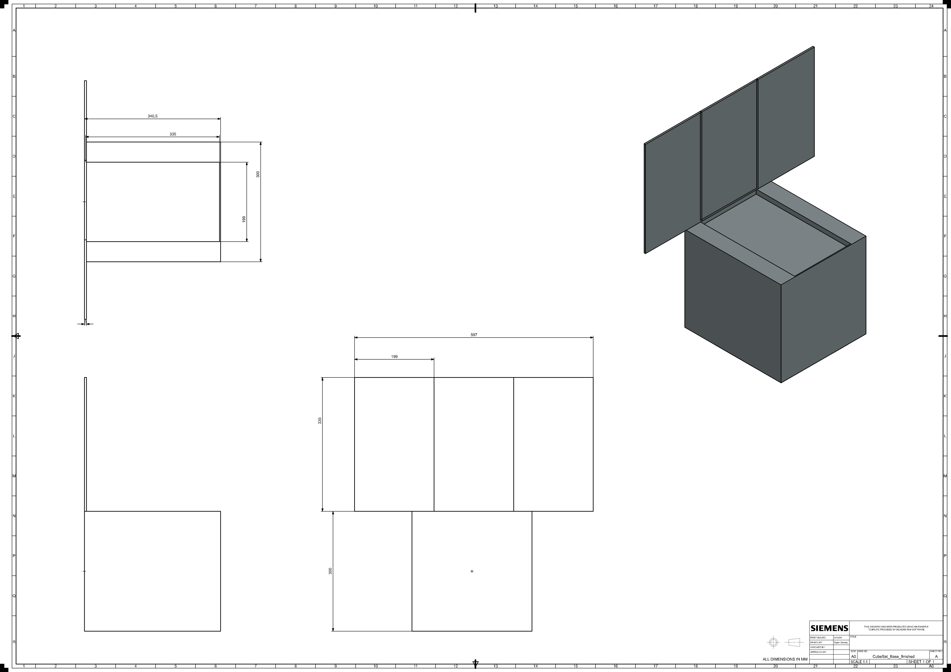
Overview
16 27U CubeSats
40 kg wet mass
Each fully functional and capable of independent operation
  Except the ability to communicate with Earth independently

Slide 20
Payload
Acronym | Name | Mission
INMS | Ion and Neutral Mass Spectrometer | Cassini
UVIS | Ultraviolet Imaging Spectrograph | Cassini
GRS | Gamma Ray Spectrometer | Odyssey
CIRS | Composite Infrared Spectrometer | Cassini
MAG | Magnetometer | Cassini
OTD | Optical Transient Detector | MicroLab-1
RPWS | Radio and Plasma Wave Science | Cassini
CAPS | Cassini Plasma Spectrometer | Cassini
VIMS | Visible and Infrared Mapping Spectrometer | Cassini
MKI | Microwave K-band Instrument | GRACE
MIMI | Magnetospheric Imaging Instrument | Cassini
ISS | Imaging Science Subsystem | Cassini/Huygens
While we are concerned about spacecraft design rather than instrument selection, it is helpful to use some likely instruments as stand-ins
Most commercial off-the-shelf (COTS) components are not rated for deep space, and most deep space instruments are not sized for CubeSats.
  True characteristics are somewhere in the middle

Slide 21
Payload
While we are concerned about spacecraft design rather than instrument selection, it is helpful to use some likely instruments as stand-ins
Most commercial off-the-shelf (COTS) components are not rated for deep space, and most deep space instruments are not sized for CubeSats.
  True characteristics are somewhere in the middle
Instrument | Power Requirements (W) | Mass (kg) | COTS or Historical
MAG | 3.1 | 3.0 | Historical
Magnetometer (3) | 1.3 - 3.0 | 0.3 | COTS
CAPS | 14.5 | 12.5 | Historical
Plasma Sensor | 5 | 0.1 | COTS
Huygens SSP | 10 | 4.2 | Historical
Anemometer | 0.5 | <1* | COTS
CIRS | 26.4 | 39.2 | Historical
Multispectral Imager | 2.6-4.6 | 0.5 | COTS
MKI | >3* | 3.0 | Historical

Slide 22
Payload
Group A: Magnetosphere and charged particles
Group B: Composition through multispectral imagery
Group C: Gravity
Group D: In-situ atmospheric measurements
Image for illustrative purposes only.

Slide 23
Attitude Determination and Control
Potentially feasible
Two necessary metrics:
  CubeSats need to be able to point at the carrier spacecraft
  CubeSats need to be able to track a feature on an observation target
Pointing budget results in a maximum slew rate of 1.03 °/s and a maximum angular acceleration rate of 0.10 °/s², with a position error of 0.01°
  Position error 0.01° is within the antenna beam profile of ± 10°.
  The necessary slew rate to track a point on Uranus at periapsis is less than 0.3°/s, which is under the maximum slew rate of 1.03 °/s (0.005 radians/s).

Slide 24
Communications
Potentially feasible
General Information
Characteristic | Value | Unit
Distance | 244000 | km
Transmitter Information
Frequency | 8.425 | GHz
Bit rate | 0.100 | Mbps
Transmit Power | 5.0 | W
Transmit antenna gain | 29.2 | dBi
Receiver Information
Characteristic | Value | Unit
Receive antenna diameter | 0.5 | m
Link Margin Computation
Link margin | 7.2 | dB
Required link margin | 6 | dB
MarCO-like antennas
Carrier spacecraft with a 0.5 m diameter dish
Only a single pass is needed to transmit all data from a CubeSat to the carrier
Characteristic | Value | Unit
Number of images for experiment | 25 | images
Number of passes to downlink all data | 1 | passes
Number of days to downlink all data | 1 | passes
Total Bytes Generated (1 Day) | 45,041,349 | Bytes
Total Bytes with Margin | 59,904,994 | Bytes
Total (kB) | 58,501 | kB

Slide 25
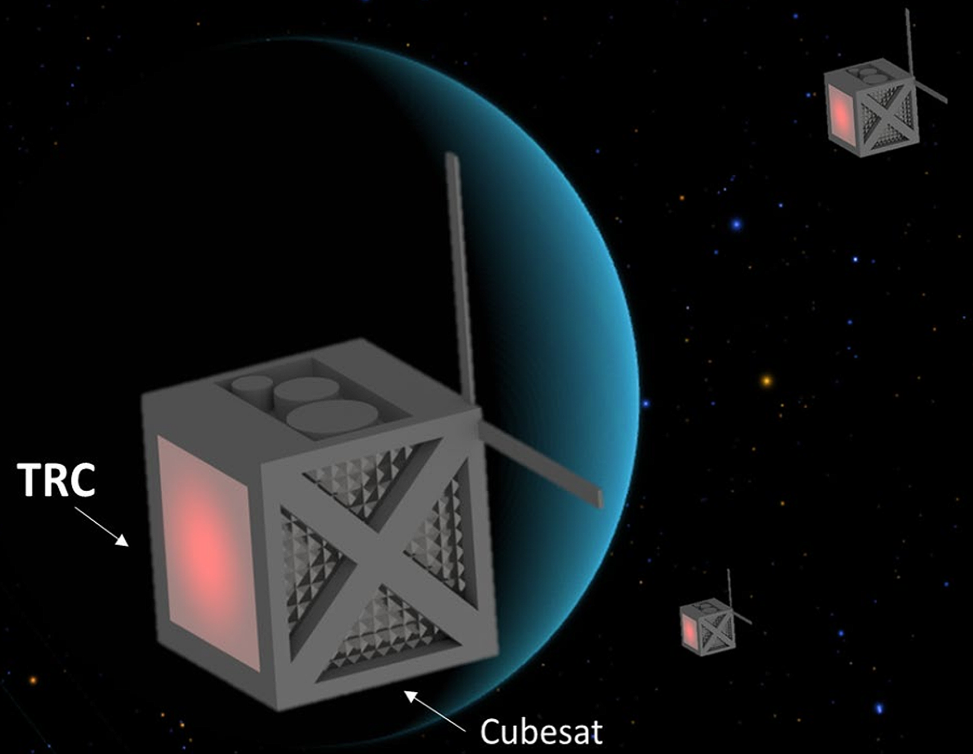
Power
Potentially feasible
CubeSats are too far away from the Sun to use solar panels
Instead, we use thermoradiative cells (TRC)
  Act similarly to a sterling engine, generate electrical power from a heat differential
  Very efficient, generate ∼30 W/kg vs the ∼3 W/kg typically produced by RTGs
The heat source is two general-purpose heat sources (GPHSs)
  The same heat sources as for RTGs
We find that we generate ∼33.86 W
  Standard operations have an excess of ~7.3 W
This is a lot of radioactive material, but an inescapable cost
Image by NASA

Slide 26
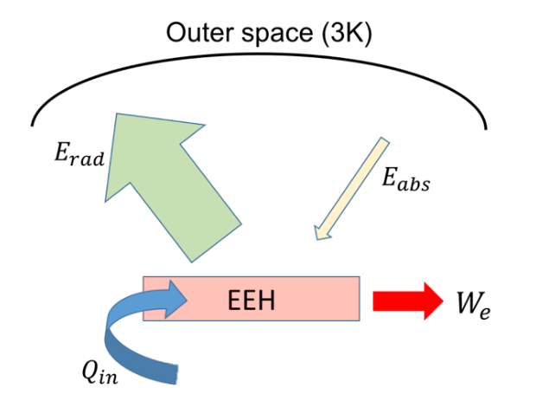
Thermal
Potentially feasible
We model each CubeSat as a black body.
We find that we retain ~140 W of waste heat, while we lose a maximum of 197 W with a uniform external temperature of 10 °C
  Thus, we require additional heaters, passive thermal control, and careful placement of components to maintain the temperature around the battery and fuel lines
Heat (~500K)

Slide 27
Structures
Potentially feasible
The CubeSat mass and volume were not limiting factors in this design, given that CubeSat-sized parts are being used
  The mass margin is 18.1%, and the volume margin is 34.9%
Both budgets close, however it would be better if we had a higher mass margin at this point of the design
  Due to the launch vehicle chosen, the CubeSat mass limit can be increased if necessary
Environmental radiation mitigated through external shielding
  100 mils
Internal radiation mitigated through internal shielding
  We can reduce the lifetime radiation dose to 1 krad with an aluminum shield 0.445 cm thick.
  This is very low for spacecraft, but the vulnerability of CubeSats and the risk of using them in deep space leads to a conservative design.

Slide 28
Outline
Introduction
Mission Definition
Carrier Spacecraft Design
CubeSat Design
Conclusions

Slide 29
Carrier Spacecraft Design
The carrier transports the CubeSats to Uranus and serves as a communication relay to Earth.
Larger spacecraft, with one RTG, two antennas, and 16 CubeSat deployers
Contains thrusters for orbital transfer maneuvers
Communications (worst case):
  CubeSat link: 0.5 m diameter dish antenna, X band, 0.1 Mbps, 6.4 dB margin
  Earth link: 2.1 m diameter dish antenna, X band, Deep Space Network, 8.9 dB margin
Attitude Determination and Control:
  Maximum slew rate of 0.20 °/s, position error of 0.01° is within antenna beam profile of ± 1°
Structures:
  Total wet mass of 2,360 kg (plus the 640 kg of the CubeSats, for a launch mass of 3,000 kg)
  The current trajectory and rocket selections allow for a launch mass of 4,488 kg (3,344 kg of dry mass, 1,144 kg of fuel), resulting nearly 50% of mass margin

Slide 30
Outline
Introduction
Mission Definition
Carrier Spacecraft Design
CubeSat Design
Conclusions

Slide 31
Conclusions
This work demonstrates that a CubeSat swarm mission to Uranus is likely a viable solution for answering many aspects of the 2023-2032 Planetary Science and Astrobiology Decadal Survey’s thematic questions and can support the UOP by collecting data that the UOP cannot.
Launching a lighter spacecraft on a lower fuel and cruise time trajectory has a unique scientific benefit, and a swarm of CubeSats can return valuable data.
We would love to deepen this study with a concurrent engineering team!
There is a lot of work to be done, so let us know if you’d like to collaborate!
Thank you for your attention! We look forward to the Q&A session.

Slide 32
References
SpaceX falcon heavy. https://www.spacex.com/vehicles/falcon-heavy/. [Ac- cessed 13-04-2024].
Spacex starship. https://www.spacex.com/vehicles/starship/. [Accessed 13- 04-2024].
Spire - Earth Online — earth.esa.int. https://earth.esa.int/eogateway/ missions/spire. [Accessed 11-04-2024].
AAC Clyde Space. Three axis satellite magnetometer.
R. Abelson, Tibor Balint, H. Noravian, J. Randolph, Satter CM, G. Schmidt, and James Shirley. Enabling solar system exploration with small radioisotope power systems. AGU Fall Meeting Abstracts, 12 2005.
R. Abelson, T.S. BALINT, K. Coste, J.O. Elliott, J.E. Randolph, G.R. Schmidt, T. Schriener, J.H. Shirley, and T.R. Spilker. Expanding frontiers with standard radioisotope power systems. Technical report, National Aeronautical and Space Administration, 2004.
Caleb Adams. High Performance Computation with Small Satellites and Small Satellite Swarms for 3D Reconstruction. PhD thesis, 05 2020.
APL. New horizons: The path to pluto and beyond.
Australian Space Academy. Space communication calculations, 2023.
Manlio Bacco, Pietro Cassara`, Marco Colucci, Alberto Gotta, Mario Marchese, and Fabio Patrone. A survey on network architectures and applications for nanosat and uav swarms. In Prashant Pillai, Kandeepan Sithamparanathan, Giovanni Gi- ambene, Miguel A ́ngel V ́azquez, and Paul Daniel Mitchell, editors, Wireless and Satellite Systems, pages 75–85, Cham, 2018. Springer International Publishing.
Dylan Barnes, Andrew Cummings, and Paula do Vale Pereira. COMMUTE: Cube- sat swarm orbital maneuvers for a mission to study uranus’ atmospheric environ- ment. In Proceedings of the Small Satellite Conference, Weekend Poster Session 2, SSC23-WP2-38, 2023.
Linda Billings. 50 years of solar system exploration: Historical perspectives. Na- tional Aeronautics and Space Administration, Office of Communications, NASA History Division, 2021.
Robert E. Bitten, Stephen A. Shinn, and Debra L. Emmons. Challenges and po- tential solutions to develop and fund nasa flagship missions. 2019 IEEE Aerospace Conference, Mar 2019.
William J. Blackwell, Laura J. Bickmeier, R. Vincent Leslie, Michael L. Pieper, Jenna E. Samra, Chinnawat Surussavadee, and Carolyn A. Upham. Hyperspectral microwave atmospheric sounding. IEEE Transactions on Geoscience and Remote Sensing, 49(1):128–142, 2011.
Scott J. Bolton, Richard M. Thorne, Sebastien Bourdarie, Imke de Pater, and Barry Mauk. Jupiter’s inner radiation belts. In Fran Bagenal, Timothy E. Dowling, and William B. McKinnon, editors, Jupiter. The Planet, Satellites and Magneto- sphere, volume 1, pages 671–688. 2004.
Bilal MM Bomani. Cubesat technology past and present: Current state-of-the-art survey. Technical report, 2021.
Scott Braun, Christopher Velden, Tom Greenwald, Derrick Herndon, Ralf Ben- nartz, Mark Demaria, Galina Chirokova, Robert Atlas, Jason Dunion, Frank Marks, Robert Rogers, Hui Christophersen, Bachir Annane, Bradley Zavodsky, and William Blackwell. Overview of the nasa tropics cubesat constellation mission. page 7, 09 2018.
J. L. Burch, T. E. Moore, R. B. Torbert, and B. L. Giles. Magnetospheric Multi- scale Overview and Science Objectives. , 199(1-4):5–21, March 2016.
Craig Burkhard and Sasha Weston. The evolution of cubesat spacecraft platforms. In AVT-336 Specialist’Meeting, 2021.
Stephen B. Cenko, Eric Christopher Bellm, Avishay Gal-Yam, Suvi Gezari, Varoujan Gorjian, April Jewell, Jeffrey W. Kruk, Shrinivas R. Kulkarni, Richard Mushotzky, Shouleh Nikzad, Anthony Piro, Eli Waxman, and Eran Oded Ofek. CUTIE: Cubesat Ultraviolet Transient Imaging Experiment. In American Astro- nomical Society Meeting Abstracts #229, volume 229 of American Astronomical Society Meeting Abstracts, page 328.04, January 2017.
Soon-Jo Chung, Saptarshi Bandyopadhyay, Rebecca Foust, Giri P. Subramanian, and Fred Y. Hadaegh. Review of formation flying and constellation missions using nanosatellites. Journal of Spacecraft and Rockets, 53, 2016.
CubeSpace Satellite Systems. Cubewheel gen 1.
Howard D. Curtis. Orbital Mechanics for Engineering Students. Butterworth- Heinemann, 2020.
E. Dotto, V. Della Corte, M. Amoroso, I. Bertini, J.R. Brucato, A. Capan- nolo, B. Cotugno, G. Cremonese, V. Di Tana, I. Gai, S. Ieva, G. Impresario, S.L. Ivanovski, M. Lavagna, A. Lucchetti, E. Mazzotta Epifani, A. Meneghin, F. Miglioretti, D. Modenini, M. Pajola, P. Palumbo, D. Perna, S. Pirrotta, G. Pog- giali, A. Rossi, E. Simioni, S. Simonetti, P. Tortora, M. Zannoni, G. Zanotti, A. Zinzi, A.F. Cheng, A.S. Rivkin, E.Y. Adams, E.L. Reynolds, and K. Fretz. Liciacube - the light italian cubesat for imaging of asteroids in support of the nasa dart mission towards asteroid (65803) didymos. Planetary and Space Science, 199:105185, 2021.
Dragonfly Aerospace. Mantis imager.
C. P. Escoubet, A. Masson, H. Laakso, M. L. Goldstein, T. Dimbylow, Y. V. Bogdanova, M. Hapgood, B. Sousa, D. Sieg, and M. G. G. T. Taylor. Cluster after 20 years of operations: Science highlights and technical challenges. Journal of Geophysical Research: Space Physics, 126(8):e2021JA029474, 2021. e2021JA029474 2021JA029474.
Chad Fish, Charles Swenson, Tim Neilsen, Bryan Bingham, Jake Gunther, Erik Stromberg, Steven Burr, Robert Burt, Mitch Whitely, Geoff Crowley, Irfan Azeem, Marcin Pilinski, Aroh Barjatya, and Justin Petersen. DICE mission design, develop- ment, and implementation: Success and challenges. 26th Small Satellite Conference Proceedings, 2012.
Joseph W. Gangestad, Brian S. Hardy, and David A. Hinkley. Operations, orbit determination, and formation control of the AeroCube-4 CubeSats. 27th Small Satellite Conference Proceedings, 2013.
Thomas Gardner, Brad Cheetham, Alec Forsman, Cameron Meek, Ethan Kayser, Jeff Parker, Michael Thompson, Tristan Latche, Rebecca Rogers, Brennan Bryant, and Tomas Svitek. CAPSTONE: A CubeSat pathfinder for the lunar gateway ecosystem. 35th Small Satellite Conference Proceedings, 2021.
James L. Green, Doug Cooke, Arthur W. Beckman, and Kristine M. Ramos. Scientific Discovery and Societal Benefits with SLS Unique Launch Capability.
Yanping Guo and Robert W. Farquhar. New horizons mission design. Space Science Reviews, 140:49–74, 2008.
Richard E. Hodges, Nacer E. Chahat, Daniel J. Hoppe, and Joseph D. Vacchione. The mars cube one deployable high gain antenna. In 2016 IEEE International Symposium on Antennas and Propagation (APSURSI), pages 1533–1534, 2016.
Mark D Hofstadter and Bryan J Butler. Seasonal change in the deep atmosphere of uranus. Icarus, 165(1):168–180, 2003.
Johns Hopkins University Applied Physics Lab. Space communication calcula- tions.
NASA JPL. Uranus.
Zhigui Kang, Byron Tapley, Srinivas Bettadpur, John Ries, Peter Nagel, and Rick Pastor. Precise orbit determination for the GRACE mission using only GPS data. Journal of Geodesy, 80:322–331, 2006.
Michael Krause, Ava Thrasher, Priyal Soni, Liam Smego, Reuben Isaac, Jennifer Nolan, Micah Pledger, E. Glenn Lightsey, W. Jud Ready, and John Christian. Lonestar: The lunar flashlight optical navigation experiment, 2024.
NASA/Caltech Jet Propulsion Laboratory. Deep space network services catalog. NASA/Caltech Jet Propulsion Laboratory, 2015.
NASA/Caltech Jet Propulsion Laboratory. Horizons system, 2023.
W. Lan, R. Munakata, R. Nugent, and D. Pignatelli. Poly picosatellite orbital deployer mk. iii rev. e user guide, March 2014.
E. R. Lancaster and R. C. Blanchard. Technical note d-5368: A unified form of lambert’s theorem. Technical report, NASA, 1969.
G. F. Lindal, J. R. Lyons, D. N. Sweetnam, V. R. Eshleman, D. P. Hinson, and G. L. Tyler. The atmosphere of uranus: Results of radio occultation measurements with voyager 2. Journal of Geophysical Research: Space Physics, 92(A13):14987– 15001, 1987.
Matthew Long, Allen Lorenz, Greg Rodgers, Eric Tapio, Glenn Tran, Keoki Jack- son, Robert Twiggs, Thomas Bleier, and Stellar Solutions. A cubesat derived design for a unique academic research mission in earthquake signature detection. In Proc. AIAA Small Satellite Conference, 2002.
A. Macario-Rojas, K.L. Smith, N.H. Crisp, and P.C.E. Roberts. Atmospheric interaction with nanosatellites from observed orbital decay. Advances in Space Research, 61(12):2972–2982, 2018.
Christopher SR Matthes, David F Woerner, Terry J Hendricks, Jean-Pierre Fleurial, Knut I Oxnevad, Chadwick D Barklay, and June F Zakrajsek. Next- generation radioisotope thermoelectric generator study. In 2018 IEEE Aerospace Conference, pages 1–9. IEEE, 2018.
Moog, 2021.
LaunchVehicle/assets/spacex-falcon-9-v1.2-data-sheet.pdf. [Accessed 13- 04-2024].
NASA. 2001 mars odyssey, 2003.
NASA. Multi-mission radioisotope thermoelectric generator (mmrtg). NASA, 2020.
NASA. Cassini mission, Jun 2021.
NASA. Cassini spacecraft, Jun 2021.
NASA. State-of-the-art of small spacecraft technology — avionics, May 2023.
NASA. State-of-the-art of small spacecraft technology — communications, Nov 2023.
NASA. State-of-the-art of small spacecraft technology — guidance, navigation, and control, May 2023.
NASA. State-of-the-art of small spacecraft technology — thermal control, Nov 2023.
National Academies of Sciences, Engineering, and Medicine. Origins, Worlds, and Life: A Decadal Strategy for Planetary Science and Astrobiology 2023-2032. The National Academies Press, Washington, DC, 2022.
Mag technical write-up. Microlab 1.
The nasa grace fact sheet.
SpaceX Falcon 9 v1.2 Data Sheet. https://sma.nasa.gov/
National Research Council. Vision and Voyages for Planetary Science in the Decade 2013-2022. The National Academies Press, Washington, DC, 2011.
Crist ́obal Nieto-Peroy and M. Reza Emami. Cubesat mission: From design to operation. Applied Sciences, 9(15), 2019.
KARA Ozan. Future cubesat swarms pose significant communications challenges.
Paradigma Technologies. K band transmitter.
Nikolaos P. Paschalidis. Mass spectrometers for cubesats. 2nd Planetary CubeSat Science Symposium, 2017.
Stephen Polly. Radioisotope thermoradiative cell power generator, Jul 2023.
NASA Launch Services Program.
Raj Thilak Rajan, Shoshana Ben-Maor, Shaziana Kaderali, Calum Turner, Mo- hammed Milhim, Catrina Melograna, Dawn Haken, Gary Paul, V Sreekumar, Jo- hannes Weppler, et al. Applications and potentials of intelligent swarms for mag- netospheric studies. Acta Astronautica, 193:554–571, 2022.
Dennis C. Reuter, S. Alan Stern, John Scherrer, Donald E. Jennings, James W. Baer, John Hanley, Lisa Hardaway, Allen Lunsford, Stuart McMuldroch, Jef- frey Moore, Cathy Olkin, Robert Parizek, Harold Reitsma, Derek Sabatke, John Spencer, John Stone, Henry Throop, Jeffrey Van Cleve, Gerald E. Weigle, and Leslie A. Young. Ralph: A visible/infrared imager for the new horizons pluto/kuiper belt mission. Space Science Reviews, 140(1–4):129–154, June 2008.
Nasir Saeed, Ahmed Elzanaty, Heba Almorad, Hayssam Dahrouj, Tareq Y Al- Naffouri, and Mohamed-Slim Alouini. Cubesat communications: Recent advances and future challenges. IEEE Communications Surveys & Tutorials, 22(3):1839– 1862, 2020.
Karan Sarda, Cordell Grant, Stuart Eagleson, Daniel Kekez, and Robert Zee. Canadian advanced nanospace experiment 2: on-orbit experiences with a three- kilogram satellite. 2008.
Josh Schoolcraft, Andrew Klesh, and Thomas Werne. MarCO: Interplanetary mission development on a CubeSat scale. Space Operations: Contributions from the Global Community, 2017.
R.C. Schulze and S. Hill. The new horizons high gain antenna: reflector design for a spin-stabilized bus at cryogenic temperatures. In 2004 IEEE Aerospace Conference Proceedings (IEEE Cat. No.04TH8720), volume 2, pages 966–974 Vol.2, 2004.
Daniel Selva and David Krejci. A survey and assessment of the capabilities of cubesats for earth observation. Acta Astronautica, 74:50–68, 2012.
Amy Simon, Francis Nimmo, and Richard C. Anderson. Uranus orbiter & probe. Technical report, NASA, 2021.
David Alan Smith. Space launch system (sls) mission planner’s guide. Technical report, 2018.
Michael Swartwout. The first one hundred cubesats: A statistical look. Journal of Small Satellites, 2(2):213–233, Feb 2014.
Jim Taylor. The deep space network: a functional description. Deep Space Com- munications, pages 15–35, 2016.
Tempco. Kapton® heater wattage and watt density information.
Paolo Tortora and Valerio Di Tana. LICIACube, the italian witness of DART impact on Didymos. 5th International Workshop on Metrology for AeroSpace Pro- ceedings, 2019.
Tursdale Technical Services Ltd. The specification of hot wire anemometer manual pce-423.
L. Wallace. The seasonal variation of the thermal structure of the atmosphere of uranus. Icarus, 54:110–132, 1983.
Jianjian Wang, Chien-Hua Chen, Richard Bonner III, and William Anderson. Thermo-radiative cell - a new waste heat recovery technology for space power ap- plications. In AIAA Propulsion and Energy 2019 Forum, 08 2019.
J. W. Warwick, D. R. Evans, J. H. Romig, C. B. Sawyer, M. D. Desch, M. L. Kaiser, J. K. Alexander, T. D. Carr, D. H. Staelin, S. Gulkis, R. L. Poynter, M. Aubier, A. Boischot, Y. Leblanck, A. Lecacheux, B. M. Pedersen, and P. Zarka. Voyager 2 radio observations of uranus. Science, pages 102–106, 7 1986.
James R. Wertz, David F. Everett, and Jeffery J. Puschell. Space Mission Engi- neering: the New SMAD. Microcosm Press, 2011.
J. C. Zarnecki, M. Banaszkiewicz, M. Bannister, W. V. Boynton, P. Challenor, B. Clark, P. M. Daniell, J. Delderfield, M. A. English, M. Fulchingnoni, J. R. C. Garry, J. E. Geake, S. F. Green, B. Hathi, S. Jaroslawski, M. R. Leese, R. D. Lorenz, J. A. M. McDonnell, N. Merryweather-Clarke, C. S. Mill, R. J. Miller, G. Newton, D. J. Parker, P. Rabbetts, H. Svedhem, R. F. Turner, and M. J. Wright. The Huygens Surface Science Package. In A. Wilson, editor, Huygens: Science, Payload and Mission, volume 1177 of ESA Special Publication, page 177, January 1997.

