Slide 1
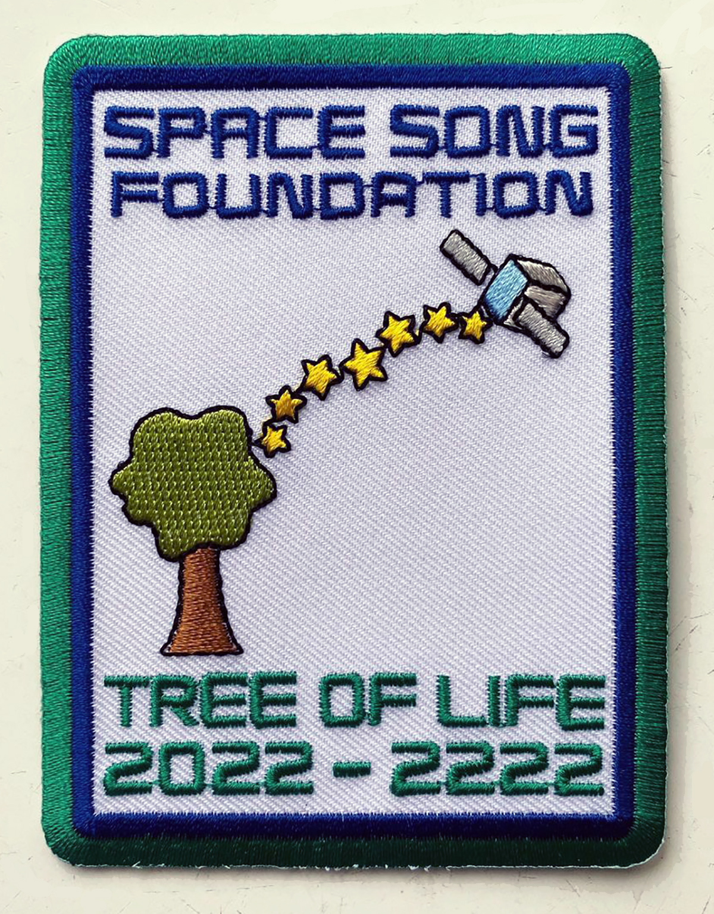
SPACE SONG FOUNDATION
ISSC 2024
UNIVERSITY OF ARIZONA

Slide 2
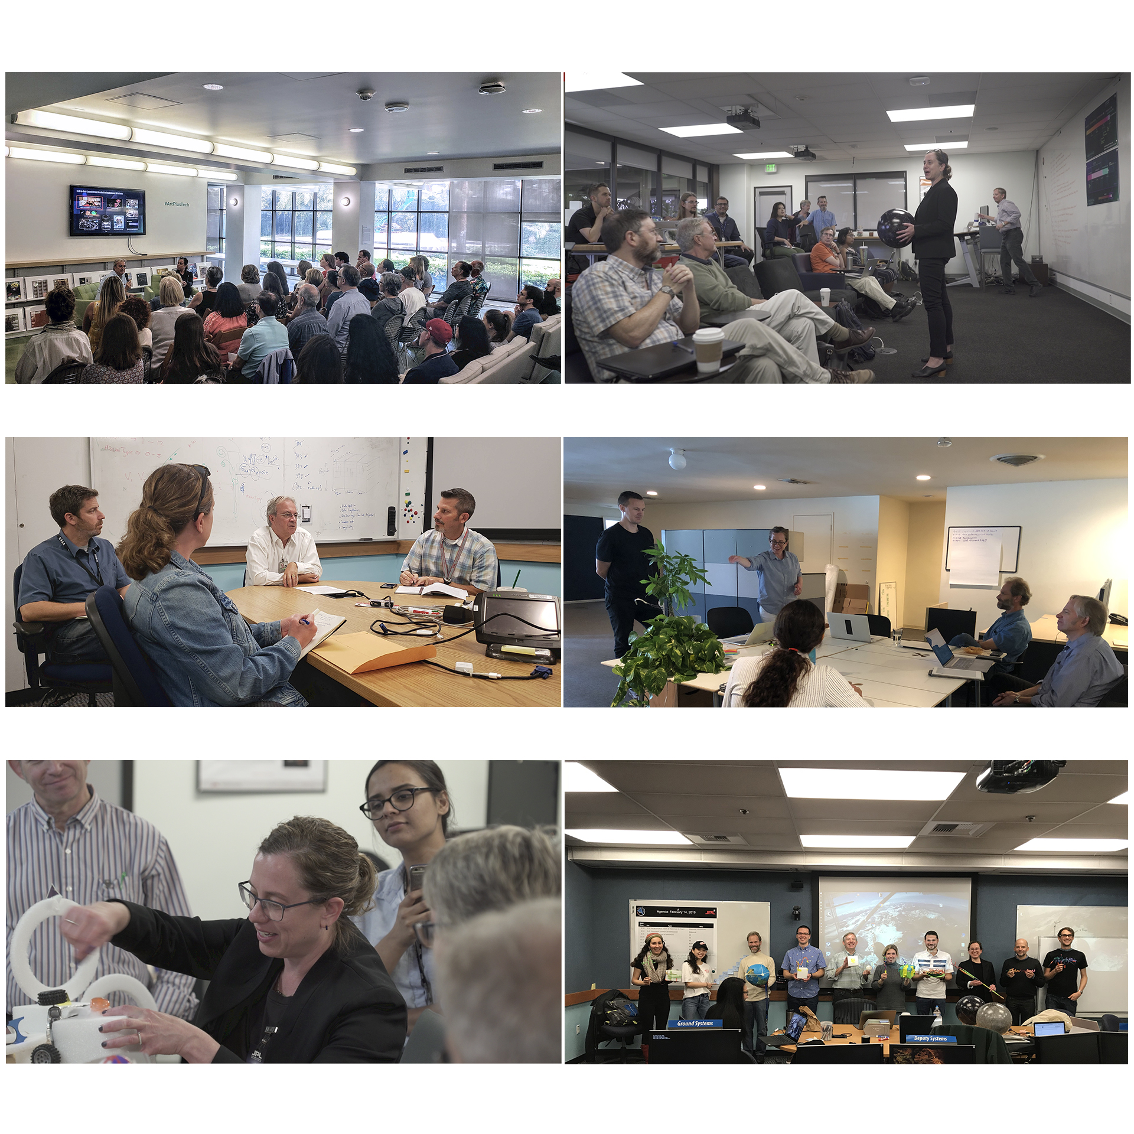

Slide 3
LONG-TERM MESSAGE
ABOUT LIFE ON EARTH?
COMMUNICATION SYSTEM HERE ON EARTH TO SEND AND RECEIVE FOR CENTURIES?
LONG-TERM SYSTEMS/STORIES ON SPACECRAFT? LONG-TERM COMMUNICATION WITH EARTH?

Slide 4
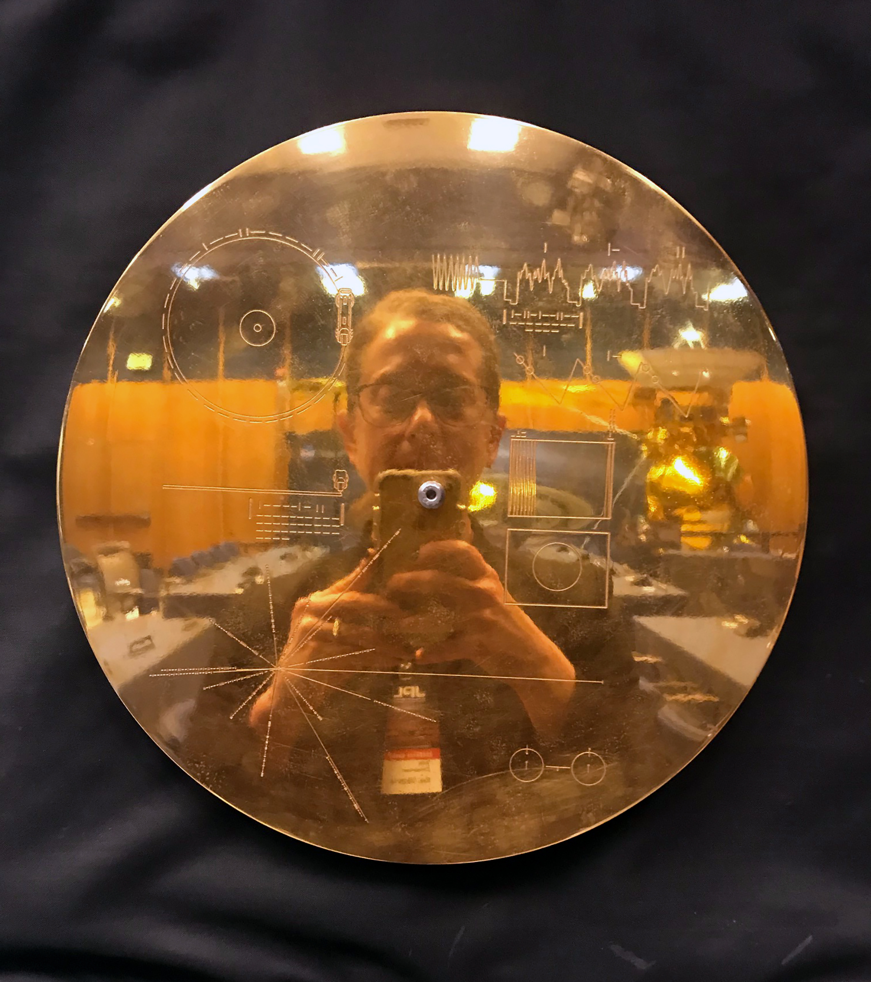
LONG-TERM MESSAGE
ABOUT LIFE ON EARTH?

Slide 5
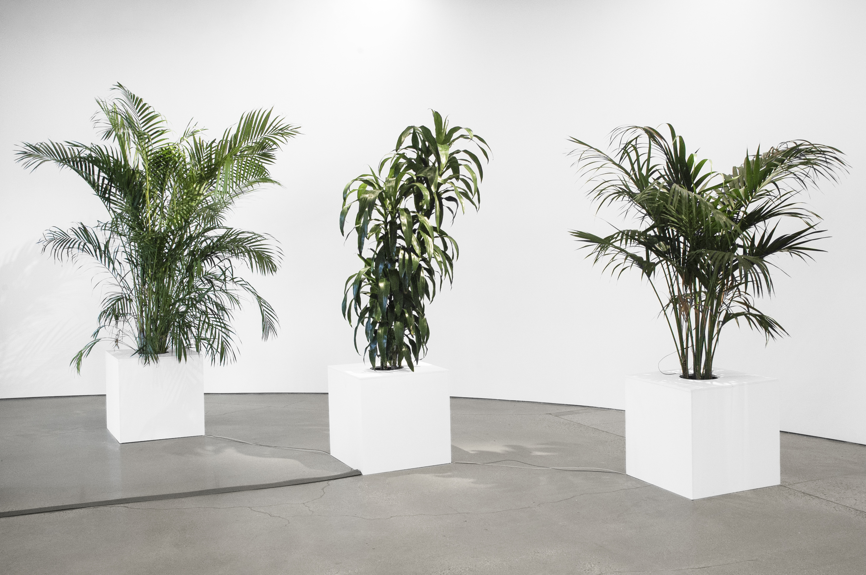

Slide 6

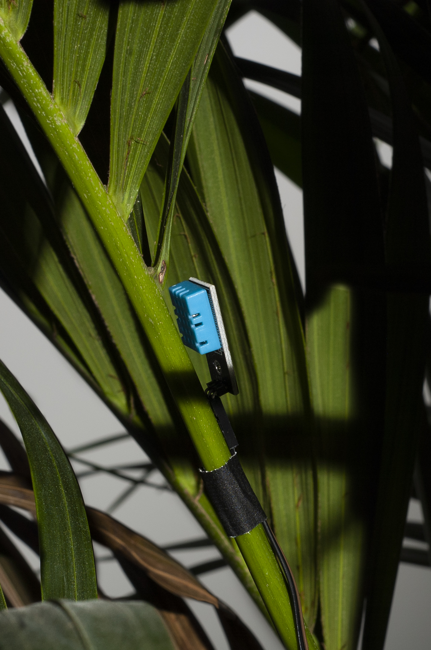

Slide 7
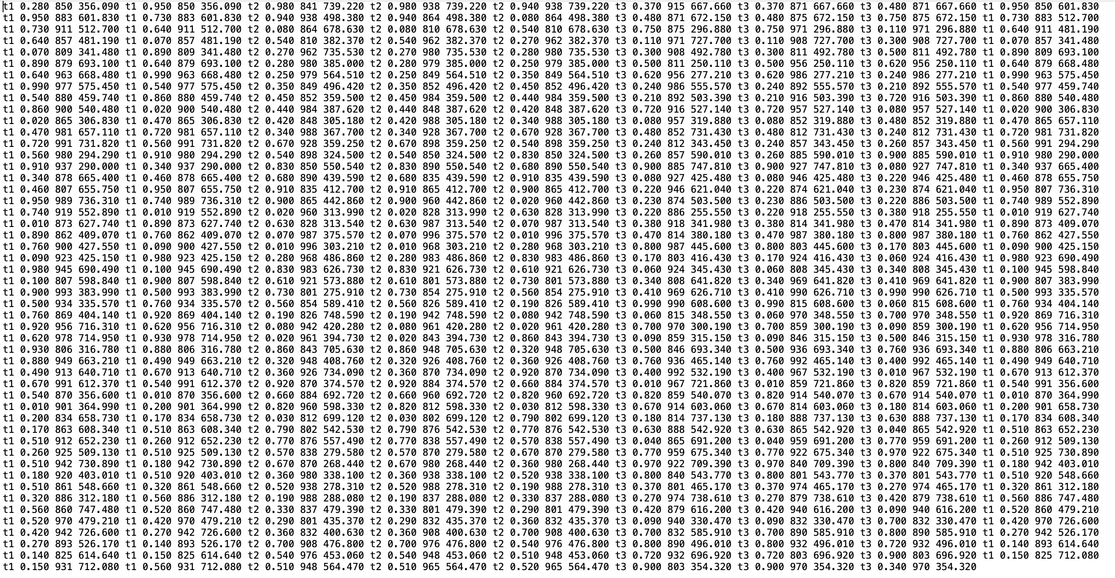

Slide 8
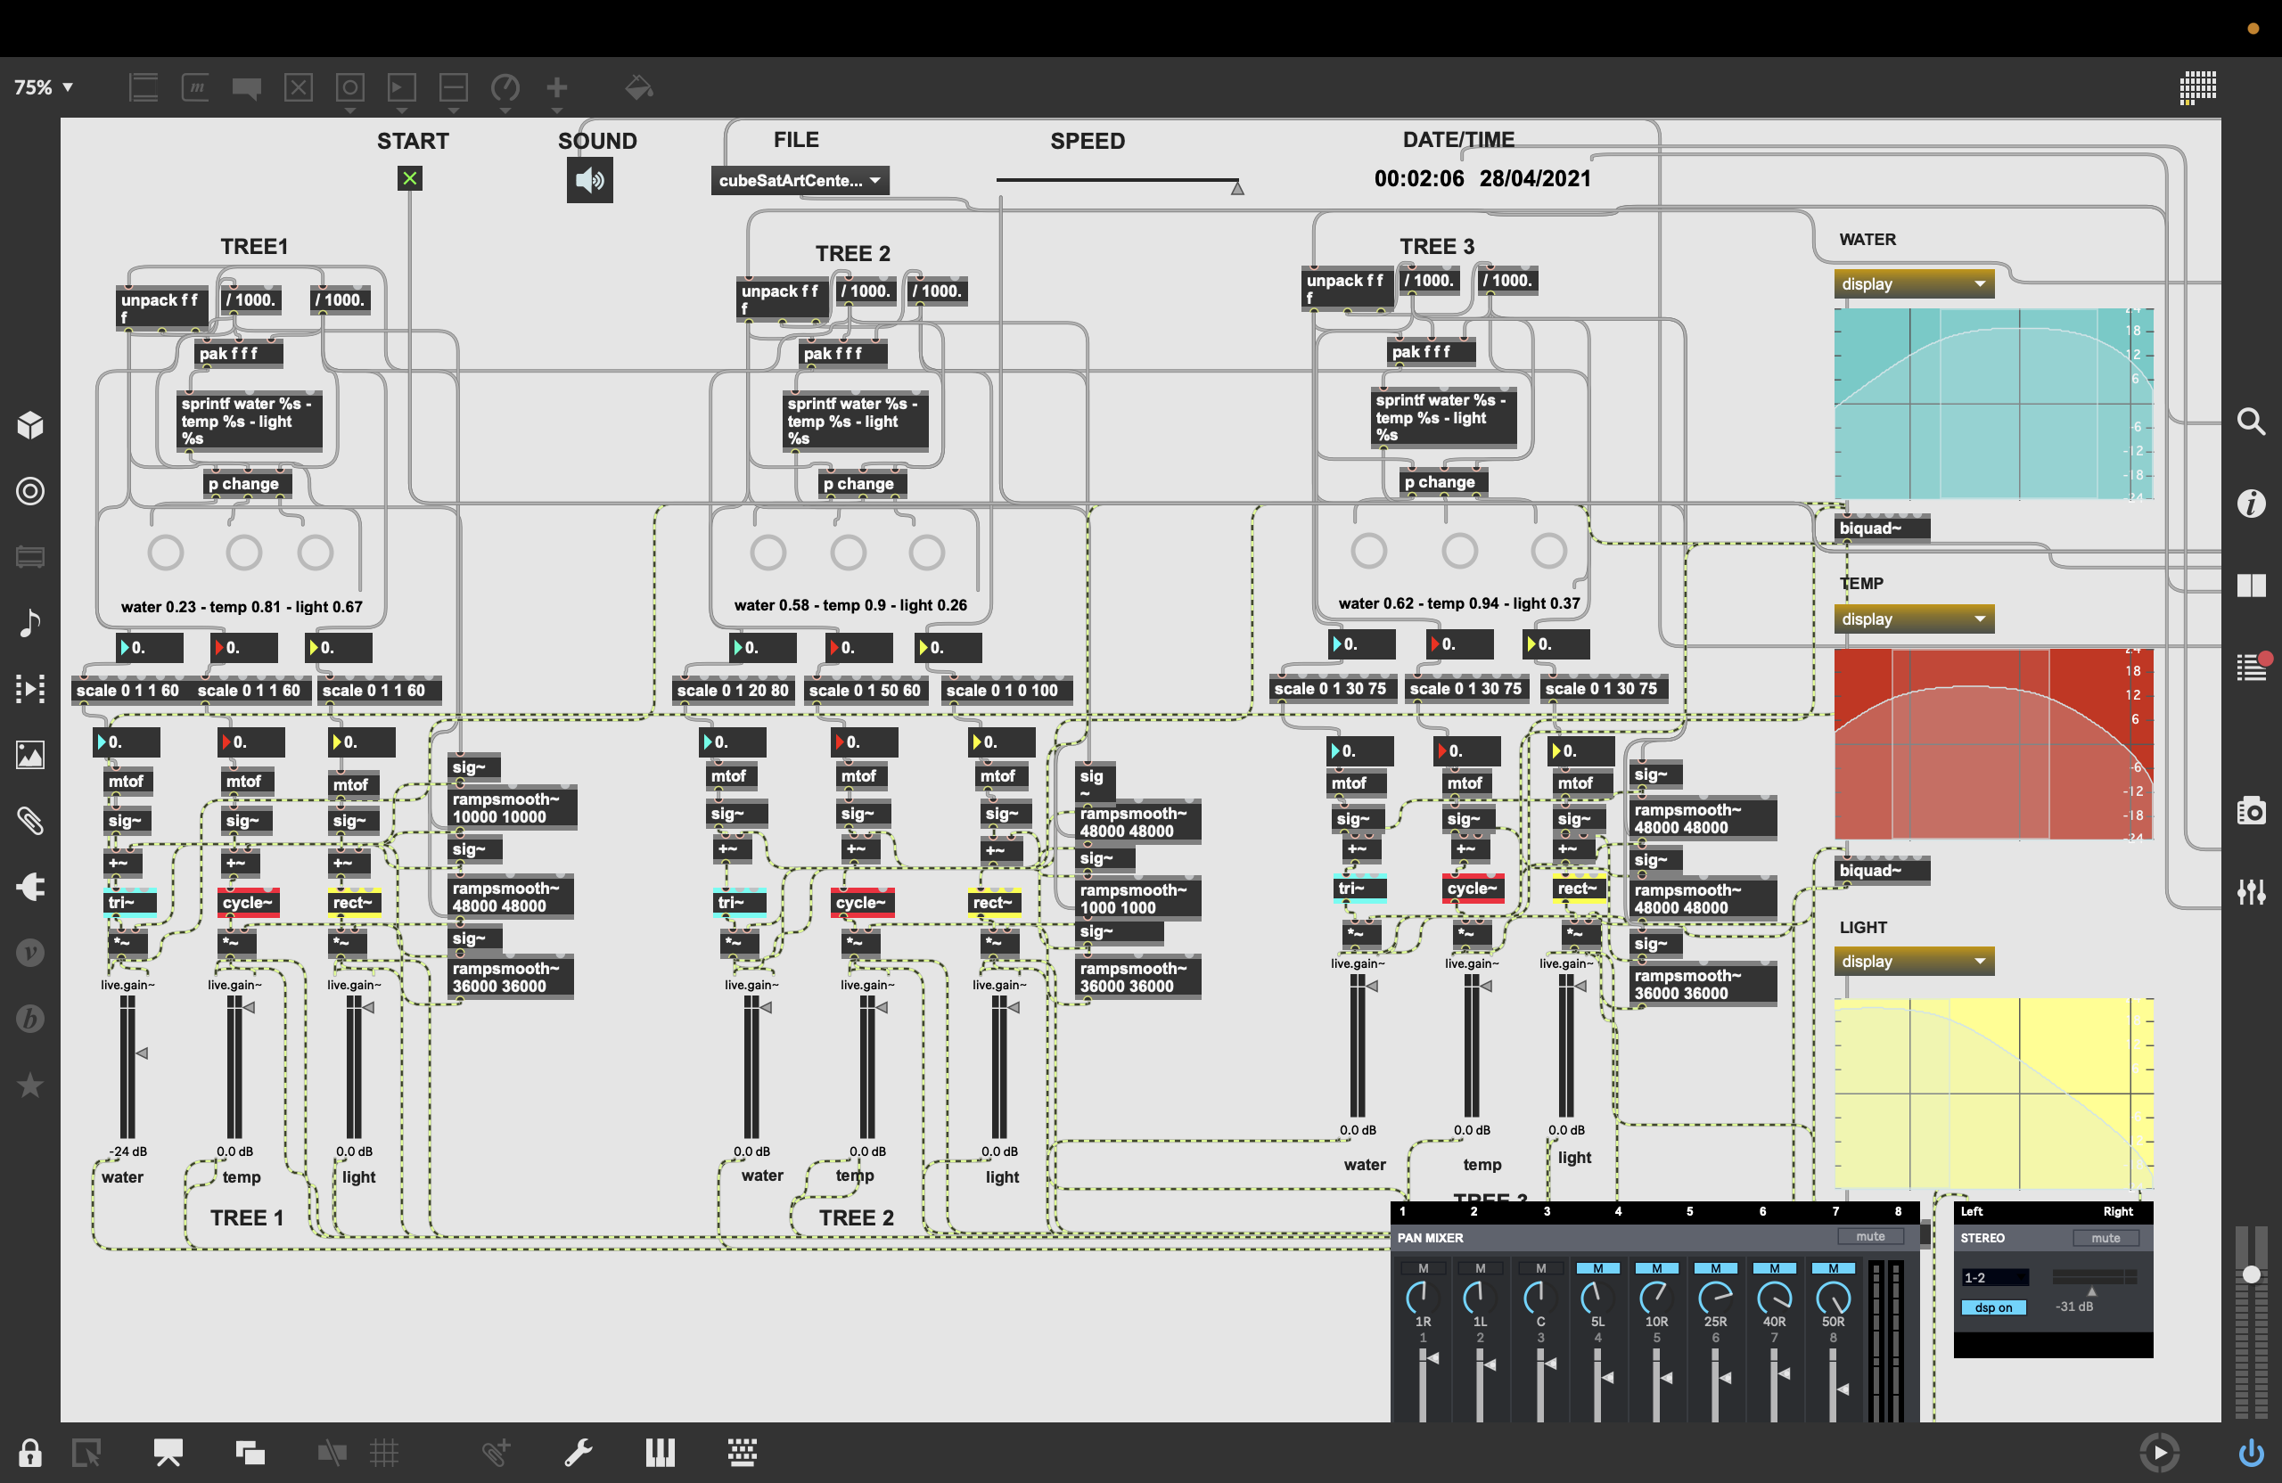

Slide 9
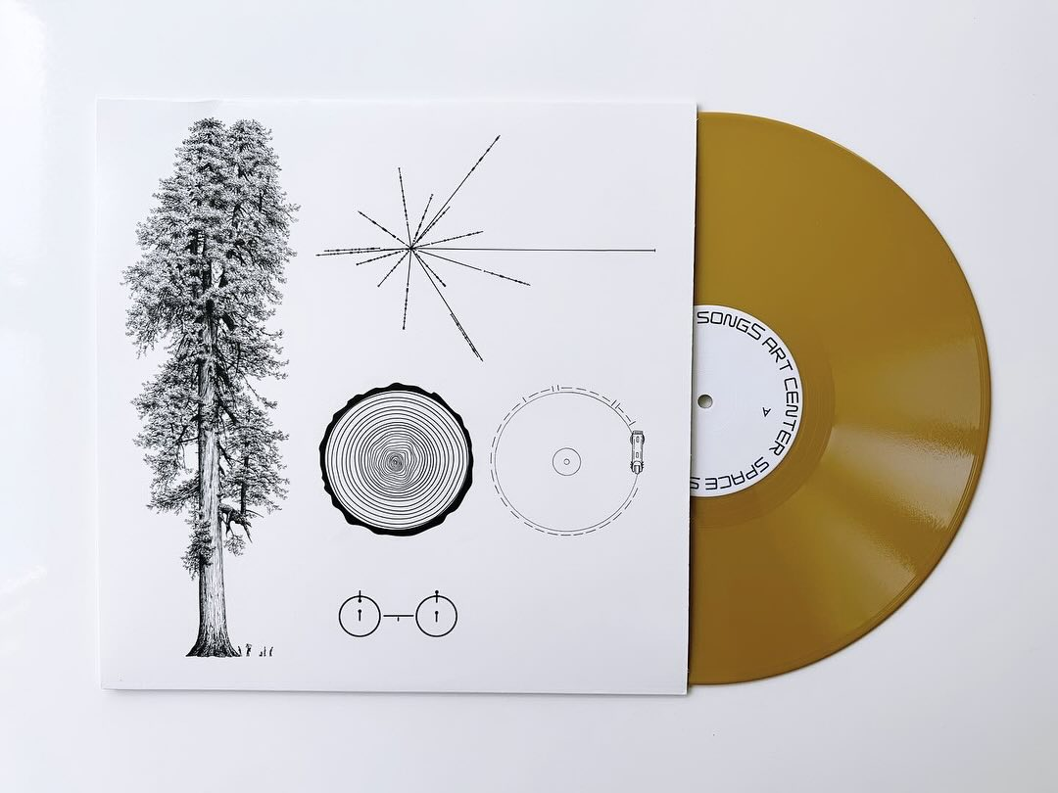

Slide 10
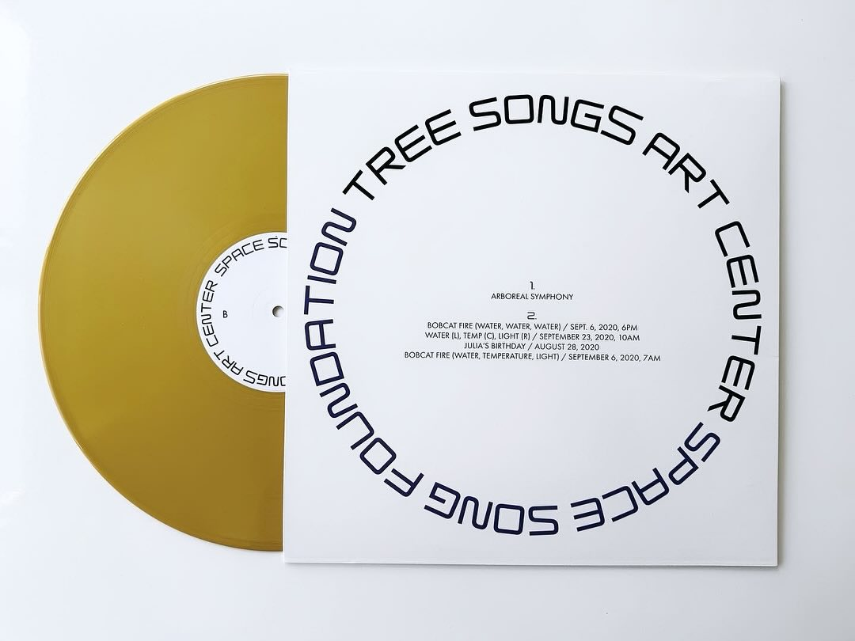

Slide 11
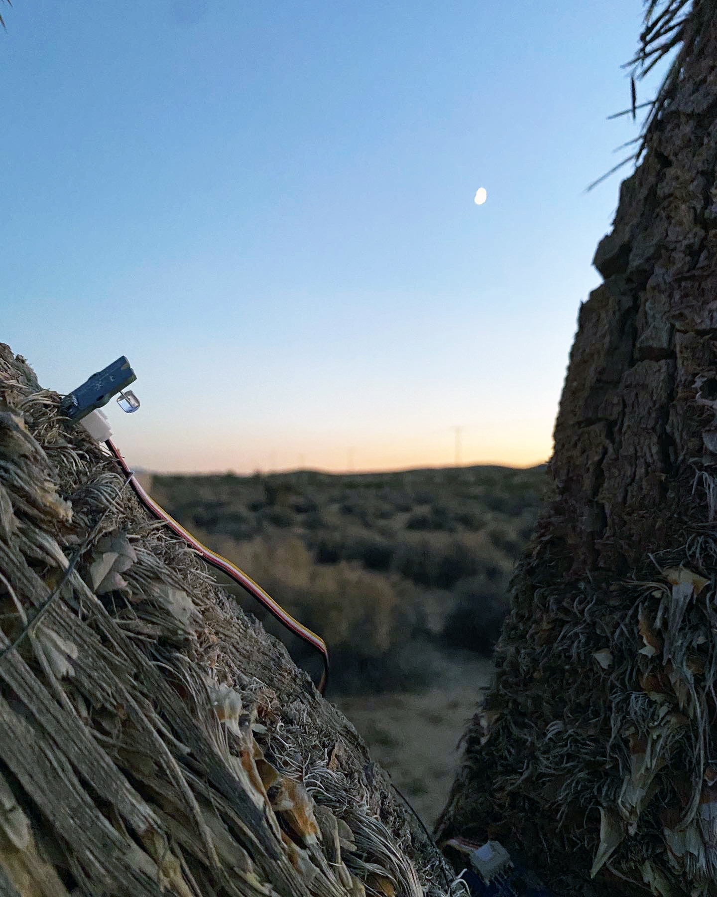

Slide 12
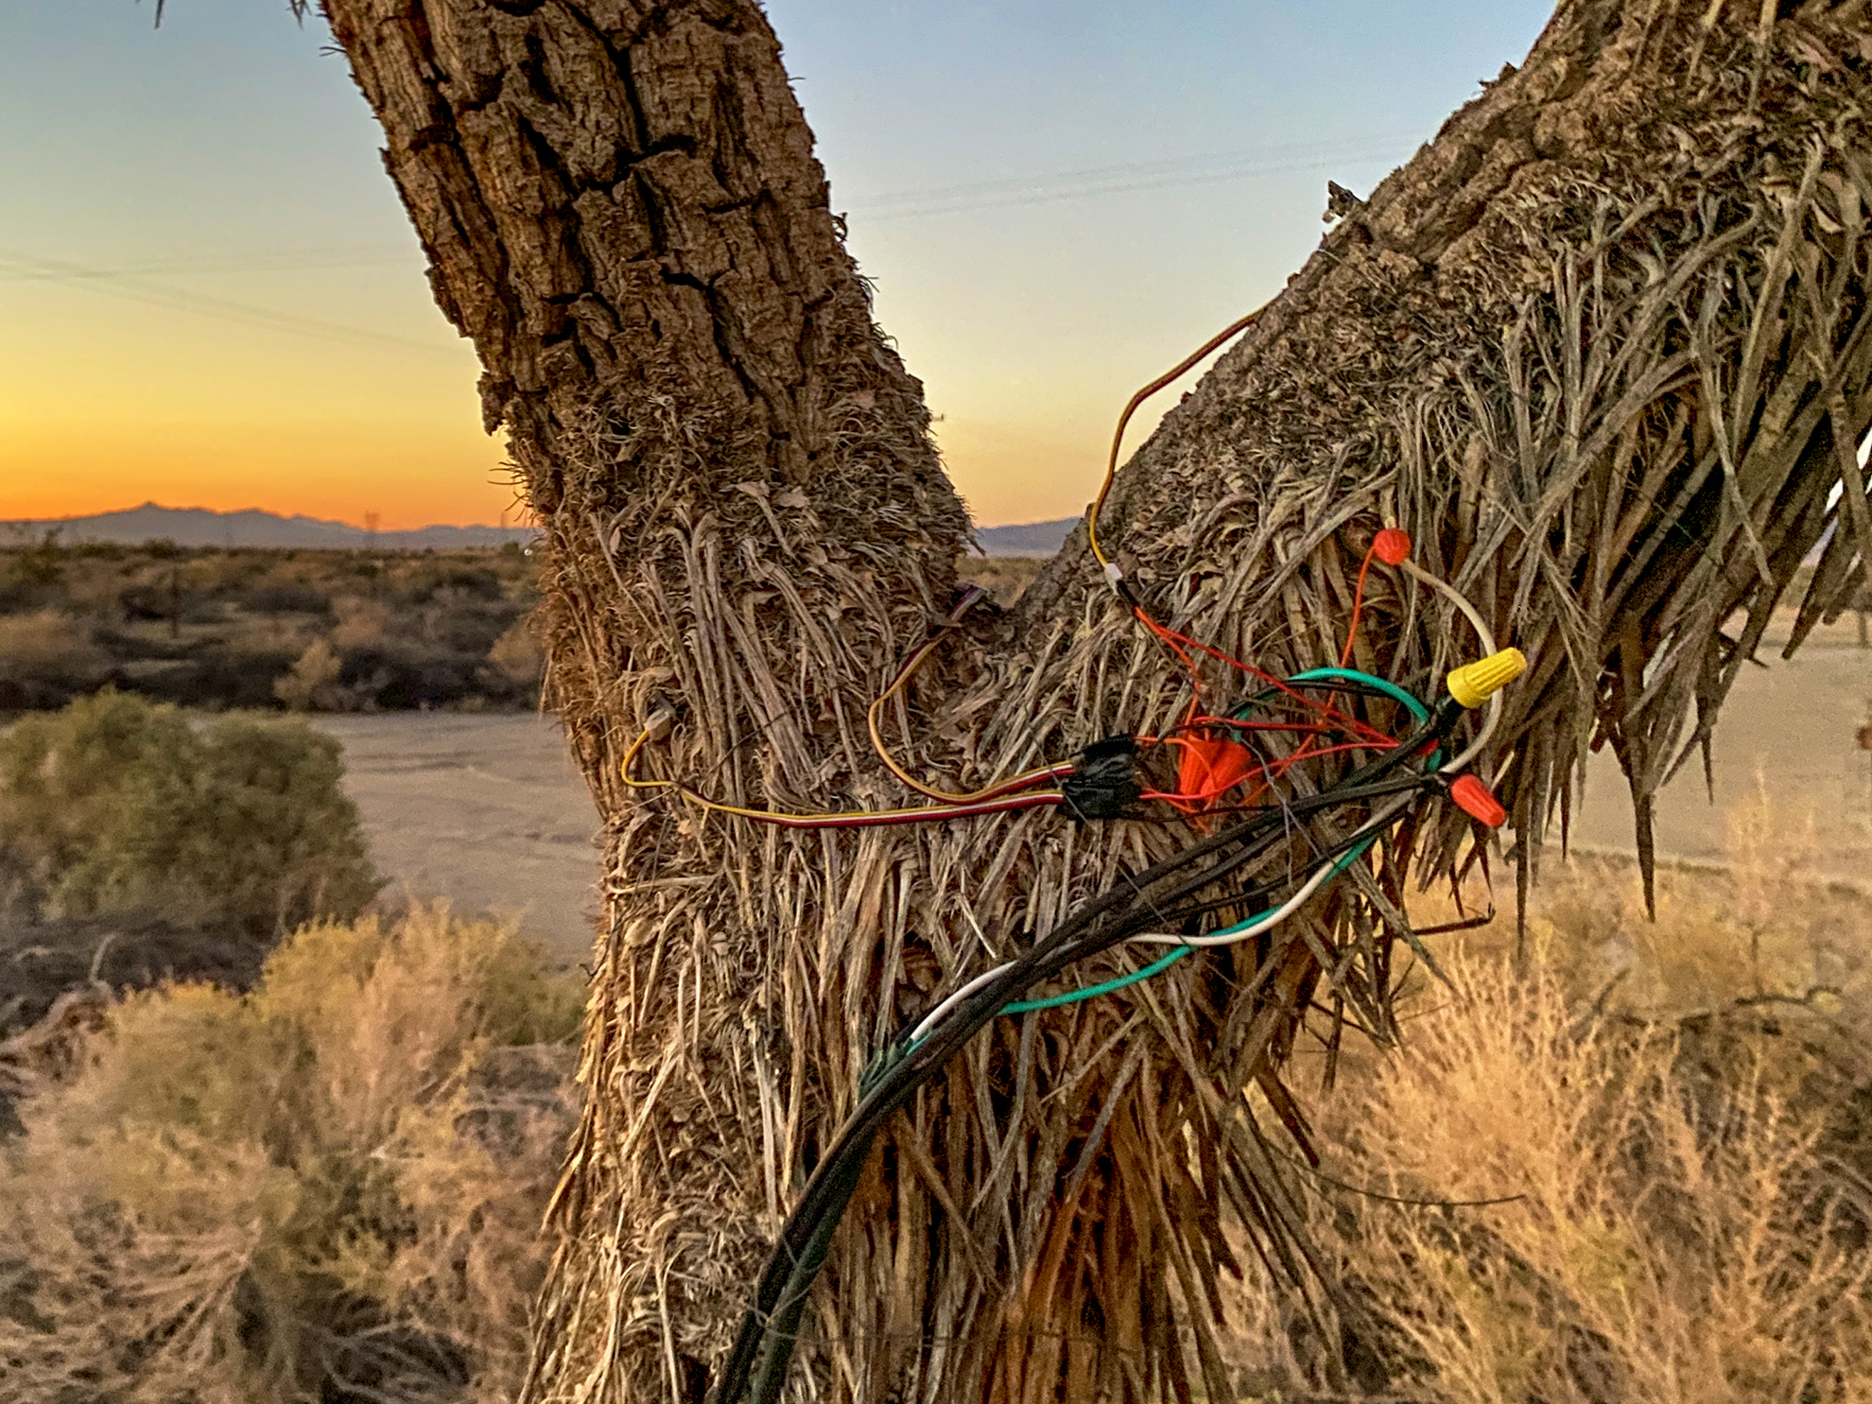

Slide 13
COMMUNICATION SYSTEM HERE ON EARTH TO SEND AND RECEIVE FOR CENTURIES?

Slide 14
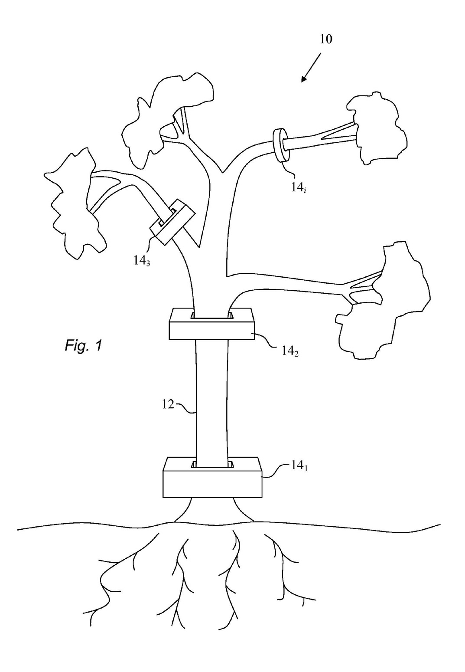

Slide 16
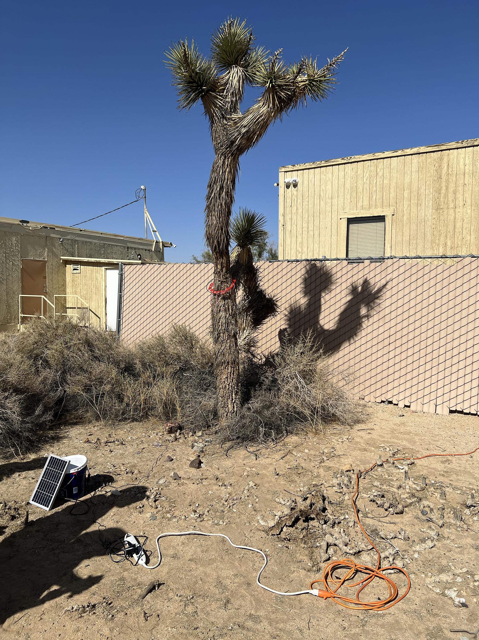
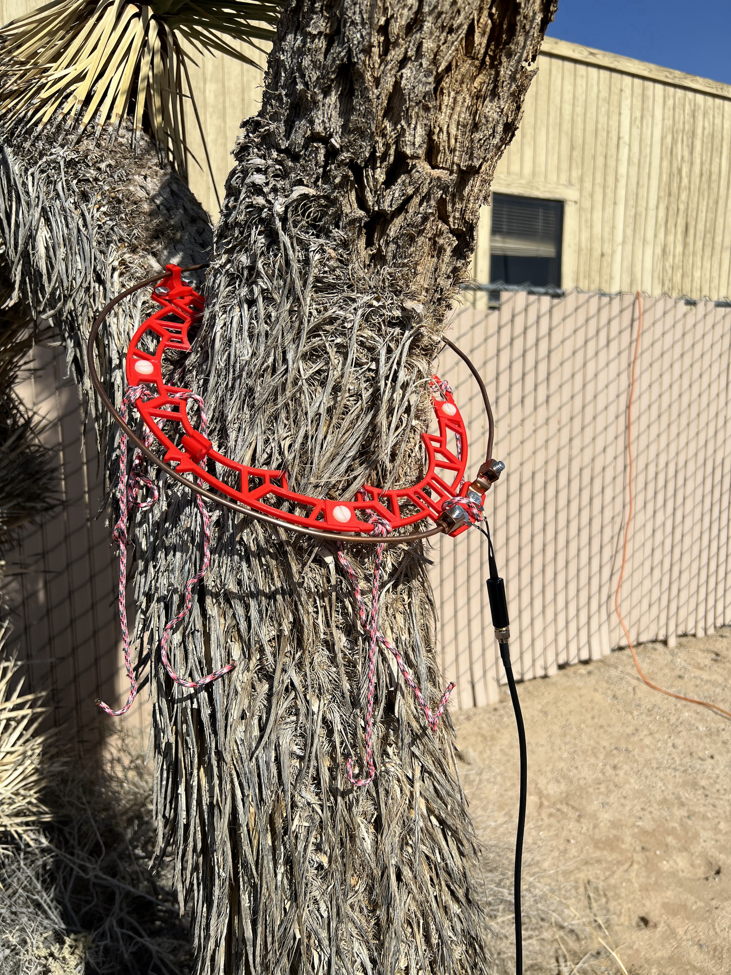

Slide 17
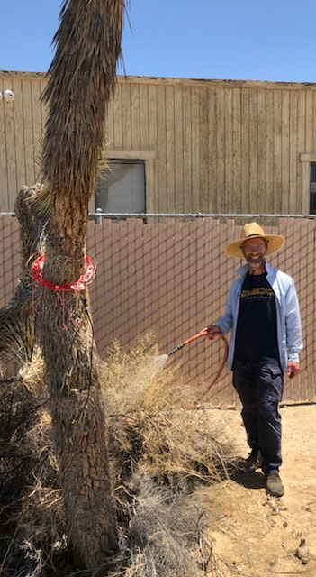
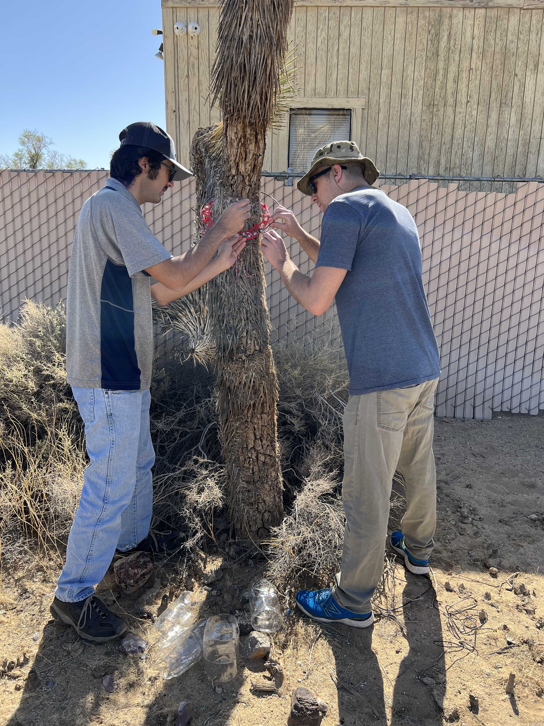
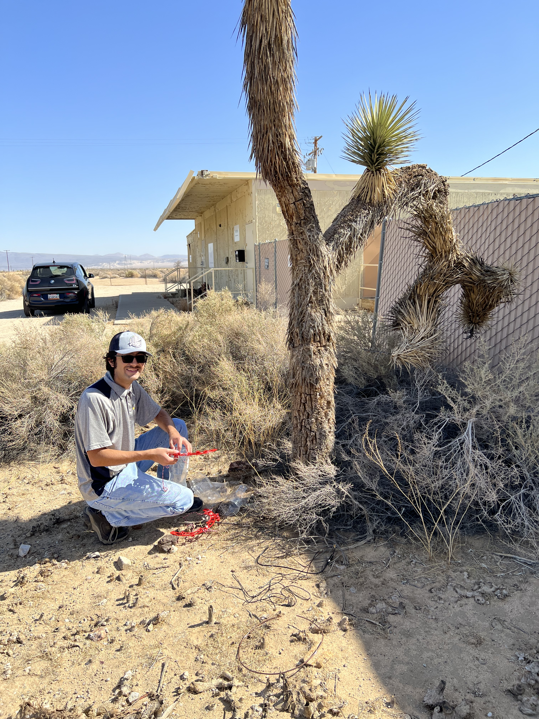

Slide 18
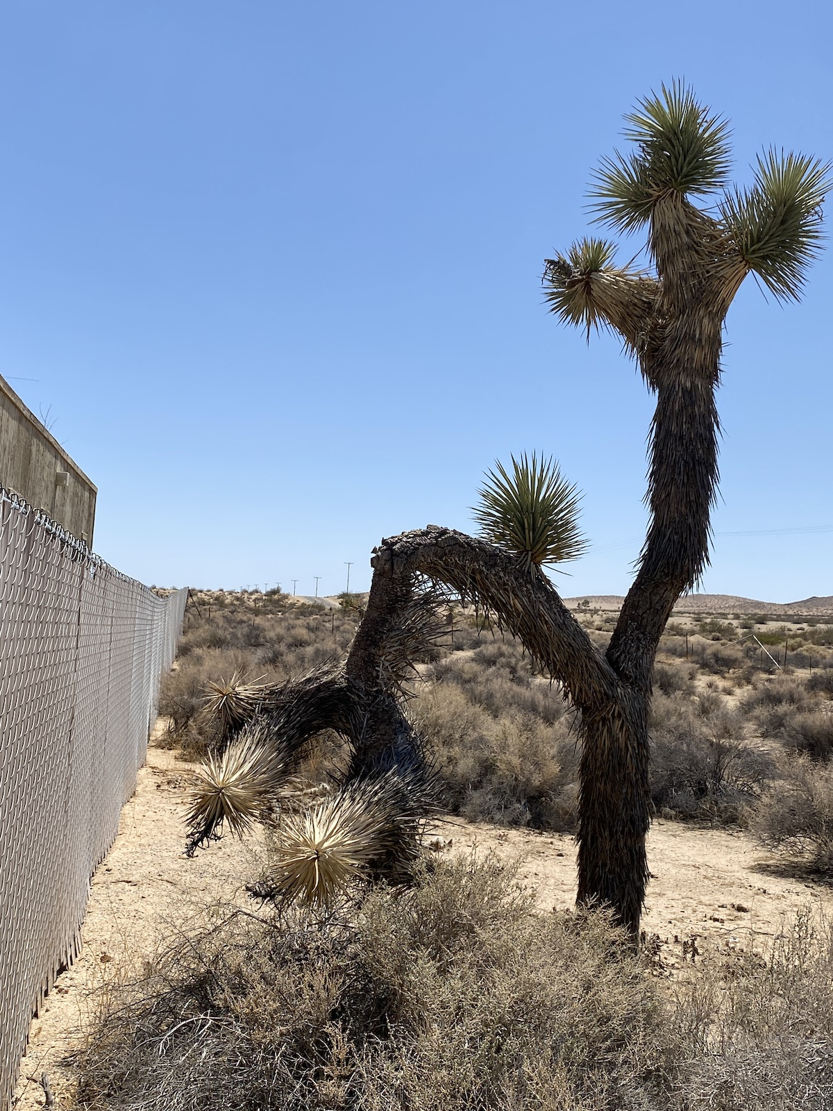


Slide 19
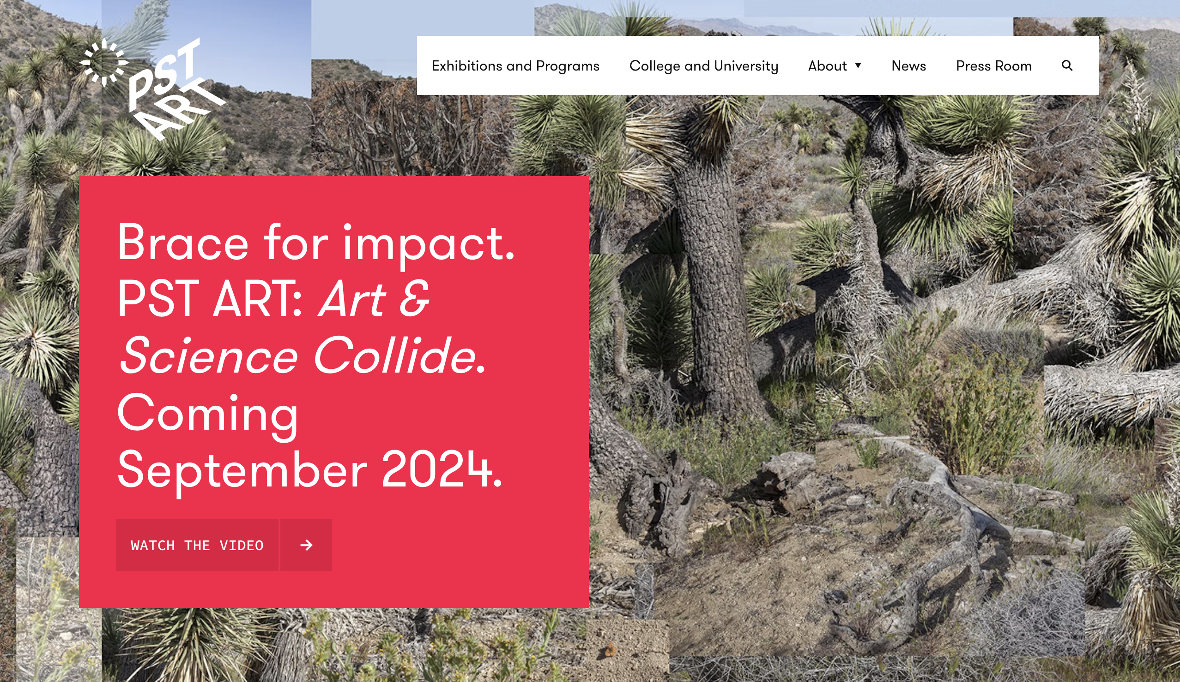

Slide 20
LONG-TERM SYSTEMS/STORIES ON SPACECRAFT? LONG-TERM COMMUNICATION WITH EARTH?

Slide 21
HOW COULD A CUBESAT LAST 200 YEARS?
* Simplified CubeSat systems : BACK TO THE FUTURE
* Turned off most of the time (1%?)
* ~1000 km altitude orbit
  * No batteries
  * No attitude control
  * Simplest computer with timer (analog?) possible
  * Maximize the outer surface area, minimize mass
  * Populate with solar cells on every face of the large ~1 m³ cube, 0.5 cm thick aluminum
    * Low gain patch ~omni antennas on two opposite faces
* An accelerated ground test of 2-3 years could help test several configurations
From “A 200 Year CubeSat That Sings With Trees,” Interplanetary Small Satellite Conference, Caltech, Pasadena, California 2020;
Steve Matousek¹, Alessandra Babuscia¹, Julia Christensen², Anthony Freeman¹, Roger Klemm¹, and Judy Lai-Norling¹. ¹
Jet Propulsion Laboratory, California Institute of Technology, Pasadena, CA, United States, ² Oberlin College, Oberlin, OH

Slide 22
CUBESAT 200 / SUBSYSTEM TRADE SPACE
C & DH x2 (only one on at a time), total of 4 cards: Single card for processor (Sphinx) Single card for timer (Sphinx custom) Fault detection 5 Watts total operating, 1 Watt standby Cross strapping (H/W & S/W) Structure 3mm wall thickness → 6.5 kg 0.5cm thickness → 11 kg "beefy" Will easily handle launch loads Attitude Control None Power Orientation independent 45 W EOL 900 cm² of solar cells Active area is 720 cm² | Thermal All passive architecture No heater No louvers No flight software control No mechanically actuated heaters No pumps Thermal control coatings Black paint Bare metals MLI Only the skin It's an envelope 1 mm – 3 mm thick 0.5 kg/m² of surface area +/- 20% Propulsion None | Payload Possibilities None Radiation sensors Camera Photodiodes (photometer) Sun sensor Earth limb sensor Ultraviolet spectrometer Visible spectrometer Infrared spectrometer Magnometer Plasma detector Microphone (vibrations) Dust detector Thermal imager Bolometer Langmuir probe, s/c charging From “A 200 Year CubeSat That Sings With Trees,” Interplanetary Small Satellite Conference, Caltech, Pasadena, California 2020; Steve Matousek¹, Alessandra Babuscia¹, Julia Christensen², Anthony Freeman¹, Roger Klemm¹, and Judy Lai-Norling¹. ¹ Jet Propulsion Laboratory, California Institute of Technology, Pasadena, CA, United States, ² Oberlin College, Oberlin, OH

Slide 23
WHAT KIND OF STORIES MIGHT A CUBESAT
TELL US OVER THE LONG TERM?

Slide 24
WHAT KIND OF STORIES MIGHT A CUBESAT
TELL US OVER THE LONG TERM?
SIMILAR DATA FROM PLANTS IN SPACE?

Slide 25
WHAT KIND OF STORIES MIGHT A CUBESAT
TELL US OVER THE LONG TERM?
SIMILAR DATA FROM PLANTS IN SPACE?
POWER ON-BOARD?

Slide 26
WHAT KIND OF STORIES MIGHT A CUBESAT
TELL US OVER THE LONG TERM?
SIMILAR DATA FROM PLANTS IN SPACE?
POWER ON-BOARD?
CHANGING CONDITIONS IN SPACE?

Slide 27
WHAT KIND OF STORIES MIGHT A CUBESAT
TELL US OVER THE LONG TERM?
SIMILAR DATA FROM PLANTS IN SPACE?
POWER ON-BOARD?
CHANGING CONDITIONS IN SPACE?
SHIFTING IONOSPHERE? SPACE WEATHER?

Slide 28




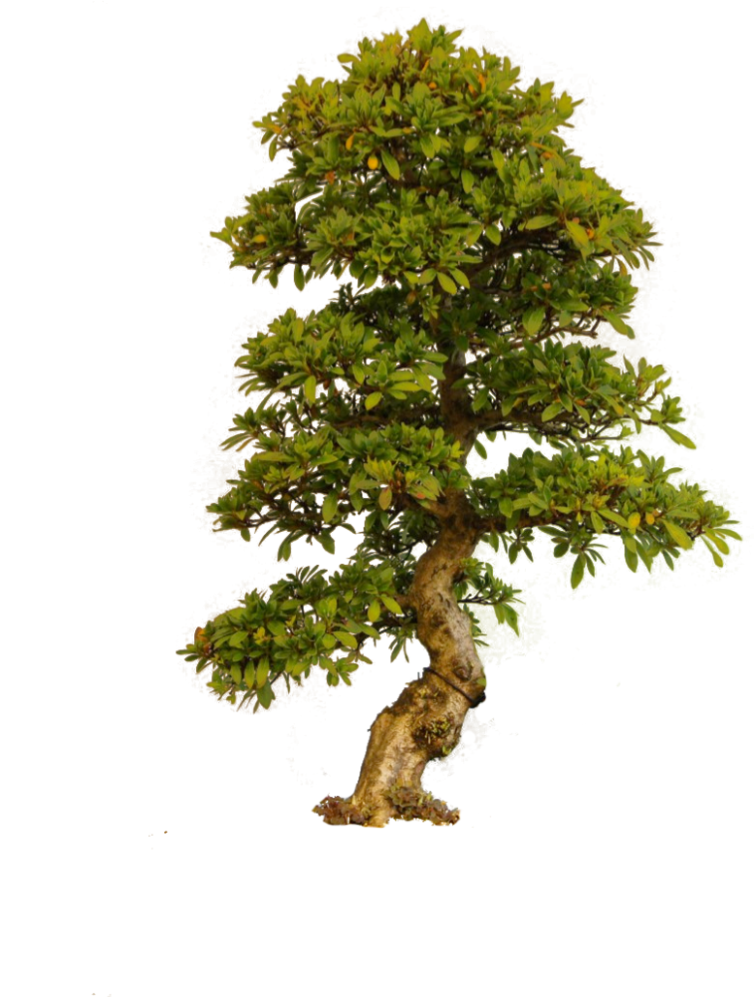
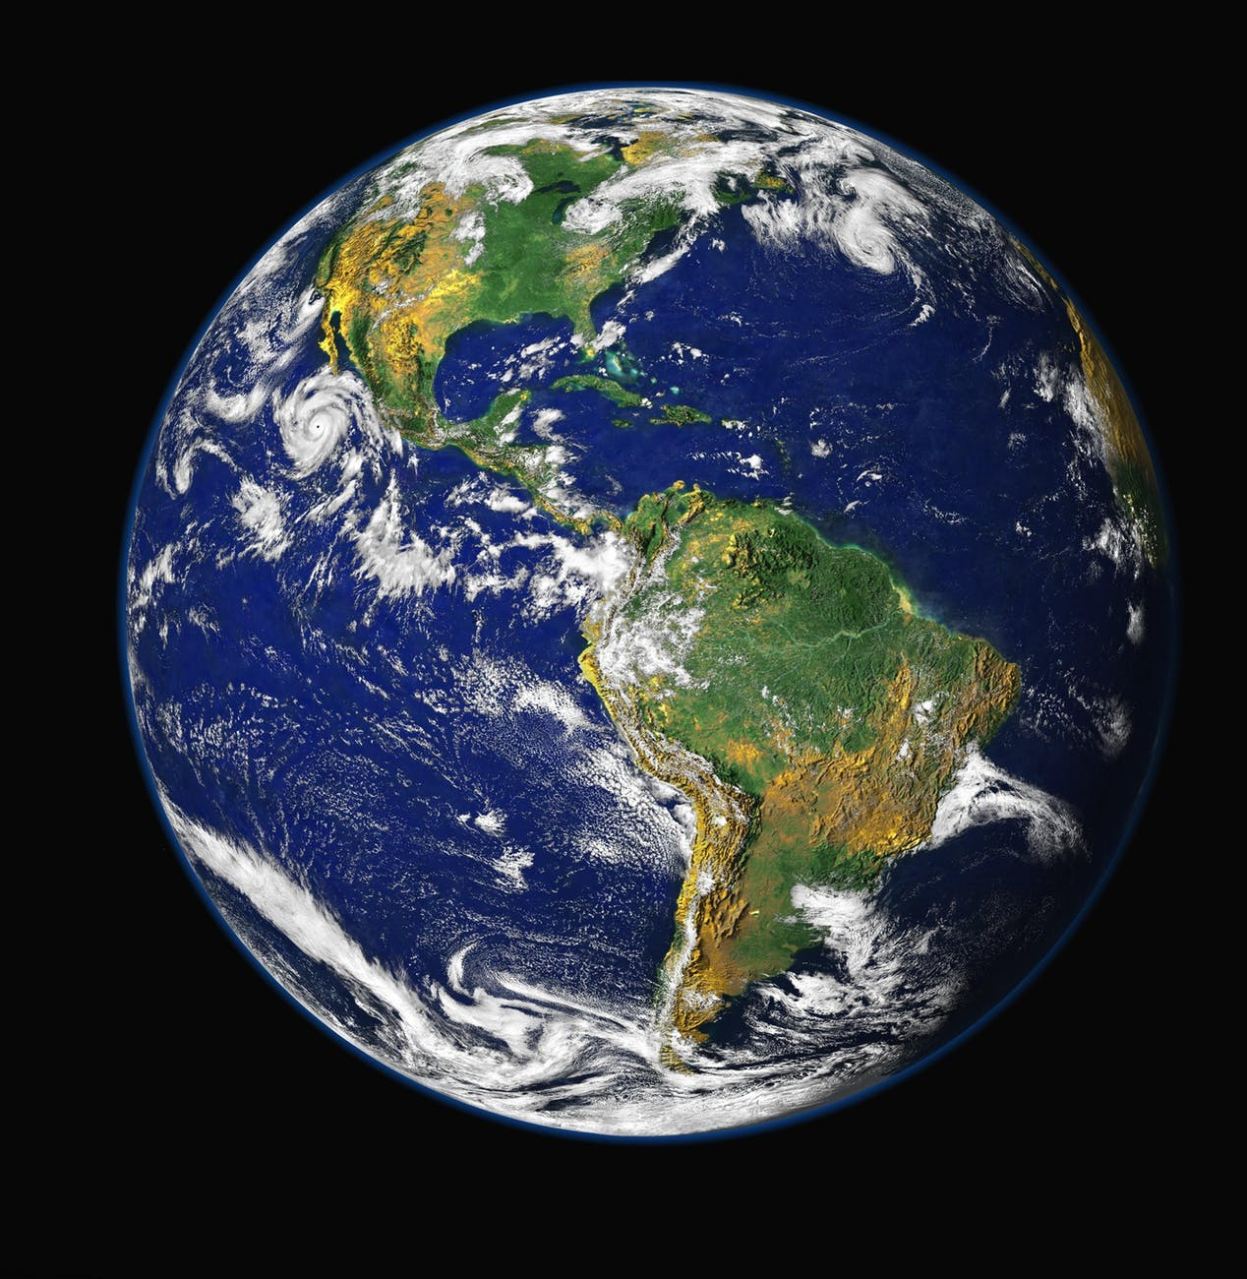

Slide 29
VISIT US AT OUR ISSC BOOTH!
SPACE SONG FOUNDATION
WWW.SPACESONG.ORG

