Slide 1
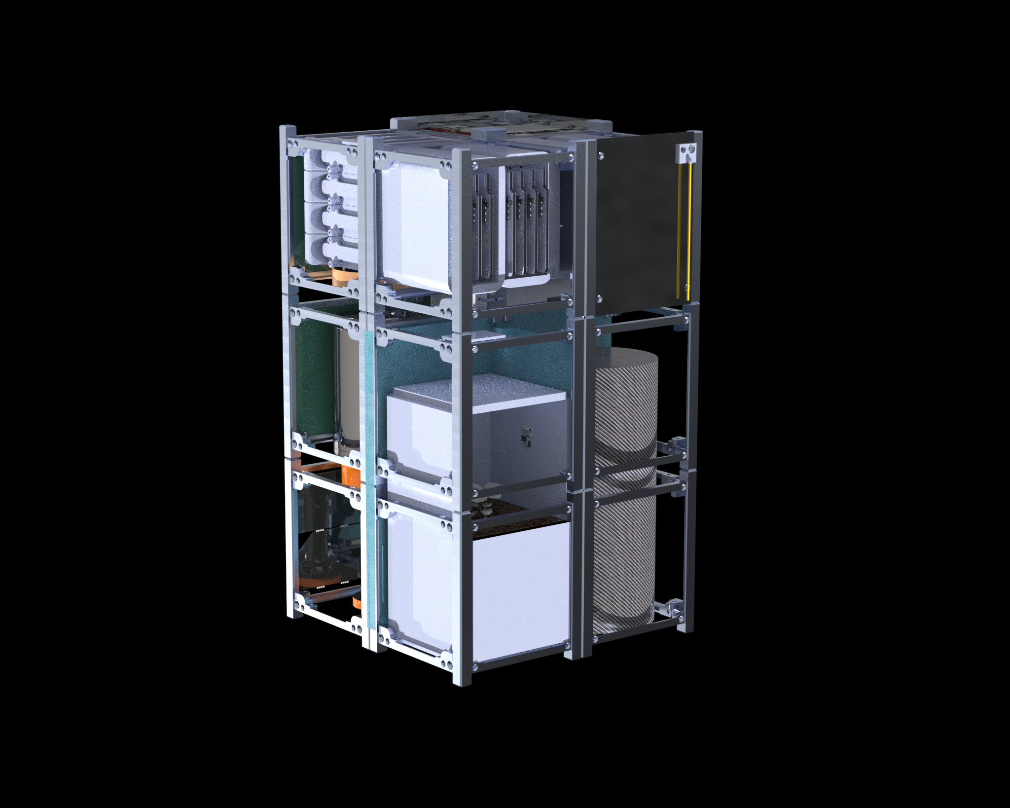
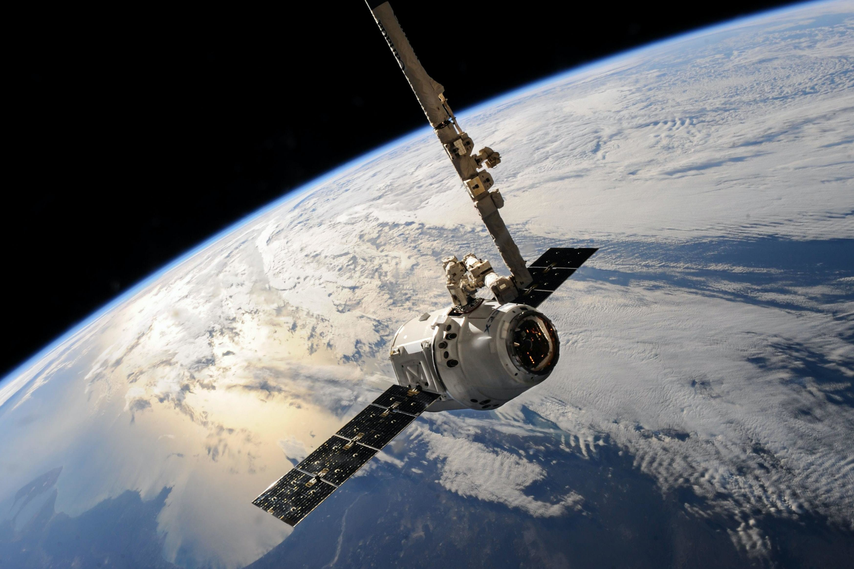
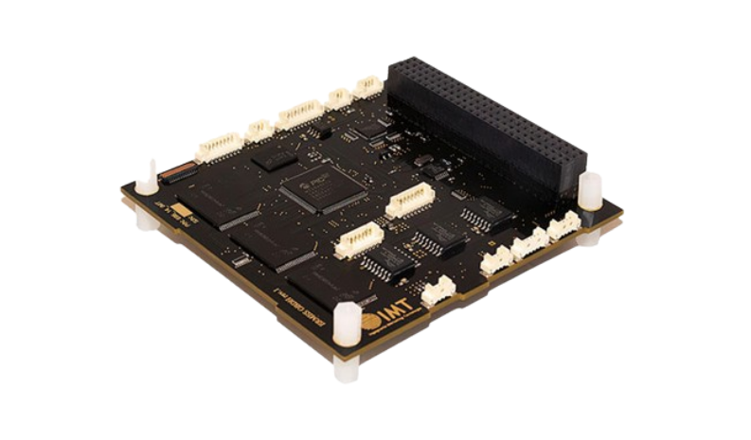
Terrarium Controller to Imitate Lunar Conditions for Live Organisms
Aleksandar Antonic, Claire Pedersen, Jekan Thangavelautham
Space Terrestrial Robotics and Exploration (SpaceTREx) Laboratory
The University of Arizona

Slide 2
Table of Contents
Background
Motivation
Current Efforts
CubeSat Design
Communications
Hardware Requirements
Conclusion and Future Work
References

Slide 3
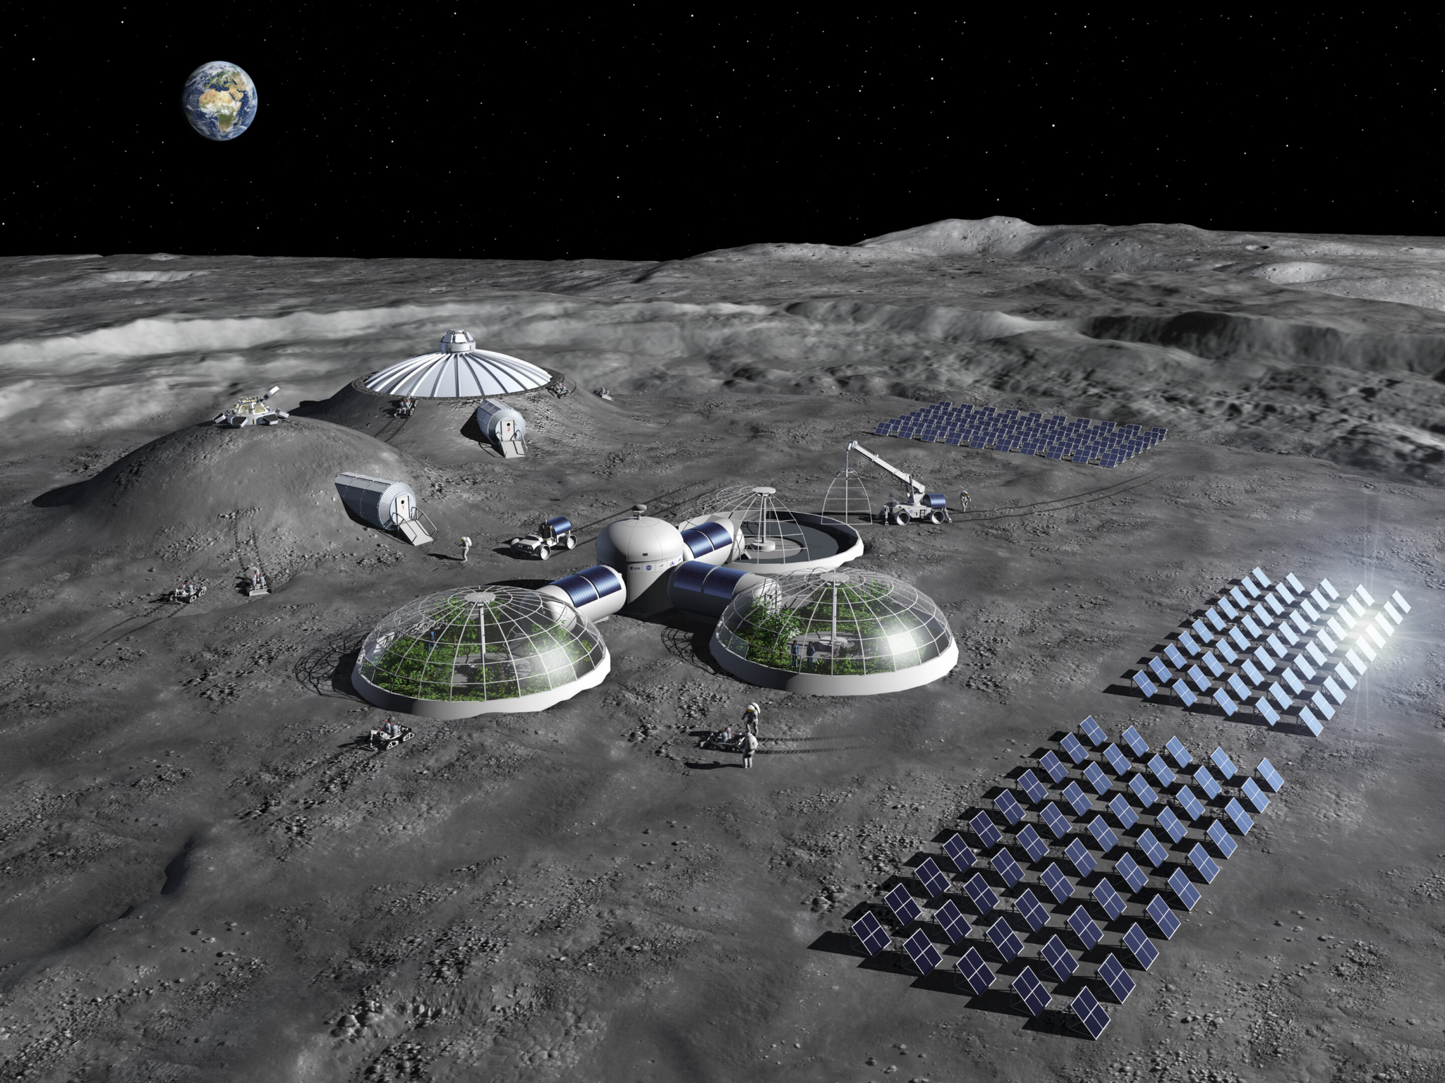
Background
A terrarium controller is required in order to test a terrarium’s viability.
  Manipulate its environment.
A CubeSat can be used to recreate Lunar surface conditions.
  -120 to 130 ℃, 1.62 m/s/s, 1361 W/m/m of light.

Slide 4
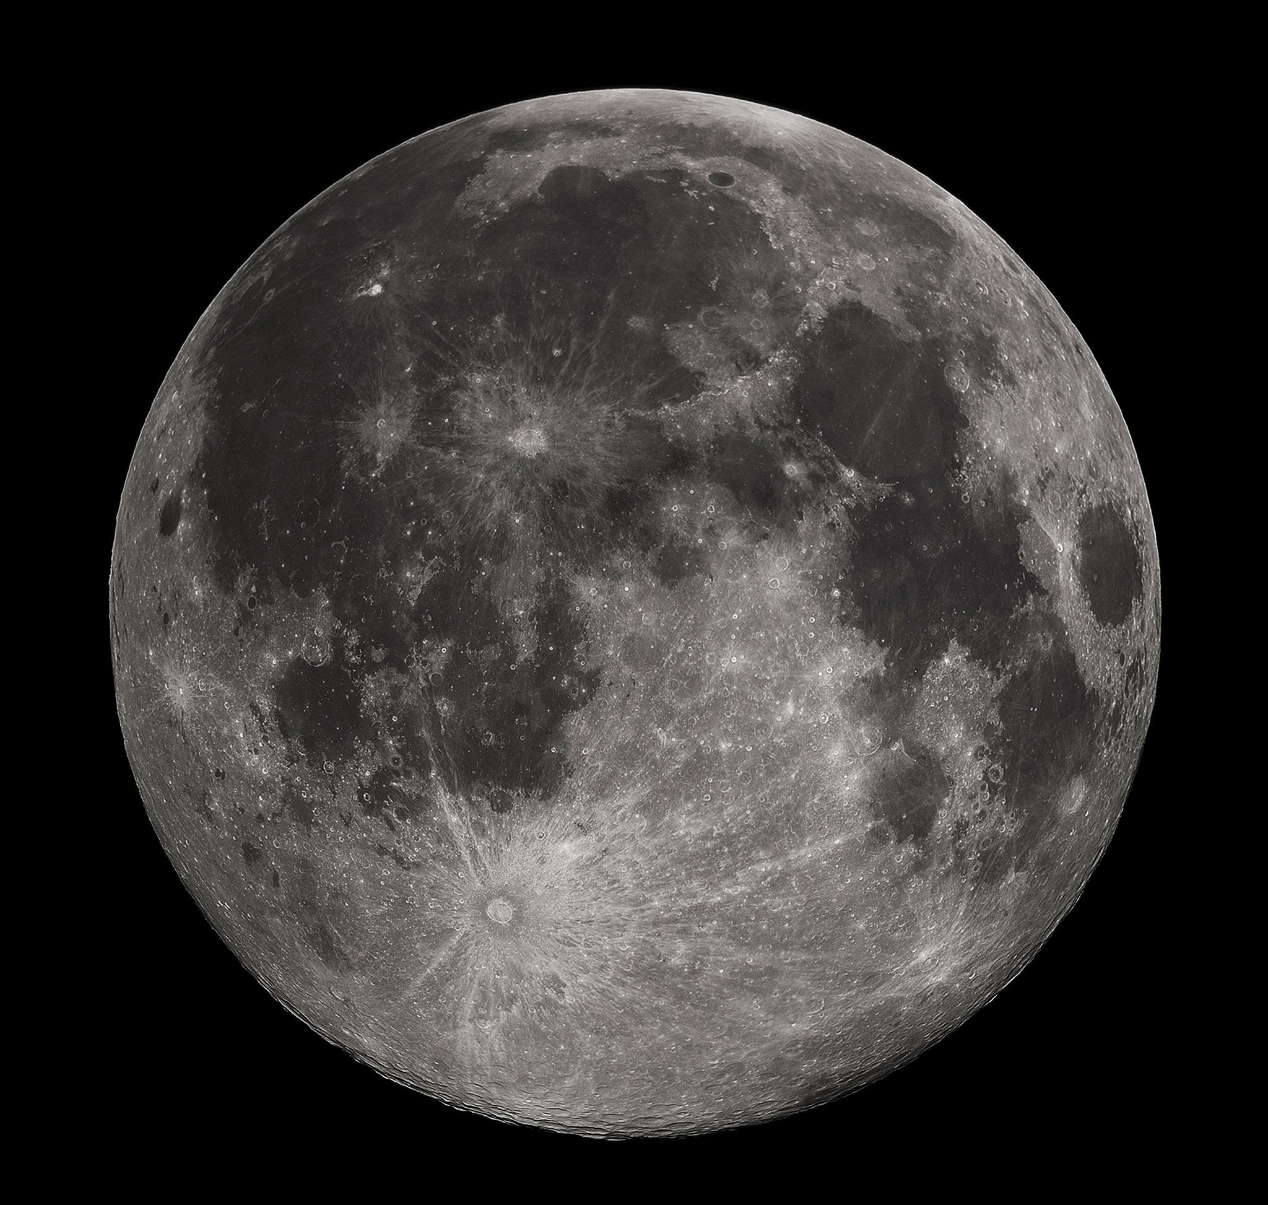
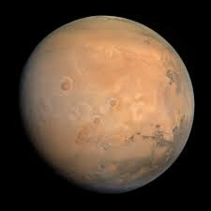
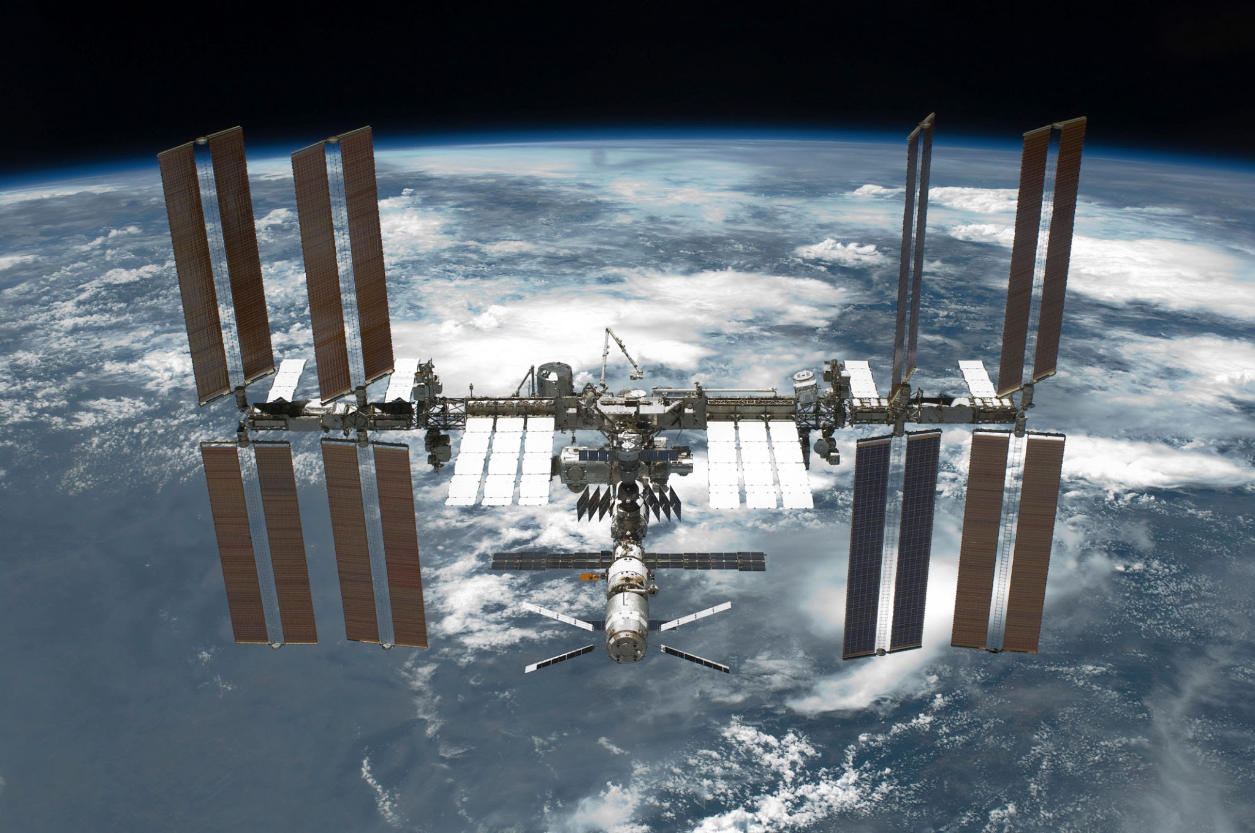
Motivation
A midpoint is required for demonstrating life in space
  Mars and Moon are future desires for human colonization.
Life in microgravity demonstrated by ISS
Sustainable food production in space is required for long term settlements.
  Plant growth

Slide 5
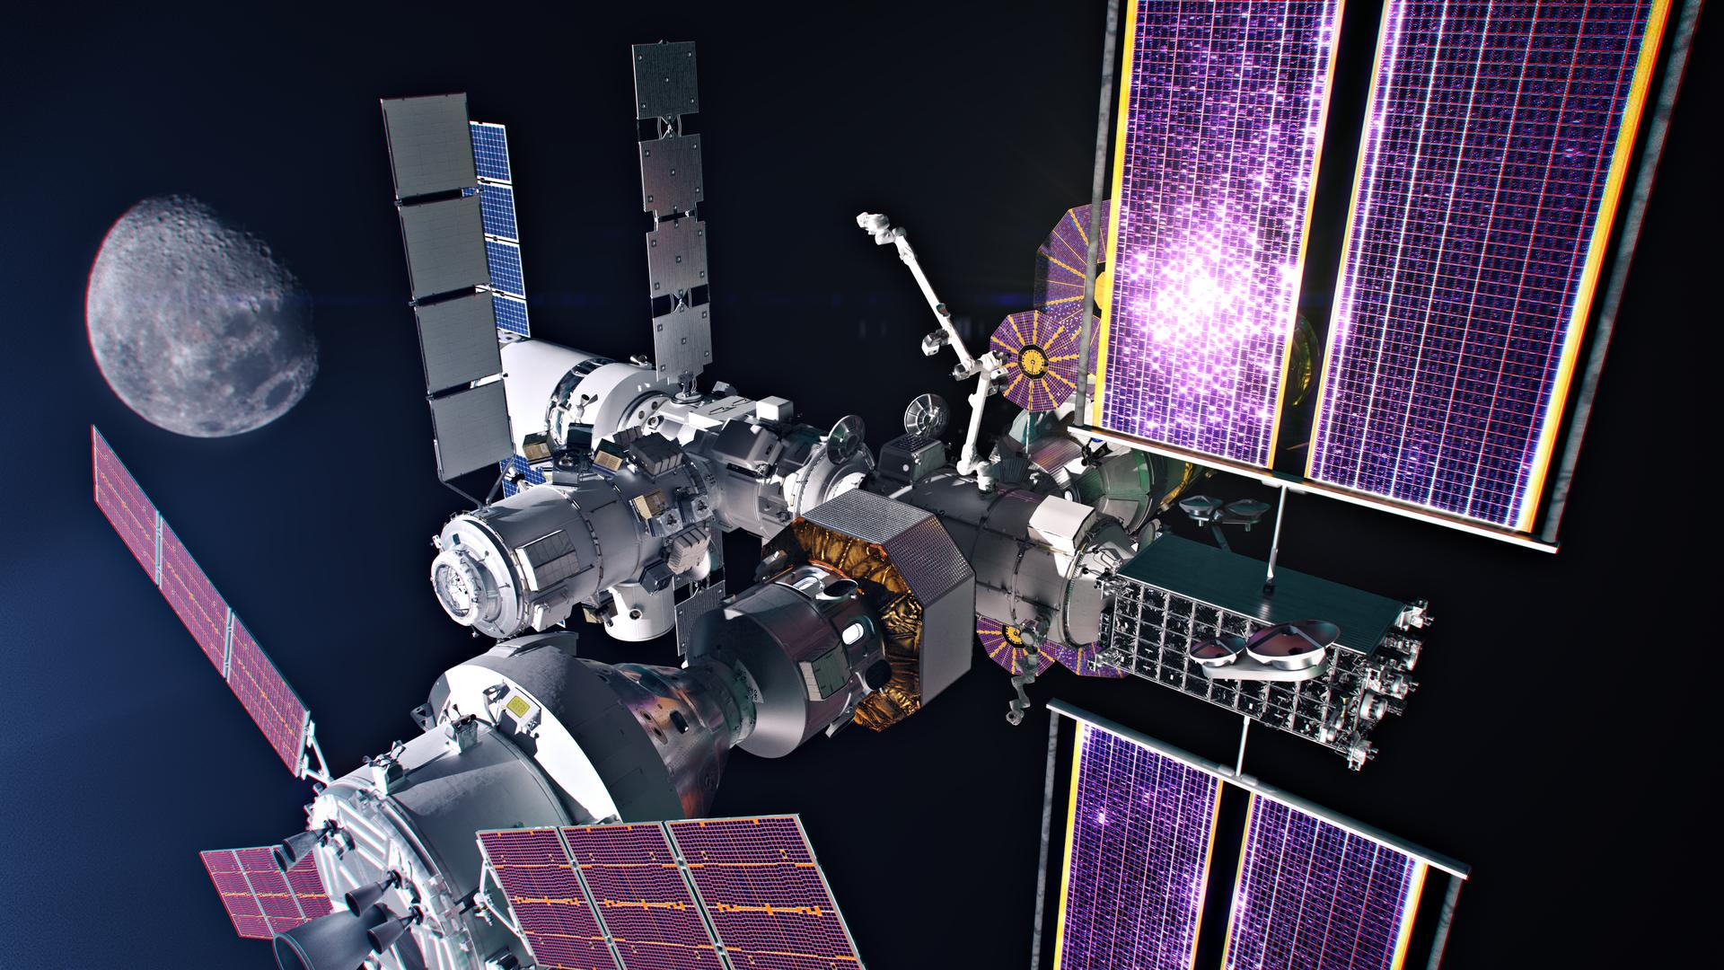

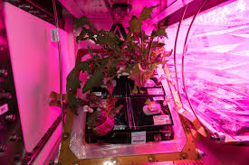
Current Efforts
Artemis IV⁴
Lunaria One¹
VEGGIE⁵

Slide 6
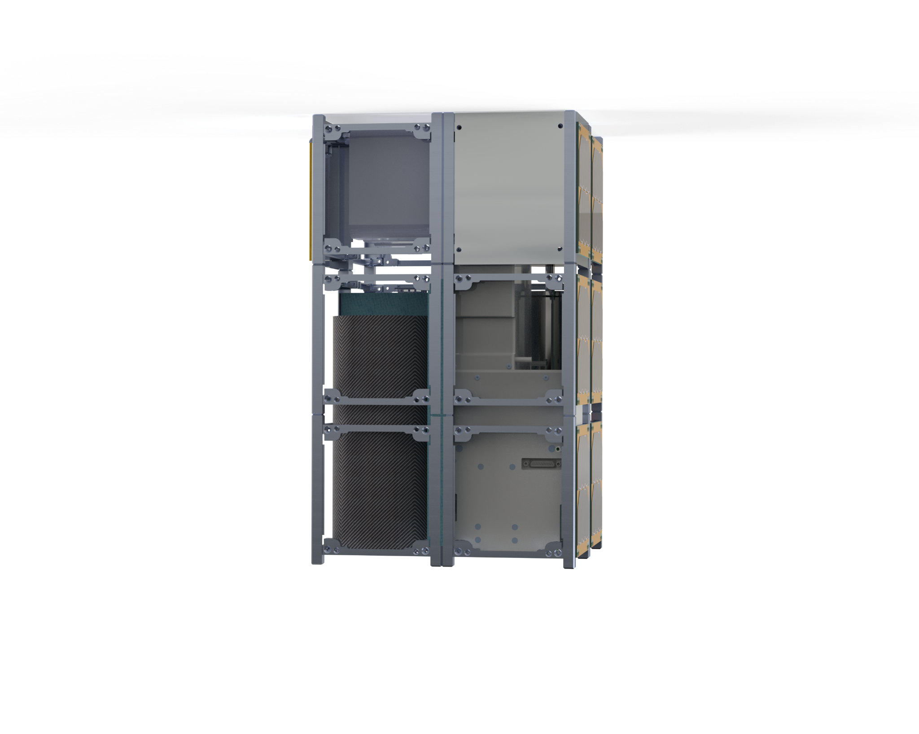
12U CubeSat
Contains an LED array and two different temperature regions to impact the terrarium based on lunar day or night.
  Radioisotope heater unit and Cryo-cooler will create the temperature
  Insulated by Aerogel
Lunar gravity will be recreated by Attitude Determination and Control System (ADCS)
  40 RPM

Slide 7
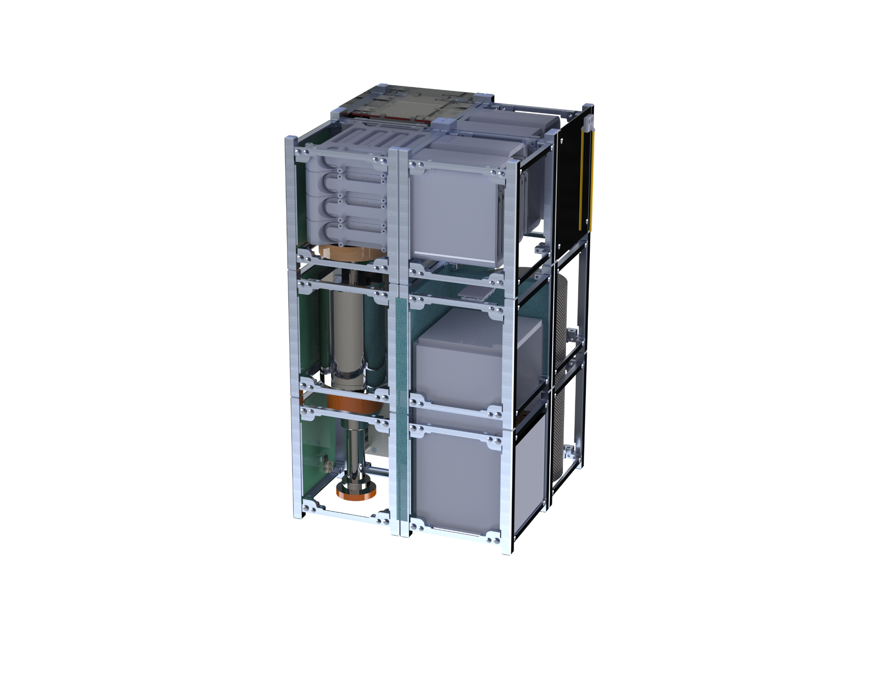
Terrarium Design
Telemetry, Telecommunications, and Command (TT&C)
Radio
Computer System
Battery
Cryo-Cooler
ADCS
Aerogel Insulation
Radioisotope Heater Unit
Terrarium
Solar Panels

Slide 8
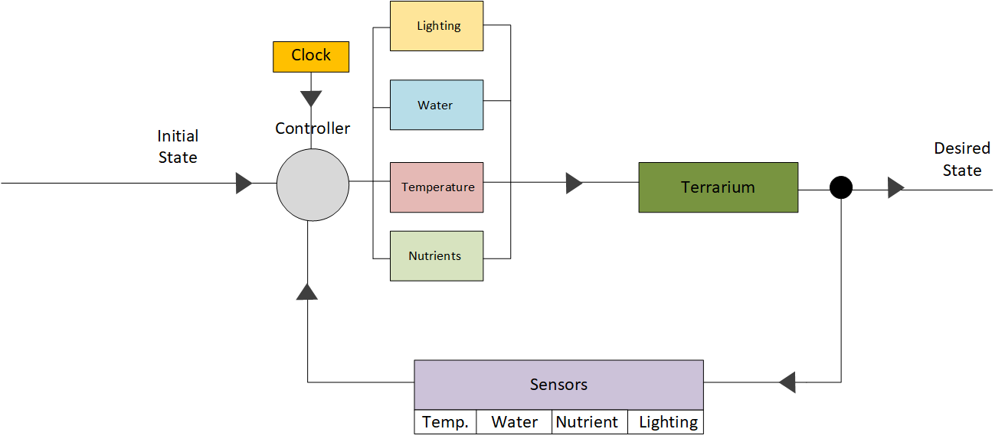
Terrarium Controller

Slide 9
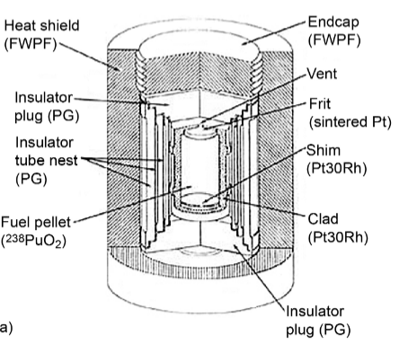
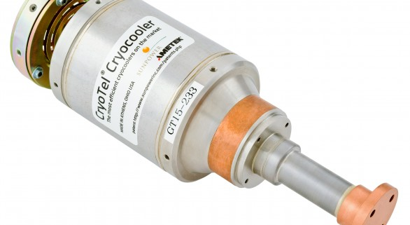
Terrarium Controller
Actuators to increase/decrease lighting, water, temperature, and nutrients.
Sensors to measure temperature, water/humidity, nutrients and lighting.
Feedback controller to intervene and adjust parameters like lighting, water, temperature, nutrients to nurse the plant into stable health.

Slide 10
Terrarium Controller Intervention
Terrarium controller will steadily reduce intervention as the plant grows to adulthood.
Terrarium controller intended to nurse plant and terrarium ecology into health at early stages.
Details of this strategy to be worked out through experiments.
Max Actuation
100%
Time

Slide 11
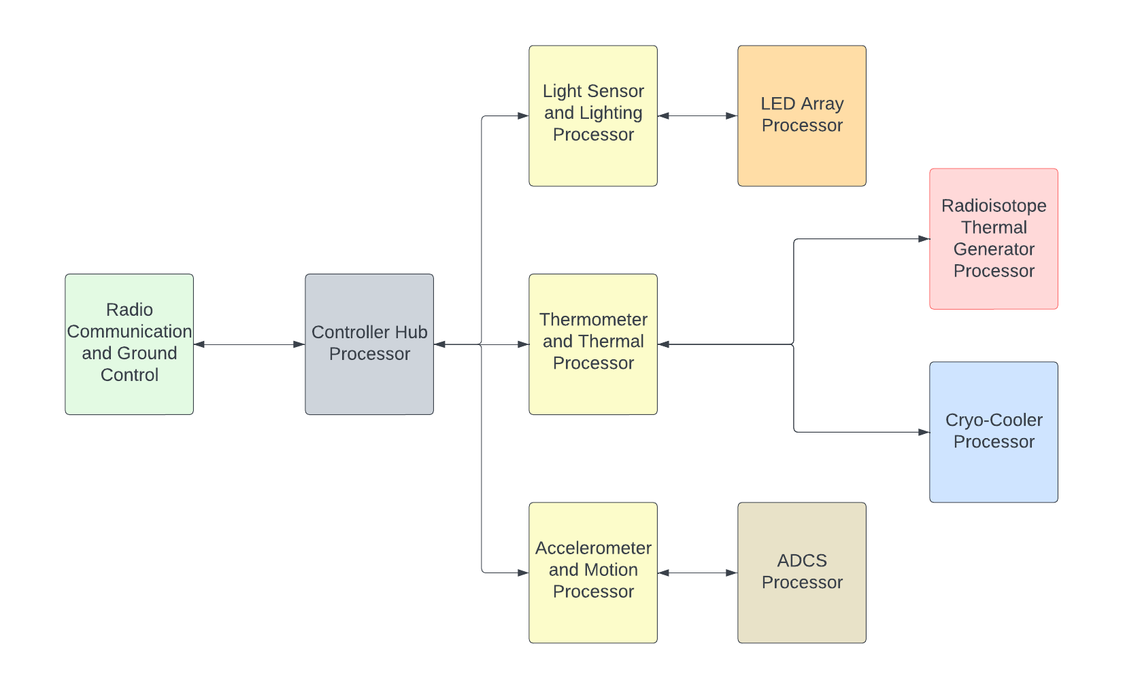
Controller Hardware Layout

Slide 12
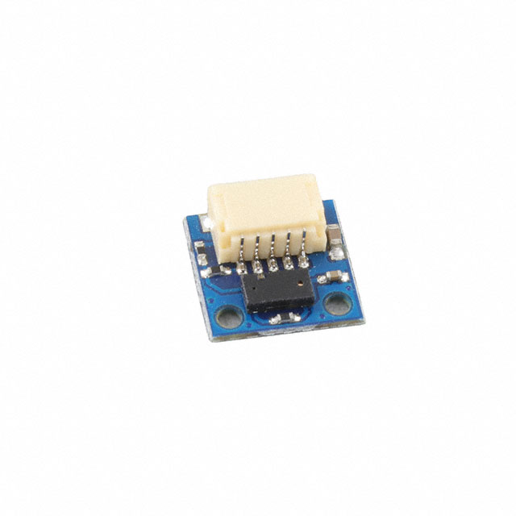
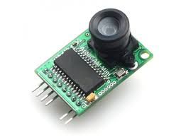
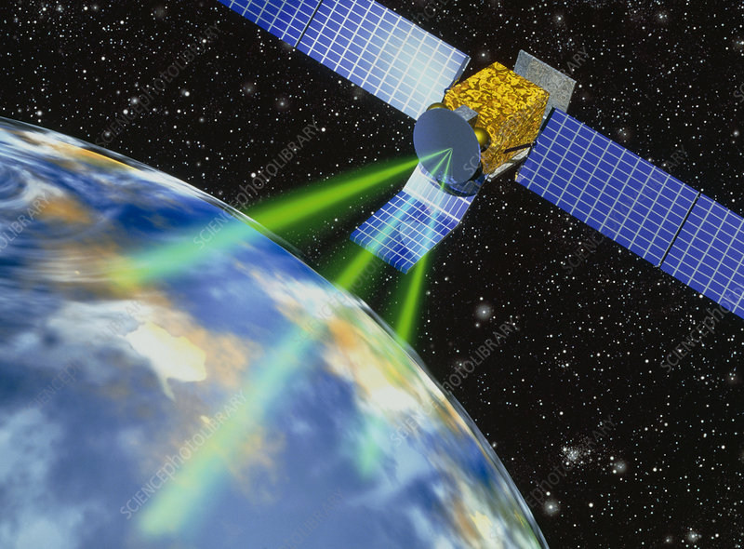
Controller Inputs and Outputs
Controller will read temperature, lighting, humidity, and nutrient concentration.
  Camera to provide live recording.
Radio-based user input system to switch between day and night.
Controller responds by changing thermal generation and lighting
Automatic reaction to external stimuli, such as solar radiation

Slide 13
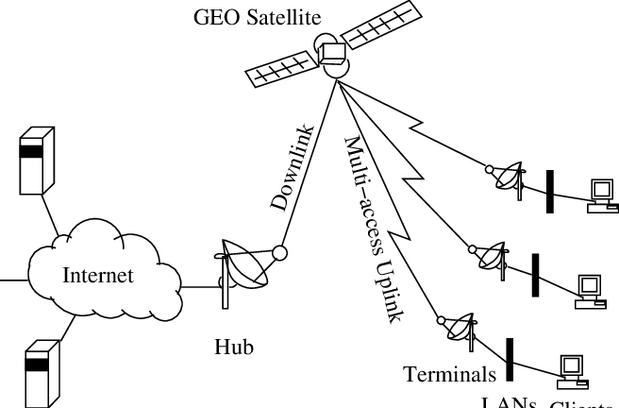
Hardware Benchmark Requirements
Average data transfer speed is approximately 4 Mb/s
  Files are assumed to be 0.5-2.5Mb, but have to be run continuously.
Response time must also be fast.

Slide 14
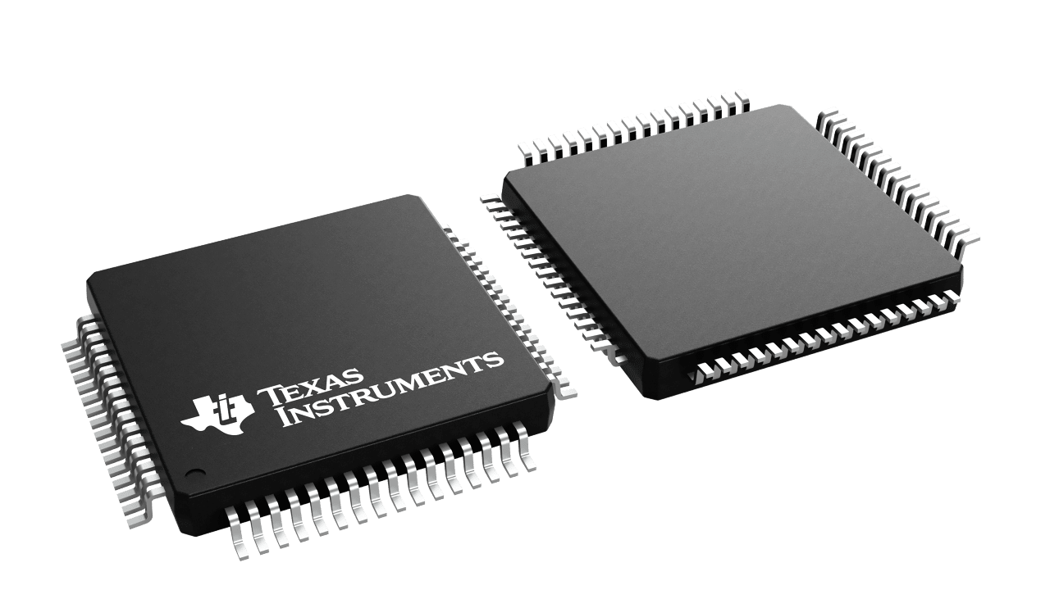
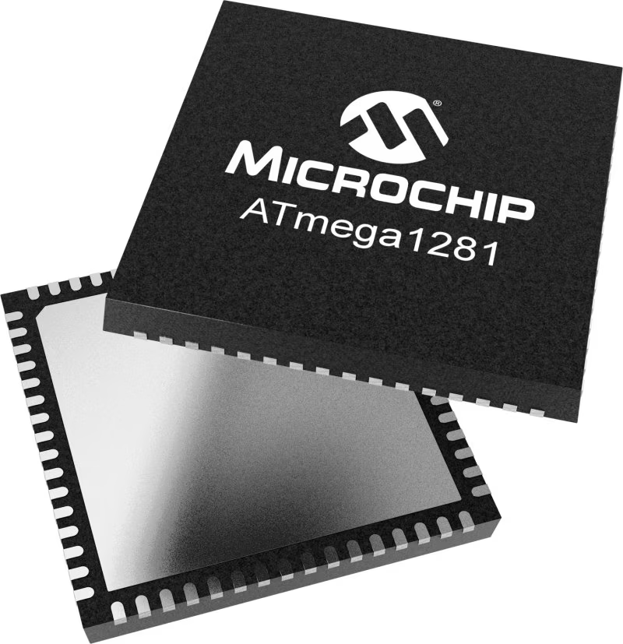
CPU Trade Analysis
Chips | Pros | Cons | Image
TI-MSP430F1612 [1] | 8 MHz Response time | 60 KB RAM
ATMEGA1281[2] | 16 MHz | 64 KB RAM
IMT PIC32MZ M14K [3] | 64 MB RAM 200 MHz Response Time | High Mass and Volume

Slide 15
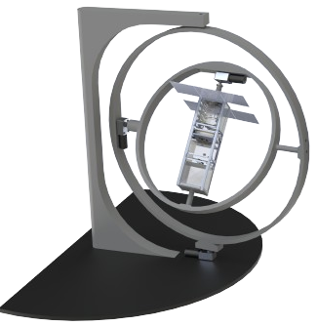
Conclusion and Future Work
A terrarium controller is key to attempting to recreate space conditions.
Construction of a gyroscope can recreate LEO effects
  Can test attitude control
Making and testing prototypes
  Plants, sensors, and communications systems.

Slide 17
References
[1] https://lunaria.one/
[2] https://www.researchgate.net/publication/330888191_Low_Power_Radioisotope_Conversion_Technology_and_Performance_Summary
[3] Microchip, “8-bit Microcontroller with 16/32/64KB In-System Programmable Flash DATASHEET”, ATmega1281, May, 2011, https://ww1.microchip.com/downloads/aemDocuments/documents/OTH/ProductDocuments/DataSheets/ATmega640-1280-1281-2560-2561-Datasheet-DS40002211A.pdf
[4] Microchip, “PIC32MZ Embedded Connectivity (EC) Family”, IMT PIC32MZ M14K, 2013, https://ww1.microchip.com/downloads/en/DeviceDoc/60001191G.pdf
[5] https://www.nasa.gov/general/nasas-artemis-iv-building-first-lunar-space-station/
[6] https://science.nasa.gov/mission/veggie/
[7] - Texas Instruments, “MSP430F161x Mixed Signal Microcontroller datasheet (Rev. G)”, MSP430F1612, Oct 2002,
https://www.ti.com/lit/ug/slau049f/slau049f.pdf?ts=1713480233560&ref_url=https%253A%252F%252Fwww.ti.com%252Fproduct%252FMSP430F112%253FkeyMatch%253D%2526tisearch%253Dsearch-everything%2526usecase%253Dpartmatches

