Slide 1




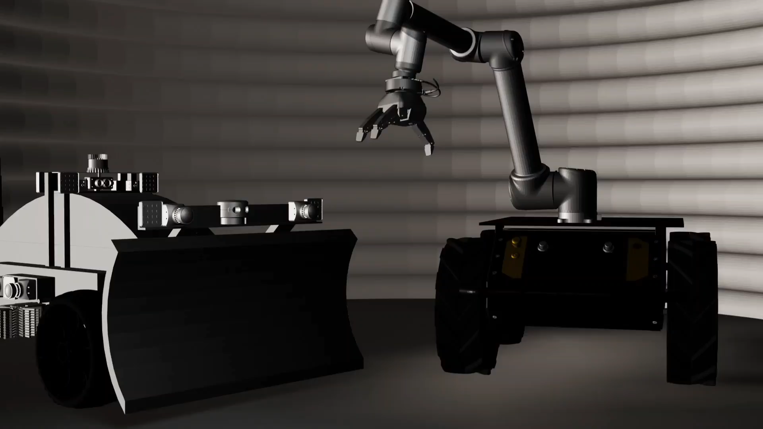
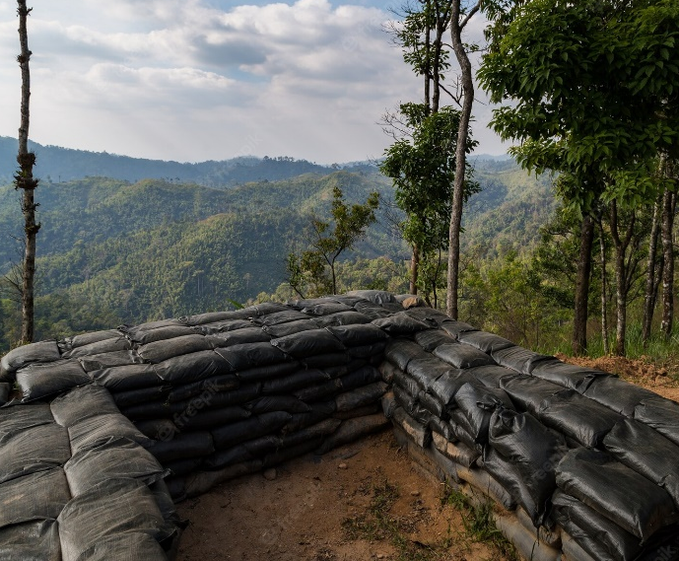
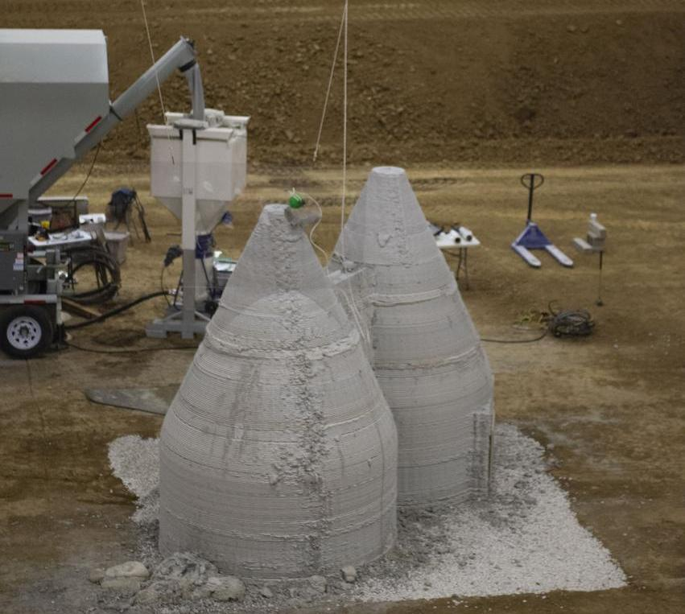
Multi-Robot Construction
Adharsh Prasad Natesan, Jekan Thangavelautham
Space and Terrestrial Robotic Exploration (SpaceTREx) Laboratory
Aerospace and Mechanical Engineering Department
University of Arizona

Slide 2
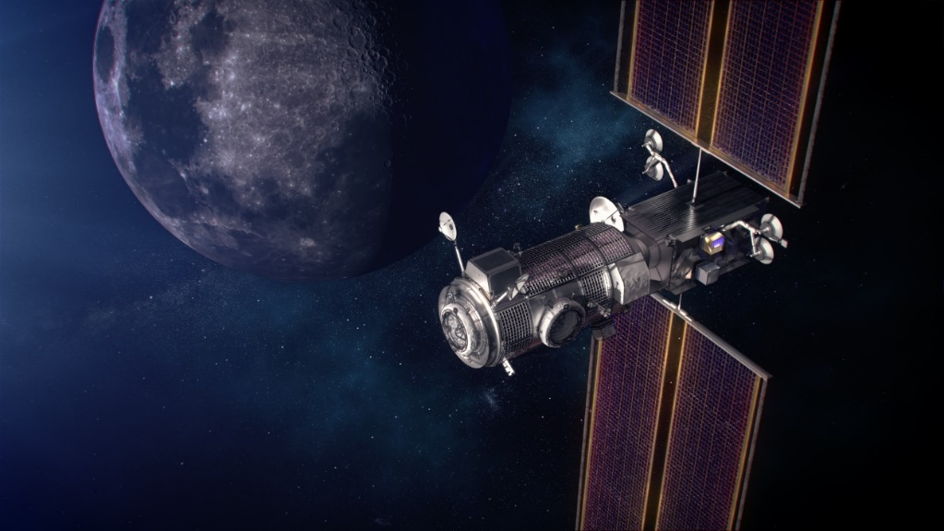
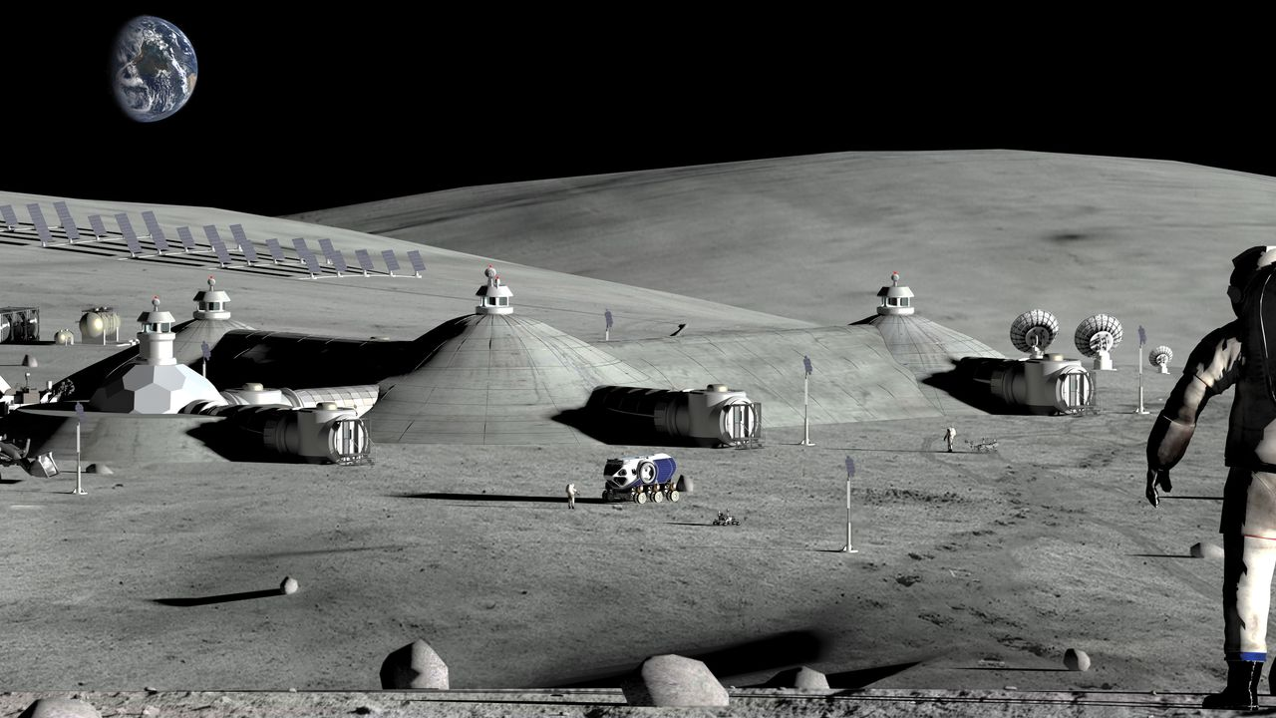
Motivation
Need for “Semi-Permanent” structures on lunar surface.
Potentially expanded role for robotics to handle dull, dirty, and dangerous tasks.
Large multi-functioning construction robot is difficult to maneuver due to wheel sinkage.
Swarm of autonomous robots that can perform varied tasks.
Need for a centralized intelligence that could manage swarm of robot!!!

Slide 3
Objective
Use swarm of multi robot systems to autonomously construct lunar structures.
  Generate the construction planning of the lunar structure.
  Simulate the results to verify the effectiveness of the algorithm.
  Propose failure recovery mechanism for off-nominal scenarios.

Slide 4
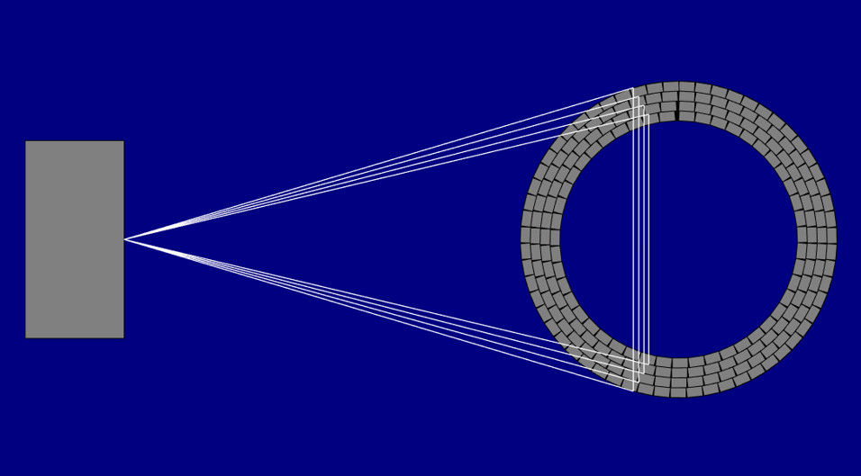
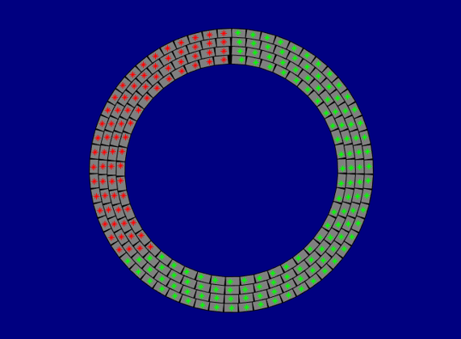
Assembly sequence
Tangent based sequence to define a precedence constraint.
Depot Location
Tangent based assembly sequence.

Slide 5
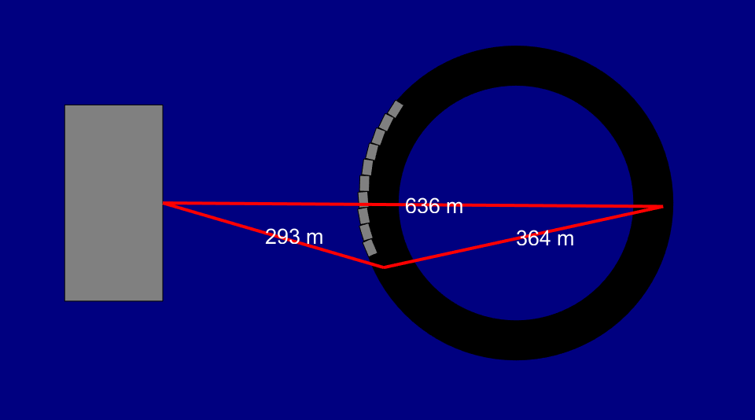
Optimality Check
Overall distance travelled by all the robot is ∑(Target_Loc(i) – Home_Loc).
Hence the total distance is fixed distance. The above sequence generated is bound to produce an optimal solution as can be seen in the figure below.

Slide 6
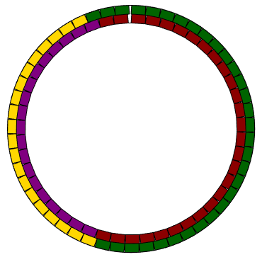
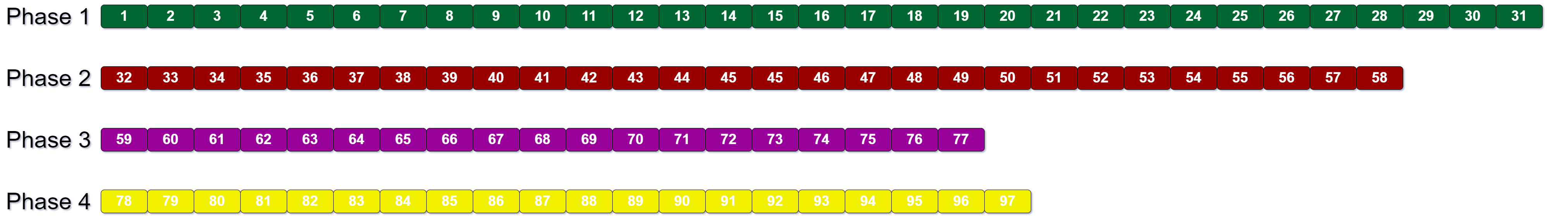

Construction Sequence
Target array formed by elements of the target

Slide 7
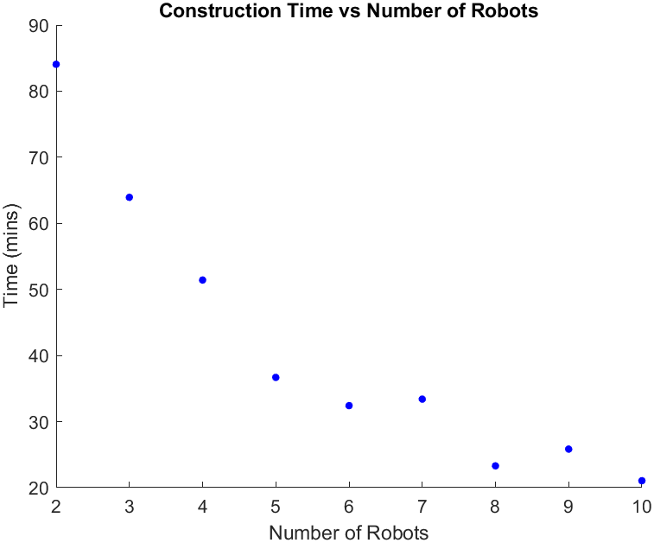

Task Planning
Uniformly assign robots to all the location equally to reduce operation time.
How to Solve the construction gap problem???
Plot showing Time vs Robot
Sandbag Blockages

Slide 8
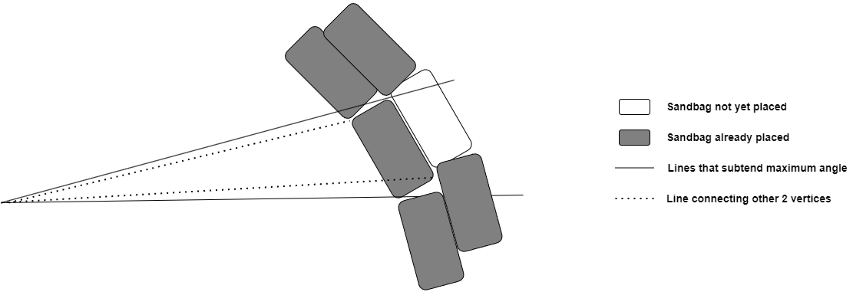
Problem Formulation
Depot Location
Represents a typical case of Sandbag-sandbag blockage.

Slide 9
Constraint Formulation
If we see from the above diagram, we could understand that the problem is caused due to the placement of sandbags at targets that are in phase (i+1) before phase (i).
But not all such placements cause a problem if the time at which Sandtarget(i) < Sandtarget(i+1).
To determine blockages, we initially identify the largest angles formed by the current target sandbag. If an empty location is subtended by this largest angle, leads to blockage.

Slide 10
Problem Formulation
If we solve all the 3 conditions, we end up being in blockage.
Hence, we could formulate the constraint as:
Targets(i) ∈ [Max_Vertex1(Target(j))∪ Max_Vertex2(Target(j))]
Where,
i ∈ [1,j-1], represent all the targets in phases 1 to (j-1).
j ∈ [2,N], represent all the targets that are placed before max(time(phase(j-1)).
N is the total number of phases.
Max_Vertex1 & 2 are the vertex that subtend maximum between them among all the vertex of the sandbag rectangle.
[A,B] represent all the points inside line joining OA and OB.

Slide 11
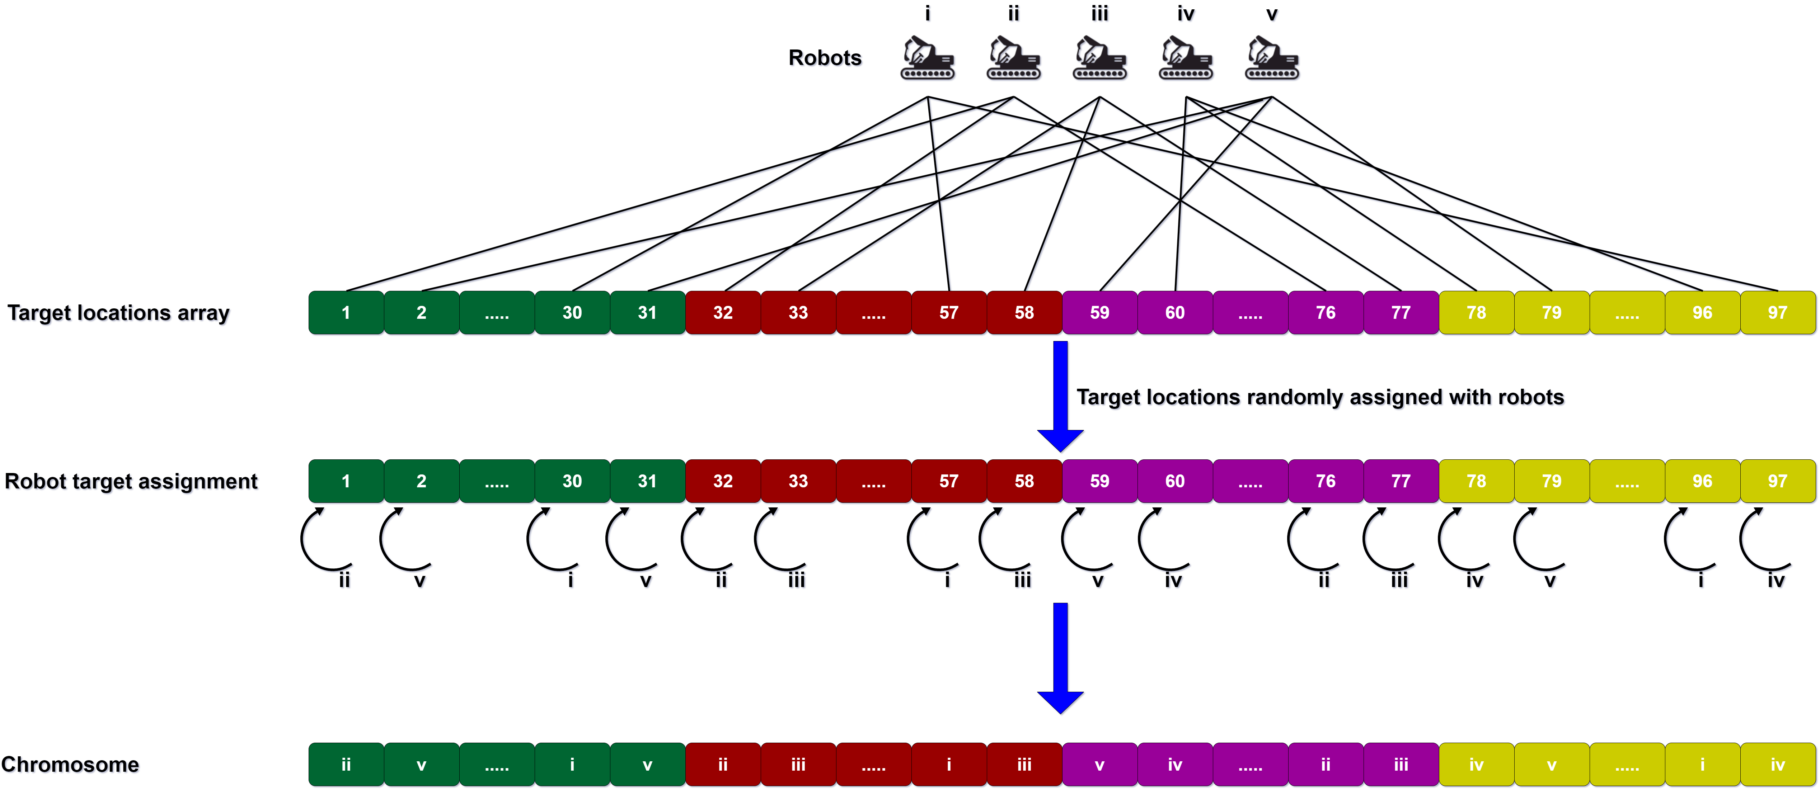
Genetic Algorithm
Randomly assigned robots to target locations array to form chromosome.

Slide 12
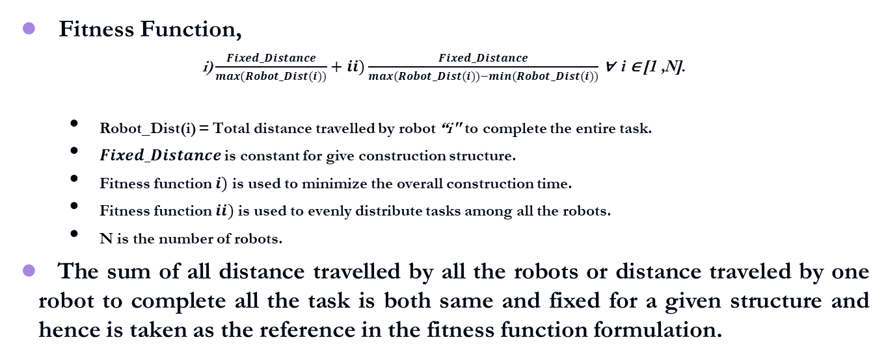
Fitness Function
Fitness Function,
$\text{i}\text{)}\frac{Fixed_Distance}{max(Robot_Dist(i))}+ii)\frac{Fixed_Distance}{max(Robot_Dist(i))−min(Robot_Dist(i))}$ ∀ i ∈ [1 ,N].
  Robot_Dist(i) = Total distance travelled by robot “i" to complete the entire task.
  $Fixed_Distance$ is constant for give construction structure.
  Fitness function $i)$ is used to minimize the overall construction time.
  Fitness function $ii)$ is used to evenly distribute tasks among all the robots.
  N is the number of robots.
The sum of all distance travelled by all the robots or distance traveled by one robot to complete all the task is both same and fixed for a given structure and hence is taken as the reference in the fitness function formulation.

Slide 13
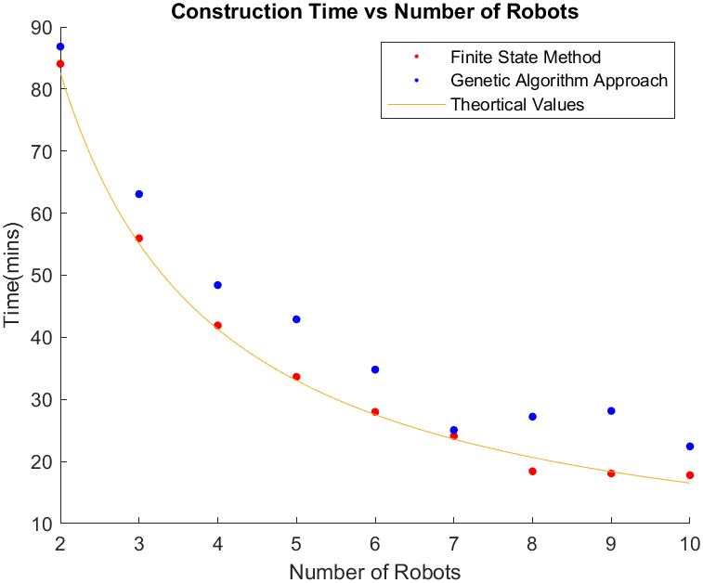
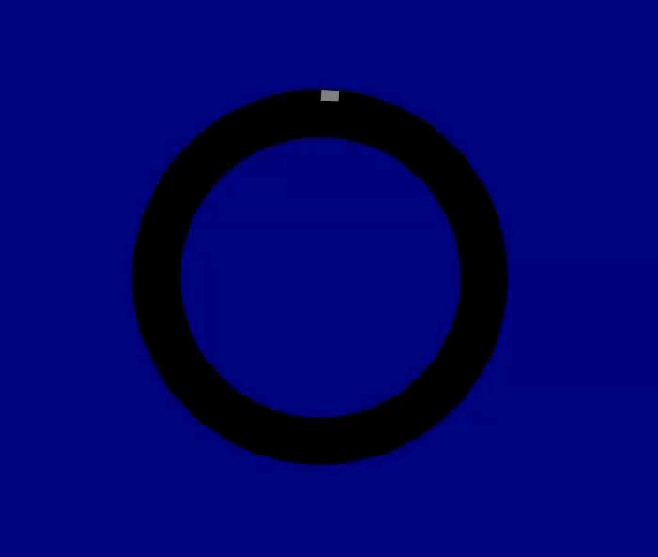
Results for Different Robot capacity
Based on the best solutions of GA we could get maximum distance travelled by a robot and hence the approximate construction time would simply Max_Distance/(Robot_Velocity).
Let us look at the real simulation with robots
Plot showing Construction time vs Robot capacity

Slide 14
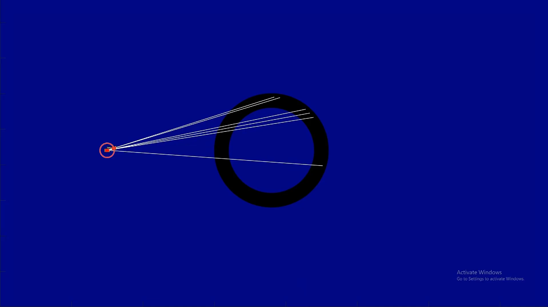
Simulation best results

Slide 15
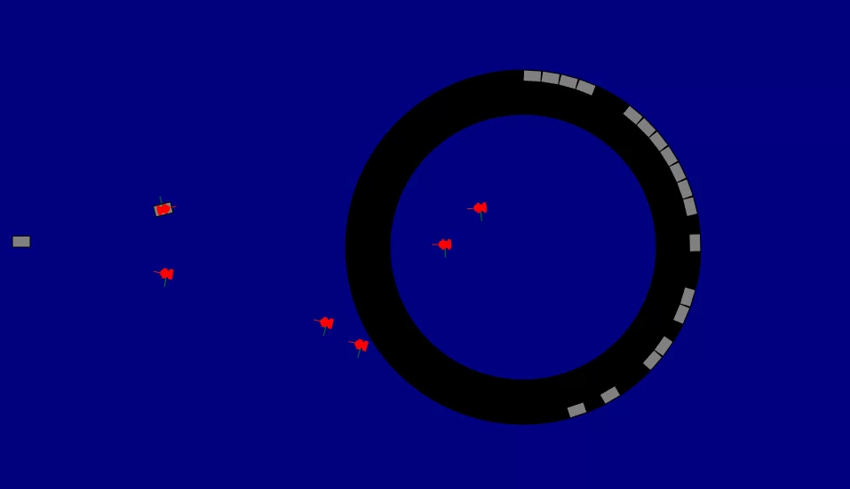
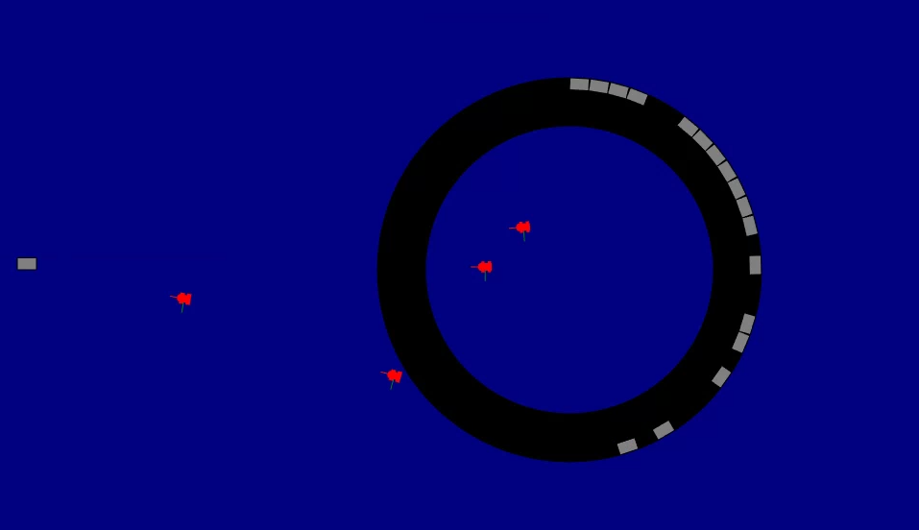
Off nominal Scenarios
Robots in the harsh lunar environment are prone to failure and in case of failure, we need to propose an effective and real time failure recovery mechanisms.
What do we do in such scenarios???
Failure in two of the robots while performing the construction tasks.

Slide 16

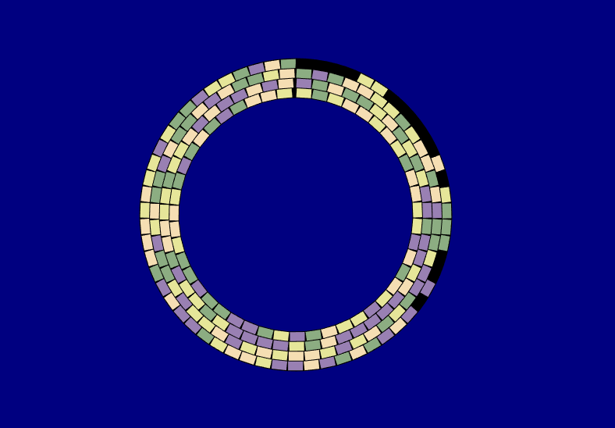
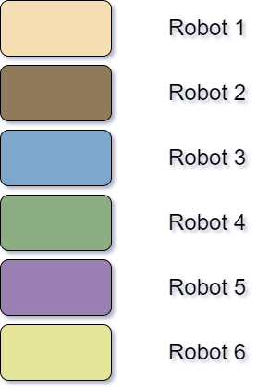
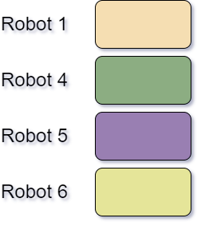
Failure Recovery Mechanism
Re allocate the remaining target locations using the Genetic Algorithm among the remaining 4 robots based on their robot location when failure happened.

Slide 17
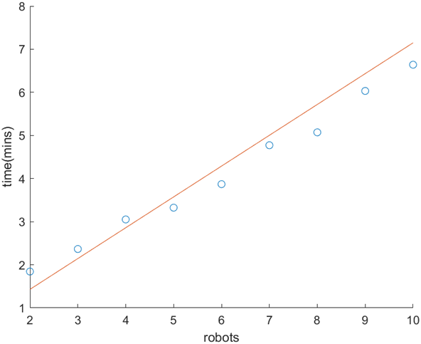
Computation time vs Number of robots
Population:- 500
Generations:- 200
Elite Population:- 25%
Number of Targets:- 212

Slide 18
Future Works
Executing a Genetic Algorithm (GA) in real-time scenarios is not viable, leading to the need for storing GA outcomes for future use.
A potential solution involves using GA-generated data to train a neural network, enabling it to learn the optimization process and ensure reproducible results for future applications.
Leveraging the ML model, propose a dynamic task planner capable of adapting to real-time changes in the targets and robot locations.

Slide 19
Thank You!!!

