Slide 1





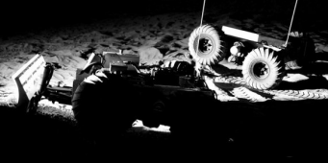
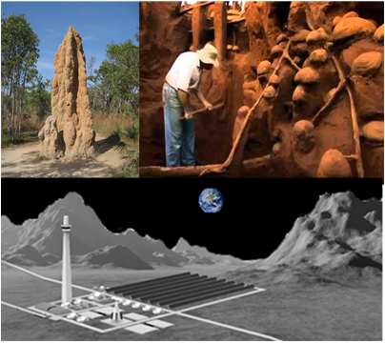
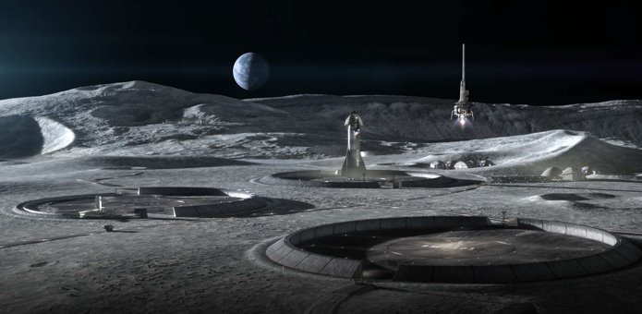
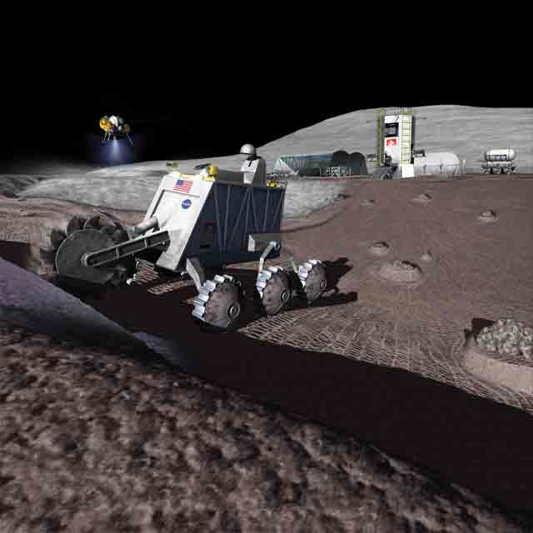
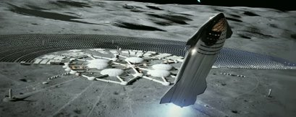
ASTEROIDS
SpaceTREx
Design and Development of an Autonomous Sandbag Filling Robot for Lunar Base Applications
Chad Cantin, Sivaperuman Muniyasamy¹, Dr Jekan Thangavelautham¹
¹Space and Terrestrial Robotic Exploration (SpaceTREx) Laboratory
¹Aerospace and Mechanical Engineering Dept.,
University of Arizona

Slide 2
Outline
Motivation
Challenges
Objectives
Related Work
Methodology
Results
Conclusion and Discussion
Future Work

Slide 3
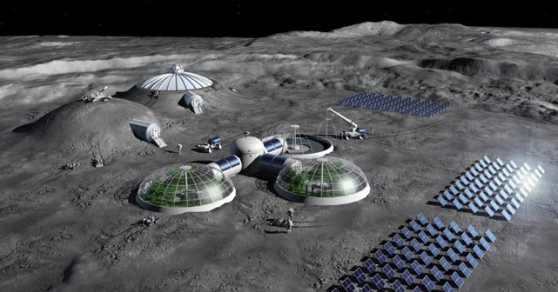
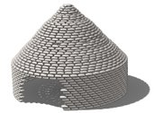
Motivation
Establishing a prolonged, permanent presence on the moon
  Enables scientific development
  Commercial and private Space economy development
>Artemis VIII (2032)
Revolutionize lunar construction methods
Render by Pierre Carril (ESA)
Lunar Base Concept (ESA)
Lunar Smart Superadobe (SpaceTREx)

Slide 4
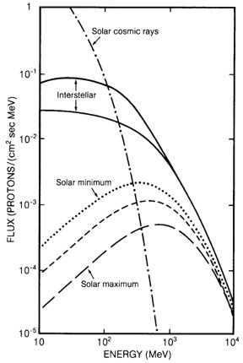
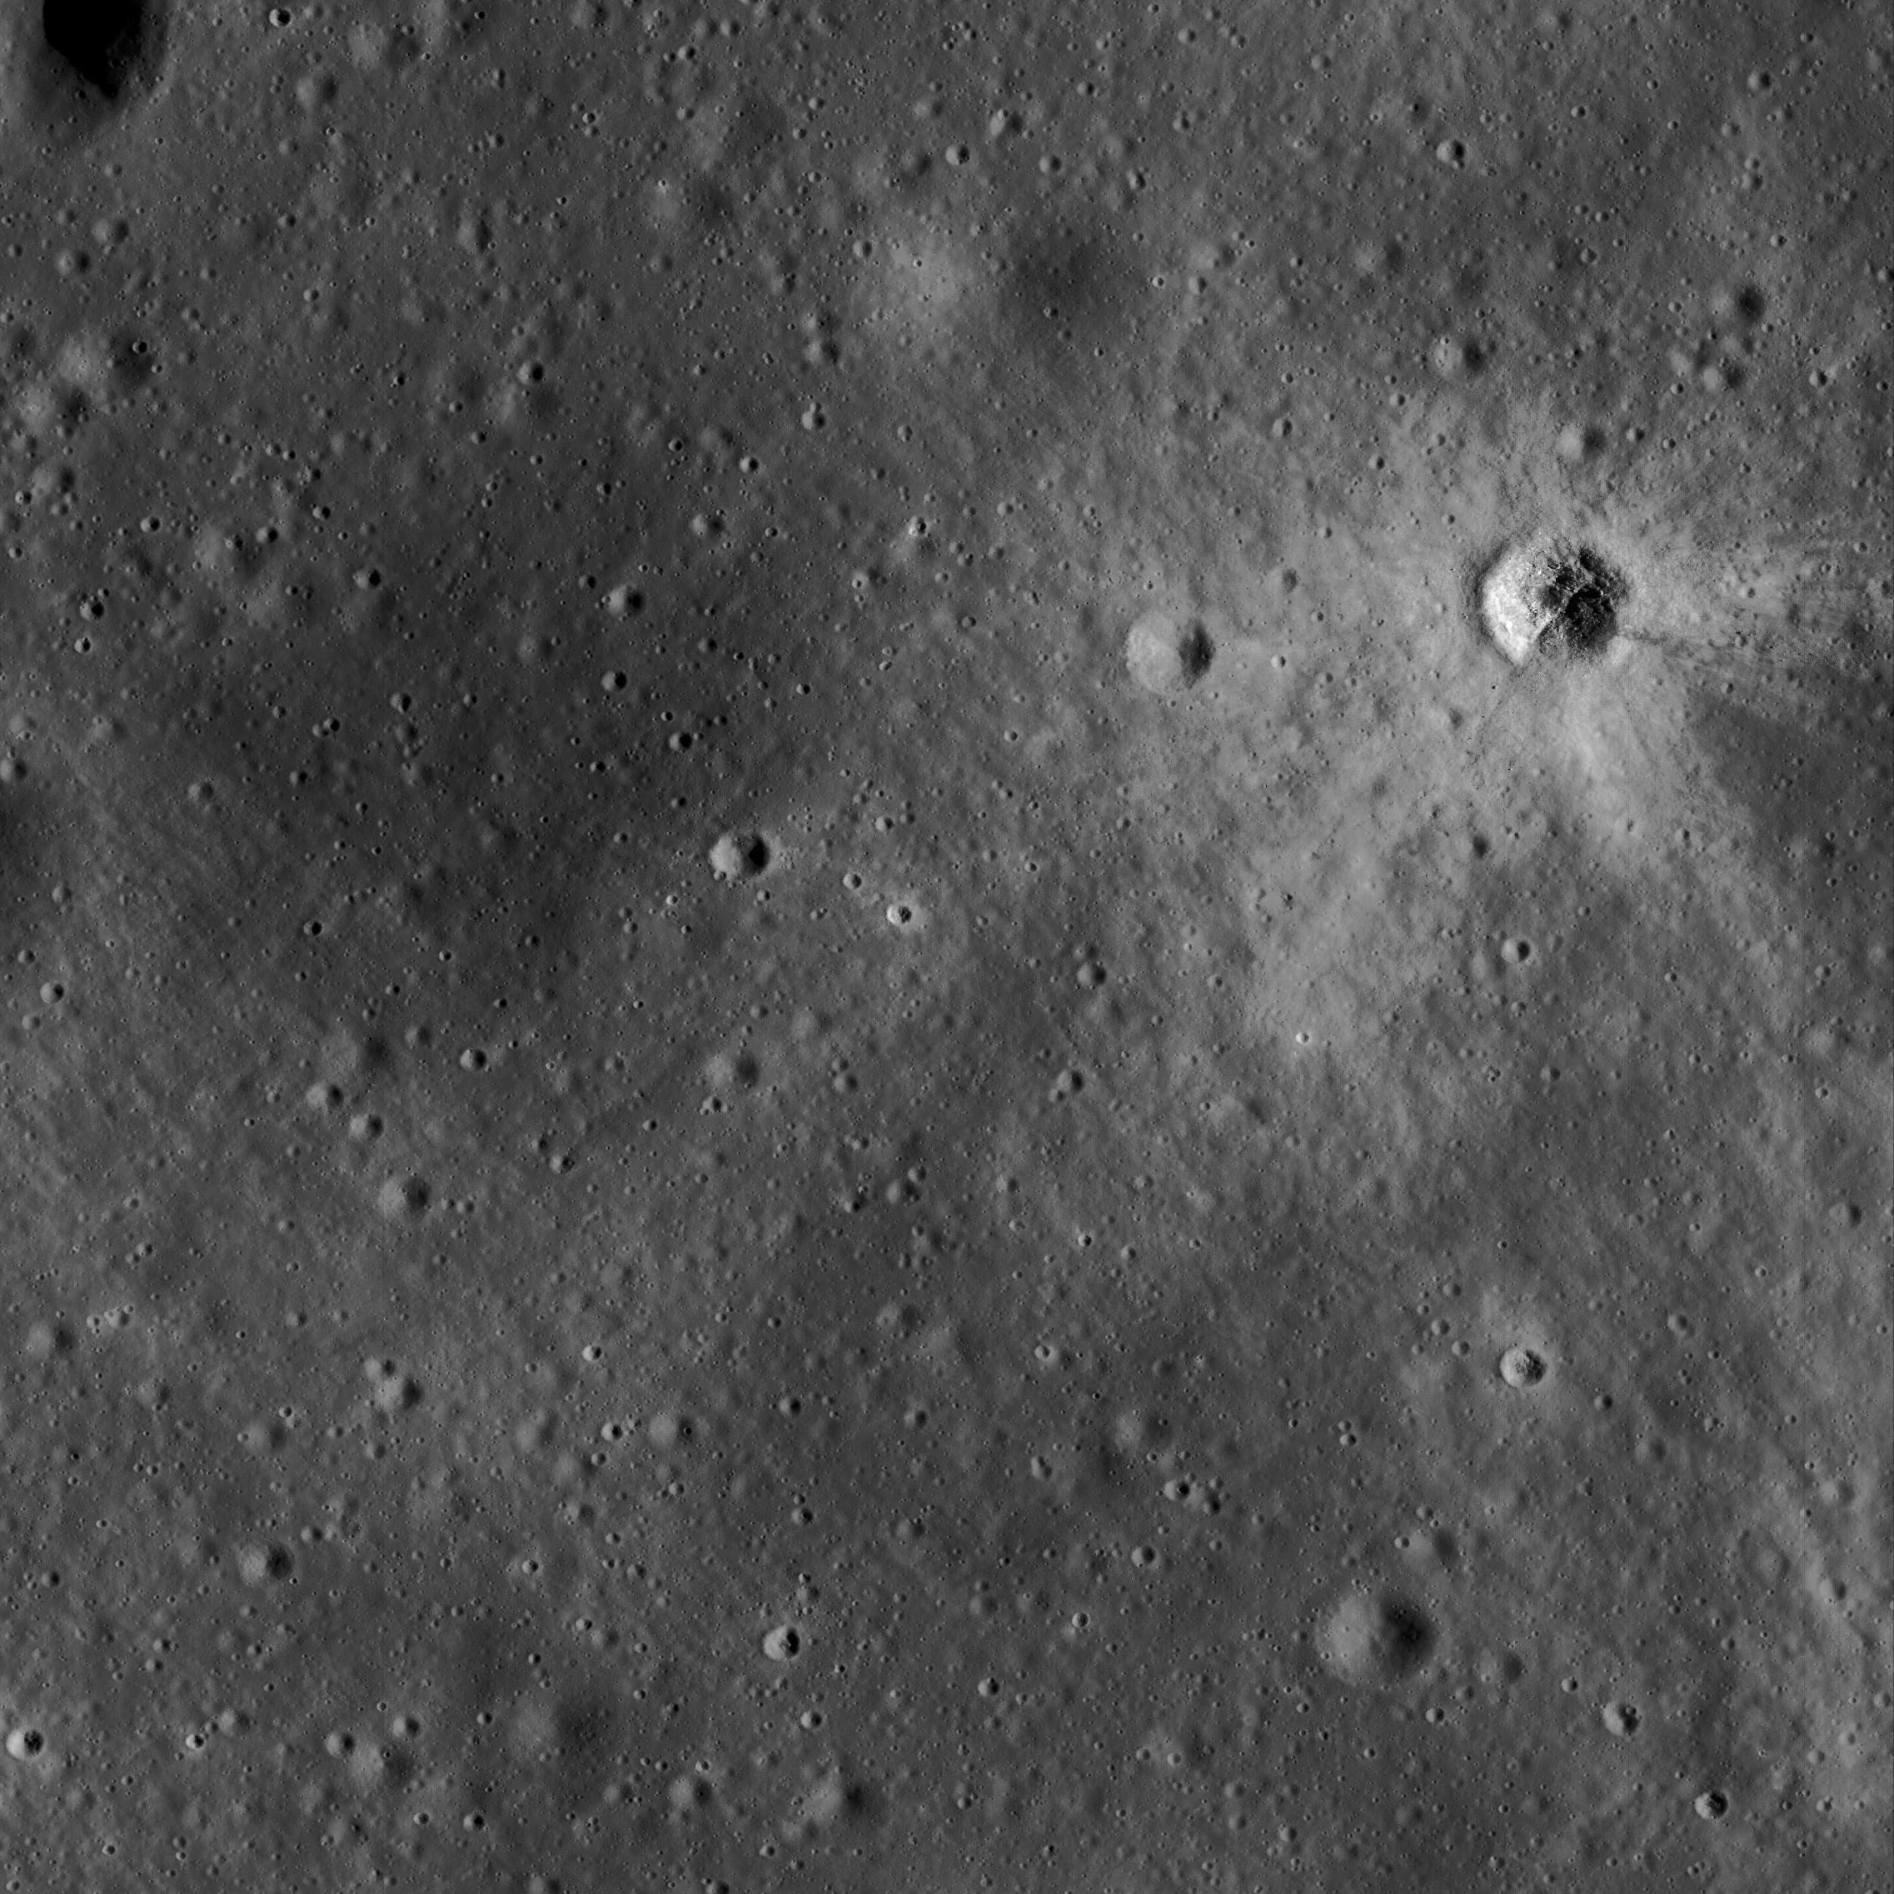
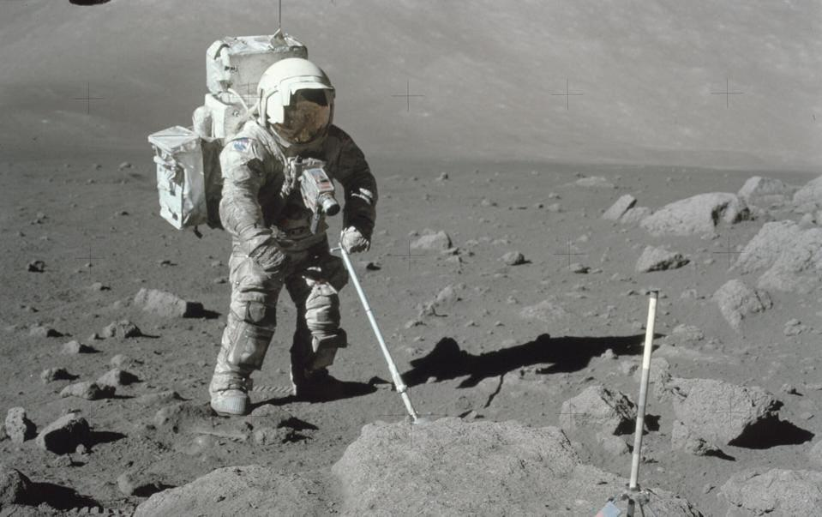
Challenges
Harsh lunar environment
  Dust and regolith management
  Surface radiation
  Micrometeorites
Abrasive Lunar Dust (NASA)
Micrometeorite Impacts (NASA, LPI)
Lunar Surface Radiation (NASA, LPI)

Slide 5

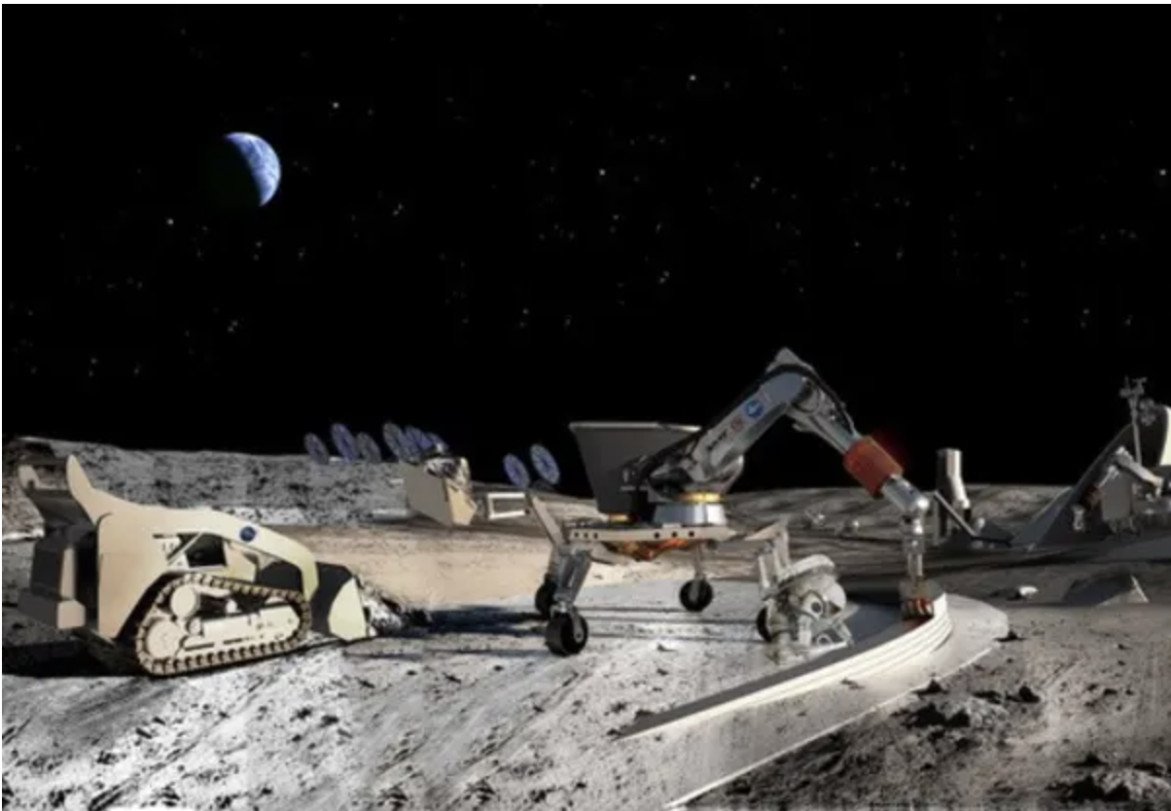
Objectives
Conceptualize, design, and prototype an autonomous sandbag filling lunar robot
  Robots will be capable of handling repetitive and strenuous tasks for various lunar base applications
Render by: NASA
Render by: NASA
Concept Autonomous Lunar Excavator (NASA)
Concept Autonomous Lunar Robots (NASA)

Slide 6
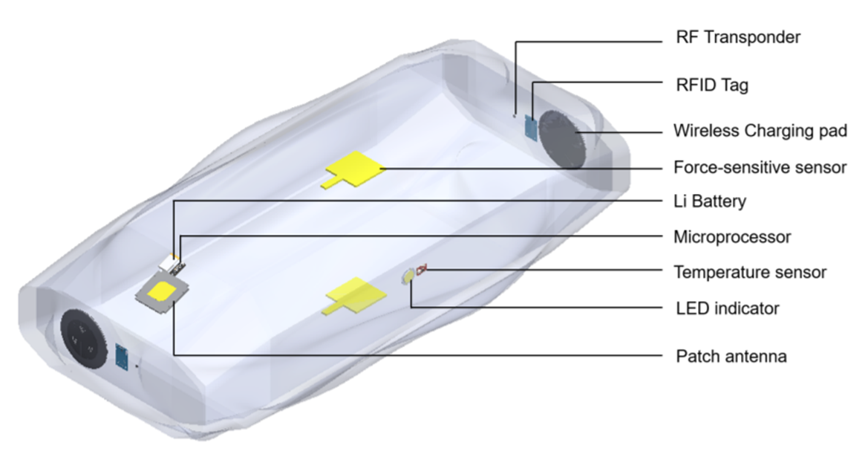
Smart Sandbag
Imagine brick in a home that can:
  Sense
  Light-up
  Compute
  Relay Comms
  Position, Nav, Track
  Measure structural health

Slide 7
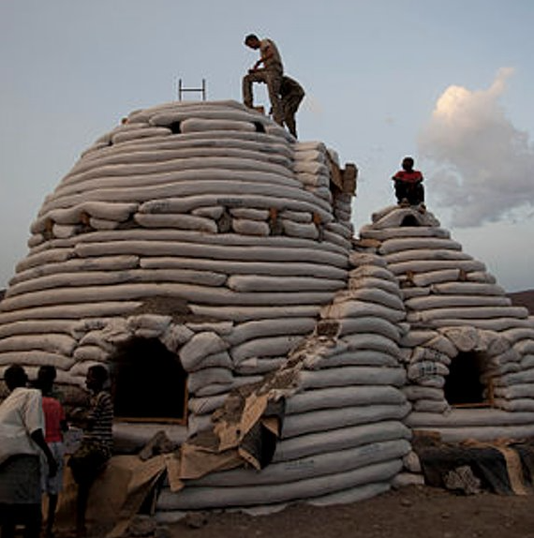
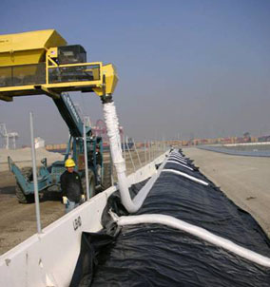
Related Work
Terrestrial superadobe applications
  Housing and Emergency Shelter
  Storage
Erosion control
  Utilization of continuous sandbags
Superadobe Dome Construction (Cal-Earth)
Sandbag Storm Basin Installment (Superior Sandbag System)

Slide 8
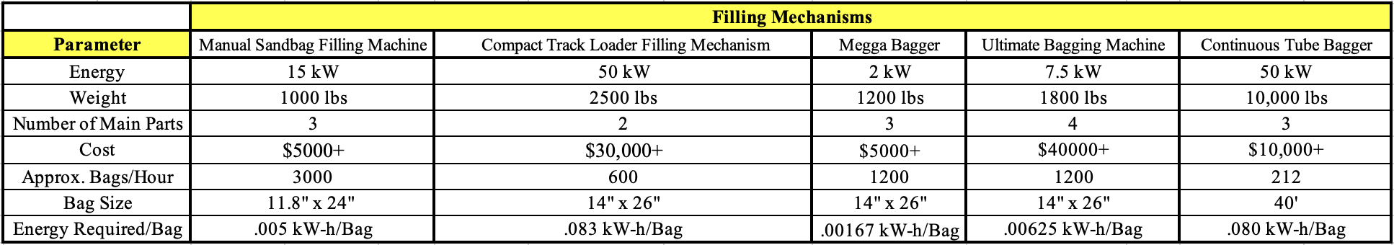
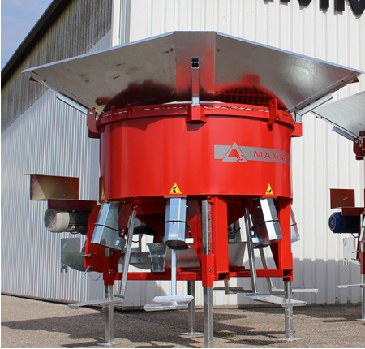
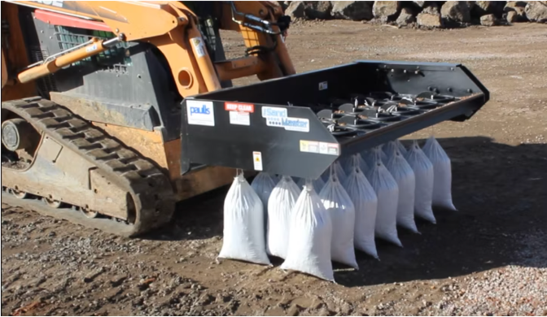
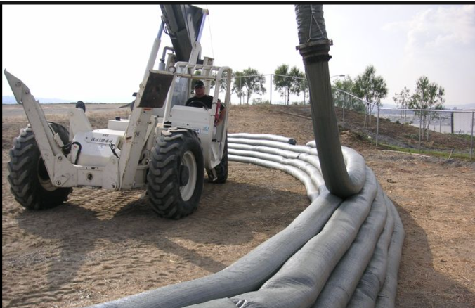
Trade Study -Filling Mechanisms
Variety of filling mechanisms compared
  Moving forward with the continuous tube bagging idea
Trade Study for Various Filling Mechanisms (Cantin, 2023)
Track Loader Mechanism (Sand Master)
Telehandler Mechanism (Superior Sandbag System)
Manual Bagging Mechanism (Megga Bagger)

Slide 9
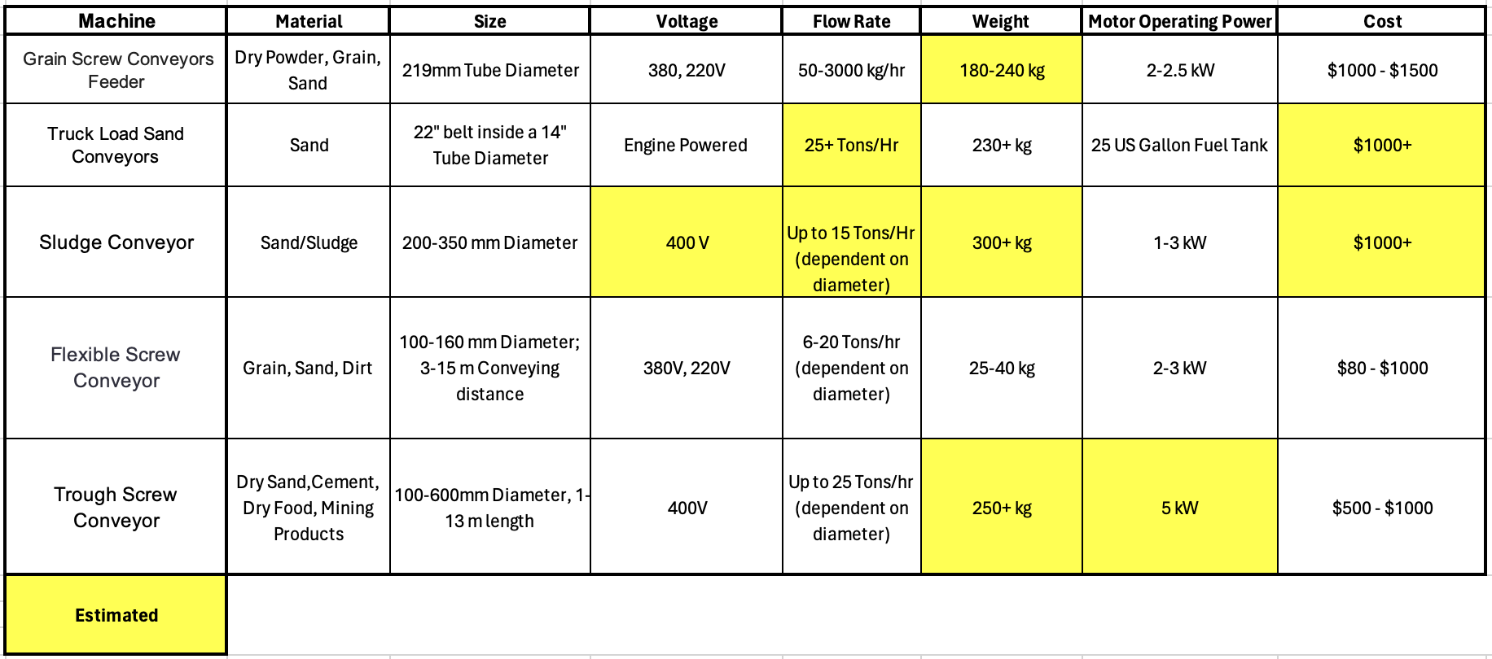
Trade Study -Screw Feeders
Trade Study for Various Screw Conveyors/Feeders

Slide 10
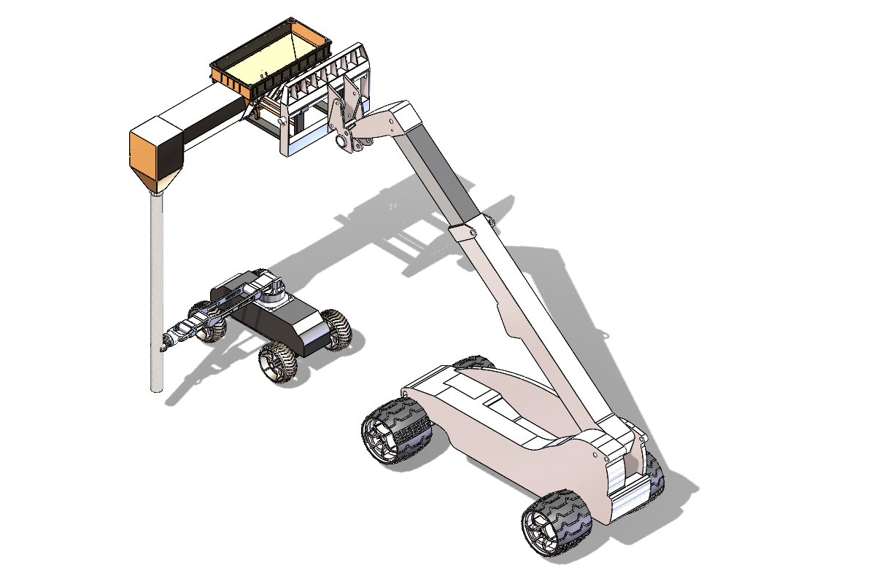
Sandbag Filling Robot CAD Model
Regolith Bin
Filling Mechanism
Regolith Pump
Assisting Robot
Robotic Arm
Sandbag
Main Robot
CAD Model of Sandbag Filling Robot (Cantin, 2023)

Slide 11
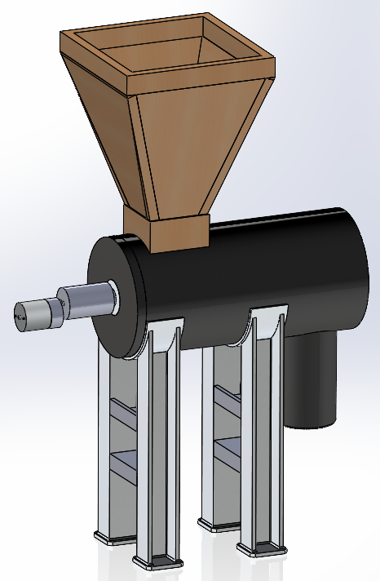
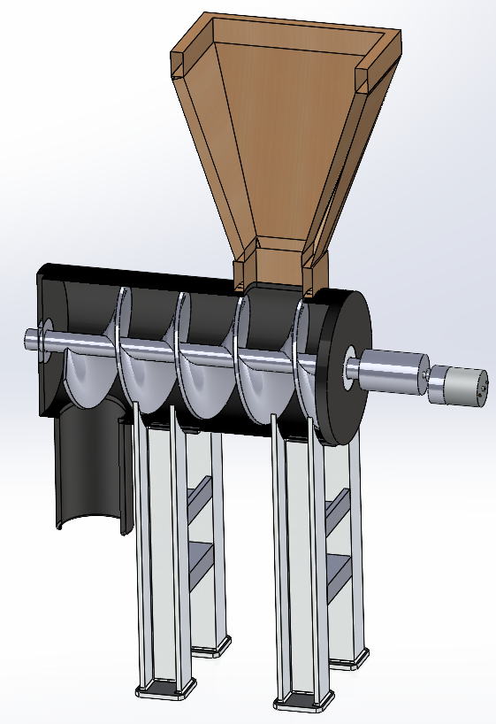
Screw Feeder Final CAD Model
Regolith Bin
Main Feeder Tube
Screw Coupler
Gear Motor
Internal Screw
Support Legs
Regular and Sectional View CAD Model of Screw Feeder Filling Mechanism

Slide 12
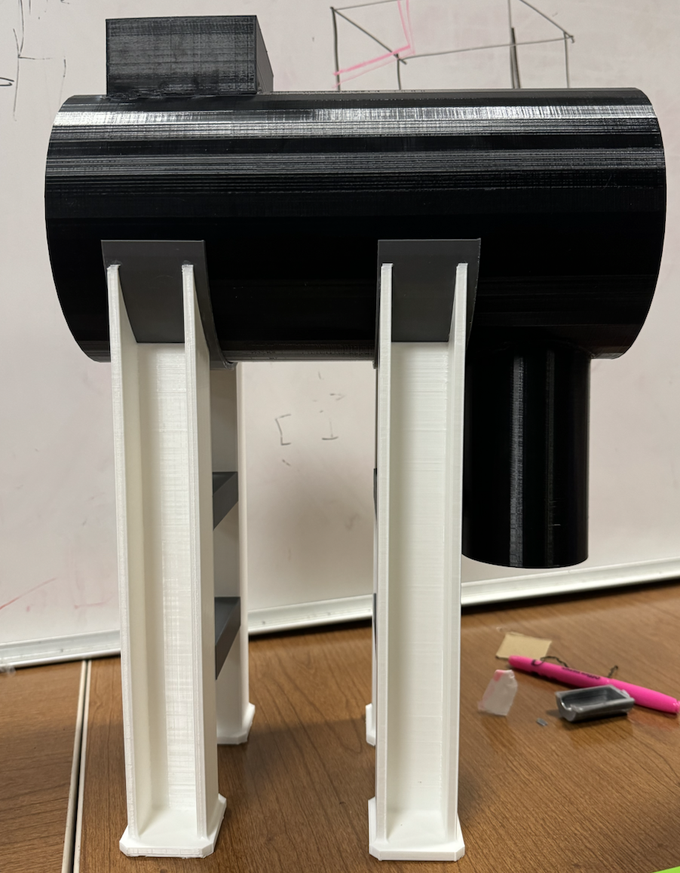
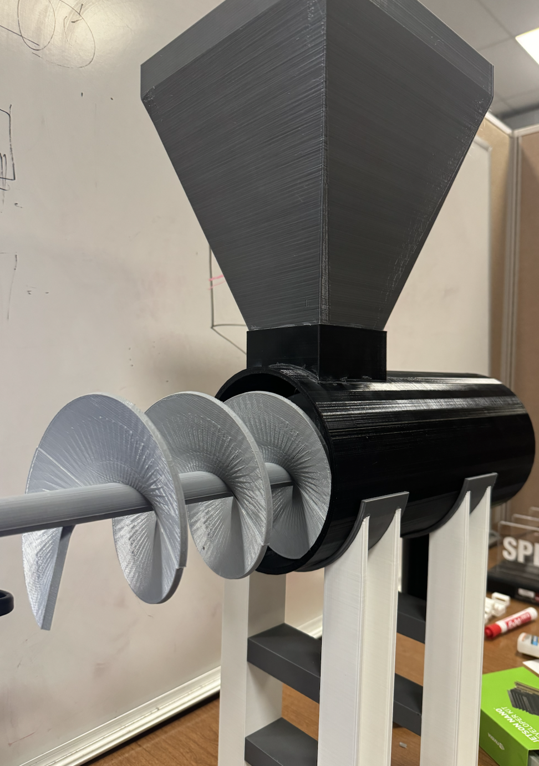
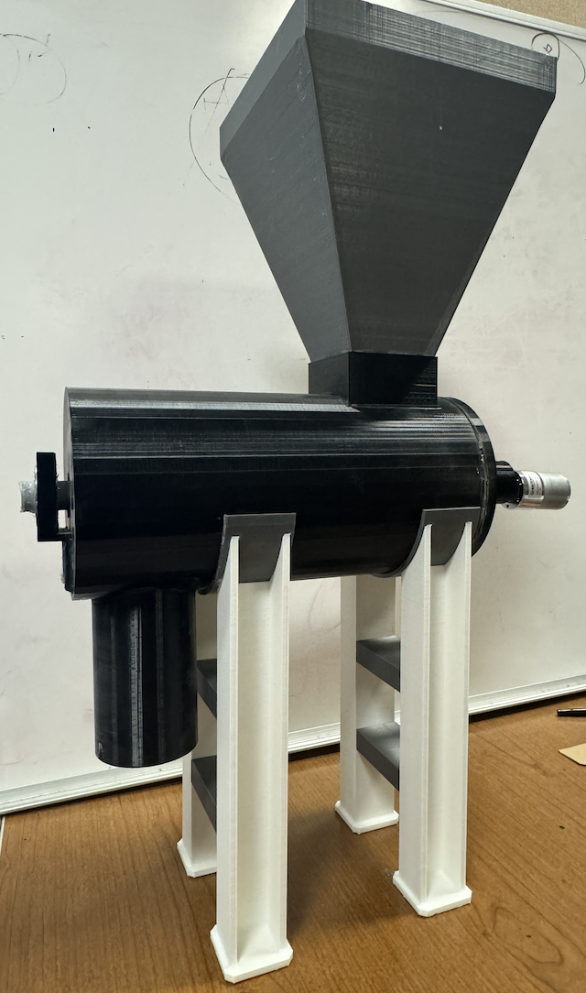
Screw Feeder Prints
3D Printed Prototype: Screw Feeder Filling Mechanism

Slide 13
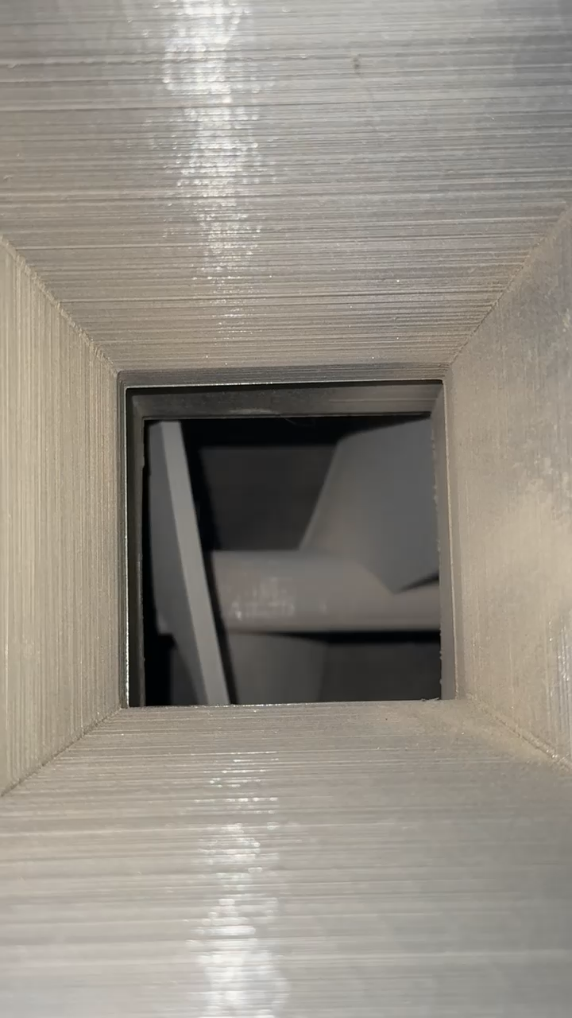
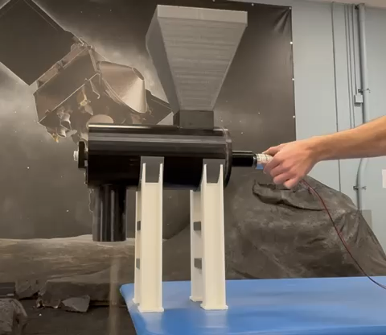
Functioning Prototype Screw Feeder
Final functioning screw feeder
Internal functioning screw

Slide 14
Conclusion and Discussion
Gained valuable insight into lunar base robotic operations and applications
  Completed trade studies, CAD models, several functioning prototypes
  Superadobe construction method is plausible with sandbag filling robot
  Enables further research, designing, and prototyping for additional external lunar robots

Slide 15
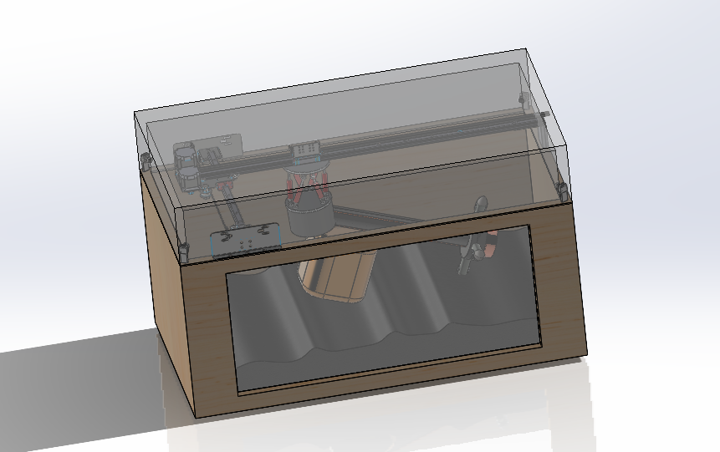
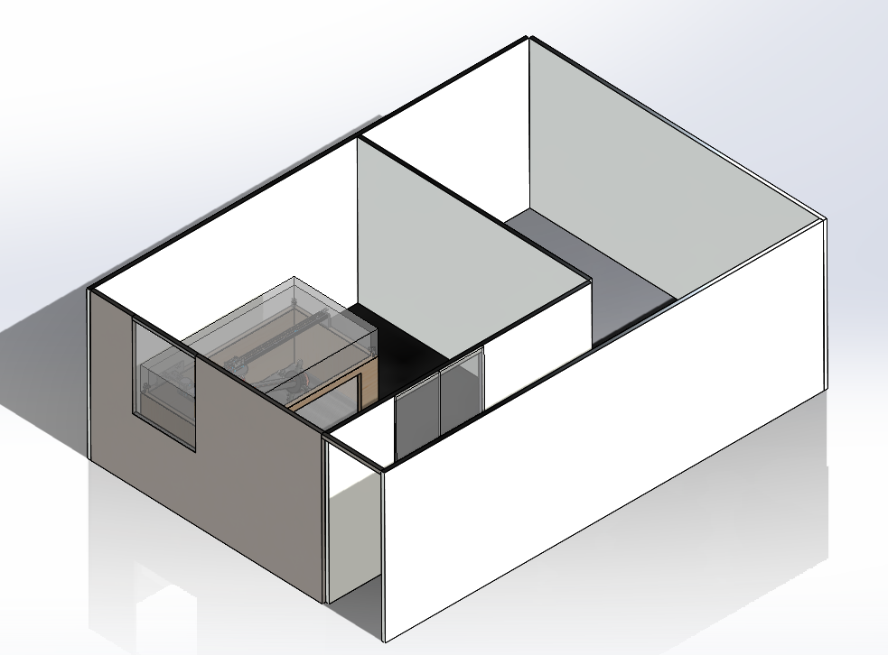
Future Work
Testing of filing mechanism
  Utilize new sandbox testing facility
  Maximize sand volume → Minimize sandbag fill time
Conduct various experiments to collect data on
  Filling efficiency, filling time, torque required and power consumption
Enclosed experimental sandbox setup
LOTUS Room with Experimental Sandbox (SpaceTREx)

Slide 16

Thank You!

Slide 17
Questions ?

