Slide 1


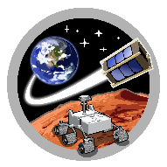

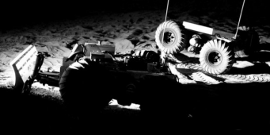
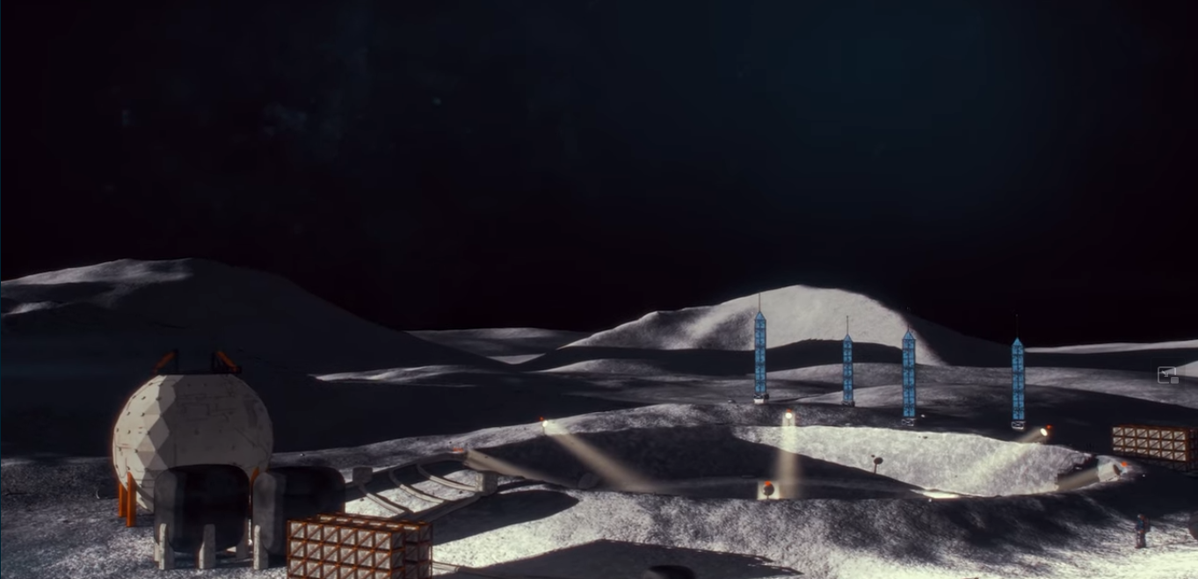
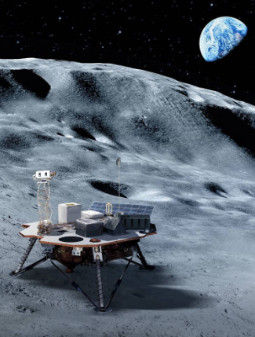
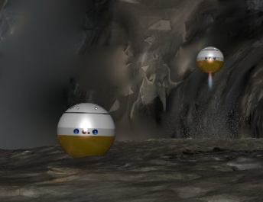
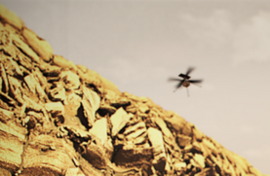
SpaceTREx
Localization and Pose Estimation of Planetary Surface Assets Using Lighting Cues
Min Kang, Athip Thirupathi Raj, Jekan Thangavelautham
Space and Terrestrial Robotic Exploration (SpaceTREx) Laboratory
Aerospace and Mechanical Engineering Department
University of Arizona

Slide 2
Outline
Introduction
Methods
Preliminary Results
Conclusion

Slide 3
Introduction
Introduction
  Motivation
  Challenges
  Objective
  Related Work
Methods
Preliminary Results
Conclusion

Slide 4
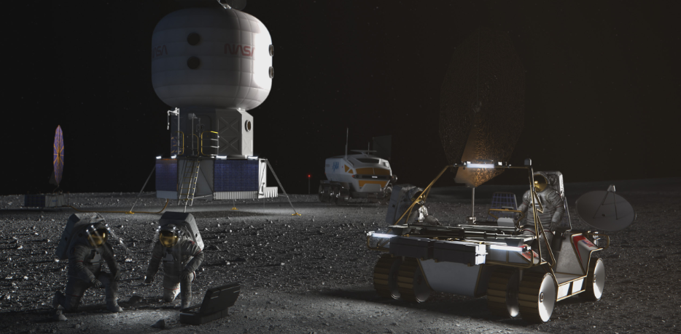
Motivation
Renewed interest in lunar exploration and development
NASA plans to use know-how gained on the Moon to explore Mars
Groups of multiple robots are expected to perform groundwork
Figure: NASA’s concept for a lunar base camp¹

Slide 5
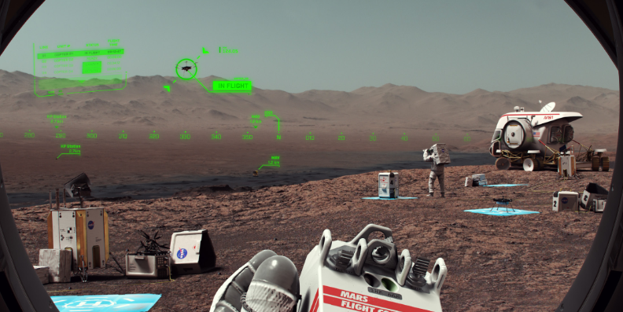
Challenges
Lack of support infrastructure
  Lighting
  Communication
  Navigation
Figure: NASA’s concept for crewed exploration of Mars¹

Slide 6
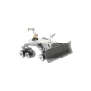
Objective
Use lighting cues as tools for localization on lunar and planetary surfaces
  Free up radio frequencies for other uses
  Estimate attitude (yaw, pitch, roll) as well as position with camera
  NASA requires ±10m (3σ) accuracy for lunar surface asset position²
Yaw (ψ)
Pitch (θ)
Roll (φ)
Figure: Attitude (yaw, pitch, roll)of a rover

Slide 7
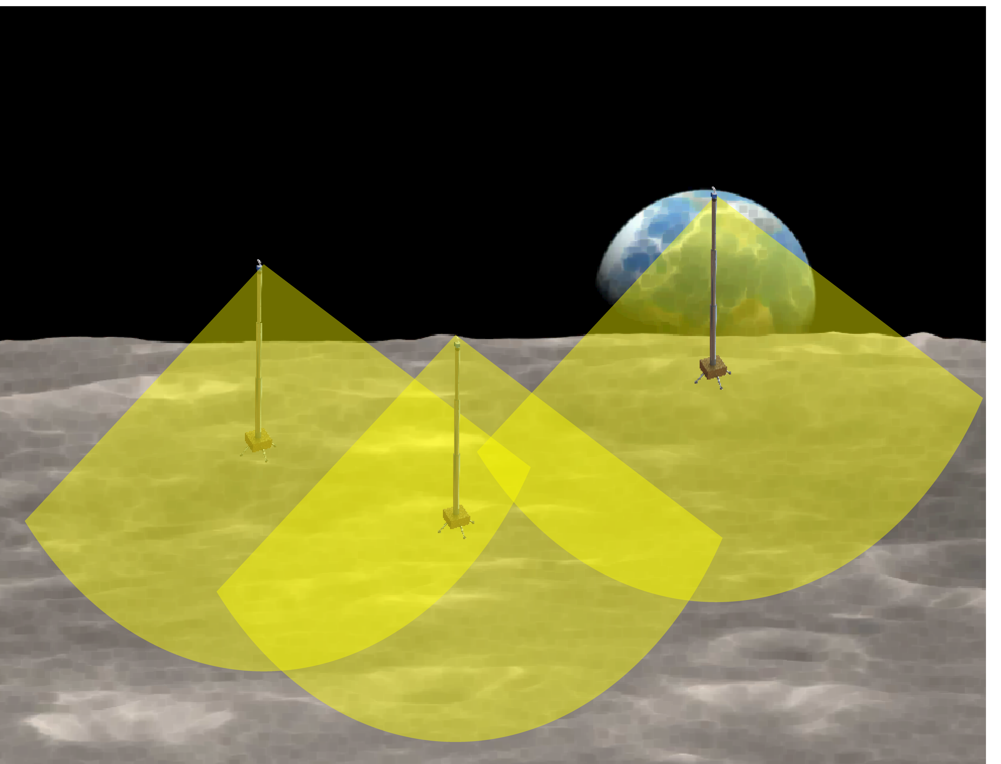
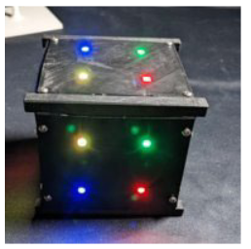
Related Work
Towers for providing illumination to lunar surface³
Lighting cues for small satellite pose estimation⁴
Figure: CubeSat with LED lighting cues for attitude estimation⁴
Figure: Towers providing illumination to the Moon

Slide 8
Methods
Introduction
Methods
  Concept of Operations
  System Architecture
  Hardware Selection
  Pose Estimation Experiment Environment
  Pinhole Camera Image Processing
  Pose estimation using neural networks
Preliminary Results
Conclusion

Slide 9
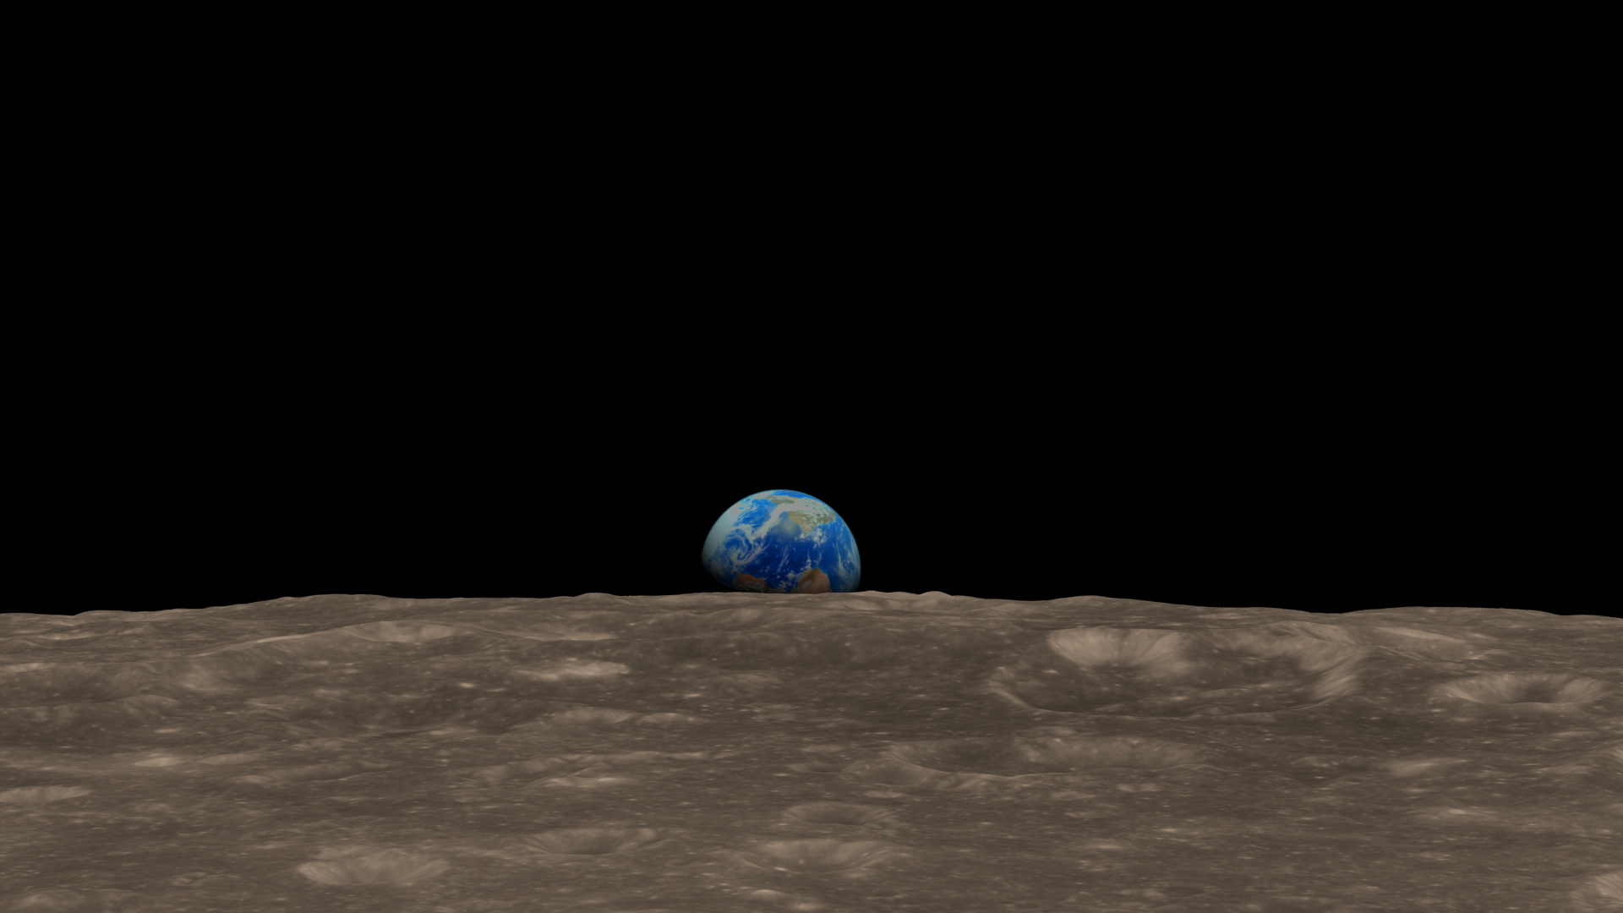
Concept of Operations
Estimate position and attitude from pixel coordinates
Towers are placed so that rover always sees at least 3 LEDs
Rover identifies LEDs and takes pixel coordinates
Camera on rover takes photo
View From Rover
(x₁, y₁)
(x₂, y₂)
(x₃, y₃)
(x, y, z, φ, θ, ψ)
(x₄, y₄)
Take Photo
Identify LEDs,
Get pixel coordinates
Estimate position and attitude from pixel coordinates
Figure: Concept of operations for surface asset pose estimation

Slide 10
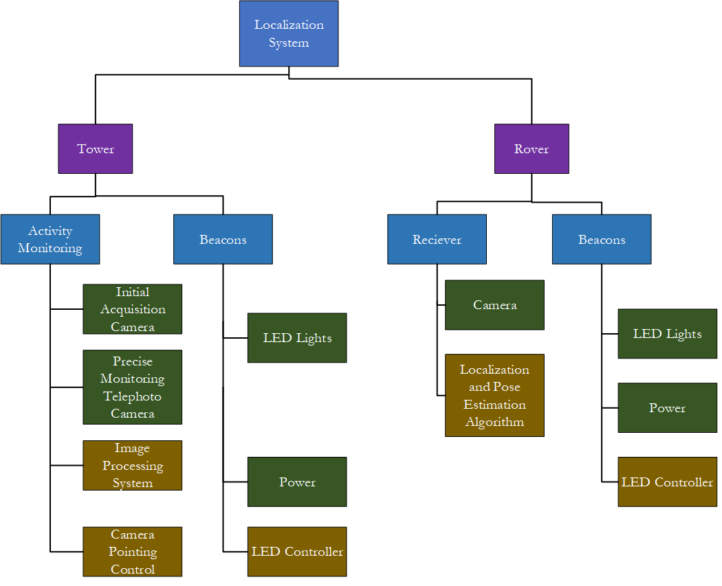
System Architecture
Hardware
Hardware and Software
Scope of this Presentation

Slide 11
Hardware Selection
Cameras for rovers
 | Mars 2020 | Triscape 100 | Auricam D35 | Auricam D80 | GomspaceNanocam
Pixel Size (μm) | 6.4 | 5.5 | 5.5 | 5.5 | 3.2
Focal Length (mm) | 120 | 580 | 25 | 10 | 8.2/34.9/70.5
Sensor Size (px) | 5120 x 3840 | 4096 x 3072 | 2048 x 2048 | 2048 x 2048 | 2048 x 1536
Sensor Size (mm) | 32.8 x 24.6 | 22.5 x 16.9 | 11.3 x 11.3 | 11.3 x 11.3 | 6.55 x 4.92
Table: Space qualified cameras for rover
Take Photo
Identify LEDs,
Get pixel coordinates
Estimate position and attitude from pixel coordinates
Figure: Flow chart for pose estimation system

Slide 12
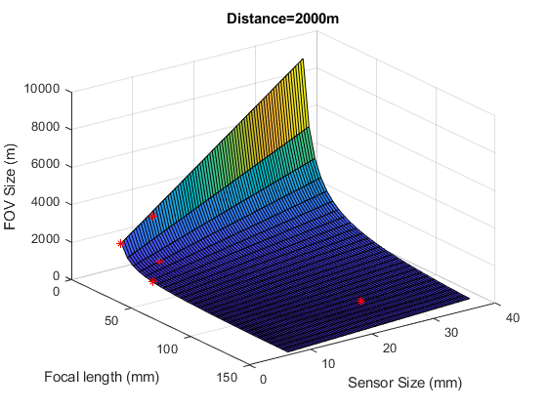
Hardware Selection
Field of view comparison
Auricam D10
2750m
Gomspace Nanocam
(8.2mm)
1650m
Mars 2020
541m
Gomspace Nanocam
(34.9mm)
400m
Figure: Field of view coverage of different cameras at a distance of 2000m
Auricam D10 and Gomspace Nanocam provide sufficient FoV

Slide 13
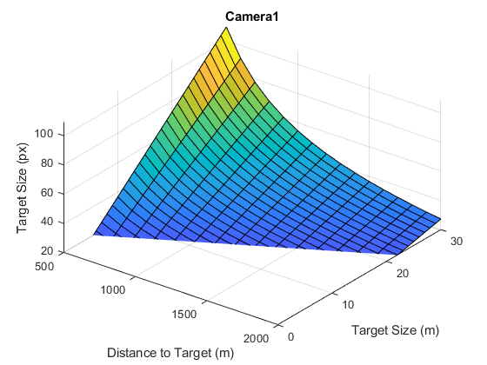
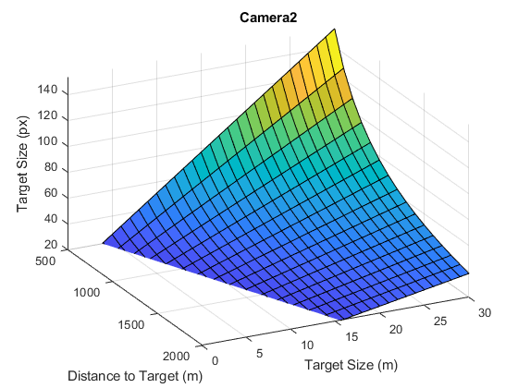
Hardware Selection
Resolution comparison
Gomspace Nanocam (8.2mm)
Auricam D10
Figure: Comparison of object size for two space qualified cameras

Slide 14
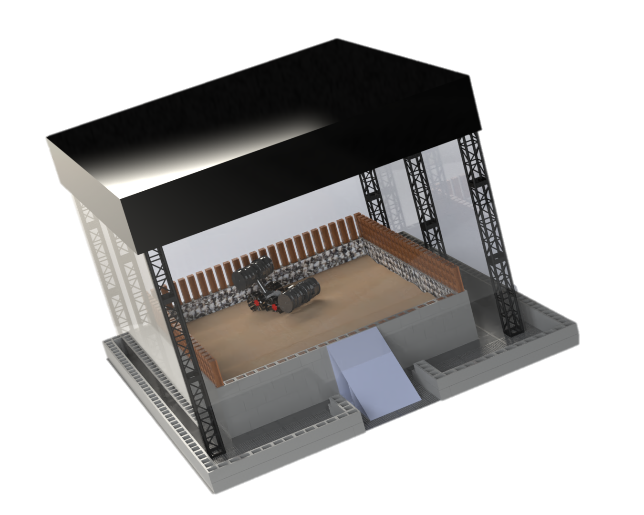
Pose Estimation Experiment Environment
Experiment in scaled down lunar landscape
1:200 scale
Towers are 5m apart
Rover moves in 1m × 1m × 1m space
Truss structure
Robot
Sand
Figure: Sandbox for hardware validation

Slide 15
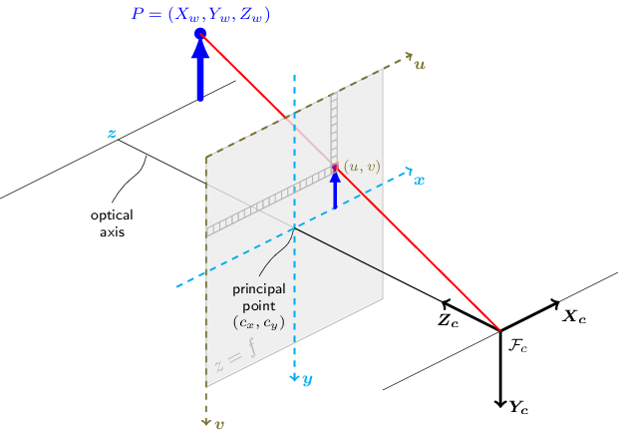
Pinhole Camera Image Processing
Geometric relationship between 3D position and image pixel coordinates
  Camera position and orientation can be obtained by matching with 3D position
Figure: Pinhole camera model⁵
Take Photo
Identify LEDs,
Get pixel coordinates
Estimate position and attitude from pixel coordinates
Figure: Flow chart for pose estimation system

Slide 16
Pose estimation using neural networks
Training and testing dataset
  Dataset with 1,515,356 data points generated with method in⁴
Parameters | Value (Range)
Position | x: 2m ~ 3m, y: -4.5 ~ 5.5 m, z: 0 ~ 1m
Position step | 0.025m
Rotation axes | Yaw, Pitch, Roll
Rotation step | 5 degrees
Camera focal length | 0.00304m
Camera Pixel Size | 0.00000112 m
Camera Resolution | 640 x 480
Table: Parameters for dataset generation

Slide 17
Pose estimation using neural networks
Neural network trained to find position and attitude from pixel coordinates and LED colors
Input layer
Hidden layers
Output layer
Pixel coordinates
Position
Hyperparameters | Value
Hidden Layers | 3
Neurons | 32, 64, 128
Optimizer | SGD
Batch Size | 64
Activation Function | Relu
Loss Function | Huber
Learning Rate | 0.001
Input Scaling | Robust
Epochs | 100
Colors
…
…
…
Attitude
…
Figure: Neural network for pose estimation
Take Photo
Identify LEDs,
Get pixel coordinates
Estimate position and attitude from pixel coordinates
Figure: Flow chart for pose estimation system
Table: Neural network hyperparameters

Slide 18
Preliminary Results
Introduction
Methods
Preliminary Results
Conclusion

Slide 19
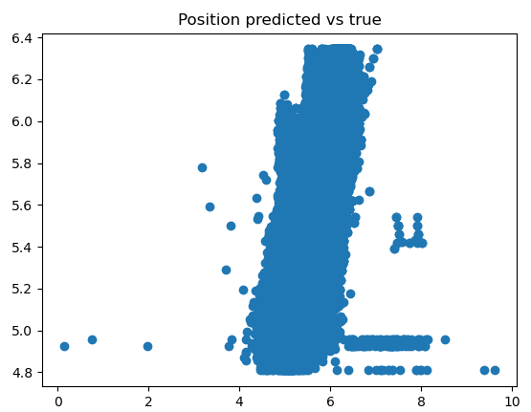
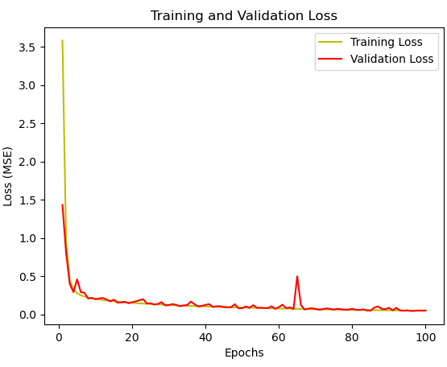
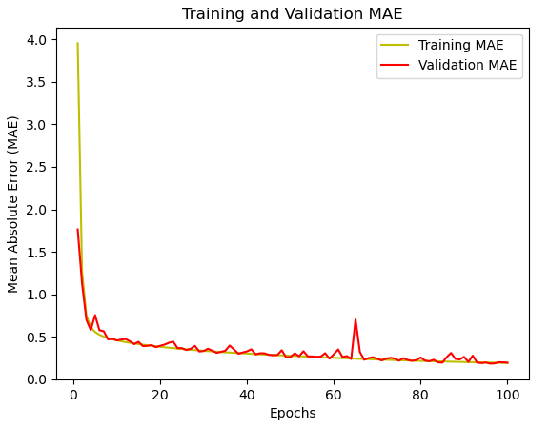
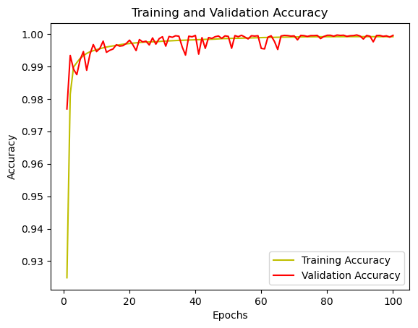
Preliminary Results
Training and validation results
  Results converge at around 100 epochs
  Large outliers found in estimated position
True Distance
Figure: Training and validation mean absolute error (MAE), loss, and accuracy
Predicted Distance
Figure: Predicted vs true range

Slide 20
Conclusion
Introduction
Methods
Preliminary Results
Conclusion
  Conclusion
  Future Work

Slide 21
Conclusion
Visual light markers can be used for localization of planetary surface assets
Neural Networks can aid in 6DOF pose estimation
  6DOF: (x, y, z position, yaw, pitch, roll)
  Further tuning required to reduce variance, remove outliers
3σ error ellipsoid
10m
Figure: NASA position accuracy requirements illustrated

Slide 22
Future Work
Validation using hardware
  Check camera’s ability to identify LEDs in lunar lighting conditions
  Test accuracy in sandbox using scaled-down lights and rover
Truss structure
Robot
Sand
Figure: Sandbox for hardware validation

Slide 23
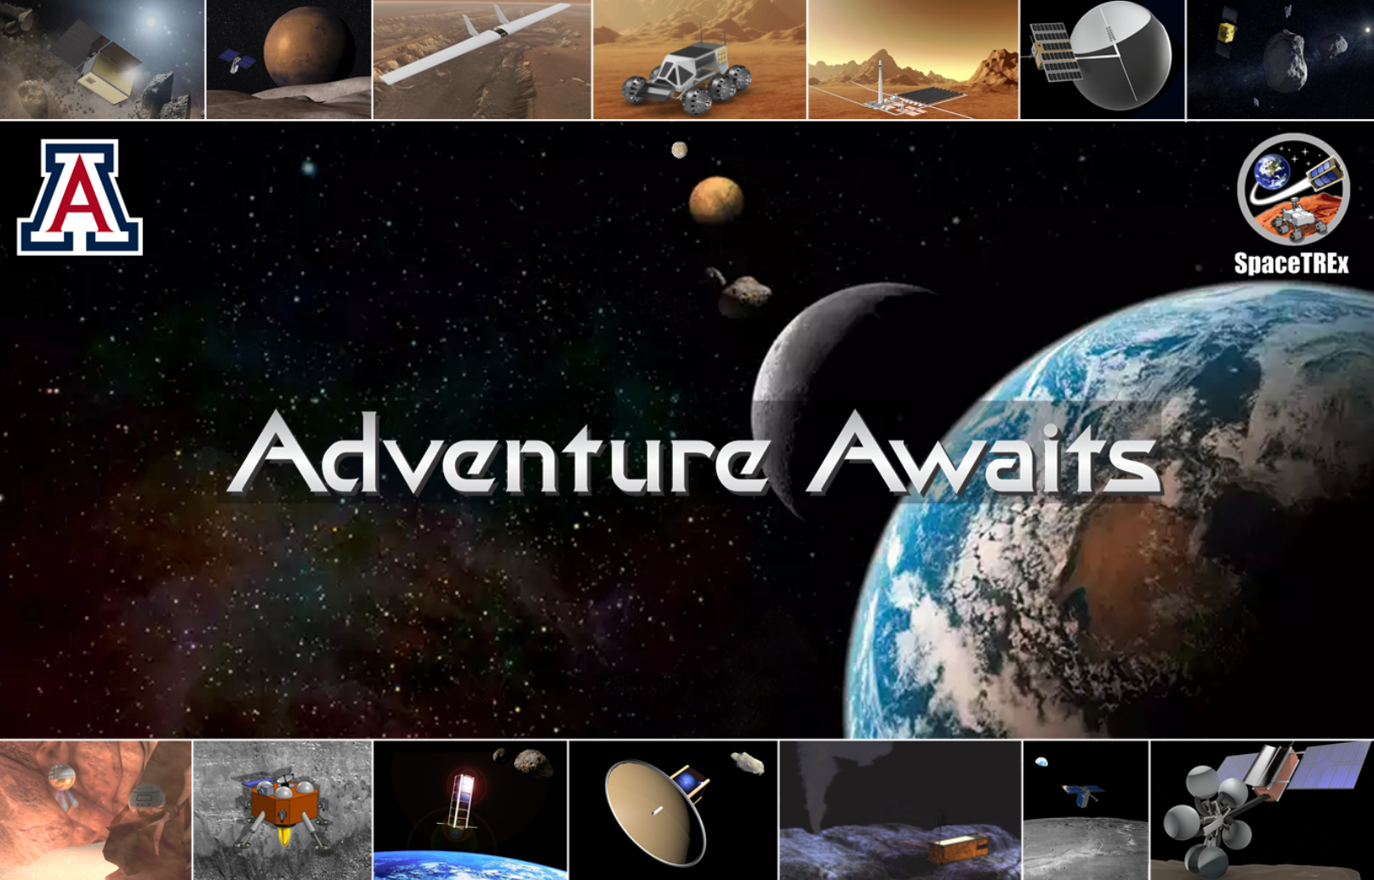
Questions ?

Slide 24
References
NASA, “NASA’S MOON TO MARS STRATEGY AND OBJECTIVES DEVELOPMENT,” Washington, DC, USA, 2023. Available: “https://www.nasa.gov/wp-content/uploads/2023/04/m2m_strategy_and_objectives_development.pdf?emrc=c21aff”
Nick Speciale, “Lunar Relay Services Requirements Document (SRD)”, NASA GSFC, Greenbelt, MD, USA, ESC-LCRNS-REQ-0090, 2022
M. Kang, J. Thangavelautham, “Power Analysis for Optimum Illumination Conditions Using Lunar Operations Tower for Surface Activity” in AIAA ASCEND 2023. doi:10.2514/6.2023-4685
A. T. Raj, J. Rickel, R. Adhikari, J. Thangavelautham, “Machine Learning based Attitude Estimation Using Active Lighting Cues Applied to CubeSat Proximity Operations” in 2024 AAS GNC
OpenCV, “Camera Calibration and 3D Reconstruction.” Accessed: Apr. 22, 2024. Available: https://docs.opencv.org/4.9.0/d9/d0c/group__calib3d.html

