Slide 1


Distributed architectures for cislunar communication and navigation services
Aman Chandra
Sr. Engineer for Aerospace Systems R&D

Slide 3

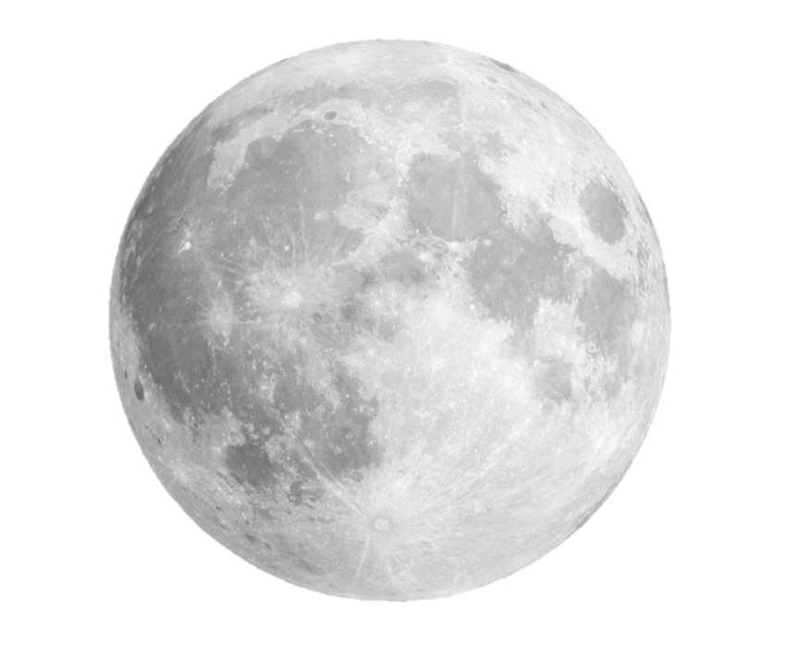

Evolution of cis-lunar communications
Gateway
Gateway
South Pole Relays
South Pole Relays
Lunar Global Coverage
2025 - 2026
2027 – 2030 and beyond
Intensive Relay service – LSP
Initial PNT service
DTE service from near side
Intensive Relay service – LSP and far side
Lunar PNT service
Lunar Global Coverage
2

Slide 4
Cis-lunar communications – space segment
Low data-rate @ S band
High data-rate @ Ka-band
Low data-rate @ X-band
Antenna requirements:
Multi-band and steerable antennas required
Low-power lightweight antennas for rapid deployment
Small satellite compatibility for large deployments

Slide 5
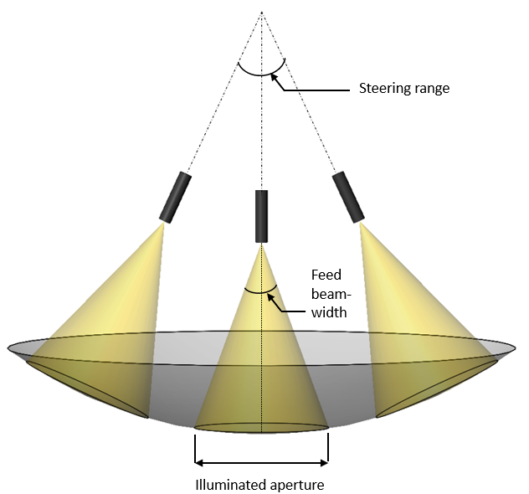
Spherical Reflector Beam Steering
Spherical reflectors are symmetric about all axes
This allows efficient high-gain beam steering by moving the feed rather than the reflector or satellite, leading to significant reductions in SWAP, complexity, and cost.
Principles of Operation
Under-illuminated reflector
Lightweight feed and motors
Constant gain through wide steering angles
Customized gain through wide steering angles
Spherical reflecting surface

Slide 6
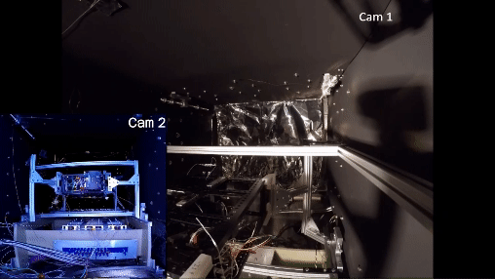


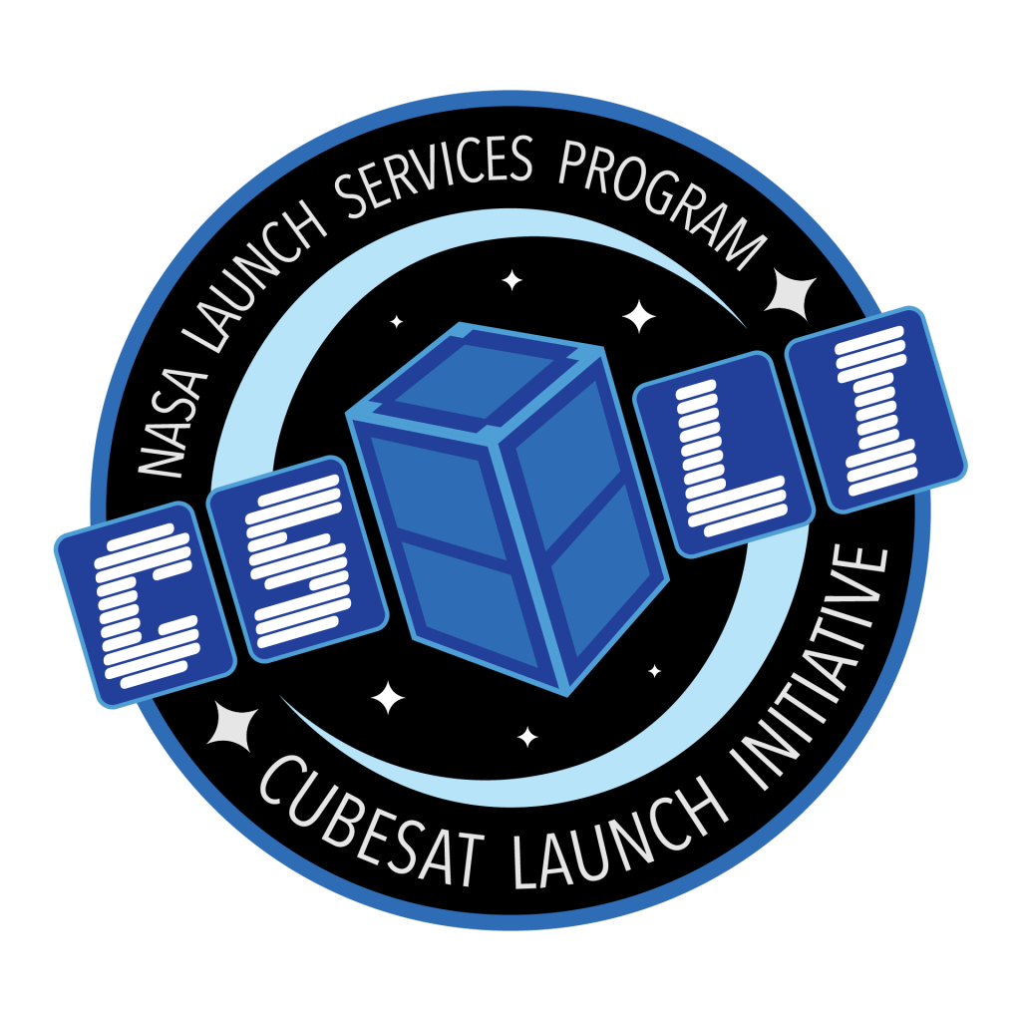




Spherical inflatable membrane antennas
From Conception
To Spaceflight
2024
CATSAT launch in June
2022
CATSAT Delivered
2018
NASA’s CubeSat Launch Initiative for CATSAT
Space Flight Qualification Test for CATSAT
2017
2014 - 2017
FreeFall Established
Core Technology Development Funded by
NASA, NRO and US Air Force

Slide 7
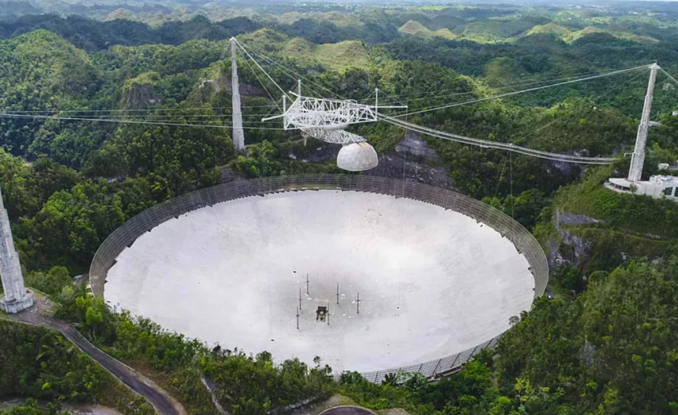
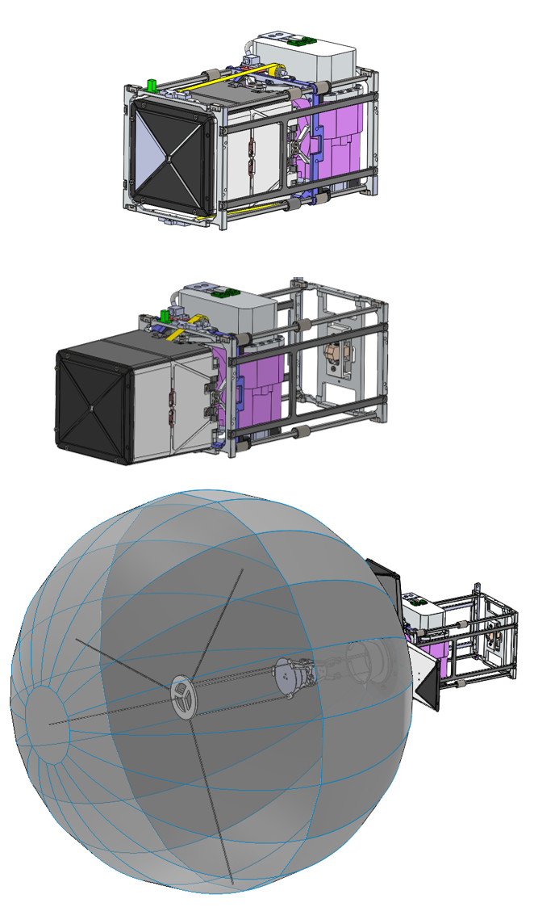
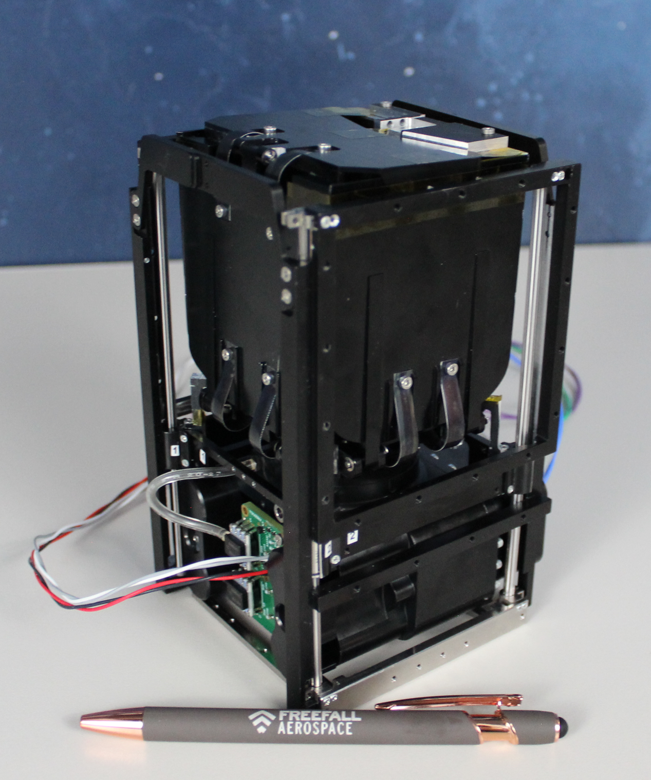
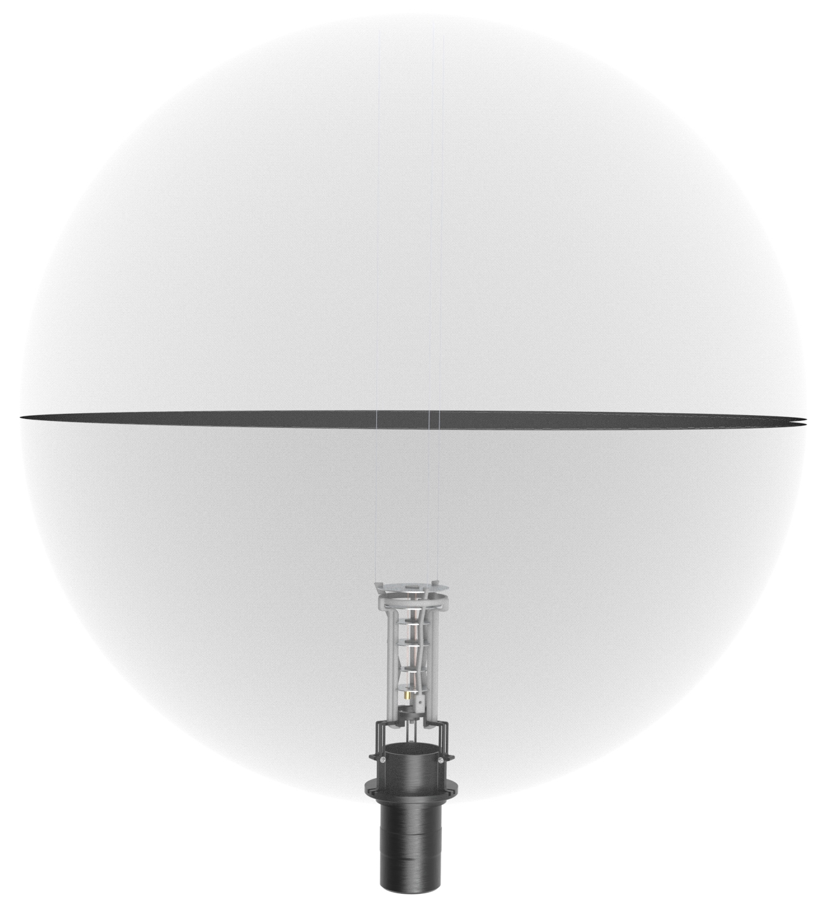

CATSAT technology development
Arecibo observatory
0.5 m spherical reflector
Line feed
CATSAT Flight Unit
1.5 U System

Slide 8
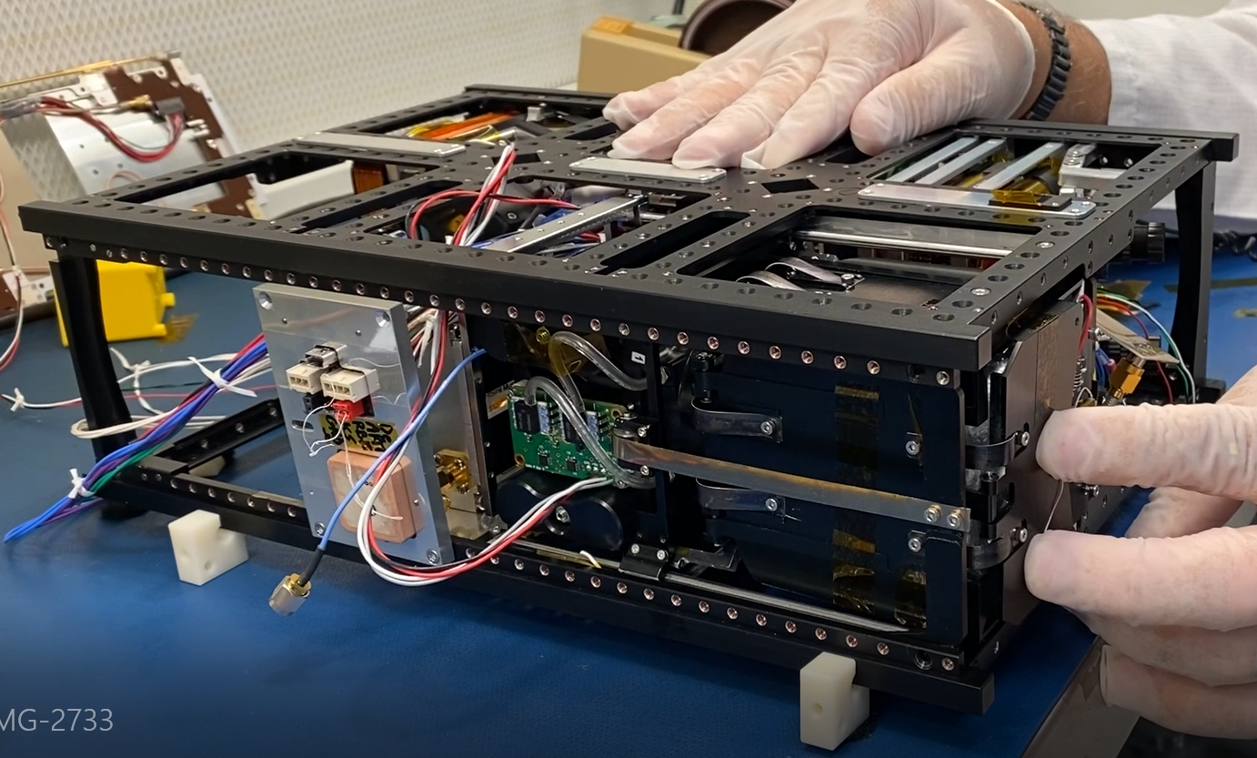
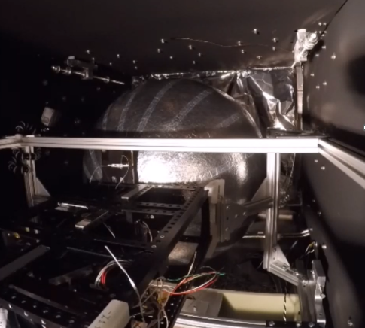
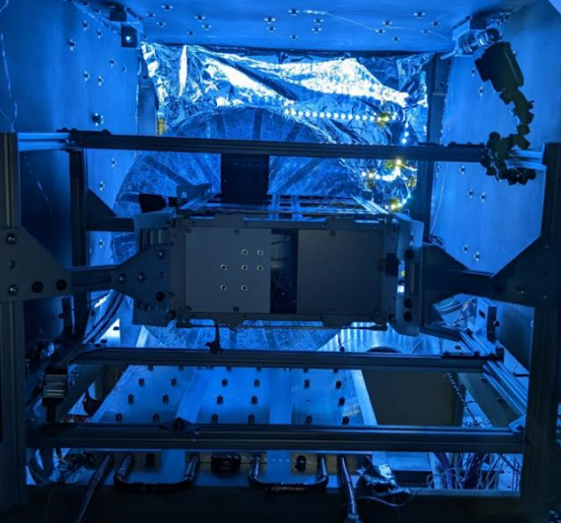
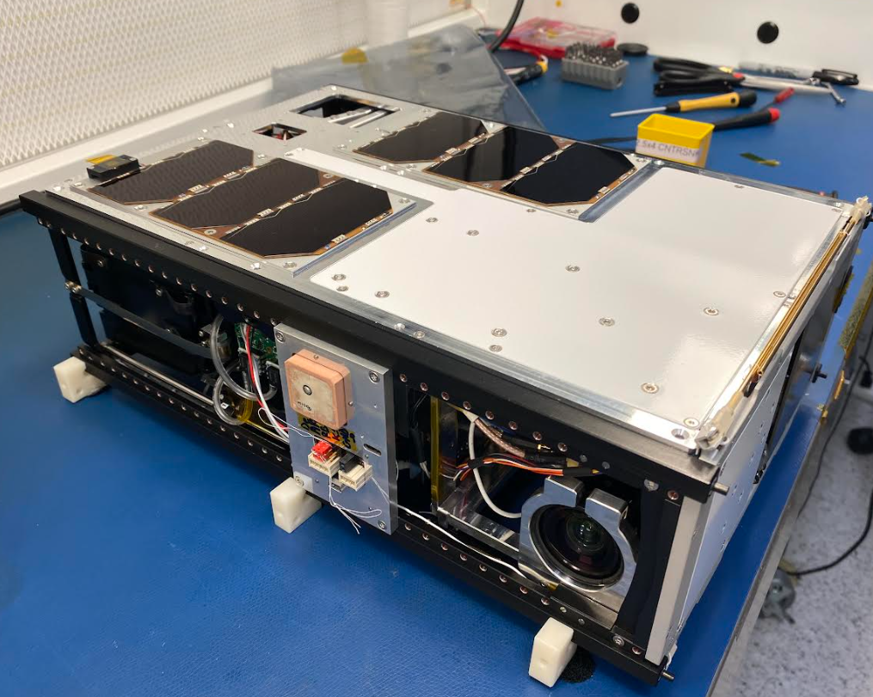
CATSAT technology development

Slide 9
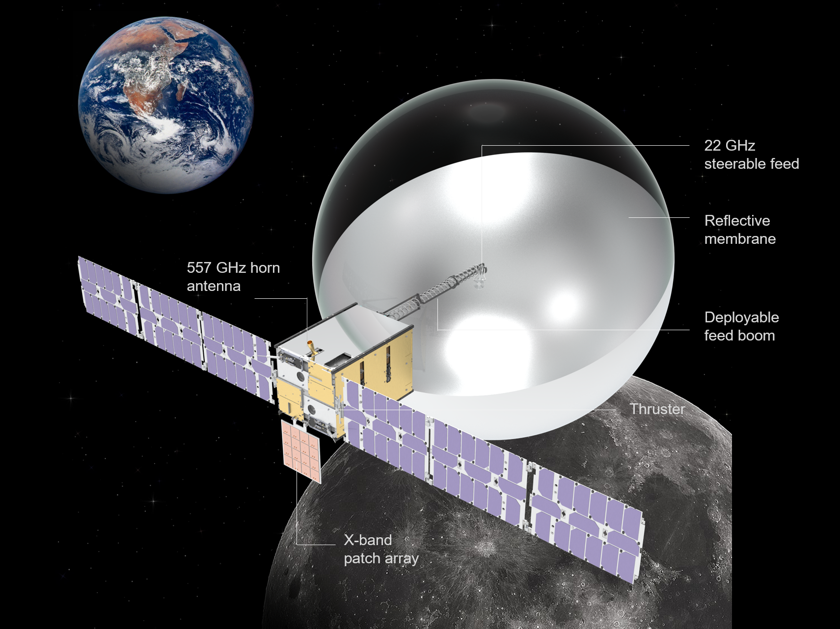

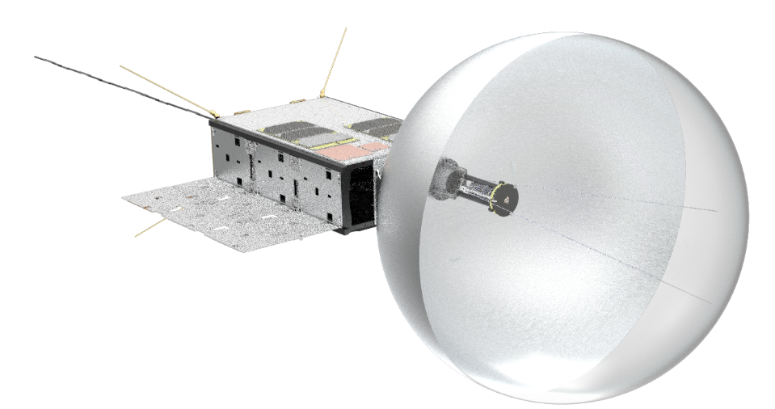
Spherical Inflatable antenna - Lunar orbit implementation

Slide 10
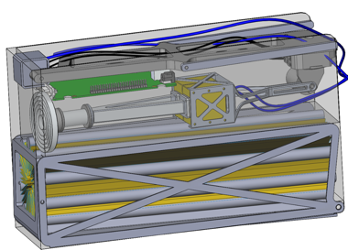
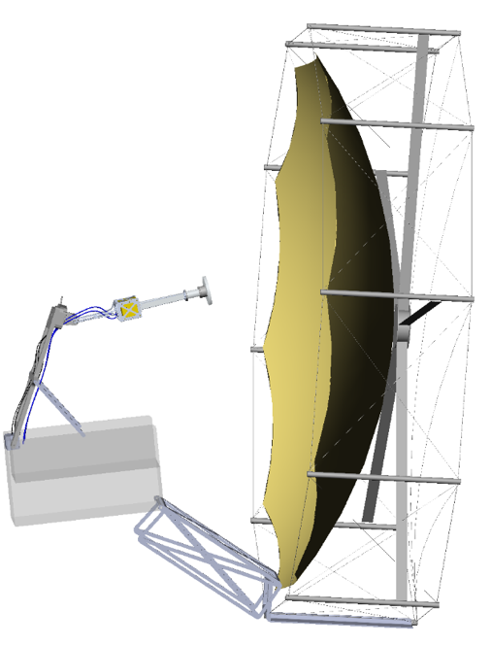
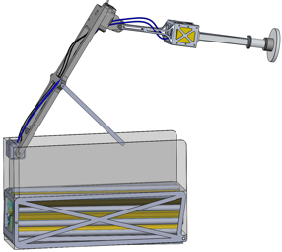
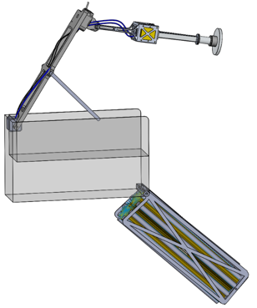
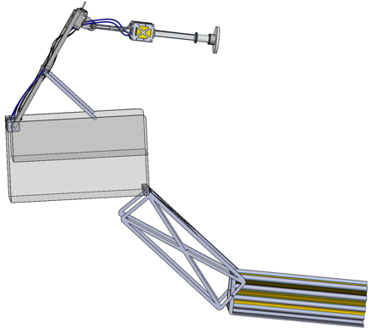
Spherical mesh reflectors
Back structure
3U steerable feed system (0.7 kg)
Total system mass ~ 5.5 kg
3 U mesh reflector system (4.2 kg)
Steerable feed system
1.3 m
Stowed mesh reflector
2-meter dia parent sphere
Tape spring deployment

Slide 11
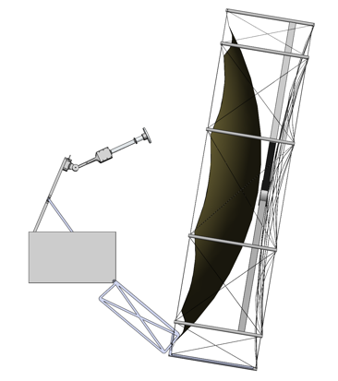
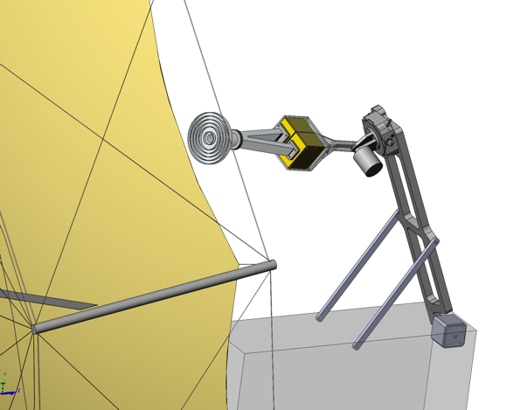
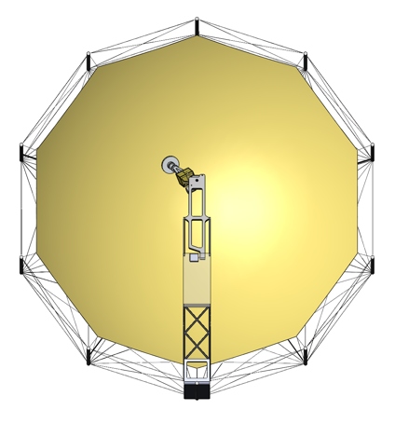
Spherical mesh reflectors
Choke horn
Elevation steering
Septum polarizer
Split waveguide
LNA
PA
AZ motor – piezo stage
EL Motor (Piezo)
Azimuth steering
Deployment motor (brushless DC)
LNA and PA mounted on feed arm to reduce losses
All electronics remain inside bus

Slide 12
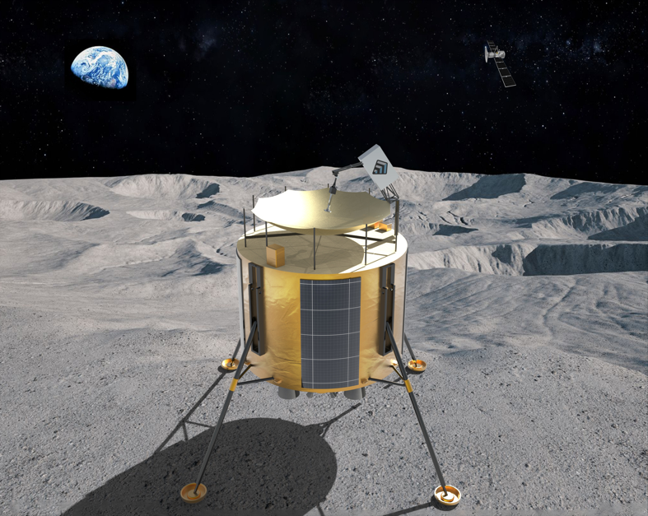
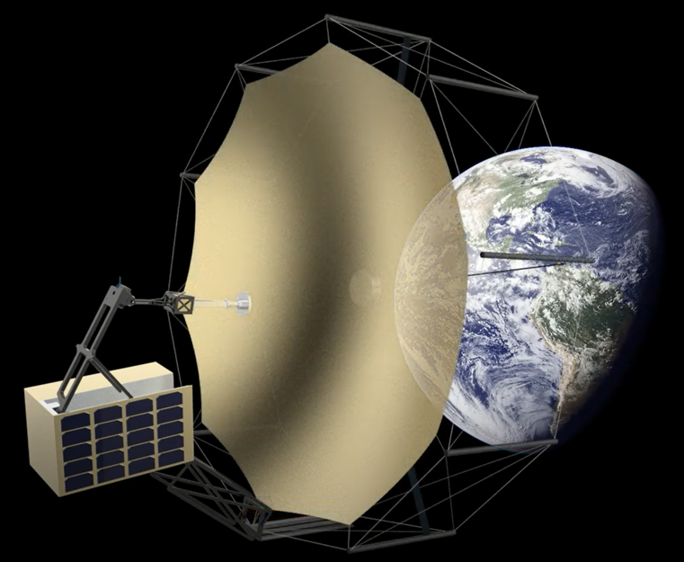
Modular Approach to Lunar Surface and Orbital Relay Communications
Compact deployable mesh antenna system
Spherical reflector with separate steerable feed for flexibility
Inflatable option for reduced stowed volume

Slide 13
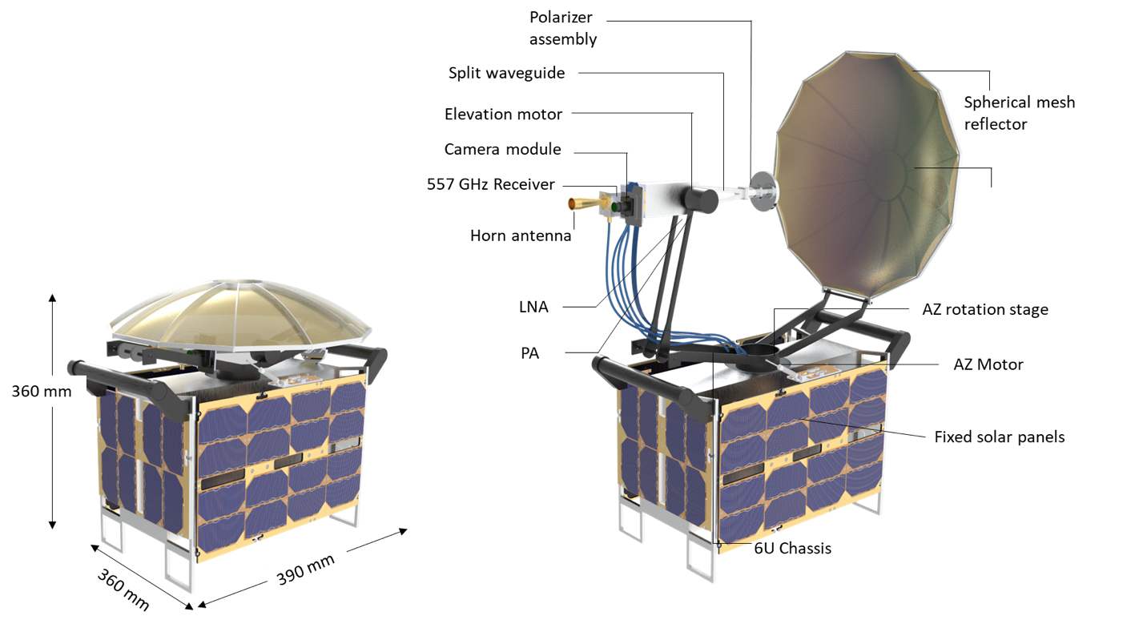
Lunar surface mesh telecom System
Strawman specs
Reflector Size | 0.36 m
Frequency | 22 GHz
Steering range | 360° AZ 0-10° EL
Gain | 32.4 dB
Transmit Power | 2 W
System mass | 10.4 kg
Notes:
Frequency 22 GHz for water line study, can be adjusted to standard Ka-band
EL steering for south pole site, can be increased for higher latitudes
Mass includes contingency
All components are TRL 6-9

Slide 14
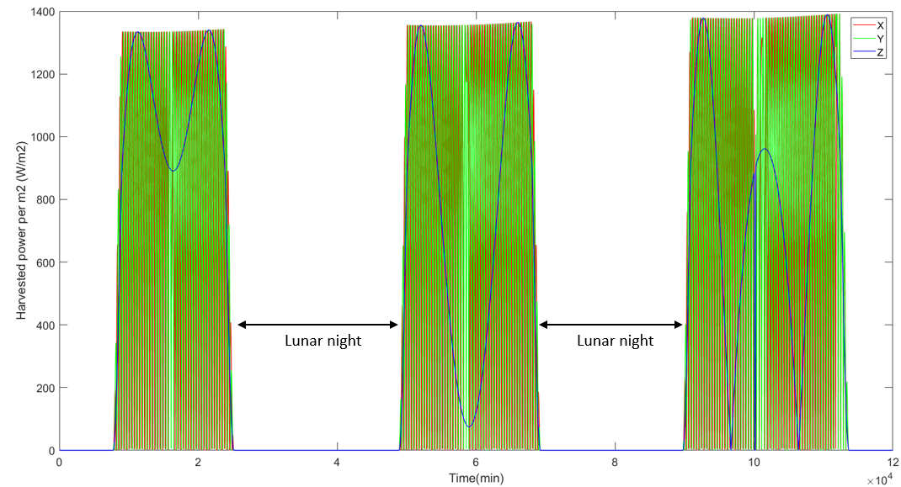
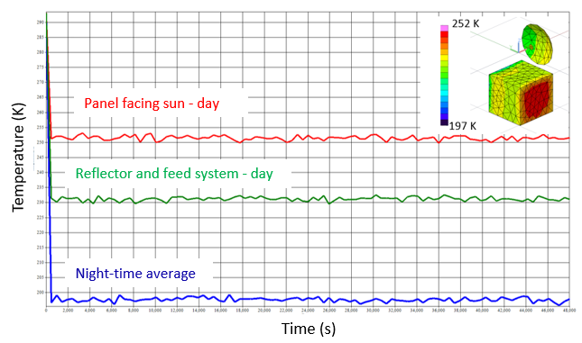
Lunar surface mesh telecom System – South pole survivability

Slide 15
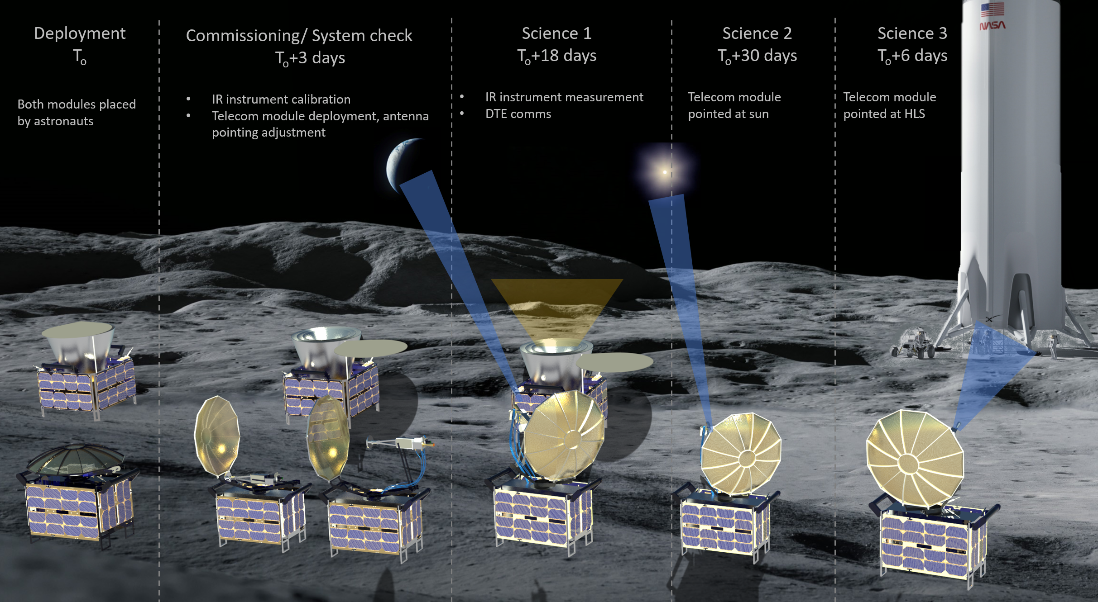
Lunar surface mesh telecom System - CONOPS

Slide 16


THANK YOU
Dr. Aman Chandra
achandra@freefallaerospace.com
(215)479-5030
FreeFall-Aerospace
FreeFallAerospace.com

