Slide 1




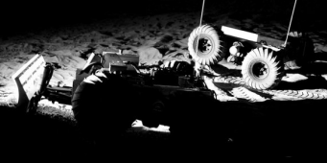
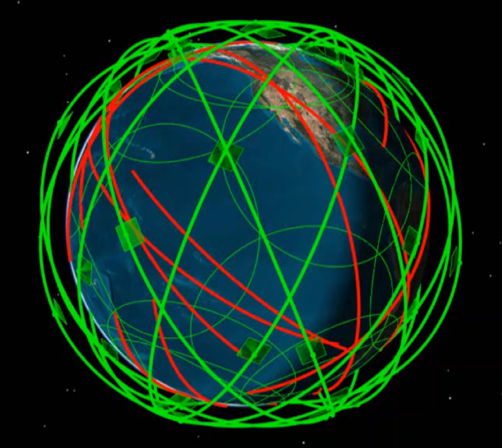
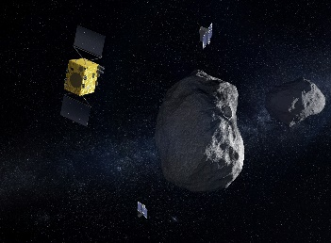
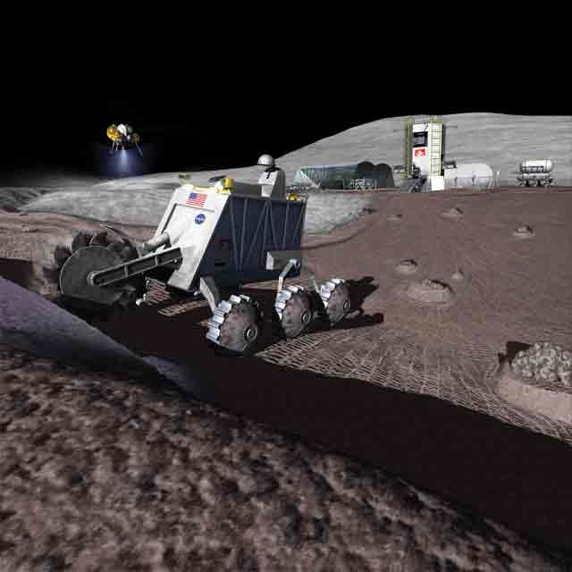
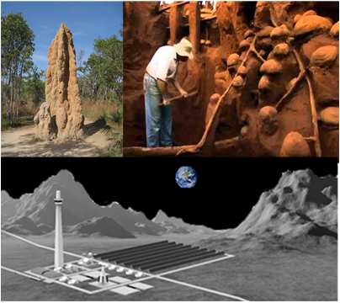
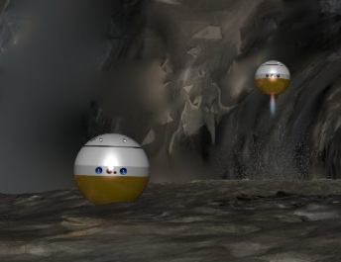
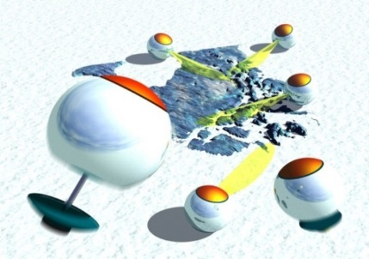
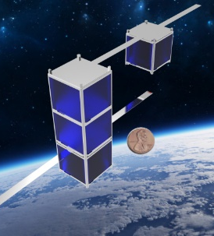
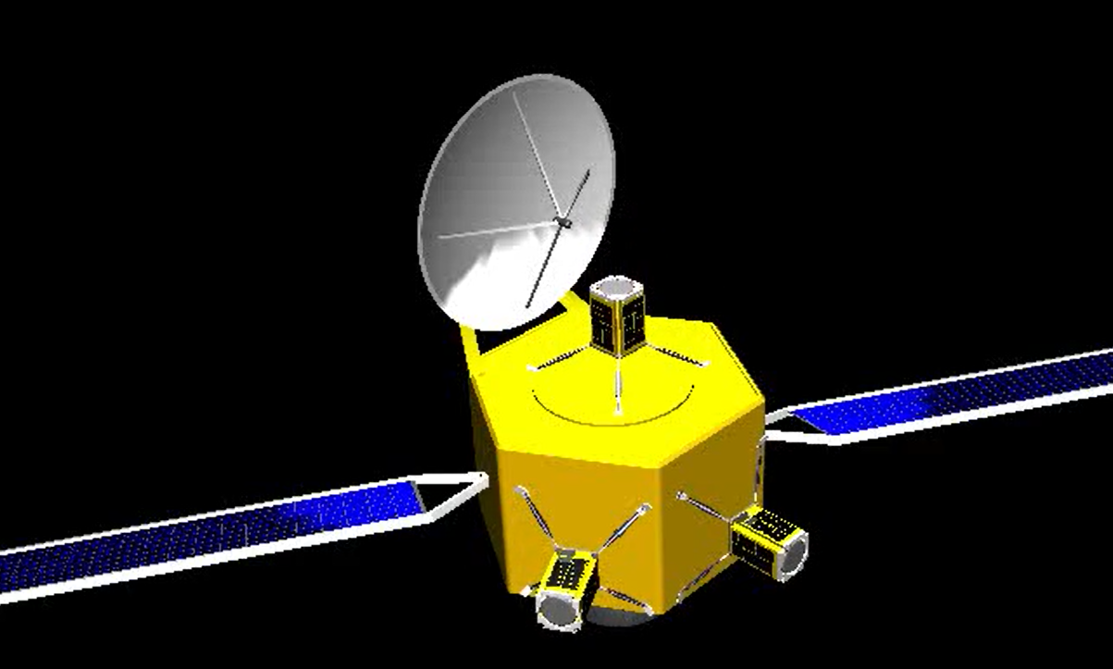
SpaceTREx
Smart Sandbag for Autonomous Lunar Construction
Michael Villasana, Sivaperuman Muniyasamy, Jekan Thangavelautham
Space and Terrestrial Robotic Exploration (SpaceTREx) Laboratory
Aerospace and Mechanical Engineering Department
University of Arizona

Slide 2
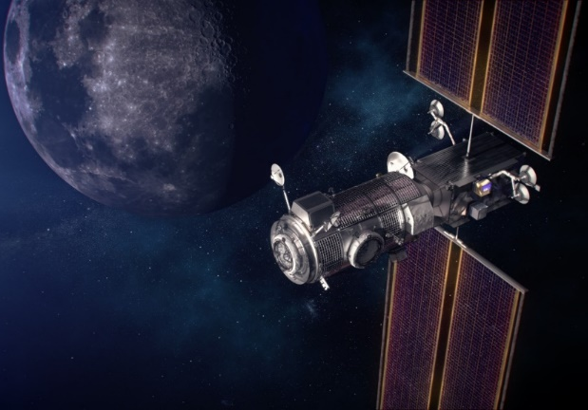
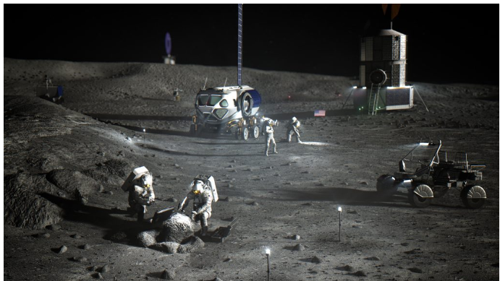

Motivation
Artemis Mission:
Return humans to the Moon
Potential need for “Semi-Permanent” Structures on the lunar surface
Establishing a lunar base
Lunar Base Concept (NASA)

Slide 3
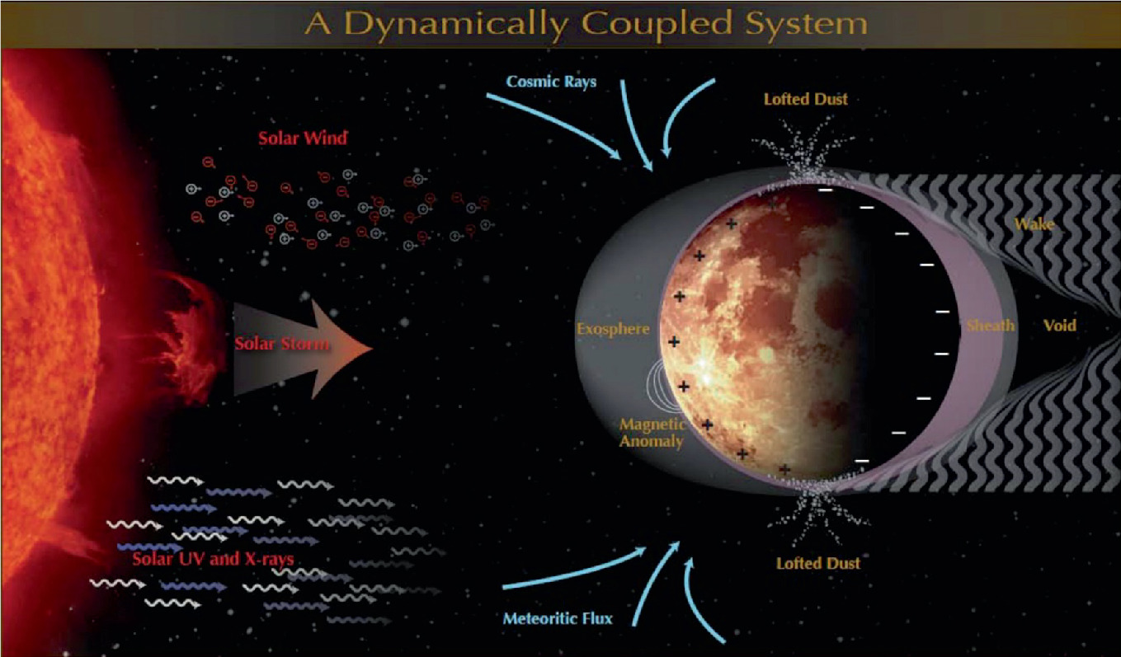
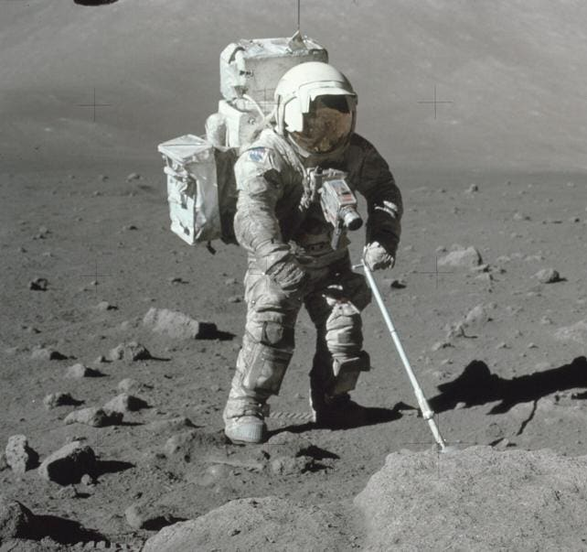
Challenges
Harsh Lunar Environment
Lunar Dust
Autonomous robots can be a viable option

Slide 4

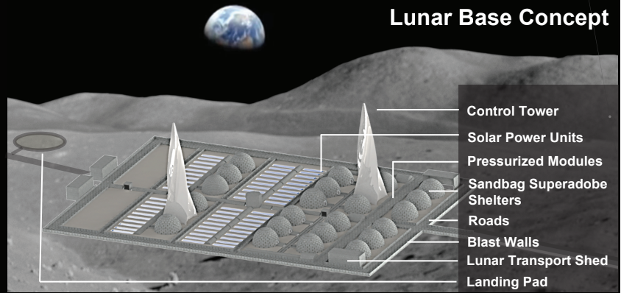
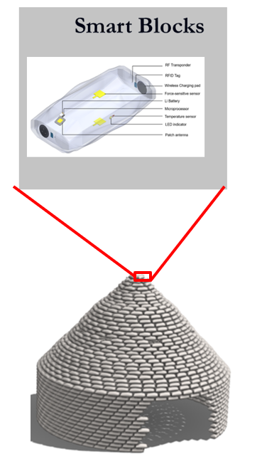
Approach
Lunar base would benefit from robots and automation.
Superadobes are a vital structures that could benefit from SMART sandbags
Smart sandbags will require support services.
  How can this be facilitated?
Sandbags with smart sensors as a building blocks

Slide 5
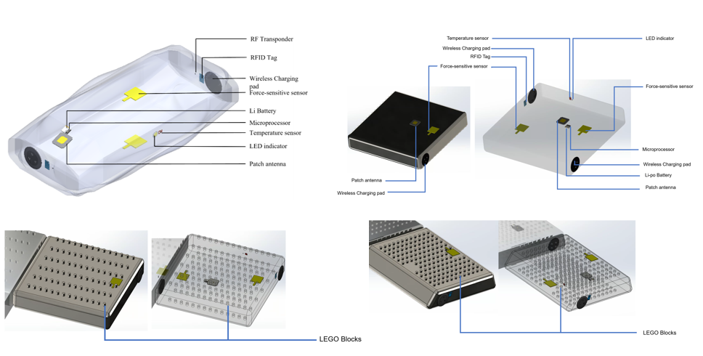
Smart Sandbags Concept
Sandbags with smart sensors to localize themselves and assist the robots

Slide 6
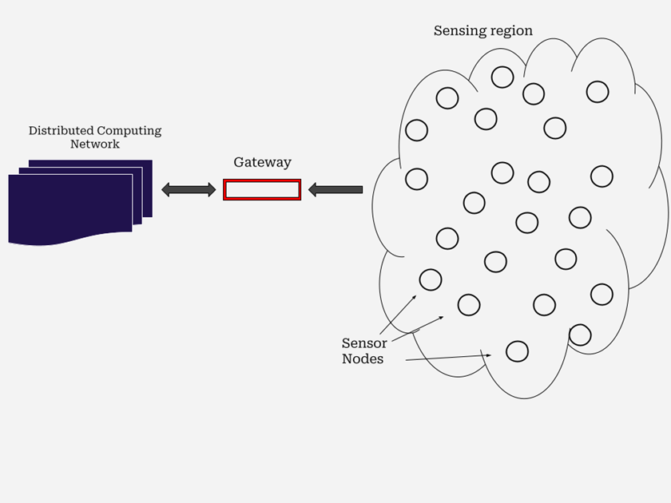
Approach
Two types of networks:
  Distributed Network
  Sensor Network
Distributed Network
  Larger, dispersed network with focus on larger computation
Sensor Network
  Smaller, concentrated network that pertains to monitoring a singular sandbag
SMART Network Architecture

Slide 7
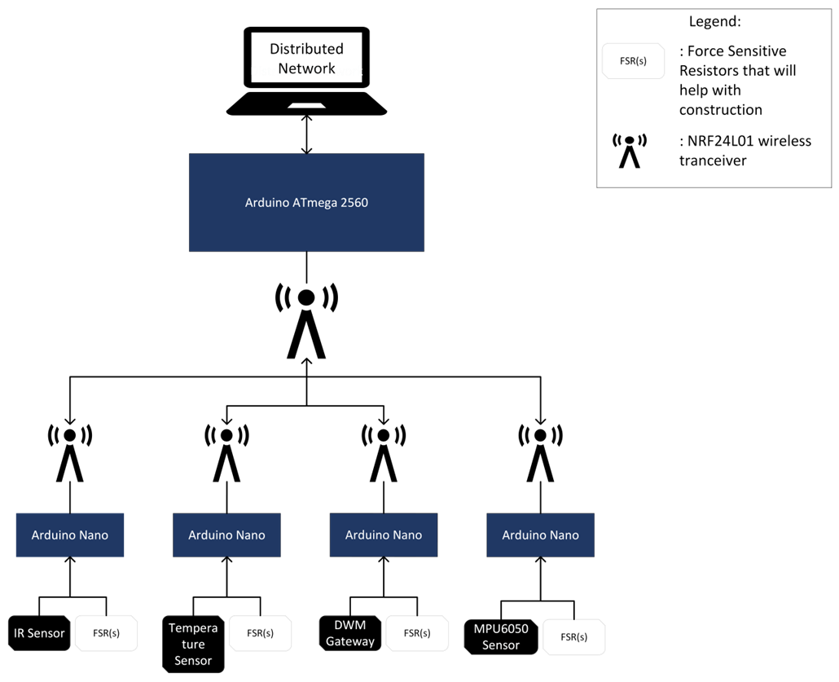
Methodology
SMART Network : A distributed array of smart modules that help with environmental awareness and construction
Can have numerous amounts of sensors, all different types (ex. Temperature, radiation, gyroscope, force sensors, position module, etc.)
Sensor Network Architecture

Slide 8
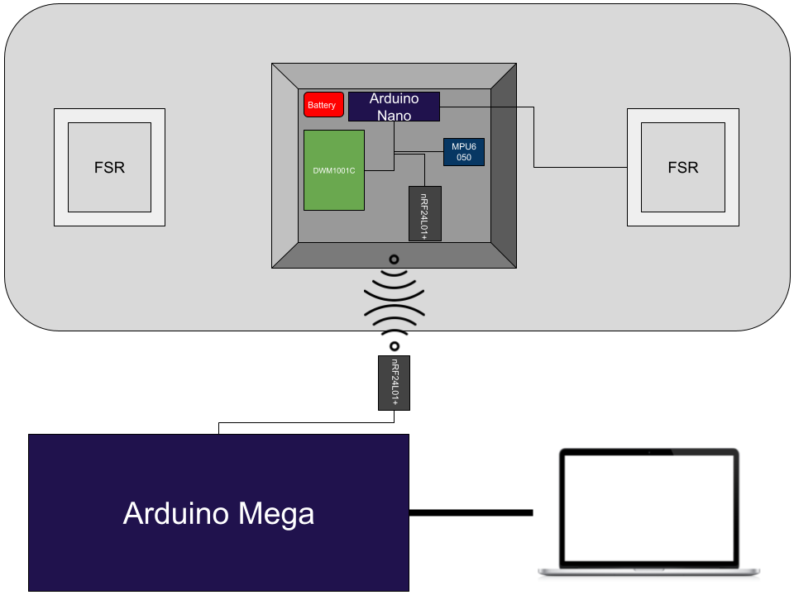
Current Work: Sensor Network
Consists of individual sensors powered by smaller microcontrollers
  Each microcontroller has wireless communication​
  Larger microcontroller serves as gateway to distributed network
Sensor Network Block Diagram

Slide 9
Current Sensors/Hardware
Wireless transmission was achieved using a wireless Transceiver (nRF24L01+)
Orientation Determination was achieved using a Accelerometer / Gyroscope (MPU6050)
Localization was achieved a Ultra-Wide Band module (DWM1001C)
Force sensing was achieved using a Force Sensitive Resistor (FSR)
Proximity sensing wad achieved using an IR Obstacle Avoidance Sensor
Extra Life Support Sensors:
  Temperature sensing was achieved using a Temperature / Humidity sensor (DHT11)

Slide 10
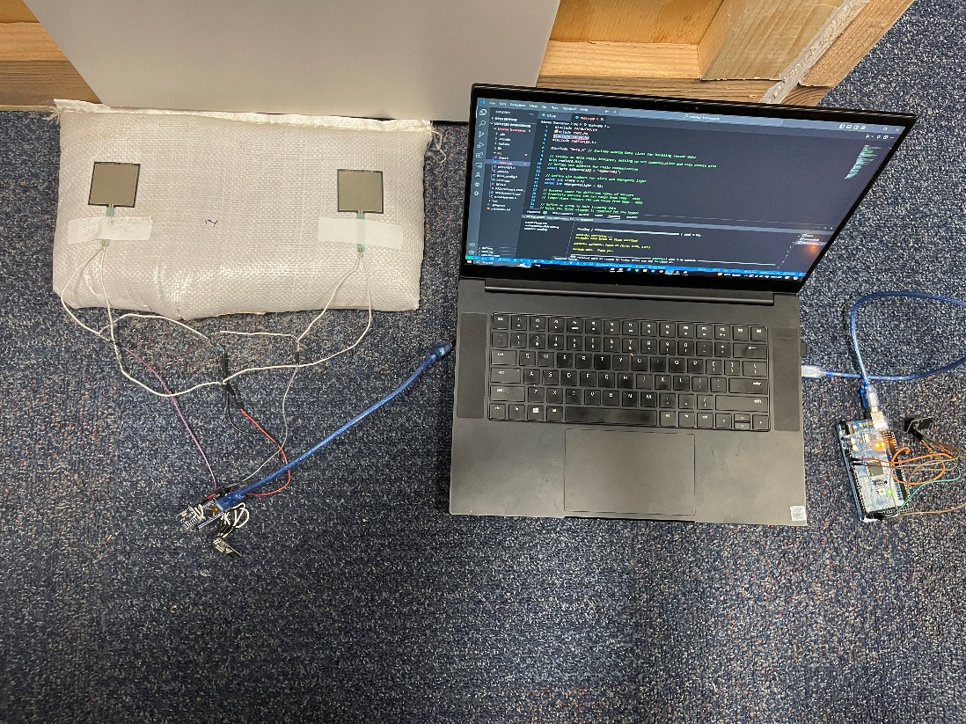
Sensor Setup
Plan
Actual

Slide 11
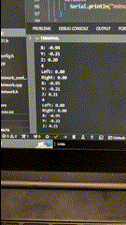
Current Work
Retrieve multiple sandbag positions “simultaneously”
Each sandbag sends wirelessly:
  Relative Position (x, y, z)
  Orientation (x, y, z)
  Relative Force Intensity (0 – 1023)

Slide 12
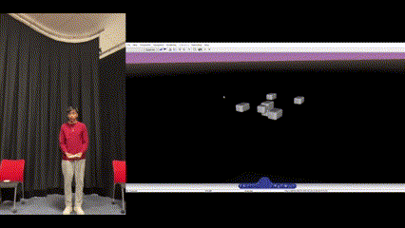
Demos

Slide 13
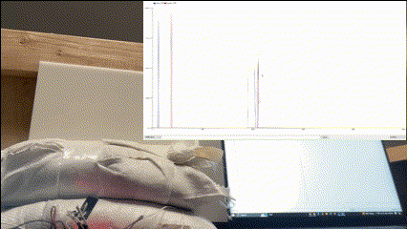
Demos

Slide 14
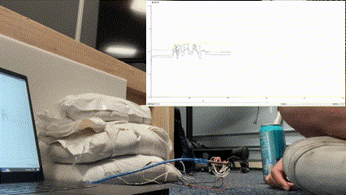
Demos

Slide 15
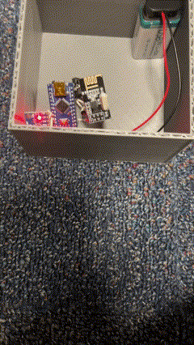
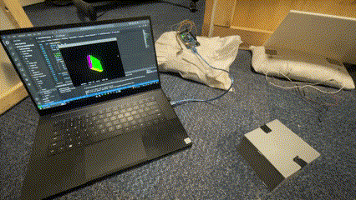
Demos

Slide 16

Conclusion
Successful wireless data transmission that could help robots
Minor obstacle has included an extra serial communication to laptop
  Plans to fix this to communicate DWM1001C to Arduino Nano via UART
  This will also allow wireless transmission of position

Slide 17

Future Work
Successful wireless data transmission that could help robots
Minor obstacle has included an extra serial communication to laptop
  Plans to fix this to communicate DWM1001C to Arduino Nano via UART
  This will also allow wireless transmission of position
Sandbag prototype will be made to test on lunar conditions

Slide 18

Thank You!

Slide 19
Questions ?

