Slide 1

The JPL Snapdragon Co-Processor
Zaid Towfic*, Dennis Ogbe, Saba Janamian,
Andre Jongeling, Douglas Sheldon, Joseph Sauvageau
All authors were members of the Jet Propulsion Laboratory, California Institute of Technology at the time this work was performed.
Reference herein to any specific commercial product, process, or service by trade name, trademark, manufacturer, or otherwise, does not constitute or imply its endorsement by the United States Government or the Jet Propulsion Laboratory, California Institute of Technology.

Slide 2
Outline
Introduction
The Qualcomm Snapdragon SoC
JPL’s uses of the Snapdragon Processor
The JPL Snapdragon Co-Processor
TRL-6
Potential Uses of Snapdragon Co-Processors
Resiliency through redundancy

Slide 3
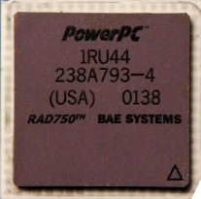
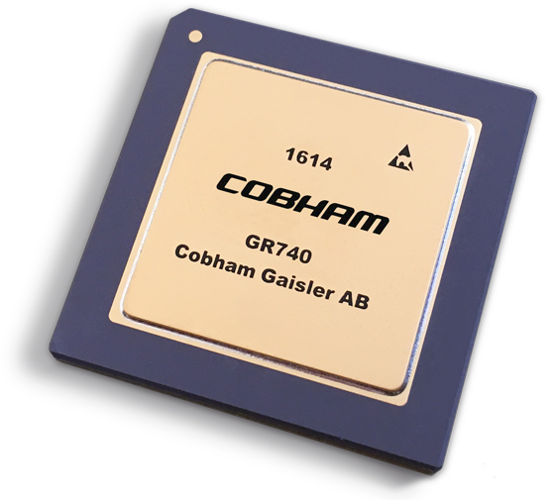
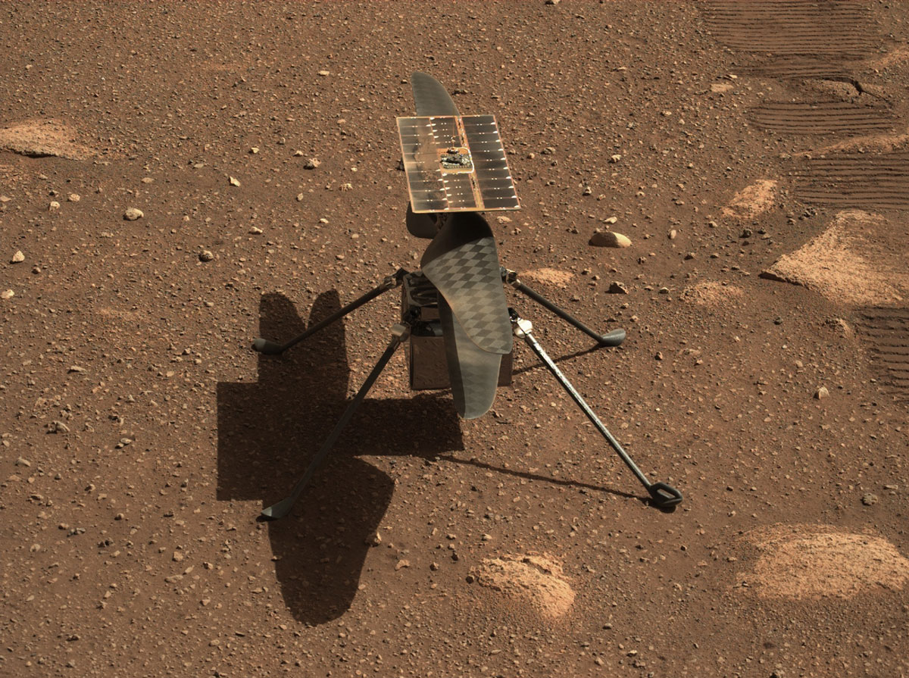
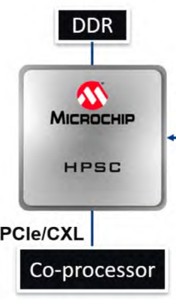
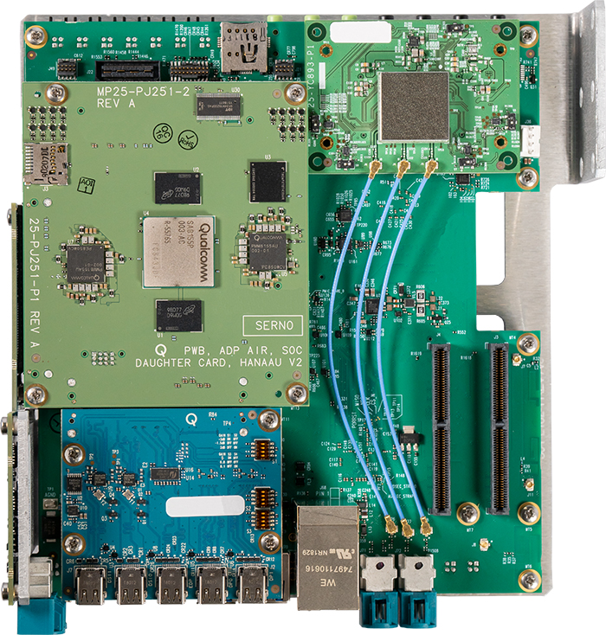
Introduction
Traditional flight computing: radiation hardened processors and microcontrollers
  Do the absolutely necessary compute on board, leave the rest for the ground.
Future: wide range of mass and energy limited missions with increased autonomy & on-board processing (deep-space CubeSats, Aerobots, etc.)
  More compute on board is enabling for smaller, cheaper, and farther missions
  Embrace use of co-processors that can handle non-critical events.
Need for increased compute capability with decreased SWaP
RAD750
Ingenuity

Slide 4

The Qualcomm Snapdragon System-on-Chip
SoC designed for mobile phone & automotive applications
Various subsystems integrated on-chip
  8-core 64-bit ARM CPU cluster (Kryo)
  Graphics Processing Unit (Adreno)
  Multicore Digital Signal Processor and Neural Processing Engine (Hexagon)
  Image Signal Processor (Spectra)
  LTE modem
  Security ASIC
Samsung Galaxy S10
SA8155P automotive development platform

Slide 5
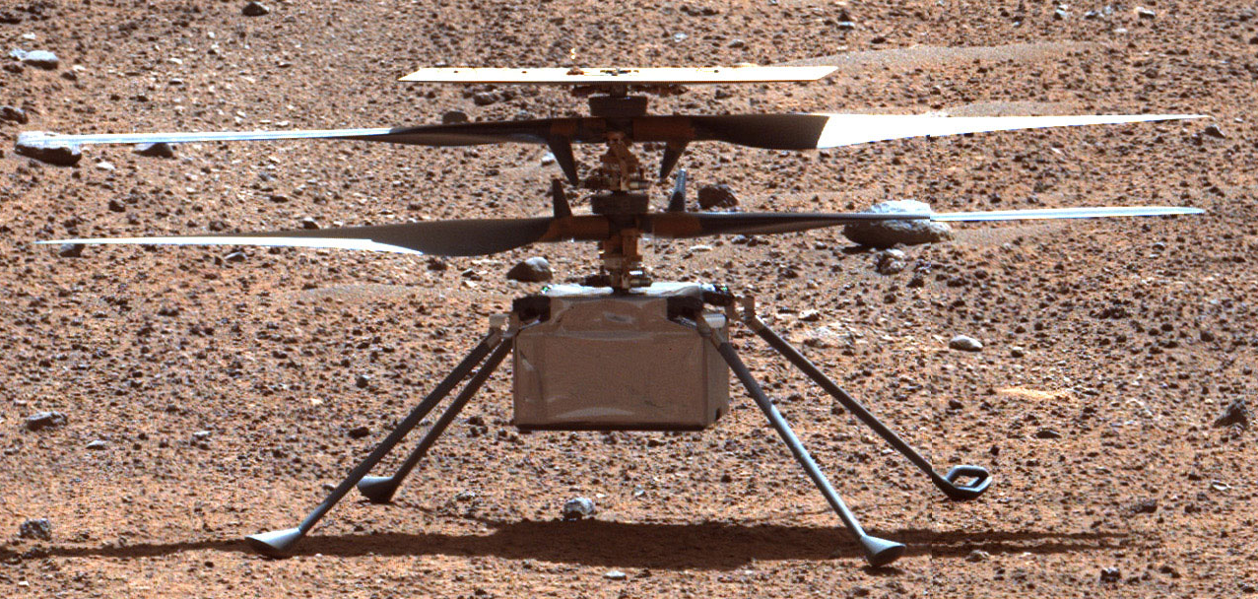
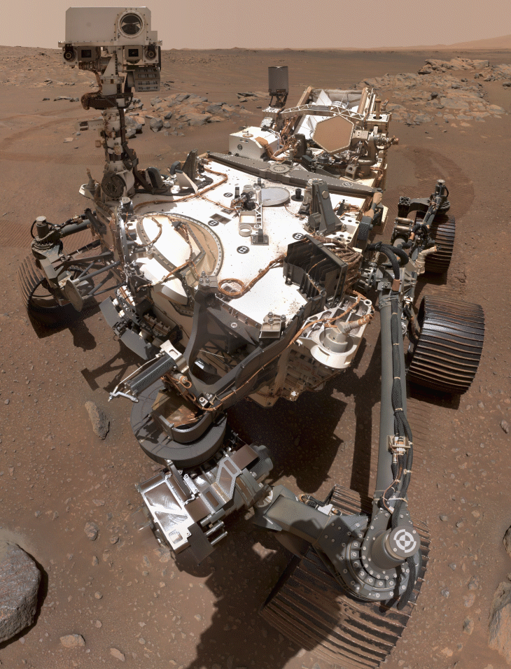
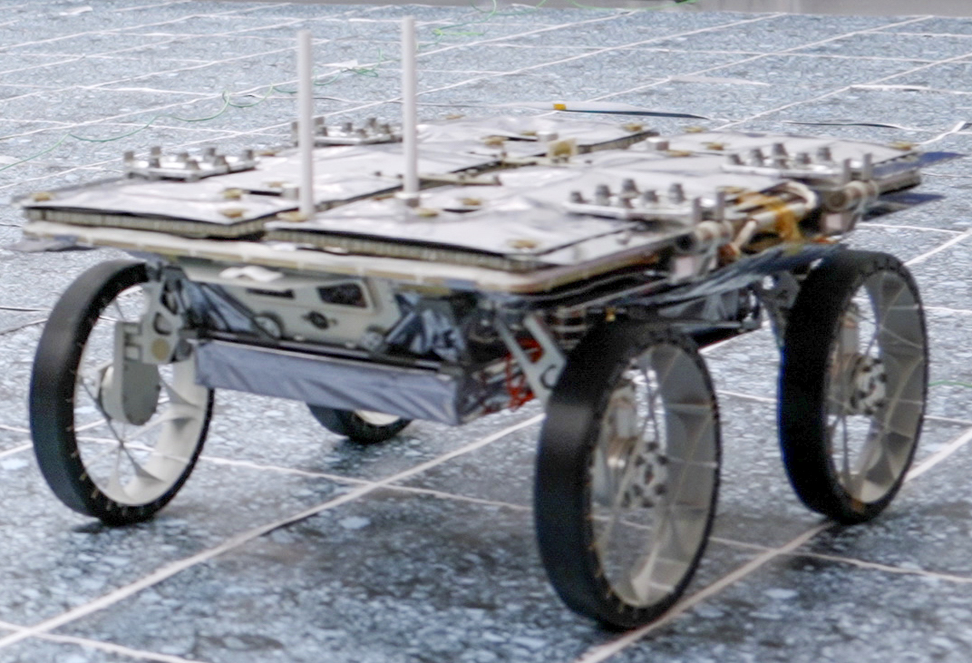
JPL’s Experience with Qualcomm Snapdragon Processors
Back in 2014, JPL wanted to fly on Mars.
  No flight computers were capable of handling the required computational needs were available.
  The helicopter was only expected to complete five flights
  Ingenuity completed 72 flights, before crash landing due to featureless terrain.
Perseverance still carries a Snapdragon 801 chip that can be used for co-processing.
CADRE mission utilizes the Snapdragon 821 SoC.

Slide 6
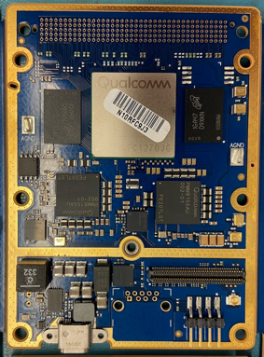
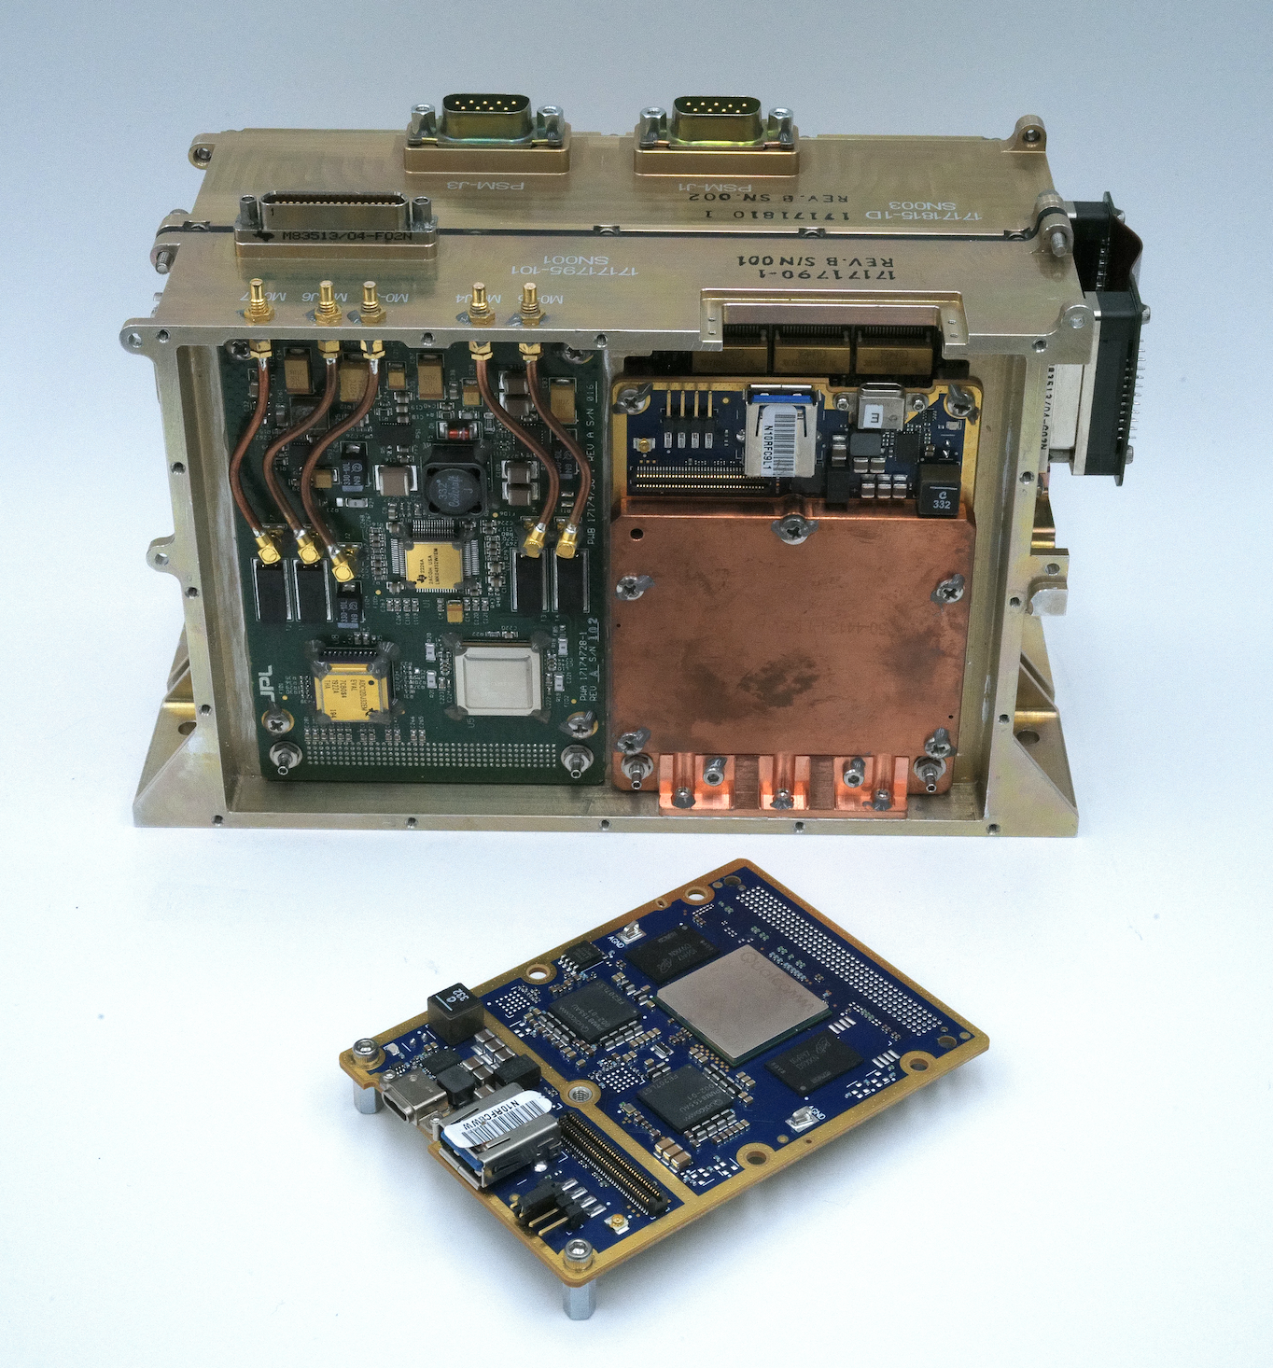
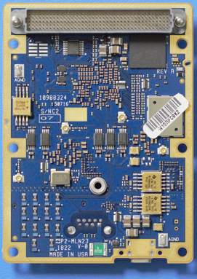
The JPL Snapdragon Co-Processor (SCP)
69 mm
The Snapdragon Co-Processor (SCP) is processing element based on the Qualcomm SA8155P SoC designed to provide a flexible and robust ultra high performance (> 7 TOPS) computing platform for a wide range of missions and instruments
The SCP is designed as mezzanine card of the Common Instrument Electronics (CIE) Swift Processor which can hosts one or two SCP mezzanines
The SCP design utilizes automotive components
  All QCOM automotive parts (SoC, PMIC, WiFi) pass
  TID ≥ 50Krad, most >100Krad, LPDDR4 > 100Krad proton - other parts (space grade switching regulators) limit SCP TID to 20Krad (upgradable to 30Krad).
  Depending on environment, some parts (SoC, PMIC LPDDR4) may suffer single-event functional interrupts (SEFI) that can be mitigated with processing architectures that incorporate redundancy
  SEFI Rates (assumes 100 mil of Al):
    Mars Surface: 3.57E-3/device-day
    ISS Orbit: 2.6E-2/device-day
Multiple SCPs can be used in parallel to provide additional computing performance or to provide redundancy for applications that require guaranteed availability
A four SCP carrier board supporting ethernet and UART interconnects is also under development and test by Div34 to explore redundancy architectures and middleware
94 mm
SCP Front
SCP mounted in CIE Swift Processor Module
SCP Back

Slide 7
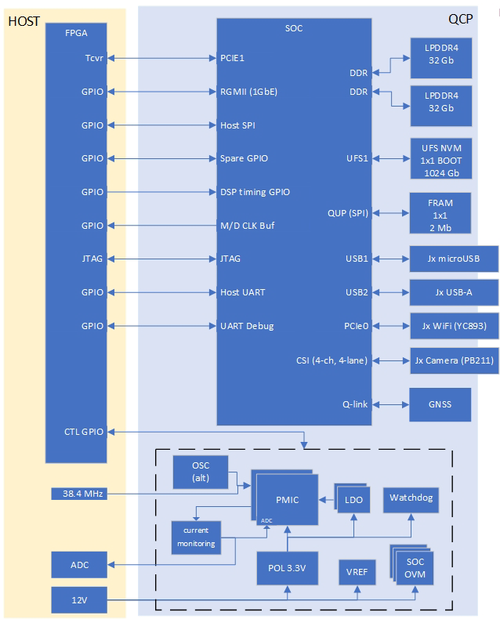
The JPL Snapdragon Co-Processor (SCP)
Coprocessor Features
  Qualcomm SA8155P SOC
  2x 64Gb LPDDR4 memory
  1024Gb Non-Volatile Flash Storage
  2Mb FRAM
  Independent rad hard (100Krad) watchdog circuit
Mezzanine Interfaces and I/O
  1x 2-lane PCIe Gen3, 2GB/s transfer rate to host
  1x 1-lane PCIe Gen3
  1x GigE RGMII support
  2x UART, 1x JTAG, 14x General Purpose IO
  5x Qualcomm Universal Peripheral ports - SPI, I2C, UART
External Interfaces
  2x USB3.0 support
  4x 4-lane MIPI Camera Serial Interface connector
  1x Boot select Jumper
Mass
  SCP with heat plate & mounting hardware -> 198 grams.
  SCP board without heat plate & mounting hardware -> 54 grams.

Slide 8
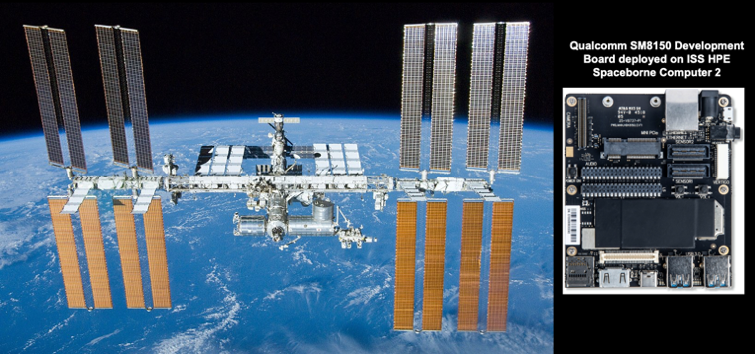
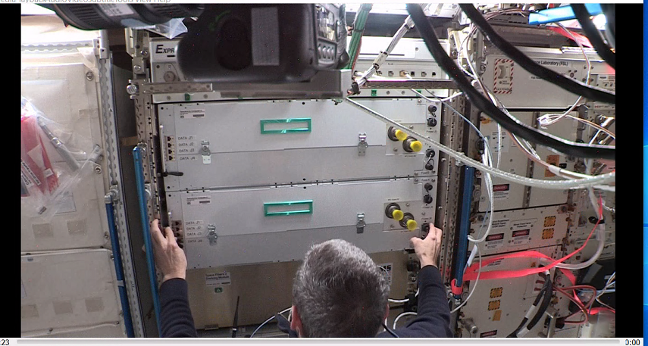
Path to TRL6
Joint collaboration with Hewlett-Packard Enterprise (HPE) Spaceborne 2 Computer
mission to integrate two Snapdragon 855 mobile platforms that arrived at the ISS in February 2021
Over 40 different AI, ML and scientific algorithms demonstrated
Long term (11+ months) COTS reliability demonstration
    Launch survivability (Antares 230+ rocket)
    No infant mortal failures (~16k board-hrs reliability test)
    No radiation upsets w/periodic rebooting & continuous power on w/variable science workloads

Slide 9
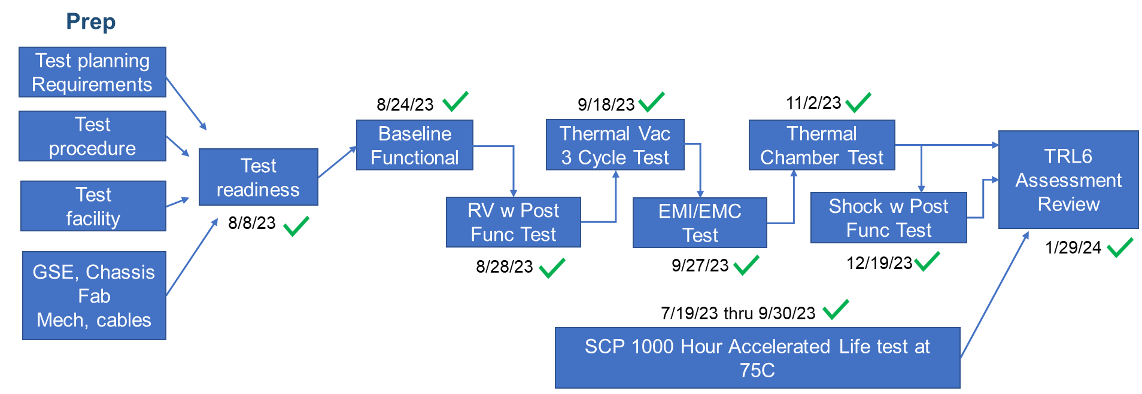
Achieving TRL-6

Slide 10
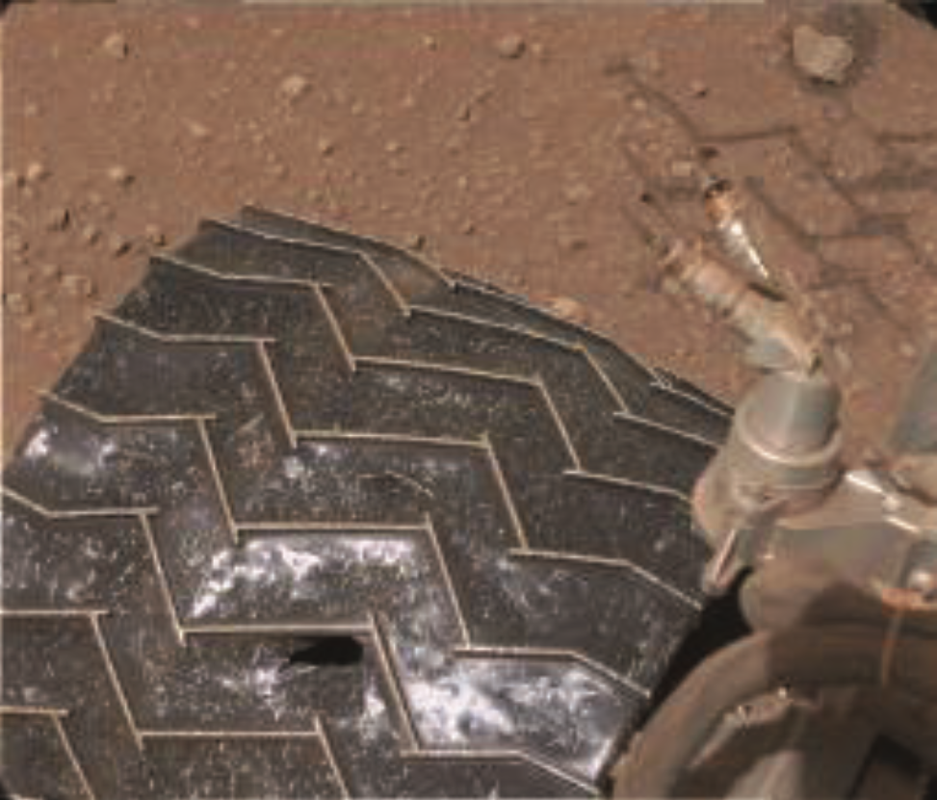
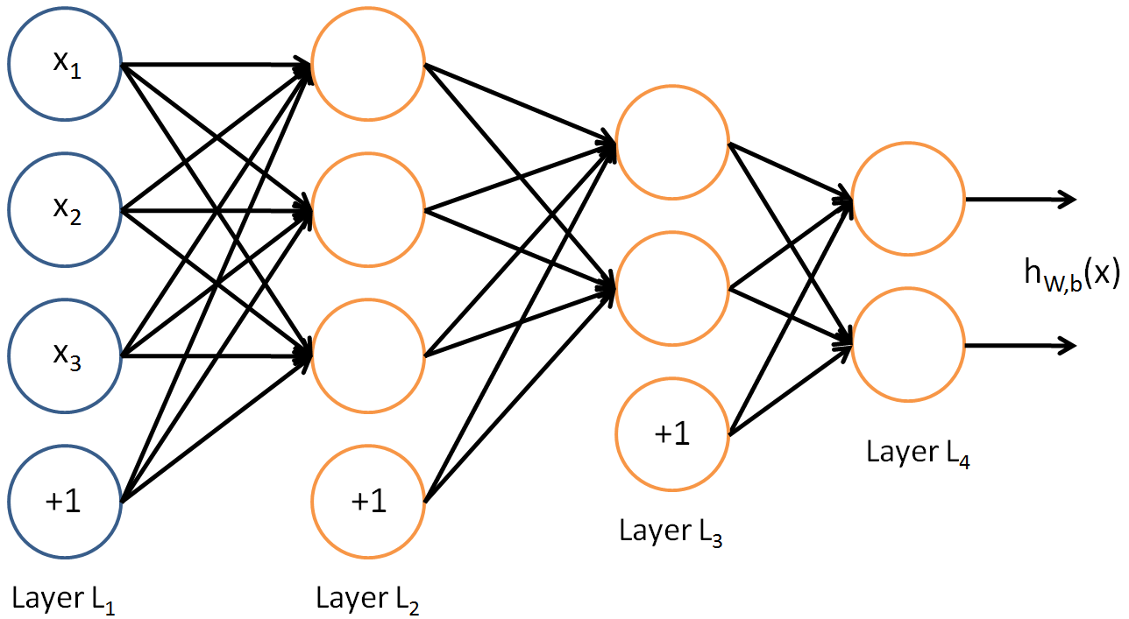
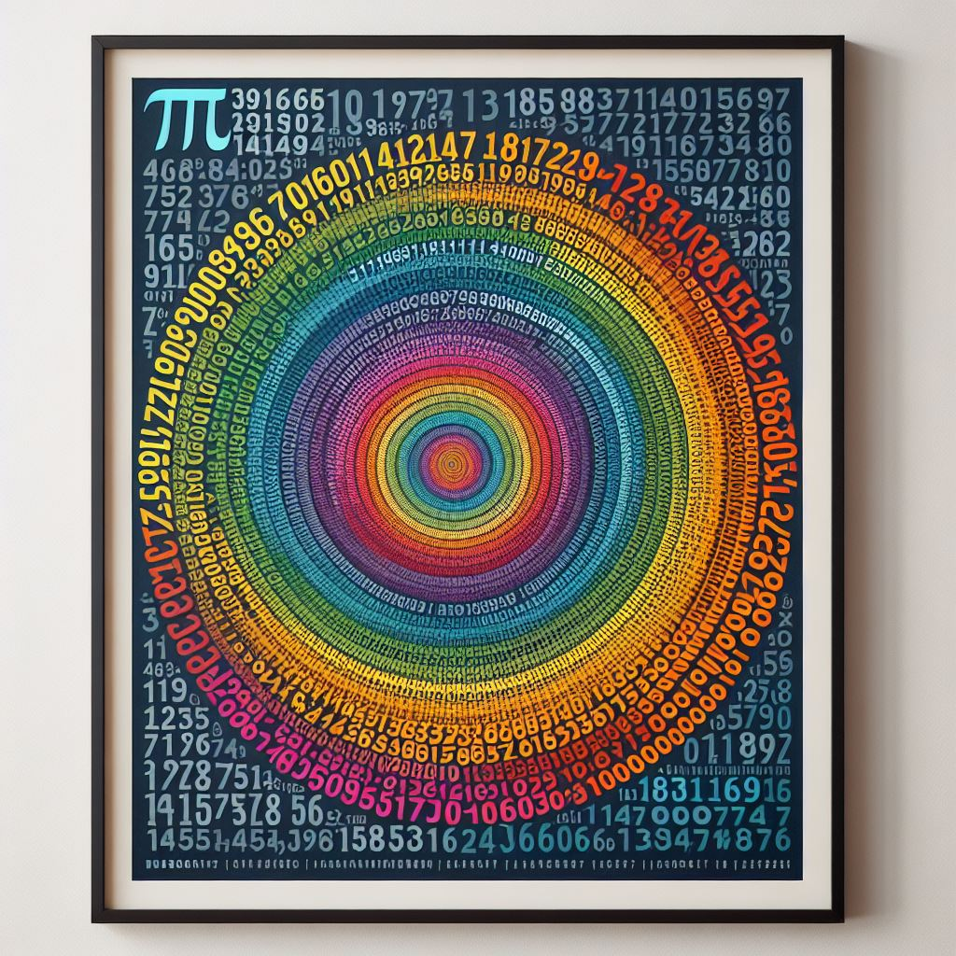

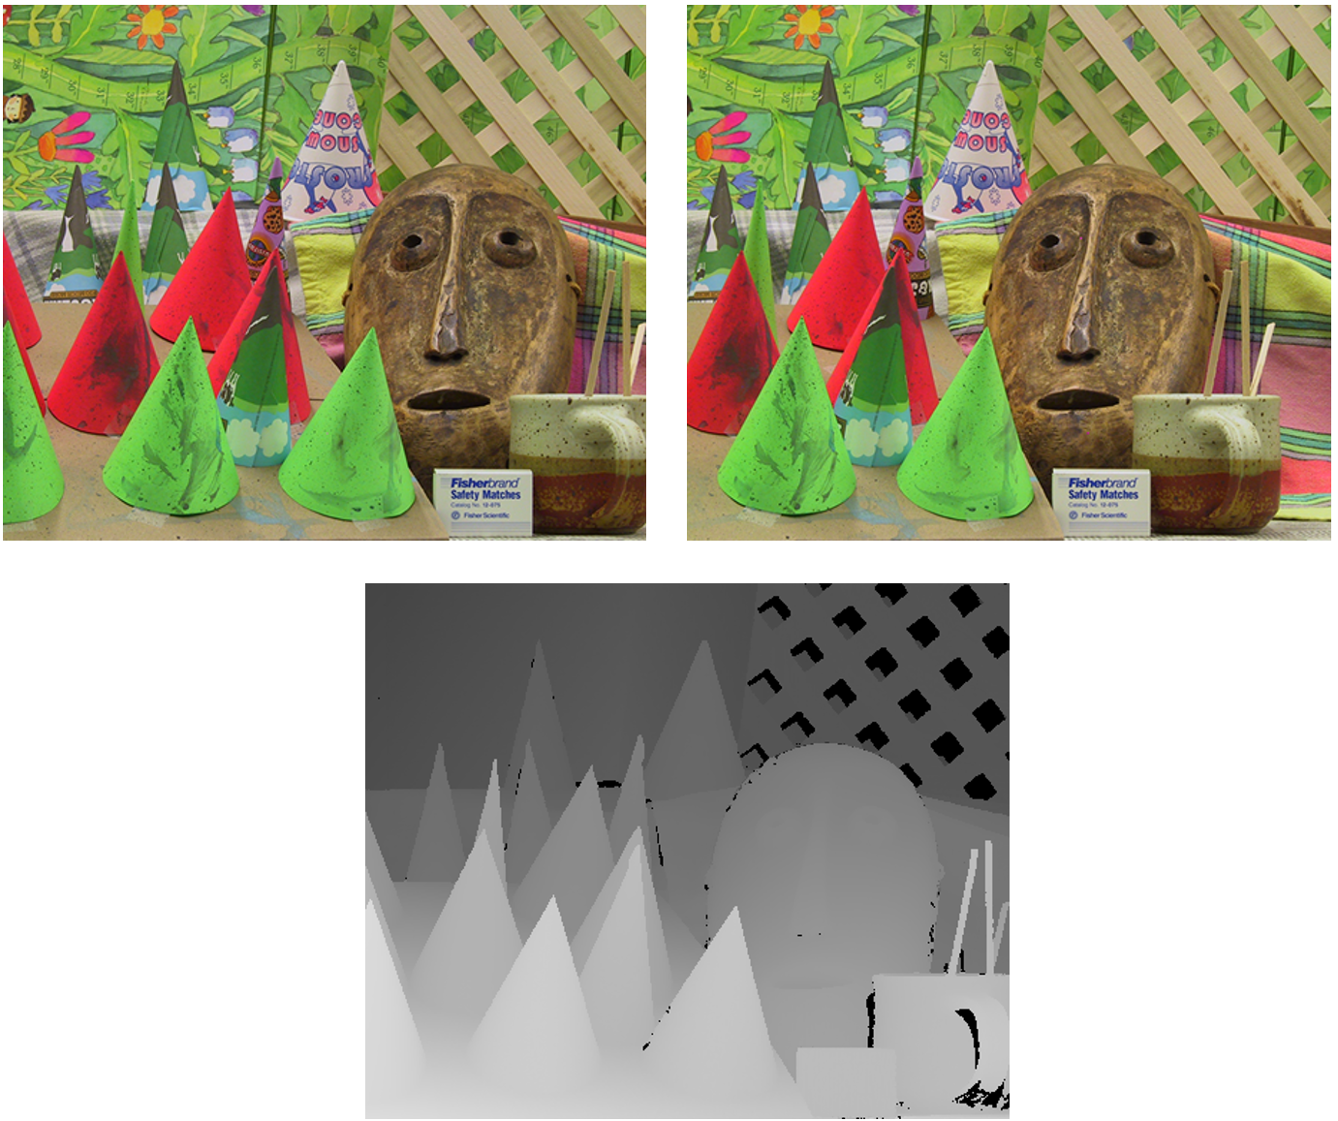
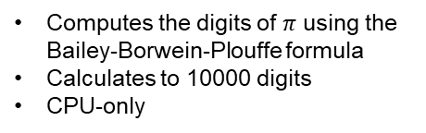

TRL6 Software Test Applications
MSLNet inference
Calculation of $π$
Image classification using convolutional neural network developed at JPL [1]
Computes the digits of $π$ using the Bailey-Borwein-Plouffe formula
Calculates to 10000 digits
CPU-only
“wheel”
Dataset derived from MSL Mastcam and MAHLI instruments
Inference computation carried out on Snapdragon CPU, GPU, and DSP subsystems
Memory checker
Depth from stereo images
Fills approx. 3 GiB of on-chip RAM with zeros and checks for bit flips or other memory errors
Computes a depth map from a pair of rectified and filtered stereo images
SAD5 algorithm
Disparity computation carried out on Snapdragon CPU, GPU, and DSP subsystems
“Static:” check for errors once at beginning, once towards the end
“Dynamic:” check for errors continuously
CPU-only; Runtime mostly dependent on the Linux virtual memory system
These applications were also used during the 1000-hour thermal chamber accelerated life test.

Slide 11
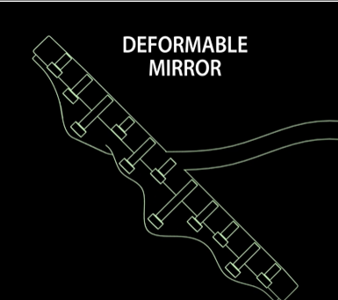
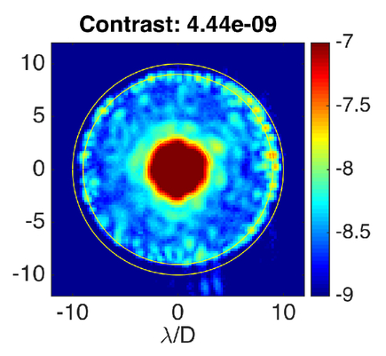
Potential Uses: HOWFSC
Coronagraph Instrument (CGI/HOWFSC) High Order
Wavefront Sensing Algorithm
  Significant computational time improvement over requirements with minimal Snapdragon porting effort (ARM CPU only)
  With Optimization (FL64→FL32 & using ARM+GPU) we expect further 2-4x factors of computational improvement
Mission Application | Requirement | Single Snapdragon ARM (CPU) Float64 Benchmark/Factor | Single Snapdragon ARM (CPU) Float32 Benchmark/Factor | Single Snapdragon Distributed workload; ARM+GPU Benchmark/Factor
Nancy Roman ST CGI | 100 hr (37.8 hr, 2019 CBE) | < 1.8 hr 20x faster than CBE | < 0.9 hr 40x faster than CBE | < 0.5 hr 80x faster than CBE
HabEx CGI | 7.6 hr | 4x faster than req | 8x faster than req | 16x faster than req
LUVOIR CGI | 0.5 hr | 4x slower than req | 2x slower than req | Same as req

Slide 12
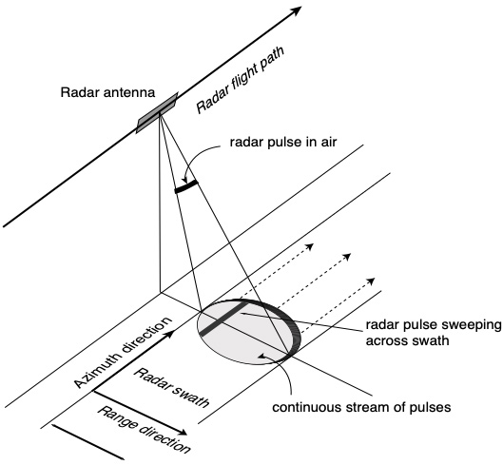
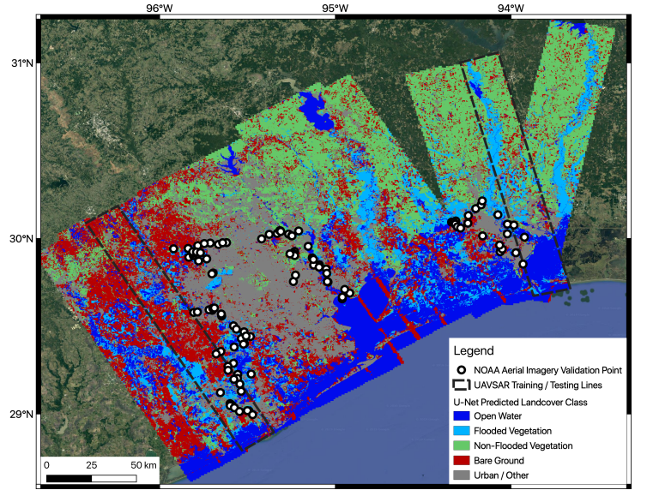
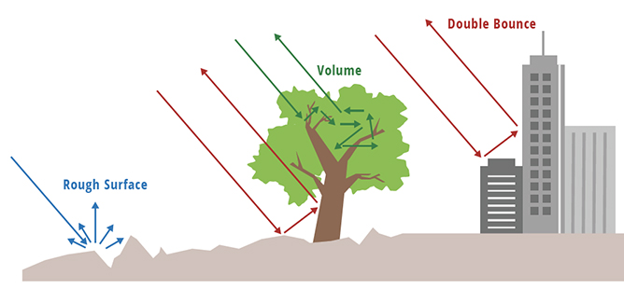
Potential Uses: SAR Processing
Radar missions scan a swath while moving, generating a “line”
Generates a great amount of data
  NISAR required a novel telecom system to stream data at 1.74 Gbps Ka-band modulator just to downlink the SAR data
For airborne missions, data is generally off-loaded after the flight.
A combination of the Swift and SCP can perform energy efficient SAR image processing at reasonable resolutions, greatly reducing downlink science data volumes.
Additional machine learning models can be deployed on the SAR images, such as UAVSAR’s flooded vs. dry vegetation classifier:
UAVSAR real-time requirement is 5.13 patches/sec.
 | CPU | GPU | DSP
Patches/sec | 19.93 | 162.1 | 391.7
Binary Misclassifications (relative to Desktop system) | 0% | 0% | 0.38%

Slide 13
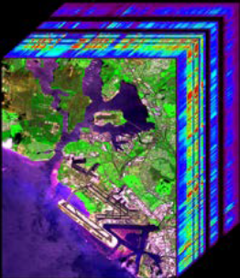
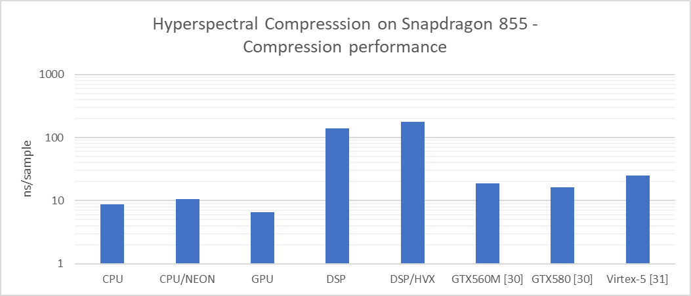
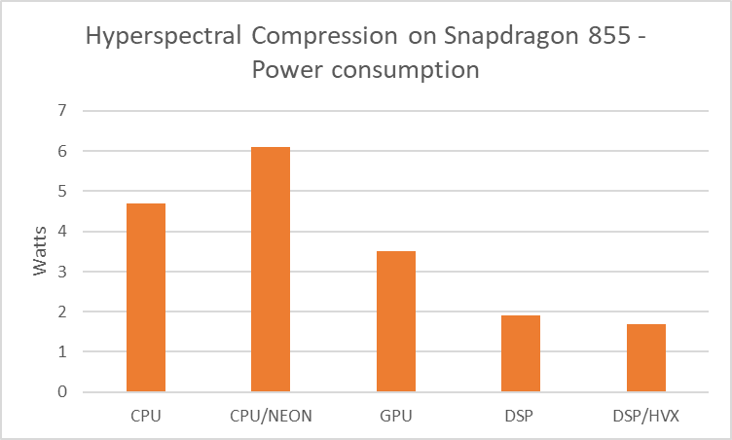
Application Benchmarking: Hyperspectral Compression
Hyperspectral images: two spatial and one spectral dimension
Captures information about the electromagnetic spectrum outside of the visible band for remote sensing applications
Large datasets require on-board compression before downlinking
Compression algorithms standardized by CCSDS [28, 20]
  CCSDS 123.0-B-1 (2012): Lossless compression with no data dependency between bands (parallel computation optimized)
  CCSDS 123.0-B-2 (2019, backwards compatible): Lossy compression introduces data dependency between bands due to re-encoding (less parallelizable).

Slide 14
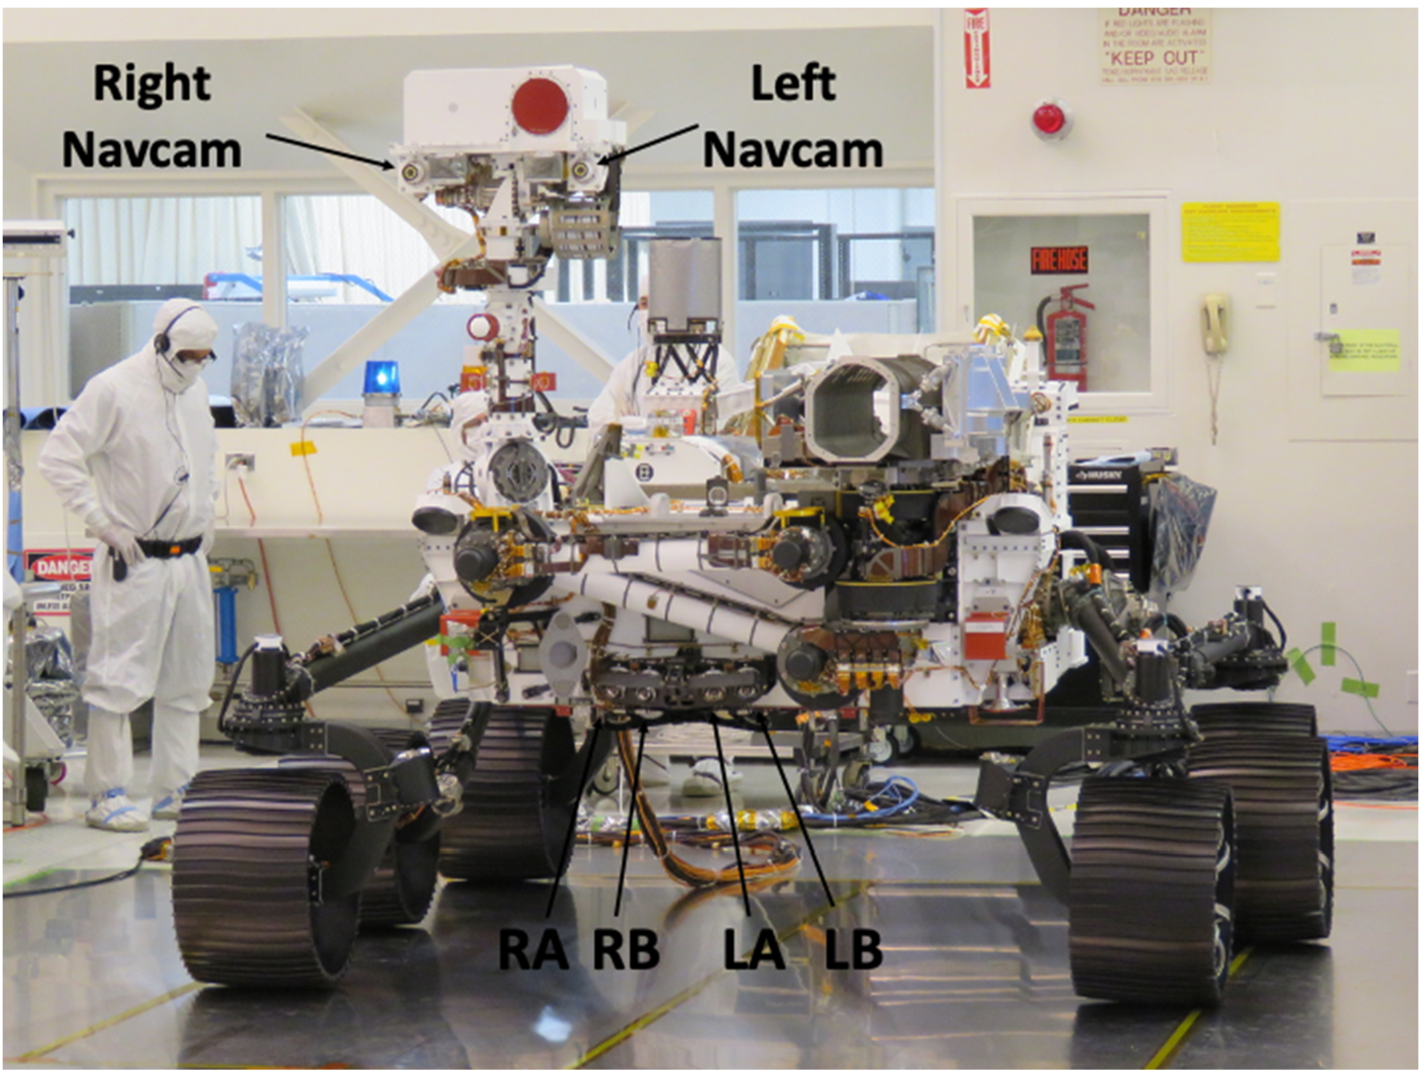
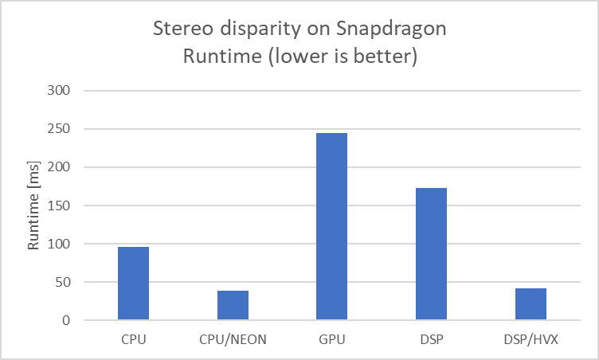
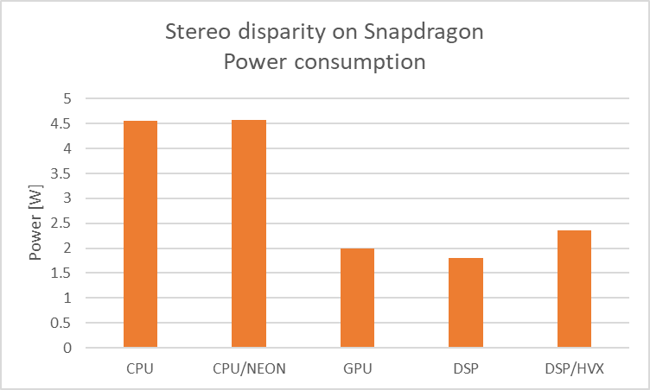
Potential Uses: Stereo Disparity Measurement
Depth perception for autonomous navigation
From camera calibration data & stereo image pair, compute range map
“Correspondence problem”: set of pixels corresponding to the same target are unknown a priori
Active topic of research
This effort benchmarked a modified sum of absolute differences (SAD) algorithm: SAD5 [25]
Algorithm favors SIMD-style architectures (NEON and HVX)
  DSP provides best performance/Watt

Slide 15
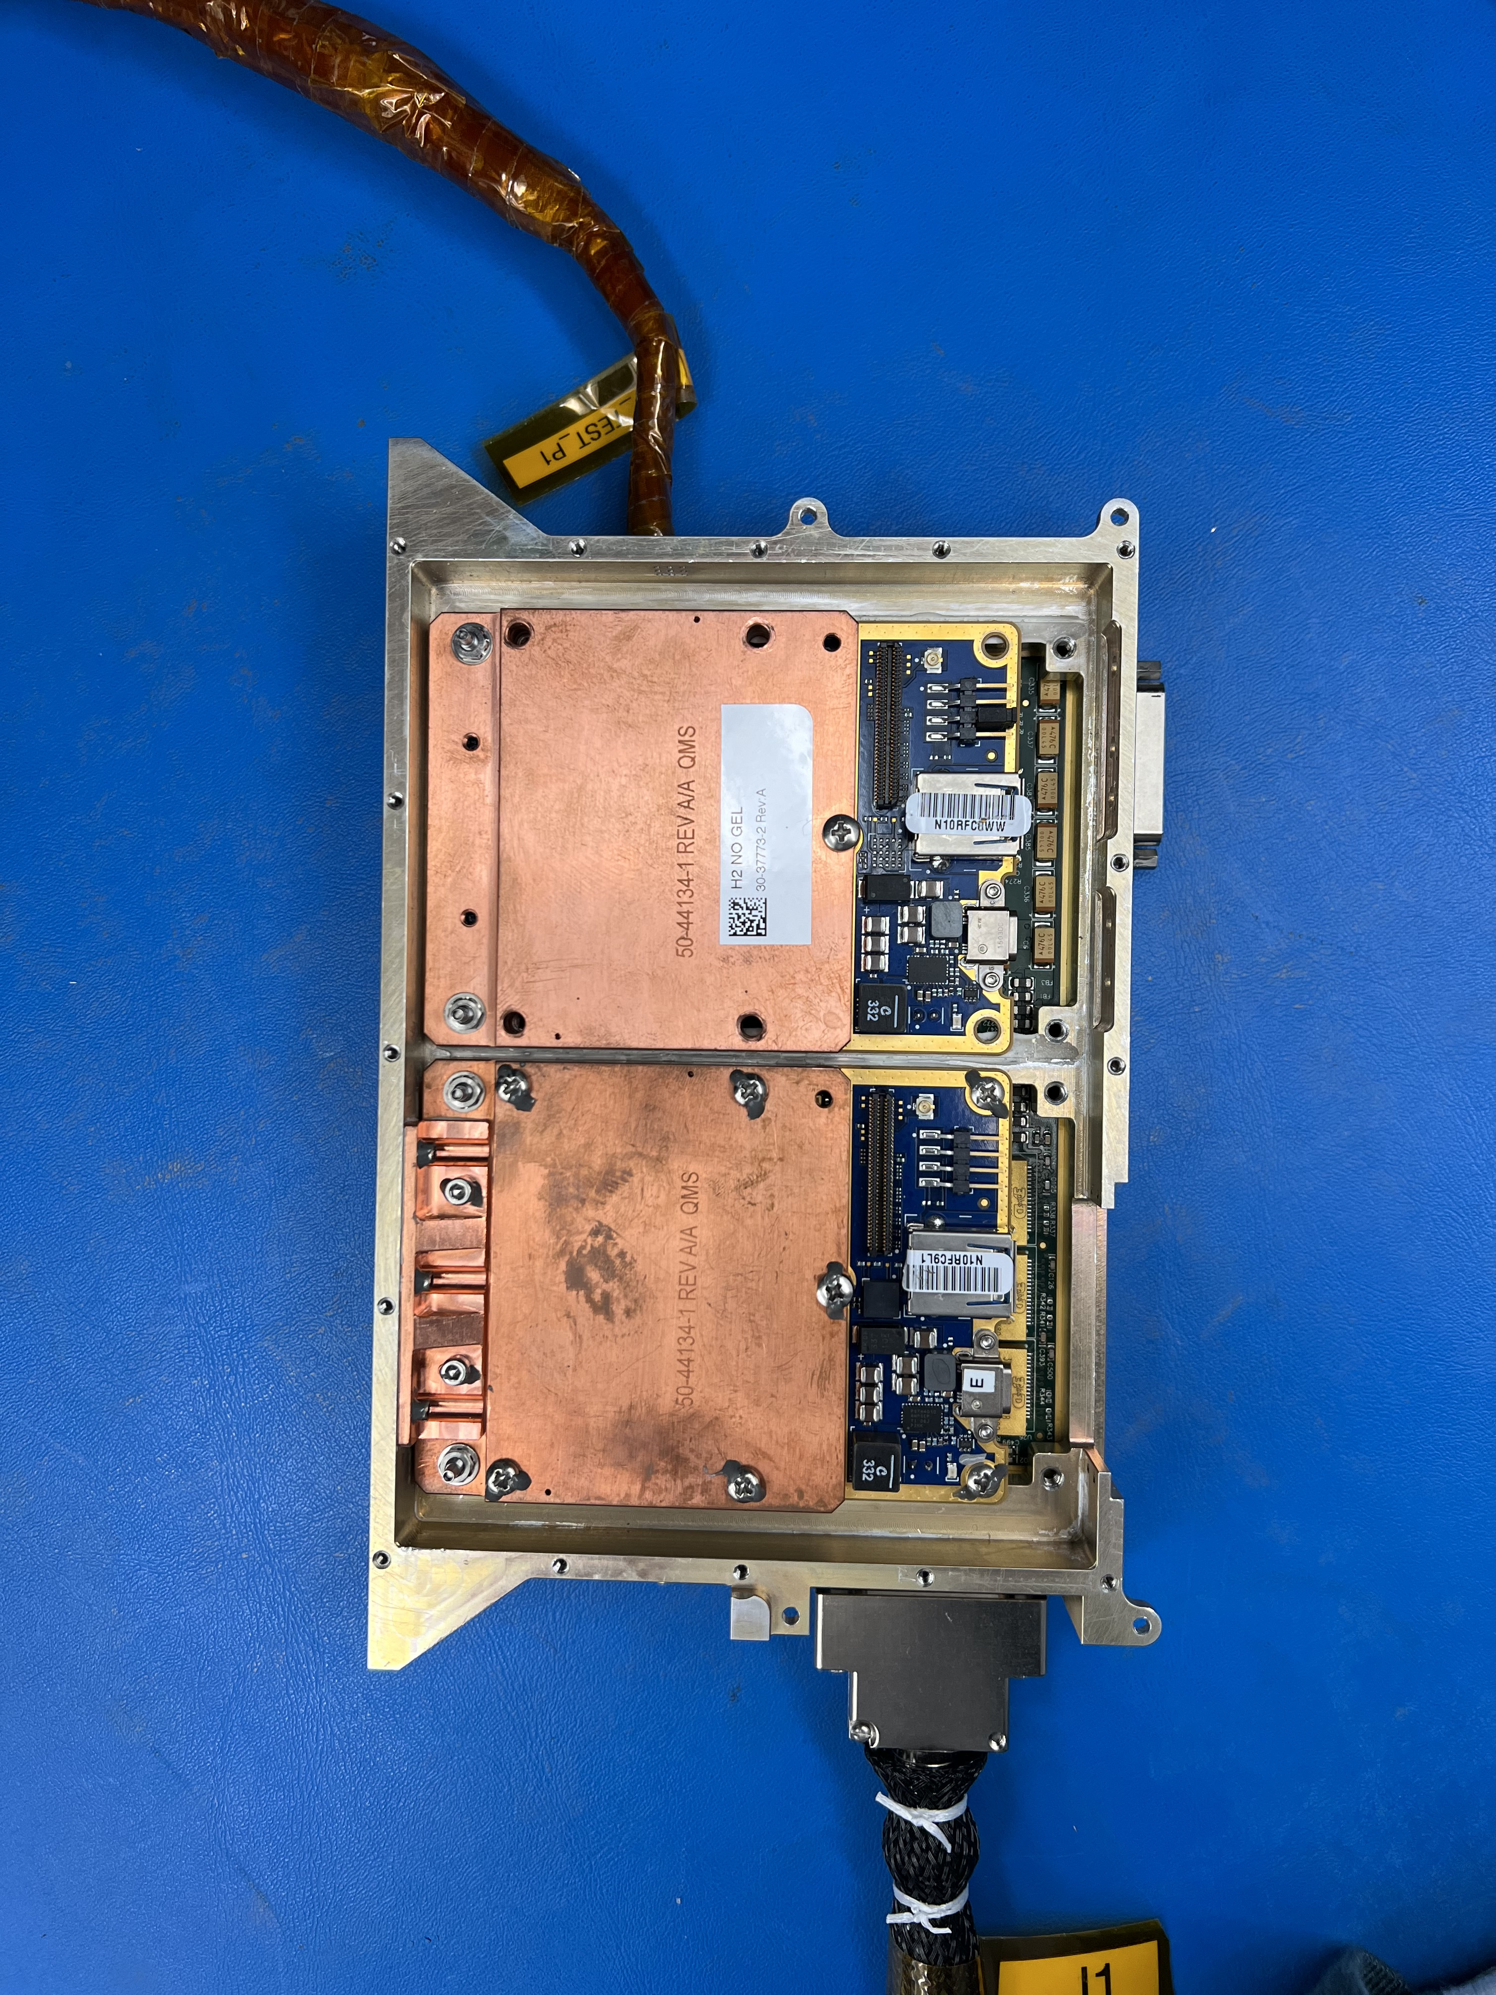
Hosted Dual Snapdragon Co-Processors (SCPs)
To verify the hardware configuration envisioned for missions, the Swift module used in environmental test was recently reconfigured to carry Dual SCPs.
  Firmware was developed to bring up and monitor the SCP in both slots in parallel
Future NASA Avionics roadmap features the High-Performance Spaceflight Computing (HPSC) interface and processor chip.
  HPSC is designed to host co-processors like the SCP via PCIe and ethernet interfaces.
  SCPs can provide missions with high performance/watt while HPSC provides management of co-processors as well as serve as spacecraft avionics.
Dual SCPs hosted by Swift module
PCIe/Ethernet
SCPs
Mission Accelerators
Future Avionics

Slide 16
Acknowledgments
Primary funding for the Snapdragon task is provided through JPL investment funds made available by Dave Gallagher, Office of Strategic Integration
JPL SCP management, development and test team – Joe Sauvageau, Doug Sheldon, Zaid Towfic, Andre Jongeling, Dennis Ogbe, Saba Janamian, Brian Bradford, Edwin Grigorian, Clay Okino, Bridget Wiley, Dave Hawkins, Mike Dombrower, Mike VanDyke, Manny Soriano, Lindsay White, Tim Canham, Joe Riendeau, Mike Blakely, Jeremiah Gayle, Steve Carlson, Randy Dodge, Allen Andersen, Lindsey Berger, Nelson Green, and many others…
Qualcomm SCP development and test team – Justin Gagne, Brad Cash, Stephen Potter,
Chris Pruetting, Luke Steenstra, Chris Pagnotta, Todd Campbell, Luis Beltre, Ed Kallal, and
many others…

