Slide 1
SunRISE Mission Operation System Overview
April 30, 2024
Authors: Shannon Berger, Jim Lux, Cate Heneghan, Joseph Lazio, Angela Dorsey, Robert R Smith, Jessi Bustos, Adrian Vazquez, Carson Schubert, and Ben Redfield
Jet Propulsion Laboratory, California Institute of Technology

Slide 2
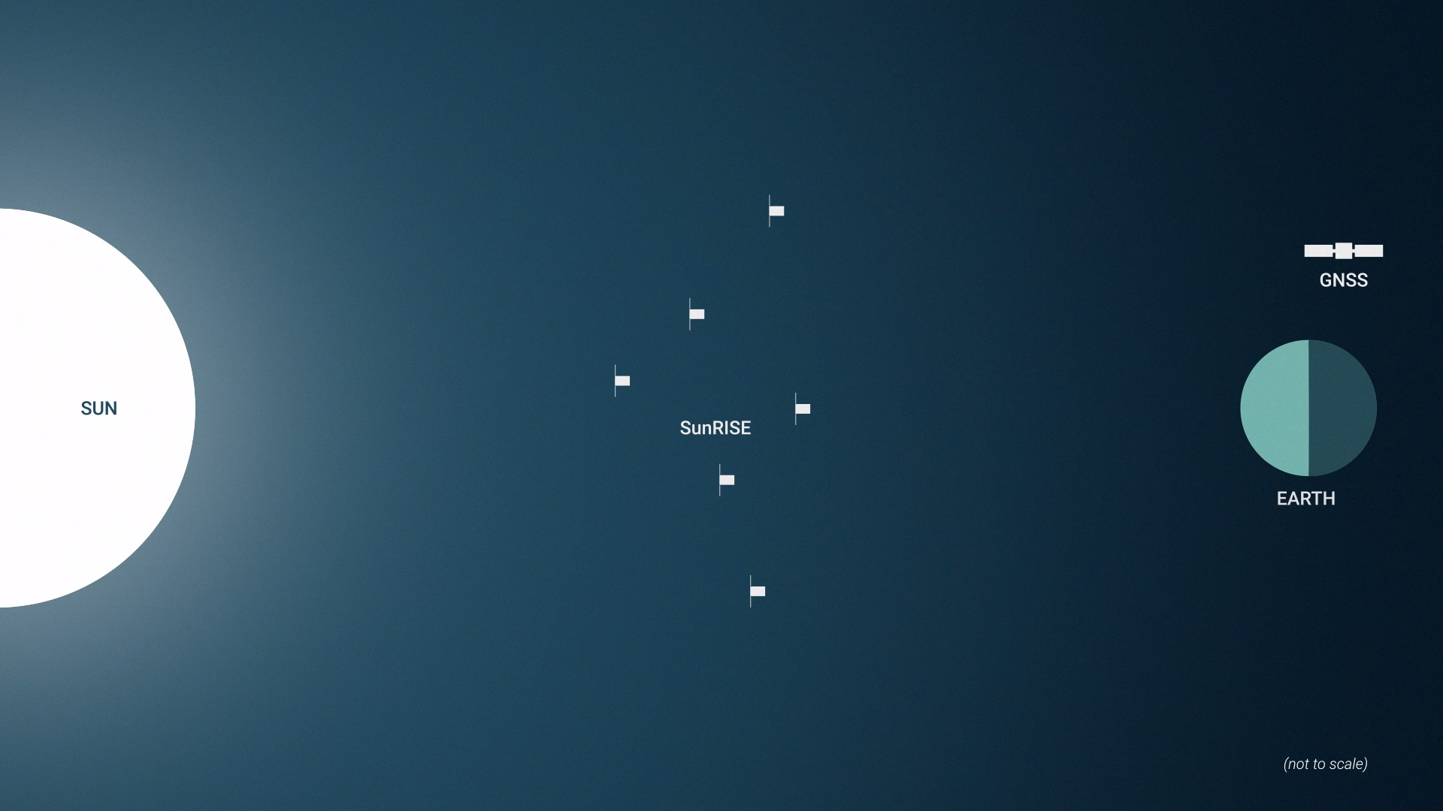
What is SunRISE?
SunRISE will be the first imaging spaceborne radio interferometer
SunRISE will be a cluster of 6 small space vehicles flying 10-km apart, to study Coronal Mass Ejections.
SunRISE merges Near- and Deep-Space Techniques

Slide 3
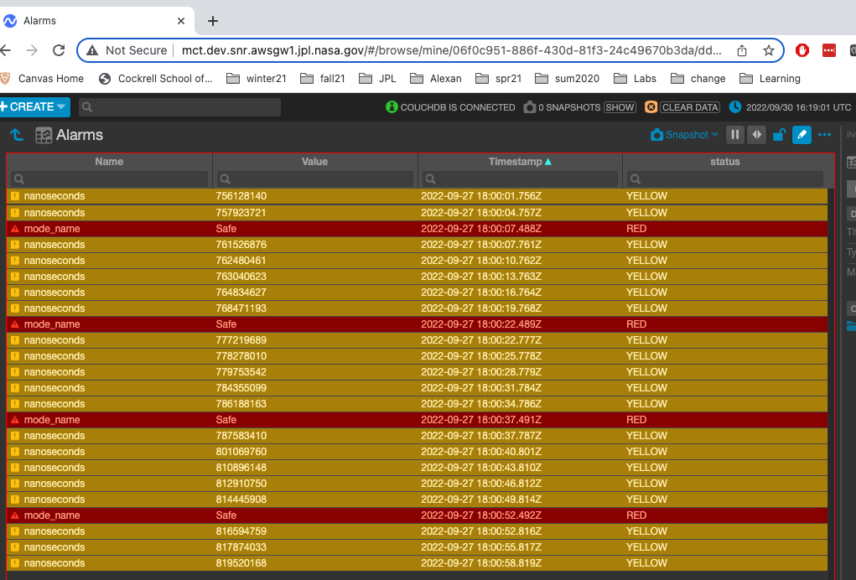
What Makes SunRISE MOS-GDS Interesting?
Three operators for 6 space vehicles (ops team < number of satellites)
  Rapid Health Check Procedures
  Ground System automated data transfer
Early career engineers paired with seasoned mentors; given creative freedom
  GDS used custom development AIT branch with tight-feedback loop with MOS team
Test Heavy Development Campaign:
  ILPT: Project-Wide Test with Flight Hardware in the Loop
  DSN Compat: Using near-Earth radios with Deep Space Network (DSN)
GDS System entirely in the cloud
DSN MSPA for telecommunications
SunRISE was one of first missions to have cybersecurity requirements imposed on Flight System.
  NASA Standard 1006, which will be the norm for future missions.
  Meant figuring out key management, uplink encryption, etc.
OpenMCT Alarms Dashboard
AIT – AMMOS Instrument Toolkit
DSN – Deep Space Network
GDS – Ground Data System
ILPT – Interferometer-Level Performance Test
MSA – Mission Support Area
MOS – Mission Operations System
Notes:
We have a noisy system that works for low earth. DSN was not used to use these radios (merging near space and deep space). Using near earth radio with DSN network. Cate says there is a whole memo about this.
The development of the SunRISE mission operations system benefited greatly from the opportunities afforded by a small mission. The relationship between the operations and ground system teams was such that they worked as a single unit, rather than as separate teams trading requests and features with one another. The developers of the ground system had clear knowledge of how their work would be used operationally, and the operations team had intimate knowledge of how the features they were requesting were ultimately implemented. As test venues improved, it became possible to iterate extremely quickly on certain features, which allowed those capabilities to become exactly what the operators needed. There was also an immense amount of creative freedom given to the team from the very beginning and maintained throughout development. This had a noticeable effect on willingness to innovate, and resulted in a system that is more efficient than it would have been otherwise. Such creative freedom is a reasonable thing to grant on projects like SunRISE that, by definition of their class D mission status [6], take on additional risk.
It is cost prohibitive to staff one operator per space vehicle for the duration of the mission. So, the operations system must be designed with the "one to many" concept in mind. In real-time, one operator must monitor, maintain, and control multiple vehicles at once. This is only possible with the aid of an efficient set of procedures, and a reliable system for processing and displaying critical information. Even when an actual ground contact is complete and additional personnel are available, there is the still the challenge of organizing six vehicle's worth of data, planning activities for the entire constellation, and managing a large set of command products. SunRISE is not able to staff a huge team to do this manually; here again, procedures and a reliable ground system must work together to enable constellation management.

Slide 4
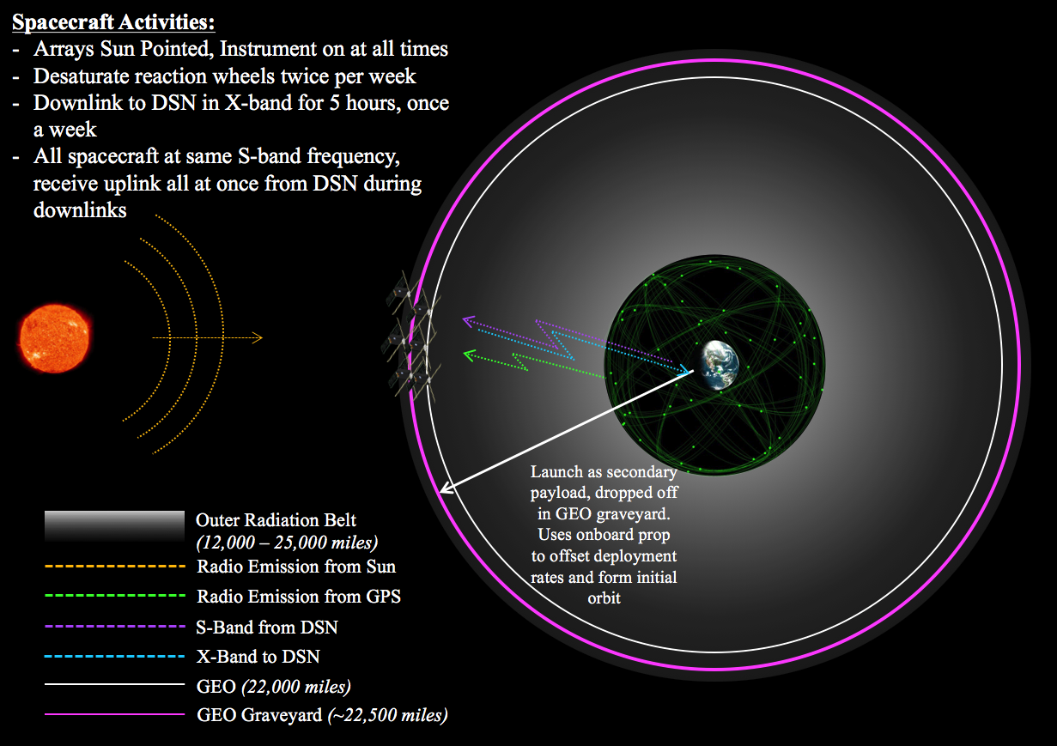
GEO Graveyard Orbit
GEO Graveyard Orbit selected because it puts SunRISE constellation above the ionosphere.
  The ionosphere would interfere with the radio frequencies SunRISE is measuring.
Space vehicles come within 1 km of each other – airplanes require greater separation than that.
SunRISE takes 3-4 months to orbit Earth.
Traditional CubeSat in LEO
Notes:
Most smallsats have operated within GEO

Slide 5
GEO Graveyard Orbit
GEO Graveyard Orbit selected because it puts SunRISE constellation above the ionosphere.
  The ionosphere would interfere with the radio frequencies SunRISE is measuring.
Space vehicles come within 1 km of each other – airplanes require greater separation than that.
SunRISE takes 3-4 months to orbit Earth.
Traditional CubeSat in LEO
Traditional CubeSat in LEO
Notes:
Most smallsats have operated within GEO

Slide 6
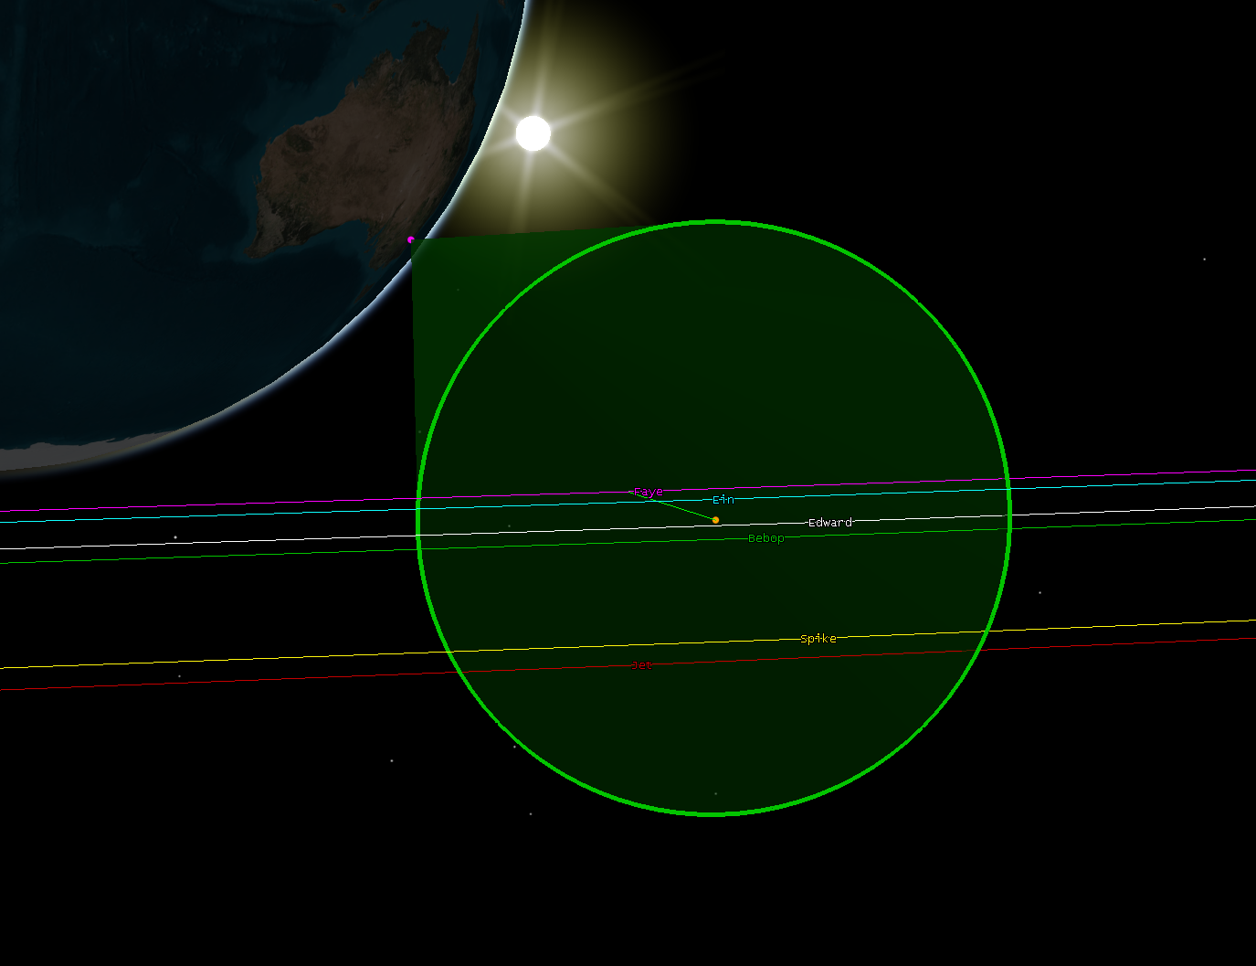
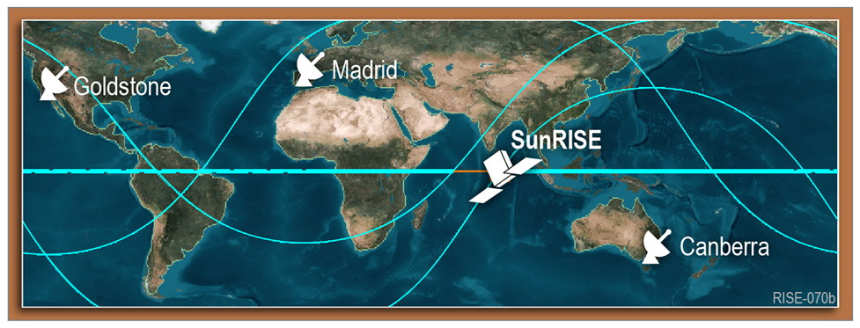
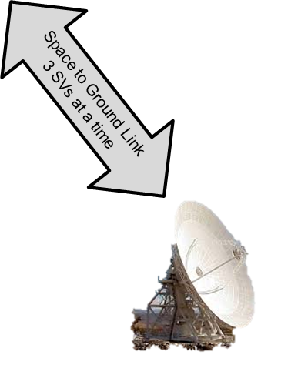
MSPA
DSN communicates with 3 spacecrafts per pass utilizing MSPA (Multiple Spacecraft Per Antenna) capability
Beamwidth: 42 km
Ground only communicates with each space vehicle once a week
Each space vehicle talks to the ground, but they do not talk to each other.
Each SCID is unique – creates challenges with DSN
Notes:
Our observatory can grow to the size of beamwidth

Slide 7
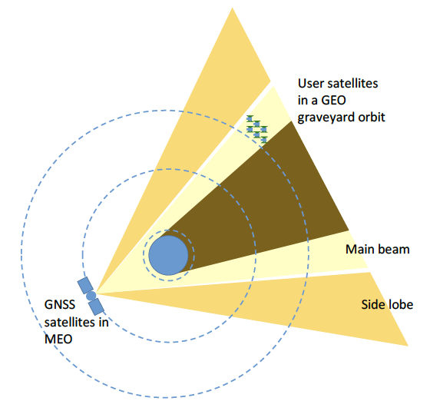
Precision Orbit Determination
L-&S-band Raw
The SunRISE mission requires both precise time and position information.
First, real-time knowledge of time (and position) at the microsecond level is required so that all 6 space vehicles in the interferometer can take the DH measurements simultaneously.
Later, on the ground, higher accuracy, post-processed POD solutions are used to determine the relative propagation delays between the space vehicle pairs in the interferometer.
Then science happens…
SunRISE
Notes:
Note from Kristine: There’s still a “d” hidden in the orange box behind “University of Michigan.” Delete?

Slide 8
Day 1 |  |  |  |  |  | Day 7
G1 DSN Pass
G2 DSN Pass
L0 Proc.
POD: Precise Orbit Determination
FOP: Forward Orbit Prediction
SOC: Science Operations Center
G1: Group 1 SVs (3 total)
G2: Group 2 SVs (3 total)
DSN Scheduling
5
4
5
4
2
L0 Processing
G1 S/C & P/L Health Check
Per-S/C Maneuver Planning
2
8
Verify Maneuvers, Generate Timing Offsets & FOP
Cross-Check Maneuvers, Replan
G1 GNSS POD
G1 Activity Planning
8
8
4
8
G1 Desat Planning
Per-S/C Maneuver Planning
G1 Command & Seq. Generation
G1 Uplink Product Preparation
4
8
8
4
Mission Planning
G2 S/C & P/L Health Check
G2 Activity Planning
8
8
G2 Command & Seq. Generation
G2 Uplink Product Preparation
Pass 1 Start Window
2
G2 GNSS POD
8
4
7
Pass 2 Start Window
8
Transmit GNSS, DH to SOC
7
G2 Desat Planning
4
P/L Freq. Selection Updates
4
32
Operator
POD
Nav
U of Michigan
Autonomous
Notes:
20% margin on average for all these activities
Traditional LEO: 1-2 pass/day
SunRISE: once per week similar to a deep space mission

Slide 9
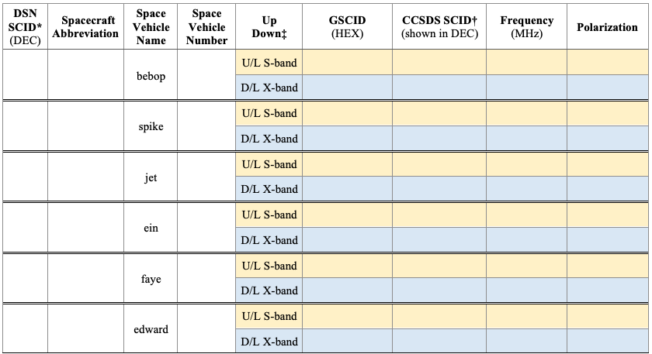
Make Different Mistakes Than Us
Include Cybersecurity and GNC Ops Engineers cost during development
Six-ness Personification
  Space vehicles were assigned nicknames
  Assign names early and ensure project is aligned.
Be in sync with MDNav about commissioning timeline
Communication difficulties are exponential with increasing number of spacecrafts
  6 space vehicles = 6 names, 6 serial numbers, 12 SCIDS, etc
  Make a reference chart

