Slide 1
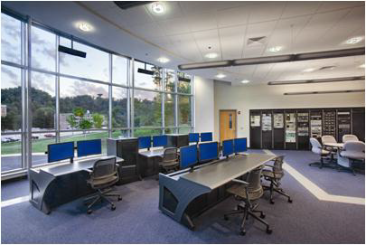
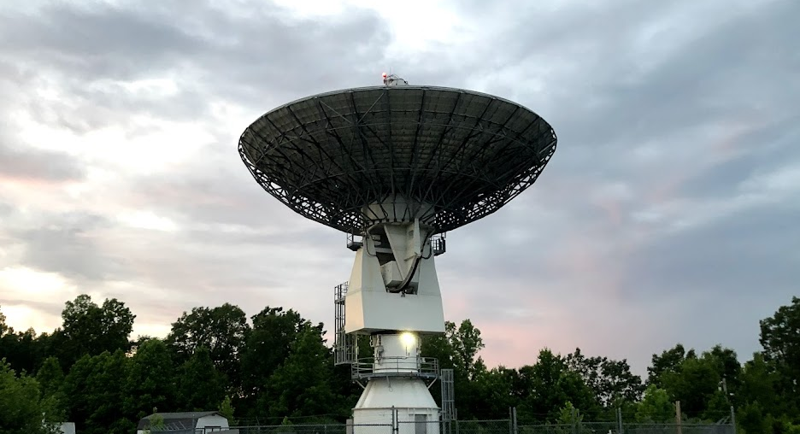
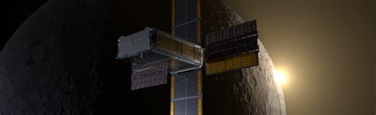
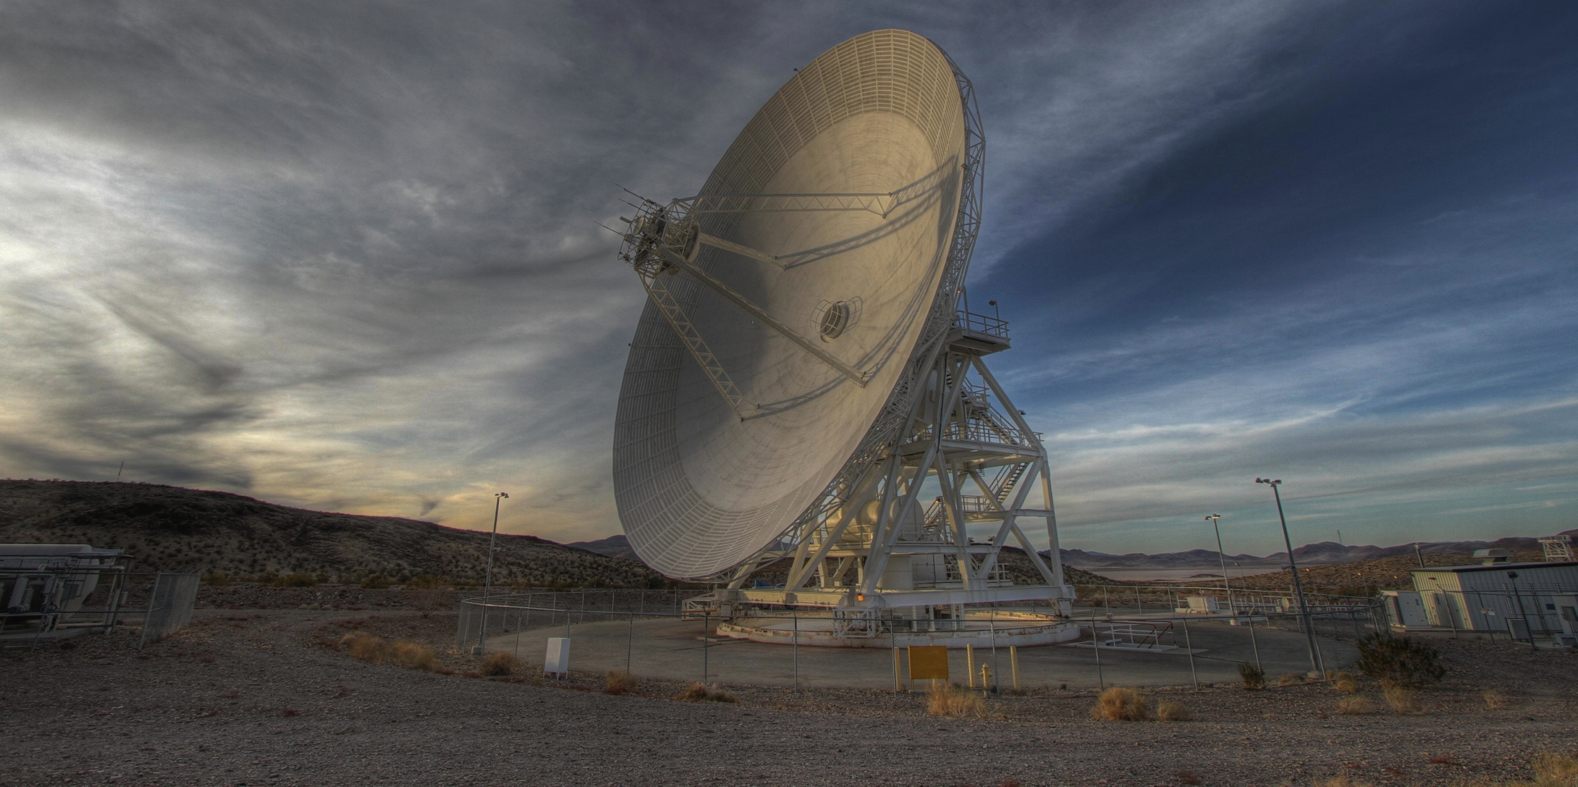
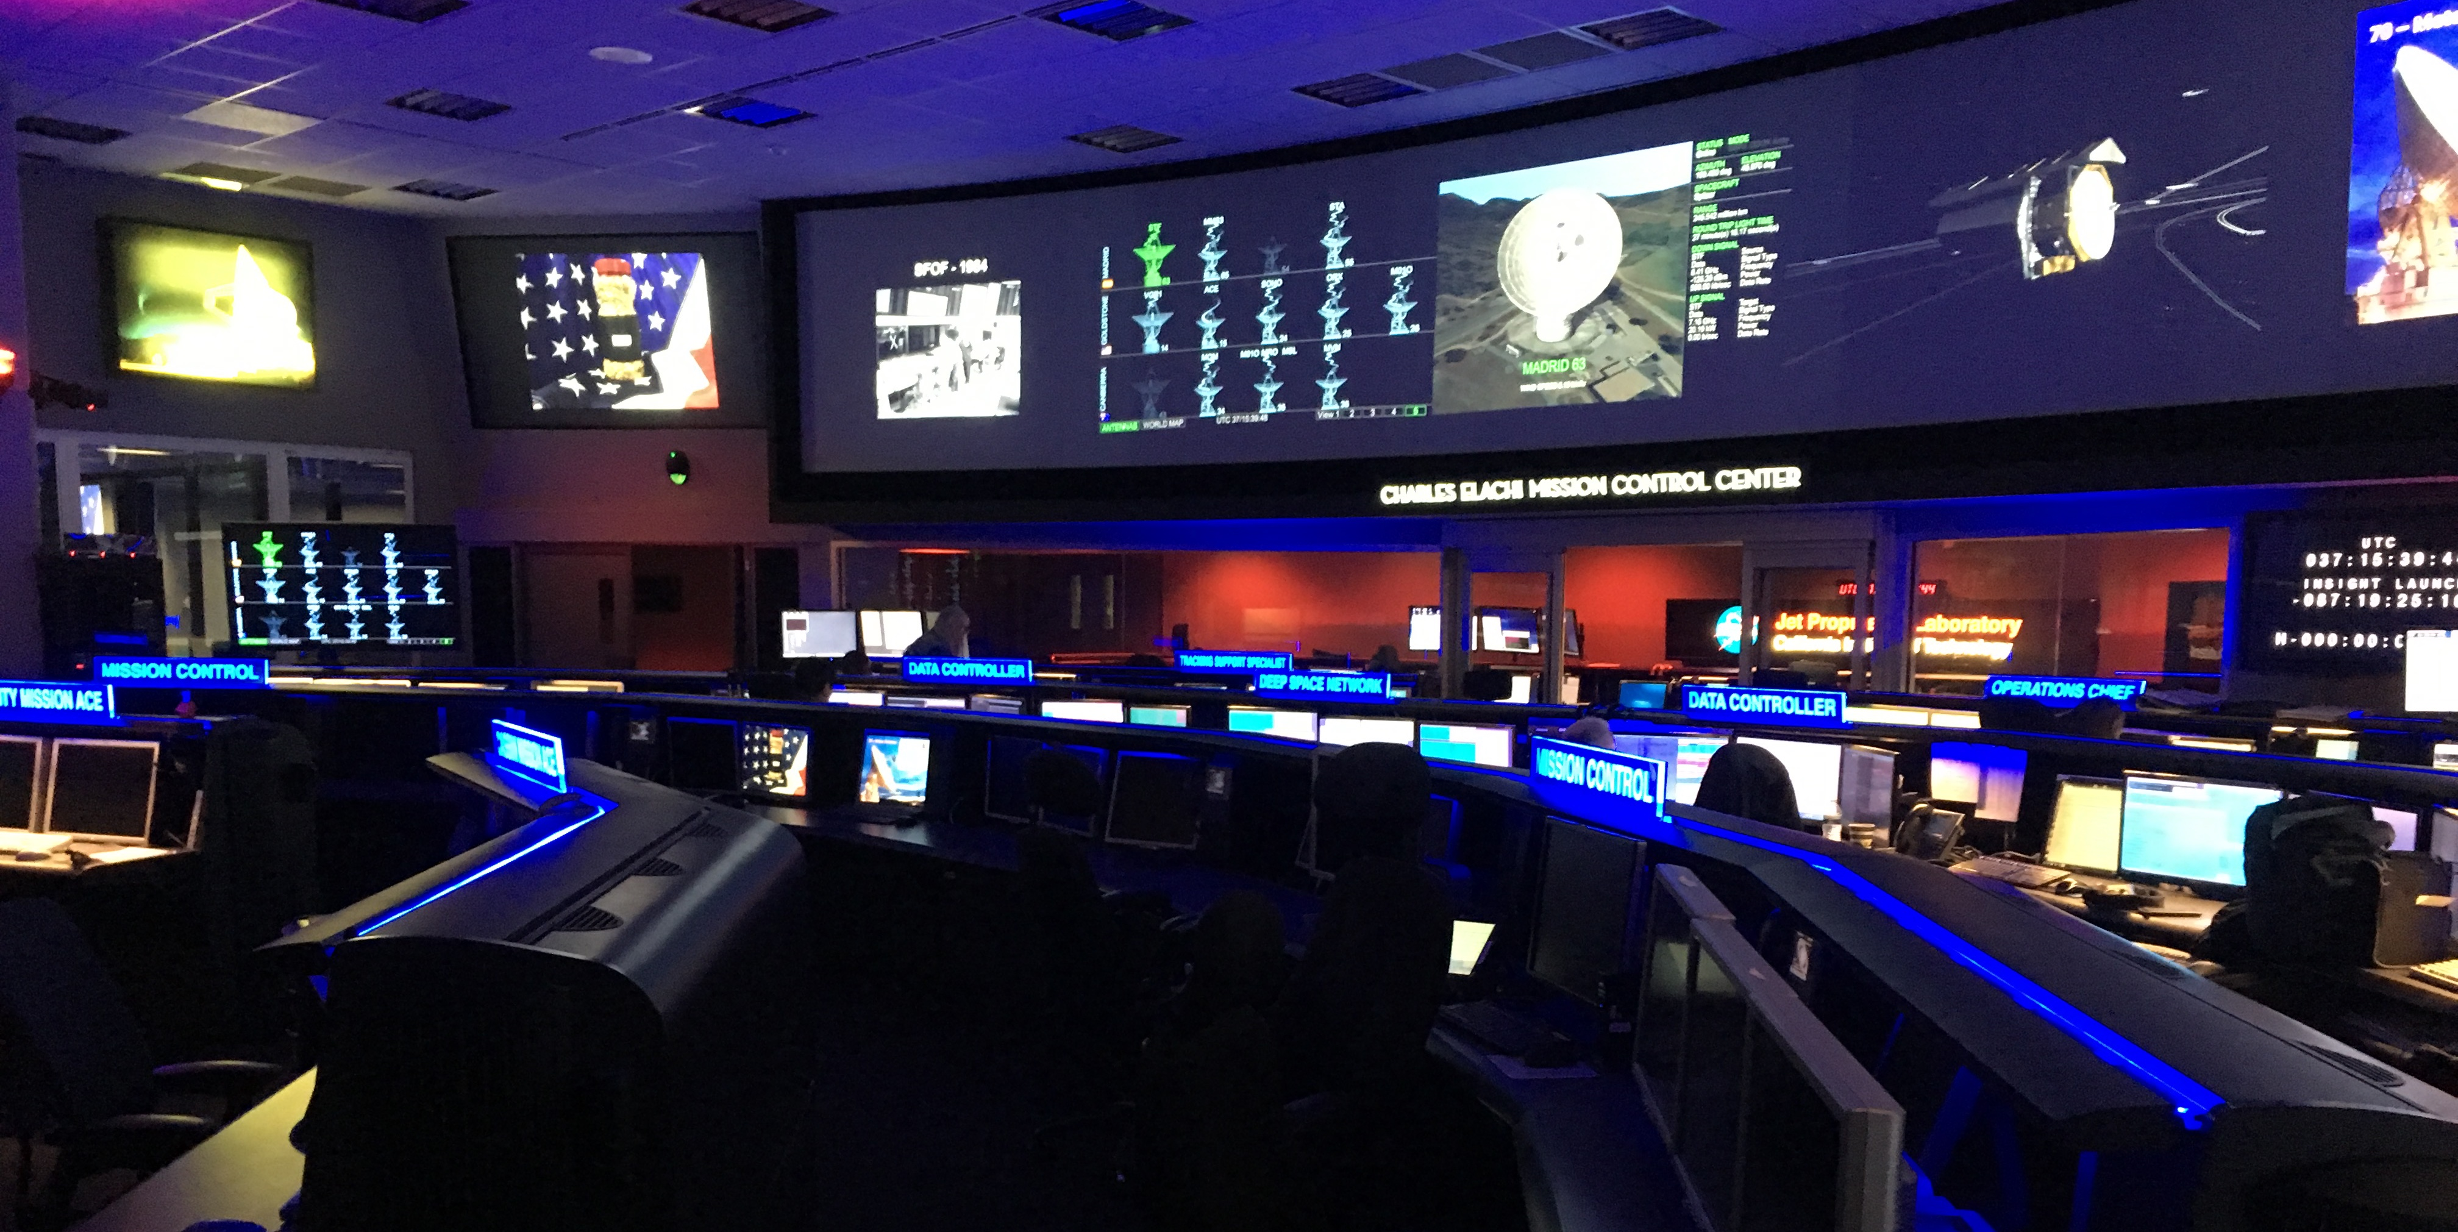
Spacecraft-Initiated Operations with the Deep Space Network
Marc Sanchez Net (JPL)
Jay Wyatt (JPL)
Tim Pham (JPL)
Gigi Lucena (JPL)
Felicia Sanders (JPL)
T. Joseph W. Lazio (JPL)
Rebecca Castano (JPL)
Stephen Townes (JPL)
Ben Malphrus (MSU)
Chloe Hart (MSU)
Ryan Collins (MSU)
Diddy Didier (MSU)
Christopher Smith (MSU)
Emily Walter (MSU)
Matthew Napoli (ARC)
Robert Nakamura (ARC)
Jesse Fusso (ARC)
The 2024 Inter-Planetary Small Satellite Conference May 2024
This document has been reviewed and determined not to contain export controlled technical data.

Slide 2
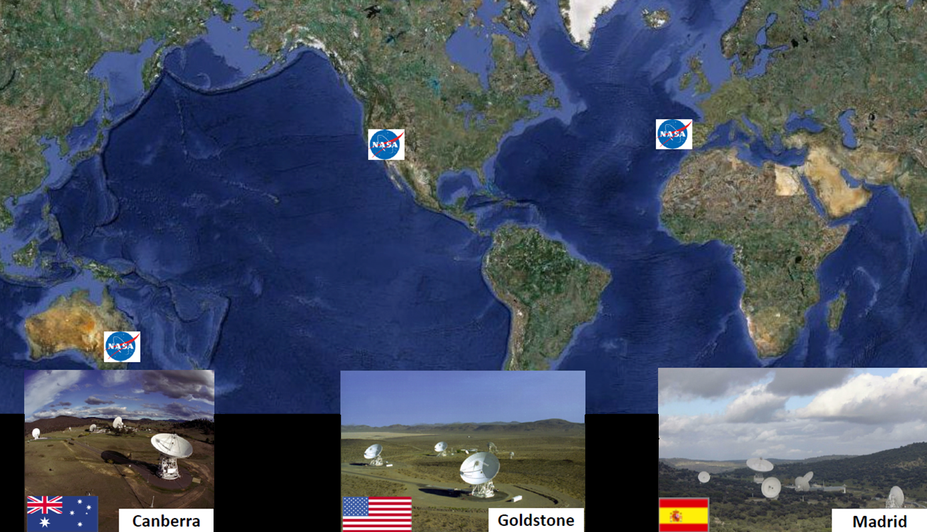
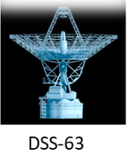
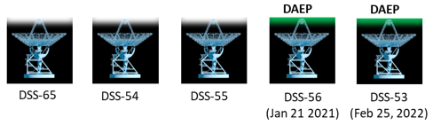
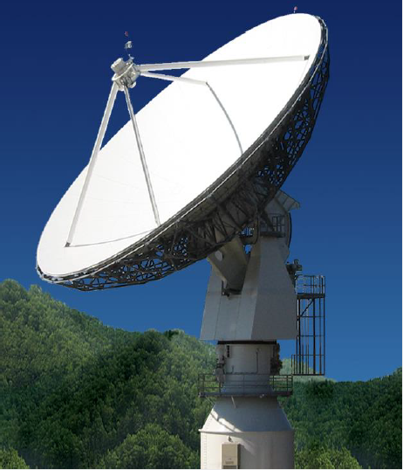
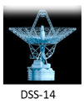
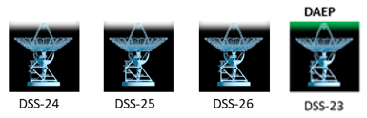
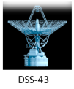
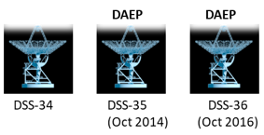
The Deep Space Network
Slide Credit: Stephen Lichten (JPL)
DSS-17

Slide 3
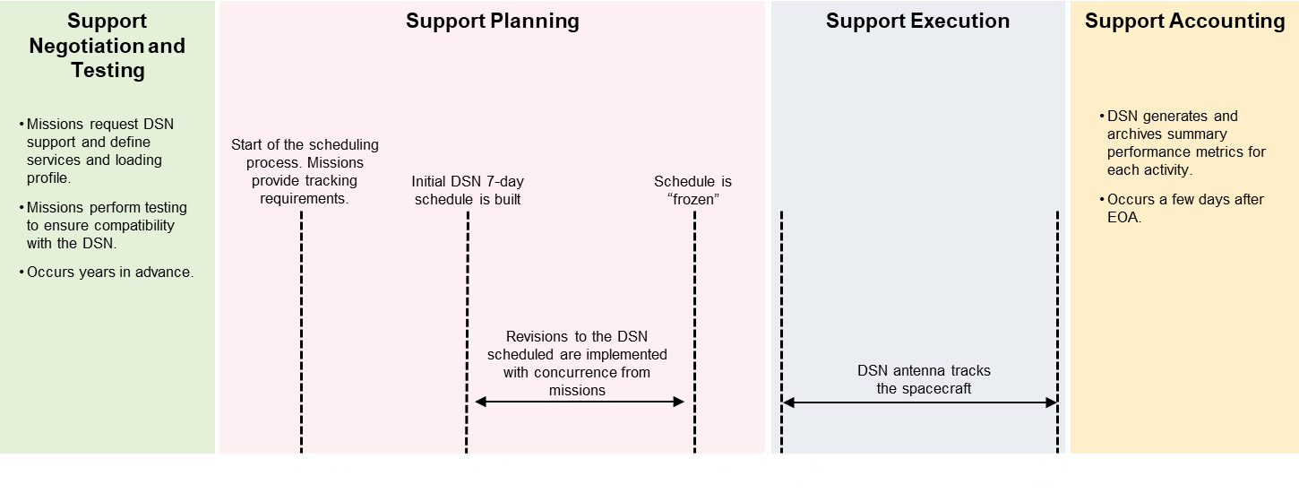
“Typical” Timeline to Obtain DSN Support
~ 6 mon.
~ 6 hr
Deterministic nature and long lead time of the DSN scheduling process means
  Schedule is optimized to satisfy needs of DSN users (and their spacecraft) as anticipated ~months/days in advance
  Projects cannot easily adapt mission operations to near real-time (~minutes, hours) changes (state of spacecraft/payloads, science, …)
In some cases, execution of unnecessary DSN tracks can occur, which “wastes” DSN antenna time.

Slide 4
Support Negotiation and Testing
Support Planning
Support Execution
Support Accounting
Missions request DSN support and define services and loading profile.
Missions perform testing to ensure compatibility with the DSN.
Occurs years in advance.
DSN generates and archives summary performance metrics for each activity.
Occurs a few days after EOA.
Start of the scheduling process. Missions provide tracking requirements.
Initial DSN 7-day schedule is built
Schedule is “frozen”
Revisions to the DSN scheduled are implemented with concurrence from missions
DSN antenna tracks the spacecraft
SOA – 7 months
SOA – 5 months
SOA – 4h
Start of Activity (SOA)
End of Activity (EOA)

Slide 5
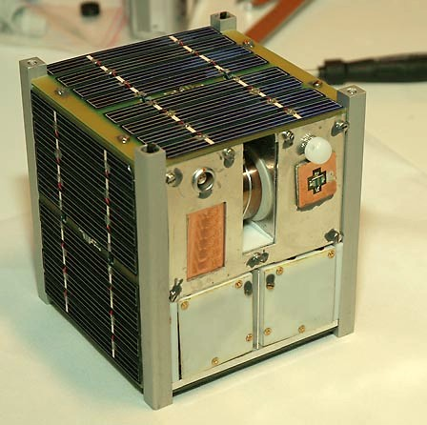
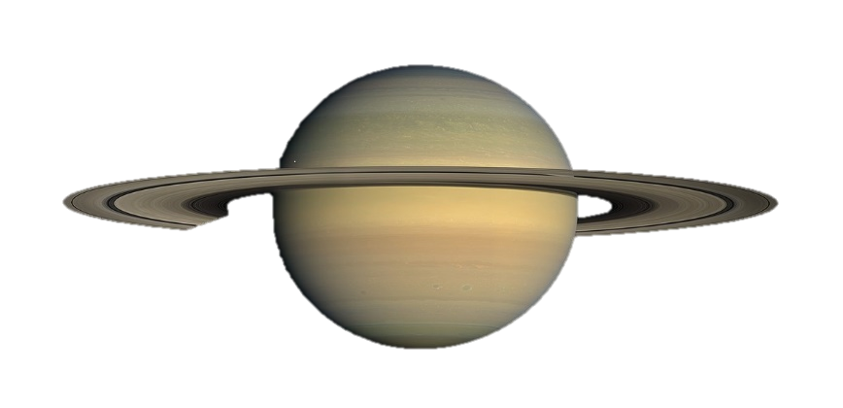
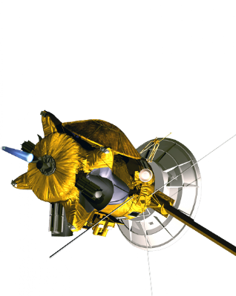
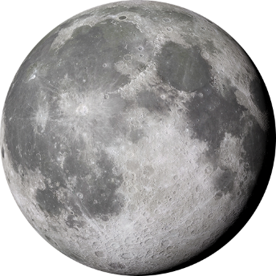
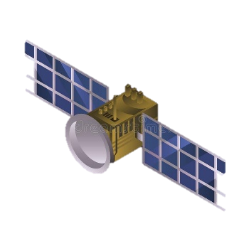
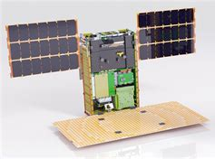
Use Cases for Spacecraft-Initiated Operations
CubeSats and SmallSats, which are less likely to obtain DSN tracking time in the future
Planetary missions with long cruises during which operations can stand-down or go quiescent
Unplanned coordinated observations in cis-lunar space and/or with ground observatories
Examples of other use cases applicable to multiple mission classes
  Engineering events on board spacecraft that require ground intervention (e.g., on board computer reset, momentum dump necessary, data recorder nearing capacity)
  Instrument-related events prior or after data collection (e.g., cooled instrument has not reached operating temperature, lens cap has not closed after instrument operation)
  Operational events (e.g., executed thrust activity was shorter than planned, spacecraft has [not] reached expected milestone)
  Science-related events (e.g., magnetic reconnection detected, Mars dust devil observed), especially if it requires other coordinated observations to be conducted
Spacecraft-initiated operations is particularly suitable for mission concepts (or mission phases) during which unpredictable events are expected to trigger near real-time (minutes to hours) operational response

Slide 6
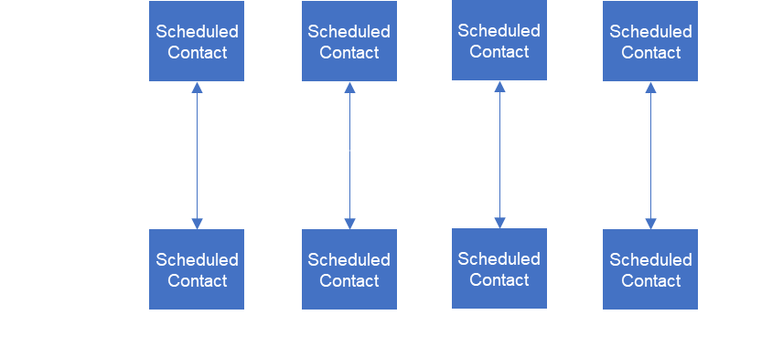
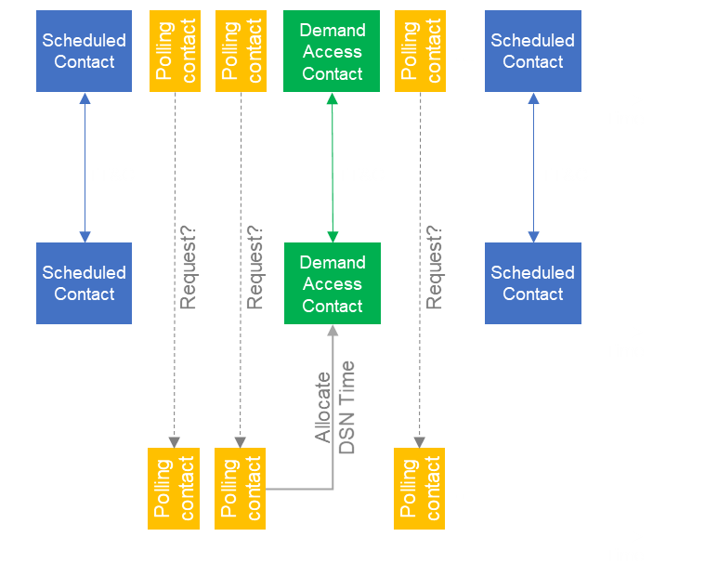
Traditional Operations vs. Demand Access Operations
Traditional Operations
Demand Access Operations
Spacecraft obtains DSN support at approximately regular intervals(*). During each scheduled contact, missions use DSN data and navigation services.
Mission operators receive vehicle information about state/needs of spacecraft only with each scheduled contact
Spacecraft obtains periodic but sporadic scheduled contacts with the DSN.
In between those contacts, spacecraft is frequently polled to gather its state. If needed, additional ground support is provided as demand-access contact using 34 m or 70 m antennas
1 day
1 day
1 day
5 days
Spacecraft
DSN 34m/70m
Queuing Antenna
(*) Elevated levels of DSN support for critical events are not considered here because they usually occur during a small part of the mission’s lifespan.

Slide 7
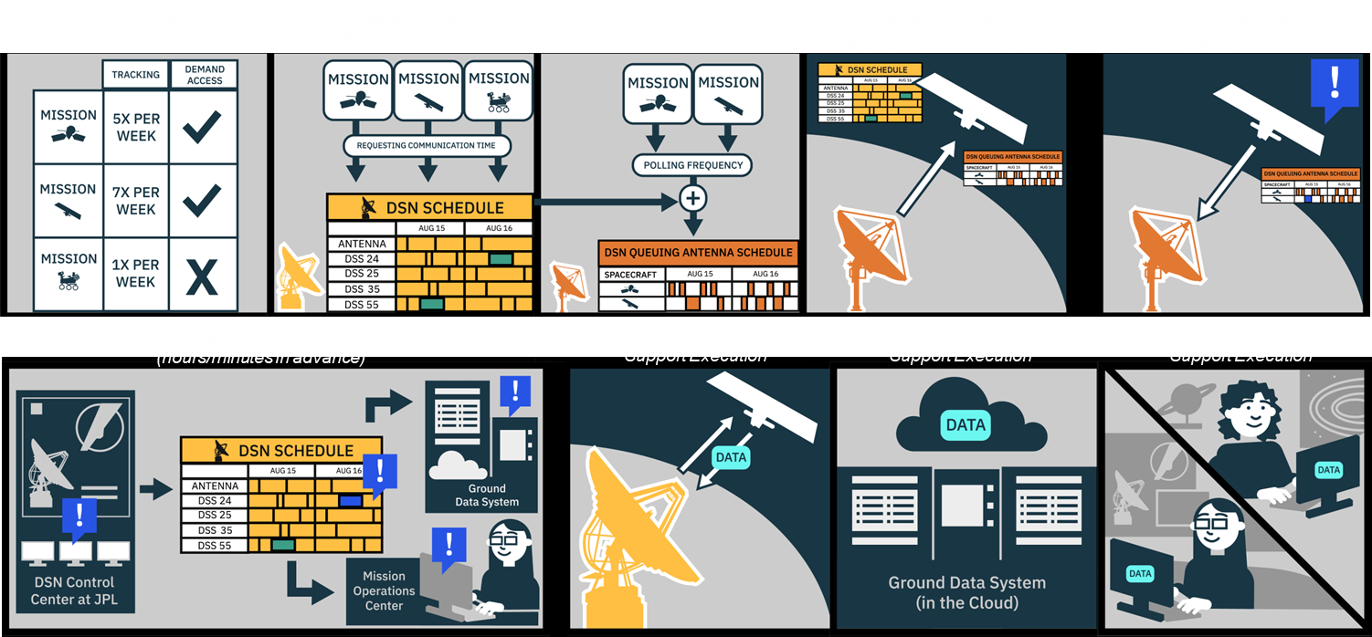
DSN Demand Access enables Spacecraft-Initiated Operations
Spacecraft-initiated Operations
During mission concept/design, spacecraft and mission ops are built to use spacecraft-initiated operations.
During flight, the spacecraft autonomy engine infers when support from the ground is needed and places requests via the DSN.
DSN Demand Access Service
Provides short but frequent contacts with the spacecraft via a small antenna (18m, 21m) to receive requests.
When a request is received, time on larger DSN 34m/70m antennas is allocated in near-real time (30min to 2h ahead).

Slide 8
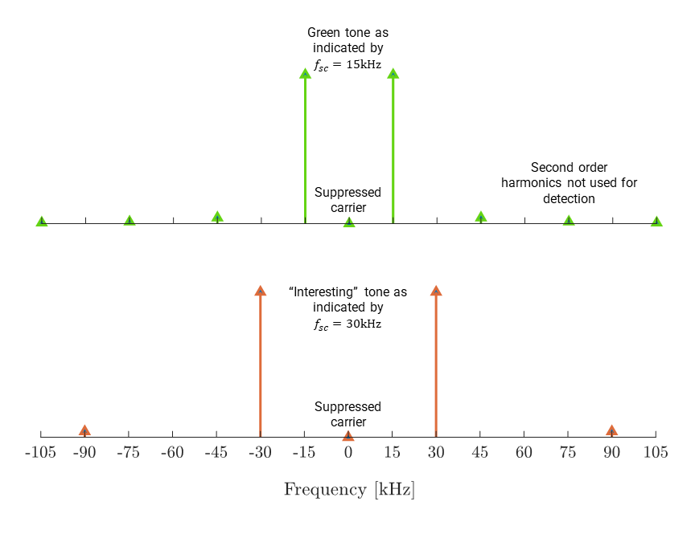
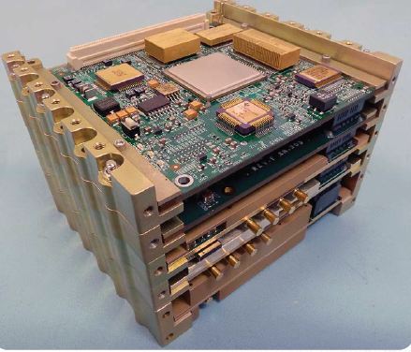
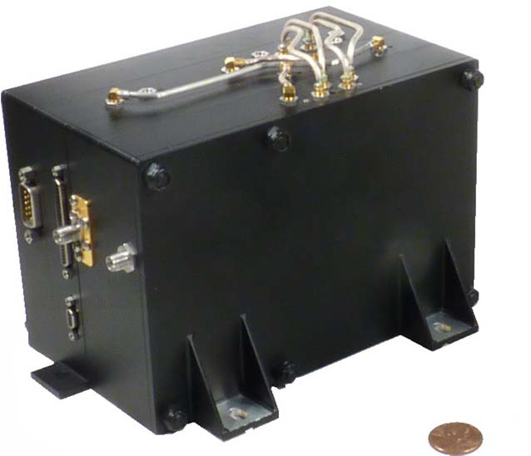
The Request Mechanism: Flight Segment
Spacecraft autonomy and/or fault management system can trigger a request to:
  Indicate the urgency with which ground support is requested.
  Provide information on a limited set of vehicle states, which elicit a ground response by operational policy.
Spacecraft radio encodes requests using DSN Beacon Tone signaling format
  Is simple and can be detected on the ground using power-efficient algorithms
  Is supported or planned to be supported by common flight radios (e.g., IRIS, UST-Lite, Frontier Radio)
Frontier radio. Credit: Applied Physics Laboratory
IRIS radio. Credit: Space Dynamics Laboratory

Slide 9
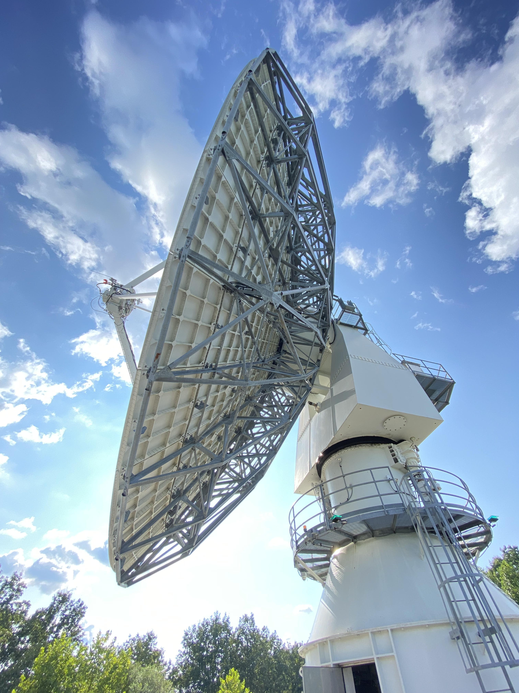
The Request Mechanism: Ground Segment
Image credit: Costin Radulescu (JPL)
Spacecraft requests are received on the ground via queuing antenna, which is smaller than DSN 34 m/70 m antennas:
  A 18m to 21m antenna can cover the entire inner solar system via an LGA/MGA, and the outer solar system via an HGA.
  Faster slew rates allow for polling more spacecraft per hour
  Commercial and/or radio science observatories can be used as queuing antennas (no transmitter needed).
  Mission tracking time/cost reduced by up to 50% compared to same support by DSN 34 m antennas.
Use of DSN Beacon Tone signaling format means that current DSN operational receivers already have the necessary algorithms implemented
  DSN Beacon Tones have been used operationally by New Horizons and Solar Parker Probe
  Current DSN receivers support up to 4 tones per carrier, but set can be expanded in the future.
DSS-17: 21m antenna at Morehead State University

Slide 10
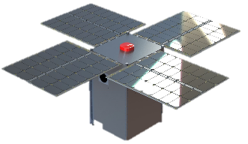
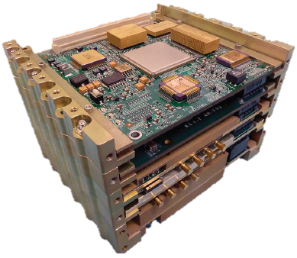
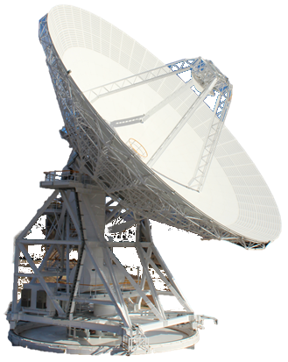
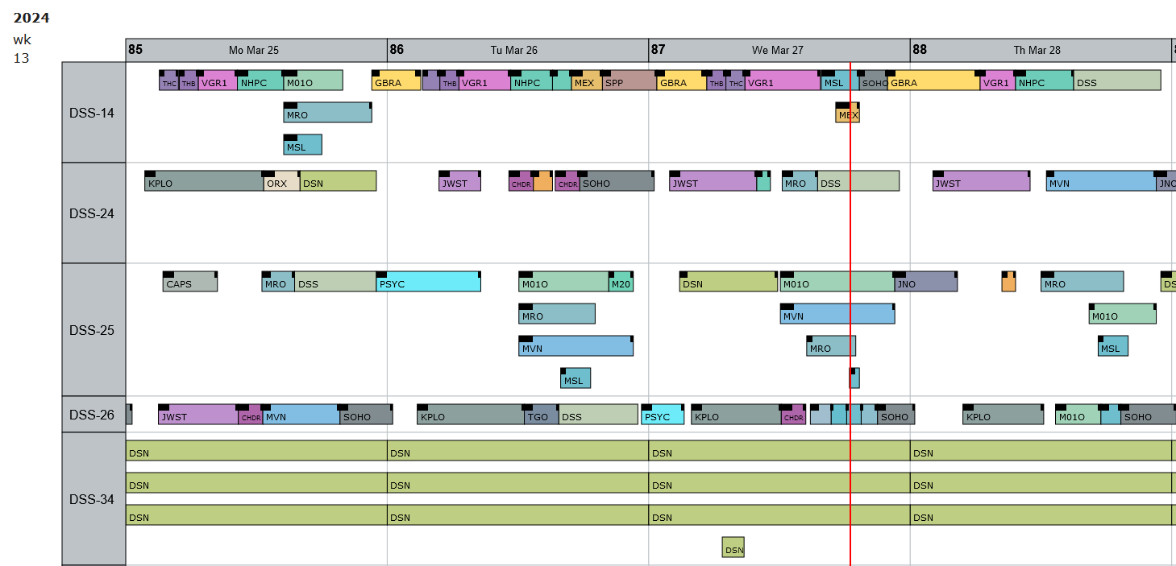
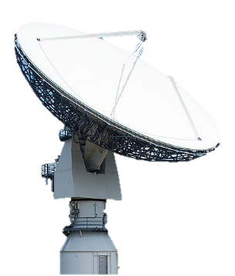
In-flight Testing of the Request Mechanism with BioSentinel (1/2)
BioSentinel
IRIS radio
DSS-25 (34m)
Beacon tone
DSN Network Operations Center (DSOC)
DSN Scheduling Service (SSS)
DSS-17 (21m)
Activity Objectives:
  Validate transmission of DSN Beacon Tones from a JPL IRIS radio flying on board a CubeSat (first-ever).
  Validate reception of DSN Beacon Tones using DSS-17, the 21m antenna at MSU affiliated with the DSN (acting as queuing antenna).
  Validate delivery of tone reception notifications from DSS-17 to DSN Network Operations Center (NOC) at JPL and distribution to SSS.
Activity was planned in coordination with BioSentinel project to:
  Generate new command sequences needed for BioSentinel to transmit beacon tones.
  Test new command sequences on an engineering unit of the IRIS radio prior to radiation to the spacecraft.
  Plan and configure all ground equipment at the DSN and at MSU.

Slide 11
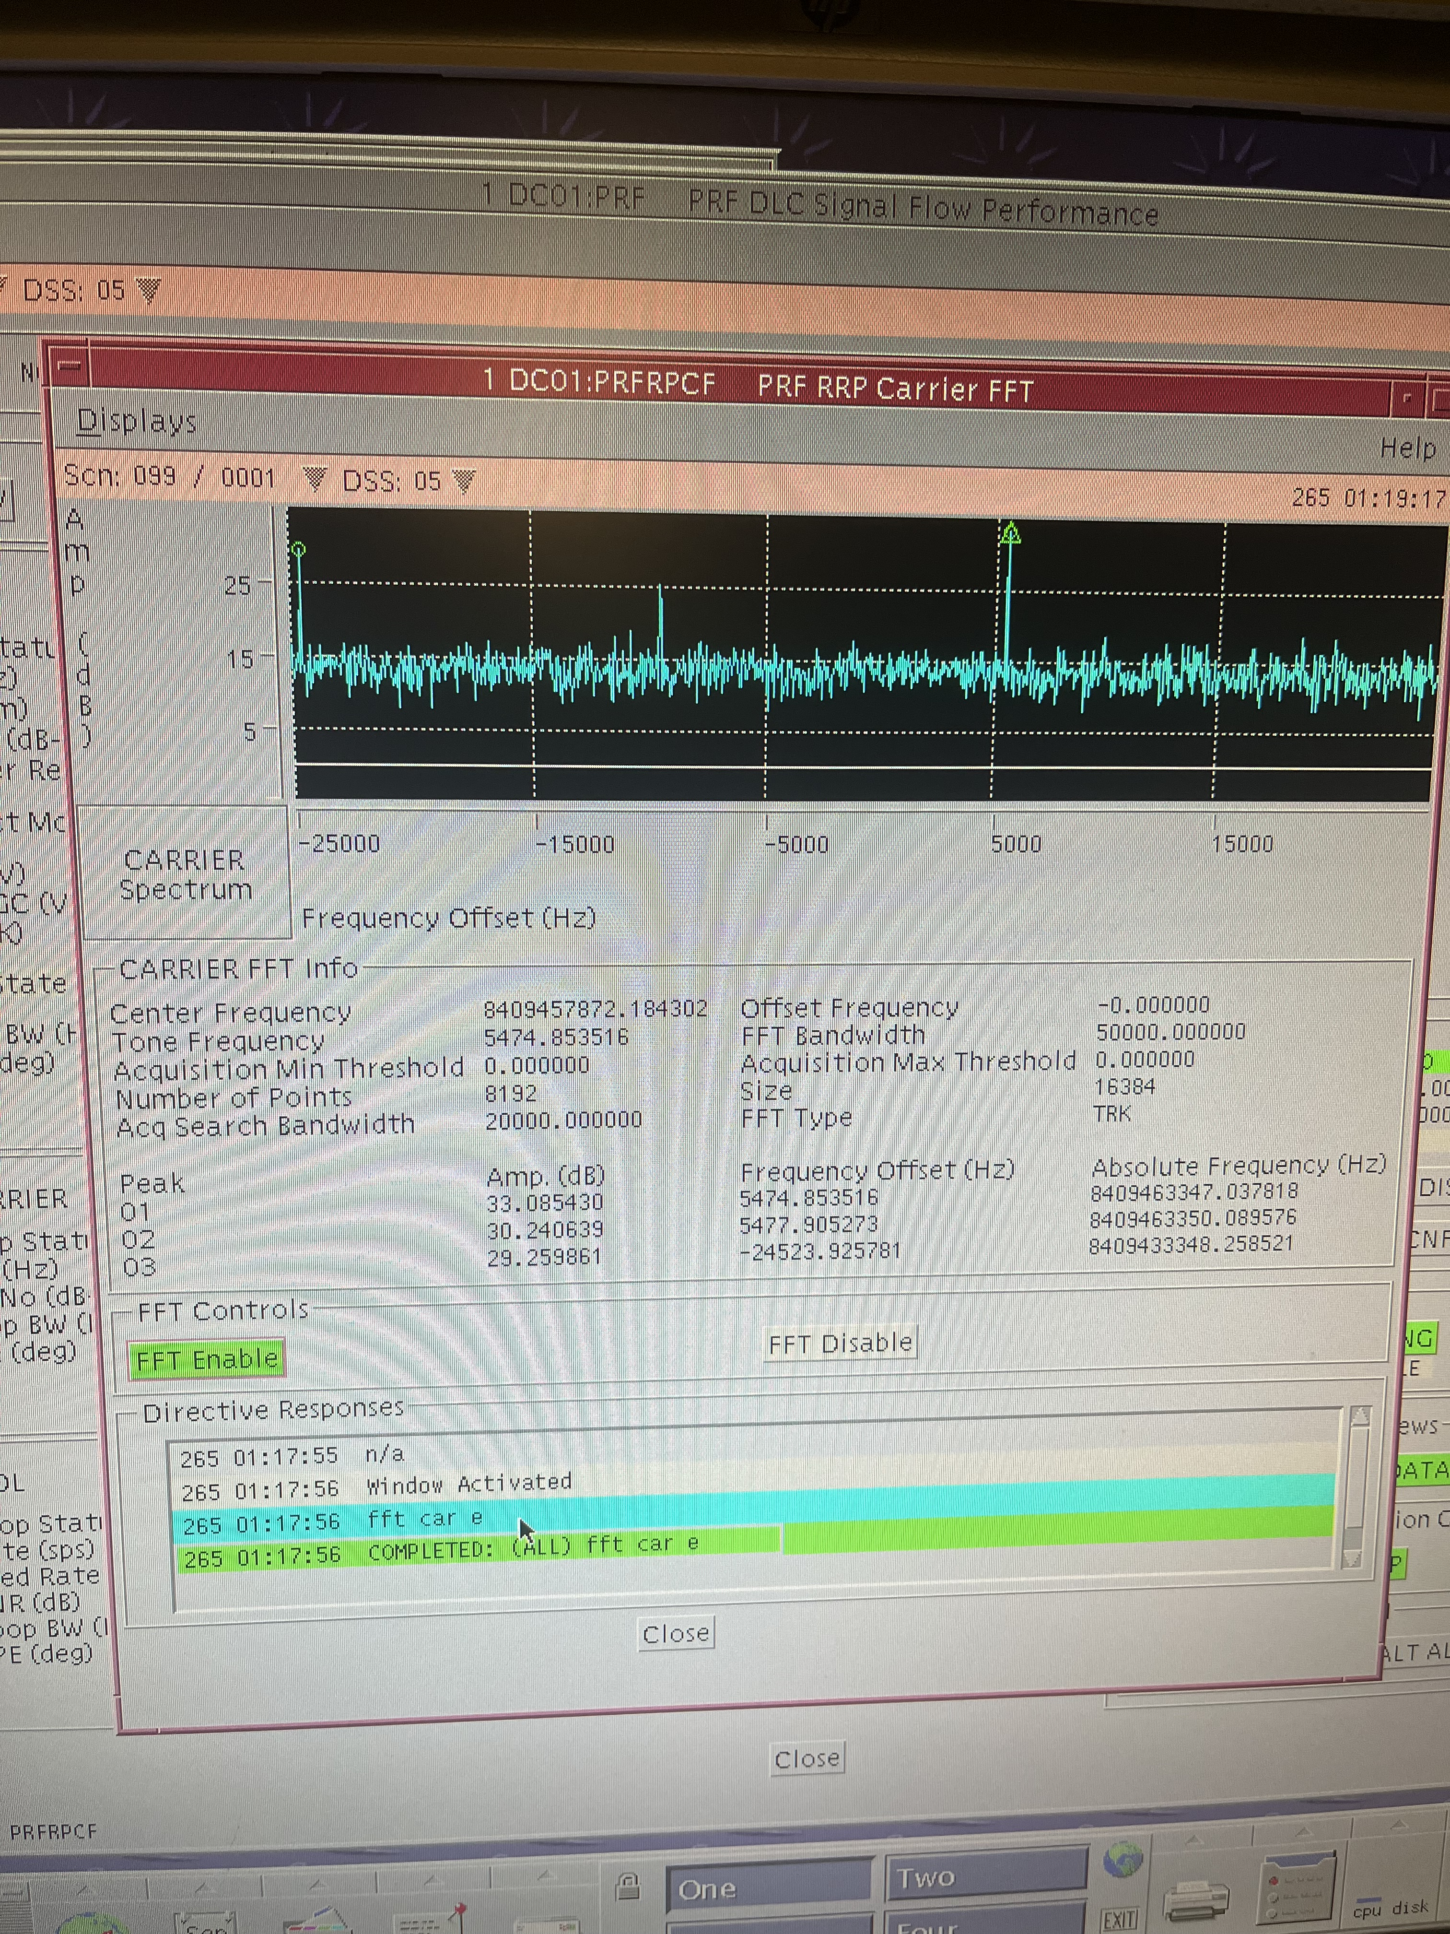
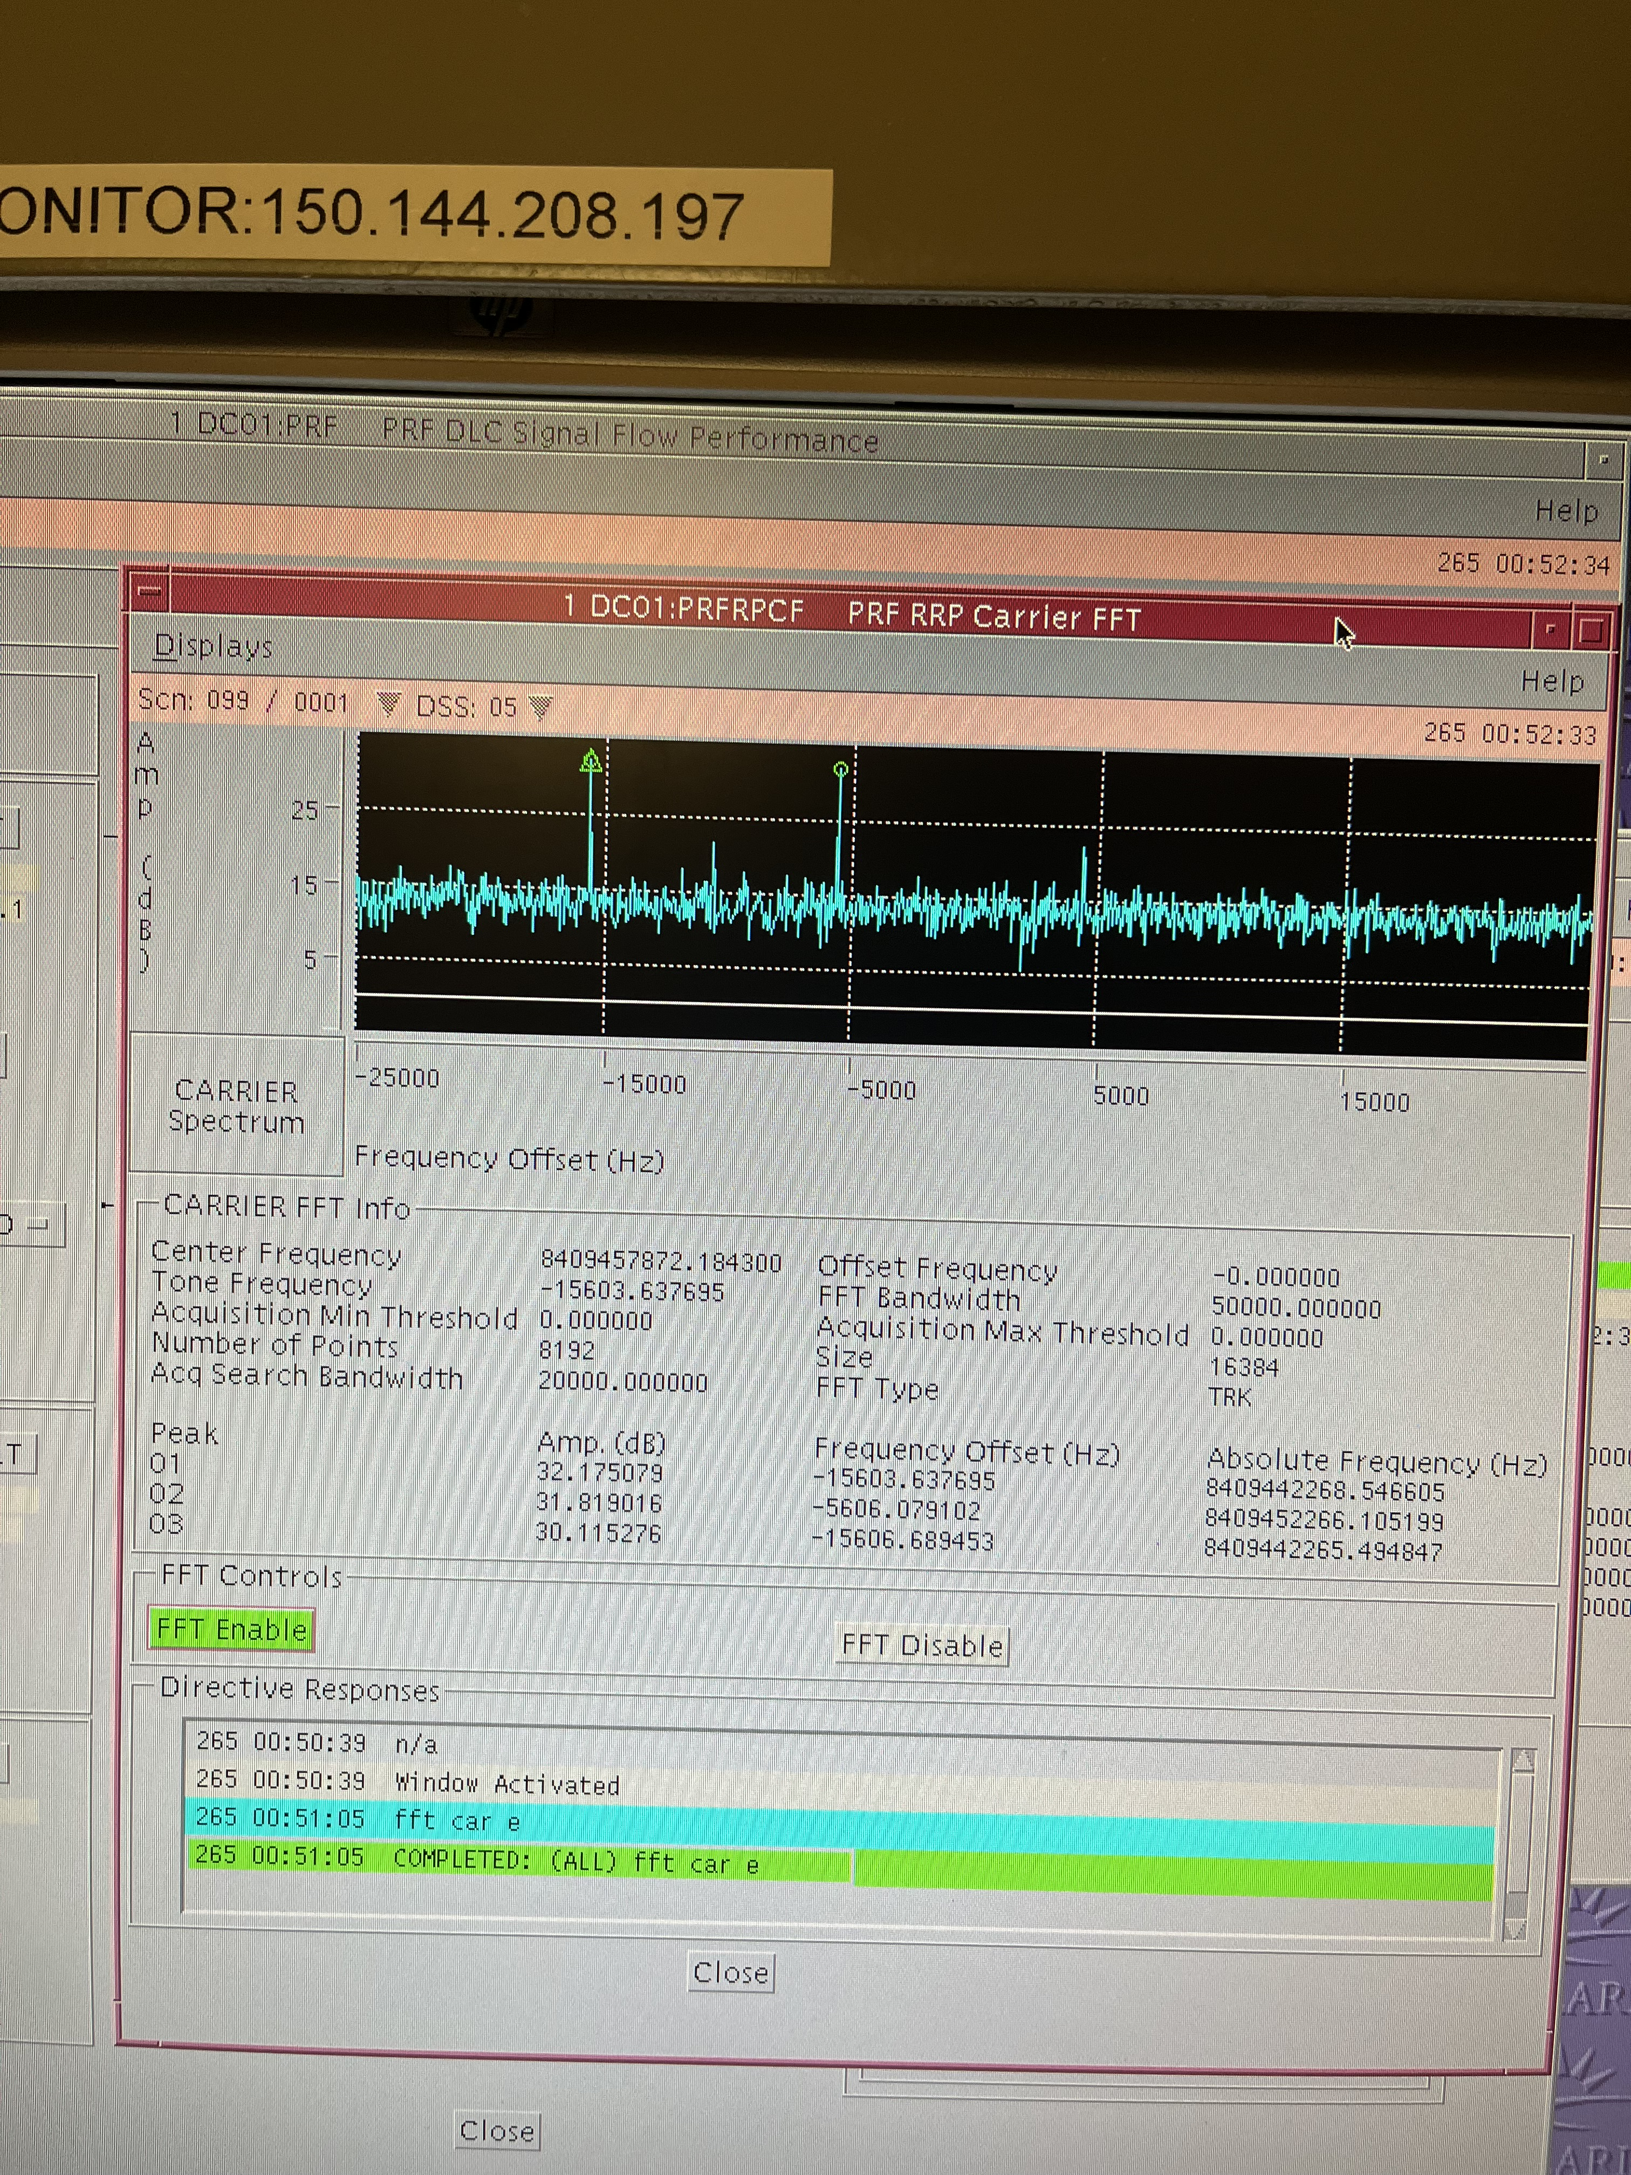
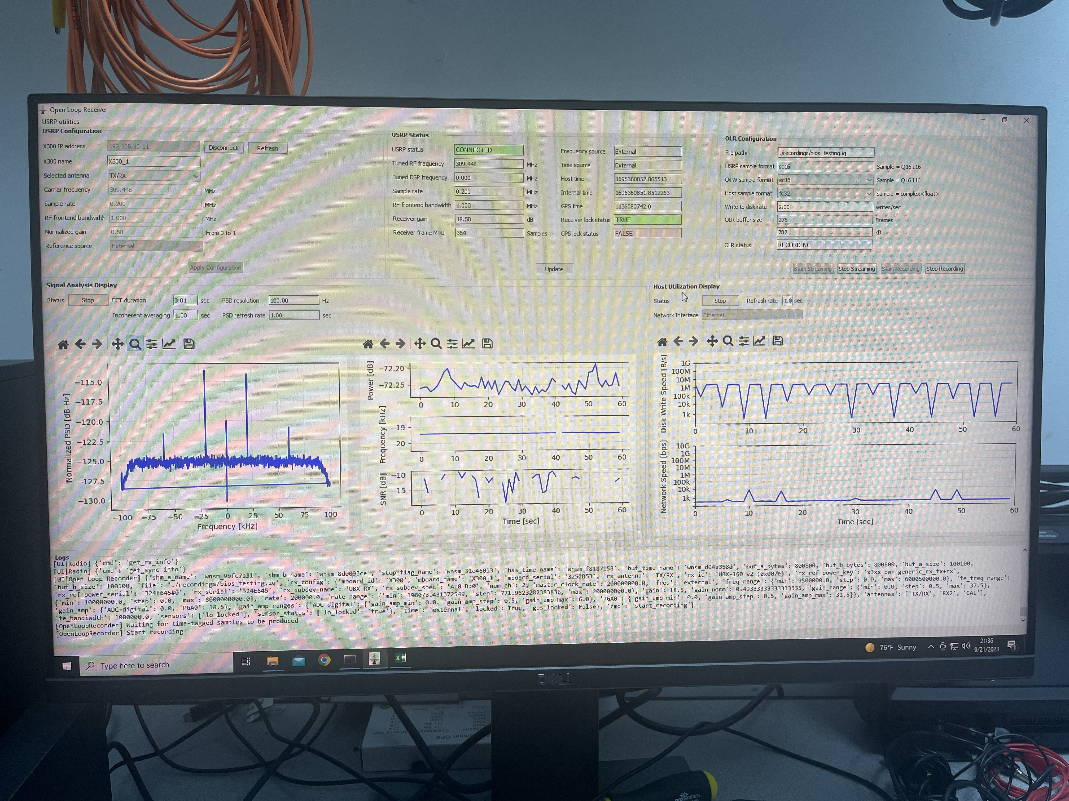
In-flight Testing of the Request Mechanism with BioSentinel (2/2)
Beacon tones were successfully received in open loop mode at both DSS17 and DSS25.
Reception events generated packets that were properly forwarded to DSOC and distributed to the access point for SSS to act on them.
Closed loop reception of tones failed at both DSS-17 and DSS-25.
  Measured tones were offset from the expected received frequency and drifted more than expected during the receiver integration time.
  Issues with tone detection are still under investigation.
5 kHz tone detected at DSS-17’s DTT
15 kHz tone detected at DSS-17’s DTT
20 kHz tone detected at DSS-17’s OLR

Slide 12
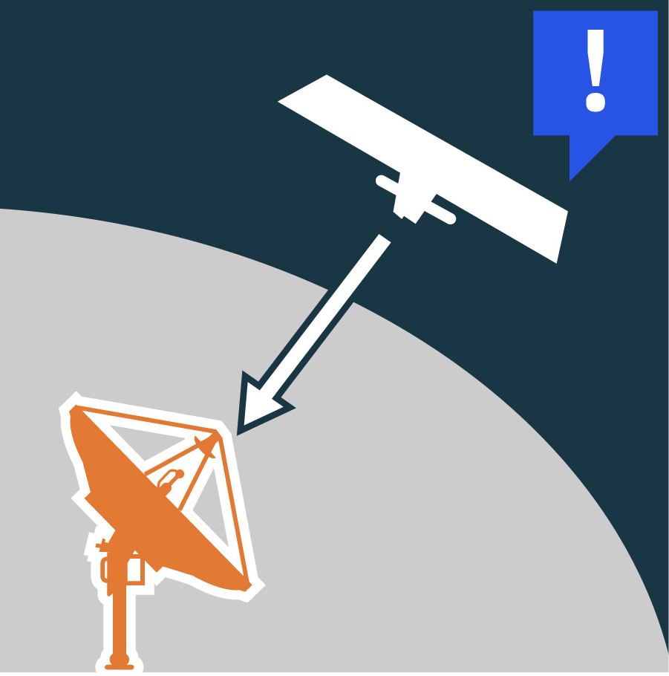
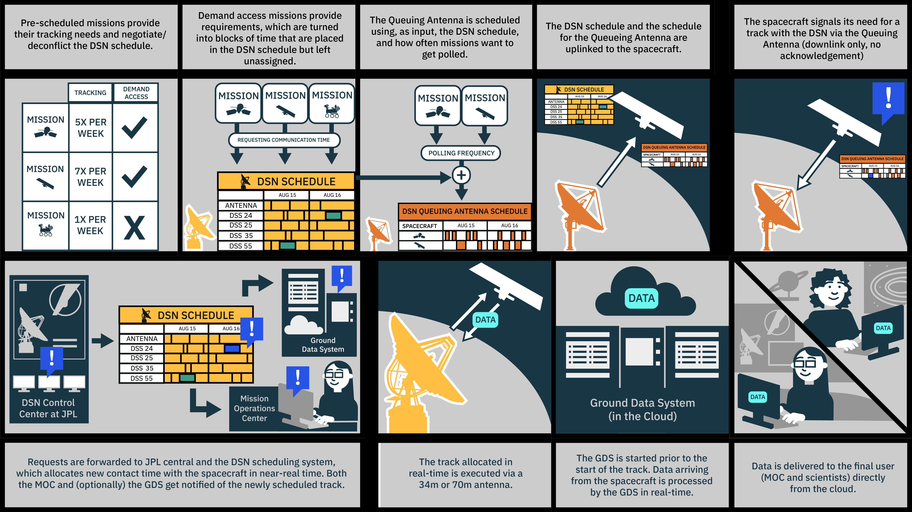
Demand Access for Spacecraft-Initiated Operations
Allows spacecraft to request ground support in near real-time (30min to 2h) via a smaller (18m to 21m) and more affordable queuing antenna.
Enables new mission concepts by:
Facilitating quiescent operations.
Allowing mission operations to adapt to unplanned/unpredictable engineering/scientific events on board the spacecraft.
Providing a new DSN service that CubeSats and SmallSats can use to obtain DSN tracking time and reduce scheduling conflicts with larger missions.
Future work:
Perform additional flight demonstrations to (1) validate close-loop reception of DSN beacon tones by the queuing antenna and (2) demonstrate operation of the DSN scheduling system to allocate tracking time.
Request
Queuing Antenna
(18-21m)
DSN 34m/70m

Slide 14
Additional References
Demand Access System:
  Marc Sanchez Net et al. “A Demand Access System for Deep Space Operations”. 17th International Conference on Space Operations, March 2023.
Queuing Antenna:
  Marc Sanchez Net et al. "Enabling a Larger Deep Space Mission Suite: A Deep Space Network Queuing Antenna for Demand Access." 2022 IEEE Aerospace Conference.
DSN Scheduling and Demand Access:
  T. M. Hackett, M. Johnston, and S. G. Bilen. “Spacecraft block scheduling for NASA’s deep space network”. 2018 SpaceOps Conference, 2018.
  J. M. Dhamani, Nihal and G. Lucena. “A demand access paradigm for NASA’s deep space network.” 2021 InternationalWorkshop on Planning and Scheduling for Space, 2021.
On-demand GDS:
  Costin Radulescu, “On-demand Ground Data System (GDS) using a Cloud Architecture”. GSAW 2022
  https://aws.amazon.com/quickstart/architecture/ammos-smallsat-toolkit/

Slide 15
Demand Access Operations: DSN

Slide 16
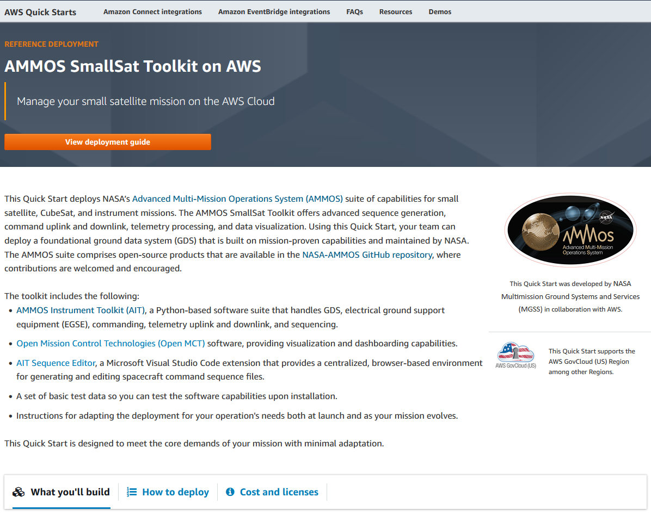
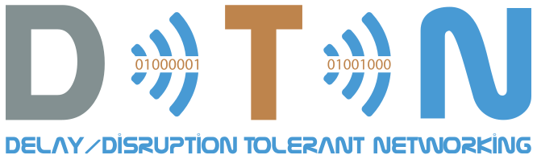
Demand Access Ops: GDS and SDS
Projects have the option to use a cloud-based GDS and SDS to automatically process data received from a demand access DSN contact.
On-demand GDS/SDS builds upon AMMOS’ new cloud-native architecture to:
  Provide interfaces between GDS/SDS and SSS so that GDS/SDS is spun up and down for demand access passes.
  Automate adaptation, configuration and deployment of the GDS and SDS.
Projects have the option to use DTN to automate end-to-end reliable data transfer with demand access operations.

Slide 17
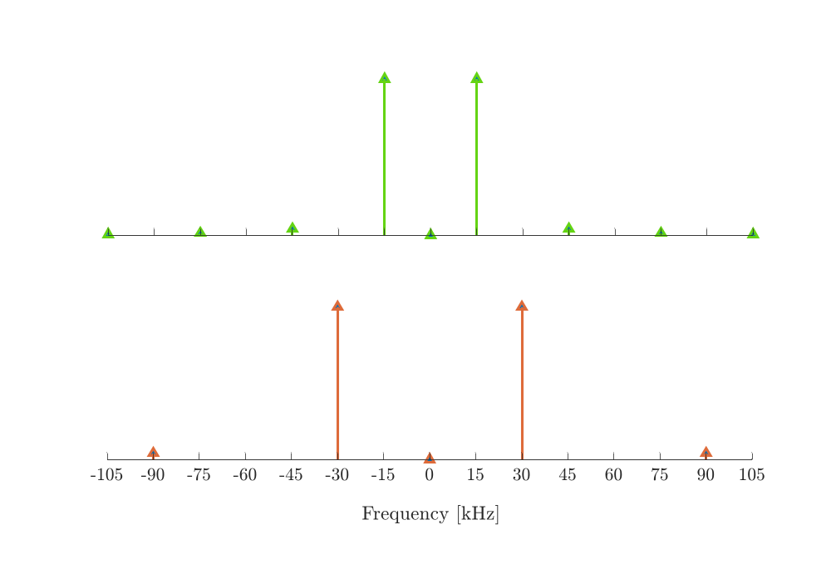
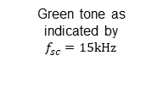

Spacecraft Request Format (DSN Beacon Tone)
Green tone as indicated by
$f_{sc}=15kHz$
The spacecraft transmits a squarewave subcarrier with suppressed carrier (inherited from DSN Beacon Service).
The frequency of the subcarrier directly encodes the information being conveyed by the spacecraft.
Subcarrier frequency can be tailored to each spacecraft (15 kHz assumed in the example).
On the ground, the receiver detects the tone using incoherent summation of FFTs:
  Computationally efficient.
  High power efficiency if long integration times are used.
Second order harmonics not used for detection
Suppressed carrier
“Interesting” tone as indicated by
$f_{sc}=30kHz$
Suppressed carrier

