Slide 1

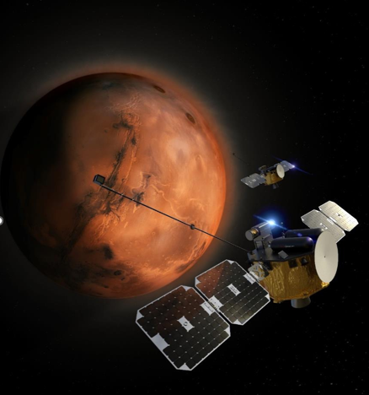
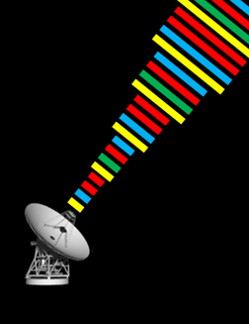
Multiple Uplinks Per Antenna (MUPA): Where Are We Now?
Douglas S. Abraham, Shantanu Malhotra, Leila Meshkat, David D. Morabito, James A. O’Dea, Emily R. Pascua, Marc Sanchez-Net, Dong K. Shin, Luke C. Stewart, and Zaid J. Towfic
Jet Propulsion Laboratory, California Institute of Technology
Interplanetary Small Satellite Conference
University of Arizona, Tucson, AZ
April 30, 2024 – May 2, 2024
Deep Space Network
Copyright 2024 California Institute of Technology.
U.S. Government sponsorship acknowledged.

Slide 2
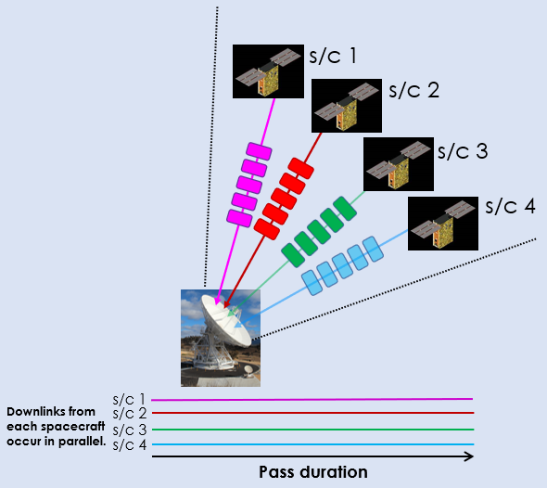
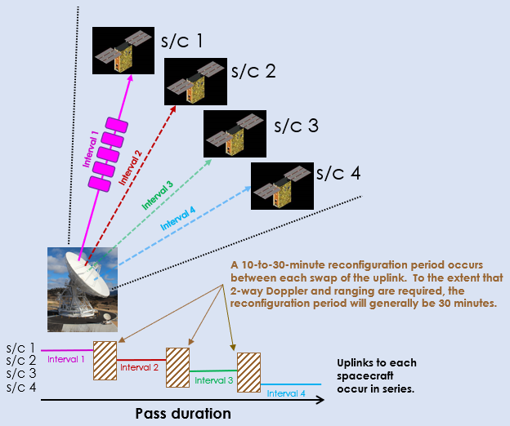
What Is MUPA? (1/2)
Traditional Multiple Spacecraft Per Antenna (MSPA)
Downlink
During MSPA
Uplink During MSPA
Frequency Division Multiplexing
Commanding and 2-way Doppler & ranging must occur 1 spacecraft at a time with reconfiguration time in between.

Slide 3
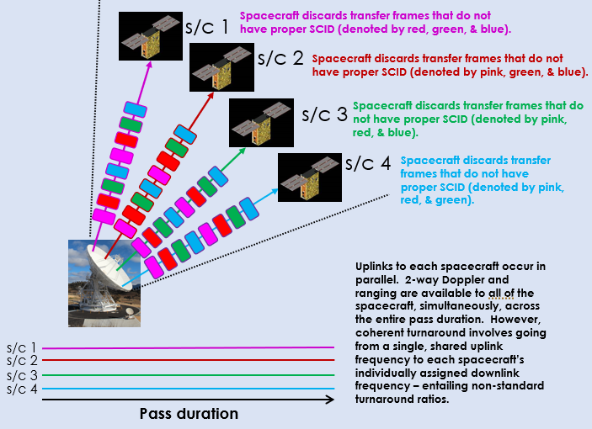
What Is MUPA? (2/2)
Multiple Uplinks Per Antenna (MUPA)
Command Link Transmission Units (CLTUs) intended for each in-beam spacecraft are time-multiplexed onto a single frequency uplink that all the spacecraft receive and process.
Each spacecraft discards the transfer frames having an improper SCID in the header.
Allows near-simultaneous commanding and simultaneous 2-way Doppler & ranging.
Time Division Multiplexing

Slide 4
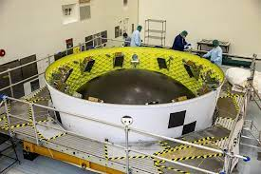
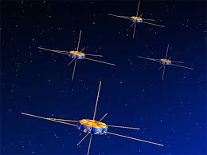
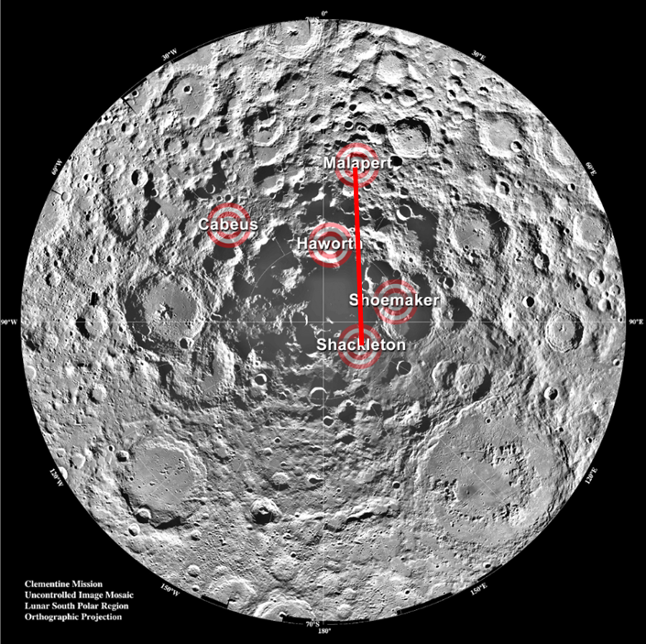
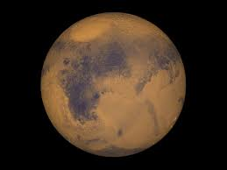
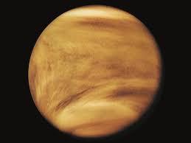
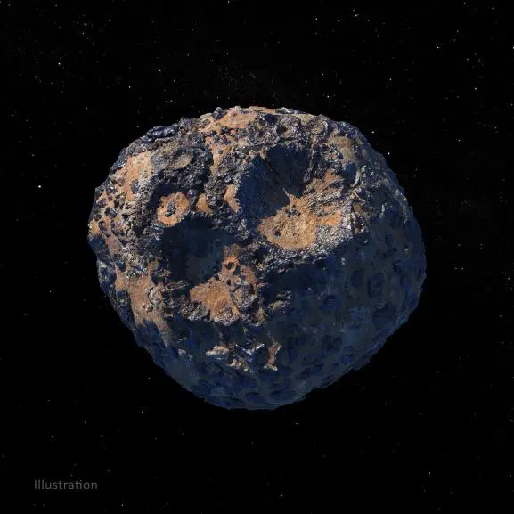
In What Situations Would MUPA Work?
Anywhere MSPA Does
Future secondary payload deployments – Artemis, ESPA rings, Blue Ring, etc.
If designed to be in-beam, constellations of spacecraft or flotillas of unaffiliated spacecraft.
Concentrations of lunar surface assets such as those planned for near the Moon’s south pole would be in-beam, even at K-band.
Most everything at Mars or Venus is within the half-power beam-width of a 34m antenna at S- and X-band. Ka-band has some orbital altitude dependence when the planets are closer to Earth.
Spacecraft orbiting more distant targets tend to always be in-beam unless in highly eccentric orbits.

Slide 5

How Far Has the Technology Come? (1/3)
The FCLTU Multiplexer (FMUX)
Mission A MOC
CLTUs flow from individual MOCs to FMUX, are queued, multiplexed, and then sent to the UPA for subsequent radiation.
Spacecraft 1 Uplink Products
CLTUs
FCLTUs
DSN Deep Space Communications Complex (DSCC)
SLE FCLTU User
Mission B MOC
Uplink Processor Assembly (UPA)
FCLTU Multiplexer¹
Spacecraft 2 Uplink Products
Multiplexed
FCLTUs
CLTUs
SLE FCLTU User
CLTUs
FCLTUs
Spacecraft 3 Uplink Products
Prototype FMUX developed and undergoing ground testing using DSN’s Development and Test Facility-21 (DTF-21).*
  Special thanks to the SunRISE and EscaPADE flight projects for participating in these ground tests.
    Basic FMUX functionality and project user interface demonstrated using project-supplied CLTUs.
    Proper multiplexing and reporting of radiated CLTUs demonstrated.
*Special thanks to JPL’s Multi-Mission Ground Systems & Services (MGSS) Office for sponsoring much of this development as part of the NASA SMD-funded Advanced Multi-Mission Operations System technology program.

Slide 6
How Far Has the Technology Come? (2/3)
The Flight Radio
What Is Needed? | What Do We Have?
Capability to switch between assigned uplink frequency and the shared MUPA session uplink frequency.¹ | Iris radio has capability. Other radios do (or will) -- e.g., UST-Lite, Frontier Radio, etc.
Ability to filter out inappropriate transfer frames on basis of spacecraft ID (SCID). | Iris radio can. Most spacecraft C&DH subsystems can.
Radio capable of supporting non-standard turnaround ratios to coherently turnaround shared uplink signal frequency on individually assigned downlink frequencies. | Iris radio can now support – DTF-21 tested.² Other radios do (or will) – e.g., UST-Lite, Frontier Radio, etc.
Radio (or C&DH in conjunction with radio) capable of compensating for perceived Doppler dynamics in single frequency uplink. | Iris radio now has a basic sweep capability + Type 3 PLL for acquisition & lock – DTF-21 tested.² Iris radio now has FFT + Improved Carrier Tracking Loop – DTF-21 tested.² Similar capabilities planned for UST-Lite, possibly incorporating a “Smart Sweep” algorithm.
¹NASA spectrum management, in conjunction with international bodies (e.g. SFCG, ITU), may need to designate acceptable MUPA session frequencies before MUPA can be used operationally.
²Special thanks to John Baker and JPL’s Section 337 for funding the Space Dynamics Laboratory’s implementation of these capabilities.

Slide 7
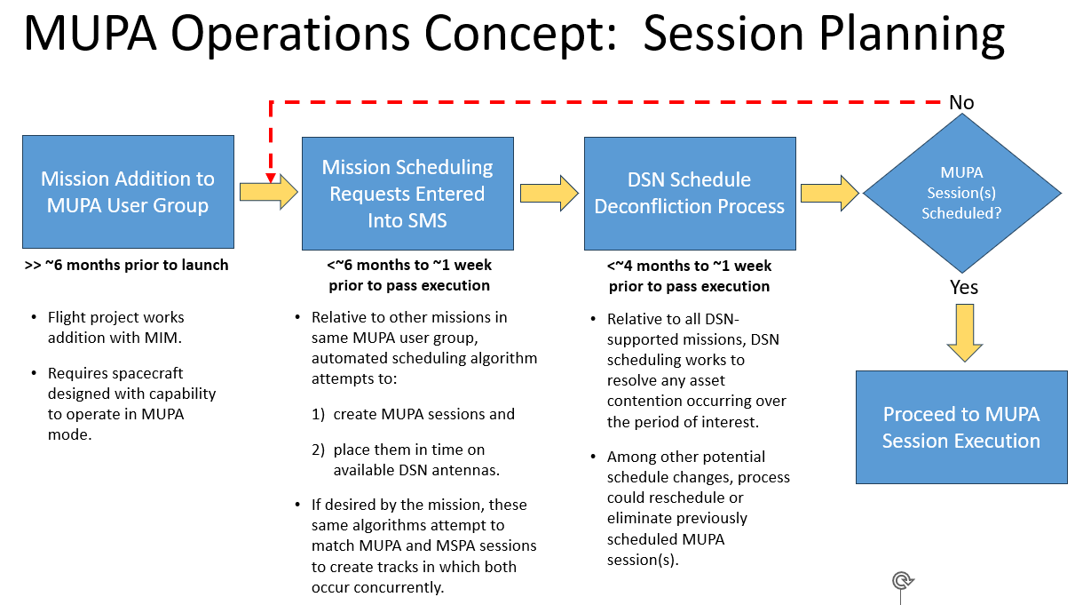
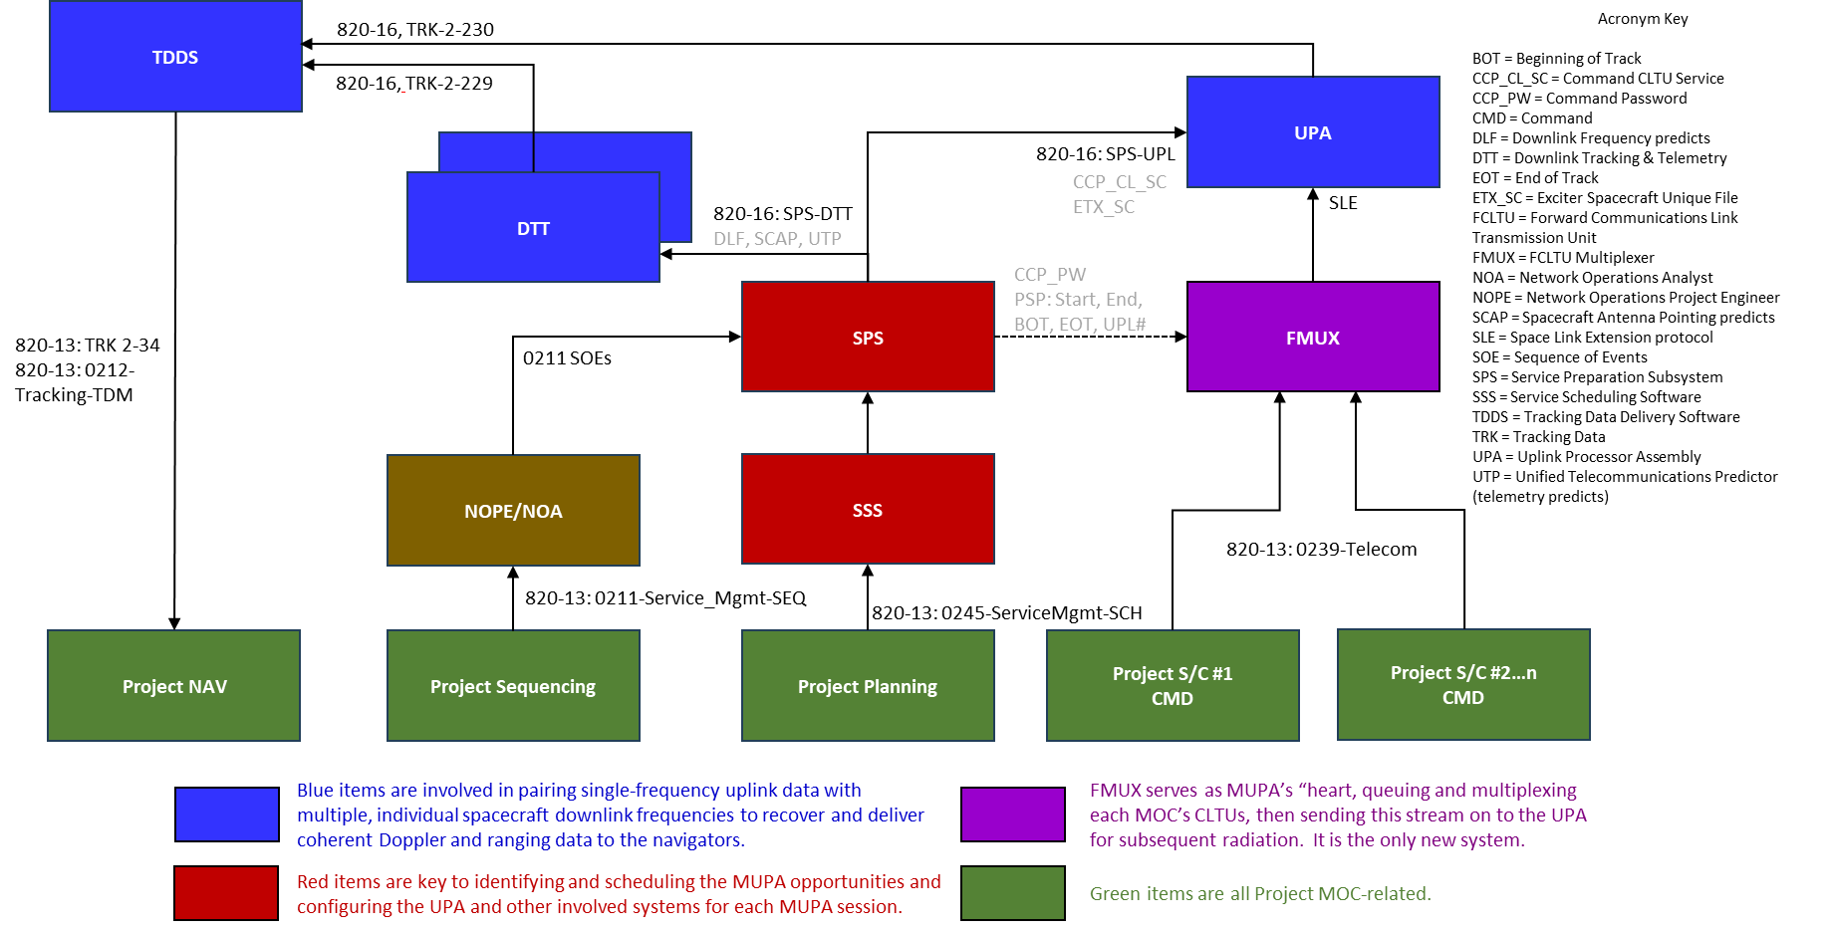
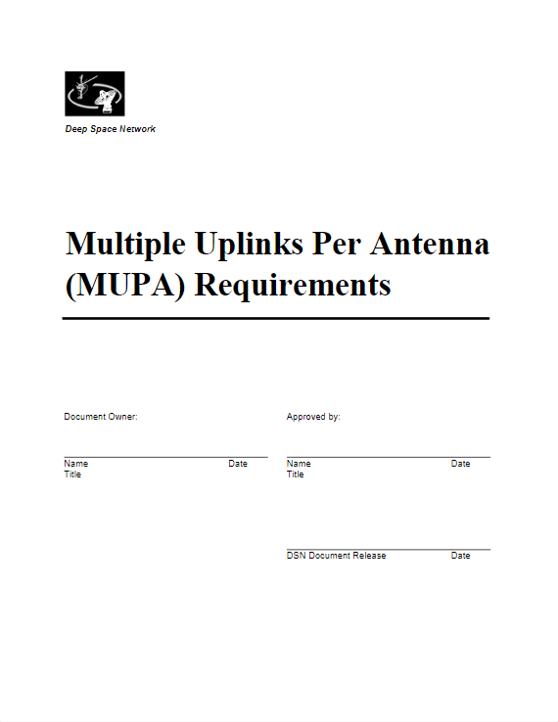
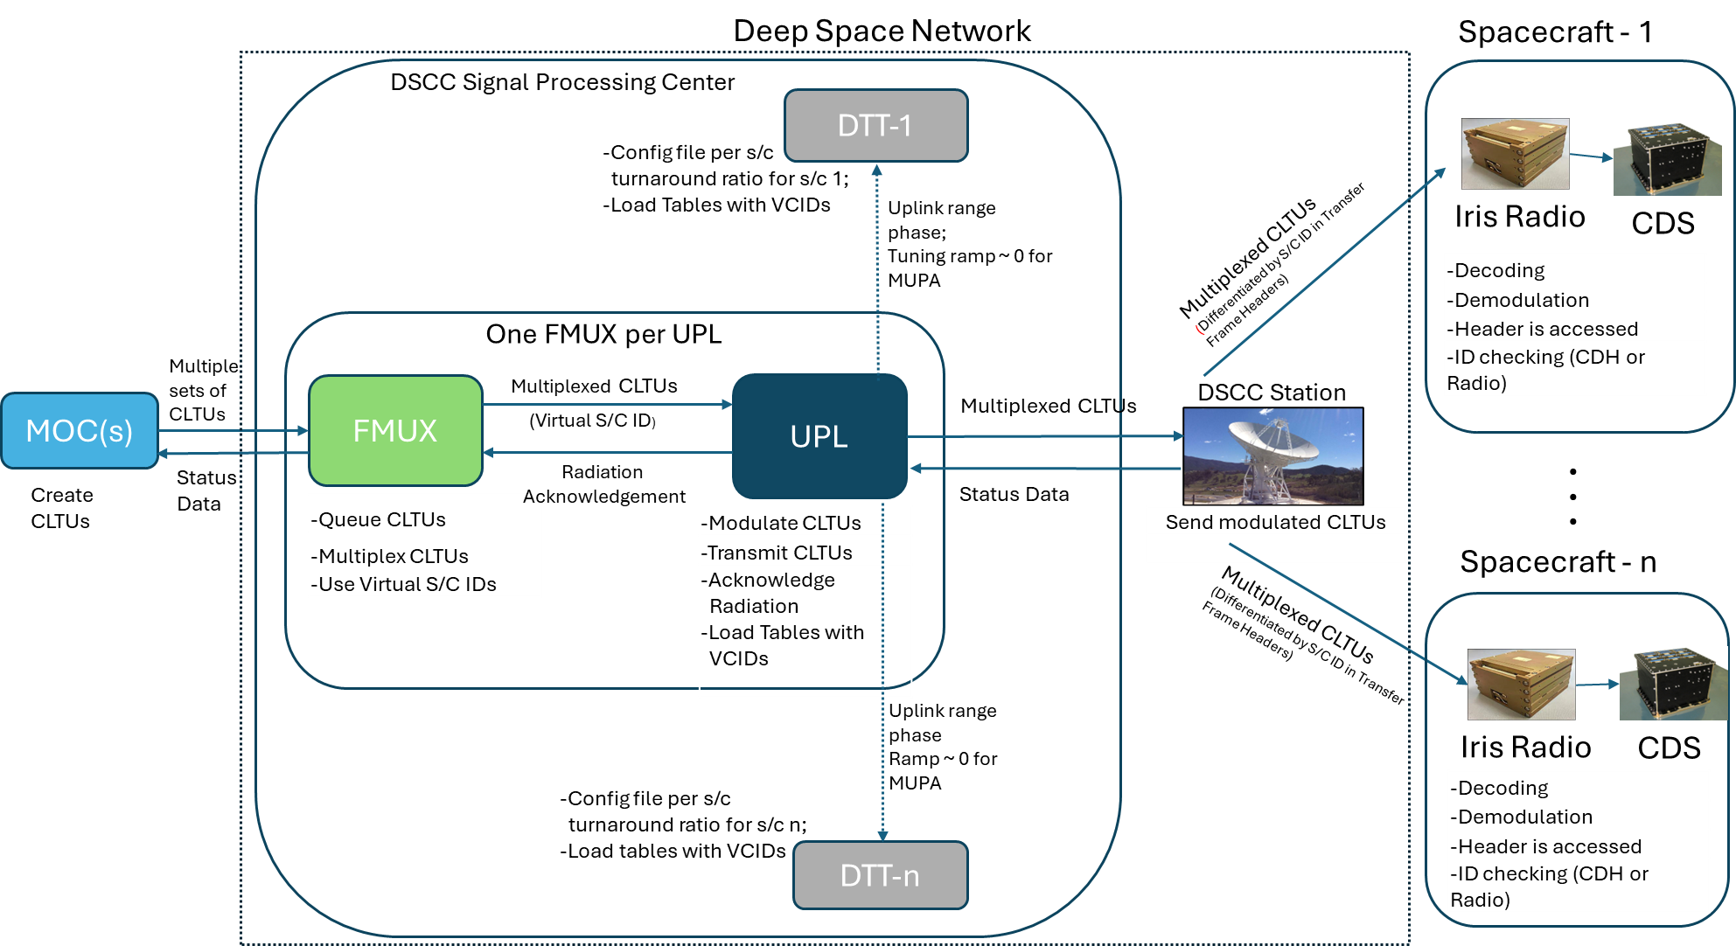
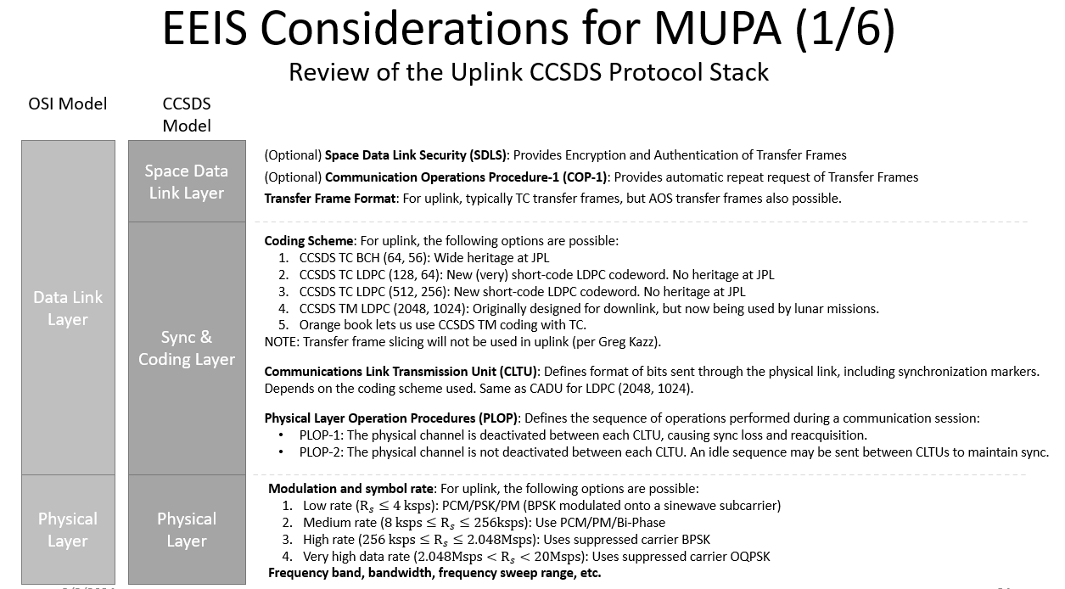
How Far Has the Technology Come? (3/3)
MUPA System Engineering*
Requirements Definition & Analysis
Concept Development
High-Level Design
*
FMUX Interfaces with DSN Subsystems for In-Flight Demos & Potential Implementation
MUPA Operations Concept: Session Execution
*
Work on these stages tends to be iterative.
*Other than being in-beam together, MUPA-session participants need to be using a common signaling format – part of the DSN-related MUPA user group coordination that must occur early in the session planning process.
*Special thanks to NASA’s Space Communications and Navigation (SCaN) Office for funding much of this work.

Slide 8
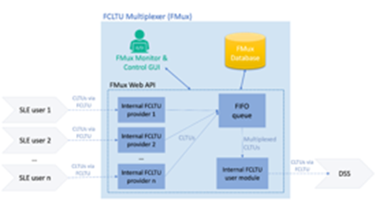
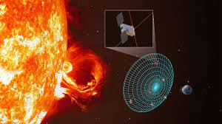
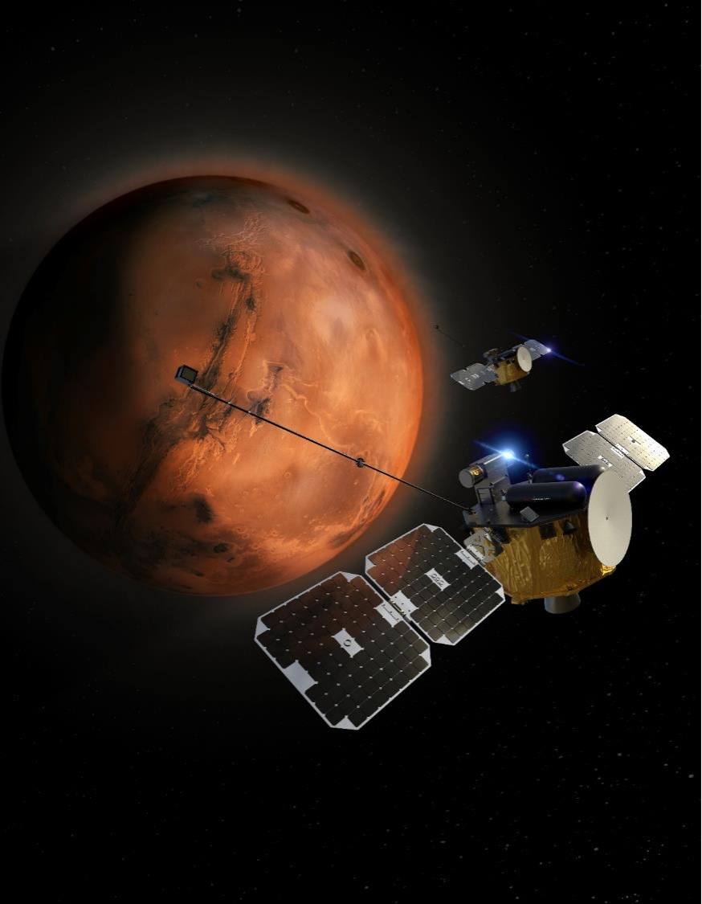
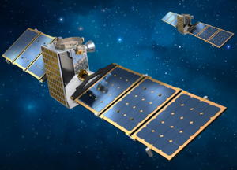
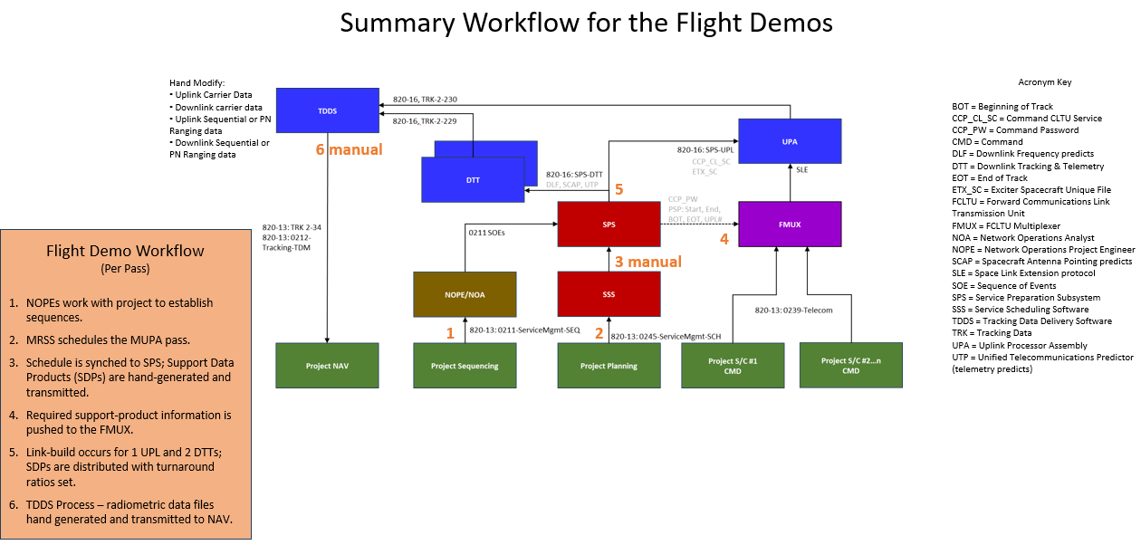
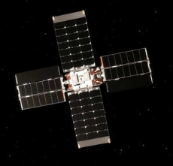
What Needs to Happen Next?
2024
2025-2027
2028-2030
Perform in-flight demonstrations.
FMUX
DSN Subsystem Interface Processes
OPERATIONAL
Perform end-to-end proof-of-concept demonstration.
FMUX
DSN Subsystem Interface Processes
Simultaneous 2-Way Doppler & Ranging.
Complete prototype FMUX development and ground testing.
?
FMUX
DSN Subsystem Interface Automation
Flight Radio
?
Flight Radio
  Switchable Uplink Frequencies
  Non-standard Turnaround Ratios
  SCID Filtering
  Onboard Doppler Compensation for Acquisition & Lock
Complete system engineering for in-flight demonstrations.
Implementation Funding

