Slide 1
C.3 Cost Effective Strategies and Tools for Interplanetary Mission Operations
Abhishek Tripathi, Director of Mission Ops (UCB-SSL)
Interplanetary Small Satellite Conference
Tues April 30th, 2024

Slide 2
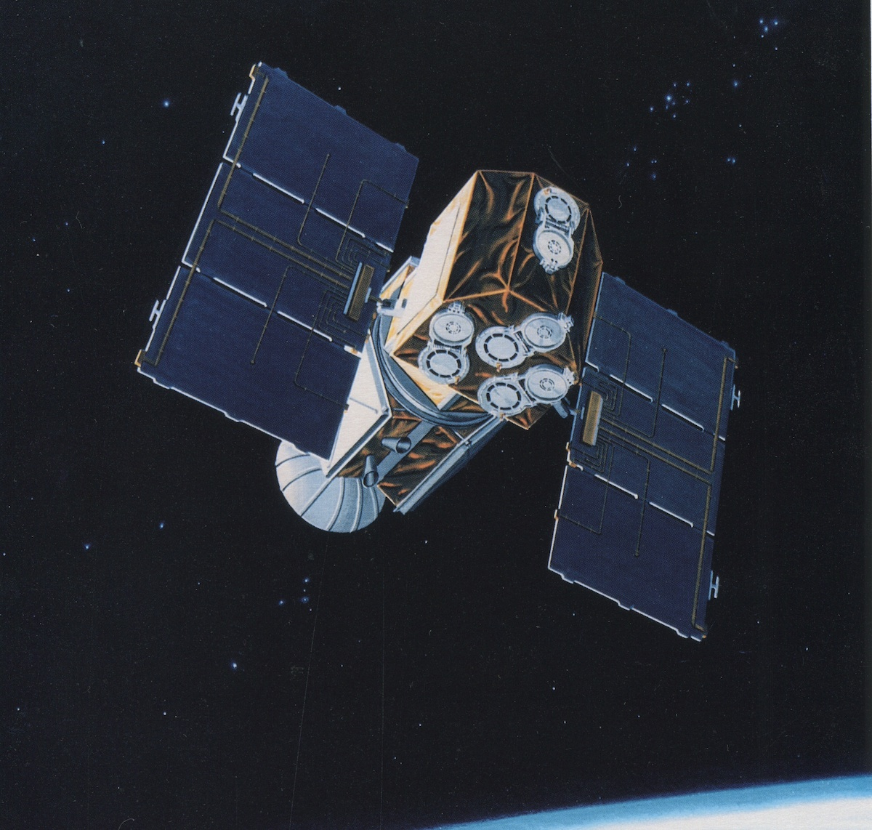
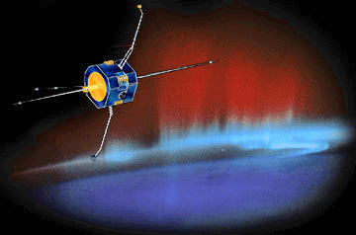
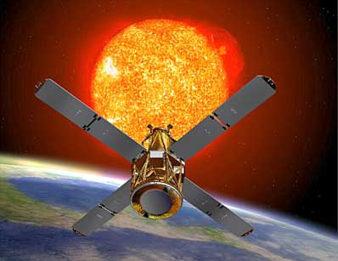
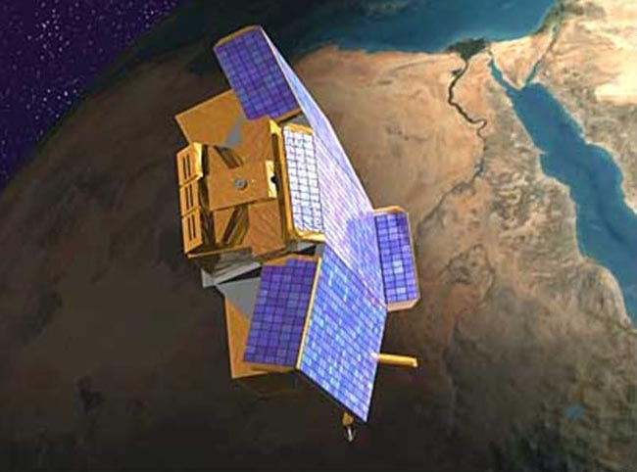
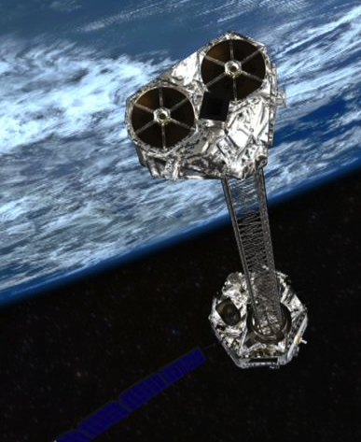
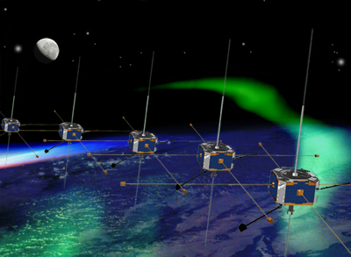
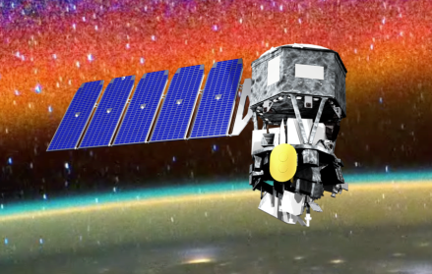
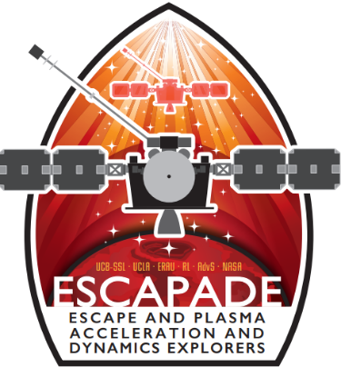
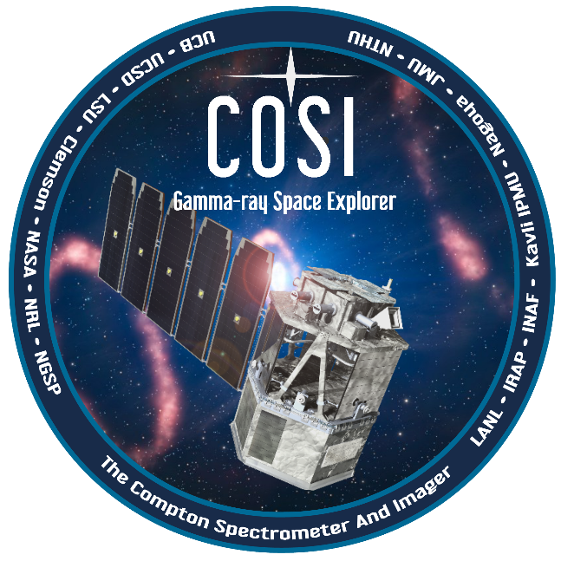
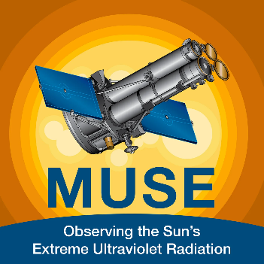

Operations History at UCB / SSL
UCB/SSL has operated 11 NASA Explorer spacecraft over a period of nearly thirty years (6 are currently operational).
EUVE
FAST
RHESSI
CHIPS
ICON
THEMIS / ARTEMIS
Active
NuSTAR
Active
COSI
Phase D (Sept 2024)
Phase D (2025)
Phase C
Phase C

Slide 3
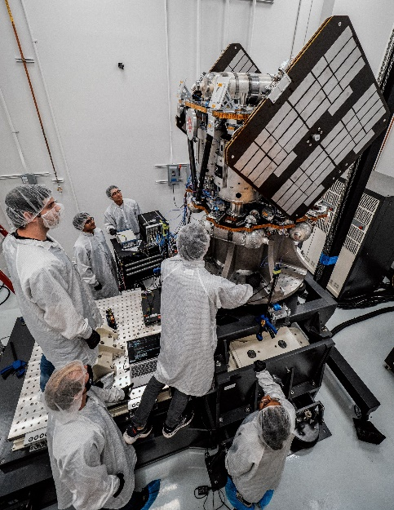
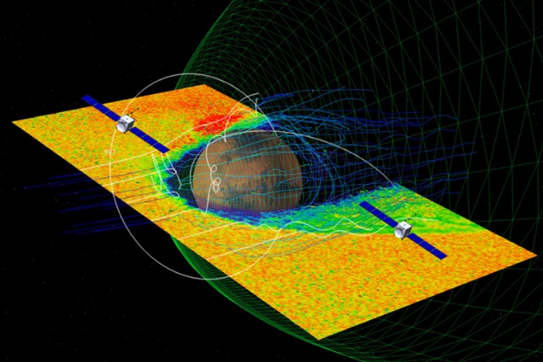
NASA’s ESCAPADE Mission as a Forcing Function for Low-cost Ops
Awarded as part of Small Innovative Missions for Planetary Exploration (SIMPLEx) program
Aims to fund low-cost, high-risk missions; ~$80 million-budget (including launch vehicle)
Two spacecraft delivered to Mars
Rocketlab busses and a New Glenn launch vehicle
Can’t do interplanetary ops within this budget without…
  Extreme (technical and bureaucratic) streamlining
  Free, or mostly in-house tools; some “new-space” tools
  Simplified ops and ops training
  Automation, automation, automation
  Maximize re-use of past infrastructure
  Small, experienced team with lots of cross-training and ownership
  We estimated that Ops had to fit within a 5-8% of total budget
  Costs are directly proportional to institutional bureaucracy and fragmentation (geographic) of Ops sub-disciplines
  Costs inversely proportional to scaling: Ops on “Mission N” are cheaper if I am doing multiple other missions with some similarities

Slide 4
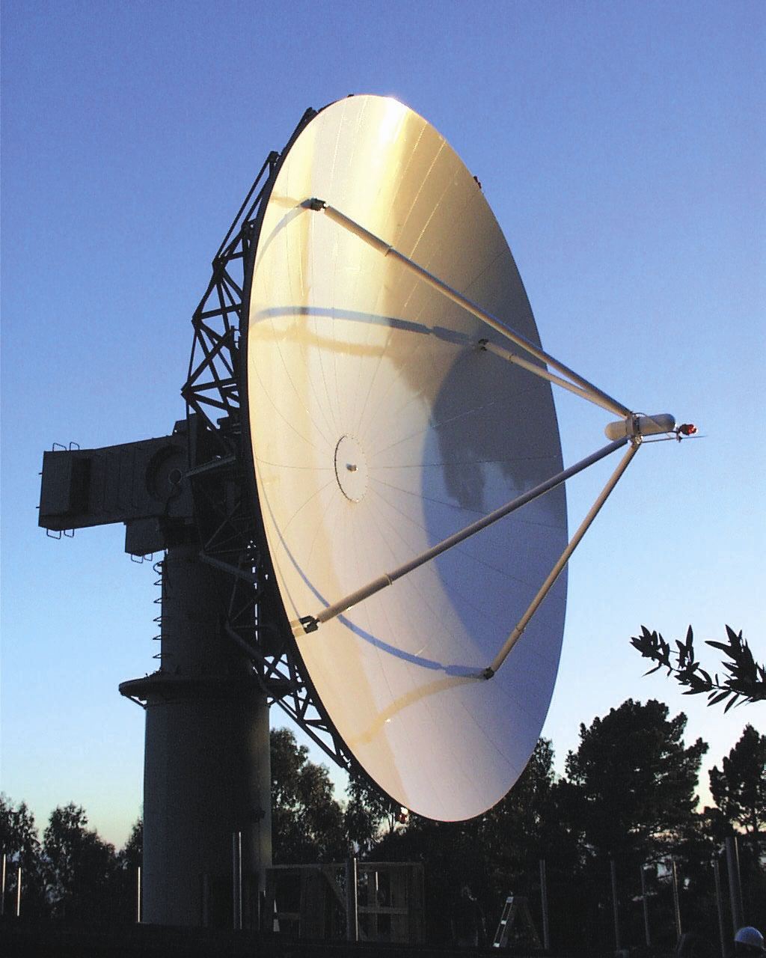
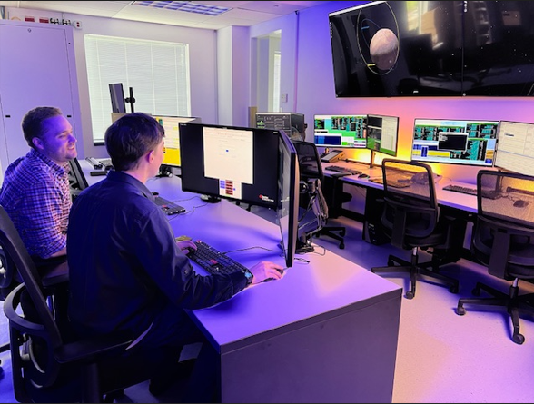
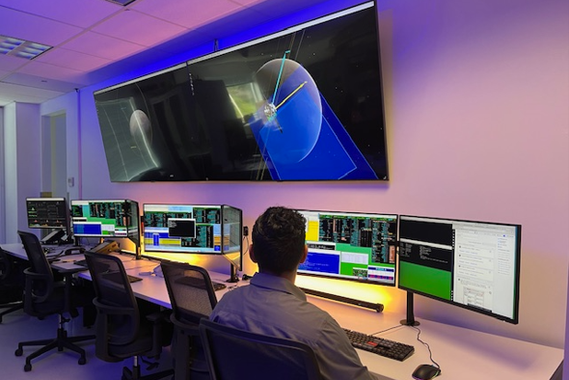
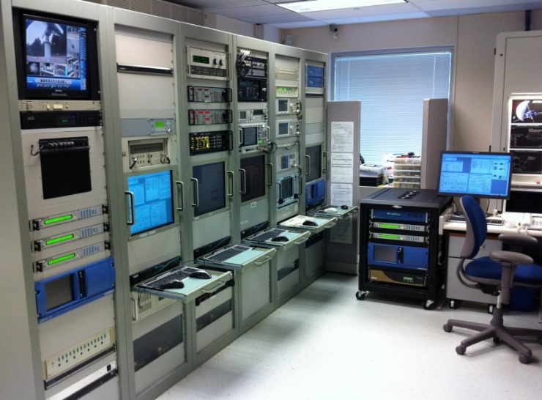
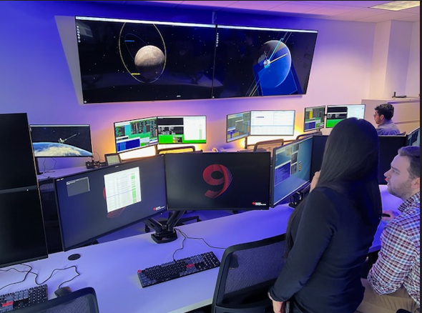
Operations Facilities at UCB/SSL
Mission Operations Center
Recent Upgrades completed in January 2024 to support our 5 new missions without increase in footprint:
Each individual workstations can control any spacecraft SSL is responsible for
Mission Ops Network upgraded onto NASA backbone with 10x bandwidth
Focus on automation going back two decades – MOC should be mostly empty except during commissioning, maneuvers and anomaly response
Spread cost between 4 different NASA missions
Berkeley Ground Station
11-m S-band antenna and equipment racks

Slide 5
Spacecraft control with Galaxy/ITOS
MOC command and control software is Galaxy, formerly ITOS (Integrated Test and Operations System) from Hammers
  Used at SSL on FAST, RHESSI, THEMIS/ARTEMIS, NuSTAR, ICON (approximately 100 spacecraft-years)
  Integrated with central MOC automation, anomaly paging systems
Galaxy/ITOS will support spacecraft and instrument real-time command and control
Up until recently, Hammers Galaxy was free for NASA missions
For the “Front-end” GUIs, we are experimenting with more intuitive custom GUIs that a person with more minimal training can easily on board to
  A Berkeley student built custom code on top of Grafana
  Lesson: Young, “inexperienced” go-getters can do a lot
Long term goal: Home-brewed Command and Control System

Slide 6
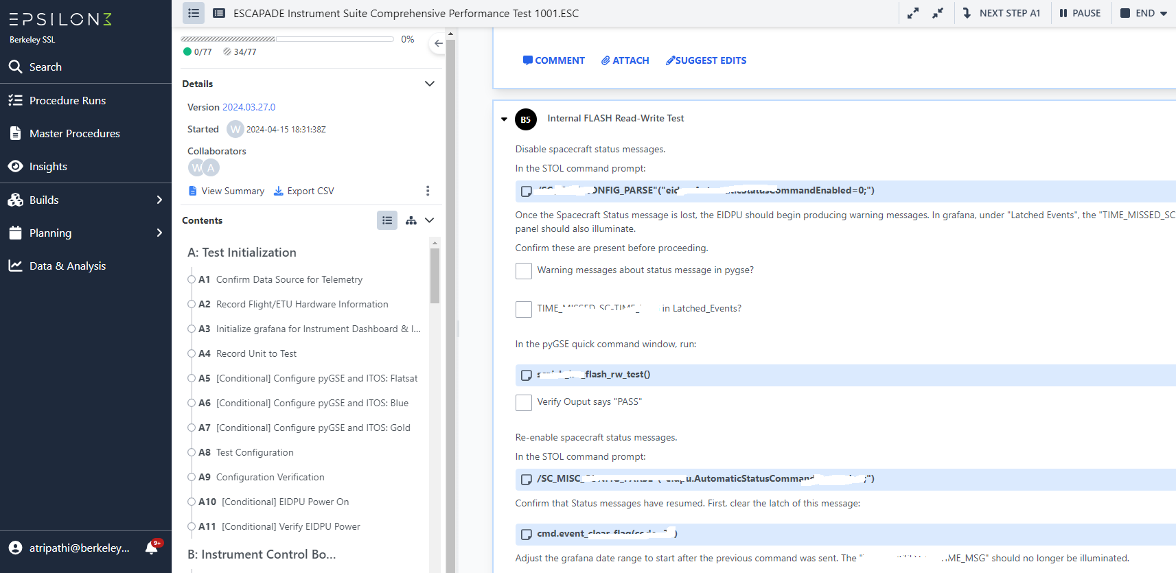
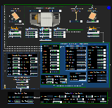
All-Electronic Procedures and Custom GUIs
100% electronic procedures with live embedded telemetry
Web-based with near real time latency – Anyone, anywhere can follow real-time
Web-based custom GUIs built on top of Grafana - Anyone, anywhere can follow real-time
Both procedures and GUI designs can be modified and partially re-used for future missions

Slide 7
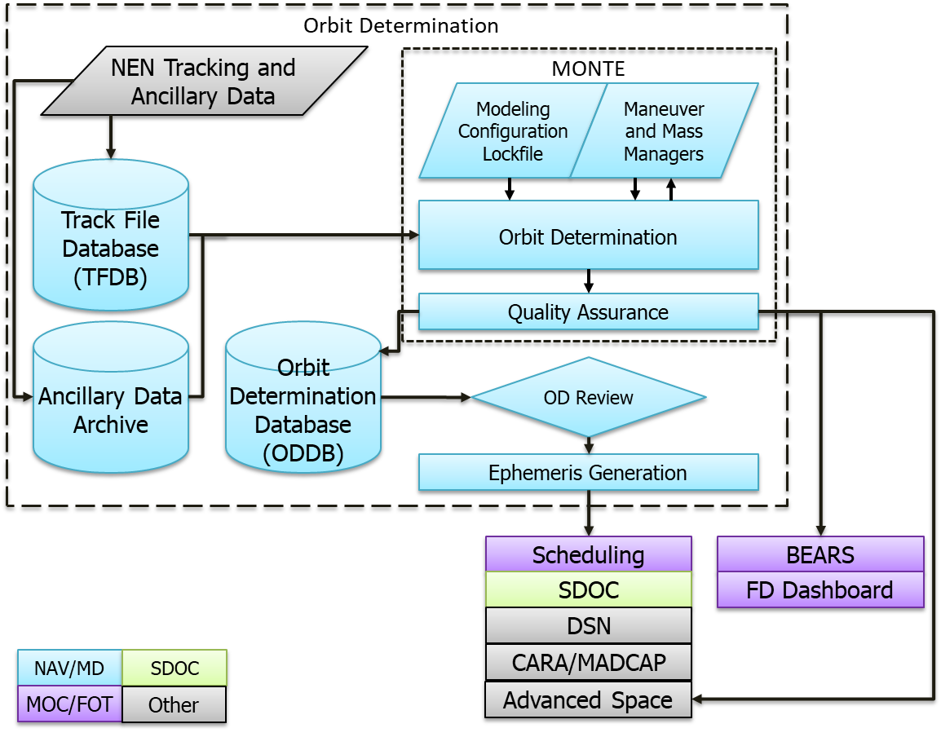
Orbit Determination Process Diagram
UCB/SSL using JPL’s Mission Analysis, Operations, and Navigation Toolkit Environment (MONTE) to support flight dynamics and navigation activities.
  Python library that supports
  Trajectory design and optimization
  Orbit determination and trajectory uncertainty analysis
  Orbit event analysis (e.g. shadows, occultations, station views, etc.)
MONTE’s mapping capabilities will be used to estimate navigation uncertainty at future events
  For example, collision avoidance analyses
Trajectory products generated in common formats like SPICE/SPK and CCSDS/OEM.

Slide 8
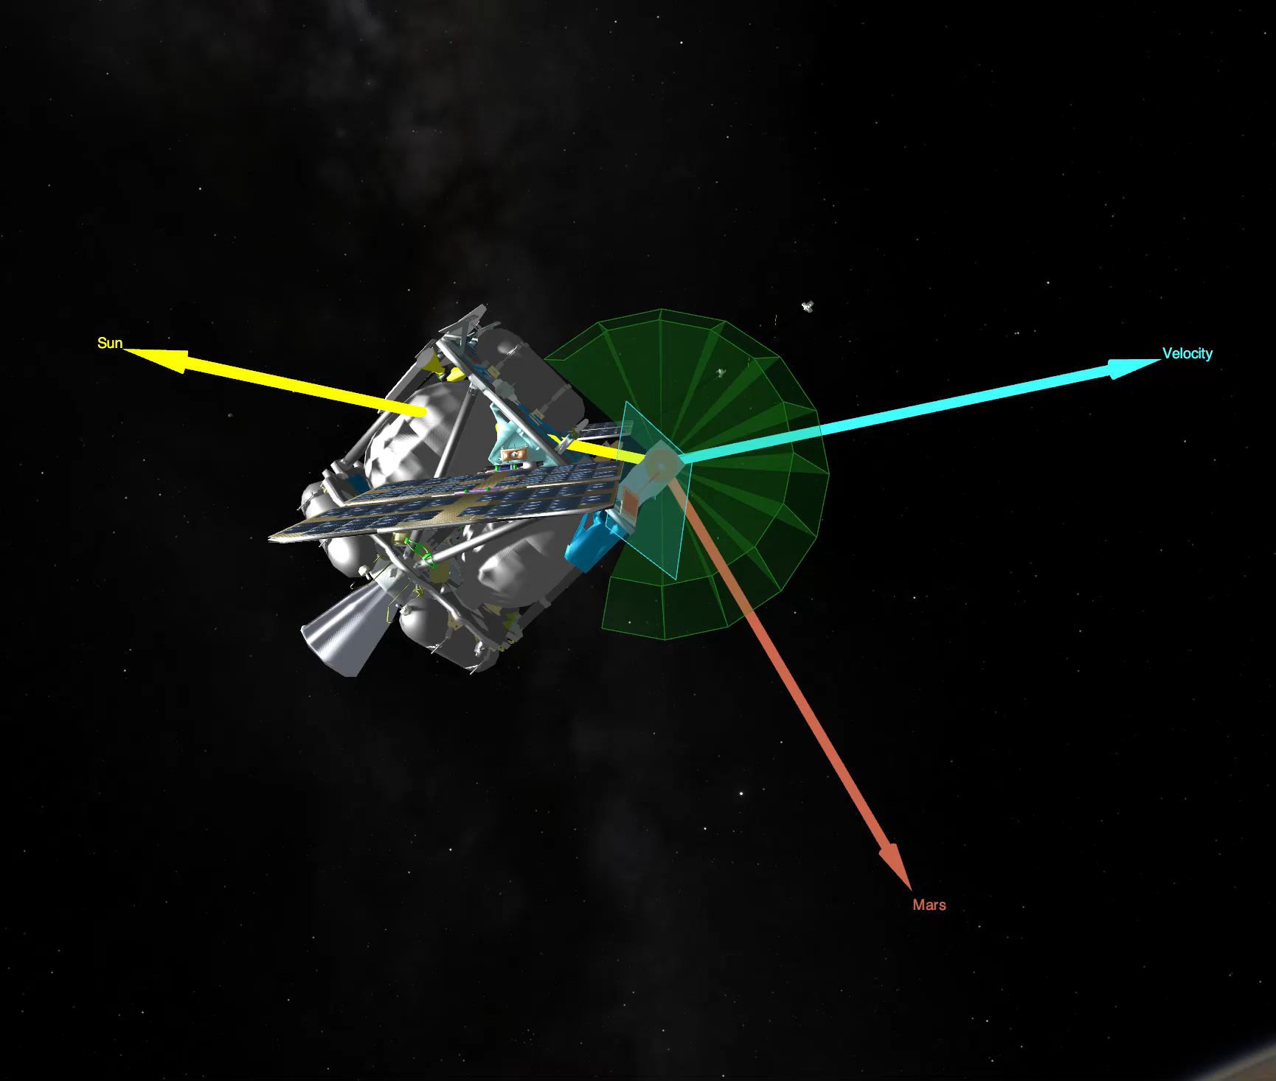
SPICE Toolkit and SPICE Enhanced Cosmographia
Cosmographia allows visual display of trajectories, orientations, and instrument fields of view
  https://naif.jpl.nasa.gov/naif/cosmographia.html
Cosmographia leveraging the JPL NAIF SPICE Toolkit for data handling and simulation
  https://naif.jpl.nasa.gov/naif/index.html
  Trajectory data in SPK format
  Frame and FOV definitions defined in SPICE frame and instrument kernels
  Orientation data handled by SPICE CK files
  Orientation simulations performed with SPICE/prediCkt
Example of orientation during a simulated ESCAPADE periapsis transit at Mars

Slide 9
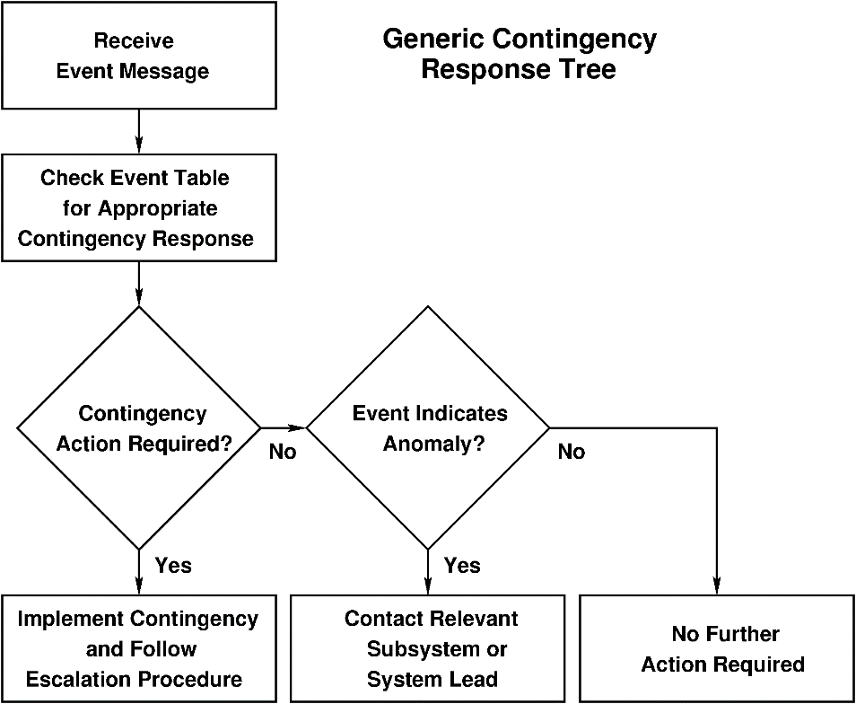
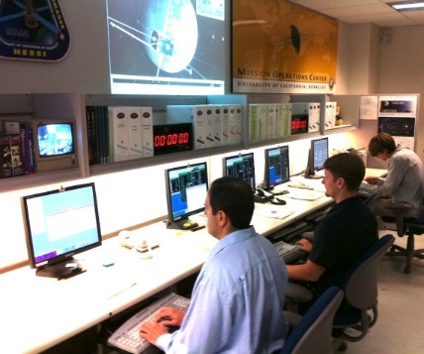
Anomaly and Contingency Response
  Anomaly and Contingency Response
  Flight controllers are trained to handle spacecraft safing operations.
  Paging systems are in place to alert flight controllers and operations management during on and off-hours.
  Anomalies are assessed in consultation with cognizant subsystems engineers.
  Operations Team Expertise
  Flight controllers are trained to act as first responders in case an anomaly is detected.
  Anomaly resolution involves operations management and all stakeholders, as required.

Slide 10
Telemetry Databases
Berkeley Trending Analysis and Plotting System – BTAPS
Designed in-house, first used during THEMIS I&T (2006)
  Stores multi-mission raw telemetry packets and telemetry format information (directly from Galaxy/ITOS input files) in a MySQL database
  Imports and stores telemetry streams in real time, loads “back orbit” telemetry from files
  Real-time strip chart plotting, random access archival plotting, and more
BTAPS supports upcoming missions
  All telemetry is sent in real time to the master database at SSL
  Telemetry can be monitored from anywhere
  I&T telemetry dataset will be kept on-line permanently to facilitate later investigations
Note: There are now several startups with reputable teams that are working on a commercial tool like this based on experience gained at SpaceX (e.g. their “BORG” tool)

Slide 11
BMPS – command sequencing
Sequencing: integrating multiple planning resources to build a spacecraft command timeline
  Communications pass schedule
  Spacecraft bus commands (e.g. maneuvers, state changes)
  Instrument mode changes
Performed by Berkeley Mission Planning System (BMPS)
  Developed in-house in 2006 (THEMIS), extended for NuSTAR, ICON
  Multi-mission design
  Tailored to MOC architecture for scheduling, flight dynamics, mission design products
  Software expands events from input files into commands for output
  Trigger and activity definitions are revision-controlled text files

Slide 12
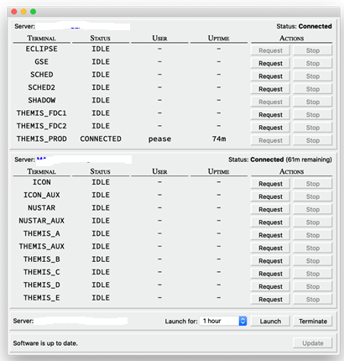
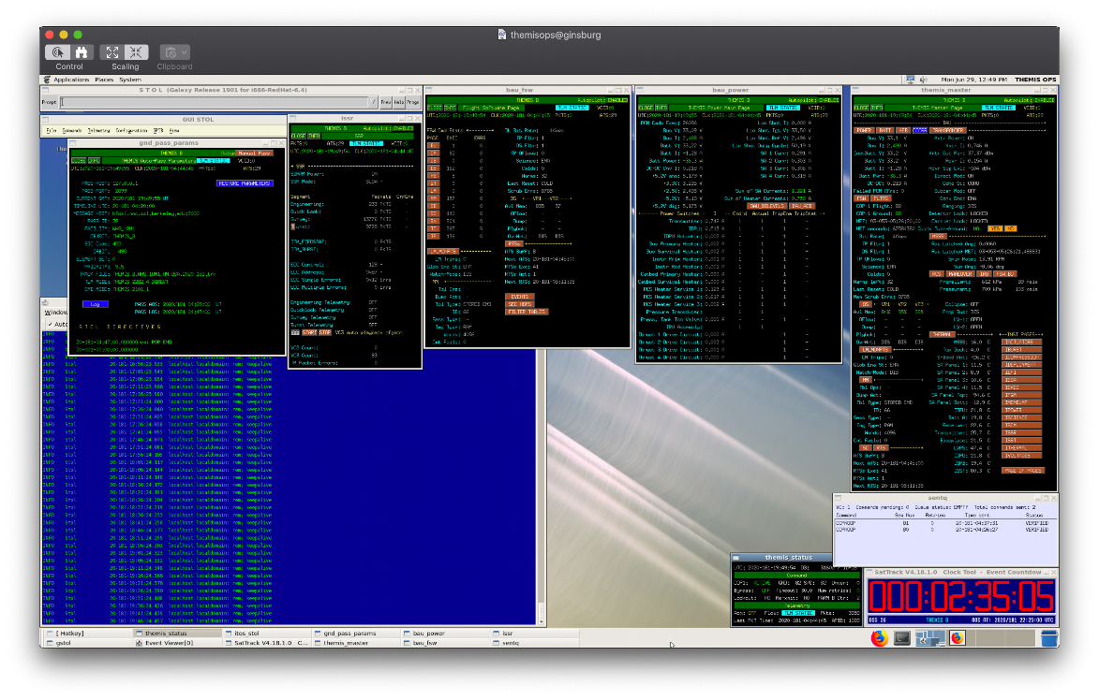
Telstar – MOC screen sharing
Inspired by COVID-19 shelter-in-place/social distancing requirements
Encrypted connections with multiple layers of security measures
Allowed for scheduling, mission design, Automated Time Sequence generation; not used for commanding
Each FOT member has a dedicated terminal (Mac mini)

Slide 13
Conclusions
Interplanetary Ops in cost effectives ways are possible
Automation and keeping close eye on new commercially available and free, open-source software, is key
Cube/Small-sats constellations are not necessarily more cost effective than tranditional missions when it comes to Ops
Must prize and prioritize good engineering and innovation above “process” and “requirements” engineering
Co-location of ops functions helps
Scaling to take advantage of efforts on your other missions helps

