Slide 1
Careful with that Joystick!
In Favor of Supervisory Control for Cislunar CubeSats
Mason Starr
Interplanetary Small Satellite Conference
April 30th, 2024
Notes:
Hello everyone, we had a bit of title change from what is in the program, today I will be talking about supervisory control operations for cislunar Cubesats. My goal for this presentation is to open a dialogue between all the experts we have in this room to discuss the pros and cons of supervisory control for our missions.

Slide 2
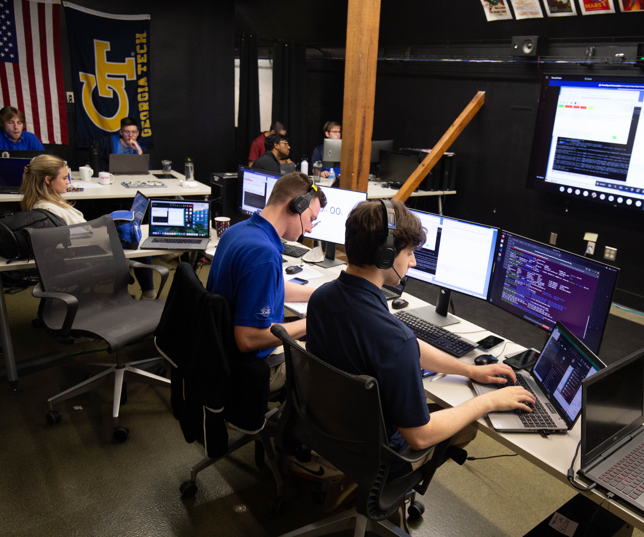
Context
Lunar Flashlight was built by JPL and operated by Georgia Tech
Launch Dec. 2022, EOM Dec. 2023
Mission differed significantly from pre-launch expectations due to in-flight anomalies
Ops had to think quickly and creatively in flight to work around anomalies
Mission Operations Center at Georgia Tech
Notes:
For some context, I was the operations lead for Lunar flashlight, a 6U ______ built by JPL and operated by GT. To my knowledge, we were the first ______. LF operated for about a year, and the ConOps we used in flight differed sig ________________. We had to think creatively to work around anomalies

Slide 3
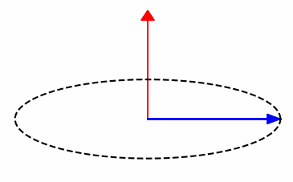
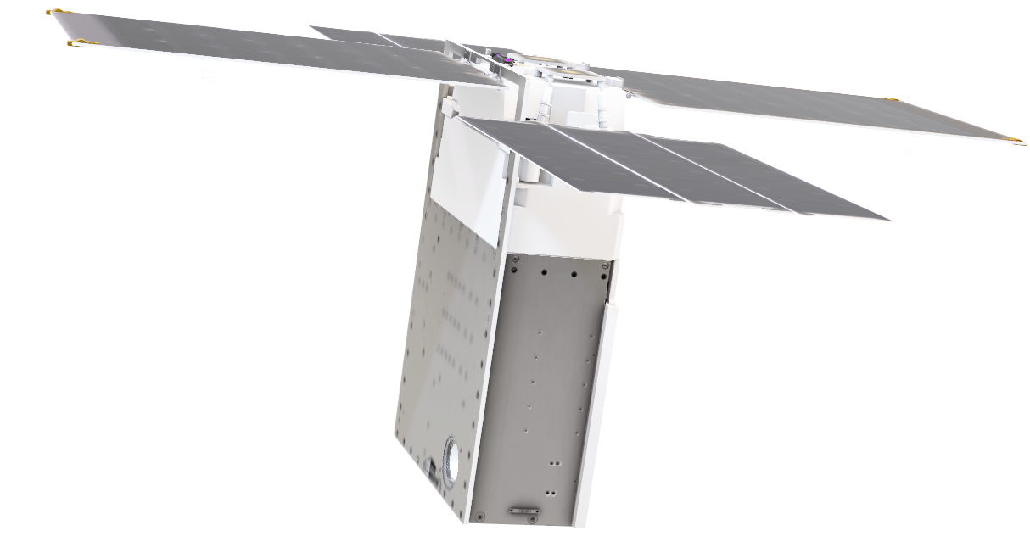
The Tale of the RTCM
Lunar Flashlight had unpredictable thrusters
Solution: perform a rotating TCM with one thruster
Challenges:
  Variable thruster performance
  Narrow phase margins on thrusting maneuvers
  Burns must be designed with current thruster performance
  No onboard ability to adapt aside from limited FP
How do we pull this off? To be continued…
Thrust
Torque
Notes:
Our main problem on LF was that our thrusters were extremely unpredictable, we believe due to FOD in the fuel lines. Celeste gave a great presentation on this topic earlier today so I won’t go too in depth, but in summary we performed ___________. Managing the spacecrafts momentum state during these burns was our top priority, to avoid reaction wheel saturation and loss of mission. *review challenges*.

Slide 4
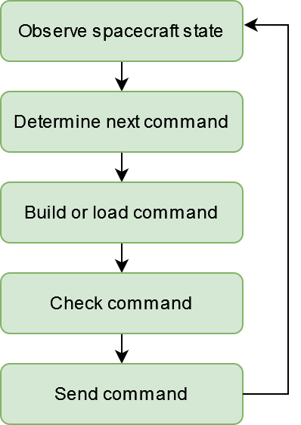
Supervisory Control
“Joysticking”: Call-and-response operations
Intentional reallocation of functions from the spacecraft to ground
  Not an example: descoping features due to short dev timeline
  Example: Fault diagnosis and recovery
Spacecraft autonomy is still required
  Joysticking is most useful for non-baseline activities
Notes:
So what do I mean by super? On LF we called it joysticking, and it’s essentially call and response operations that we see on the left. While in 2-way contact with the spacecraft with DSN, we _____.
Intention reallocation: This reallocation is often an undesired thing, like running out of dev time and having to descope FSW features, putting the burden on the ops team. A form of this that many of us are familiar with is fault diagnosis and recovery, something that currently occurs on the ground, but recent advances in autonomy has many people striving to make this a spacecraft function, which is great.
Autonomy is of course still required, can’t reallocate all autonomy to the ground. Still need FP, a sequence engine, and all the things that make standard operations work. Joysticking can be very useful for non-baseline spacecraft activities, which we had a lot of on LF.

Slide 5
The Joysticking Tradeoff
Pros
Reduced cost – spacecraft automation is expensive
Rapid development
Easy to test and V&V
Adapt to unpredictable spacecraft state
Cons
Joysticked activities must be performed human-in-the-loop
Higher operator workload
Slower activity execution
Introduce risk of operator error
Notes:
The main benefit of joysticking is that it is less expensive, from both a money and time perspective. For example, It is far easier to develop and test a python script that commands a non-standard activity than it is to write a FSW patch that does the same thing.
There are several cons to joysticking. Of course, joysticked activities must occur HitL. Reallocating functions from the spacecraft to ground can result in higher workload for operators, but this can often be mitigated by using ground automation. Activity execution times are slower due to the back-and-forth nature of joysticking rather than the spacecraft handling everything. Finally, operators typically make mistakes more frequently than computers, so ground processes can introduce risk of real-time operator error.

Slide 6
Joysticking Cislunar CubeSats
As the industry trends towards advanced spacecraft autonomy, cislunar CubeSats are in a unique position to make use of supervisory control and ground autonomy
Low-latency communications
Extended tracks with DSN
Constrained budgets
Relaxed risk posture
Notes:
The central thesis of this presentation is that cislunar CubeSat missions are uniquely poised to take advantage of supervisory control. Why?
We meet the first prerequisite, low latency comms for the call and response. Deep space missions don’t have this due to light time.
Extended tracks give operators lots of time to maneuver the joystick. LEO missions don’t have this.
SS missions often have constrained budgets, which as we will discuss is a major reason to pursue supervisory control
Additionally, we often have a relaxed risk posture, which means we can accept many of the cons of this approach because the upsides are so valuable.

Slide 7
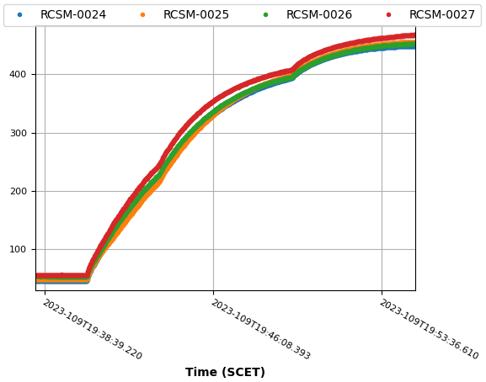
Example: Heating Lunar Flashlight’s Thrusters
For power load reasons, duty cycle must be increased at certain temperature thresholds
No conditional logic in LF’s sequences to support the duty cycle increase
Could have used a conservative amount of time in a sequence, but power was tight
Temp (Celsius)
4 heaters on
3 heaters on
2 heaters on
Notes:
Here is a simple example of what this looks like in practice. Heating LF’s thrusters for a burn pulled a lot of power, so we slowly needed to increase the duty cycle of the heaters from 2 being on at a time, to 3, to 4. On LF, we did not have conditional logic in our sequences, so we did not have the ability in our command sequences to say “once we hit this temperature setpoint, change the duty cycle.” We could have given the sequence ample margin, for example giving it 3 minutes of heating when we only expected 2 minutes were needed, but we wasted a lot of power doing that. So we found it was best to just observe in real-time when the setpoint was reached, and send the command to increase the duty cycle manually.

Slide 8
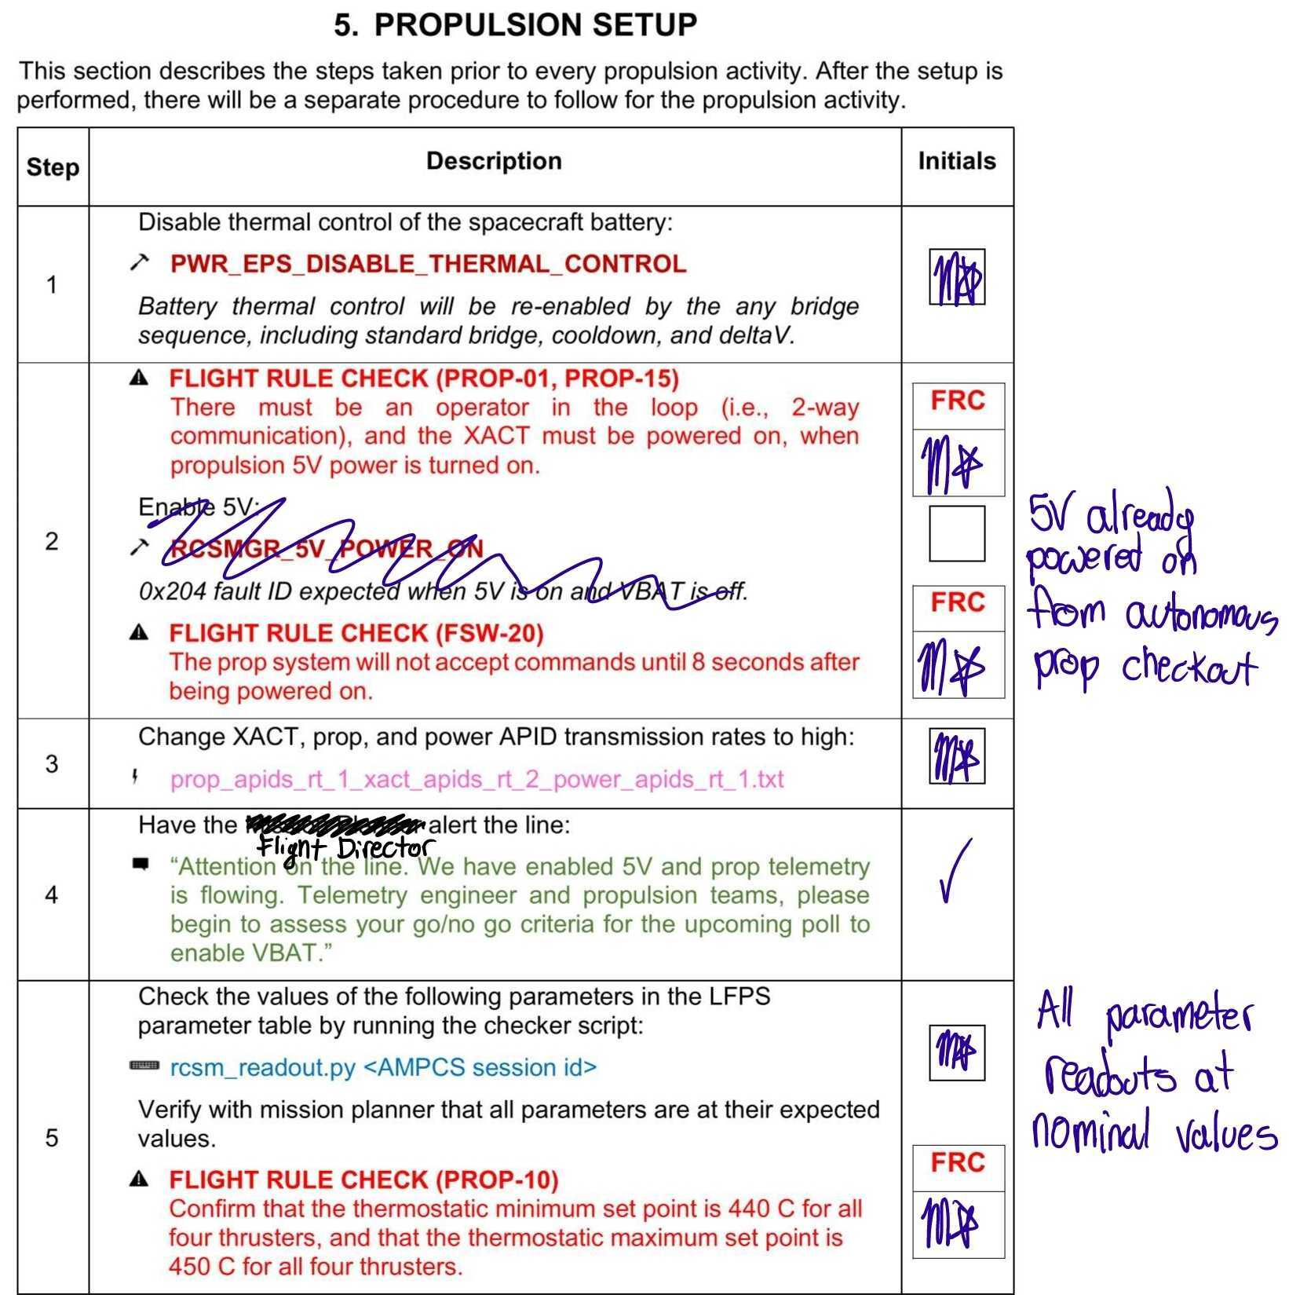
Tactical Procedures Help Mitigate Risk
V&V’ed on testbed; reviewed
Two sets of eyes; verbal “GO”
Flight rule signoffs built in
“As-runs” serve as records of events
Notes:
When we executed joysticked activities on LF we used PDF tactical procedures that we annotated on tablets. Procedures were always Verified & Ved on the testbed and reviewed by the team before execution, so that we knew they would work. Any deviations from the procedure required signoff from FD and other project members. Before any command was sent, we required the FD and Ace to review the command and give a verbal go to check for any errors. Procedure as-runs serve as a record of events after the contact.
In early LF days, we were trying to rapidly characterize and understand our spacecraft, so we were developing, V&Ving, and running new procedures every 12 hours. We could not have developed robust command sequences on that timeline.

Slide 9
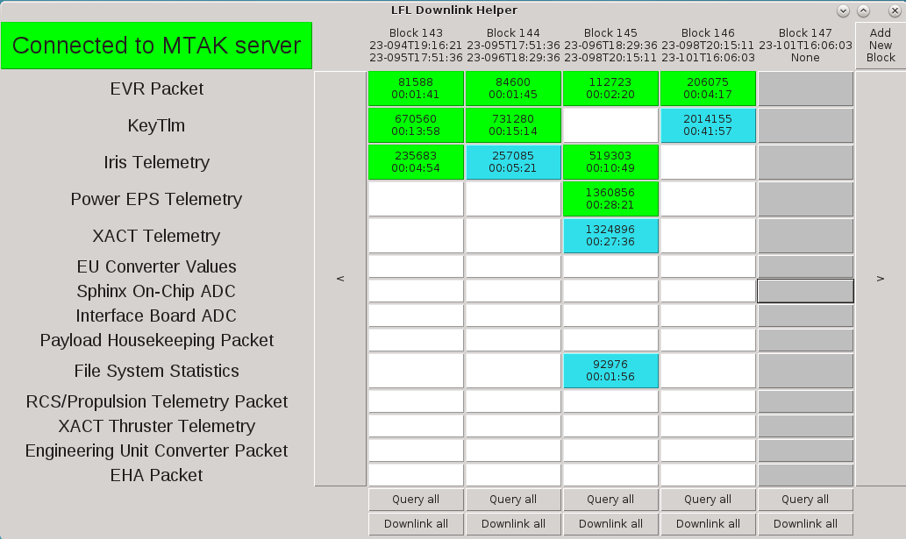
Ground Automation
Develop tactical tools
  Capture spacecraft state
  Perform calculations
  Issue commands
Scripts are fast to develop, GUIs are often easier to use for advanced applications
Lunar Flashlight Downlink Helper GUI
Example applications:
  Robust file uplink adapting to dropped packets
  Calculation of custom telemetry channels using SPICE
  Dumping and downlinking log files with changing names
  There is a paper, ask me for it!
Notes:
Another way to mitigate risk of operator error is to use ground tools to automatically build and send commands based on the observed spacecraft state. Because our ops team was formed mainly of students with no prior experience with command line, we found that GUIs were useful for complex activities. This GUI is our downlink helper, which helps with downlinking recorded telemetry from the spacecraft. It allows operators to easily see the state of what telemetry is downlinked and onboard, and initiate queries and downlinks with single button clicks, rather than identifying time windows, performing SCET to SCLK conversions, and typing in numbers by hand. This tool allowed us to make the most of our contact time by choosing what telemetry to downlink based on the time we had left in each contact following activity execution.
Some example applications that we used on ground automation for on LF are shown here, I think the most useful one we came up with was an uplink script that used EVRs to dynamically handle unstable file uplink, this was very useful when we were having some GDS problems effecting our uplink. I wrote a paper on the tools we used, so just ask and I will send it to you.

Slide 10
Ground Automation Development
Real-time commanding and telemetry viewing software, with API
  LF used JPL’s AMPCS with Python API
  Custom telemetry views
Minimize real-time manual command building to reduce risk
  Typing in a bunch of numbers is risky!
  Version controlled immediate commands
  Scripts, GUIs, or ground automation
Notes:
So what does a mission need to develop ground automation like this? To enable joysticking, you need at minimum real-time commanding a telemetry visualization software, preferably with the ability to develop custom views. An API is necessary for developing custom scripts and tools. We used JPL’s AMPCS, which was fantastic, if a bit overkill for a CubeSat mission.
A general guideline is to minimize the amount of real-time commands built by operators, because operators can make mistakes. Using pre-written command snippets, and automation is key for this.

Slide 11
What Happens If We Lose Comms Right Now?
Notes:
The most important question to be asking when developing joysticking processes is to ask “what happens if we lose comms right now?” We learned this lesson the hard way, when we were heating the thrusters for a burn, and at the point marked with this arrow, our DSN transmitter went down. The spacecraft was left in a state with the heaters on, which was pulling a lot of power and generating a lot of heat, so there was real risk of AFT violations and even UVLO if we didn’t recover fast. We ended up declaring the only spacecraft emergency that we ever declared on LF and got another antenna to turn off the heaters. After this, we learned our lesson, and included sequenced safety nets on all commands that put the spacecraft in a precarious state, such as commands that heat or slew off sun. Command timeouts for mode transitions are important.

Slide 12
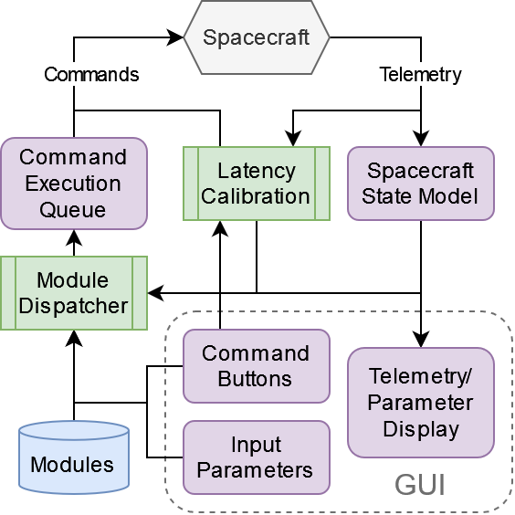
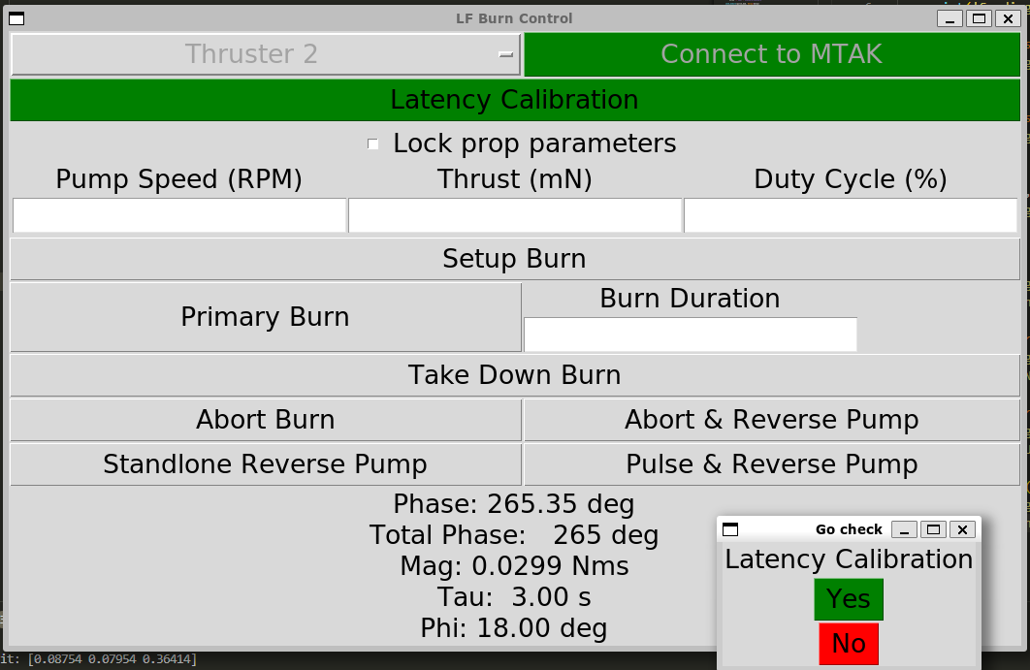
The Tale of the RTCM (Continued)
Ground tools perform live calculations of thruster performance and generate the proper commands
Perform a latency calibration to execute commands at a target rotation phase ± 1°
Notes:
So let’s revisit the rotating TCM from earlier. With all the narrow margins and complications of balancing momentum state, we developed a tool that reads the spacecrafts current momentum state and thruster performance, and automatically generates commands with the correct burn parameters and timing. The tool performed a latency calibration and was able to send commands at exactly the right time to execute at a target rotation phase, within a single degree of accuracy, which was a .4 second window.

Slide 13
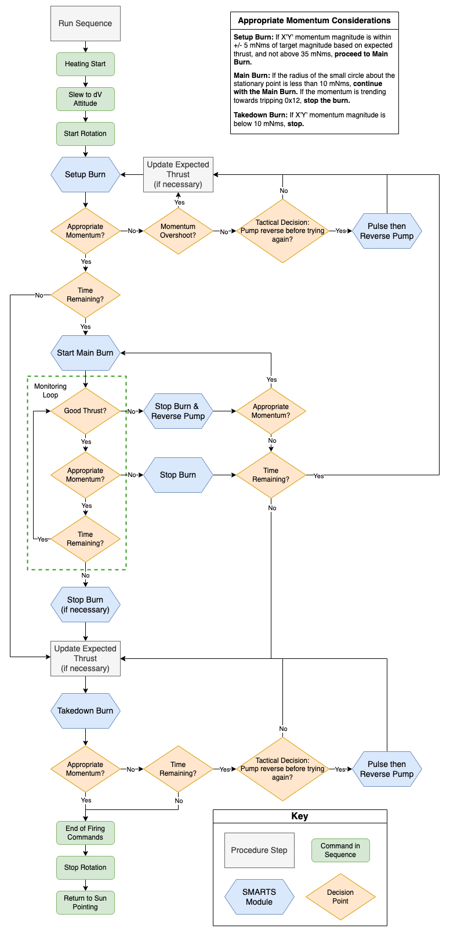
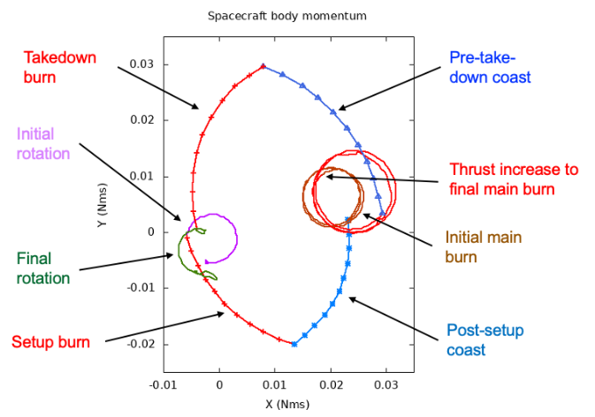
The Tale of the RTCM (Finale)
Notes:
So how did this all work out? We were able to execute many successful RTCMs on LF when the burn thrusters were more predictable. Eventually, the fuel lines clogged completely and we were unable to do any more burns, so we missed our chance to enter a lunar orbit. But the process worked, and we would have reached the moon if the thrusters didn’t stop working. Here on the right, you can see a decision-making flowchart that we followed when performing the burns, which shows how operators and the tools adapted to the variable spacecraft state.

Slide 14
Conclusion
Cislunar CubeSats are uniquely poised to take advantage joysticking due to our limited budgets, low-latency comms, and extended tracks with DSN.
Reallocating spacecraft functions to the ground can save money and speed development, but introduces risk.
Let’s talk about this! mstarr32@gatech.edu
Thank you to
  The entire LF project
    JPL engineering support
    MSFC propulsion
    GT operations
    Science Team
  Glenn Lightsey, LF Operations PI
Notes:
In conclusion, ____________________. I would love to talk about this more with you all and know if you agree or disagree, and if you have used joysticking on your missions. Please reach out!

