Slide 1

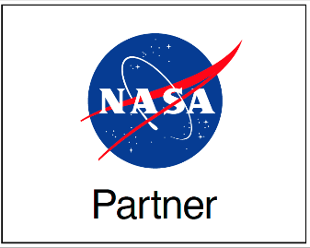
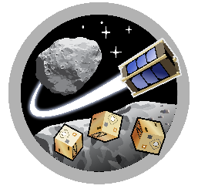
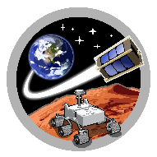
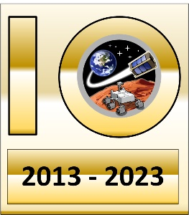
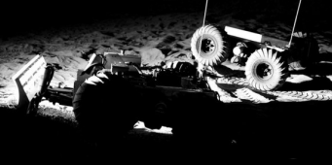
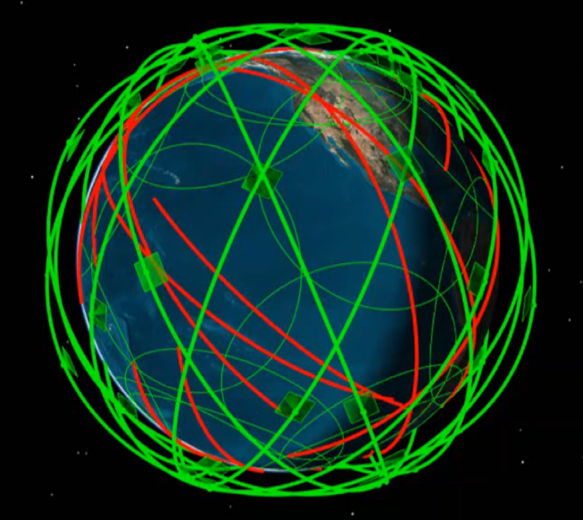
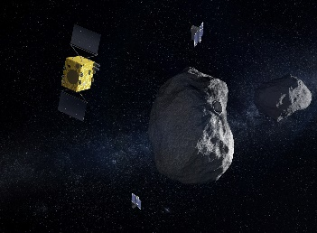
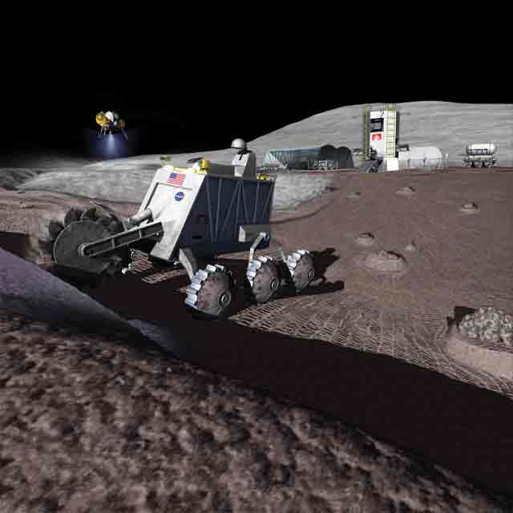
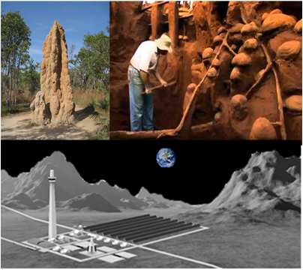
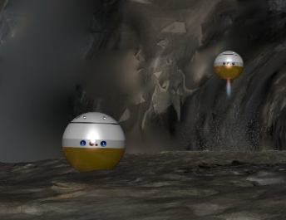
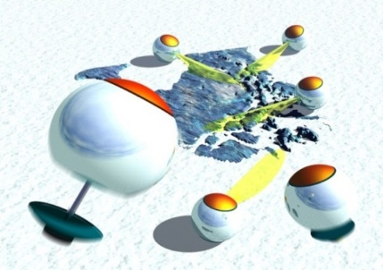
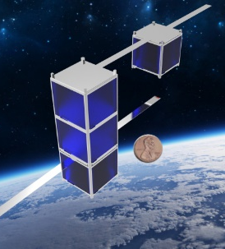
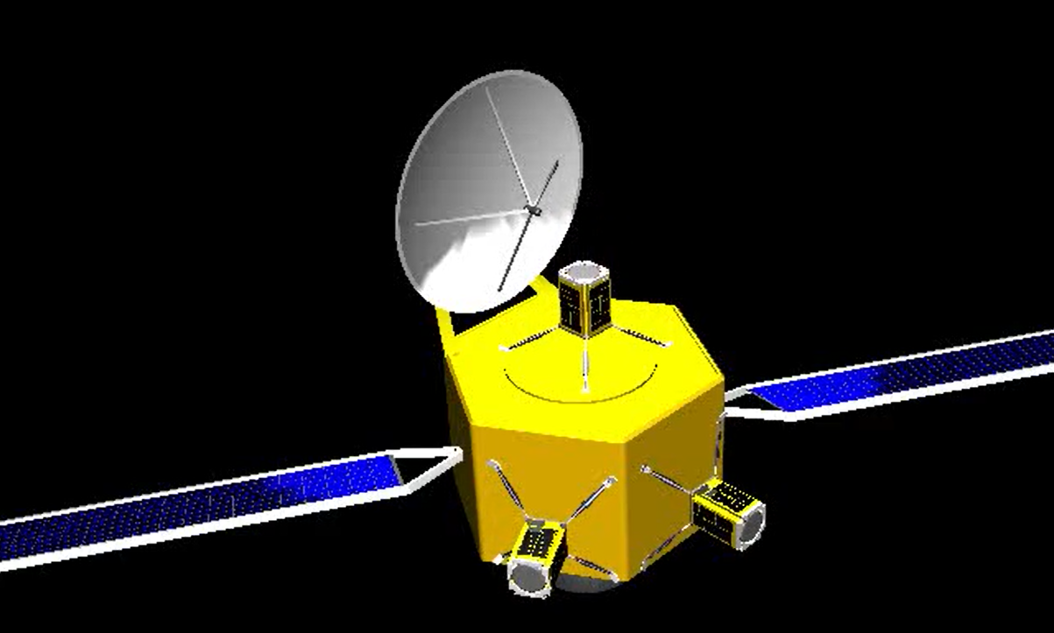
ASTEROIDS
SpaceTREx
Delta-V Distribution for Mission Requirements Towards an Interstellar Object
Adam Nekolny
Space and Terrestrial Robotic Exploration (SpaceTREx) Laboratory
Aerospace and Mechanical Engineering Department
University of Arizona

Slide 2
Contents
Science Objectives
Interstellar Objects
Simulation
  Setup
  Spacecraft Positioning
Results
  Delta-V Distribution
  TOF Distribution
Small Spacecraft Feasibility
  Propulsion, Payload
Conclusion
  Spacecraft types, instruments, objectives

Slide 3
Science Objectives
Develop Monte Carlo Simulation for ISOs
  Finding the Delta-V distribution
  Validating the results
Analysis of Interstellar Objects Similar to Oumuamua and Borisov
Compare different spacecraft launch location within solar system
Determine the feasibility of Small spacecraft use for ISO interception

Slide 4
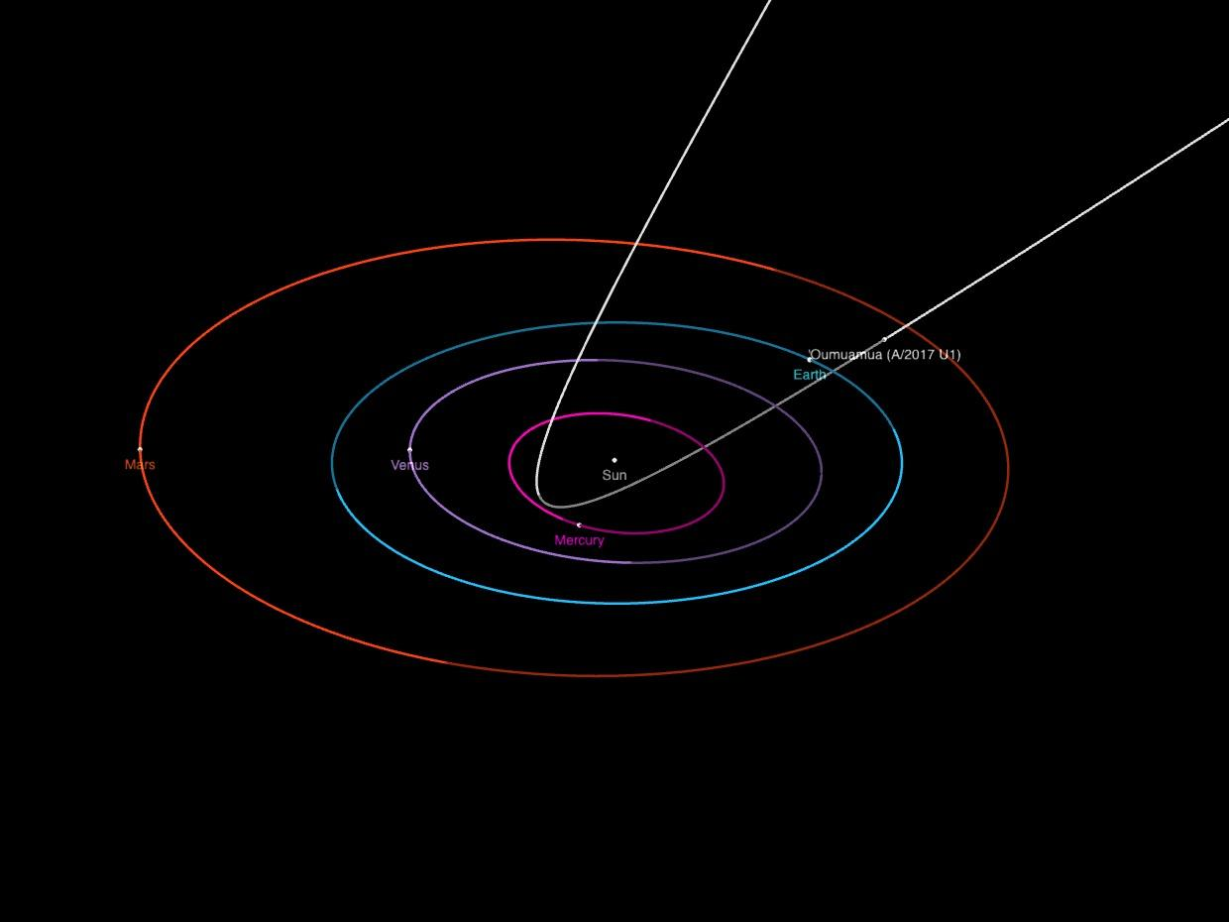
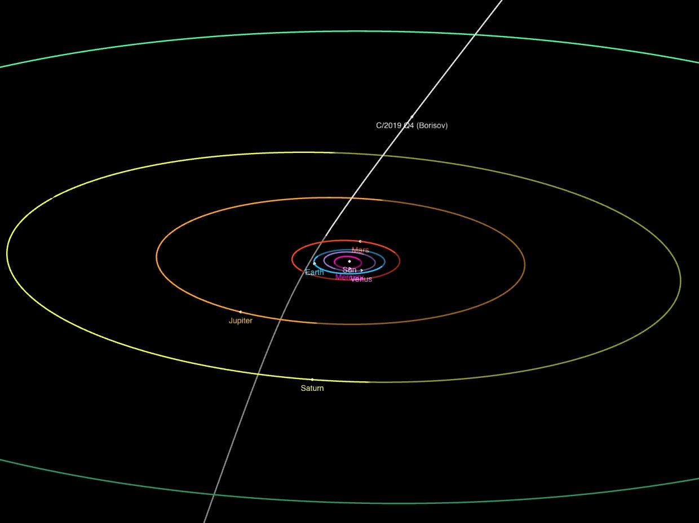
Interstellar Objects
(A/2017 U1) - ’Oumuamua
  Resembling Asteroid
  Spinning and tumbling motion
  Initial size range estimates
    200 m - 1 km
(C/2019 Q4) - Borisov
  Hyperbolic Comet
  Initial size range estimates
    500 m - 2 km
Scientific Interest
  Imaging
  Spectroscopy
  Sample collection

Slide 5
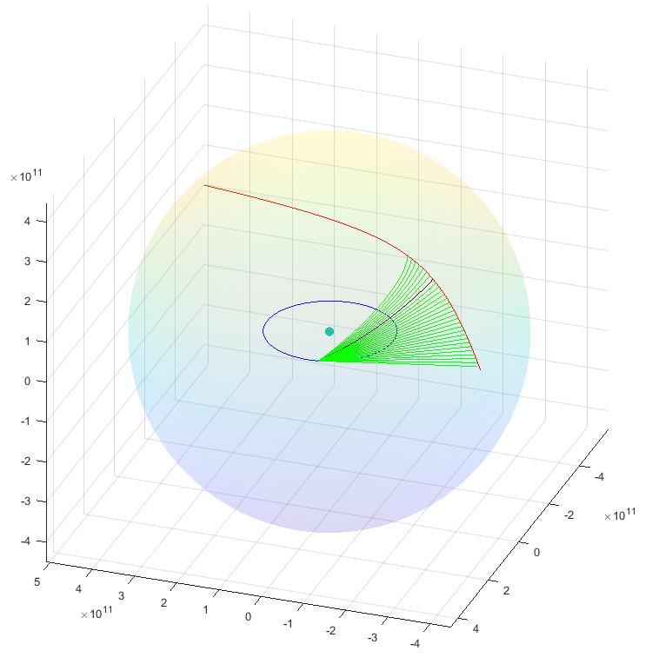
Simulation Setup
Generate Objects
  100,000 cases
  Random position/velocity
  Initial position at heliosphere
  Velocity magnitude
    Oumuamua - 26.657 km/s
    Borisov - 32.286 km/s
Detection Checks
  Velocity vector into the system
  Position of 4 AU from Sun
  Position of 3 AU from Earth
    Borisov first detection
Spacecraft Launch
  Time fixed - 01-01-2024
  TOF - 5 days - 8 years
  No launch delay
  Direct lambert transfer

Slide 6
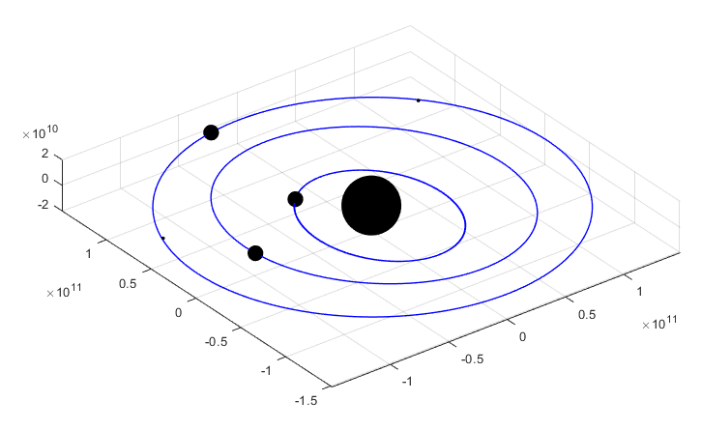
Spacecraft Positioning
Based on the time fixed positions for 01-01-2024
Assumed launch from sphere of influence
Based on JPL ephemeris data
Locations
  Earth
  Sun-Earth
    L1
    L2
    L3
    L4
  Venus
  Mercury

Slide 7
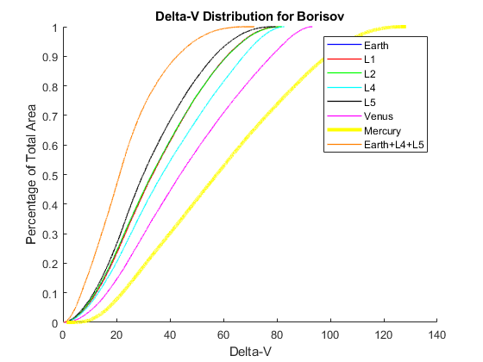

Delta-V Distribution
[km/s] | Earth | Earth+L4+L5 | L1 | L2 | L4 | L5 | Venus | Mercury
∆V < 10 (1I/2017) | 7.911% | 17.711% | 6.693% | 7.121% | 6.043% | 7.816% | 3.751% | 0.777%
∆V < 10 (2I/2019) | 6.913% | 17.711% | 6.693% | 7.121% | 6.043% | 7.816% | 3.751% | 0.777%

Slide 8
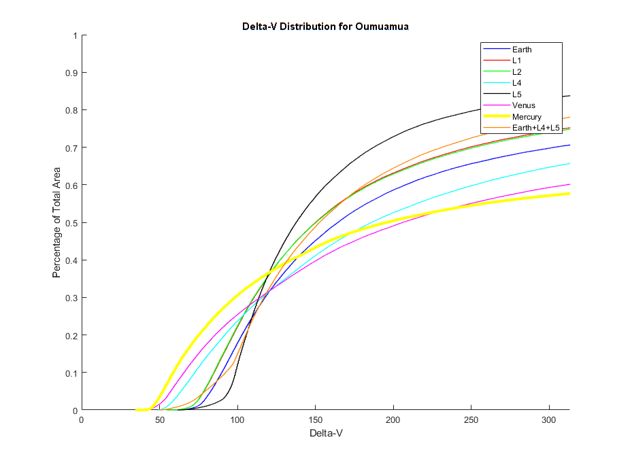
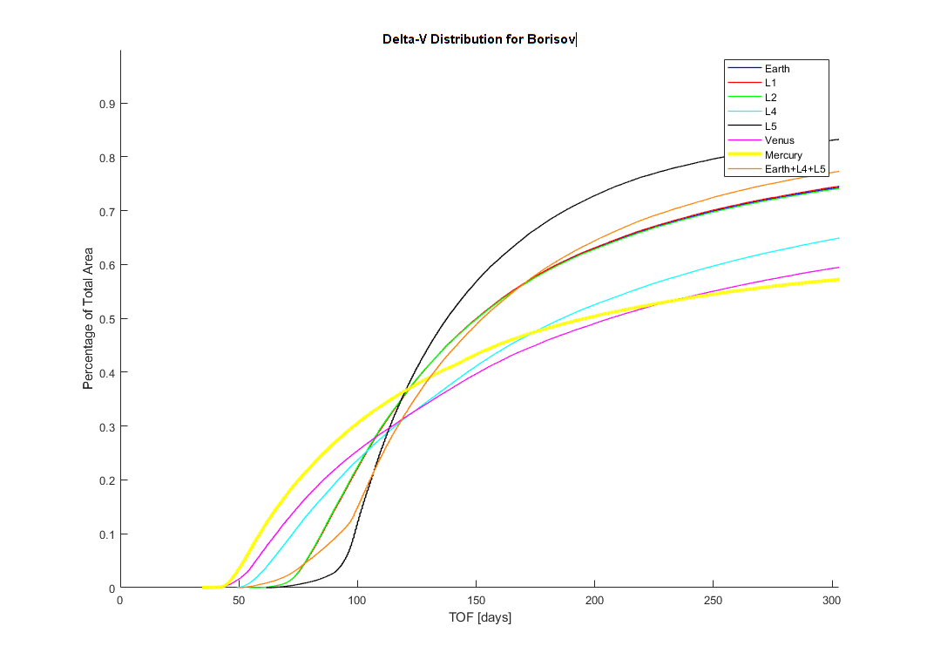
TOF Distribution
[days] min-max | Earth | Earth+L4+L5 | L1 | L2 | L4 | L5 | Venus | Mercury
∆V < 10 km/s (1I/2017) | 69-340.5 | 65.5-270.5 | 66-283 | 49.5-298 | 66-216 | 43.5-255 | 45.5-189 | 50-298
∆V < 5 km/s | 73-262 | 68-220.5 | 69-227 | 50-231.5 | 66-194 | 45.5-189 | 48-81 | 50-231.5
∆V < 10 km/s (2I/2019) | 65.5-273.5 | 65.5-270.5 | 66-283 | 49.5-298 | 66-216 | 63.5-255 | 46.5-189 | 50-298
∆V < 5 km/s | 69-226.5 | 68-220.5 | 69-227 | 50-231.5 | 66-194 | 45.5-189 | 48-81 | 50-231.5

Slide 9
Small Spacecraft Feasibility
Small spacecraft < 500 kg
  Increasing Chances for success
    Simultaneous launch
      Multiple positions
      Singular Position
  Limited payload
    Few instruments per spacecraft
  Limited fuel
    Propulsion
      High ISP - Long burn time
        Hall-effect, Ion
      High Thrust - High fuel mass
        Chemical, Hybrid
Propulsion Type | ISP max (s) | Thrust max (N)
Hydrazine | 285 | 28
Hybrid | 300 | 222
Cold Gas | 110 | 3.6
Solid | 269 | 461
Electrothermal | 350 | 1
Electrosprays | 3000 | 0.02
Gridded Ion | 3000 | 0.02
Hall-Effect | 1920 | 0.055
Pulsed Plasma & Arc Thrusters | 3200 | 0.0005
Ambipolar | 1100 | 0.017

Slide 10
Conclusion
Spacecraft Type
  Large spacecraft ≥ 1000 kg
    More payload, Larger Delta-V Range
    High cost
  Small spacecraft
    Limited payload, Swarm deployment
    Lower cost
Objectives
  Visual imaging of the Interstellar Object
  Spectroscopy - Flyby, Impact
Instrumentation
  Cameras, Spectrometer
Longevity
  Radiation, Power, Fuel, Degradation
Alternative Positioning
  Increase number of spacecraft locations

Slide 11
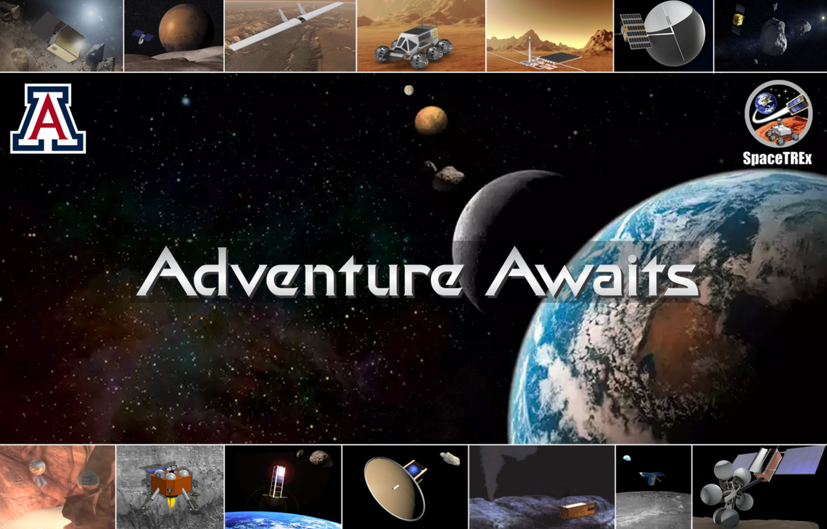
Thank You!

Slide 12
Questions ?

Slide 13
References
https://www.nasa.gov/smallsat-institute/sst-soa/in-space_propulsion/
https://ntrs.nasa.gov/api/citations/20190031730/downloads/20190031730.pdf
M.Hein, A., Eubanks, T. M., Lingam, M., Hibberd, A., Fries, D., Schneider, J., Kervella, P., Kennedy, R., Perakis, N., and Dachwald, B., “Interstellar Now! Missions to Explore Nearby Interstellar Objects,” Advances in Space Research, Vol. 69, 2022, pp. 402–414.

