Slide 1
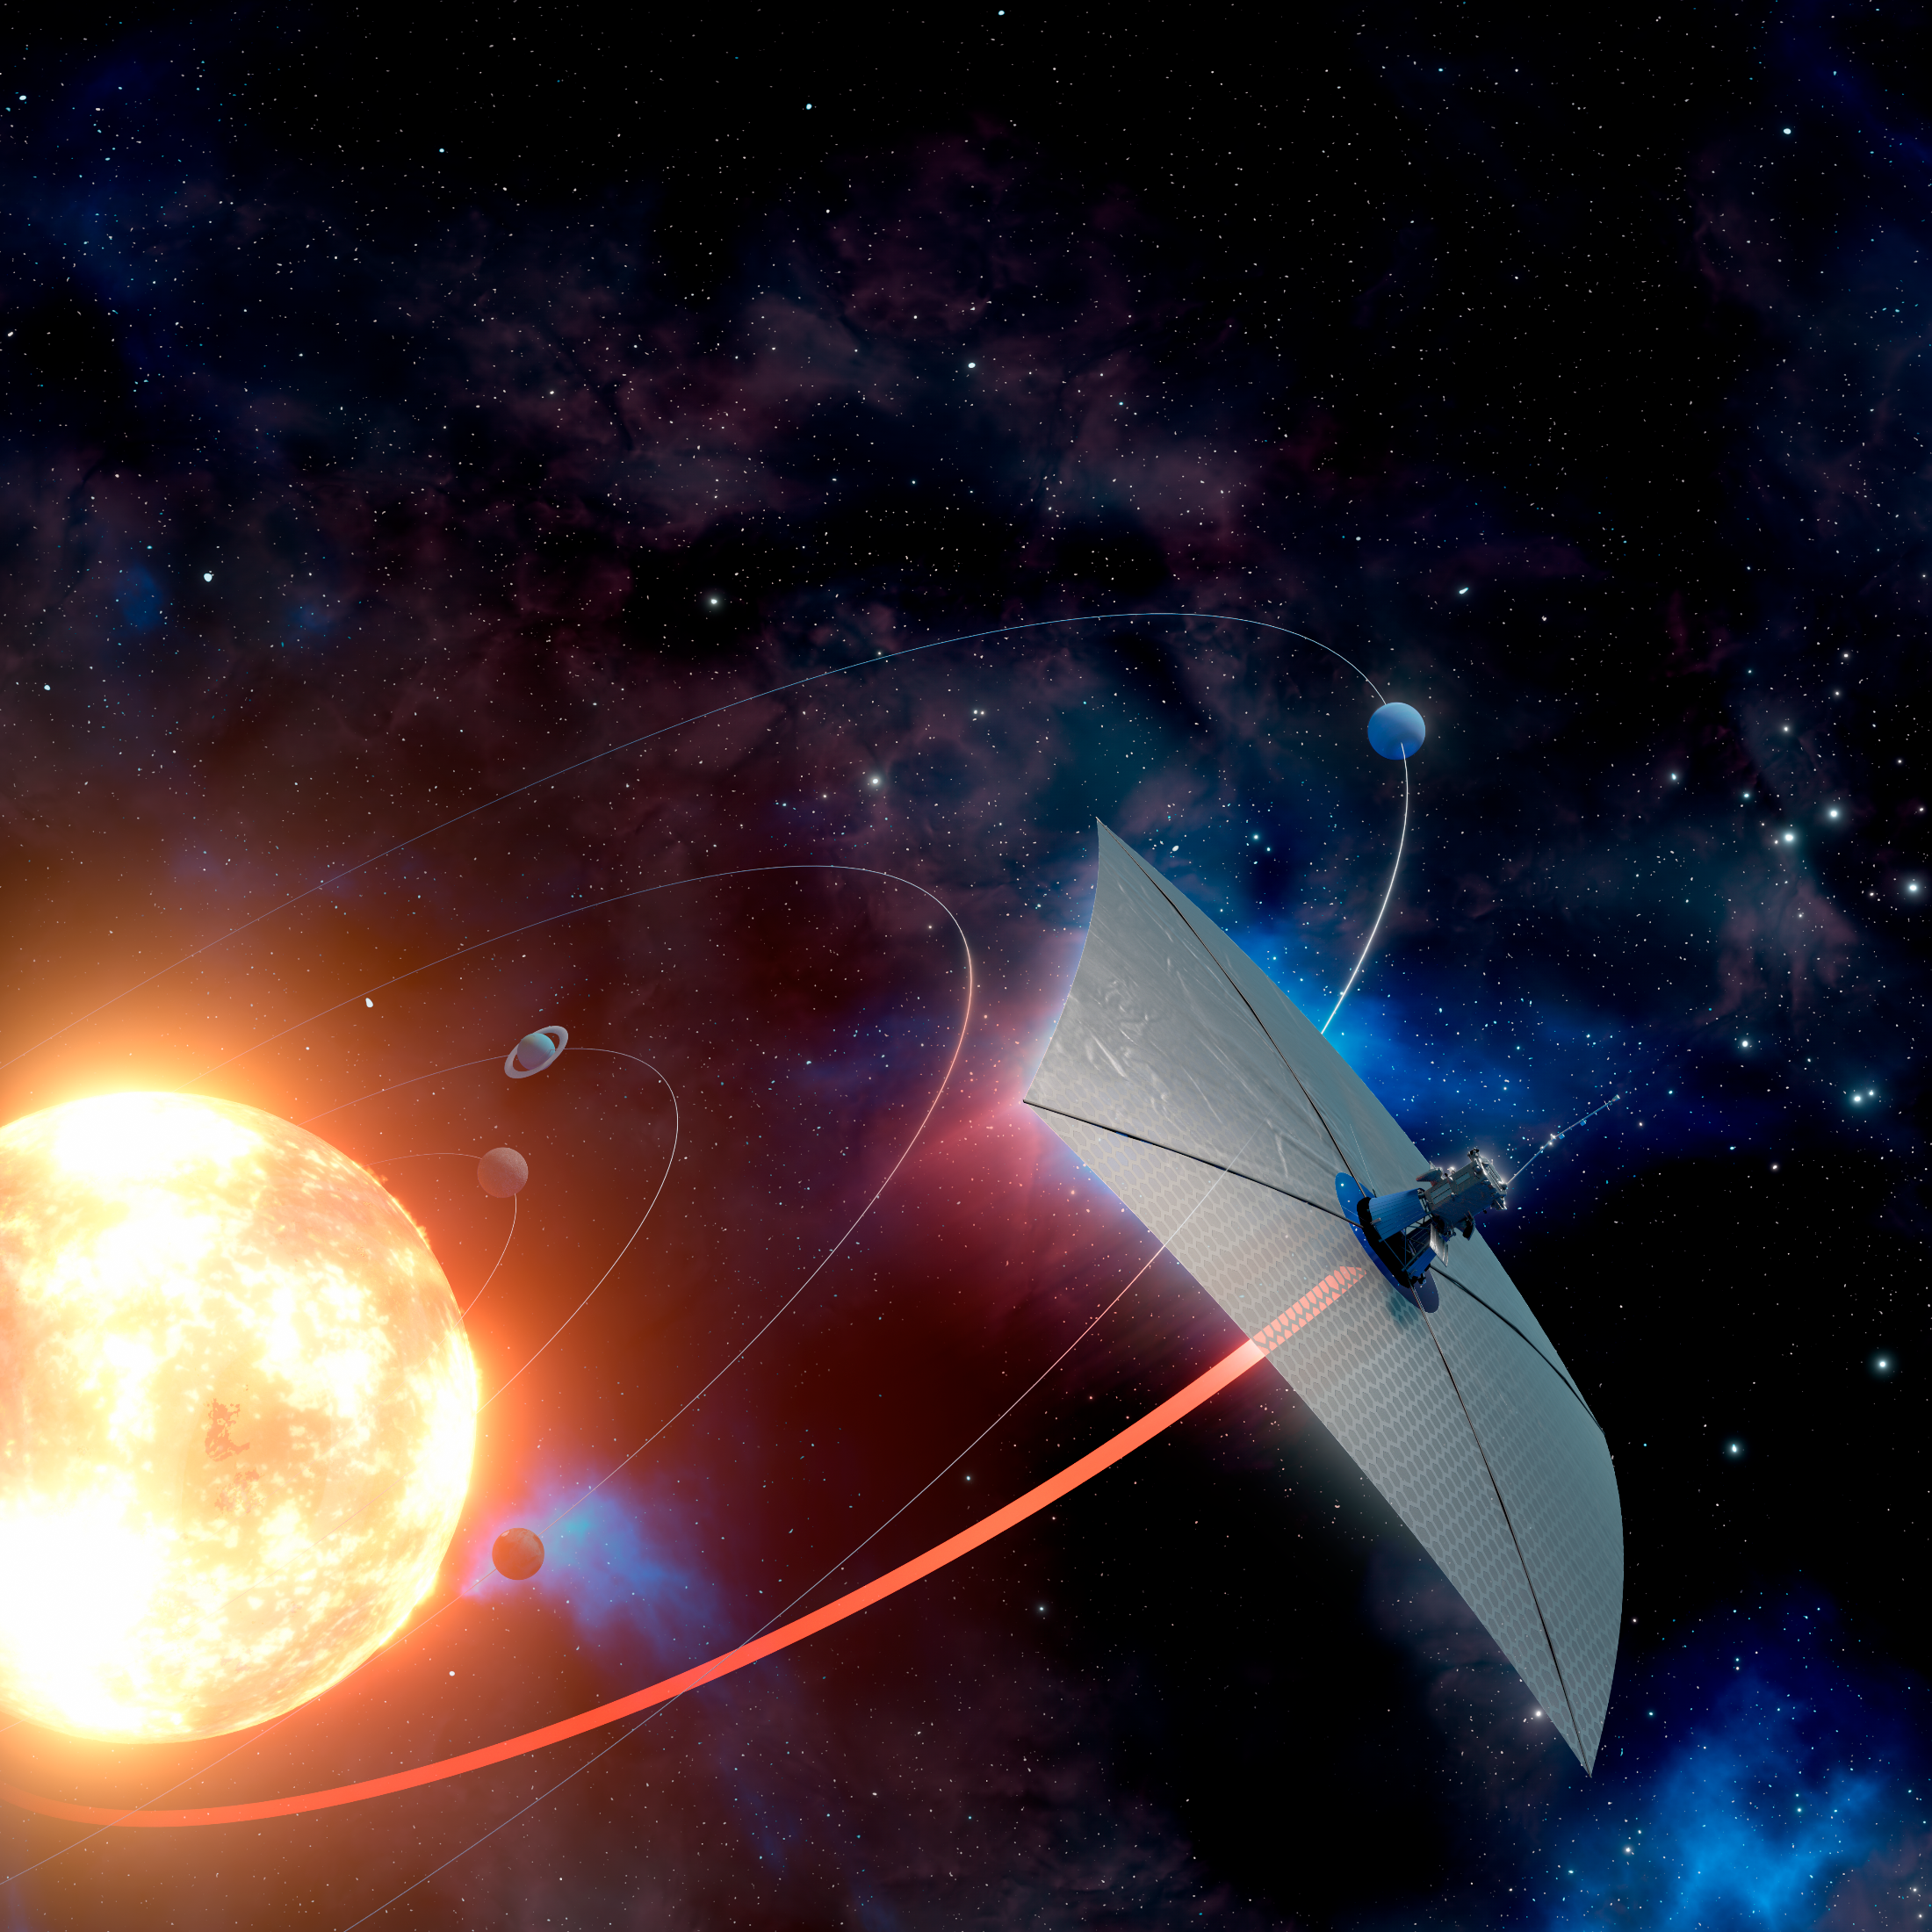


Thin-Film Kirigami Actuators for Solar Sail Attitude Control
Hanseong Jo

Slide 2
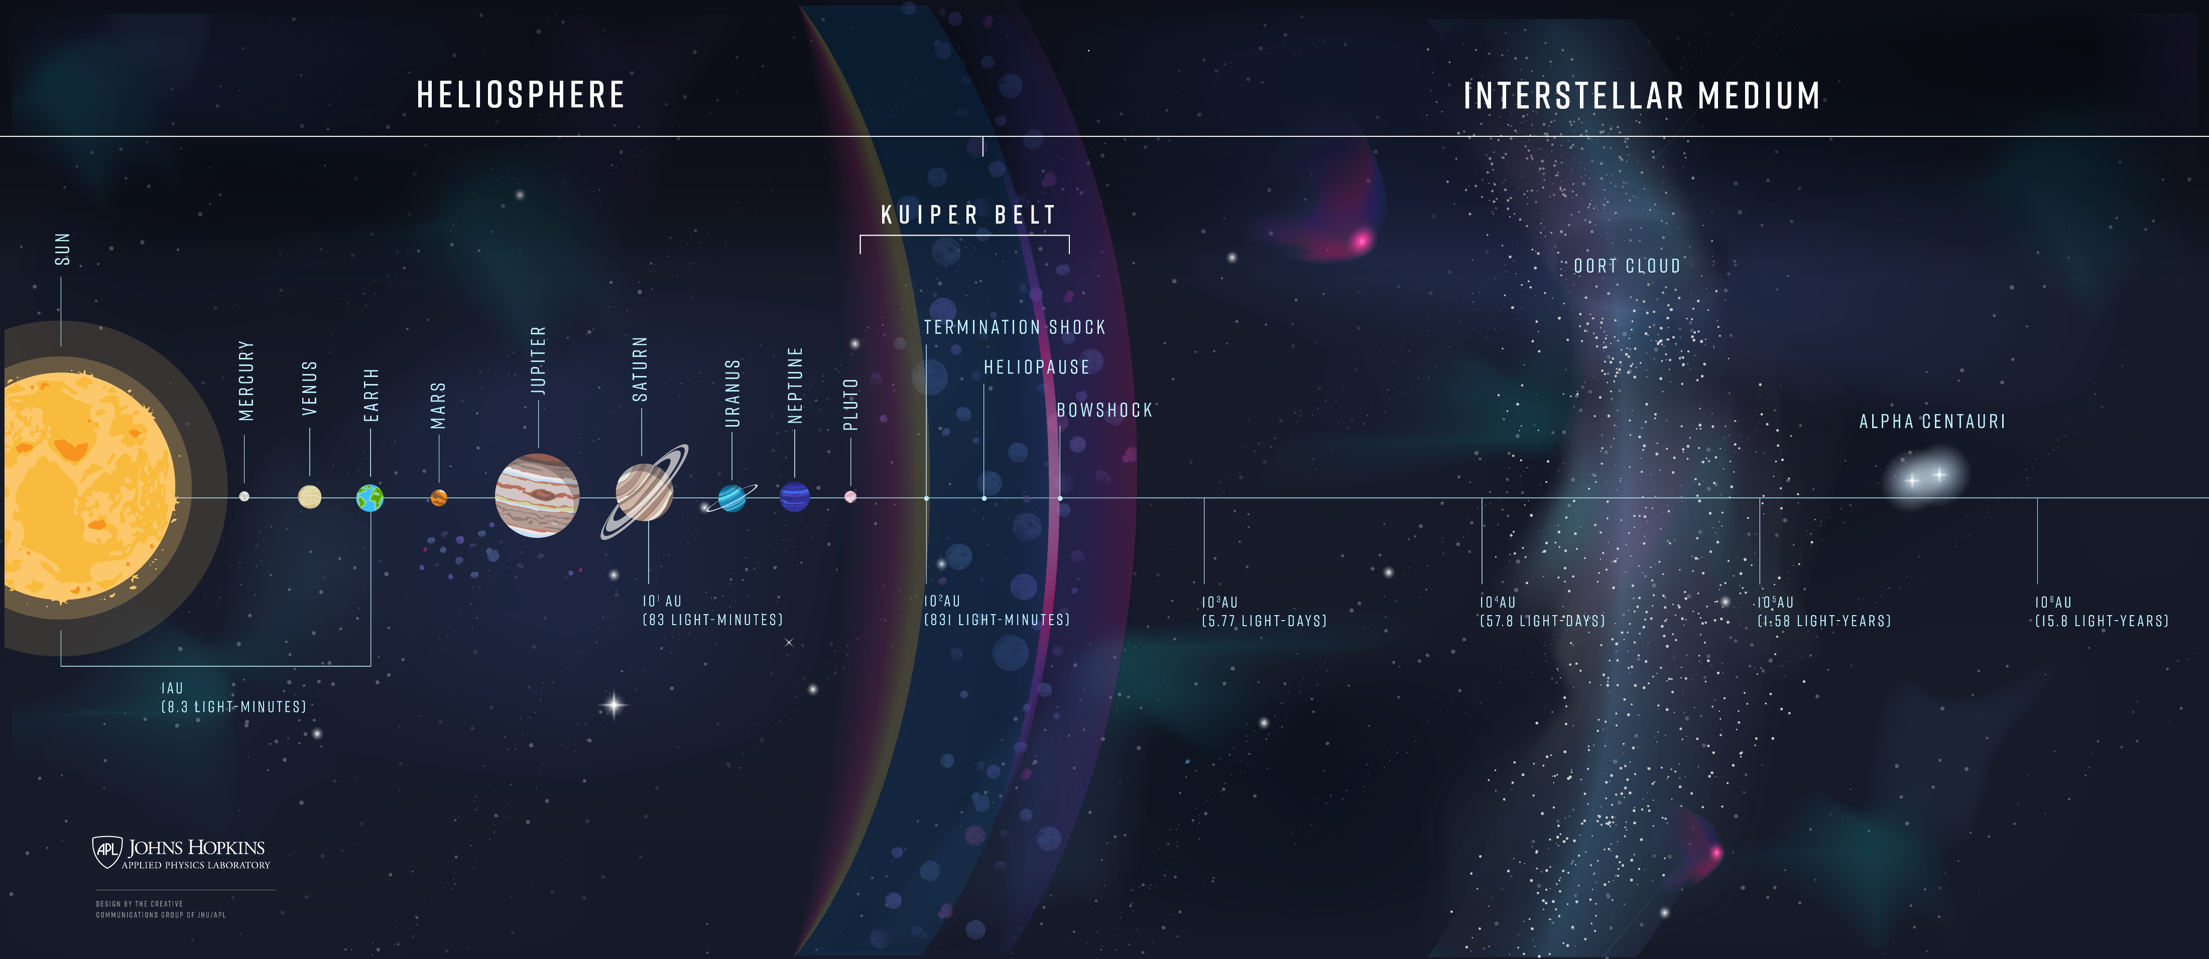

Current Status of Space Exploration
2 Missions
Voyager 1 (161 AU)
Voyager 2 (135 AU)
Credit: Johns Hopkins APL
Notes:
Smooth transition
voyager

Slide 3
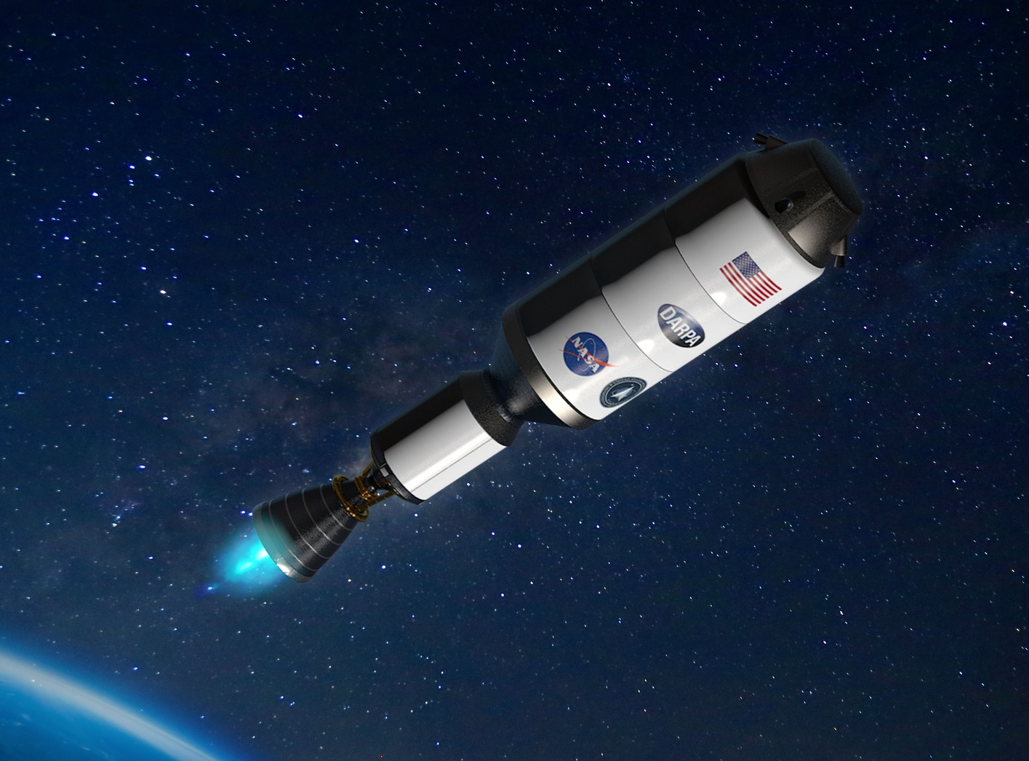
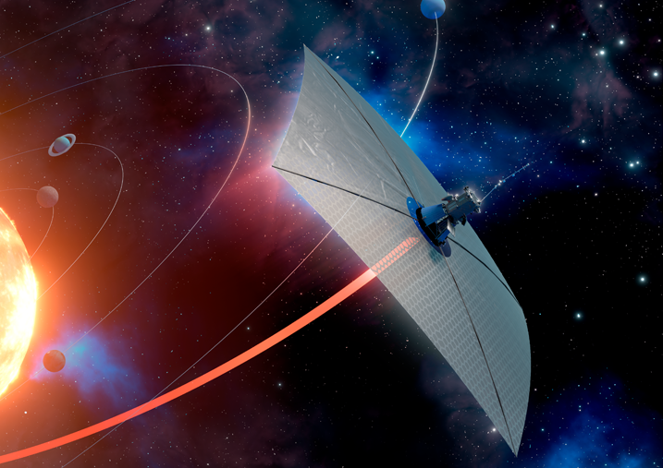
Solar Sail: Next Generation Propulsion
Rockets
Solar Sails
Notes:
Animate rockets, sails
Less detail
More comparison

Slide 4
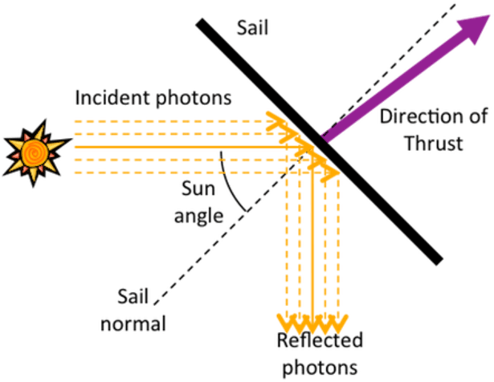
Solar Sails : Harnessing Solar Radiation Pressure for Propulsion
Solar radiation pressure
Credit: Adeli, Thesis, 2011
Solar radiation pressure (SRP) is everywhere
Small pressure & years of acceleration → very high delta V
Notes:
http://muonray.blogspot.com/2016/06
https://www.researchgate.net/figure/Solar-radiation-pressure-SRP-force-components_fig2_259869877/the-spacecraft-that-requires-no-fuel.html
Polish language (less detail)

Slide 5
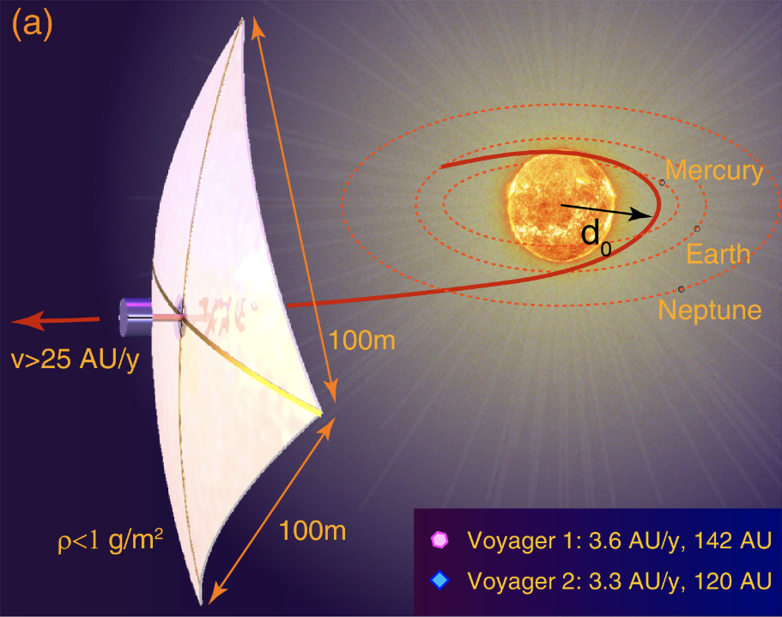
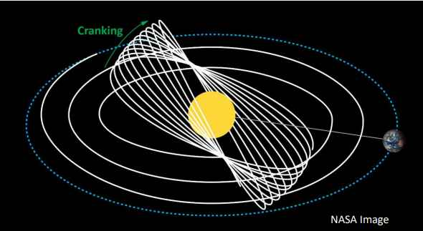
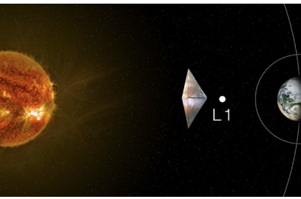
Solar Sails Enables New Possibilities
Continuous acceleration (very-high delta V) provides new possibilities
Fast Transit to Outer Space
High Heliocentric Inclination
New Trajectories & Locations
Credit: Davoyan et al., Optica, 2021
Credit: NASA
(sub-L1 Lagrange point)
Credit: NASA
Notes:
More explanation
Example (parker probe, station keeping, artificial orbit)
Animate

Slide 6
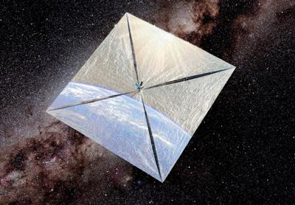
Control for Solar Sails: A Major Challenge
Thrust = (Pressure) X (Sail Area)
→ Ideal Solar Sailcraft:
Very large sail area
Extremely thin & lightweight sail
Minimal bus size & weight
→ Control : Challenge
Control scheme should be tailored for sails
Credit: Planetary Society
Notes:
Smooth transition
https://global.jaxa.jp/projects/sas/ikaros/

Slide 7
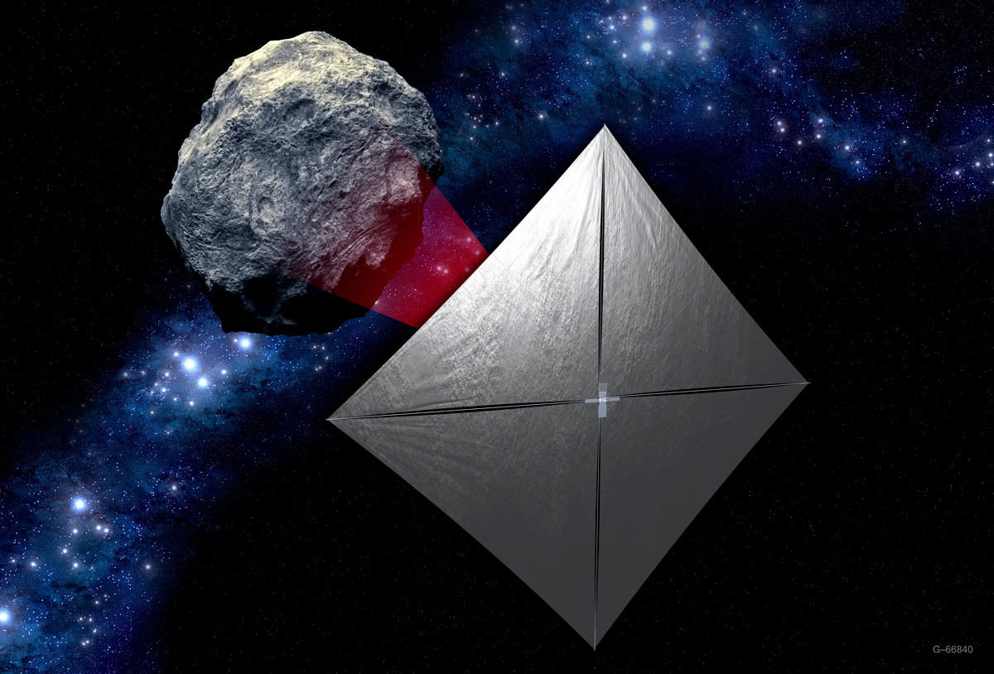
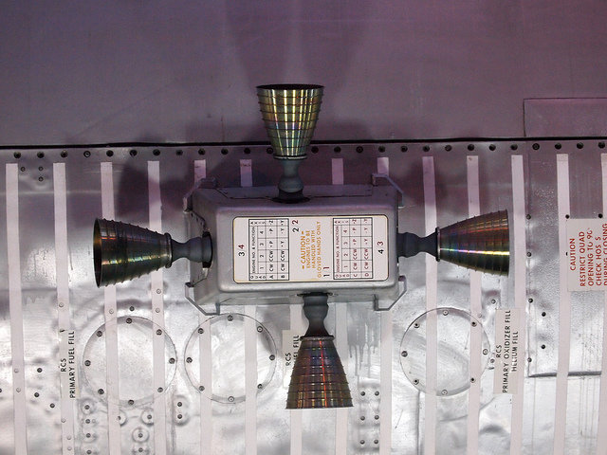
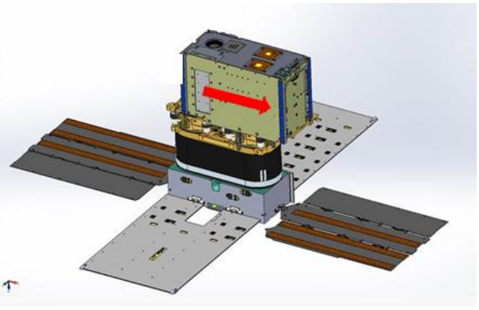
Existing Sail Attitude Control Systems – Mechanical
System is located at bus → difficult to scale
Used in NEA SCOUT
Credit: NASA
Credit: Orphee et al., AIAA Conf., 2018
Reaction control thruster
Active mass translation
Challenges: high mass & volume budget, not scalable
Notes:
Sub section name (difficult to scale)
Split into two slides
Animate
Can we make it better (for rcd)

Slide 8
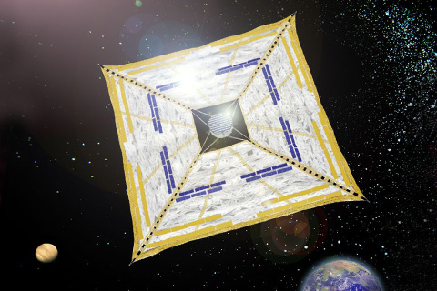
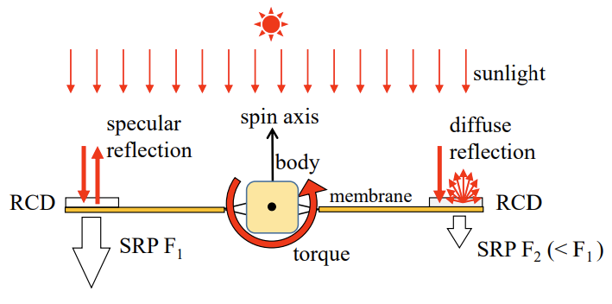
Existing Sail Attitude Control Systems - Optical
System is located on sail→ scalable
Used in IKAROS
Credit: Ishida et al., P. Int. Symp. Sp. Flt. D., 2017
Reflection control devices
Challenges: hard to achieve roll (no in-plane force), limited performance
Can we make it better?
Notes:
Sub section name (difficult to scale)
Split into two slides
Animate
Can we make it better (for rcd)

Slide 9
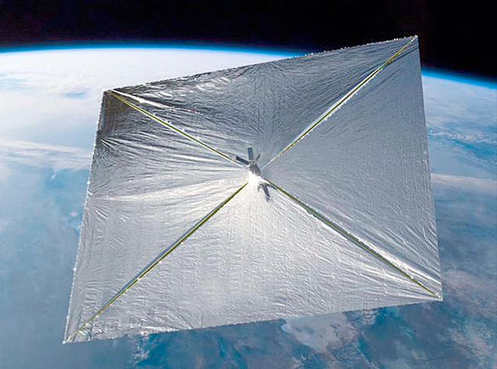
Plenty of Real Estate
Solar sail membrane is massive
Can we manipulate the membrane?
Notes:
Sub section name (difficult to scale)
Split into two slides
Animate
Can we make it better (for rcd)

Slide 10
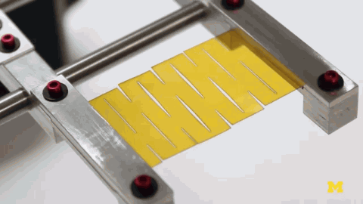
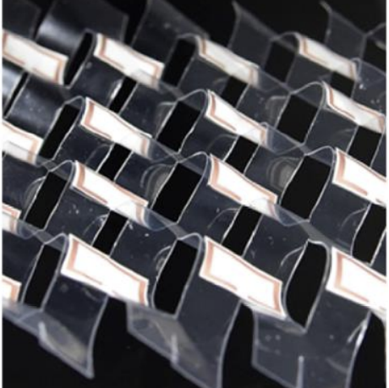
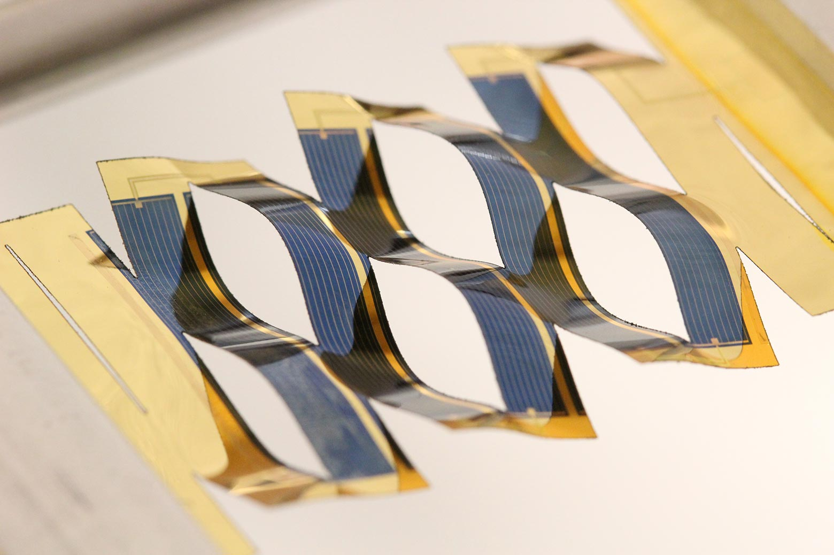
Engineered Membranes in Soft Robotics
Kapton
Resonance Array
Solar Trackers
Parallel-cut kirigami
Engineered thin polymers films has unique characteristics and are used for optical applications
Notes:
Picture of sail (membrane, real estate)
Play with membrane itself
Next slide – just kirigami (soft robotics, also made of Kapton)
Next slide – this slide
Animate
Kirigami smaller

Slide 11
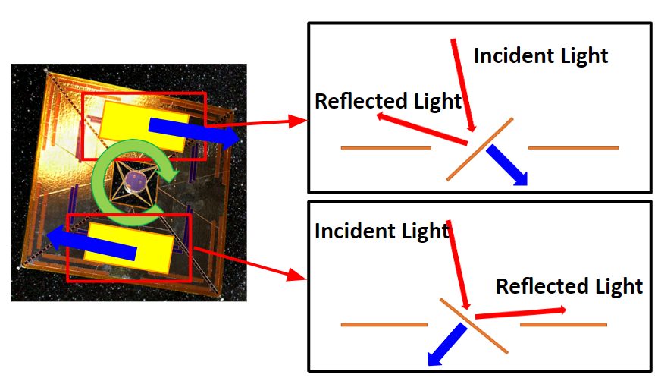
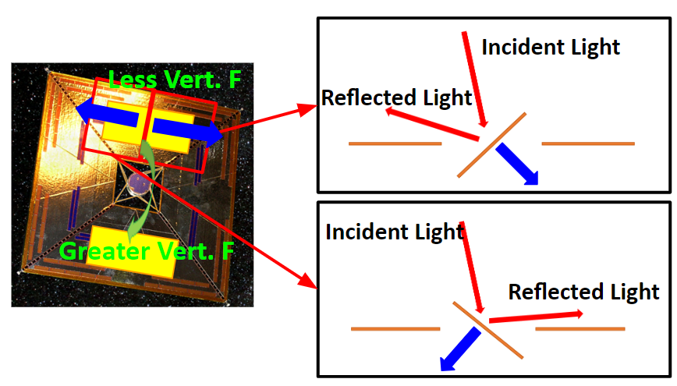
Proposed Embedded Thin-Film Control System
Changing the direction of the reflected light by manipulating the sail surface
Roll Maneuver
Pitch/Yaw Maneuver
Control system can be integrated into the sail film itself → simple, ultralight, deployable, scalable
Notes:
Picture of sail (membrane, real estate)
Play with membrane itself
Next slide – just kirigami (soft robotics, also made of Kapton)
Next slide – this slide
Animate
Kirigami smaller

Slide 12
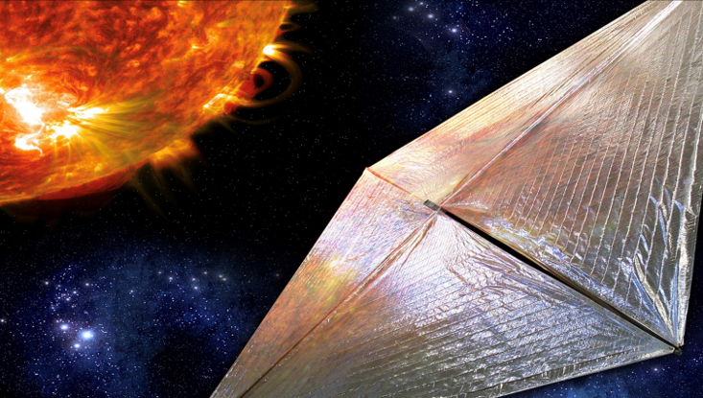
Kirigami Actuation on Solar Sails
Can we make kirigamis deform without stretching?
Can we electrically actuate kirigamis?
Can the entire system be integrated with the film?

Slide 13
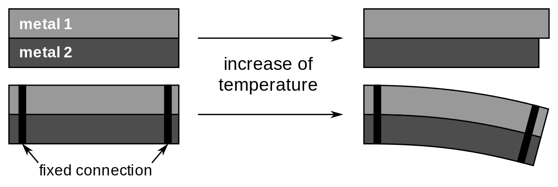
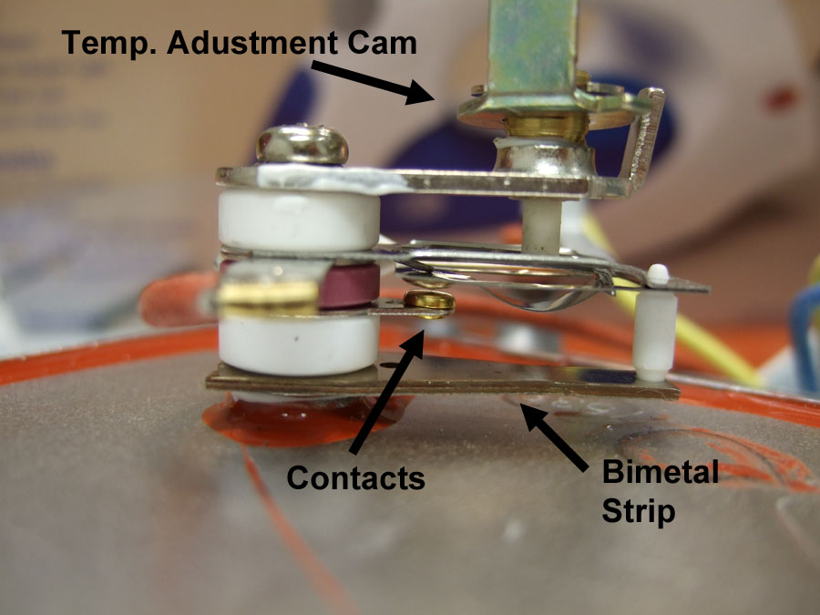
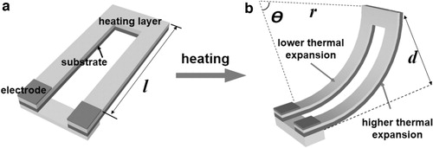
Thin Film Electric Actuators - Electrothermal Actuators
Working principle: Inspiration from bimetal strips
strain mismatch by heat → curvature
Heating by resistive heating
Notes:
Split into two slides
https://www.liebertpub.com/doi/10.1089/soro.2019.0164
https://pubs.acs.org/doi/full/10.1021/nn505535k?src=recsys

Slide 14
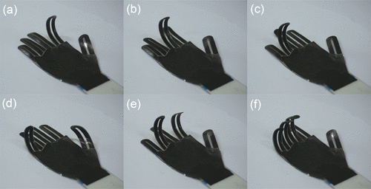
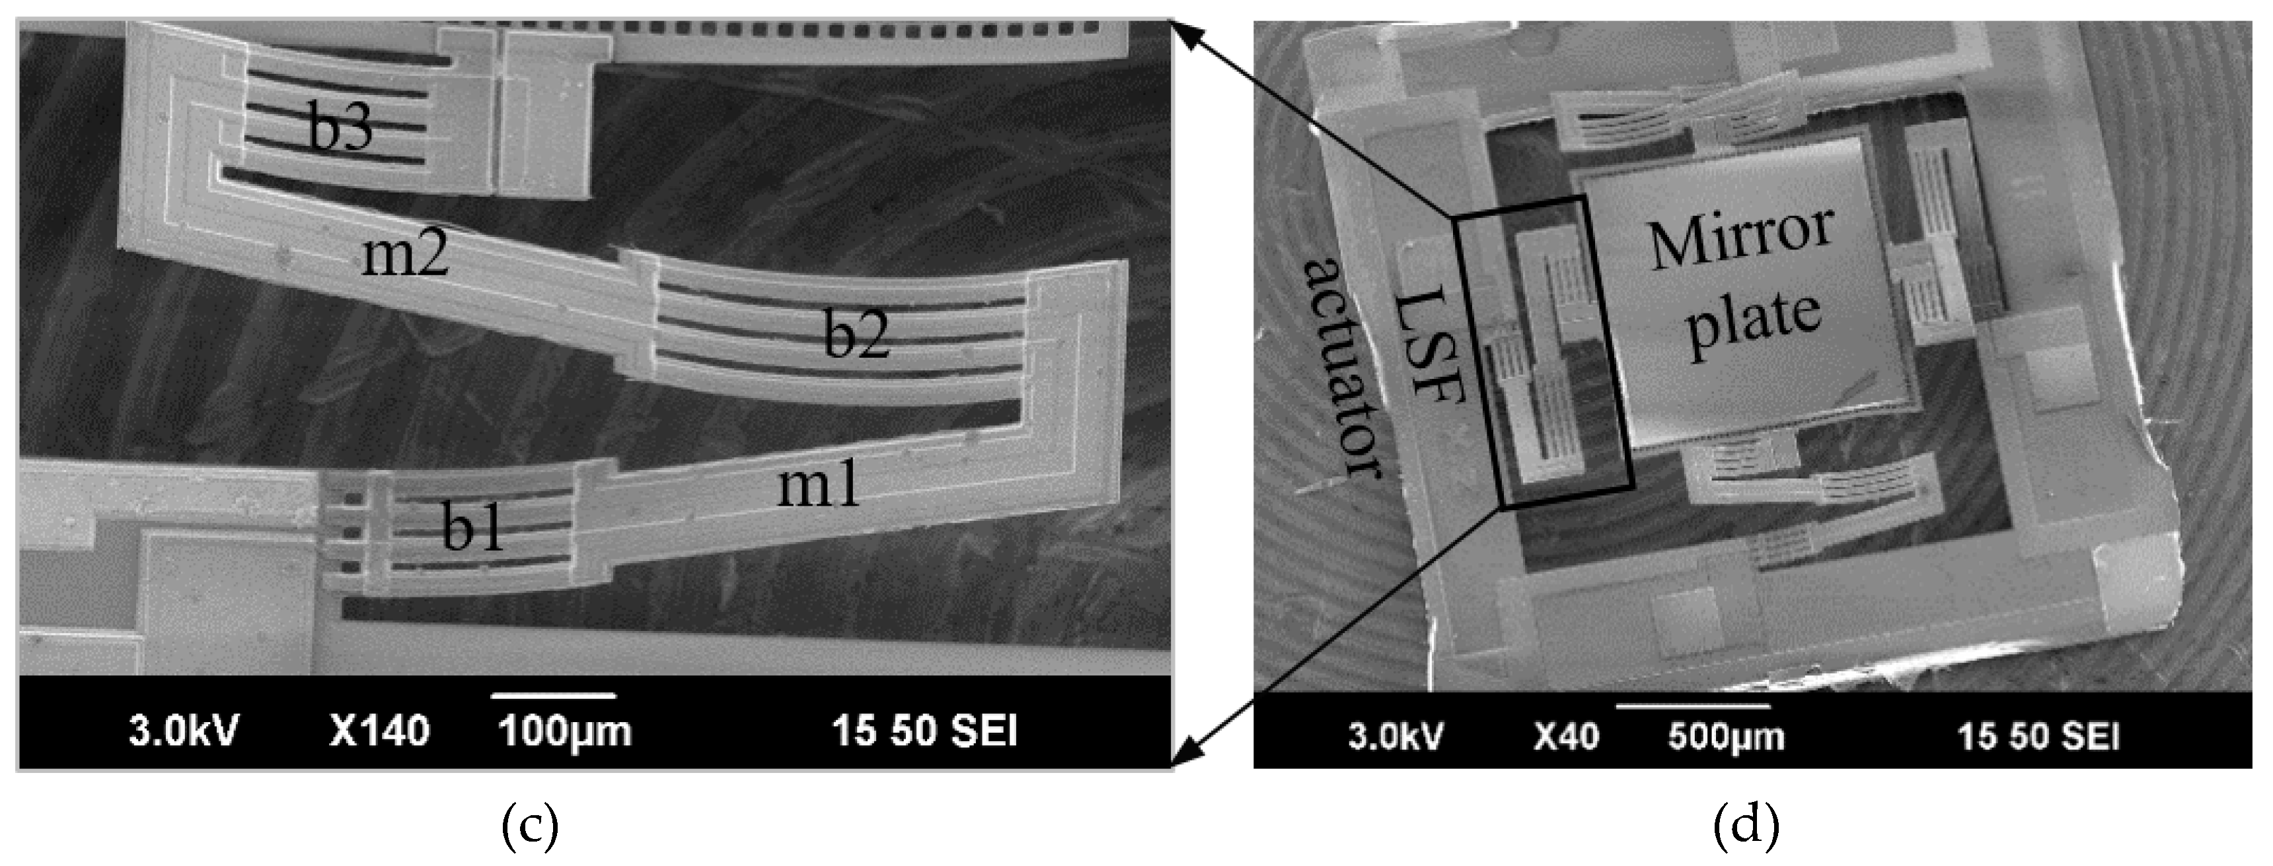
Thin Film Electric Actuators - Electrothermal Actuators
Wide applications in various fields
For MEMS micromirrors
Credit: Zhou et al., Micromachines, 2019
For soft robots
(artificial hand)
Credit: Li et al., ACS nano, 2015
Notes:
Split into two slides
https://www.liebertpub.com/doi/10.1089/soro.2019.0164
https://pubs.acs.org/doi/full/10.1021/nn505535k?src=recsys

Slide 15
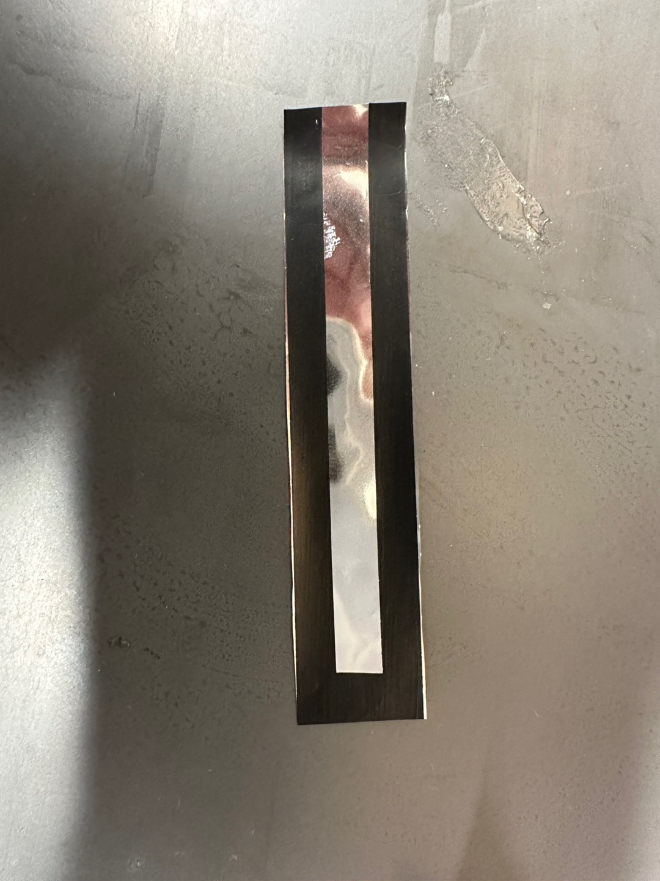
Electrothermal Actuators for Solar Sails
10 cm long, CNT (< 10 µm) - Mylar (10 µm) bimorph
Actuation at low power (<1 W) & low temperature rise (<10 °C)
CNT
V_{out}
Mylar
V_{in}
Notes:
Split into several slides
Image of sails
Next slide only actuation
Next slide – temperature

Slide 16
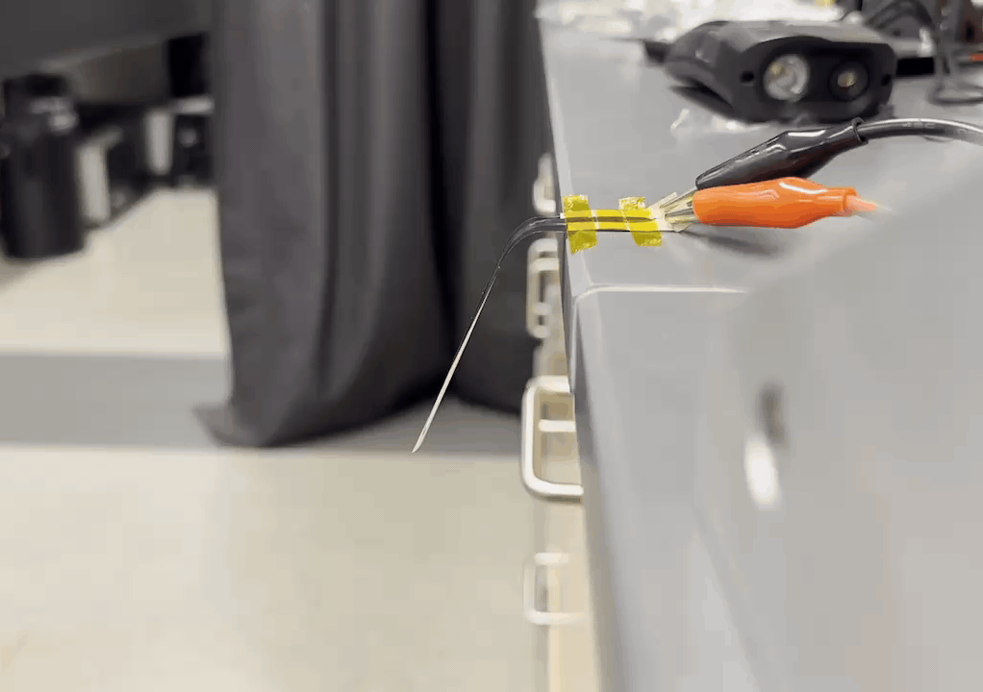
Electrothermal Actuators for Solar Sails
10 cm long, CNT (< 10 µm) - Mylar (10 µm) bimorph
Actuation at low power (<1 W) & low temperature rise (<10 °C)
CNT
Mylar
Actuation of more than 20°
Notes:
Split into several slides
Image of sails
Next slide only actuation
Next slide – temperature

Slide 17
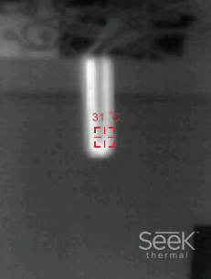
Electrothermal Actuators for Solar Sails
10 cm long, CNT (< 10 µm) - Mylar (10 µm) bimorph
Actuation at low power (<1 W) & low temperature rise (<10 °C)
CNT
Mylar
Temperature rise of only 9 °C
Notes:
Split into several slides
Image of sails
Next slide only actuation
Next slide – temperature

Slide 18
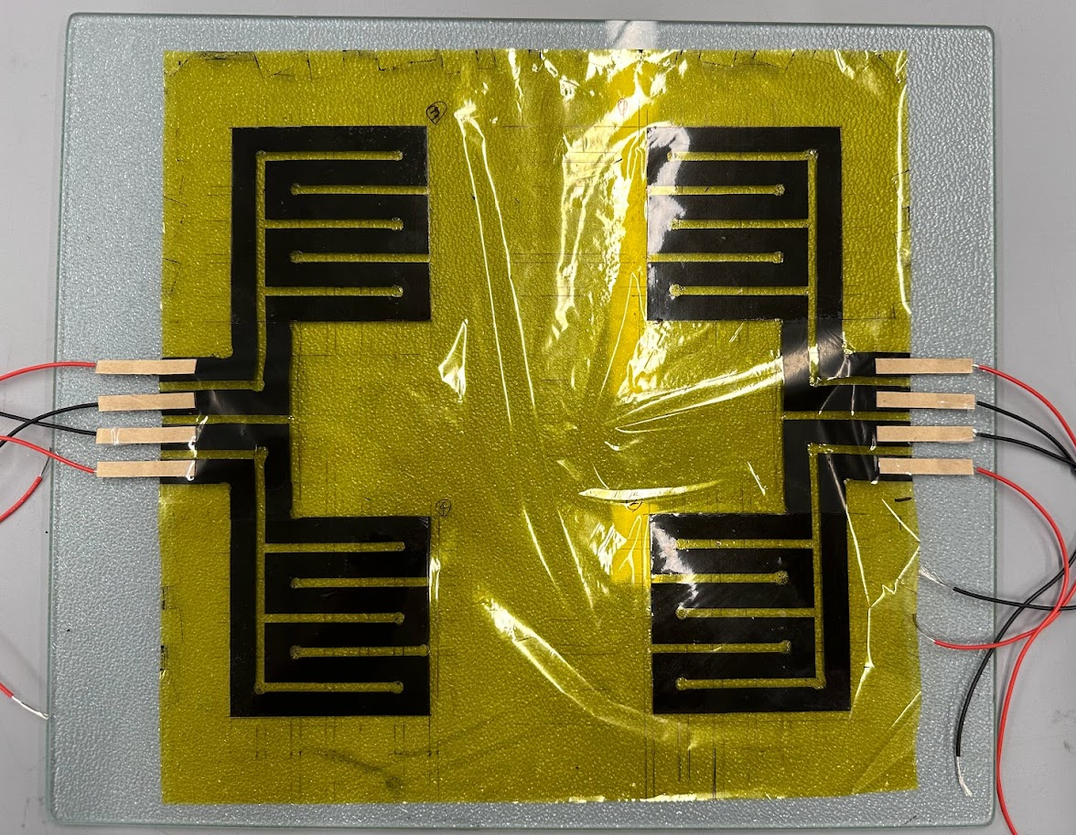
Surface Manipulation Using Electrothermal Actuators
Locally & Individually bulging out-of-plane continuous sheet
PP
PP
CNT
CNT
Kapton
Large sheet with multiple actuators
Notes:
Split into two slides
Image only in first slide
Video- how much does it actuate
Add another slide – curved and uncurved (schematic)
Better connection
Speak while video is playing

Slide 19
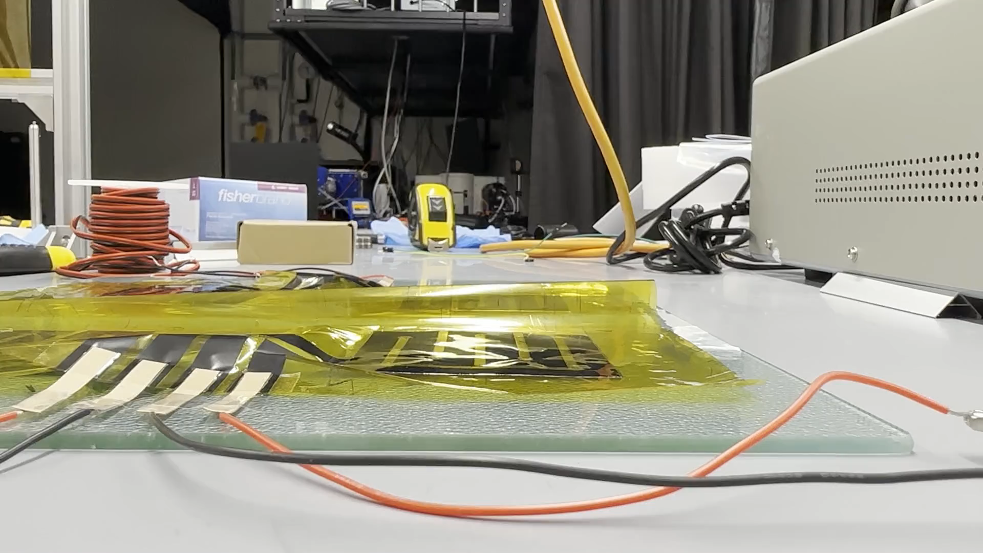
Surface Manipulation Using Electrothermal Actuators
Locally & Individually bulging out-of-plane continuous sheet
Large sheet with multiple actuators
Actuation Video (10x)
Notes:
Split into two slides
Image only in first slide
Video- how much does it actuate
Add another slide – curved and uncurved (schematic)
Better connection
Speak while video is playing

Slide 20

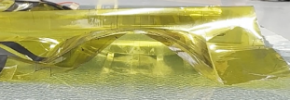
Surface Manipulation Using Electrothermal Actuators
Smaller Radiation Pressure
Greater Radiation Pressure
Can be used to control radiation pressure
Notes:
Split into two slides
Image only in first slide
Video- how much does it actuate
Add another slide – curved and uncurved (schematic)
Better connection
Speak while video is playing

Slide 21
Surface Manipulation Using Electrothermal Actuators – Adding Cuts
Electrothermal actuators create curvature mimicking buckled shape of kirigamis.
PP
PP
CNT
CNT
Kapton
CNT
Joule heating
CNT
PP
PP
Notes:
Separate slide
Both side coated, cuts instead of kirigami
Radiation pressure
Expand bi-directional
Kirigami application to solar sail
Actual sail application

Slide 22
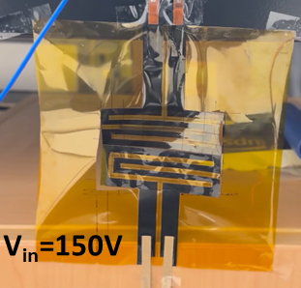
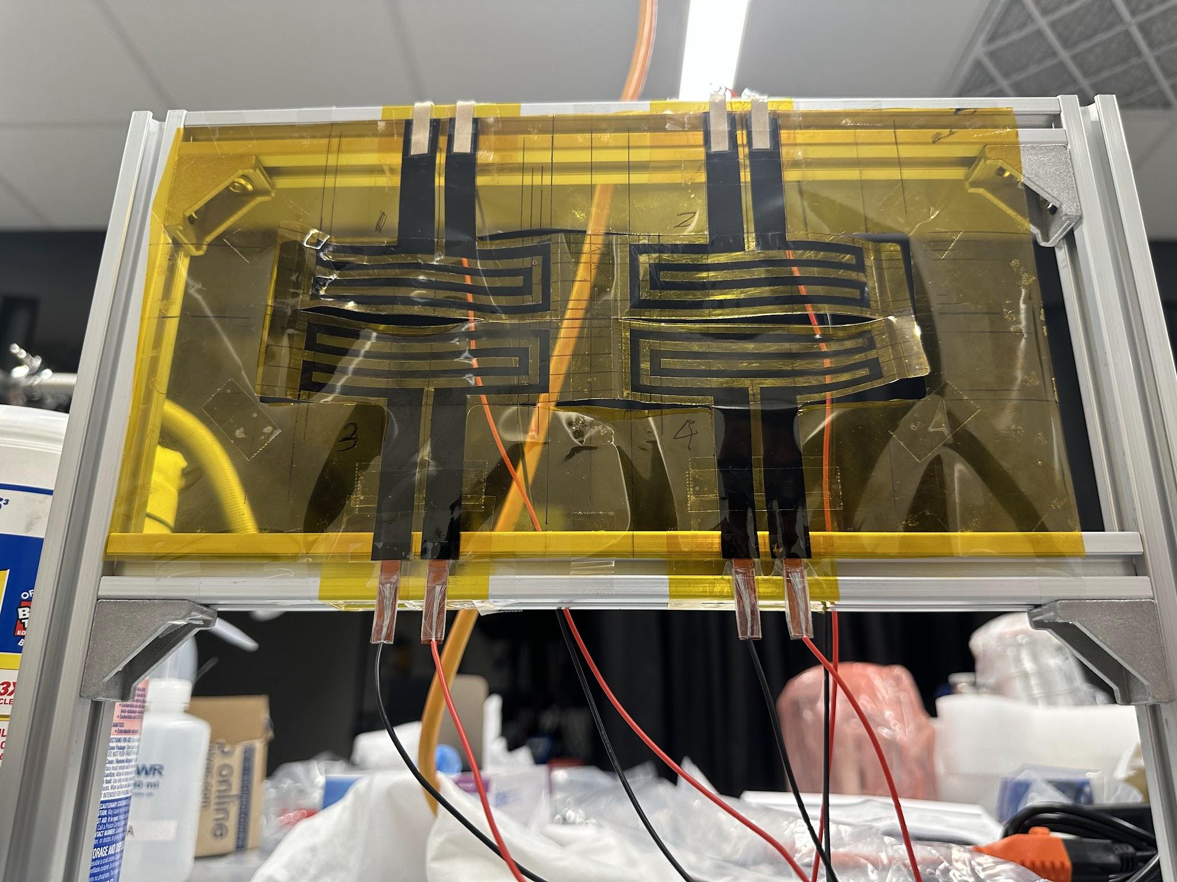
Surface Manipulation Using Electrothermal Actuators – Adding Cuts
Electrothermal actuators create curvature mimicking buckled shape of kirigamis.
Single-cell
Double-cell
Notes:
Separate slide
Both side coated, cuts instead of kirigami
Radiation pressure
Expand bi-directional
Kirigami application to solar sail
Actual sail application

Slide 23
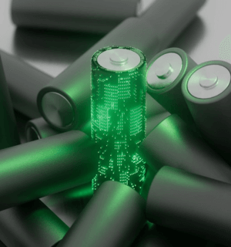
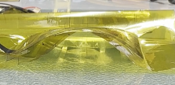
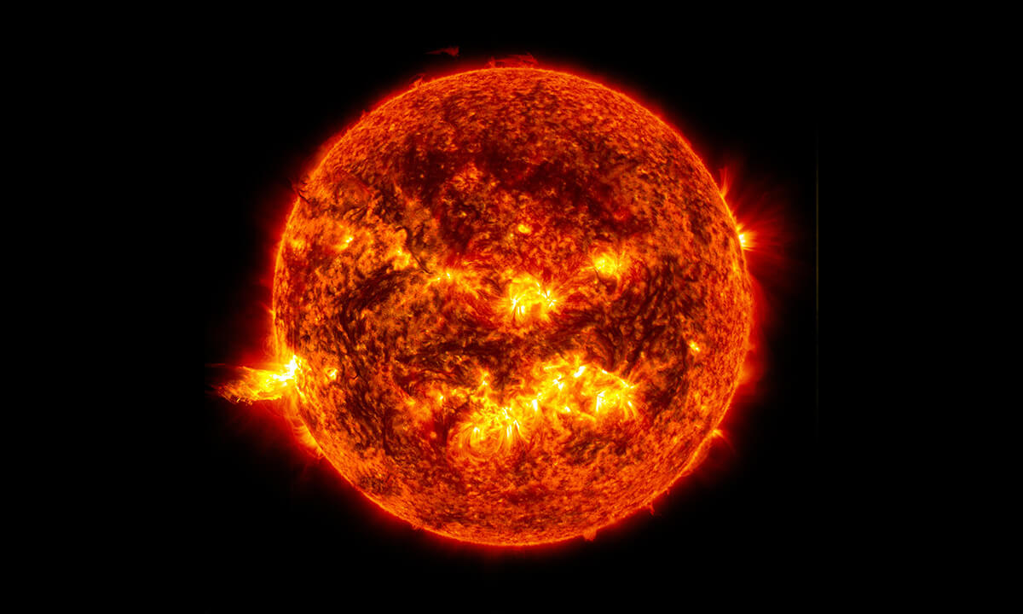
Critical Issue - Heat Sensitivity
Conventional electrothermal actuators are affected by any heat sources
Electric Power
Heat in Actuators
Actuation
Joule
Heating
Strain
Mismatch
Solar Flux
Heat in Actuators
Strain
Mismatch
Radiative
Heating
Notes:
Put actuator picture in the slide
visualize
Expand bi-directional
Kirigami application to solar sail
Actual sail application

Slide 24
How to Handle Heat Sensitivity Problem
Heater & 2nd layer on both sides → heat resistivity, bi-directionality
2nd layer
2nd layer
CNT
CNT
1st layer
1st layer
CNT
Conventional design
2nd layer
New design
2nd layer
CNT
Radiative
Heating
1st layer
CNT
2nd layer
Notes:
Split into several slides
Asymmetric
Comsol image – powerpoint image
Expand bi-directional
Kirigami application to solar sail
Actual sail application

Slide 25
How to Handle Heat Sensitivity Problem
Heater & 2nd layer on both sides → heat resistivity, bi-directionality
2nd layer
Joule
Heating
CNT
1st layer
CNT
2nd layer
2nd layer
Joule
Heating
CNT
1st layer
CNT
2nd layer
How to selectively heat layers?
Notes:
Split into several slides
Asymmetric
Comsol image – powerpoint image
Expand bi-directional
Kirigami application to solar sail
Actual sail application

Slide 26
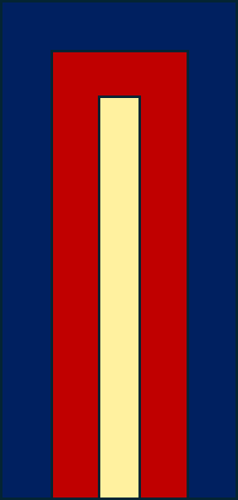
Selectively Heating Layers
Non-overlapping heater design enables selective heating
z
y
x
Below Film
Above Film
Heater Design
Extremely thin membrane:
Efficient Heat Transfer in z direction,
Inefficient Heat Transfer in xy direction
Notes:
Split into several slides
Asymmetric
Comsol image – powerpoint image
Expand bi-directional
Kirigami application to solar sail
Actual sail application

Slide 27
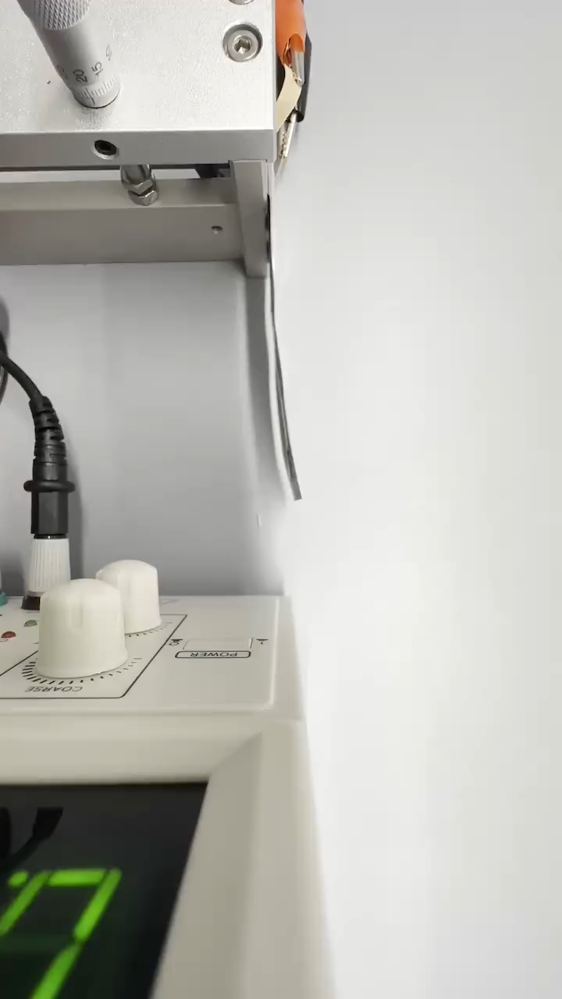
Selectively heating layers
2nd layer
Joule
Heating
CNT
1st layer
CNT
2nd layer
2nd layer
Joule
Heating
CNT
1st layer
CNT
2nd layer
Demonstration of Selective Actuation
Notes:
Split into several slides
Asymmetric
Comsol image – powerpoint image
Expand bi-directional
Kirigami application to solar sail
Actual sail application

Slide 28
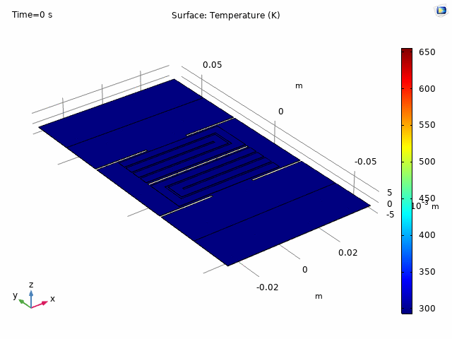
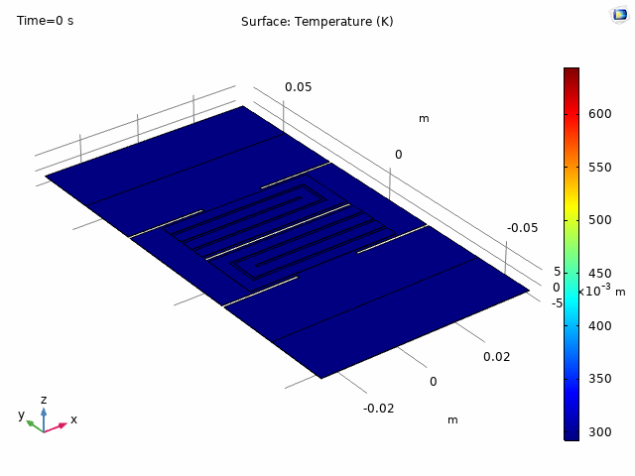
Application to Complex Designs - Bi-directional Kirigami
Using the concept of bi-directional bimorph actuators, kirigamis can be actuated in 2 directions
Simulation of a bi-directional kirigami actuator
Notes:
Split into two actuator

Slide 29
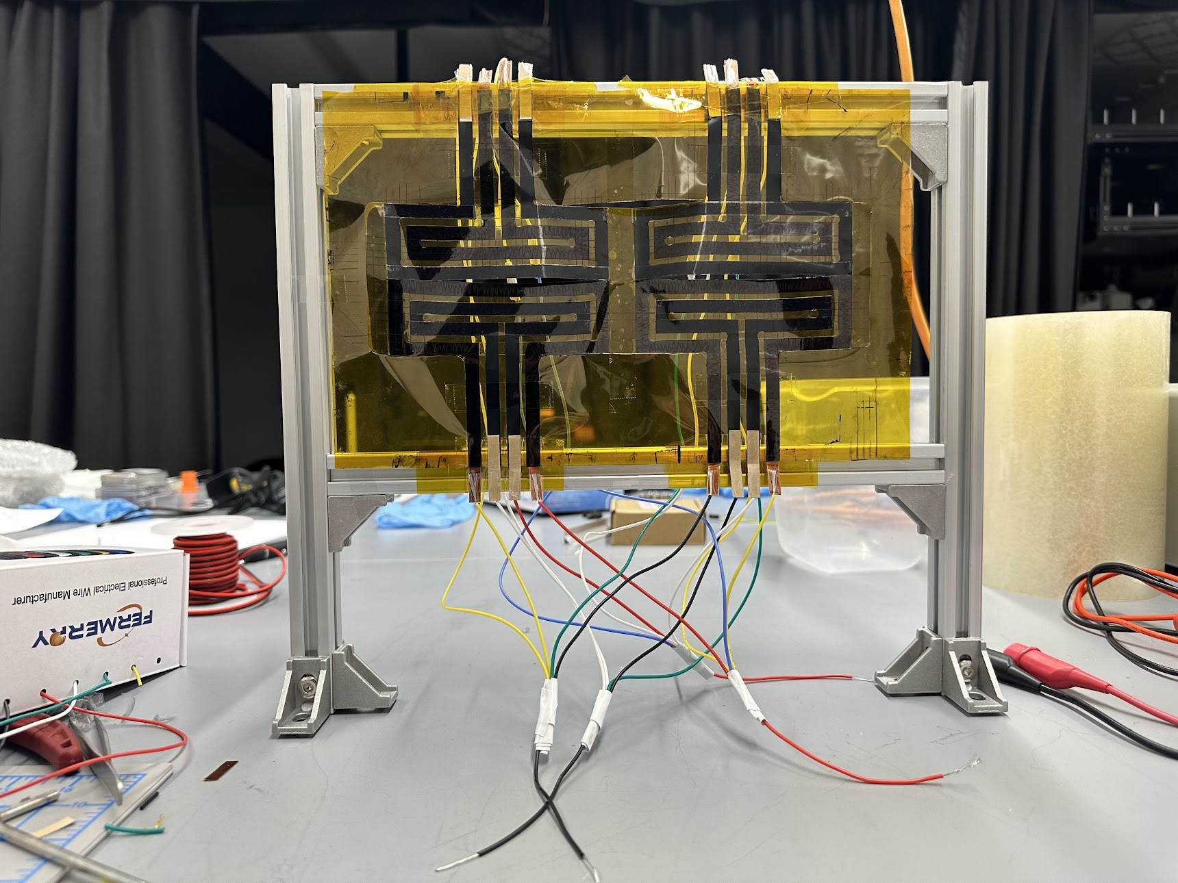
Application to Complex Designs - Bi-directional Kirigami
Using the concept of bi-directional bimorph actuators, kirigamis can be actuated in 2 directions
Fabricated bi-directional kirigami actuator
Notes:
Split into two actuator

Slide 30
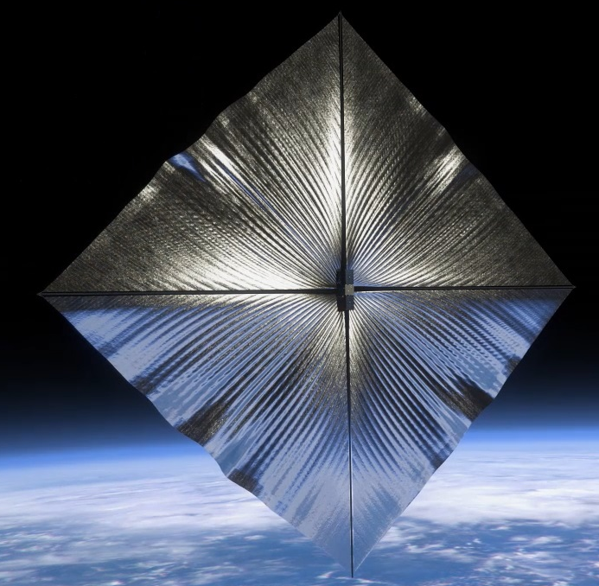
Summary
Thin-film Kirigami metasurface actuator can control all degree of freedom
System can be directed applied onto the sail → Scalable & Deployable & Lightweight
System is also resistant to ambient heat

Slide 31
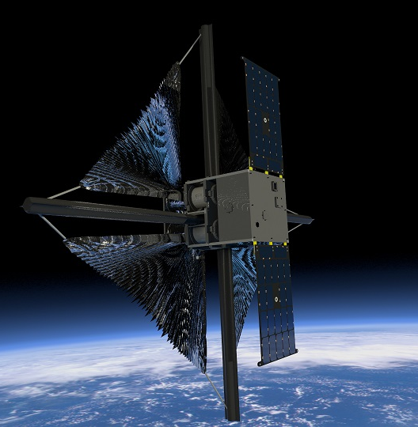
Other Issues and Improvements
1. Better thrust control
Can we change how light reflects fundamentally?
Can we generate in-plane forces directly?
2. Materials
Can we get closer to the sun?
Can we improve optical performance?
Can we reduce the weight and thickness?
Credit: Rocket Lab USA

Slide 32
Anomalous Reflecting Metasurfaces
Specular Reflection
Anomalous Reflection
Incident angle = Reflected angle
No in-plane forces
Incident angle < Reflected angle
In-plane forces directly generated
Notes:
Image of a sail
Thrust vector to both images

Slide 33
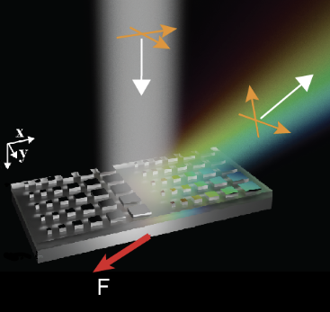
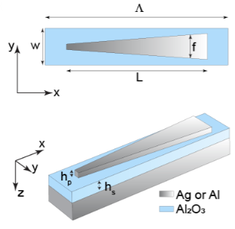
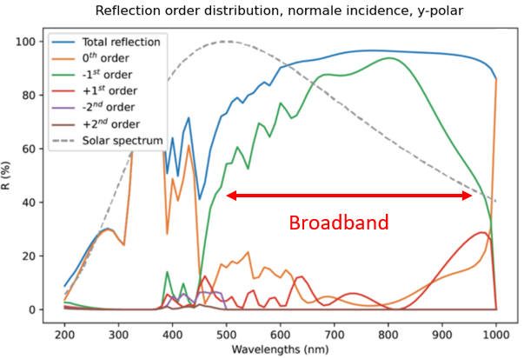
Anomalous Reflecting Metasurfaces
Anomalous reflecting metasurfaces can generate in-plane forces directly
Design optimized for broadband solar spectrum
Design
Reflectance Spectra
Notes:
Pattern and sunlight

Slide 34
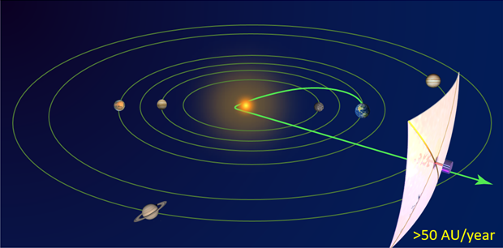
Materials to Get Closer to the Sun
Benefits:
More Delta-V
Better Solar Missions
Challenges
High temperature
Plasma
Lightweight Materials
Notes:
Not too much detail

Slide 35
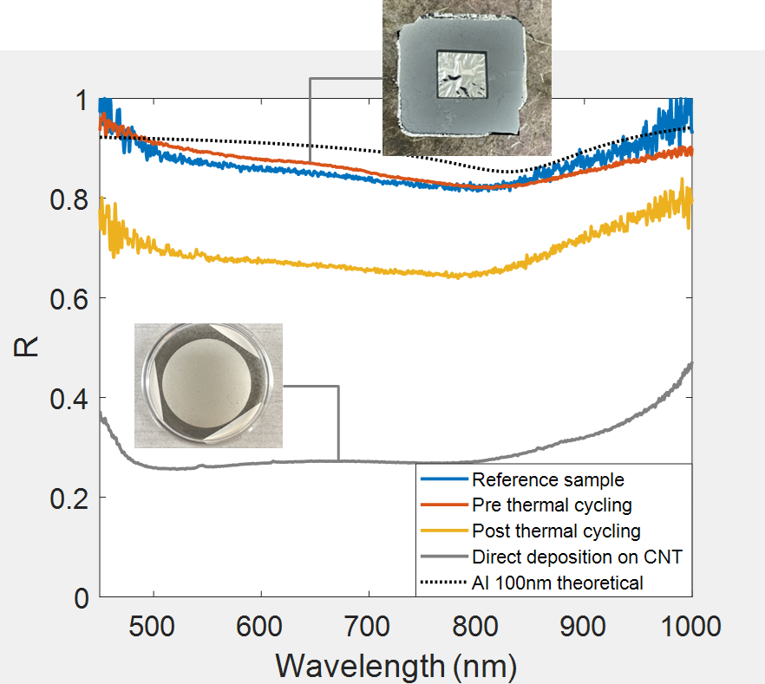
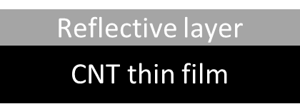


Sail Materials – Ultrathin CNT Films with Specular Reflective Coatings
New fab approach to make optically smooth coatings on CNT films
Lightweight, high heat resistivity, plasma resilience
Specular reflective
(front side)
Back side
(CNT)
Reflectance Spectra
Notes:
Not too much detail

Slide 36


Team and Acknowledgements
Team
Prof. Artur Davoyan, Hanseong Jo, Tom Joly-Jehenne, Ho-Ting Tung, Christopher Le, Howard Trinh, Isaac Shih, Caden Chan
Collaborators
L. Johnson, A. Heaton, S. Mahmooda, H. Helvajian, M. Velli,, S. Turyshev, D. Garber, L. Friedman
Notes:
Grateful for funding agencies

