Slide 1

SunRISE Opening a New Window on the Sun
Sun Radio Interferometer Space Experiment
James P. Lux (Jet Propulsion Laboratory, California Institute of Technology)
With help from:
Justin C. Kasper (University of Michigan)
T. Joseph W. Lazio
(Jet Propulsion Laboratory, California Institute of Technology)
Andrew Romero-Wolf (Jet Propulsion Laboratory, California Institute of Technology)
Cate Heneghan (Jet Propulsion Laboratory, California Institute of Technology)
Tim Neilsen (Space Dynamics Laboratory)
And many, many others!
CL # 24-1985
The cost information contained in this document is of a budgetary and planning nature and is intended for informational purposes only. It does not constitute a commitment on the part of JPL and/or Caltech.

Slide 2
SunRISE is Different
SunRISE opens a new spectral window for observation of radio frequency (RF) signals
  Frequencies from 100 kHz to 23 MHz are blocked and distorted by Earth’s ionosphere.
  We will get images of the Sun, at radio frequencies.
SunRISE is using a ride share
  The ride has changed, but most of the mission didn’t change
  Scheduling when you have a rideshare is a challenge – hurry up and wait
SunRISE is doing (literally) big science on a small budget
  A >10 km aperture instrument in space for $70M using half a dozen shoebox sized space vehicles.
  Surprisingly, we don’t need more than shoebox-size SVs. These are the right vehicles for the job.
SunRISE is an instrument made up of six space vehicles (the observatory) and ground processing
  Sort of turns the spacecraft with multiple instruments on its head.

Slide 3
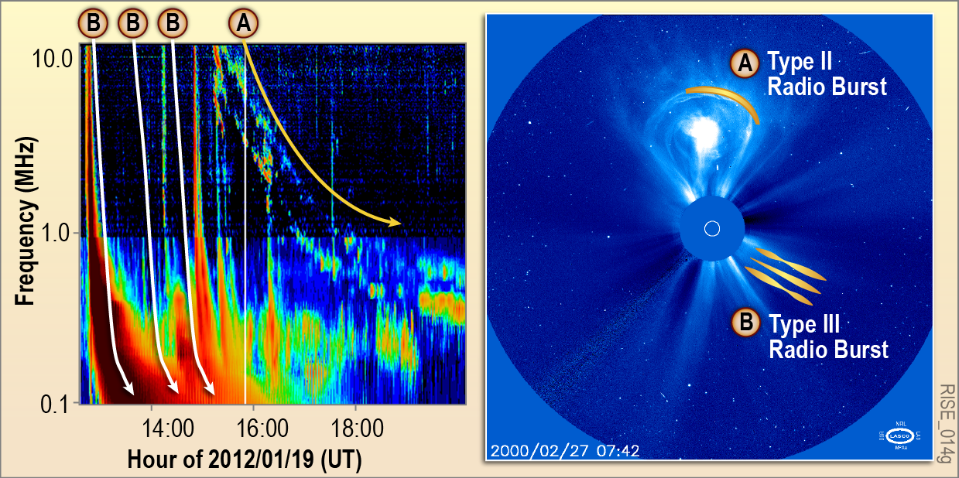
What SunRISE images:
Solar Radio Bursts: Type II and III
Notes:
In order to address these Decadal Survey-level goals, the SunRISE mission focuses on two classes of solar radio emission, Type II and Type III solar radio bursts.
The panel on the left shows a dynamic spectrum from the Wind/WAVES instrument.
On the horizontal axis or abscissa is the time; on the vertical axis or ordinate is the frequency.
The color scale shows intensity, on a logarithmic or dB scale.
The right panel shows a white-light coronagraphic image from the LAASCO instrument on SOHO. The Sun itself is occulded, so the small white circle is intended to represent the Sun's disk. A coronal mass ejection (CME), the feature oriented toward the top of the slide, is seen lifting off the Sun.
Two features are apparent in the Wind/WAVES dynamic spectrum.

Slide 4
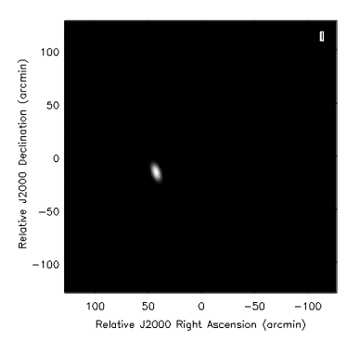
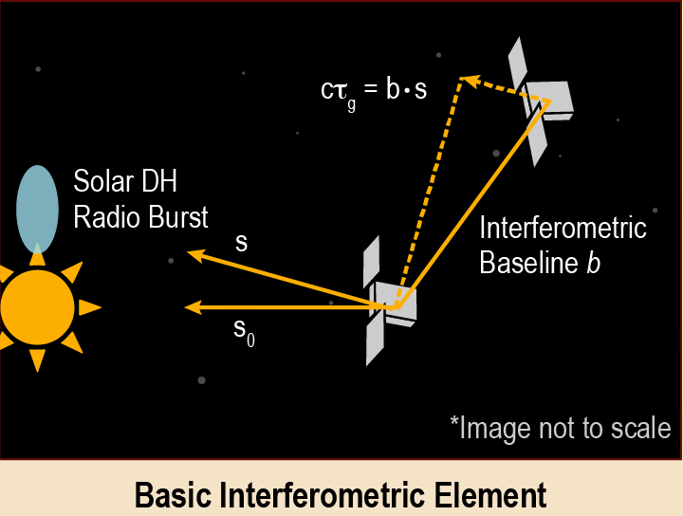
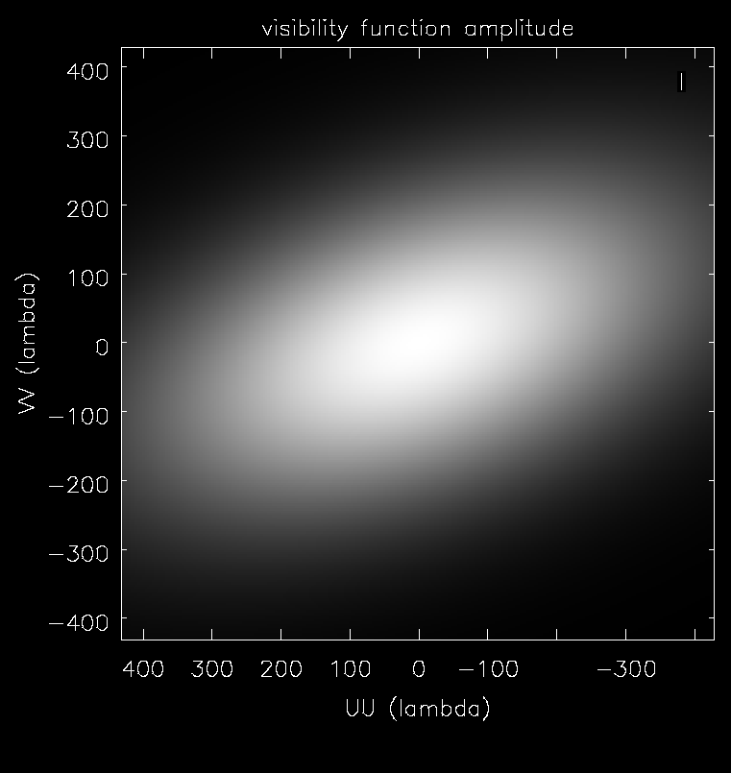
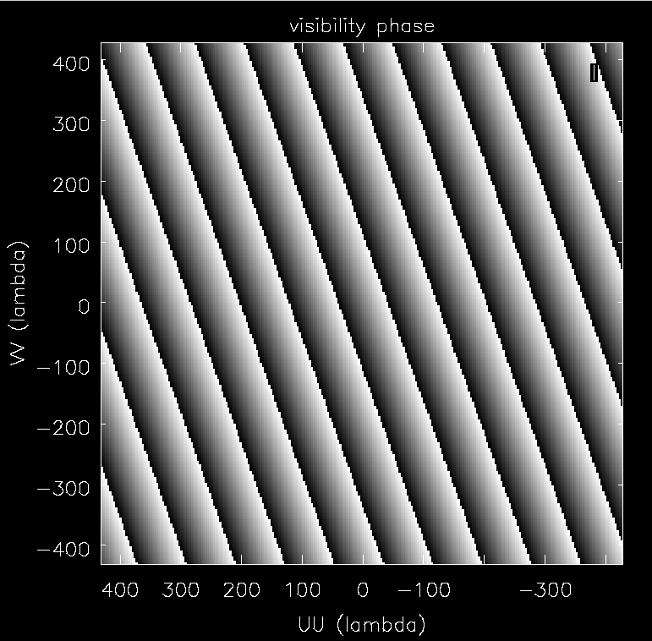
Interferometer for Imaging
SunRISE combines visibilities from all unique baselines (15 for N=6)
Requires knowing position and time accurately (~1m, ~1ns)
Fourier transform
amplitude
phase

Slide 5
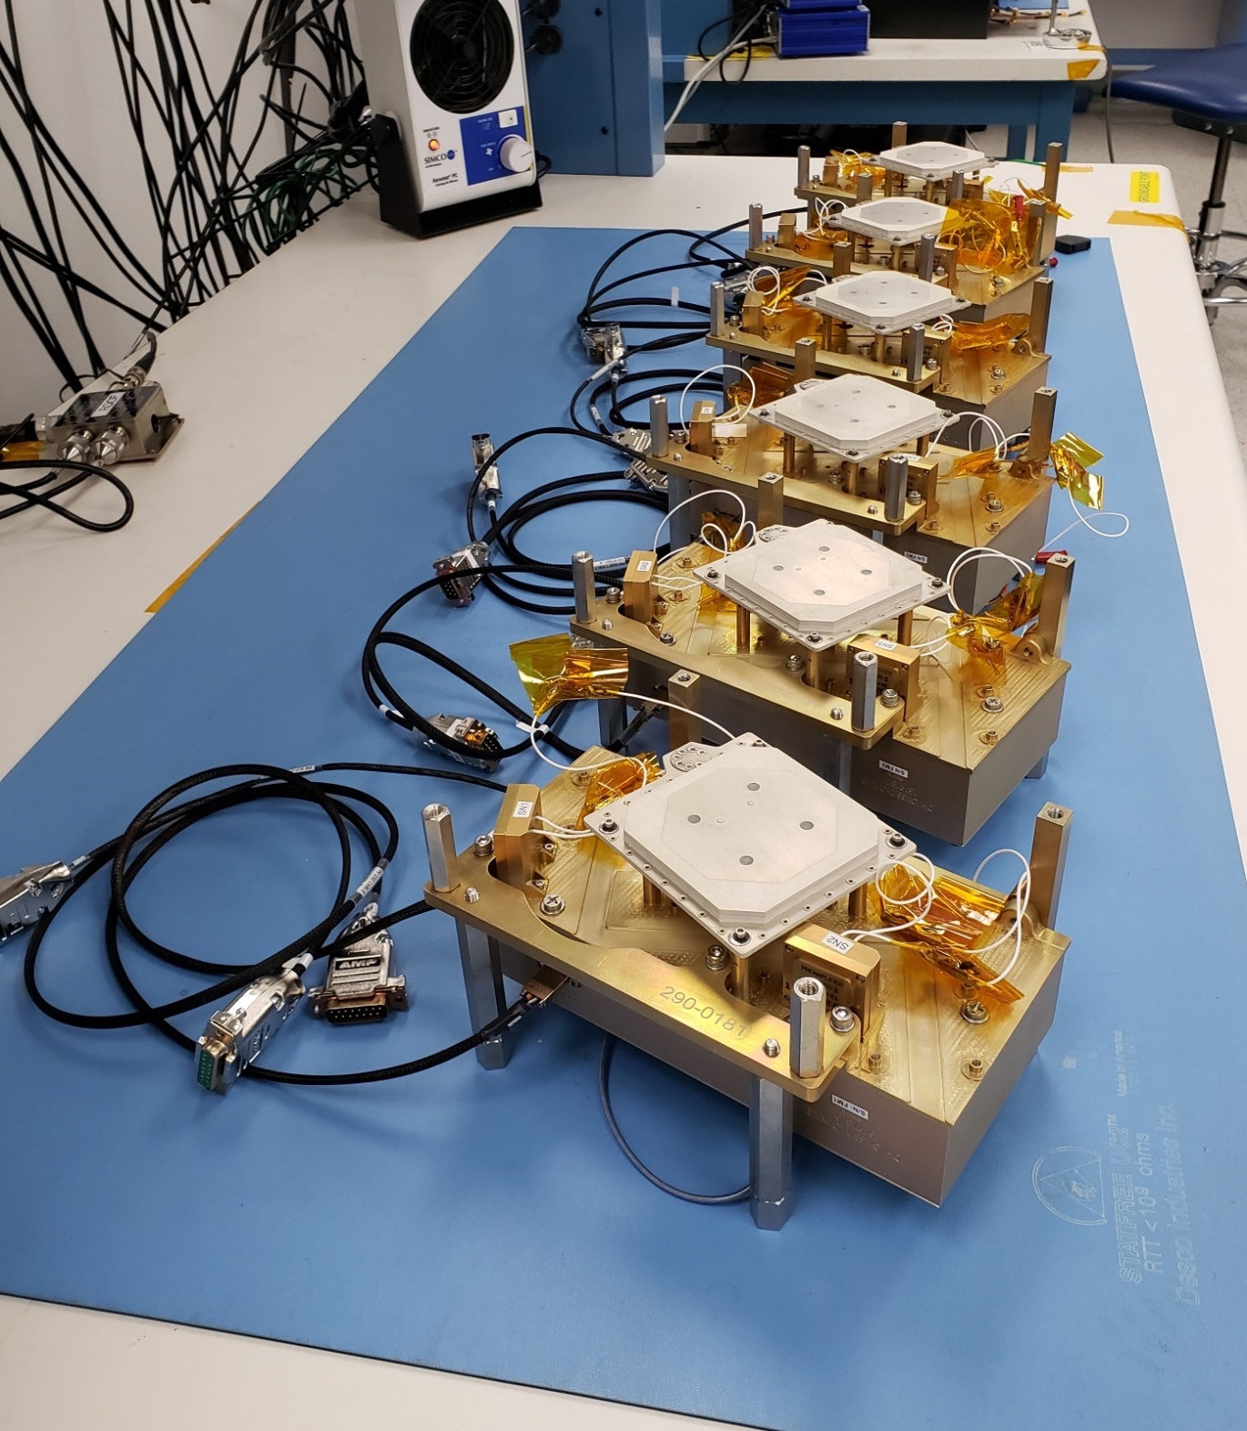
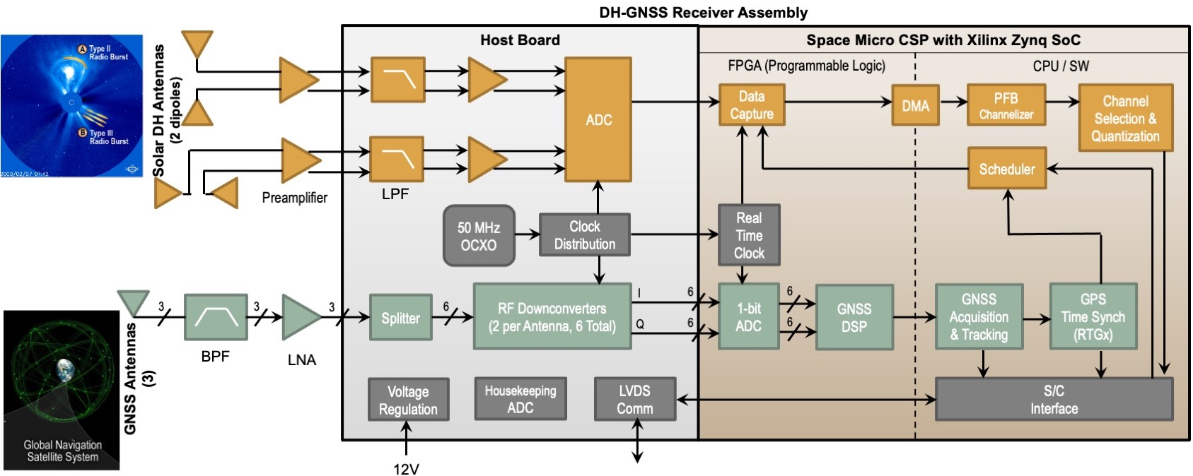
Science Payload
Measures the burst
Tells where and when we made the measurement
Common clock for GNSS and DH measurements connects the measurement to a time and place
All six Payloads during Integration and Test (I&T)

Slide 6
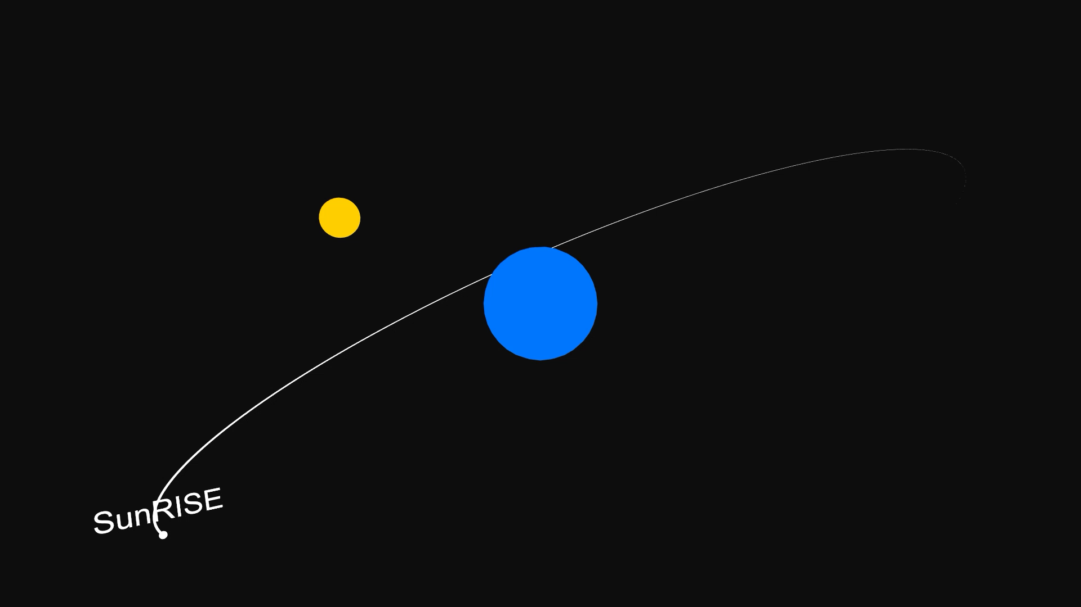
Orbitology
Notes:
The SunRISE orbits are key to implementing the synthetic aperture or interferometer.
This video is intended to illustrate the orbits, with the blue disk representing the Earth, the yellow disk representing the Sun.

Slide 7
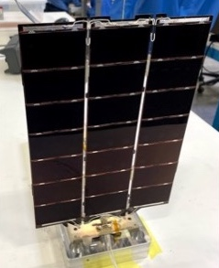
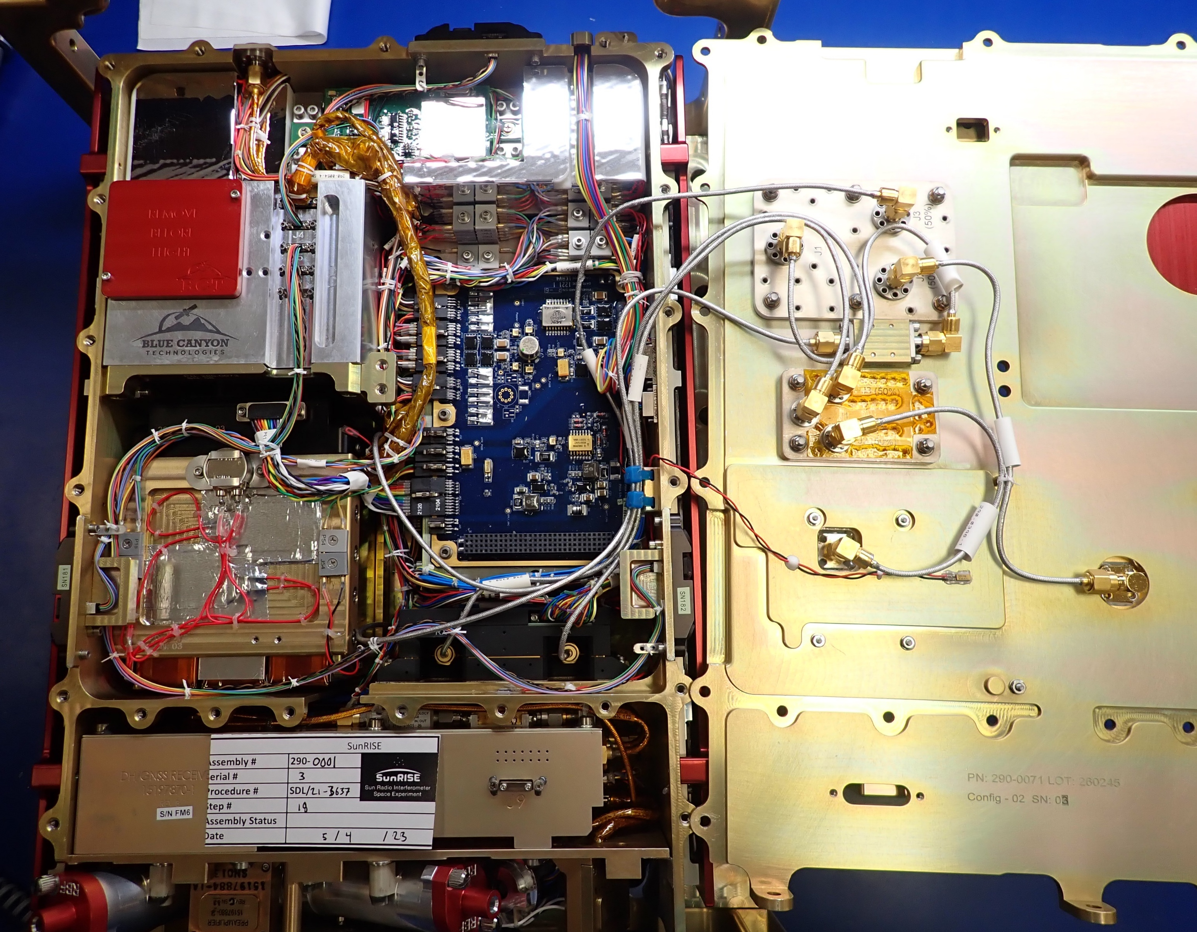
What’s inside SunRISE Space Vehicle
Propulsion
Spacecraft Chassis
Avionics
Attitude Determination & Control
Battery Pack
Solar Panel (2x)
Telecom Radio
About 12 kg in 6 liters is ~2g/cm³
Compare Aluminum 2.7 g/cm³
Like most cubesats, we run out of volume before we run out of mass
(Dispenser is max 14 kg allowable)
Telecom / antenna routing
Solar DH-GNSS Payload

Slide 8
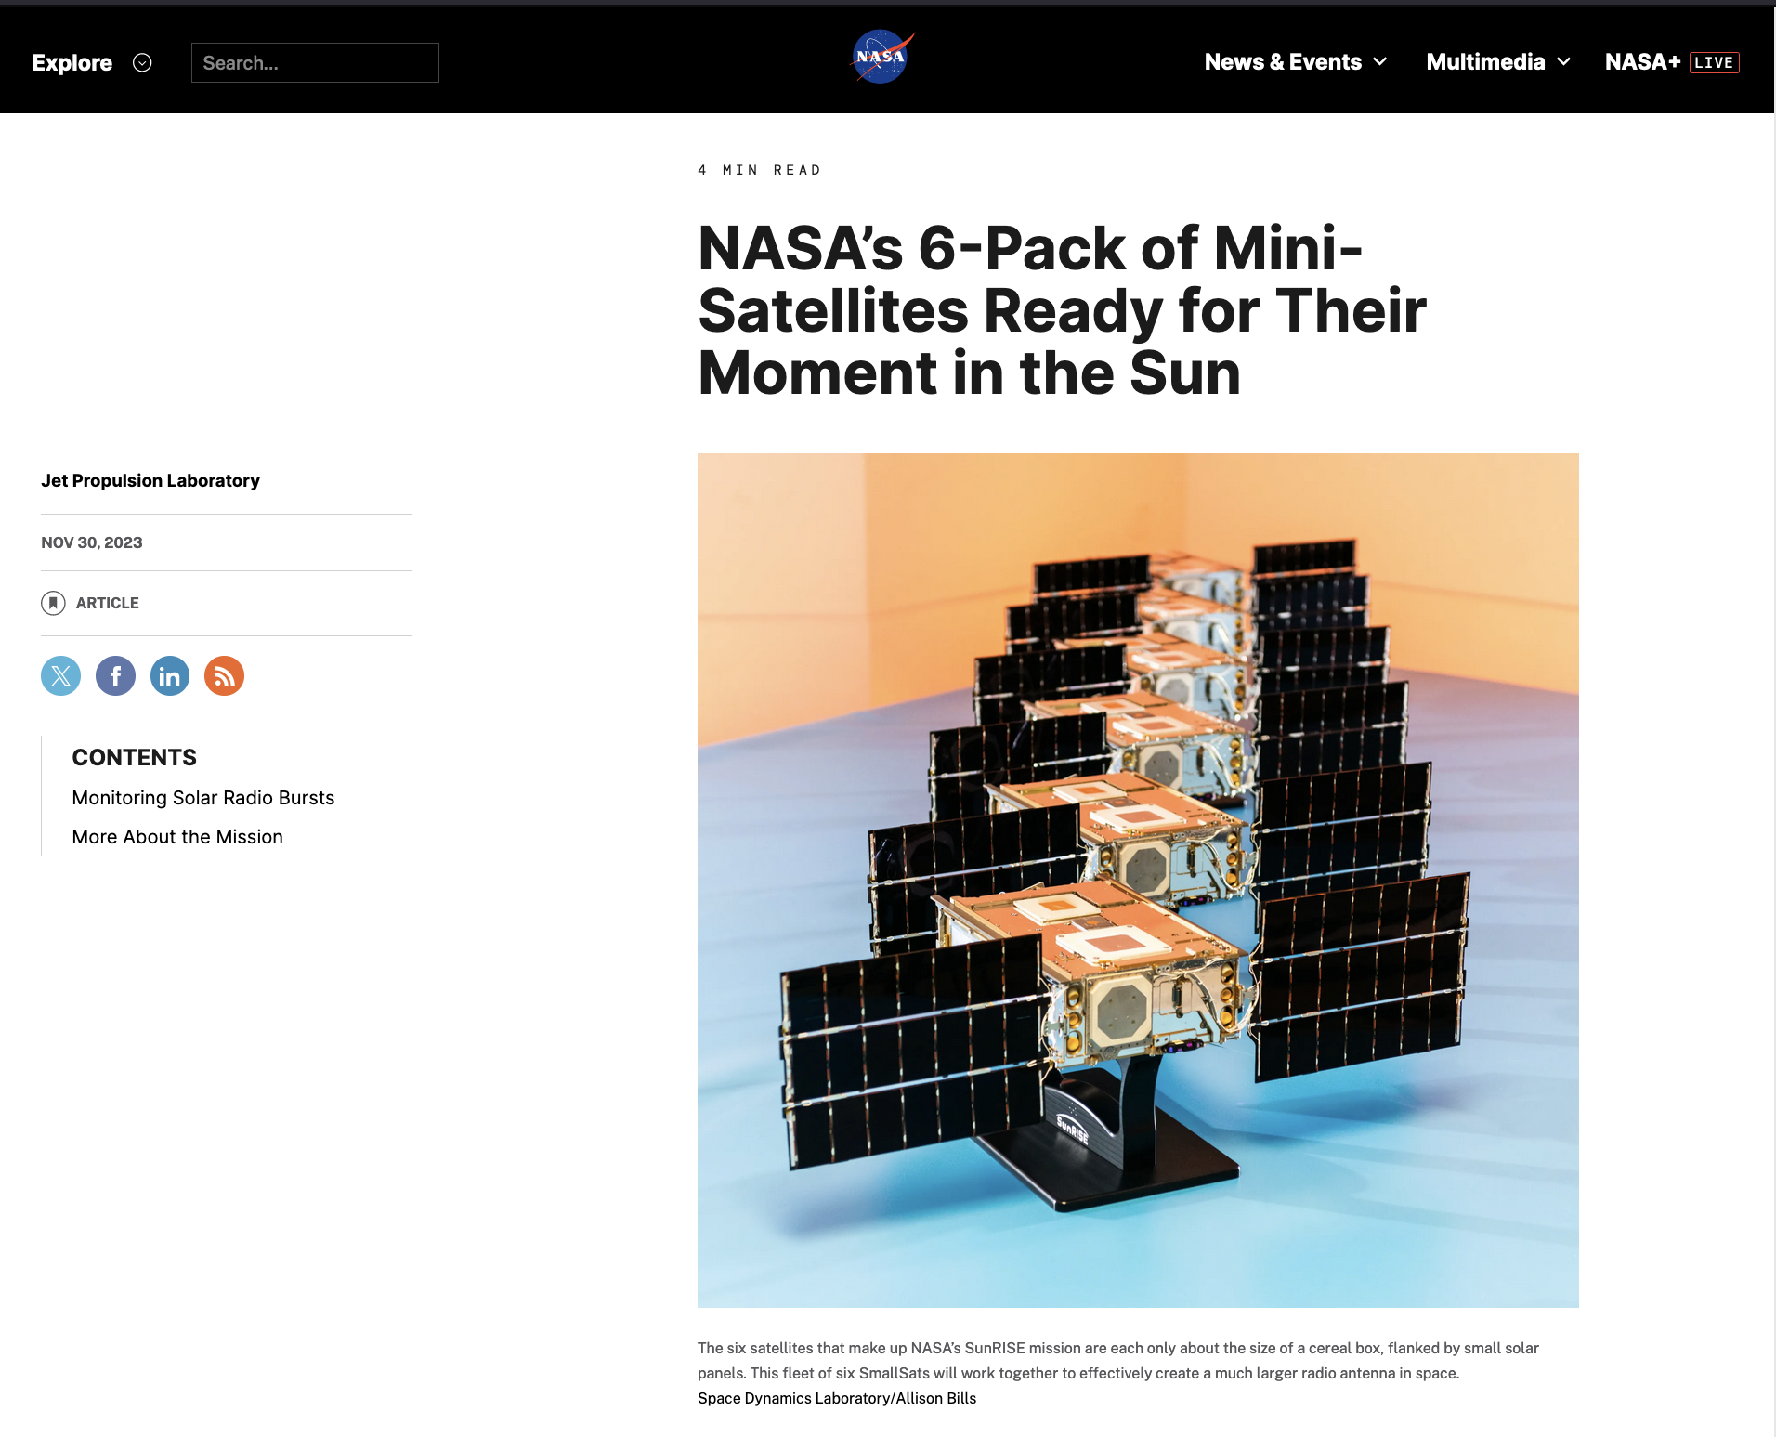
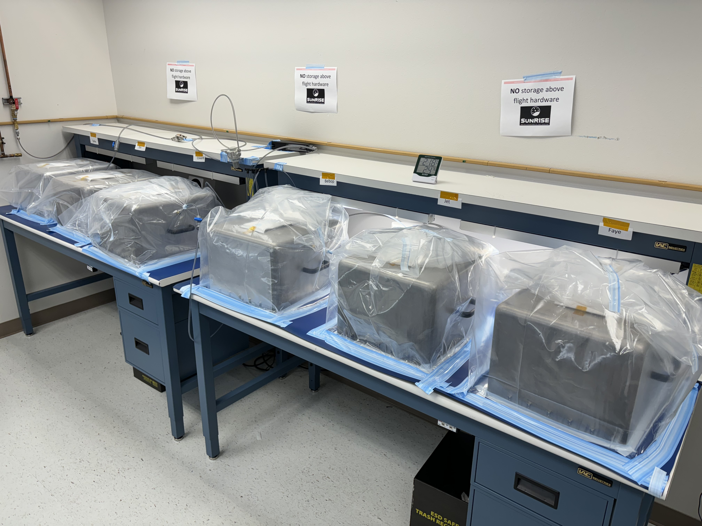
NASA’s 6-Pack of Mini-Satellites
Ready for Their Moment in the Sun
Credit: SDL/Allison Bills
All the SVs snug in their storage
No, they do NOT fly this close together in space! 1km is a “close approach”
Launch No Earlier Than Sep 2024
More likely in mid-late 2025

Slide 9
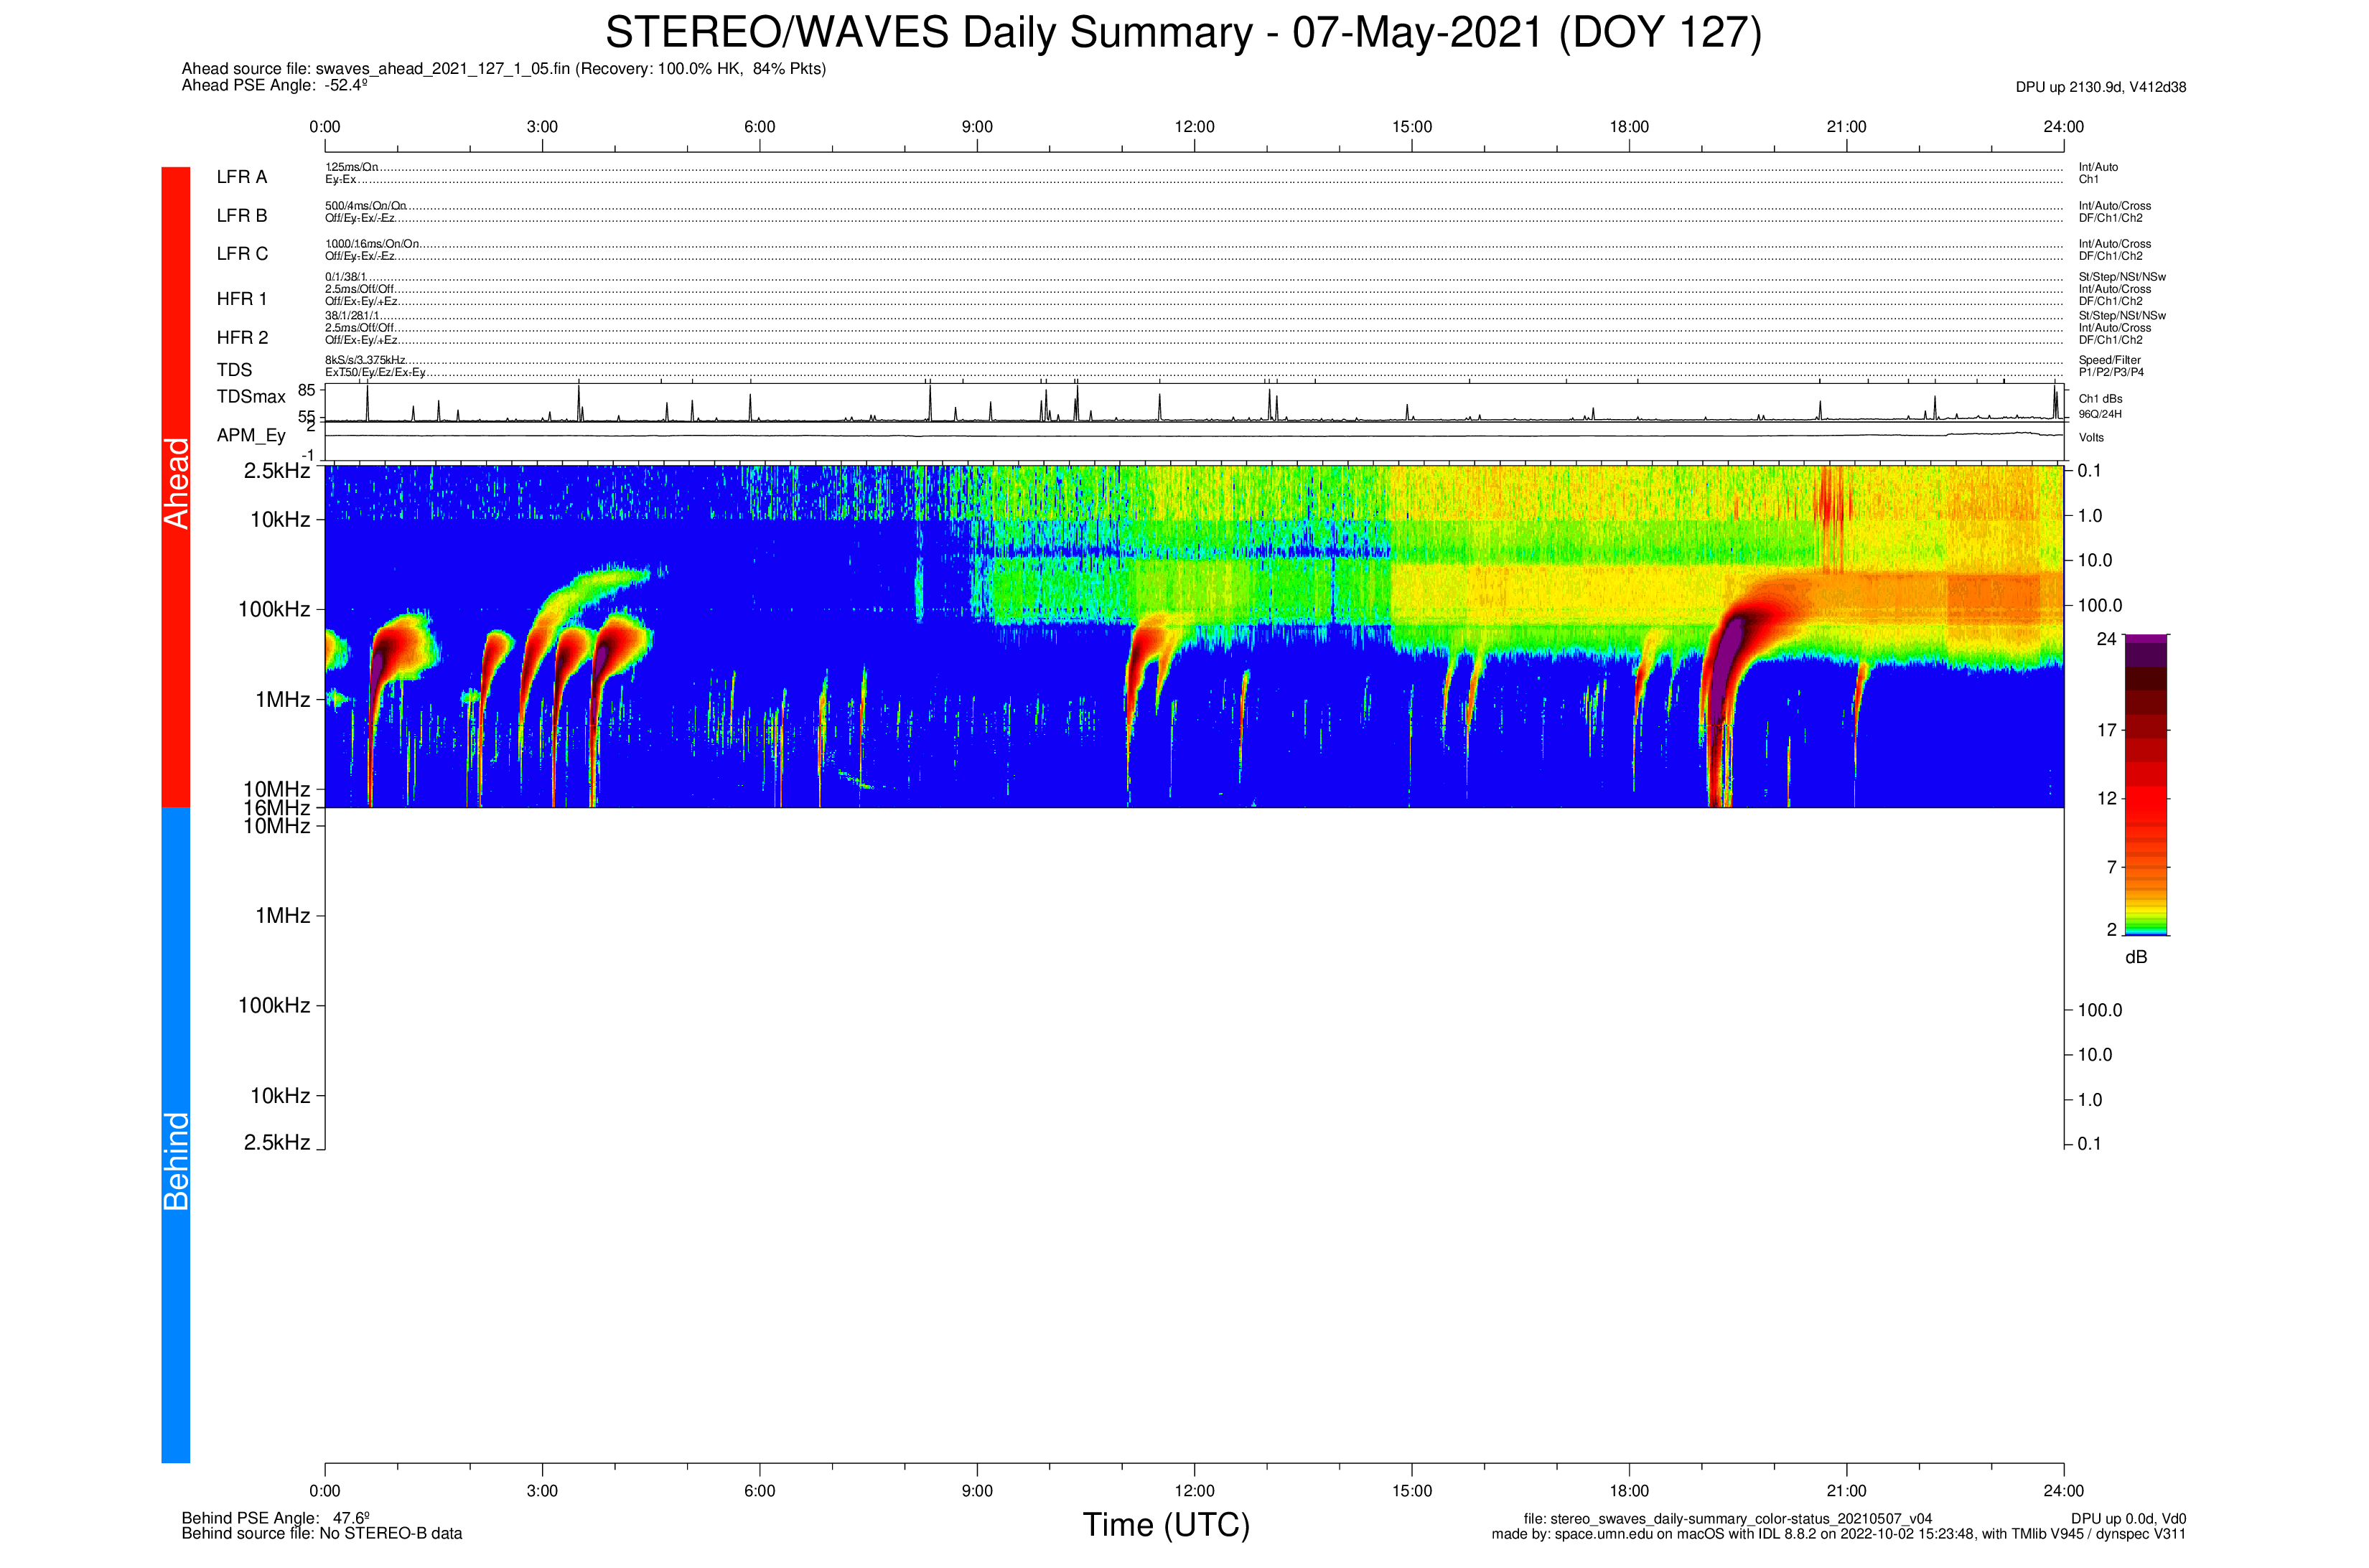
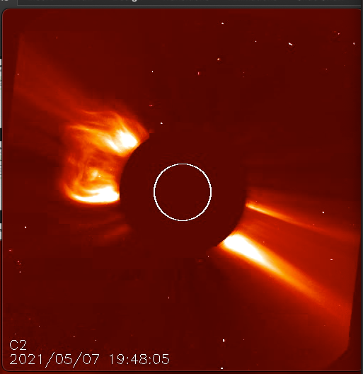
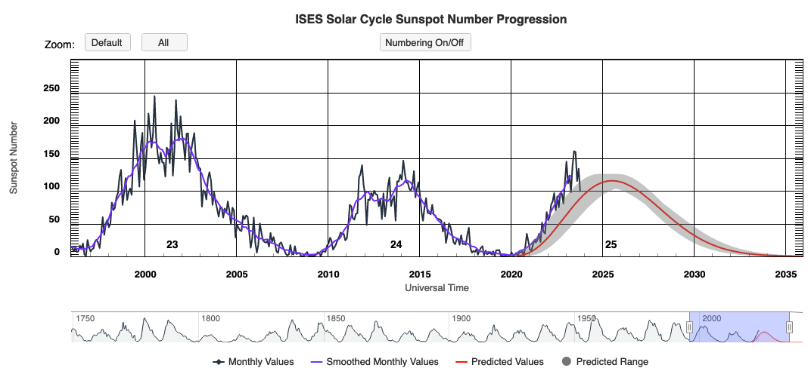
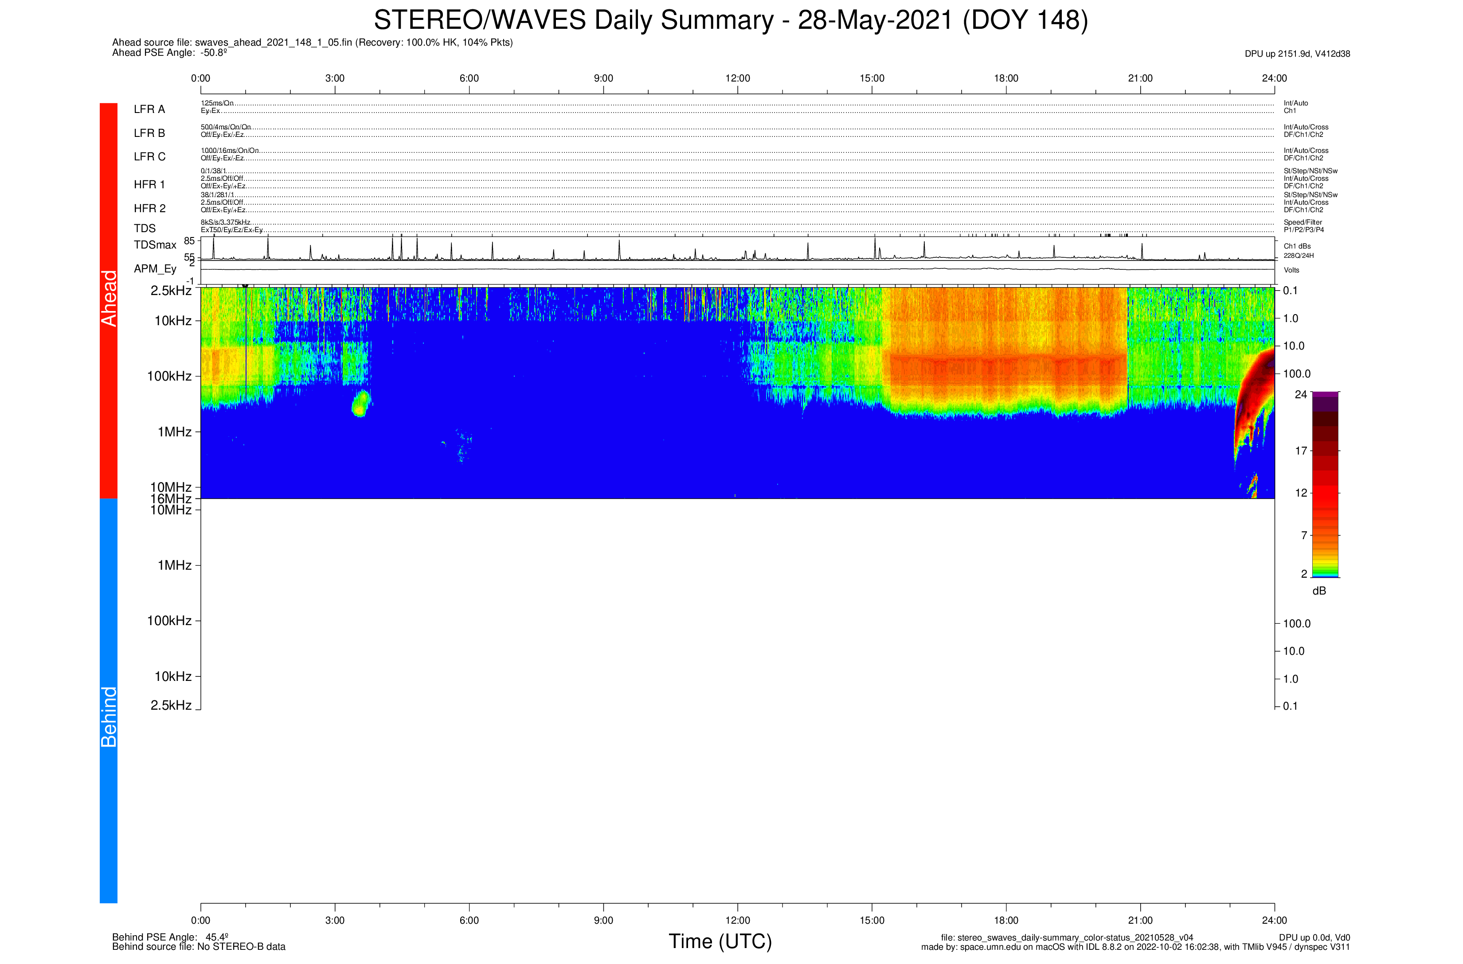
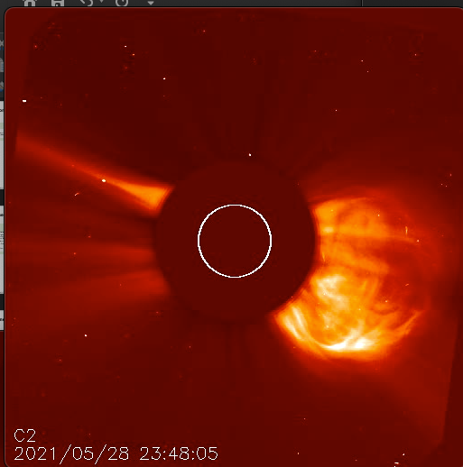
Solar Cycle 25
CME-Associated Type II Bursts
Launch is about here
And we operate for a year
https://www.swpc.noaa.gov/products/solar-cycle-progression

Slide 10
What if we aren’t in Earth Orbit?
Constellations will be larger - 50-100 receivers spread over longer distances
  Good ideas needed (at TRL6 ☺ if you please)
Position, Navigation, and Timing (PNT) – GEO is about as far as GNSS will support reliably.
  Don’t need absolute position, but do need to know relative position and orientation of the baselines relative to the sky.
  Multilateration among the SVs using in band signals, and 2-3 mother ships as “reference positions”
  Mother ships use star trackers and beacons for precise knowledge of attitude.
Moving the data back – 2 Mbps from GEO is pretty limiting
  Probably want one or more “mother ships” to serve as a relay
More Nav autonomy is needed
  If you’re flying dozens of SV, they need to figure out what to do and where to go without needing a human (or ground) in the loop.
  With a lot of SVs, a non-deterministic method can work
    If you spread 100 SVs across a 50-100 km diameter sphere, the probability of collision is quite low, even with random paths.

