Slide 1

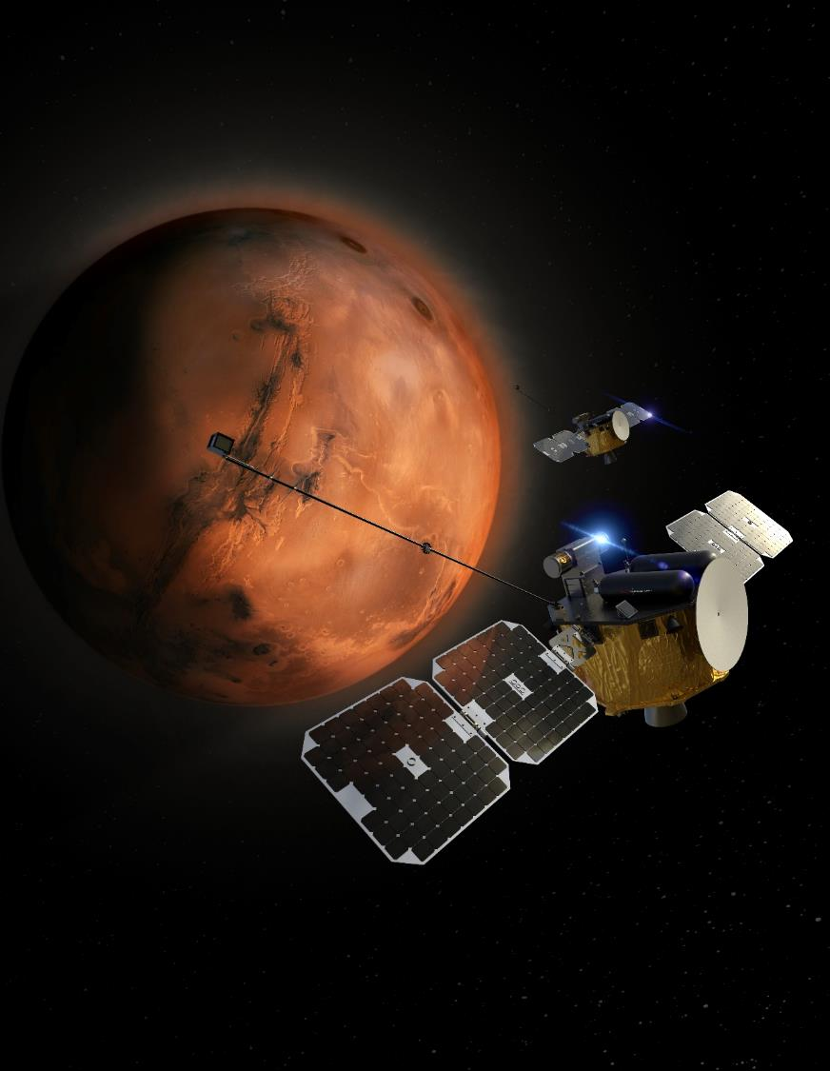





ESCAPADE: low-cost formation flying for unique space weather science at Mars
Interplanetary Small Satellite Conference
2024-04-30
1

Slide 2
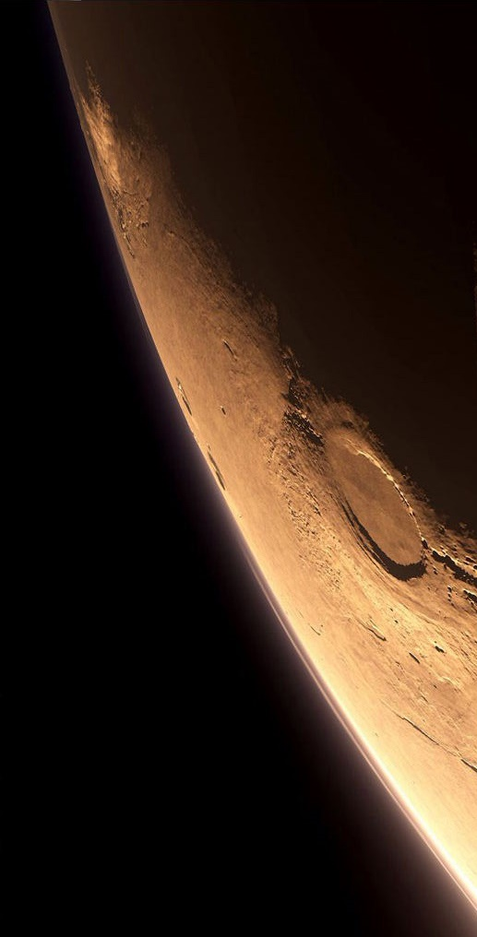
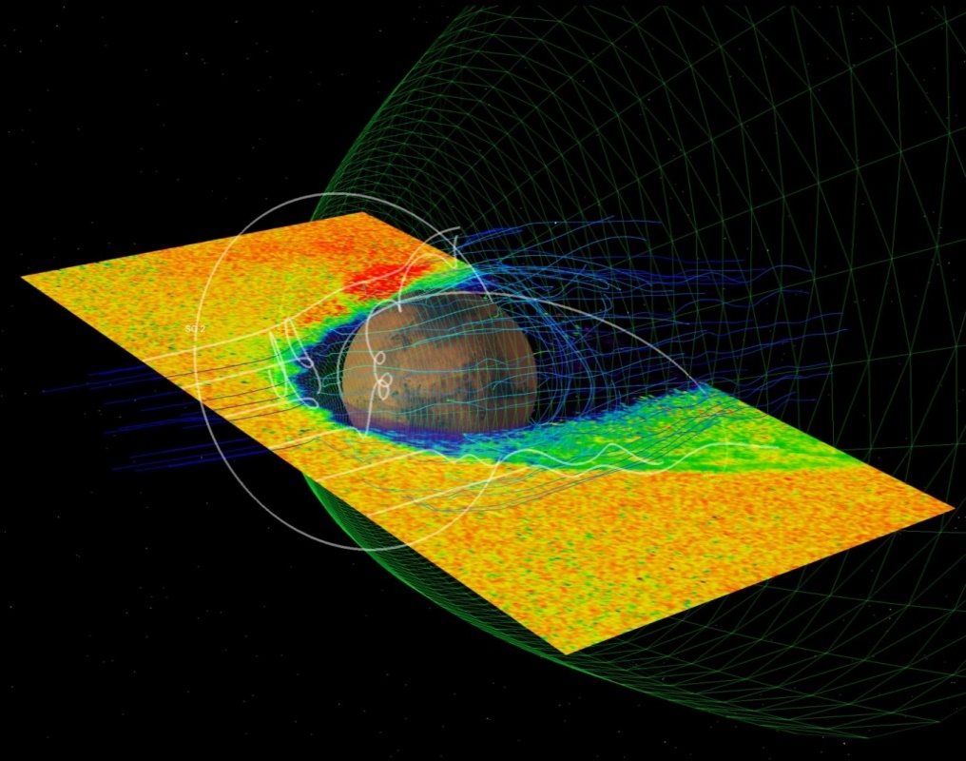

What is ESCAPADE?
ESCAPADE is a twin-spacecraft Class D tailored low-cost (<$60 million) mission dedicated to studying the transfer of solar wind energy and momentum through Mars’ unique hybrid magnetosphere and how it drives ion and sputtering escape.
Simulation by R. Modolo
Selection | SRR | PDR | PDR 2 | CDR | PER | PSR/ORR | Launch
08/2019 | 11/2019 | 07/2020 | 06/2021 | 11/2022 | 11/2023 | 07/2024 | 09/2024

Slide 3
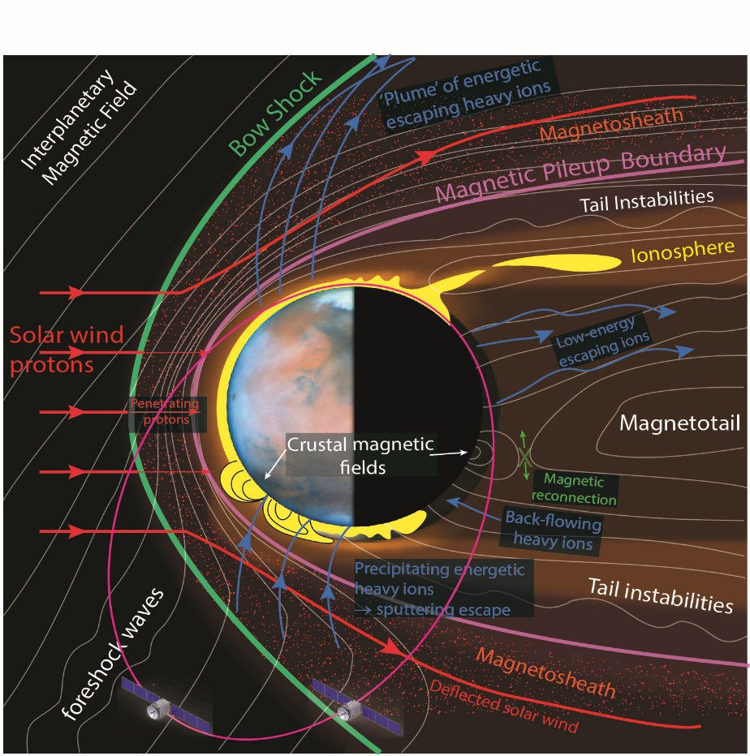
Q: Why ESCAPADE?
A: A single measurement platform leaves major questions unanswered
spatial and temporal plasma variations cannot be distinguished
System response to space weather (~1 minute) can only be measured with a time-lag of an hour or (much) more
Multi-point in situ observations from coordinated orbits are required to untangle spatial from temporal variability and characterize real-time response to heliospheric drivers.
Notes:
The figure on the bottom shows the evolving orbit of MAVEN in MSO coordinates, or with respect to the sun, showing the nominal location of the various plasma regions and boundaries. Black is the undisturbed solar wind, behind which is the bow shock and the magnetosheath region where the solar wind plasma slows down, heats up, becomes turbulent and diverts around the conducting obstacle of the ionosphere. The yellow region is where the interplanetary magnetic field piles up and drapes around the planet. The blue region is the wake where the double-lobed magnetotail trips behind the planet. This is a highly simplistic representation of a very complex picture that displays enormous variability as the properties of the solar wind change: density, velocity, IMF magnitude and IMF cone and clock angle.

Slide 4
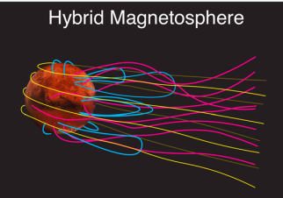
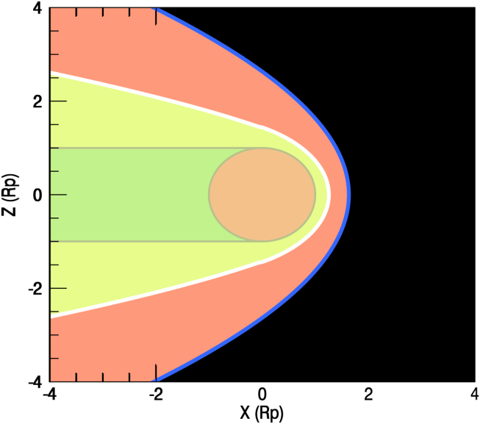
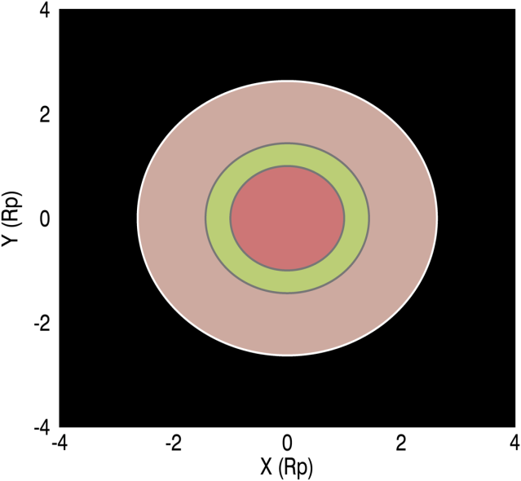

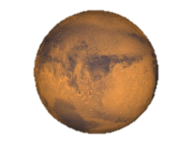
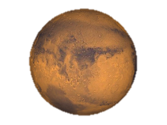
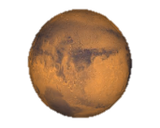
ESCAPADE Goals
Goal A. Understand the processes controlling the structure of Mars’ hybrid magnetosphere and how it guides ion flows. | Goal B. Understand how energy and momentum is transported from the solar wind through Mars’ magnetosphere. | Goal C. Understand the processes controlling the flow of energy and matter into and out of the collisional atmosphere.
View from Sun
B1: Bow shock flow
C1: Outflowing ions
B4: Tail-Sheath flow
A1: Magnetotail
A2: Escape plume
Plume
escape
B3: Terminator flow
Solar wind
B3: Terminator flow
E
E
Tail escape
B4: Tail-Sheath flow
B2: Magnetosheath
& pileup boundary
C1: Precipitating ions
E
Neutral atmosphere
4

Slide 5
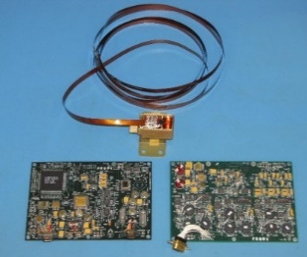
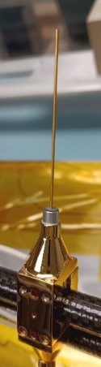
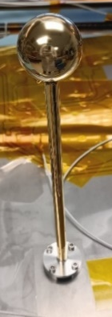
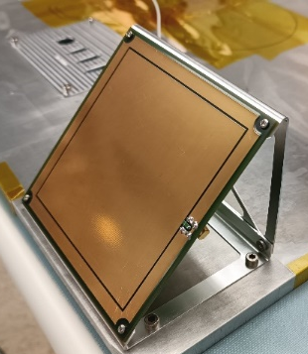
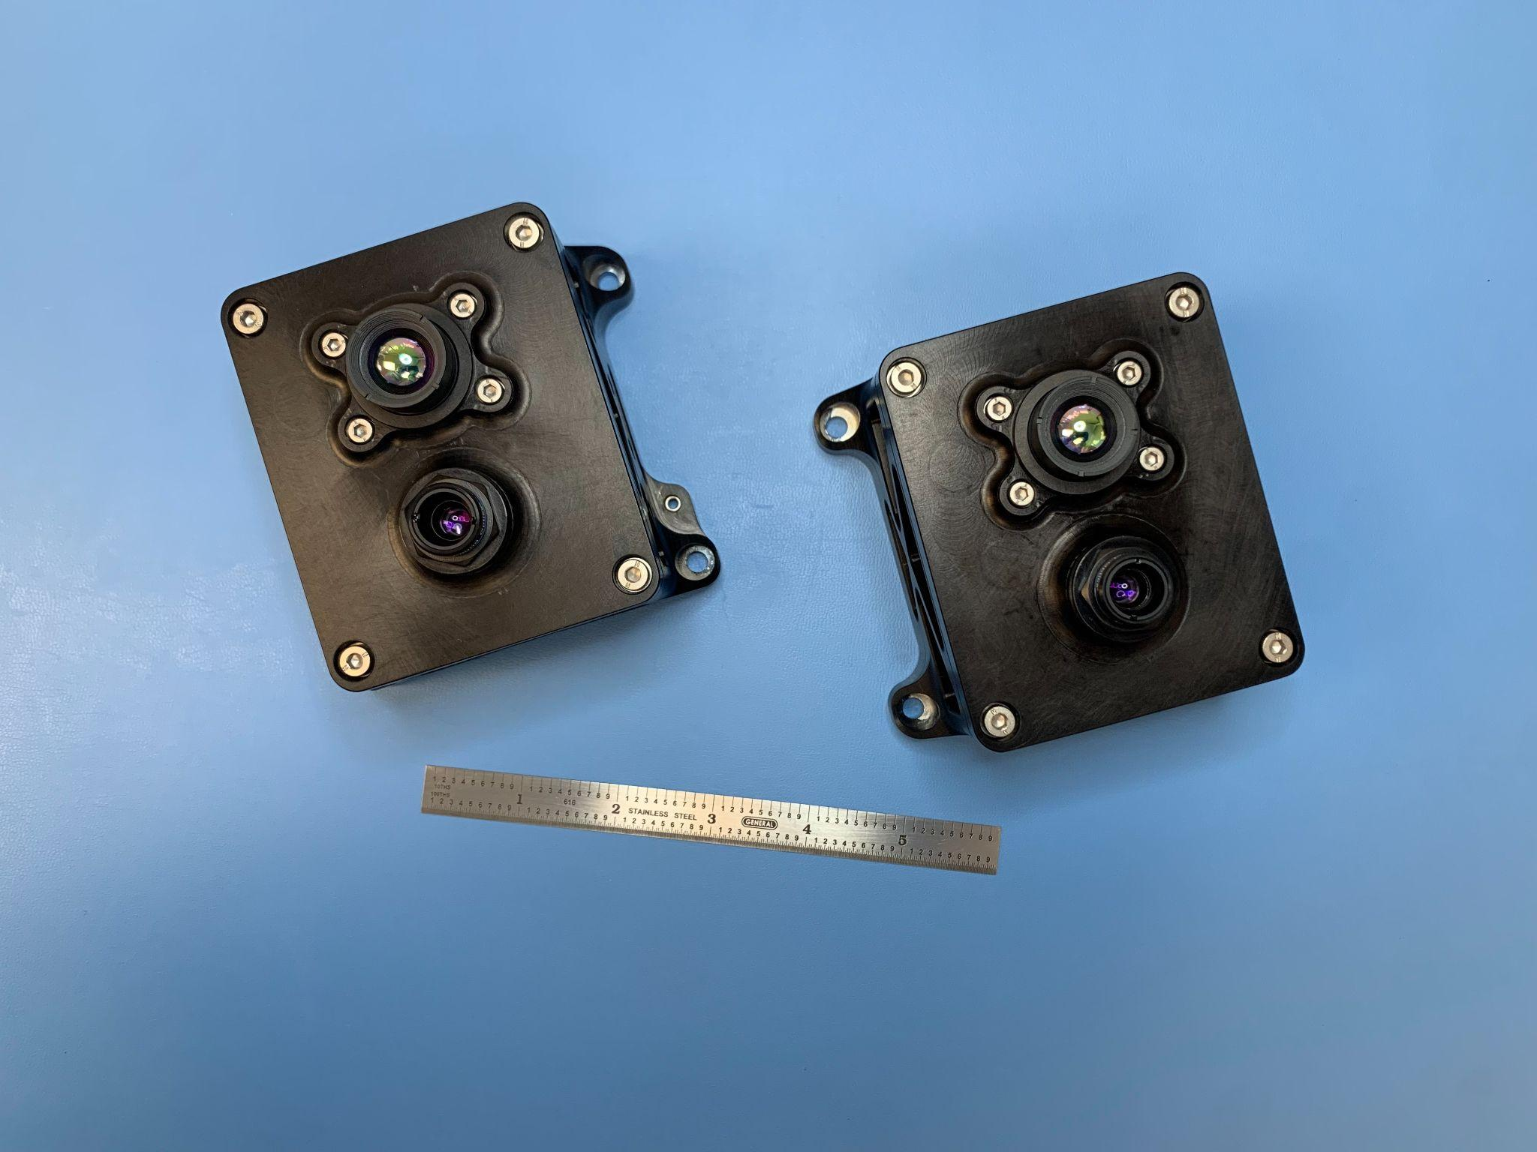
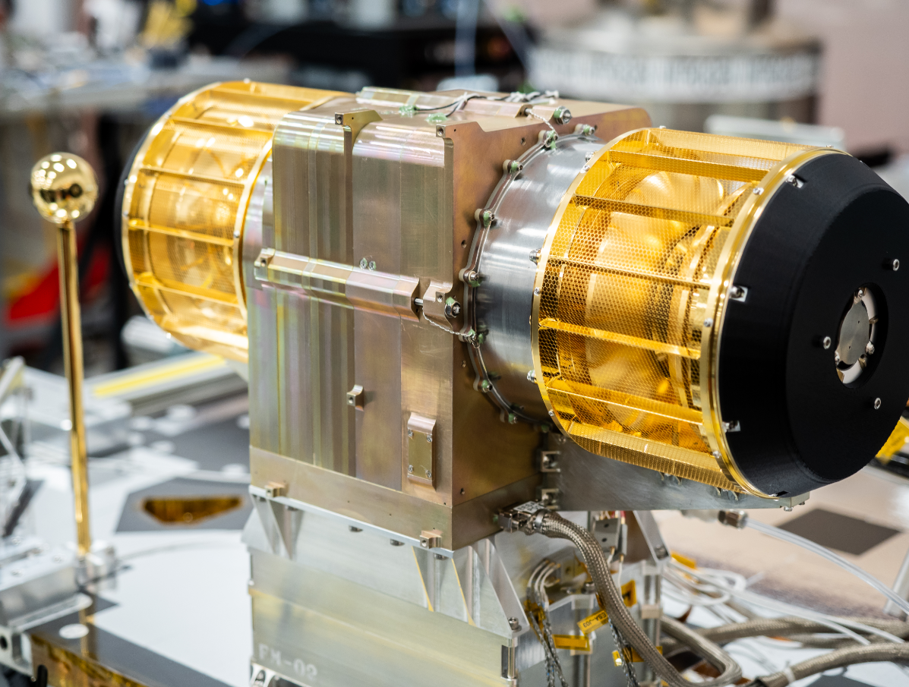
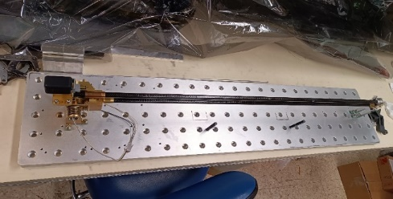
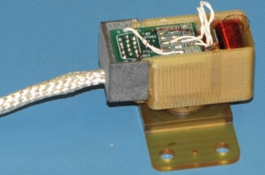
ESCAPADE Instruments
ESCAPADE Magnetometer (GFSC)
EMAG: DC Magnetic Fields
Mass¹ (MEV): 450 g Power (CBE): 1.3 W Data² (CBE): 21.5 bps
ESCAPADE Electrostatic Analyzer (UCB)
EESA-i: Suprathermal ions ESSA-e: Suprathermal electrons
Mass (MEV): 5.34 kg Power (CBE): 6.1 W Data² (CBE): 183+ 67 bps
ESCAPADE Langmuir Probe Suite (ERAU)
mNLP: Thermal electron density | Planar Ion Probes (PIPs): Thermal ion density | Floating Potential Probe (FPP): Relative SC Potential
Sensor + Board Mass (MEV): 538 g Power (CBE): 0.95 W Data² (CBE): 10.8 bps
Boom (UCB)
2.0 meter boom supports mNLP, EMAG
Mass (MEV): 850 g
VISIONS Vis & IR Camera (NAU)
Viz: RGB sensor 39°x33° 45 m/pixel @periapsis 3.2 km/pix @apoapsis IR: 8-14 µm, 45°x37° 460 m/pix @periapsis 34 km/pix @apoapsis
Mass: 603 g

Slide 6

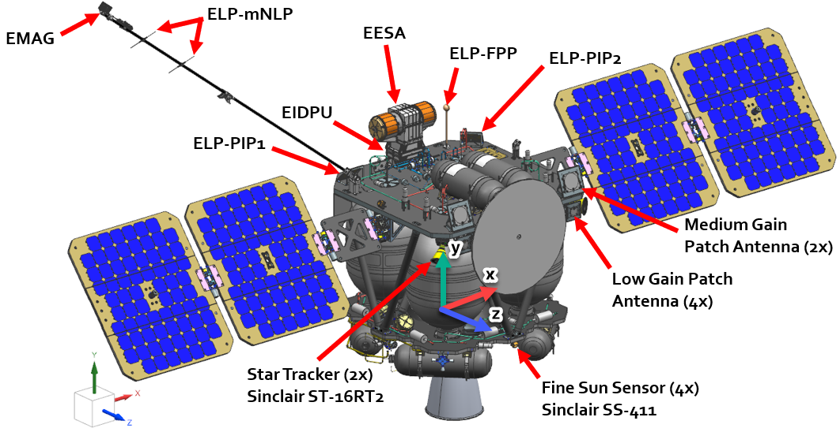
Spacecraft architecture
Twin ~200 kg (dry mass) Spacecraft (named “BLUE” & ”GOLD”)
Rocket Lab Photon Bus
Fixed solar arrays
2.0 m boom.
60 cm fixed antenna
Continuous in situ data.
Cadence, instrument modes, data products, and orientation optimized for collection above and below 1000 km.

Slide 7
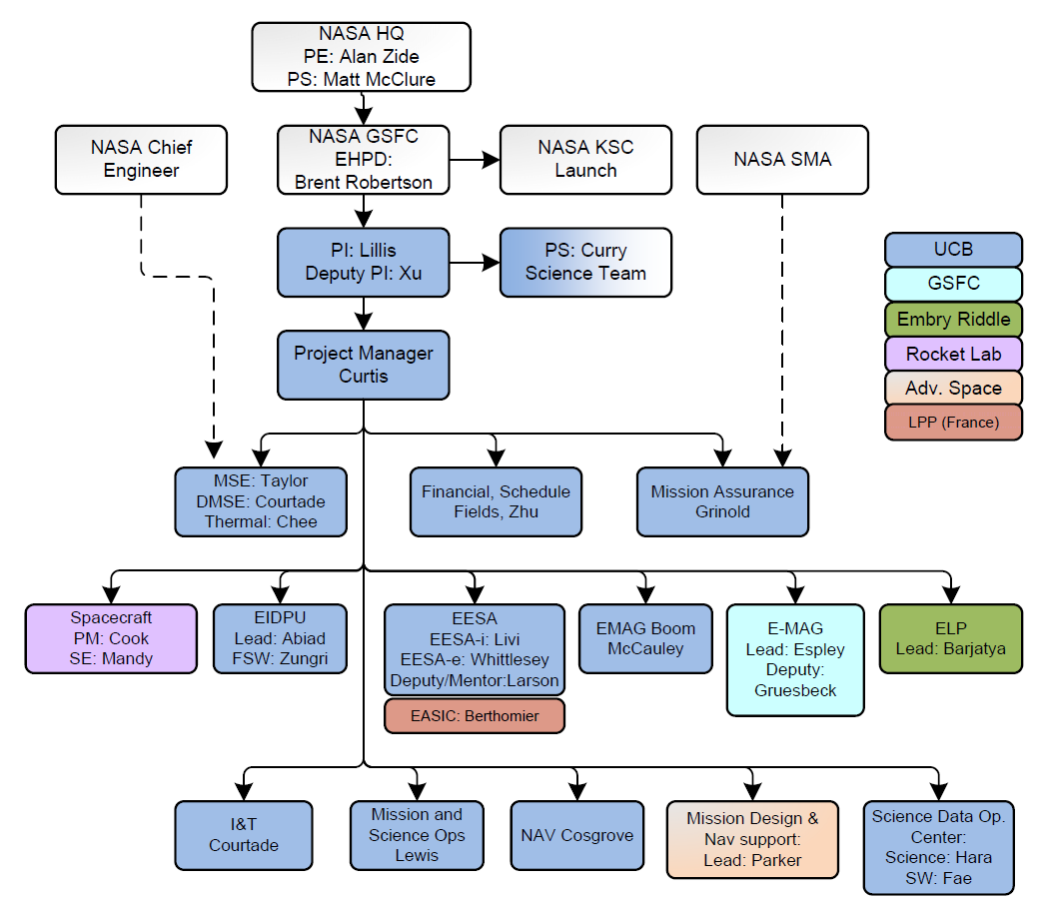
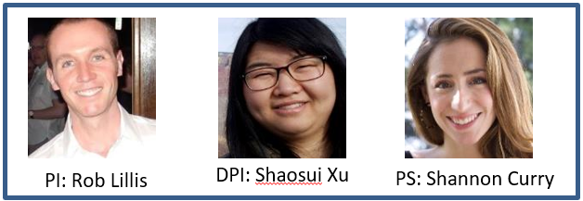
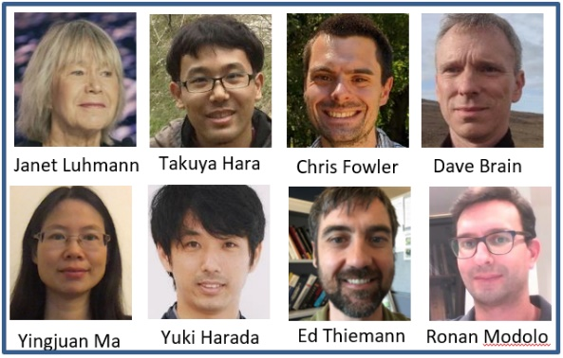
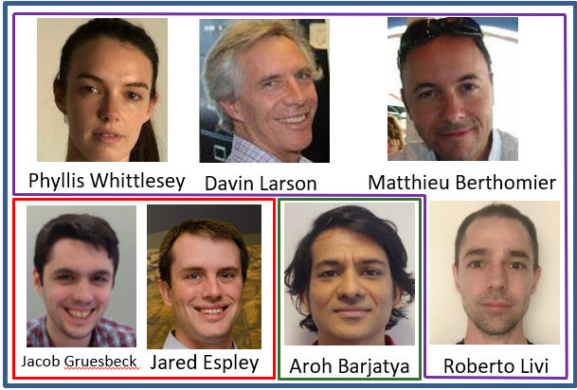
ESCAPADE Team
Project Team
Science Team
Science Leadership
Data
Analysis &
Modeling
Instrument Scientists
EESA
EMAG
ELP

Slide 8
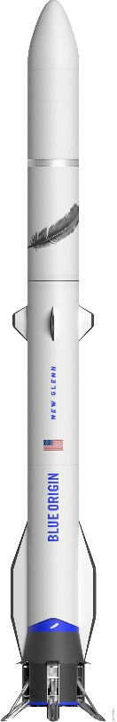
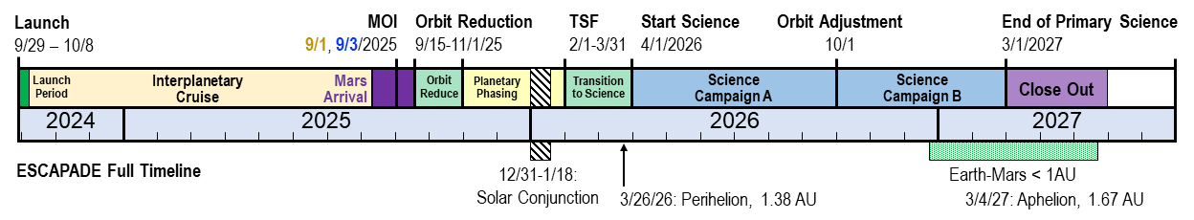

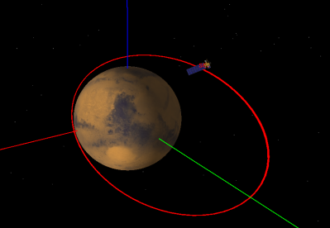
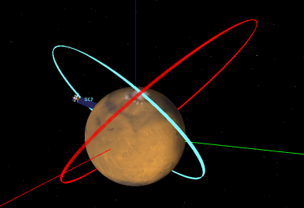


ESCAPADE Mission Design
TCM-3
Science Campaign A
Science Campaign B
TCM-2
Periapse altitude: | ~160 | km
Apoapse altitude: | 8400 | km
Inclination: | 65 | deg
Period: | 5.66 | hrs
Periapse altitudes: | ~160, | ~160 | km
Apoapse altitudes: | 10000, | 7000 | km
Inclinations: | 65, | 65 | deg
Periods: | 6.6 hrs, | 4.91 | hrs
TCM-4
TCM-5
Mars at MOI
TCM-6
Sun
TCM-1
Earth at TMI
Launch Period
Orbit C
String-of-pearls:
Optimized for studies of short-timescale variability and short-distance spatial correlation
Planes precess differentially:
Optimized for correlations between more distant regions (e.g. solar wind & magnetotail).
First flight of Blue Origin New Glenn
Launch Readiness Date 9/18-29 TBC
Direct inject to Mars.

Slide 9
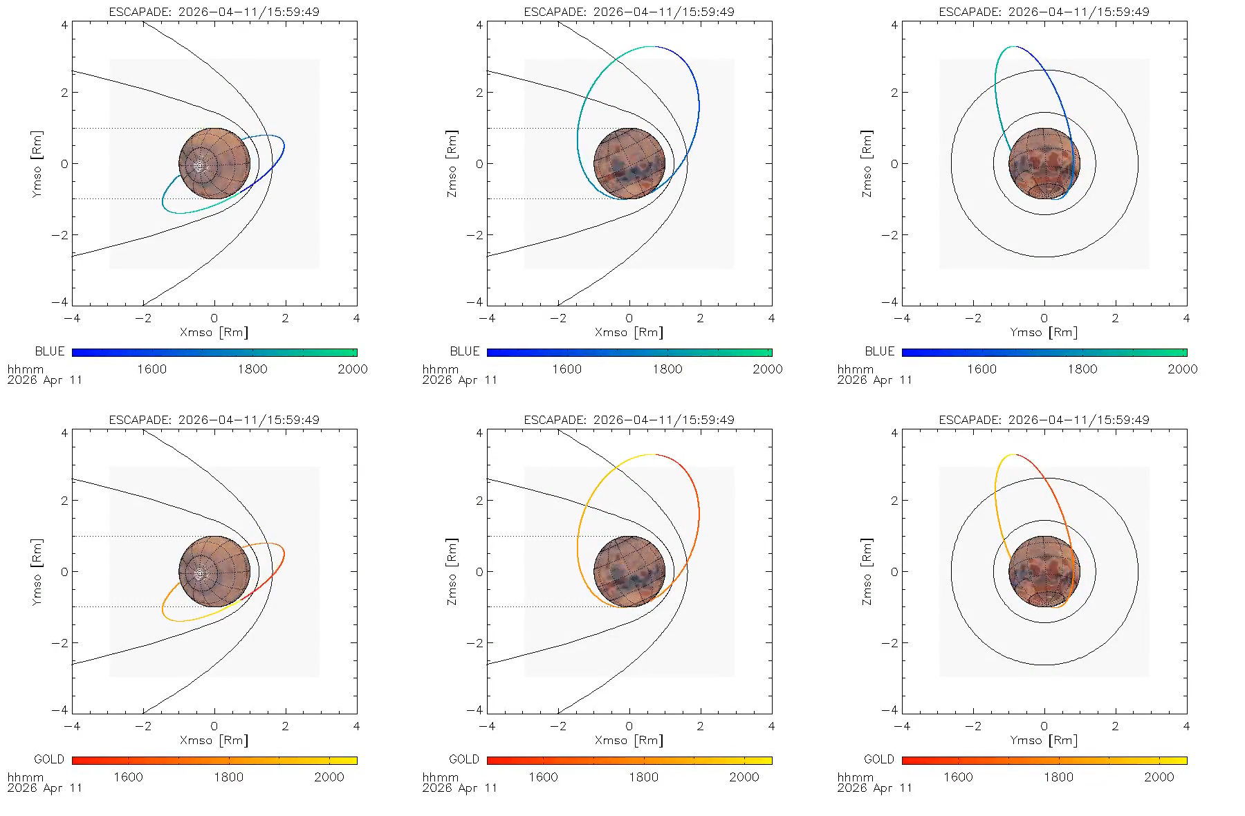
Orbit Evolution
“Blue” Spacecraft
Top View
Side View
View from Sun
“Gold” Spacecraft
Top View
Side View
View from Sun

Slide 10
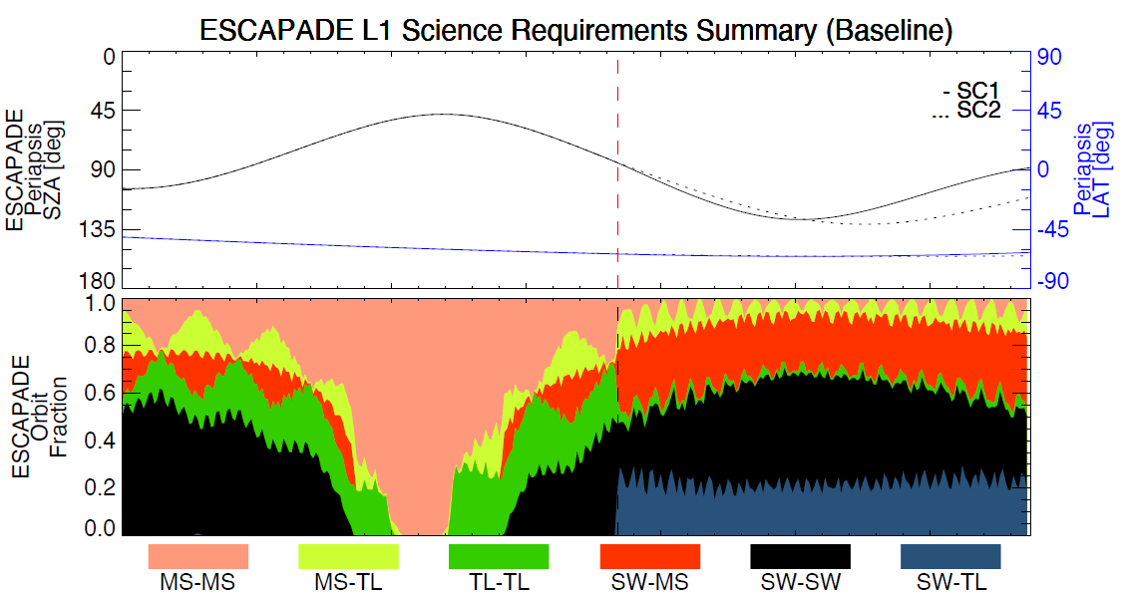
Orbit Evolution & Coverage
Graphic: T. Hara

Slide 11
Campaign A – Spacing
Spacecraft travel between 0 and 30 min relative to each other, in the string of pearls.
Minimum crossing distance of 10 km

Slide 12
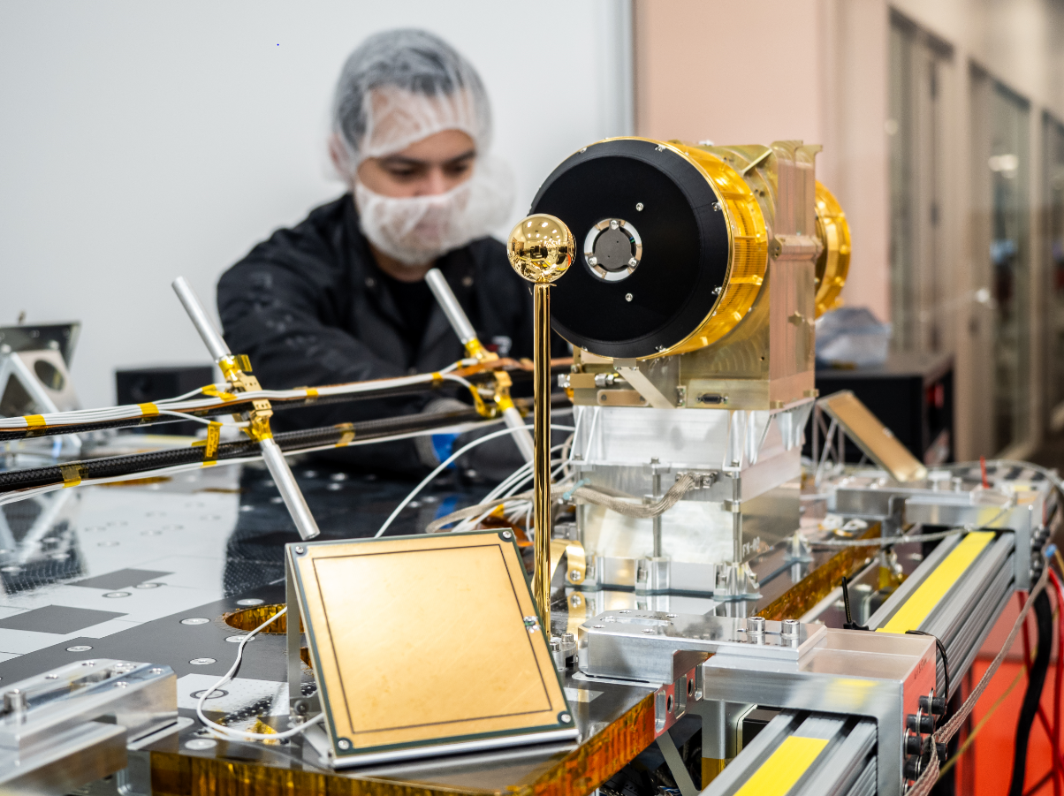
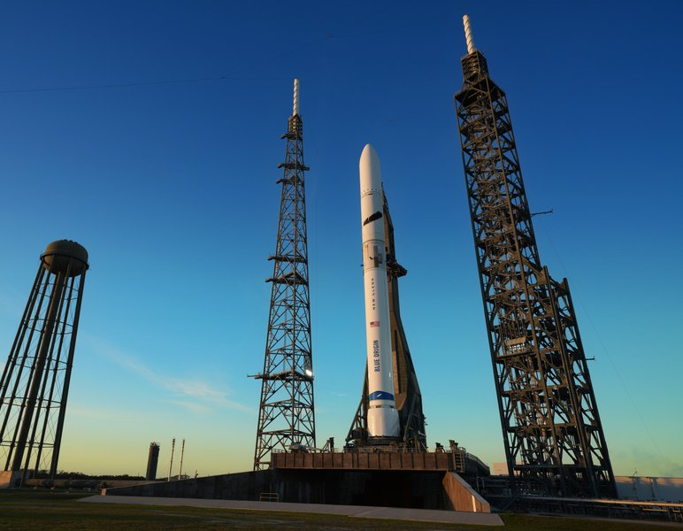
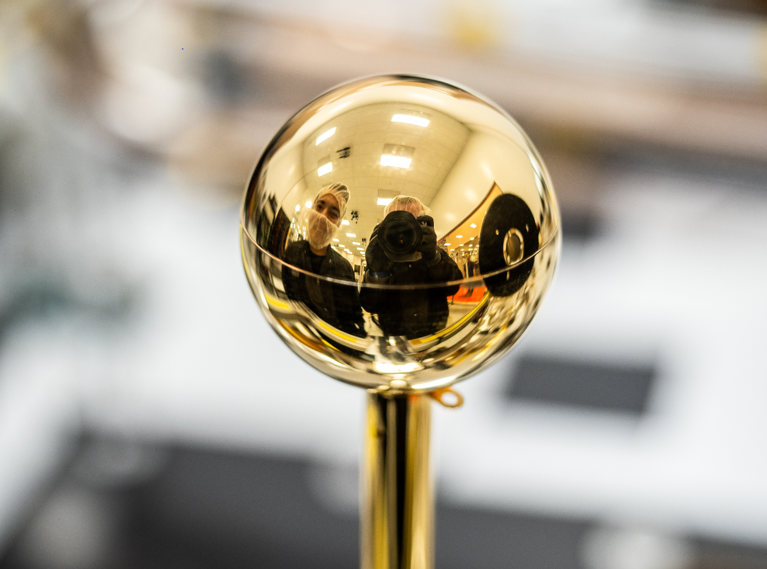
Project Status Overview April 2024
Instruments
All instruments integrated on Blue & Gold buses & working well ☺.
Launch Vehicle
Launch Readiness Date still TBD (9/18 to 9/29).
Launch Period goes to 10/08.
Fixed launch energy (C3 = 7.25 km²/s2) and DLA allows the same launch profile each day
Working details of ground ops campaign at Astrotech (including Planetary Protection)
Above: EESA (L: electrons, R: ions)
Top left: Planar Ion Probe (PIP), floating potential probe (FPP),
EESA-e, mNLP on folded boom
Above: floating potential probe

Slide 13
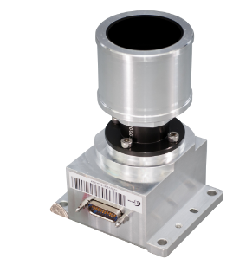
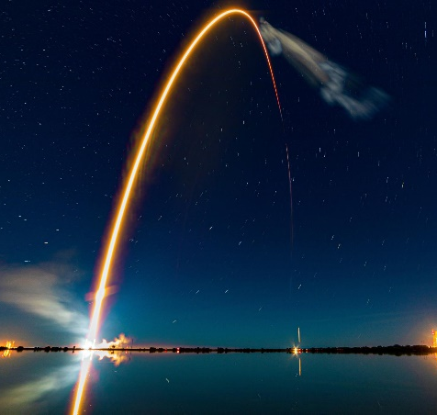
ESCAPADE Phase A/B Lessons Learned
Development Cycle Mismatch. ‘Newspace’ commercial vendors’ business model of rapid iteration is not always compatible with NASA projects.
  Lesson: press your vendors/SC provider on parts/subsystem development & make very clear your needs. Do it early.
Parts are still not cheap or quickly available. While Class D is compatible with COTS subsystems re: reliability, COTS falls short w.r.t. e.g. Radiation Tolerance.
  Lesson: press your vendors/SC provider on parts/subsystem development & make very clear your needs. Do it early.
Launch uncertainty hampers system/mission design.
  LSP will be in your corner working hard, but things can still be bumpy, esp. with new launch providers.
  Mission Design uncertainty flows to:
    Prop. system & fuel mass requirements.
  Lesson: try to be as flexible as possible to be resilient to changes in schedule or capability.
Notes:
Antenna, solar arrays

Slide 14
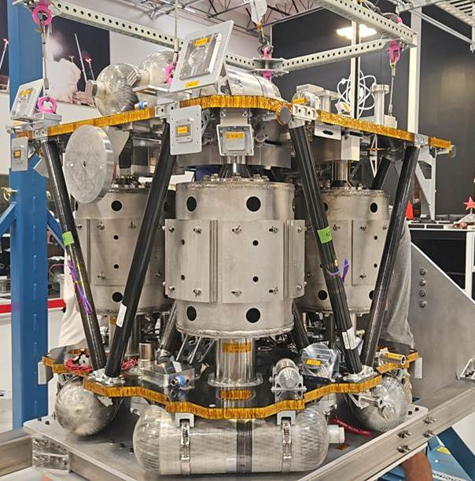
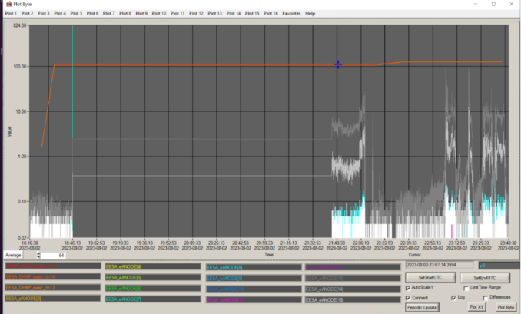
ESCAPADE Phase C/D Lessons learned
Compressed Schedule Impacts: to achieve cost reductions by shortening schedule, ESCAPADE took some risks in instrument (and spacecraft) development.
  Reduced EM development and flight subsystem test campaign.
  Saves schedule & $$, but significantly increases the risk of discovering problems late in flow.
  Lesson: Maintain additional schedule margin at the end (some part of the time saved) to resolve late issues.
Heritage resides in the team.
  There is hidden expertise in the team that is not well documented. MCP screener technician left, new tech did not detect MCP noise issue until calibration.
  Lesson: document all procedures, particularly “specialist” processes.

Slide 15
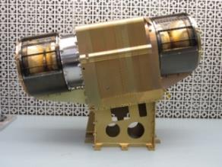
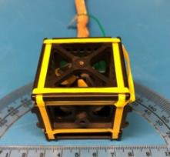

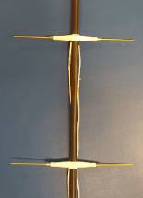
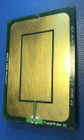
Reasons ESCAPADE is possible (1)
Low-cost instruments:
  Low-FTE and/or short dev. schedule. EM work only where necessary.
  Simple and/or Very High Heritage
    EESA: almost build-to-print from Parker Solar Probe SWEAP. No desirements: e.g. ESA boom, full 4π FOV, etc.
    EMAG: very similar to Insight, MMS MAG.
    ELP sensors: non-sweeping, ISS & rocket heritage, student-built.
EESA-i
EMAG
R. Livi (UCB-SSL)
Suprathermal ions
Y. Ma (UCLA)
Magnetic field
EESA-e
ELP
P. Whittlesey (UCB-SSL)
Suprathermal electrons & Magnetic topology
FPP
PIP
mNLP
Lesson: price goes up if any new development is needed and/or if instruments are inherently complex.
A. Barjatya (ERAU)
Thermal plasma
Notes:
Okay so I want to address a question I’m sure is on everyone’s minds: Can you REALLY get 2 spacecraft to Mars for $55M PI-managed cost Phase A-E, even under a Class D tailored risk posture? And I’m here to say the answer is yes, under very a very narrow set of circumstances that ESCAPADE is fortunate enough to have.

Slide 16


Reasons ESCAPADE is possible (2)
Orbit C
EBN-4
EBN-5
Lots of Delta-V. Mission design requires almost 3 km/s.
  ESCAPADE can get to Mars from either:
    Direct-to-Mars injection October 2024
    ~1.6 day elliptical Earth orbit launched May-August 2024.
  Result: ESCAPADEs are >2/3 fuel by mass.
  Without this high ΔV flexibility, we would be praying for a direct ride on Starship or something else.
Orbit B
Orbit A
SSO
to Mars
EBN-1
EBN-2
EBN-3
TMI
TCM-3
TCM-2
TCM-4
TCM-5
Lesson: Simpler propulsion and much lower SC mass if delivered on Mars-bound trajectories or directly into Mars orbit.
TCM-6
Mars at MOI
Sun
TCM-1
Earth at TMI
Launch Period
Orbit C

Slide 17
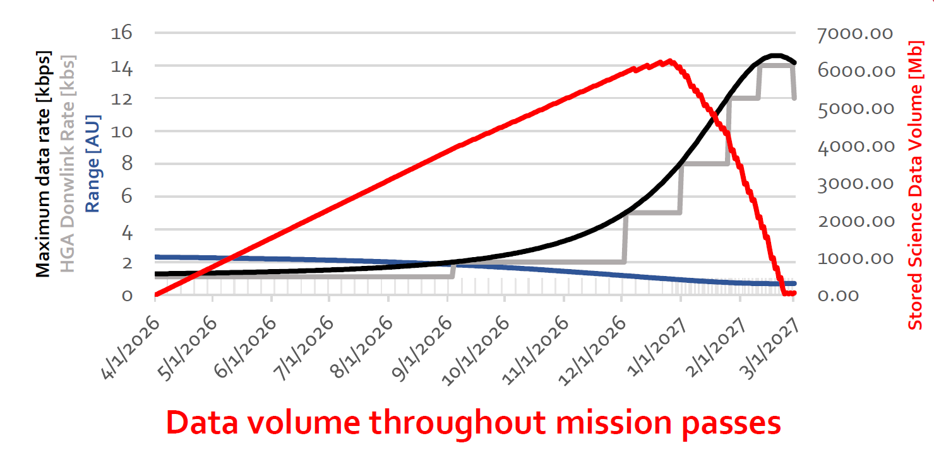
Reasons ESCAPADE is possible (3)
Modest Telemetry Requirements.
  No imagers or imaging spectrometers
  60 cm antenna. Limited to 300 bps average.
    Judicious slices of 4-D plasma data (e.g. range, resolution) are sufficient for science.
  Data builds up on board: >80% of data downlinked over final 20% of 11 month mission. L1 requirements resilient to this.
  Exploits short Earth-Mars distance near end of mission (up to 6 x 8-hour DSN passes/week)
Lesson: Mars Science is highly constrained by small satellite antennas & radios. Telecom relay needed for anything more ambitious!

Slide 18
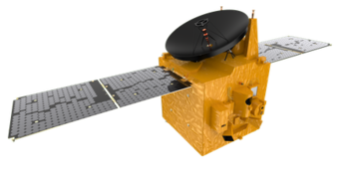
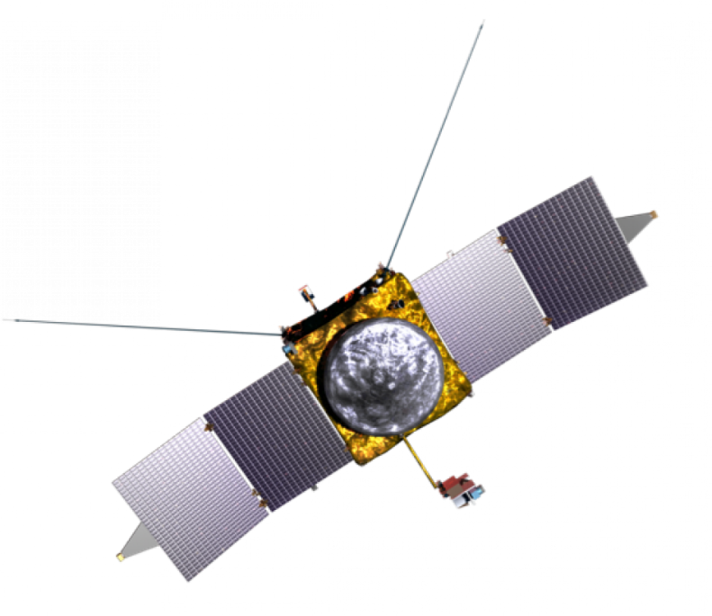
Reasons ESCAPADE is possible (4)
MAVEN & EMM Experience.
  Many team members on EMM and/or MAVEN
  Plasma parameter ranges are known.
  Data formatting, processing & archiving.
  Deep Space & Mars orbit mission design, navigation, ops, incl. MOI.
  Drag & instrument erosion risk from Mars Upper Atmosphere.
Lesson: less familiar teams will need greater resources, assistance etc. to succeed. This will cost money.

Slide 19

Reasons ESCAPADE is possible (5)
Rocket Lab USA Financial Commitment.
  Firm Fixed-Price (FFP) contract for SC buses & I&T.
  Details provided to NASA HQ showing strong company financial position.
  Personal guarantee from CEO Peter Beck that company will see it through for agreed price.
  Given current uncertainty in smallsat cost modeling, all 3 above were needed for NASA to be confident in ESCAPADE’s costs.
Lesson: cost story has to make sense. Need realistic cost models and/or estimates from Newspace companies when setting cost caps for Smallsat Deep space missions.

Slide 20
ESCAPADE Lessons Learned Summary
# | Topic
1. | Mission Design Uncertainty | Repeated iteration adds cost
2. | COTS doesn’t always mean low cost | Parts costs are still higher than commercial (e.g. radiation)
3. | Newspace subsystem development cycle | Sometimes too rapid for NASA mission lifecycle
4. | Instrument maturity & complexity | Some instrument types may be priced out.
5 | Propulsion | Rides directly toward Mars or into Mars orbit reduce costly Delta V requirements
6 | Communications | Smallsat comm systems very limited for DTE communication. Mars relay network enables much greater Science return.
7 | Mars Environment familiarity | Providing Mars expertise to teams will reduce risk.
8 | Deep space smallsat cost models | These need to be greatly improved with the help of Newspace companies.
Many things had to go ESCAPADE’s way to fit in a SIMPLEX cost cap. $55M is too low for most realistic missions. And we’re not done yet!

Slide 21
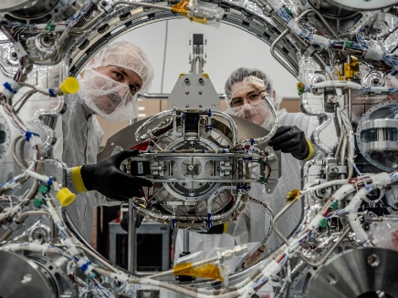
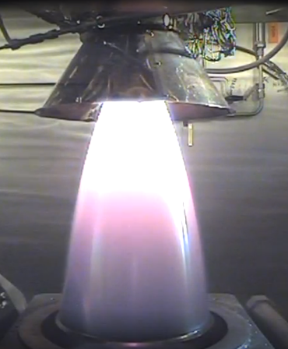
Advice to PIs: Managing your Spacecraft Provider
Rocket Lab USA have been wonderful. Generic advice:
They are your partner but also (prob) a for-profit company. Are project & company aligned?
PSE/PM should be always be aware of status/problems and continually track SC risks, including vendors.
Make sure the SOW is detailed and clear!
You will have to negotiate with their BD/execs.
  Don’t be afraid to push back on requests & prices.
  NASA can be your “bad cop” if necessary.
Contract Type: Firm Fixed Price (FFP) vs. Cost-Plus (CP)
  CP works with high heritage, large technical & schedule margins, healthy cost reserves.
  FFP works well if some technology unproven and company is both financially stable and won’t walk away, i.e. committed.
Thruster Hot Fire Test
Note: modify above if SC provider is managing the project
Notes:
NOTE: everything I’m about to say applies to the situation where your space provider is not also your management institution.
- They are your partner but that doesn’t mean they care about your science. Have a chat with somebody senior at the company (CEO if it’s a small company, SVP if it’s big). Make sure they are invested in mission success. Our first contractor we sort of inherited from a previous project. While the couple of folks we interacted with were good people, turned out they had no real support from their corporate execs (who didn’t really see the point of NASA science missions, didn’t understand them). Things got much better once we started working with Rocket Lab in terms of alignment: their CEO is clearly a big fan of science, their commitment showed in their work etc.
- Make sure that your project systems engineer and project manager are in regular contact with the SC provider. You as the PI should probably be at almost every meeting early in the project to make sure science is represented, dialing back later when it’s all technical details.
- Make sure there are enough points of contact between your team and the SC provider: PSE, payload, ops. There are a million details and if a significant one slips through the cracks it can mean big trouble.
- Can’t stress this enough: your Statement of Work between you and the company is the BIBLE when it comes to conflicts later. Don’t assume they have the same definitions as you do, clarify everything!
- Be prepared to have to negotiate with your business POC at the company. Setbacks, changes in scope etc. are inevitable and they all come with price tags. Be prepared to push back if they are being unreasonable. If they (or one of their subcontractors) is being difficult, sometimes gentle pressure from NASA itself can help get things unstuck.
- Contract type. This is a big one. Firm fixed price contracts have pros and cons. The pro is obvious: SC technical issues don’t cost the project any more $. The con is that in the past contractors have tried to “get well” by charging exorbitantly for very minor changes, or they have been driven to insolvency by under bidding. Cost-plus contracts can lead to large overruns, but they’re preferred if you’re going with a legacy contractor, you have healthy margins and cost reserves. However if there is something obviously risky upfront, FFP is a way to keep costs down.

Slide 22
Summary
ESCAPADE is:
  The first multi-spacecraft science mission to Mars.
  An opportunity to separate temporal from spatial variability and characterize real-time response to space weather.
  An experiment by NASA in reducing costs for planetary missions.
ESCAPADE is a Pathfinder: can decadal-level science be done for low cost with high success probably?
Our success & problems will inform future missions.

Slide 23
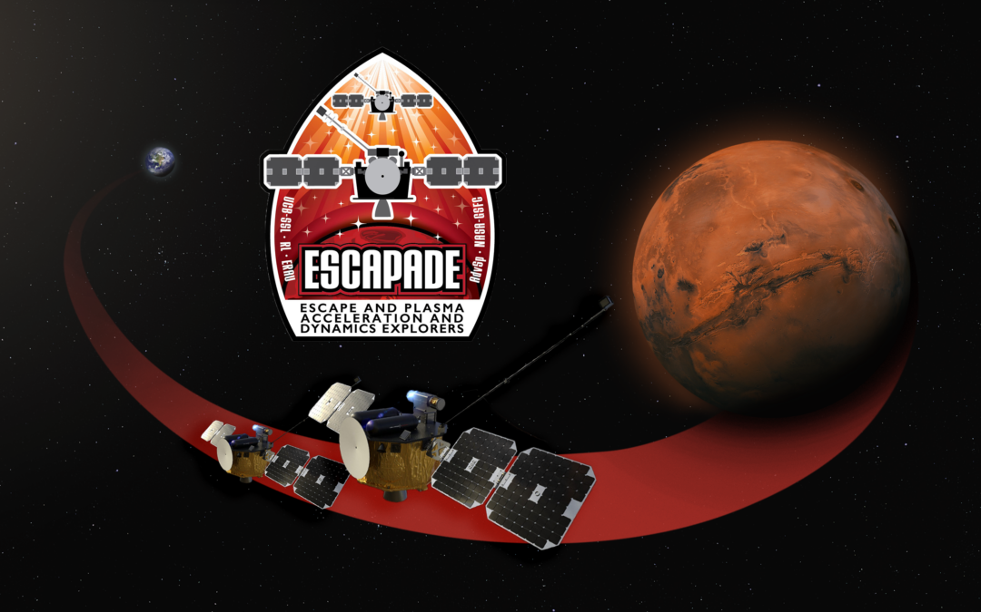
Thank you!
Questions?
Graphic credit: UCB, Rocket Lab, and Advanced Space
Notes:
Kongo no koraboreshon o tanoshiminishiteimasu

Slide 24
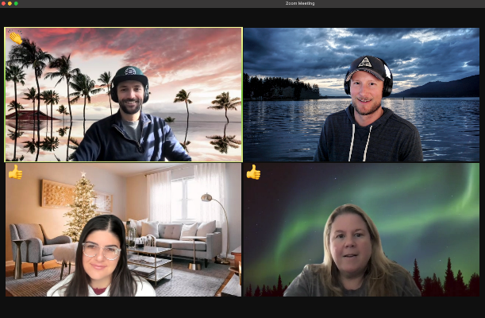
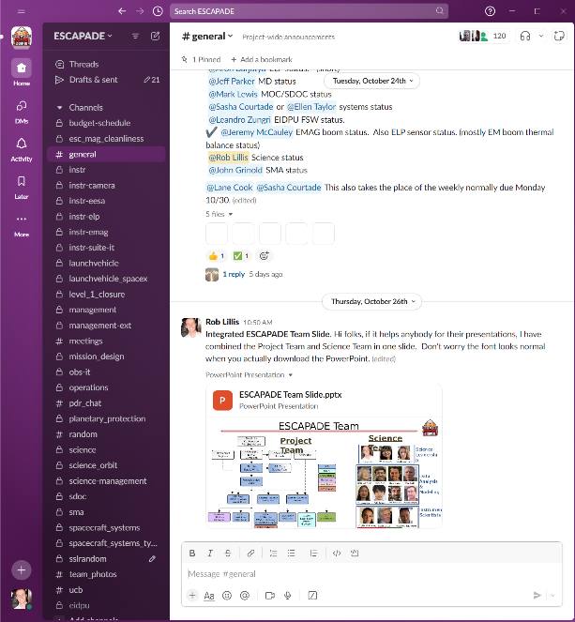
Advice to PIs: Team Communication
3 Fs of communication: Frequent, Frank, Focused.
Weekly management meetings: Monday mornings.
  Status, issues, plans. Safe space to discuss strategy, concerns, even rumors. Limited participation.
  Touch all aspects: contracts/budgets, schedule, science/ data, instruments, spacecraft/systems, launch, ops, SMA.
  PI/DPI/PS should attend. Try never to miss these.
Give subsystem leads freedom ((bi)weekly vs. monthly)
Slack (or Teams): Birdseye view for PI/PM.
  Allows rapid iteration/clarification on specific topics.
  Invite everybody in your org chart.
  Recommend keeping channels private (cuts down on noise)
Use email when appropriate:
  Communications outside the team (NASA HQ/GSFC/KSC, media, vendors, admin).
  Sensitive items (e.g. budget docs).
Notes:
-3 Fs: communications should be frequent. Any time you’re not sure whether people are on the same page, CHECK. Especially important in Phase A/B when requirements are being developed. Frank: Every team member should feel empowered to be fully frank with every other team member (while staying respectful). Focused: don’t shut down useful discussion, but as the leader it’s your job to keep discussions on track. Every PI has their own style, and small talk is finding small quantities or if it can add much-needed levity, but a mission has a lot of moving parts.

Slide 25
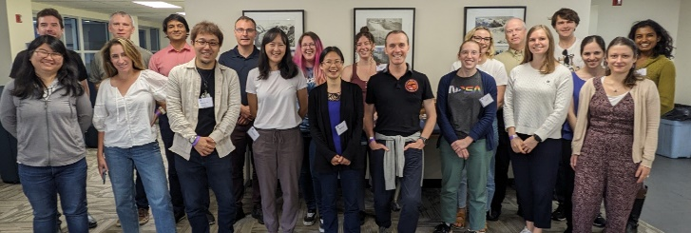
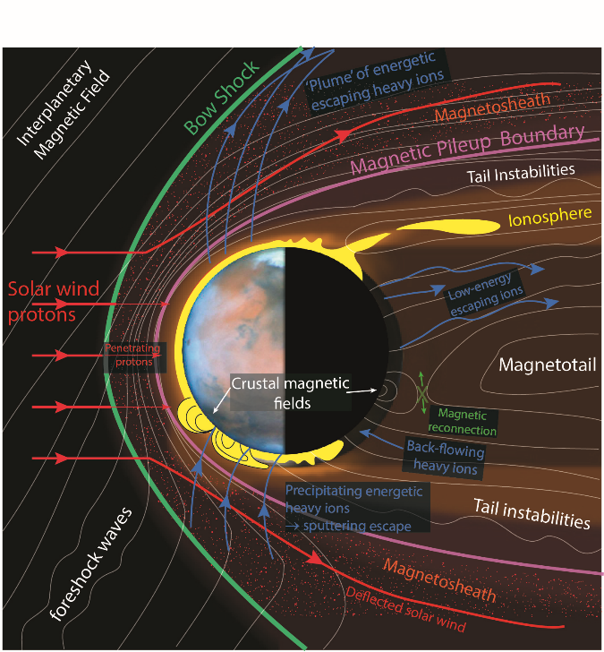
Advice to PIs: Managing your Science Team
Give DPI and PS real responsibilities.
Clear role for all team members (1-1 convos)
Topical Working Groups focus minds.
Phases A/B will be busy
  L1 Requirement Development.
  Requirement Traceability (verification analyses)
  Algorithm Development (if needed).
Be respectful of team members’ time.
  Only pull in necessary people for specific tasks
  Advanced notice of deadlines, review dates etc.
  Monthly science team Zoom meeting/updates
  In person meetings: have clear goals
Notes:
- DPI/PS: there is no one answer here, but make sure your science leadership team is not just shadowing you (they should do that too). Give them actual autonomy/responsibilities. Examples: own complex retrievals for RS missions, lead science groups, conjunction analysis etc.
- Every team member should be clear on their role. How much effort will you be needing from them? One on one conversations recommended. Some may honestly not be needed until Phase E and that’s fine.
- If you haven’t already, it’s useful to establish working groups for specific science objectives or topics. These groups may have their own separate meetings when necessary.
- Certain members of your science team will be very busy in Phase A/B as you develop your requirements flowdown, including L1 science requirements. These and the verification analyses for these may take significant effort, which you will ultimately have to manage.
- Unlike your engineering team, your science team is likely not getting much funding early in the project, and they likely have a lot of other work on their plate. Try to give team members as much advance warning as possible (e.g. Deadlines, dates for reviews etc.). Don’t pull in the entire team for every task. Make sure the full science team stays updated with monthly remote science team meetings.
- As far as in person team meetings are concerned, I recommend meeting at least twice a year. This could be a half-day meeting attached to existing meetings or conferences, to help with team cohesion.

Slide 26


Advice to PIs: Management style & Decision-making
PI-led mission: the buck stops with you.
Don’t manage the “how”: let your PM/SEs & other technical folks do their jobs.
Sometimes only the PI can get things “unstuck”
Big decisions (PI only) affect/change:
  Org chart (i.e. key personnel & partners).
  Science Measurements (e.g. descopes, mission design).
  Budgets (trading off cost vs. risk).
On big decisions, ask lots of questions, trust your people & postpone if need more analysis.

